Slide 1
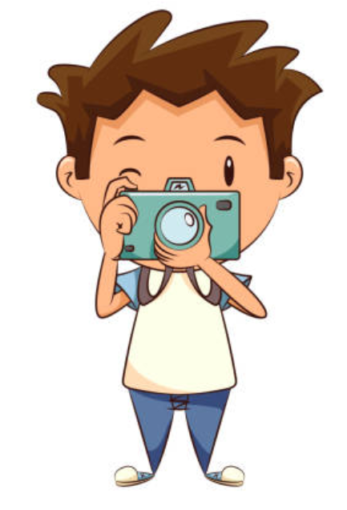
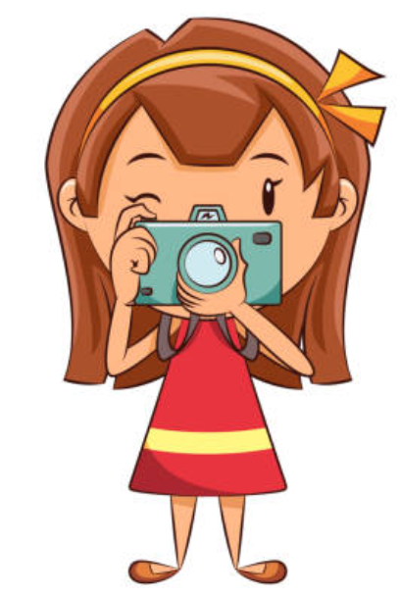
Our activities in June - November
“Teaching and Learning through photography art”

Slide 2
Last activities before summer vacation
We finished our school year in June and decided to make a small exhibition from plastic products. We should keep our planet clean!

Slide 3
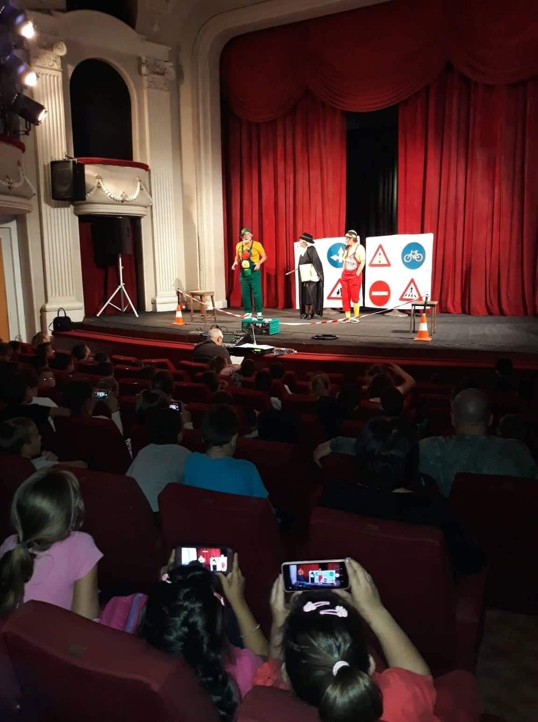
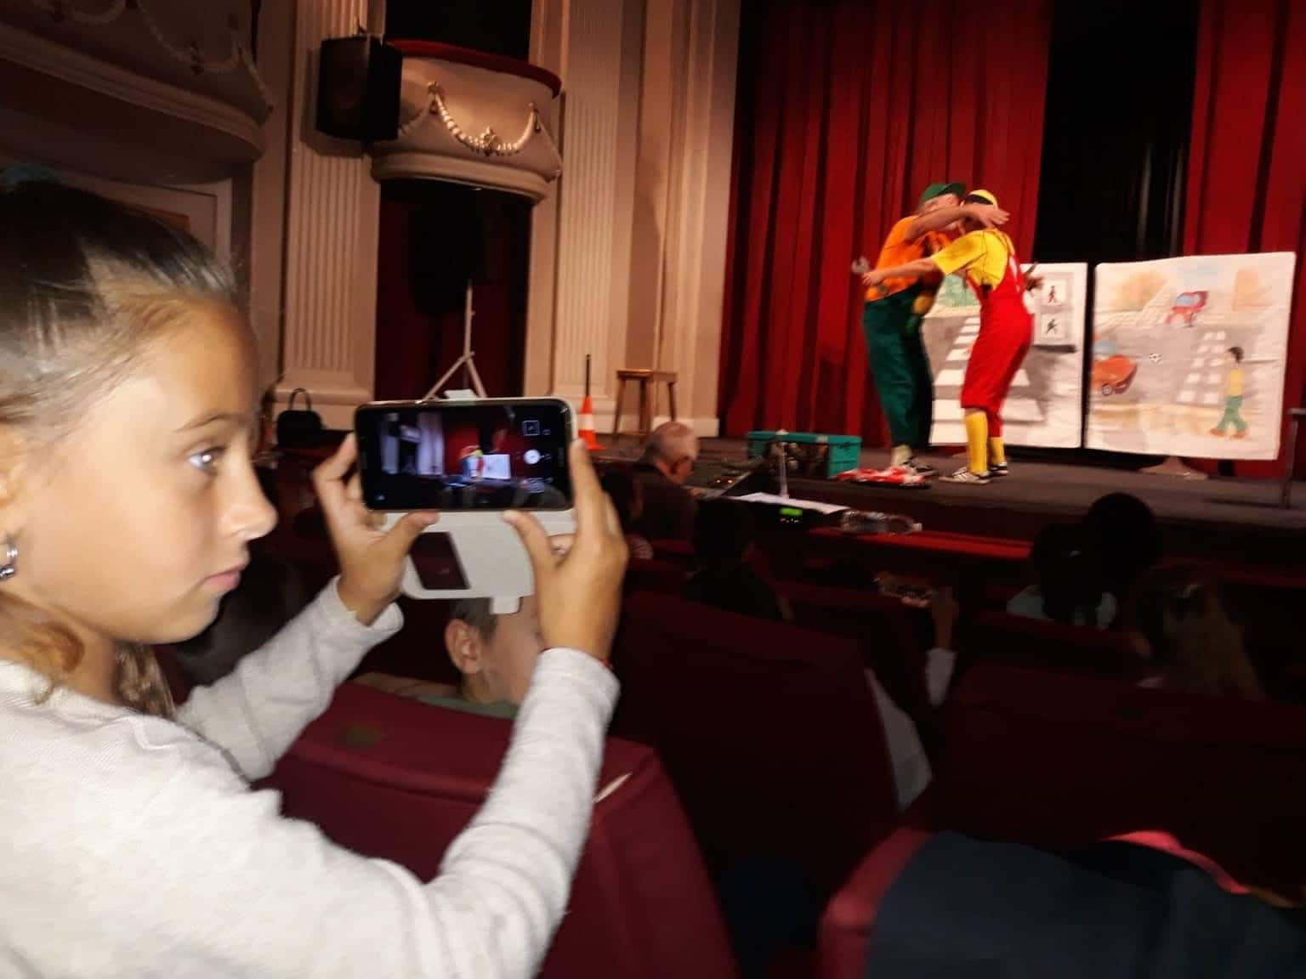
First activity for the new school year
We started our new school year with a theatre! Some of the classes made their own play and it was amazing!

Slide 4
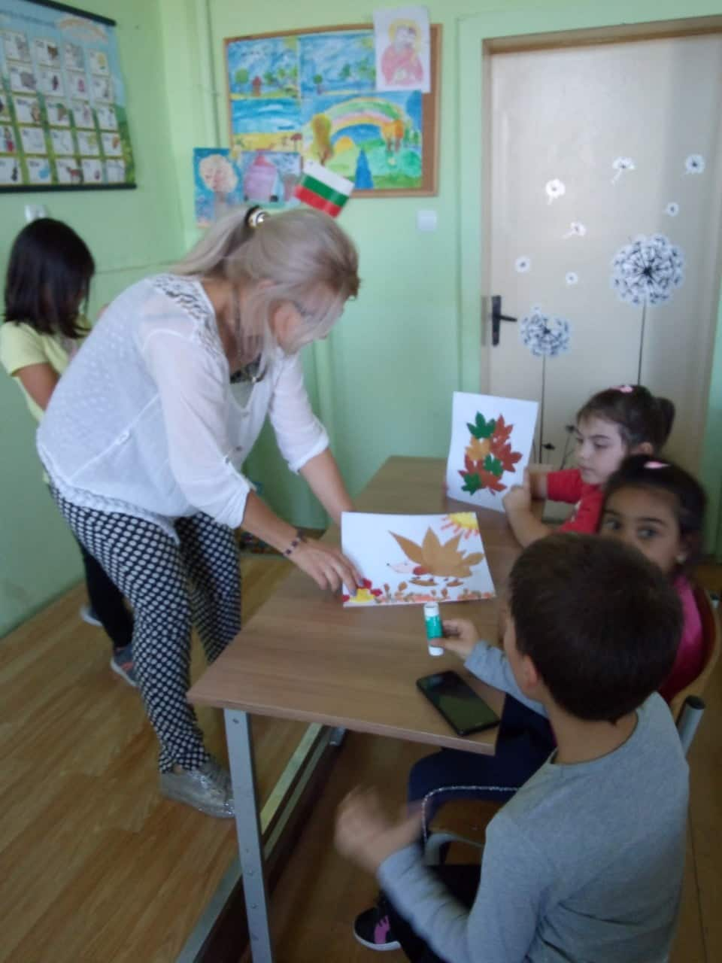
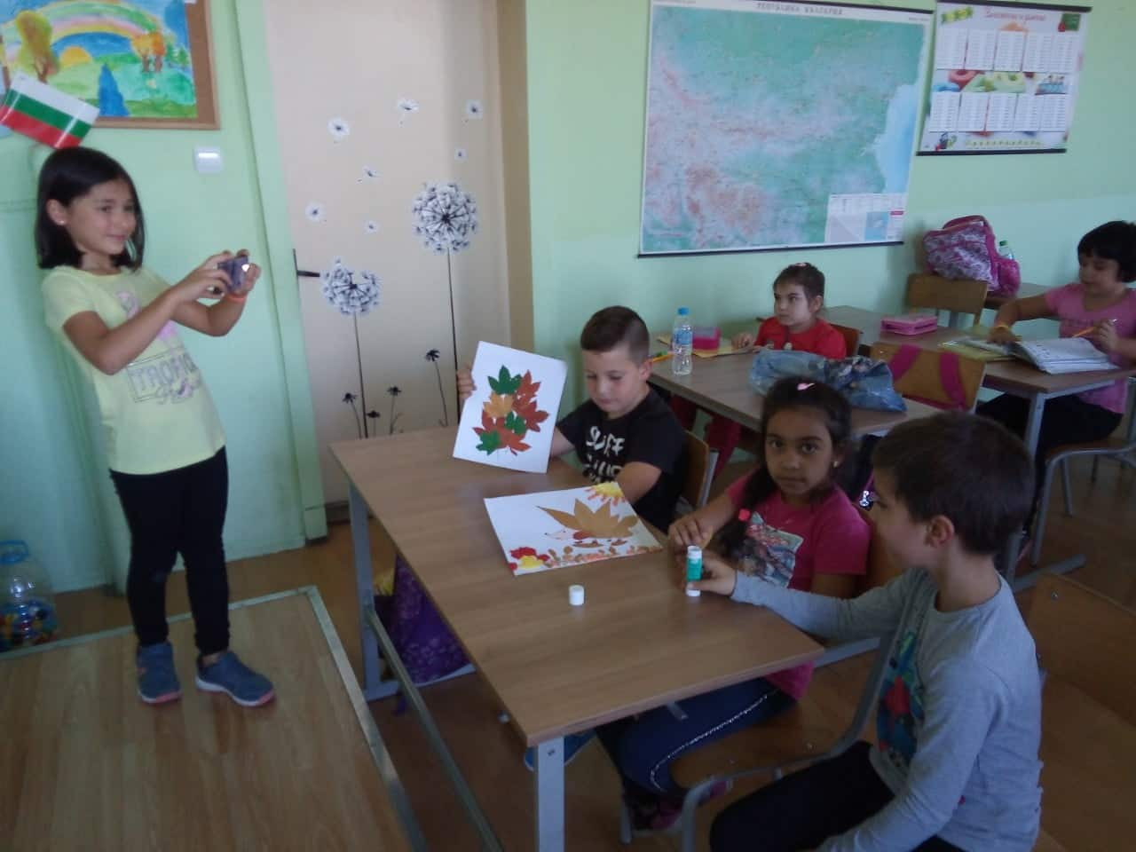
Our autumn activities
We created art with autumn leaves:

Slide 5
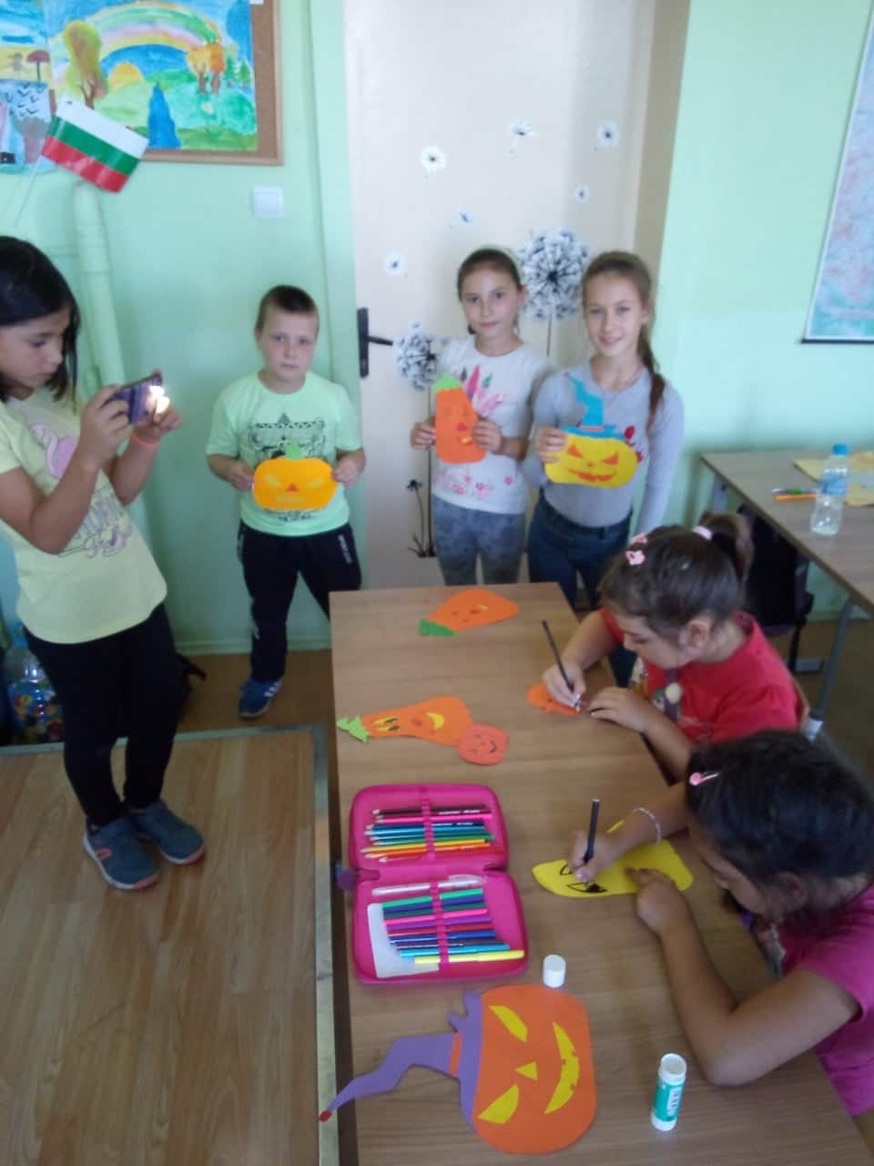
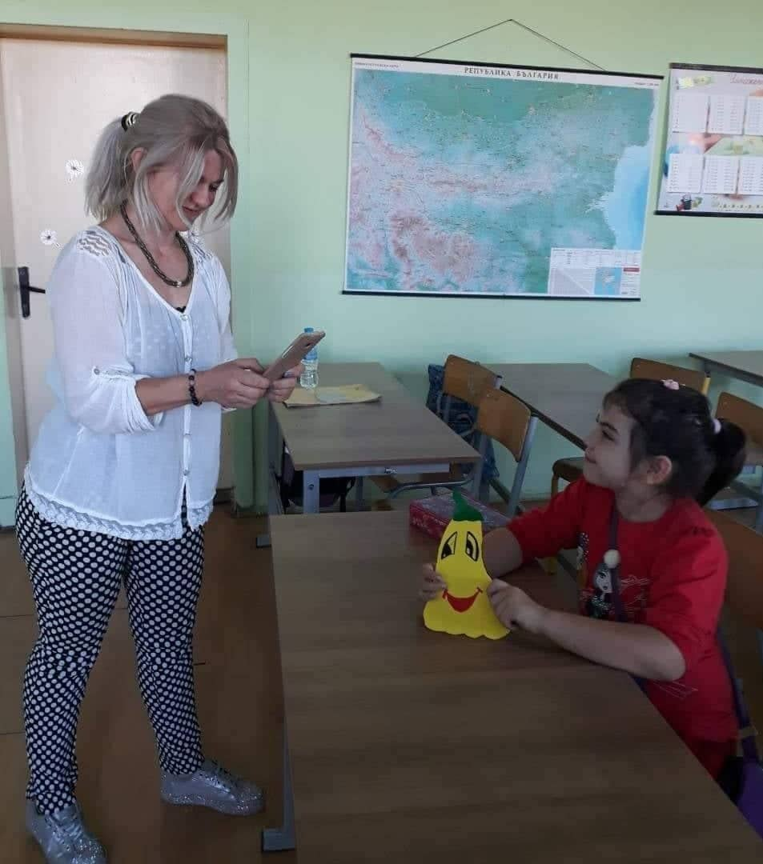
We love Halloween! ☺
We made our Halloween decoration:

