Slide 1
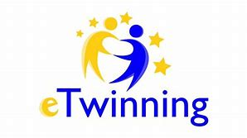
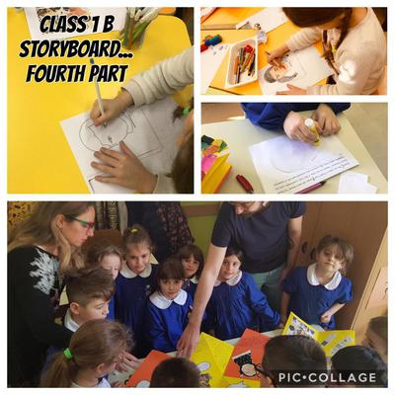
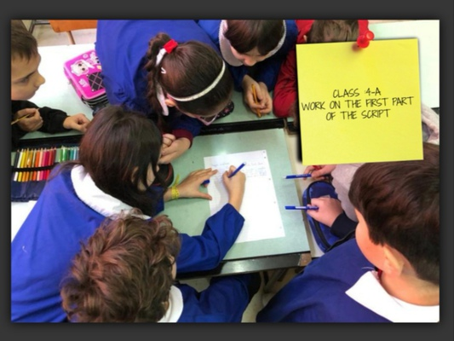
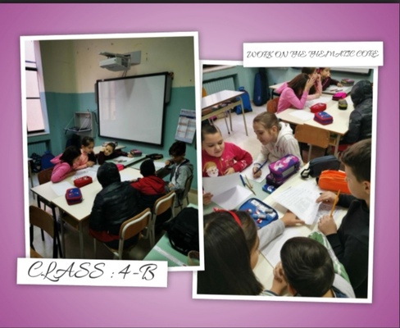
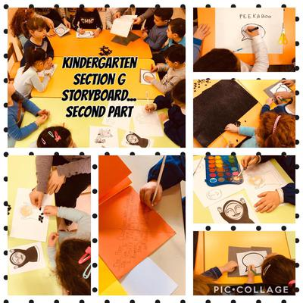
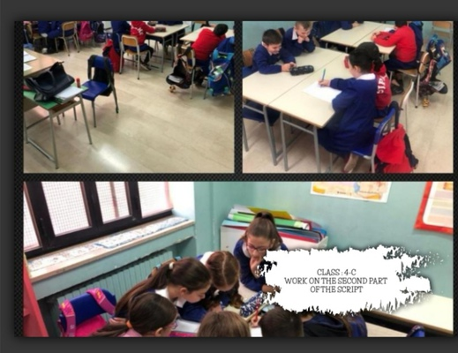
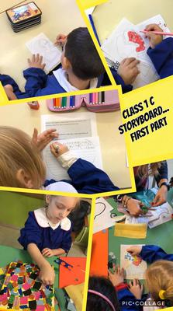
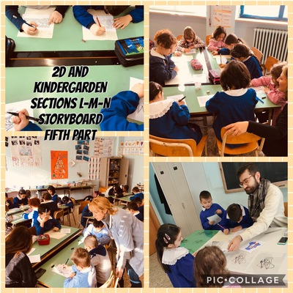
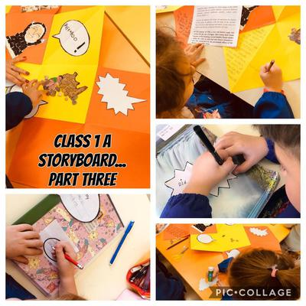
«TEACHING AND LEARNING THROUGH
PHOTOGRAPHY ART»
V MEETING IN CARBALLO PRIMARY SCHOOL, SPAIN. February, 2020.

Slide 2
SPECIFIC OBJECTIVES OF THE FIFTH PROJECT DEVELOPMENT PHASE:
Through this fifth phase of the project development, disciplinary and interdisciplinary objectives are strictly connected to the general purposes of the project. Among these, the objective of fostering a sense of belonging, giving value to the cultural heritage of the territory through direct exploration, is particularly important.
Goals
- The pupils have to recognize significant elements of the past of their school environment
- The pupils have to recognize and to explore in greater depth the historical traces in the territory and they understand the importance of the artistic and cultural heritage.
- The pupils will be able to produce simple historical texts, even with digital resources, accordion books and ebooks using significant images to attract and involve other students while sharing the final results of their work.
- Finally, they will be able to communicate in Italian and in English the most important steps of their learning path.
The students reconstruct the historical events through the use of sources and they use methodological processes to analyze, compare, criticize everything that has been recovered from the past. Furthermore, official documents and papers, materials and artistic sources will be at the students’ disposal. These images and photos eventually become the starting point where the historical research starts, therefore it represents an opportunity to aknowledge the key turning points related to the historical changes of the closest realities.

Slide 3
Methodology.i (Traditinal Storytelling Methodology and Digital Storytelling Approach)
In this phase we have implemented the methodology of storytelling combined with the use of pictures and photos. The Italian students have been working in a cooperative way for weeks to produce a storyboard, a script, comic strips and texts related to the selected theme and topics. Old photos, images and drawings from the archives or old books narrating the history of our school have been helpful to guide the children to explore and represent the ancient reality of our environment.
This methodology seems to be attractive and involving while allowing the students to acquire tools and techniques to support the process of understanding and internalizing the value of cultural heritage. The designed learning path, the strategies and techniques stimulate the development of creativity and manual skills in students also providing the functional conditions to support the curricular paths of the various disciplines.
In the light of this approach, the students are invited to find materials also on the internet, to share information, to interact positively and to think critically; the teachers facilitate the process and guide the pupils to reach functional alphabetical and literacy skills and key competences for lifelong learning

Slide 4
Digital Storytelling and its Definition
The technique of the digital storytelling employs digital tools to create multimedial engaging narrations to share and enjoy together. Digital narrations base their expressive potential on a mixture of photos, videos, music and voice. These multimedial languages tend to favor creativity and the interaction between the students exploring different meanings. (Cfr. J.Lambert (2013) from Berkley’s Center of Digital Storytelling).
Referred psycopedagogical theories
Learning by doing
Situated Learning
Constructivism
Key Competences involved in digital storytelling.
1 Communication in the mother tongue
2 Communication in foreign languages
3 Mathematical competence and basic competences in science and technology
4 Digital competence
5 Learning to learn
6 Social and civic competences
7 Sense of initiative and entrepeneurship
8 Cultural awareness and expression
Educational Goals
- Develop narrative skills
- Generate interest in learning
- Empower the students and their school community
- Develop metacognitive skills
- Develop communicative and expressive skills
- Develop cooperation and collaboration
- Develop emotional and empathetic skills
- Increase digital education.

Slide 5
Our students in "Santa Chiara-Pascoli-Altamura" Primary School, in Italy had been working for weeks on the project to select visual materials and to create comic strips with images and texts about the History of our school.
Teachers are innovating their teaching style through the Methodology of the Storytelling and Digital Storytelling Approach that seems to be very attractive and involving to both the pre-schoolers and the primary school students.

Slide 6
The older students in the 4th grade have selected old photos and documents from libraries and archives to re-narrate through images the History of the ancient building.
Other than this, they created a plot and a script that was manipulated by the younger pupils who had to produce the graphic representations with illustrated scenes in chronological order.
In the final steps, the 4th grade students have recorded their voices and uploaded all the materials on an internet website to share with an audience the results of their project .

Slide 7
The building was an ancient monastery and the students have reconstructed the key turning points related to its past events

Slide 8
The younger ones have created an accordion book by assembling different materials and putting together images and texts produced in the previous days.

Slide 9
Our pre-schoolers too had been working about the Storyboard guided by an expert teacher of Storytelling Methodology.

Slide 10
The pupils in the 1st grade have created star ballons for the voiceover and round balloons to insert the texts.
They have made a collage to illustrate the story created by the older students.

Slide 11
The younger pupils actively learn through hands on activities. They represent the illustrated scenes in chronological order.
Storytelling is not a simple way to tell stories, but it is a way to educate to a form of narrative thinking (Bruner,2002).
In fact, through this specific way of thinking we build our personal beliefs about us and the world.
.

Slide 12
Work in progress... The children, even the younger ones, learn how to cooperate and collaborate to pursue a common objective.

