Slide 1
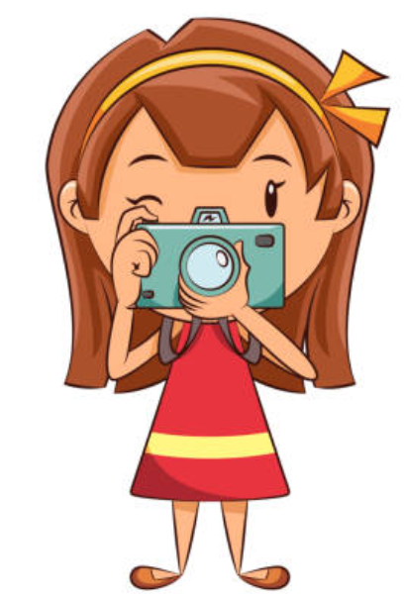
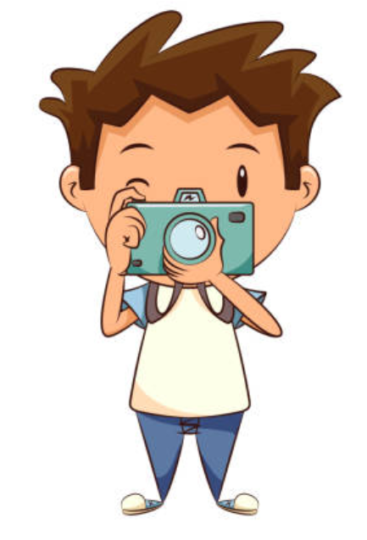
Education of children with special needs and immigrants in Bulgaria
“Teaching and Learning
through photography art”

Slide 2
What are Special Educational Needs?
SEPs may have children with different learning difficulties because of:
Sensory impairment - visual or hearing
Physical disabilities
Mental retardation
Speech and language disorders
Emotional or behavioral;
Communication and communication disorders
Chronic illnesses leading to SEP
Multiple injuries

Slide 3
How are SEPs regulated in Bulgaria?
from Ministry of Education and Science in Bulgaria
with Public Education Act
with Law on Integration of People with
disability and rules for its application

Slide 4
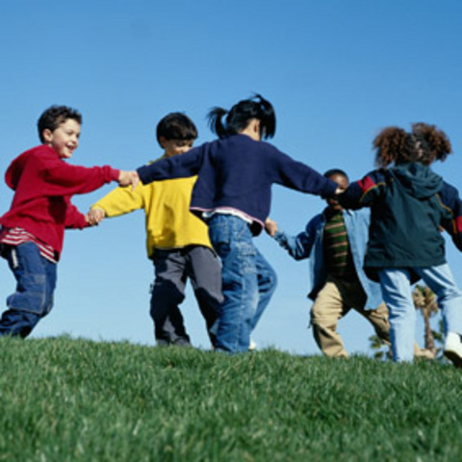
Our goal: integrated training and education
What does this mean? the child, regardless of the type of
Disability, is included in the general educational environment.
All immigrants are welcomed in Bulgarian schools and there
isn’t any difference for them by learning
and playing with the other children.

Slide 5
Work of the resource teacher
With the child with special needs
With other teachers
With the parents of the child
Other specialists, who educate the children with SEP:
psychologist
special educator
speech therapist

Slide 6
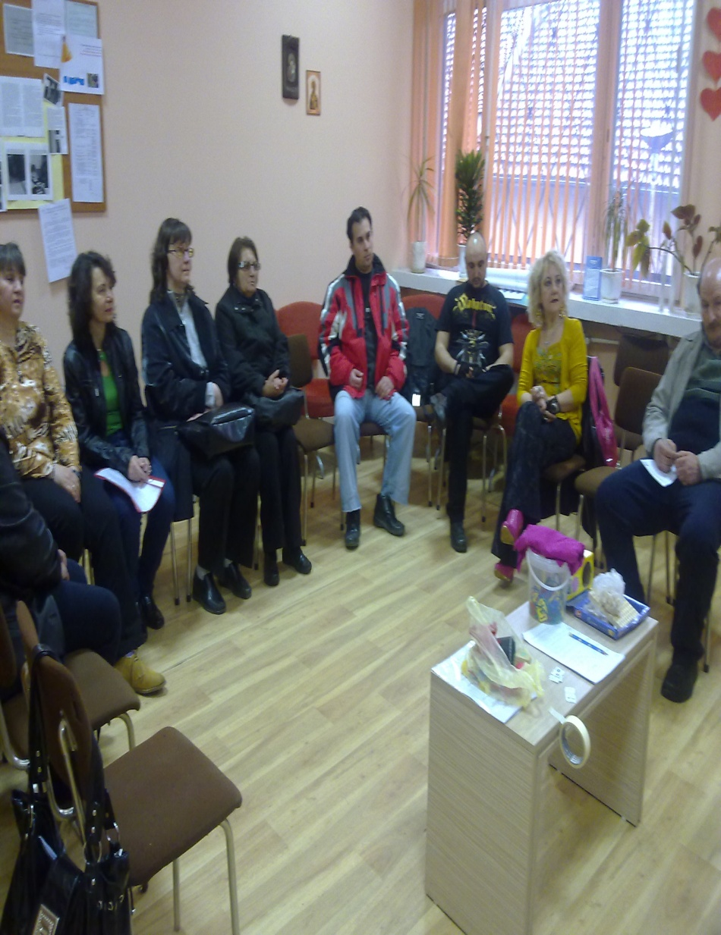
THE USEFUL WORK NEEDS:
Creating a team of children, parents and teachers, who work in partnership and cooperation

Slide 7
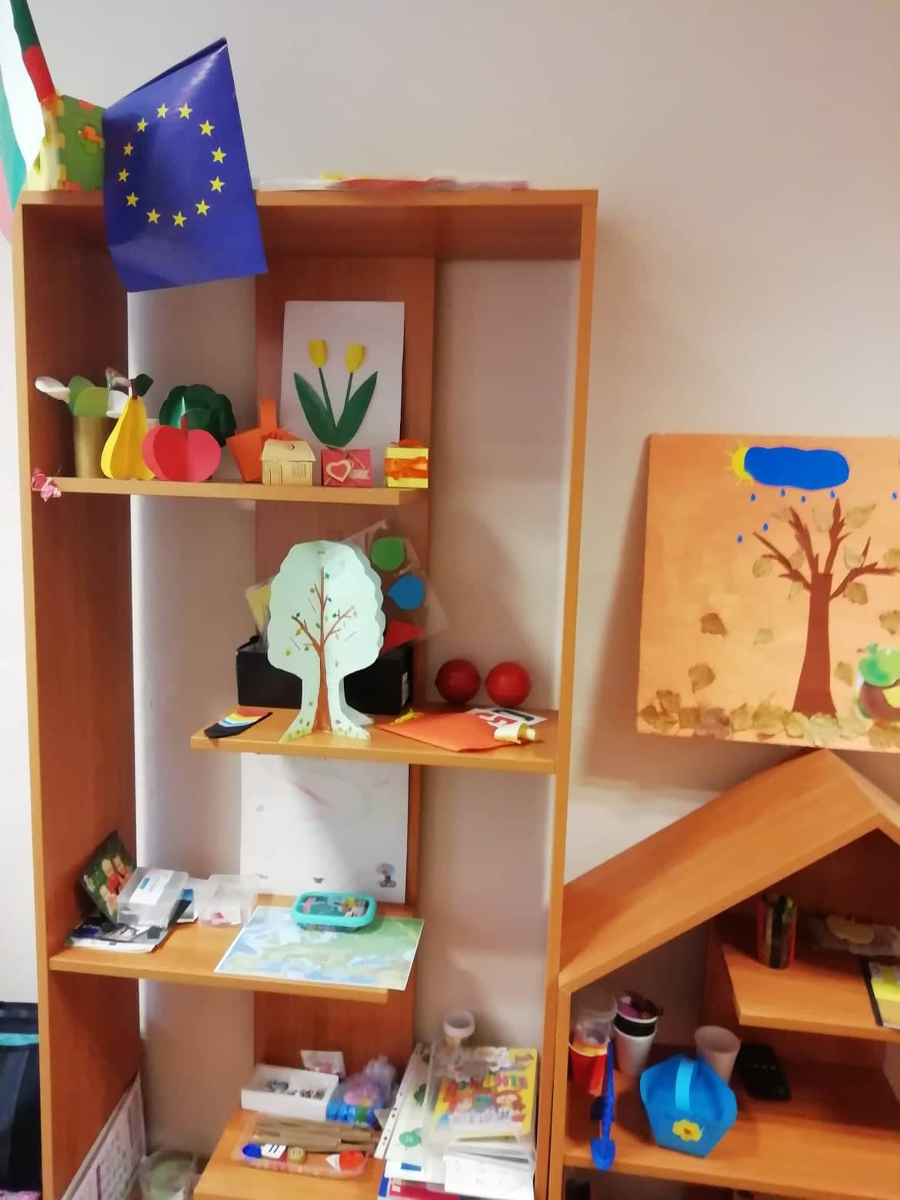
New technologies for the children with special needs
We created a resource room with a laptop and games for different visual, speech and hearing problems

Slide 8
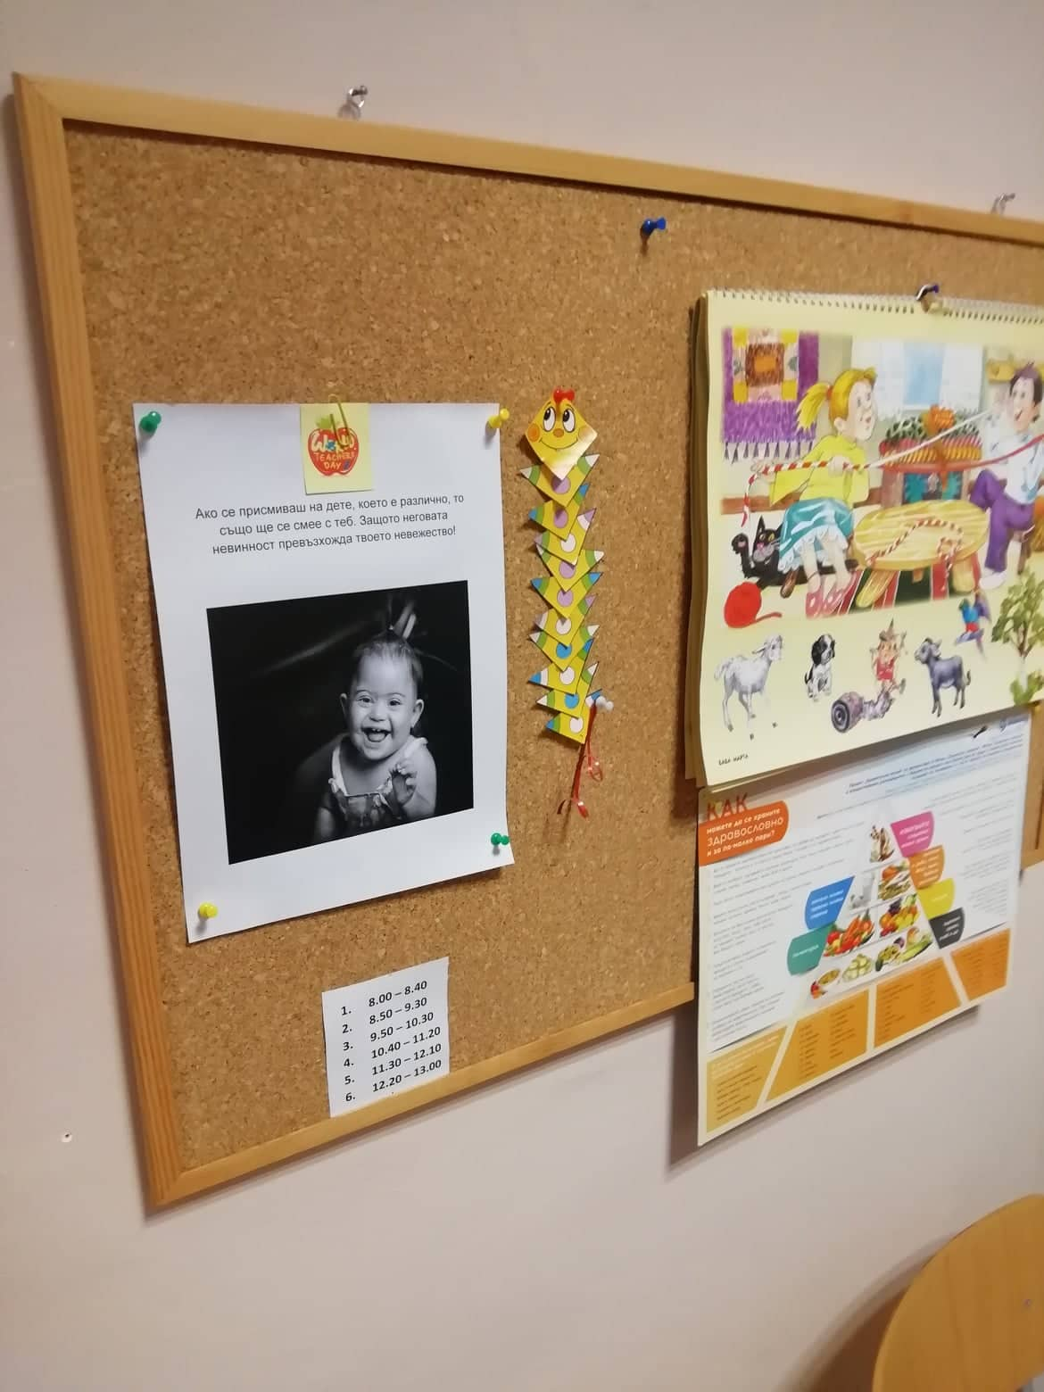
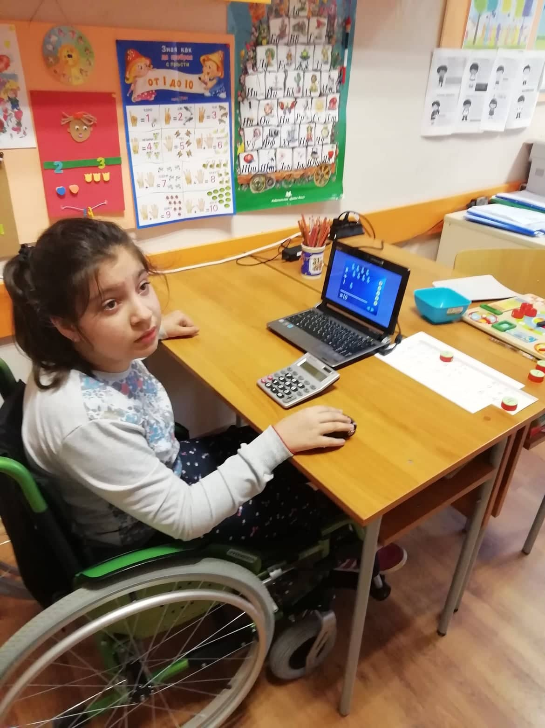
New technologies for the children with special needs
Every lesson we teach is like a game – we need to awake children’s interest and emotions

Slide 9
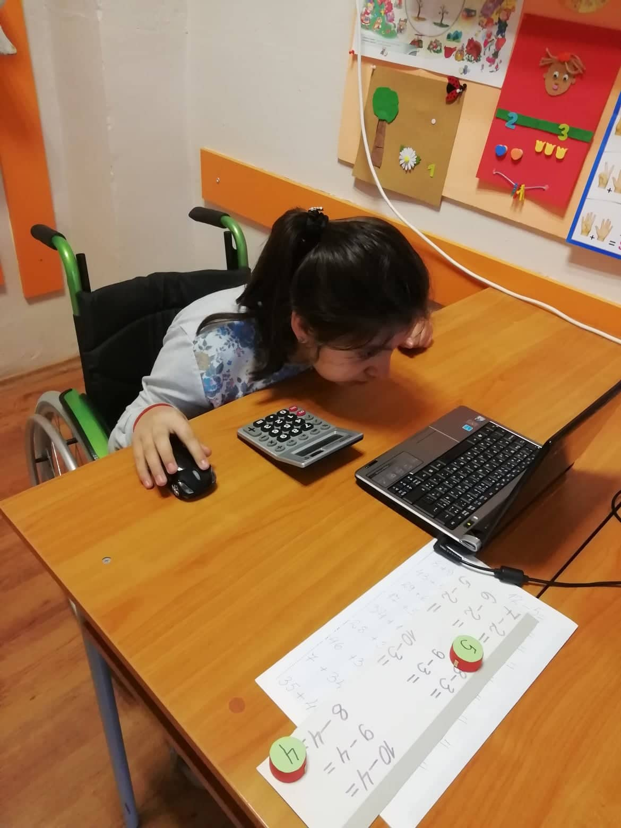
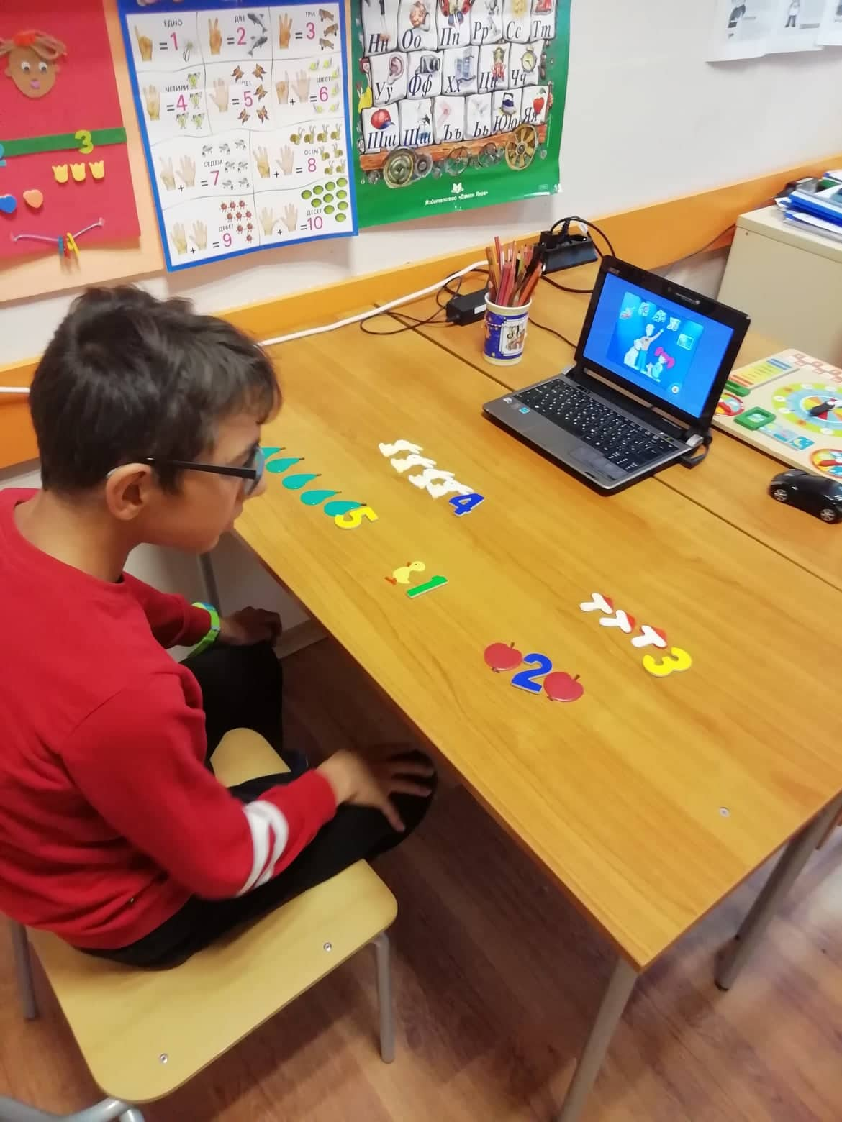
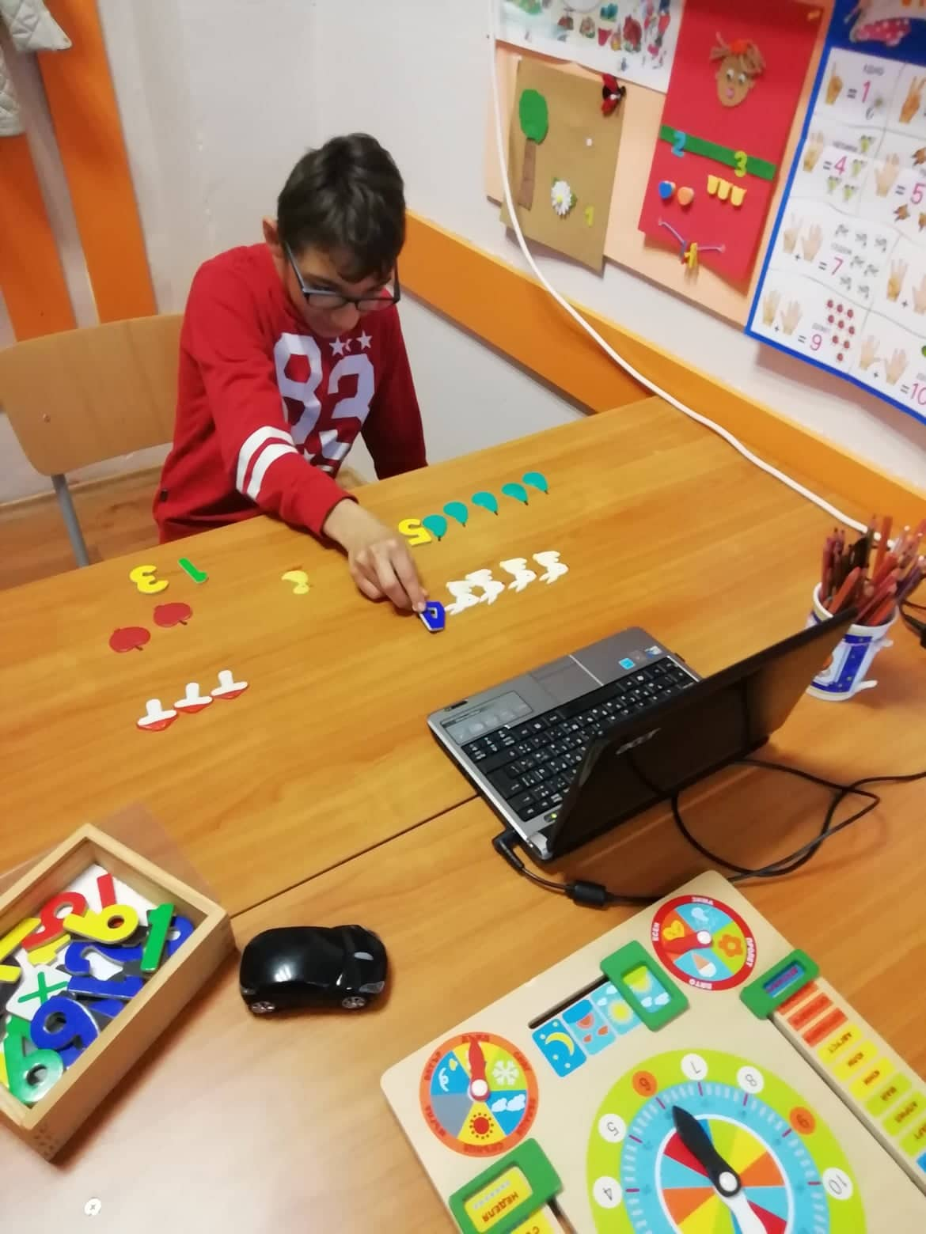
New technologies for the children with special needs

Slide 10
No matter what - they are all children- and they should be happy!

Slide 11
Thank You!
One great woman once said…

