Slide 1
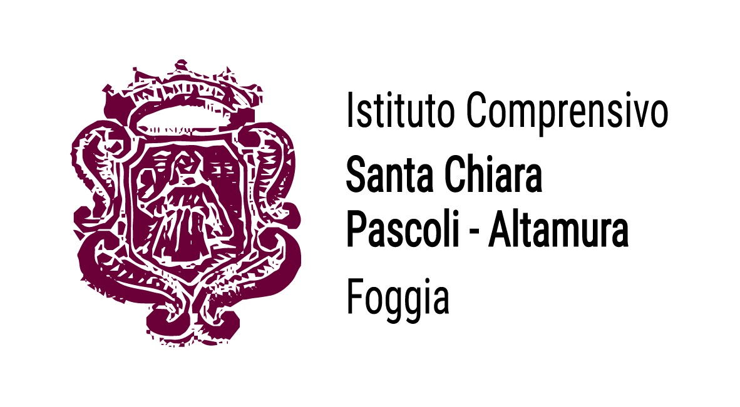
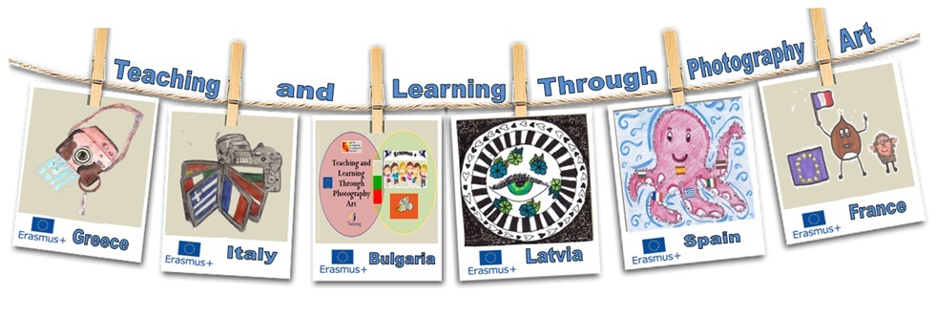
4th transnational meeting in Gulbītis, LATVIA
11- 15 November 2019

Slide 2
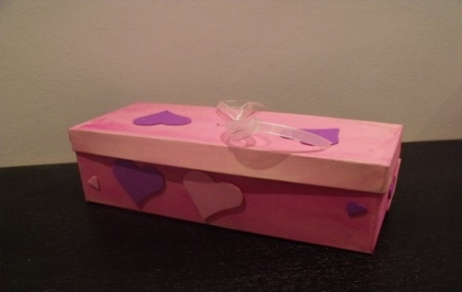
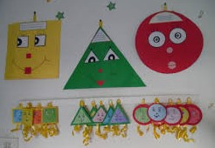
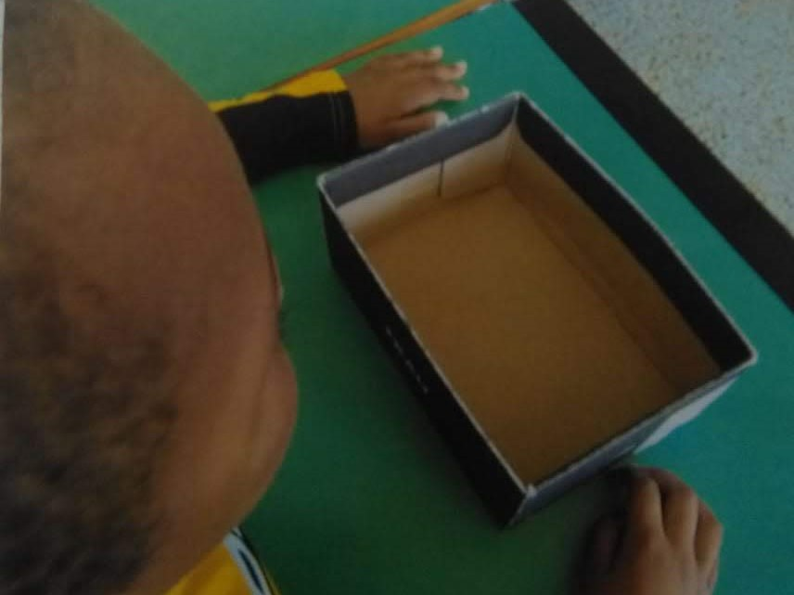
LEARNING UNIT
Geometric plane figures: «From boxes to shapes».
Skills: recognizing, identifying and classifying figures according to geometric characteristics.
Learning Objectives:
- recognize, identify, indicate, distinguish and describe geometric figures.
draw geometric figures and cut and shape polygons and circles using different materials
METHODOLOGICAL APPROACH.
Hands-on activities, exploration and manipulation are important for the construction of knowledge related to forms.
THE ACT OF MIRRORING THE ACTIVITIES IN THE PHOTOS TAKEN BY THE TEACHER DURING THE ITEMS HELPS THE PUPIL TO BECOME AWARE OF HIS SUBSEQUENT STEPS IN THE LEARNING PATH.
The learning path takes place in the classroom and in the laboratory where there are tools and materials necessary for the development of the experience.

Slide 3
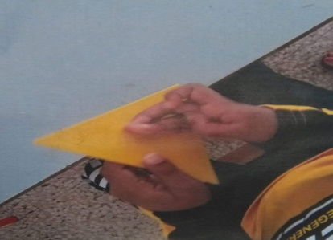
THE LEARNING PATH WAS DESIGNED AND PLANNED BY THE TEACHER Mrs De TINNO
FOR A SIX YEAR OLD PUPIL, COMING FROM ABROAD, WHOSE BEHAVIOUR, INTERACTION
AND COMMUNICATION SKILLS WERE DIAGNOSED AS AUTISM SPECTRUM DISORDER.
THE USE OF IMAGES AND PHOTOS TAKEN DURING THE DEVELOPMENT OF HANDS-ON ACTIVITIES IN THE LABORATORY WERE HELPFUL FOR THE CHILD LOOKING AT HIMSELF AFTERWARDS IN THE PICTURES WHILE
MANIPULATING,
DRAWING,
SHAPING,
GROUPING AND CLASSIFYING OR CONSTRUCTING MORE COMPLEX IMAGES WITH POLYGONS AND CIRCLES.
THE BOY, RARELY SPEAKING AND SMILING, USED TO WATCH AT THE PHOTOS OF HIMSELF OR OF THE ACTIVITIES JUST PERFORMED. AS A CONQUENCE, HE SHOWED CURIOSITY AND INTEREST FOR THE NEXT STEP OF THE LEARNING PATHWAY, ALWAYS USING GESTURES AND MIME.

Slide 4
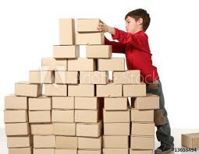
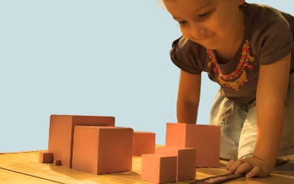
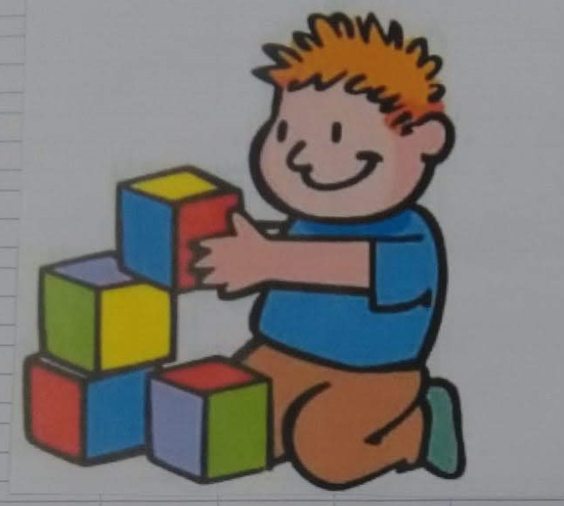
The teacher shows the pupil pictures of children playing with boxes of different geometric shapes.
The pupil is fascinated and attracted by the images and photos taken in the classroom or selected while surfing the internet

Slide 5
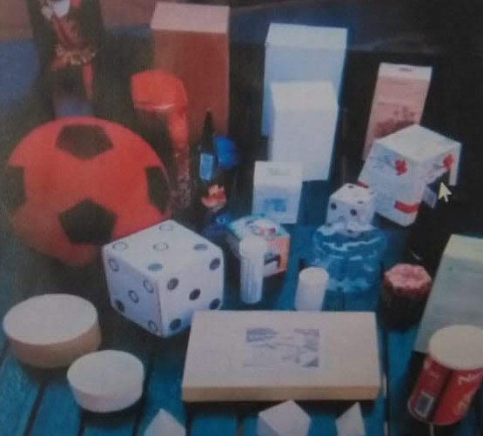
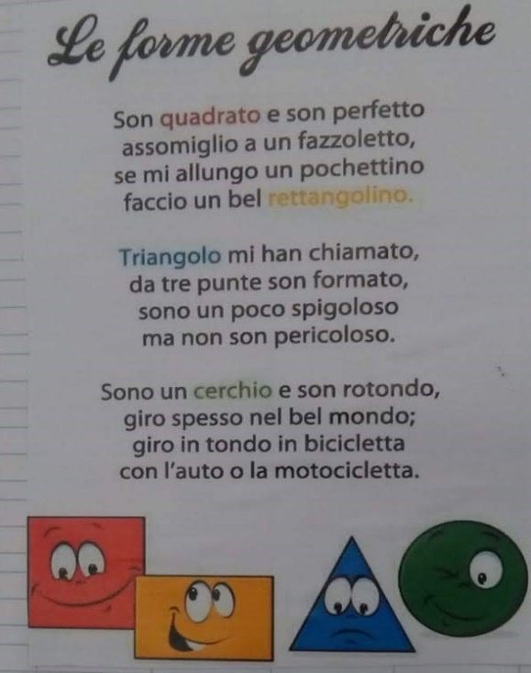
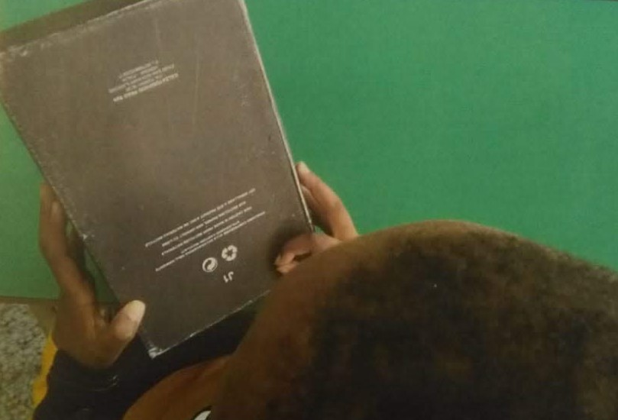
The teacher takes photos during the activities to stimulate reflection and, metacognition in the boy when he will look at them later.
.
The teacher presents various types of boxes.
She begins by reading a poem about geometric shapes and at the same time she lets the student play with a series of different boxes to help him familiarize with polygons and with scraps of coloured plane figures.
Then the teacher asks questions:
- “Can you separate boxes with different shapes?"
- “Do you notice any differences?"
"What names would you give to these forms?“
Now he pays attention and reacts using gestures and mime

Slide 6
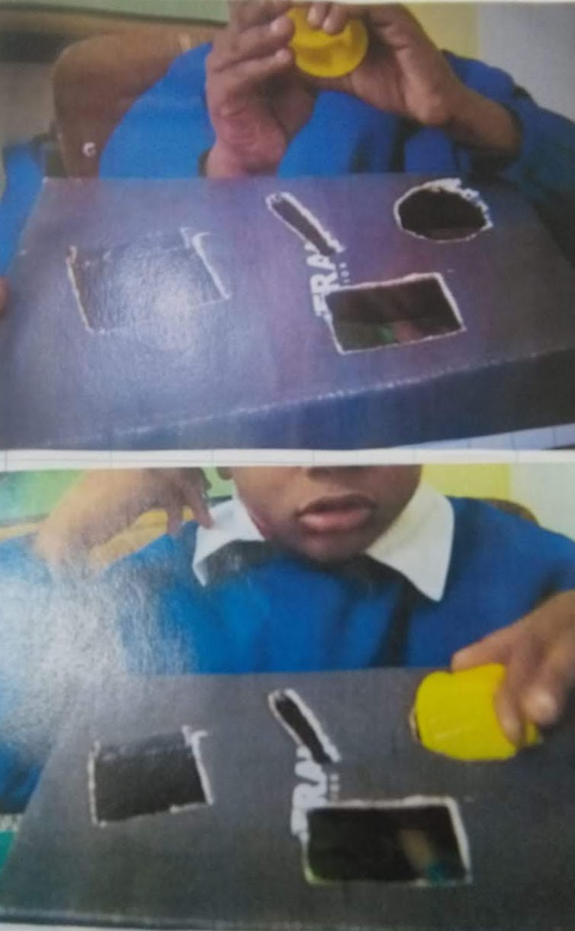
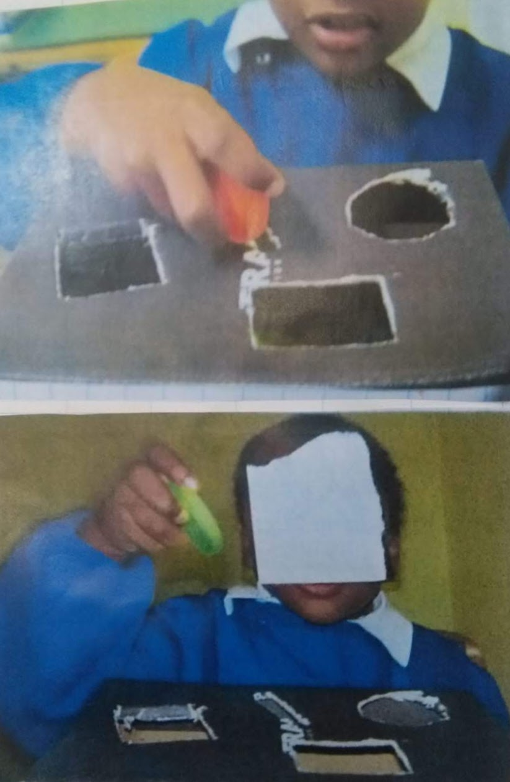
He participates in the activities enthusiastically.
The teacher asks him to insert various objects in the holes entangled on the lid of a box perfectly corresponding to the profile of different shapes
As usual, before and after each item, the teacher reinforces and enhances the pupil’s awareness about his learning path by showing him the photos she had taken during the former activity in the lab.

Slide 7
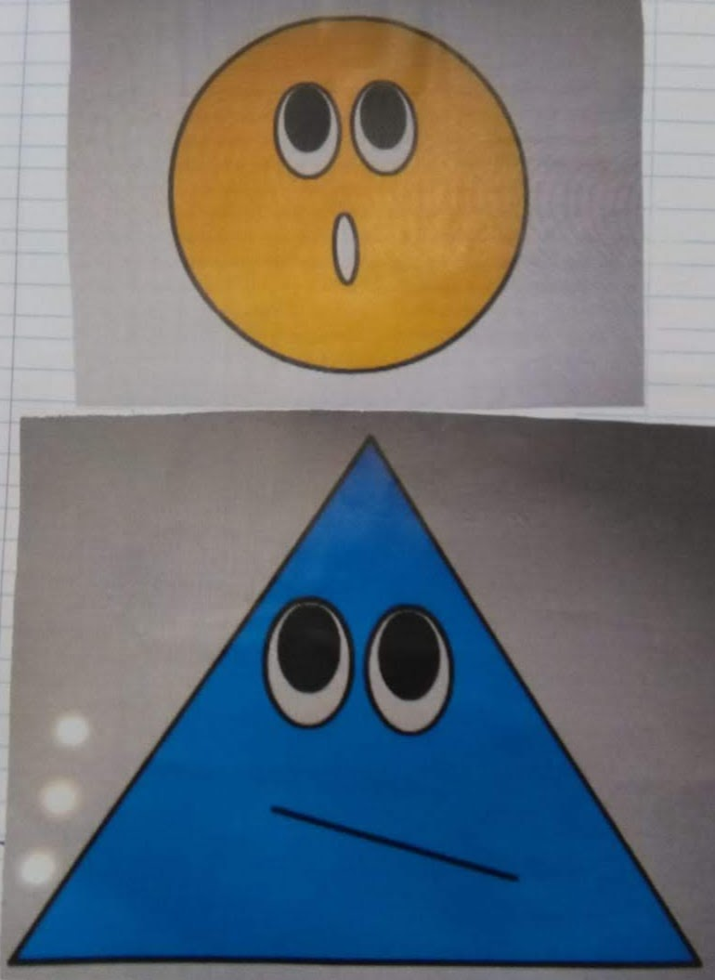
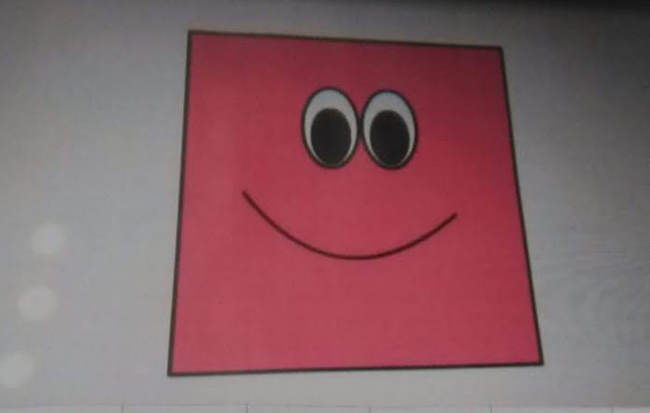
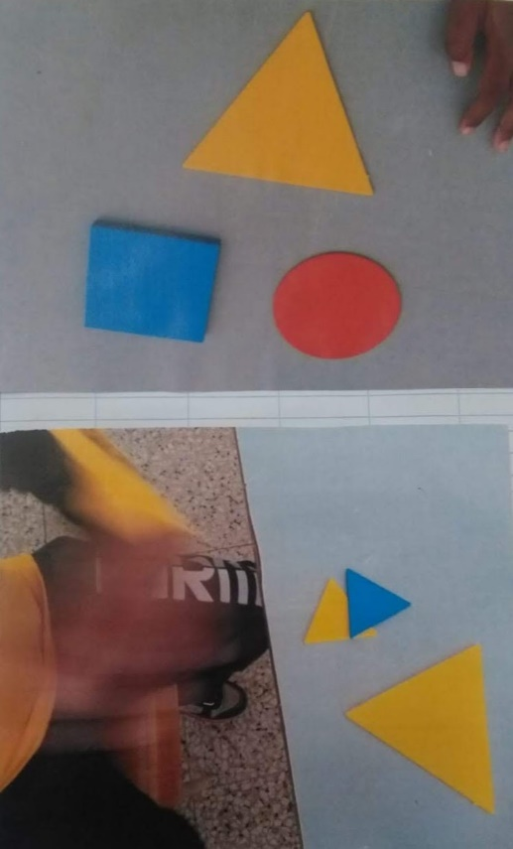
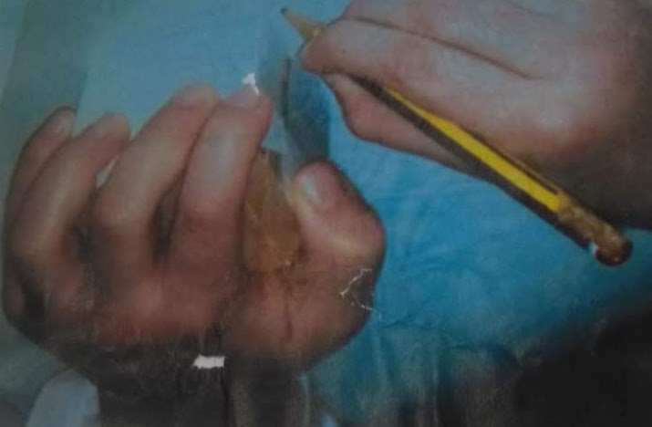
The teacher presents three images to introduce the names and the characteristics of CIRCLES, TRIANGLES and SQUARES.
The boy draws and cuts out different shapes using cardboard and strips of cloth.

Slide 8
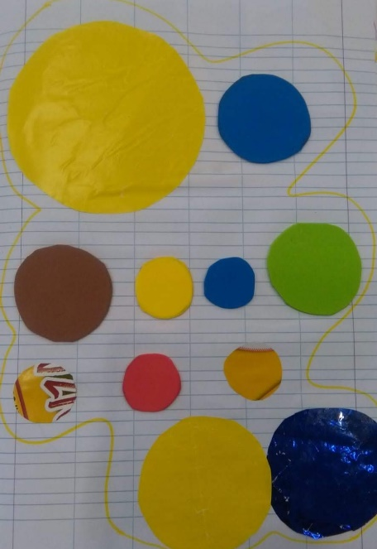
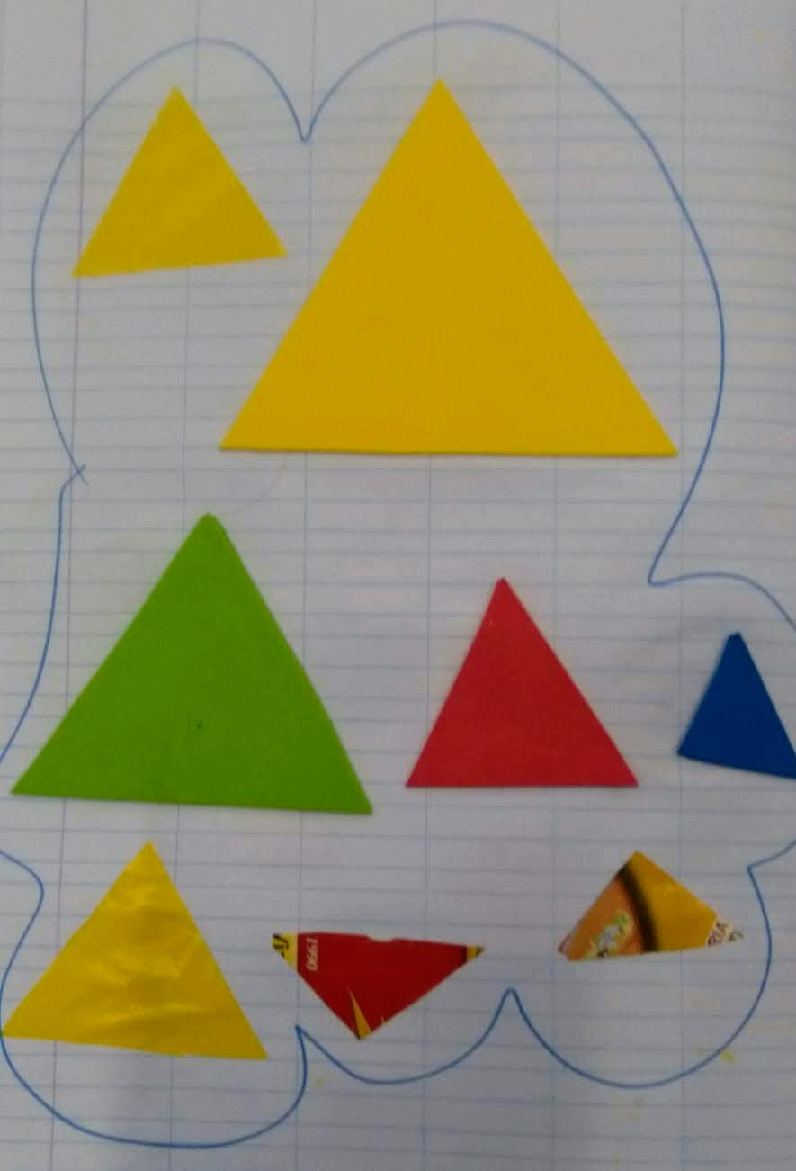
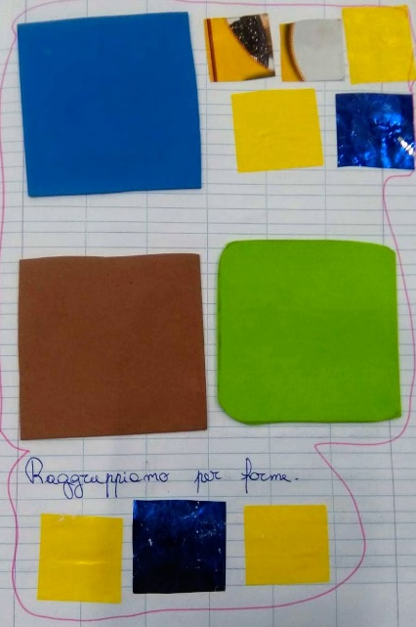
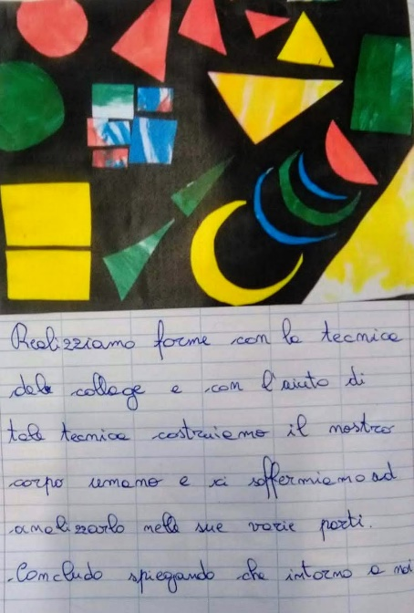
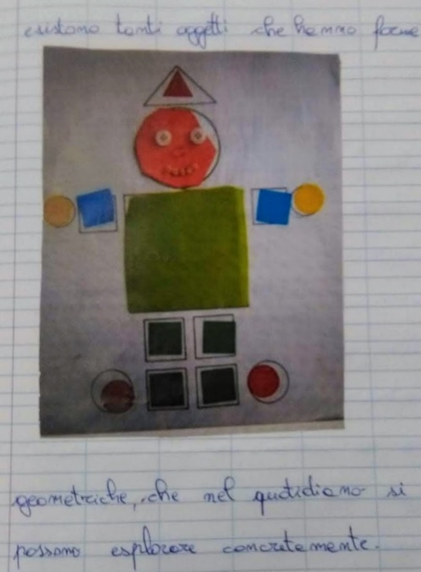
Then he has to gather and classify the two-dimensional shapes.
The boy cuts out a set of polygons to put together to create different and more complex images, such as a stylized human body.

Slide 9
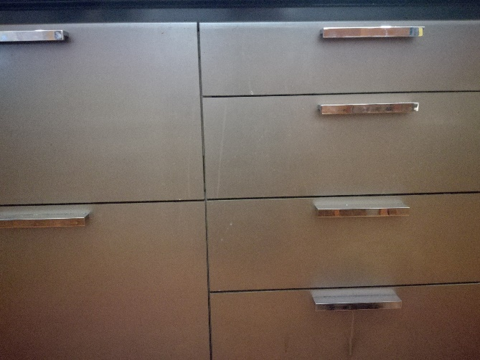
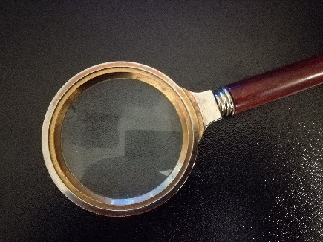
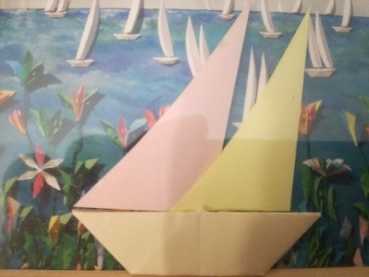
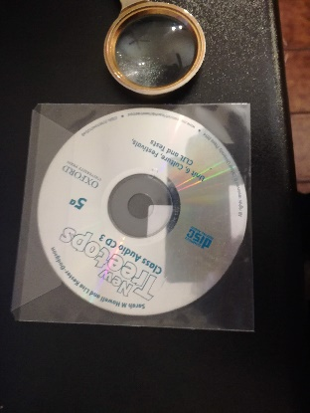
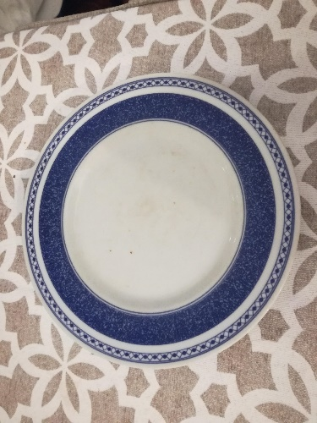
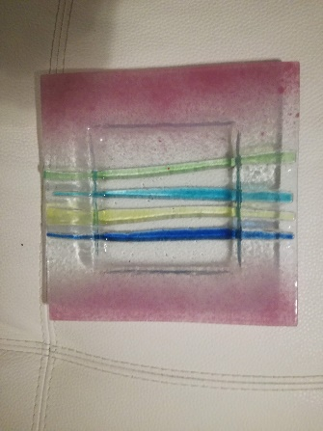
Finally, the boy, with a little help from the teacher, takes photos while exploring the world around him through sight and touch and recognizes the two dimensional geometric shapes suggested by different objects:
a plate, magnifyng lens, drawers, doors, a sheet of paper.
FINAL ASSESMENT
The teacher asks the child to
search and find round and different shaped objects…. and to
take photos..
The teacher prints the photos and finally asks the child to associate and match the photos with the right geometric plane figures.
Finally, he is able to recognize and point at the geometric shapes by their characteristics when named by the teacher.

Slide 10
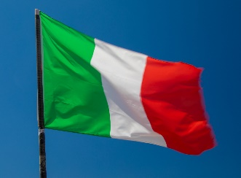
Thanks for your attention
Credits:
Teachers
The unit has been designed by Mrs. Giovanna De Tinno, Mrs. Monja Selano in collaboration with Mrs. Roberta Foglio.
Ppt by Mrs. Pasqua Aida Pappalepore
Coordinator: Mrs. Brigida Clemente
November 2019

