Slide 1
USLU
31.1 2022.

Slide 2
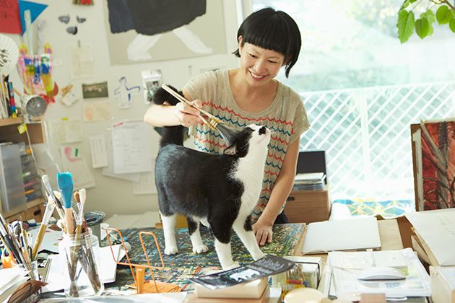

Slide 3
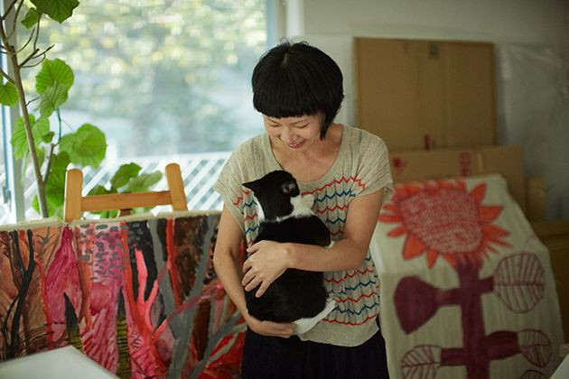
MIROCO MACHIKO

Slide 4
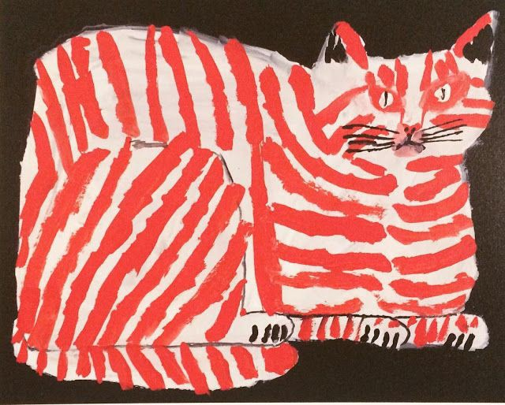
Miroco Machiko

Slide 5
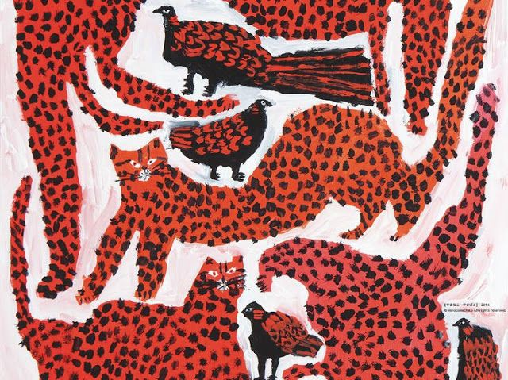
Miroco Machiko

Slide 6
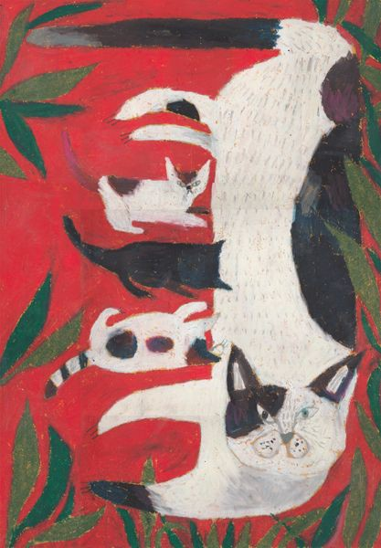
Miroco Machiko

Slide 7
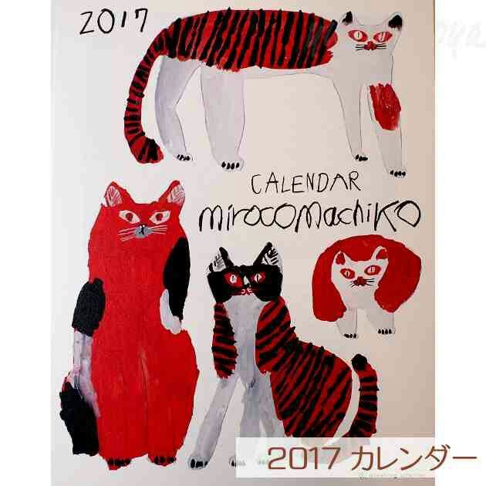
Miroco Machiko

Slide 8
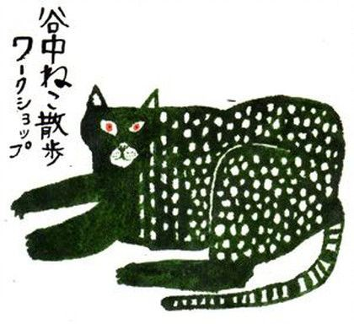
Miroco Machiko

Slide 9
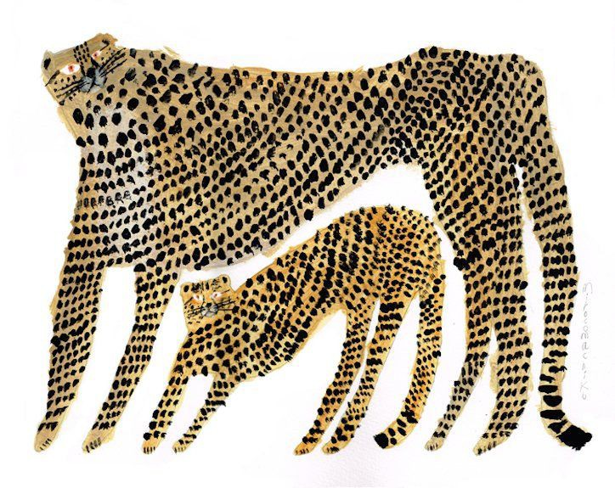
Miroco Machiko

Slide 10
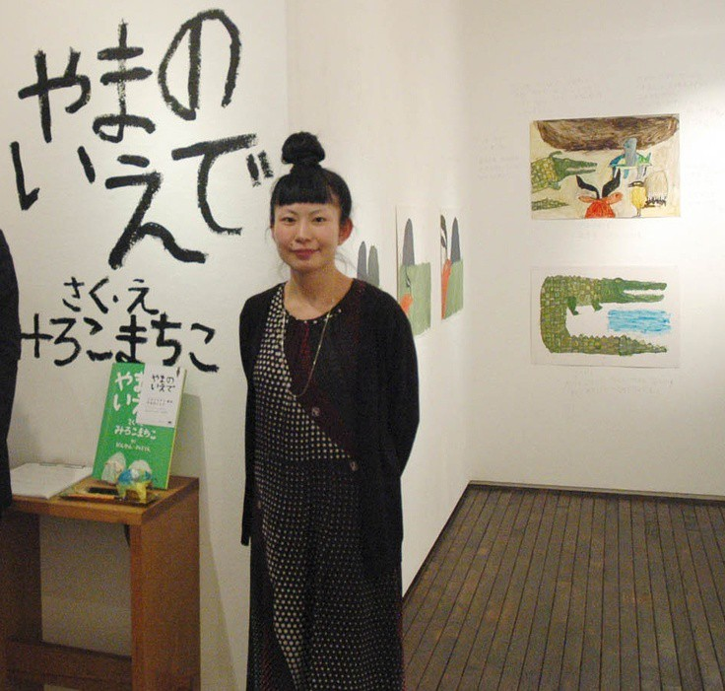
Miroco Machiko

Slide 11
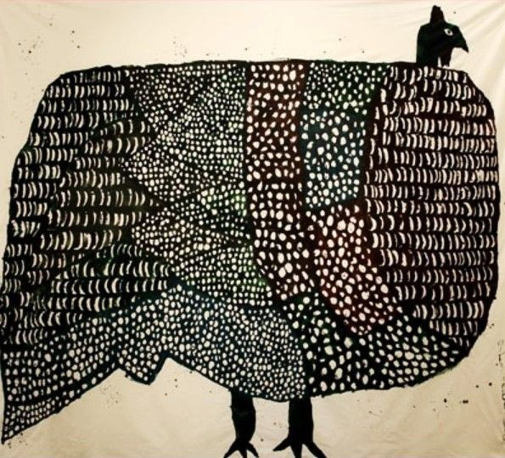
Miroco Machiko

