Slide 1
USLU
14.2.2022.
Yulia Belasla

Slide 2
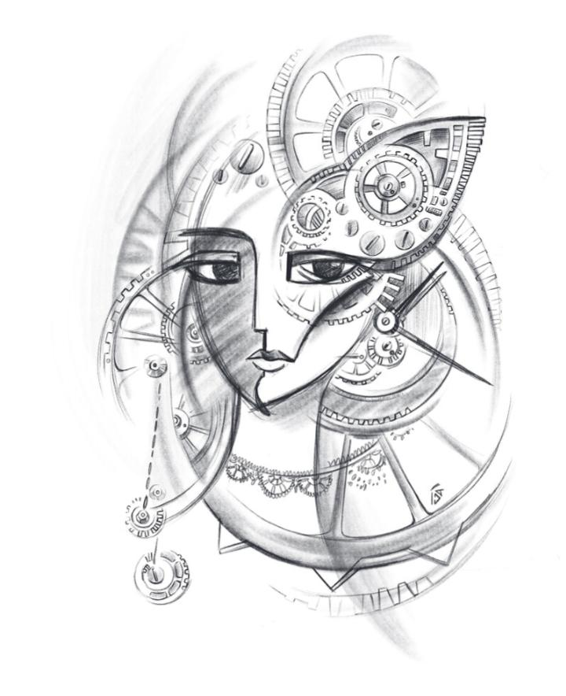
Yulia Belasla

Slide 3
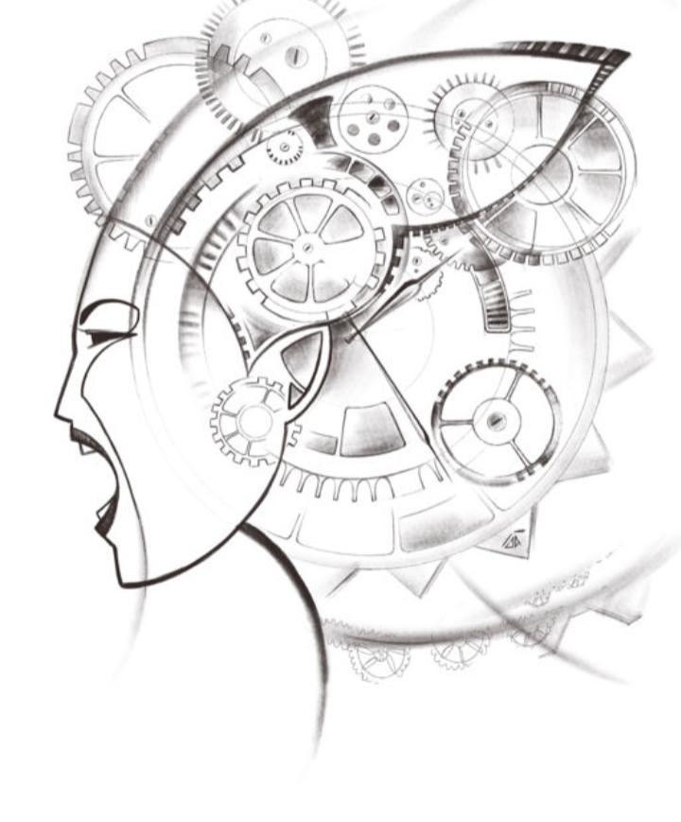
Yulia Belasla

