Slide 1
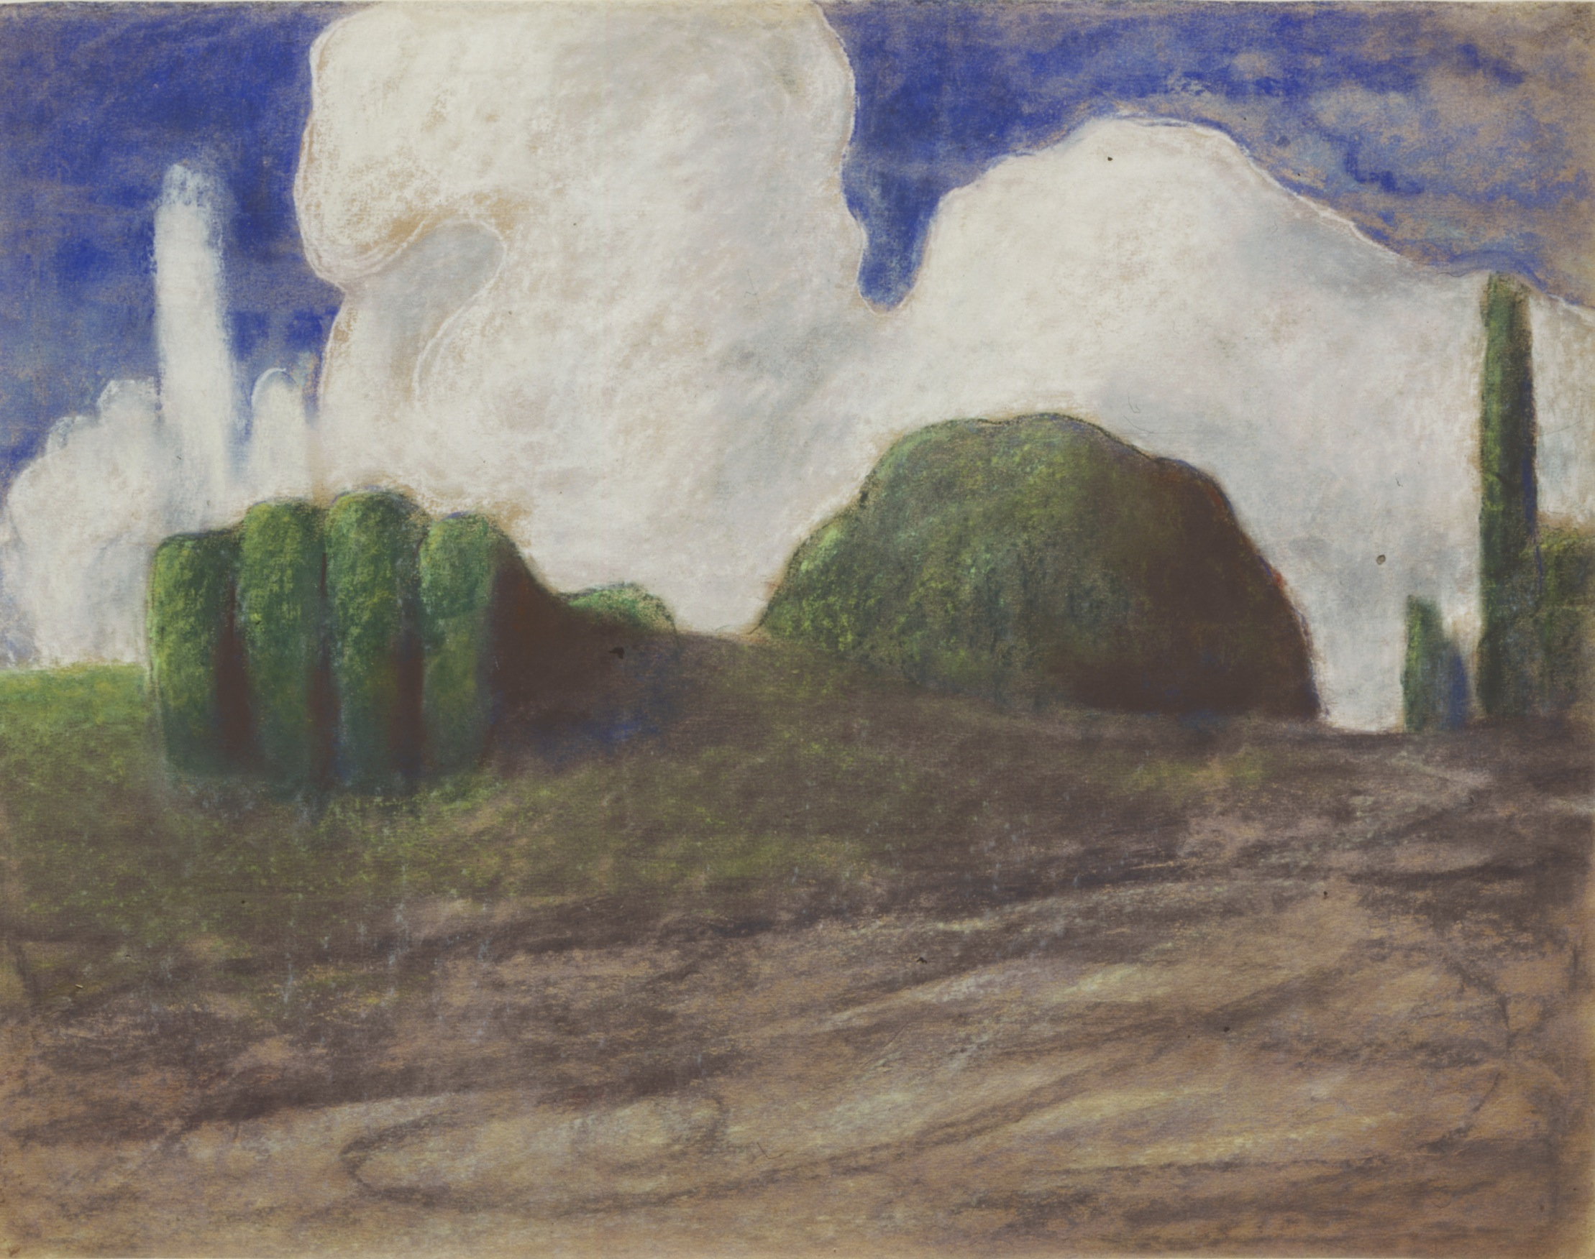
M.K.Čiurlionis’s Painting
Erasmus+ project “Improve Teaching and Achieve Results Through Inclusion”
Prienu “Azuolo” progimnazija

Slide 2
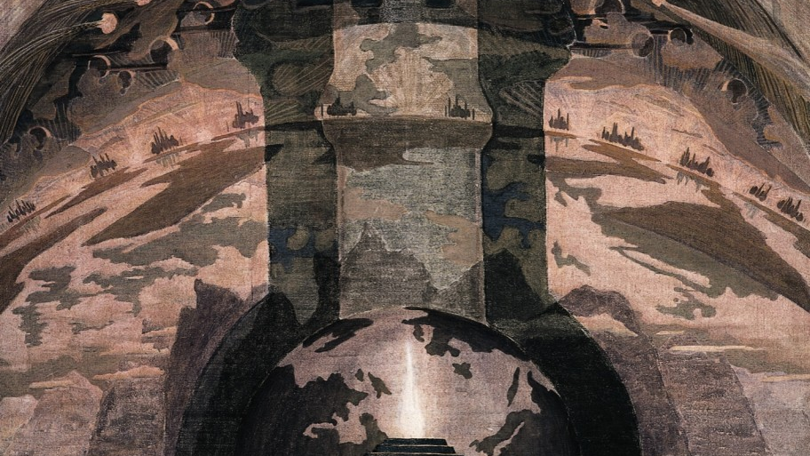
The artistic universe of Mikalojus Konstantinas Čiurlionis , formed in the early 20th century, was marked by the interaction of diverse artistic ideas of Neo-Romanticism, Symbolism and Art Nouveau. Having embarked on painting career, Čiurlionis did not stop composing music. His artistic work (painting, graphics) lasted six years (1903–1909). He painted many of his works during summer vacations at his parents’ house in Druskininkai. He spent the years 1908 and 1909, with intervals, in St Petersburg, where he created his last paintings including the great Rex (1909).

Slide 3
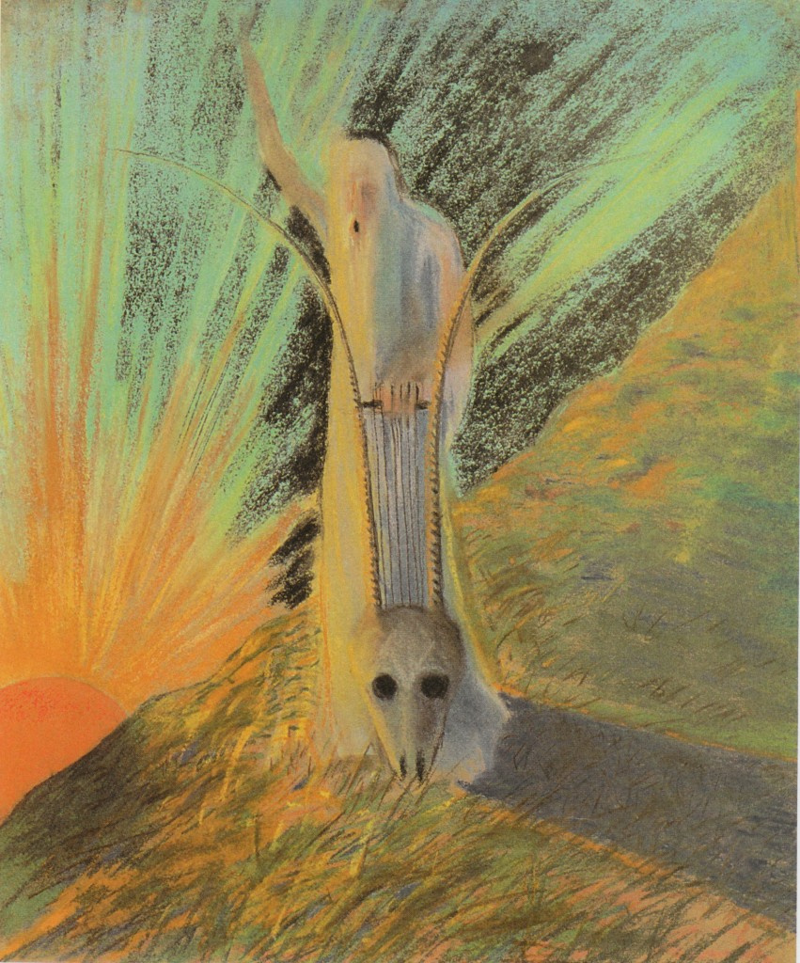
Čiurlionis left a legacy of around 300 paintings and prints. The bulk of the works are housed in the National M.K. Čiurlionis Art Museum in Kaunas, individual pieces belong to different museums in Vilnius, Warsaw and St Petersburg, and several works are the property of private collections.

Slide 4
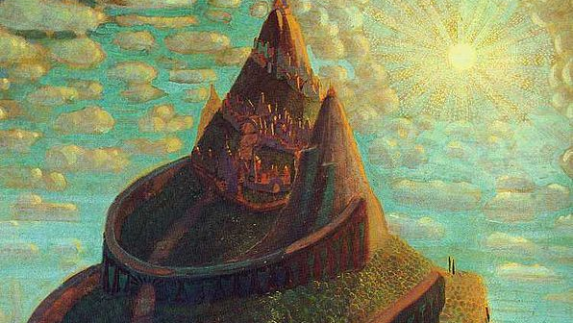
Čiurlionis’ painting captivates not only with its mysterious content and picturesque imagery, but also with its original artistic form. Čiurlionis’ art is closely aligned with European Symbolism by similar themes and motifs, and symbolic treatment of the subject matter. At the same time, noteworthy was his ability to think fairly independently from the leading artists of the time and create paintings of totally new plastic form, namely pictorial sonatas, preludes and fugues. By fusing painting and music into a unique artistic formula, these paintings have significantly enriched European Modernism. With his investigations into the plastic vocabulary of painting he cut his way into Modernism much deeper than any other artist of Central and Eastern Europe.

Slide 5
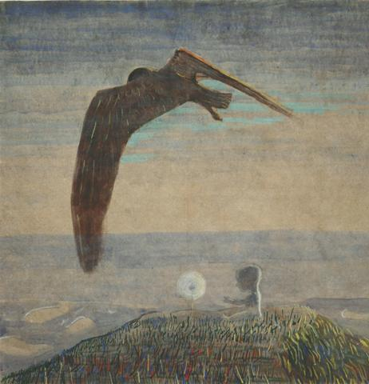
In the context of the 1900s art, Čiurlionis’ paintings of 1907–1909 are considerably innovative. He broke ground with his ingenious method of abstraction, which is based not on colour, but on the graphic-spatial organisation of the painting, offering one of the most unique formulas for applying the musical principle in painting. Thus he belongs to the ranks of the pioneers of abstract art.

Slide 6
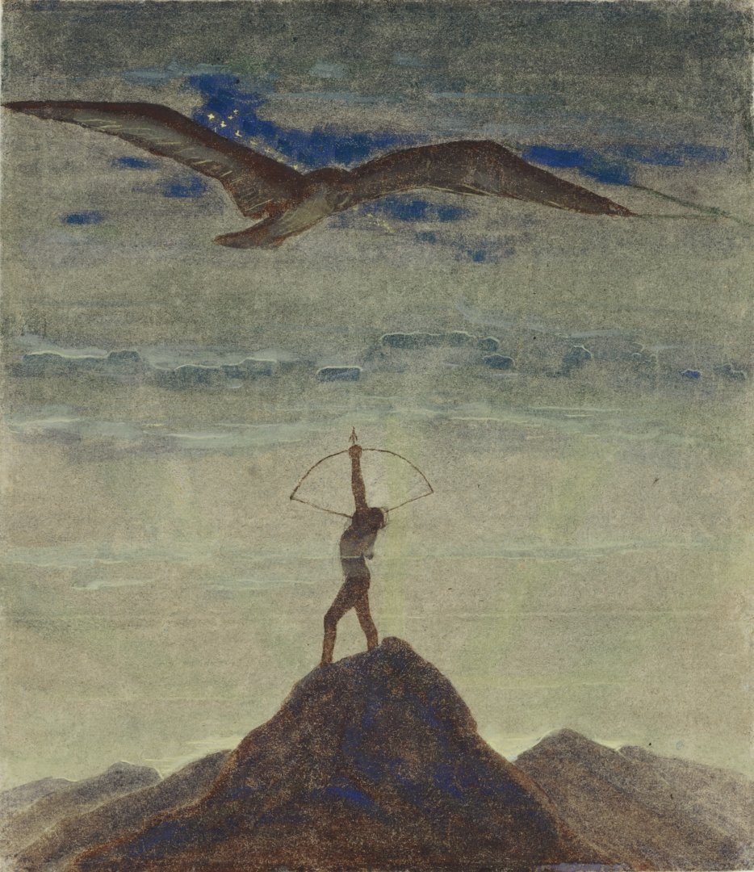
Čiurlionis started trying his hand at drawing and painting while still studying at Leipzig Conservatoire (1901–1902). His artistic attempts from 1903 – painted postcards he sent to brother Povilas – are compositions for his future paintings.

