Slide 1
Ouranio Toxo Chalkida Greece
RECYCLING

Slide 2
Materials
With some help from our mascot we learn about different materials, which can be recycled.

Slide 3
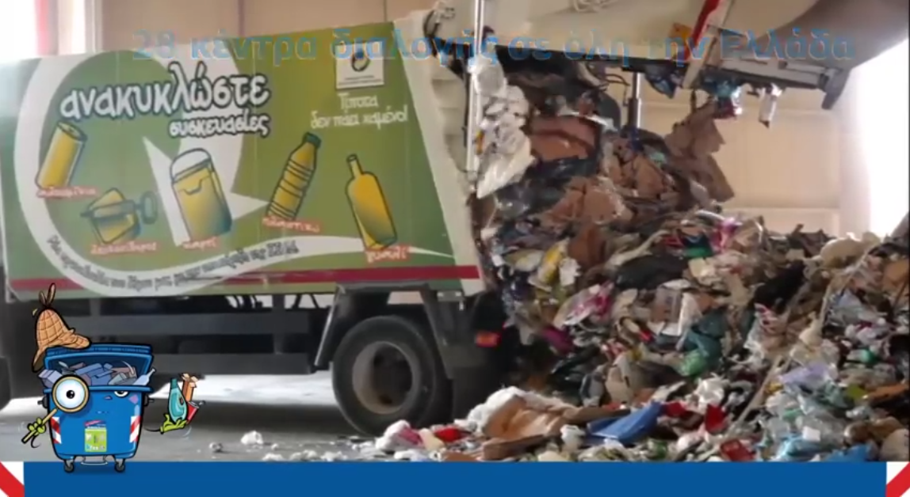
Recycling Factory
While watching a video made by the Hellenic Recovery Recycling Corporation we witnessed step by step the recycling process in a factory.

Slide 4
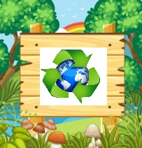
Recycling Signs
We learned what they are, where we can find them and their meaning.

Slide 5
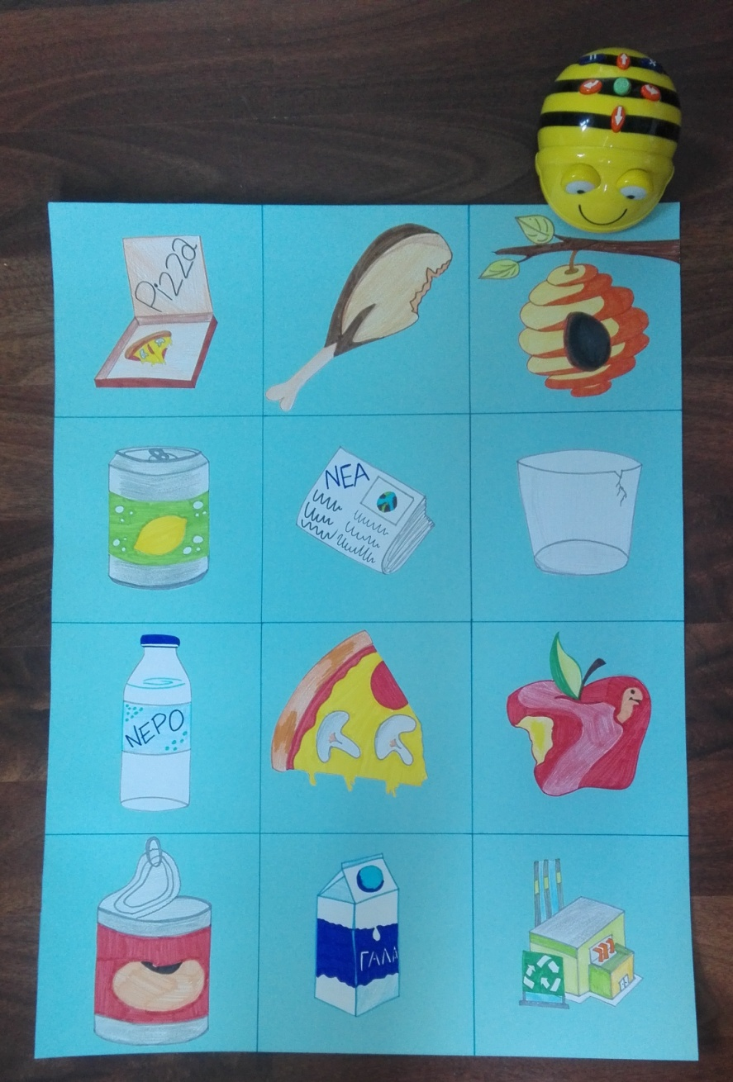
BEEBOT
We made a new beebot
game mat.

Slide 6
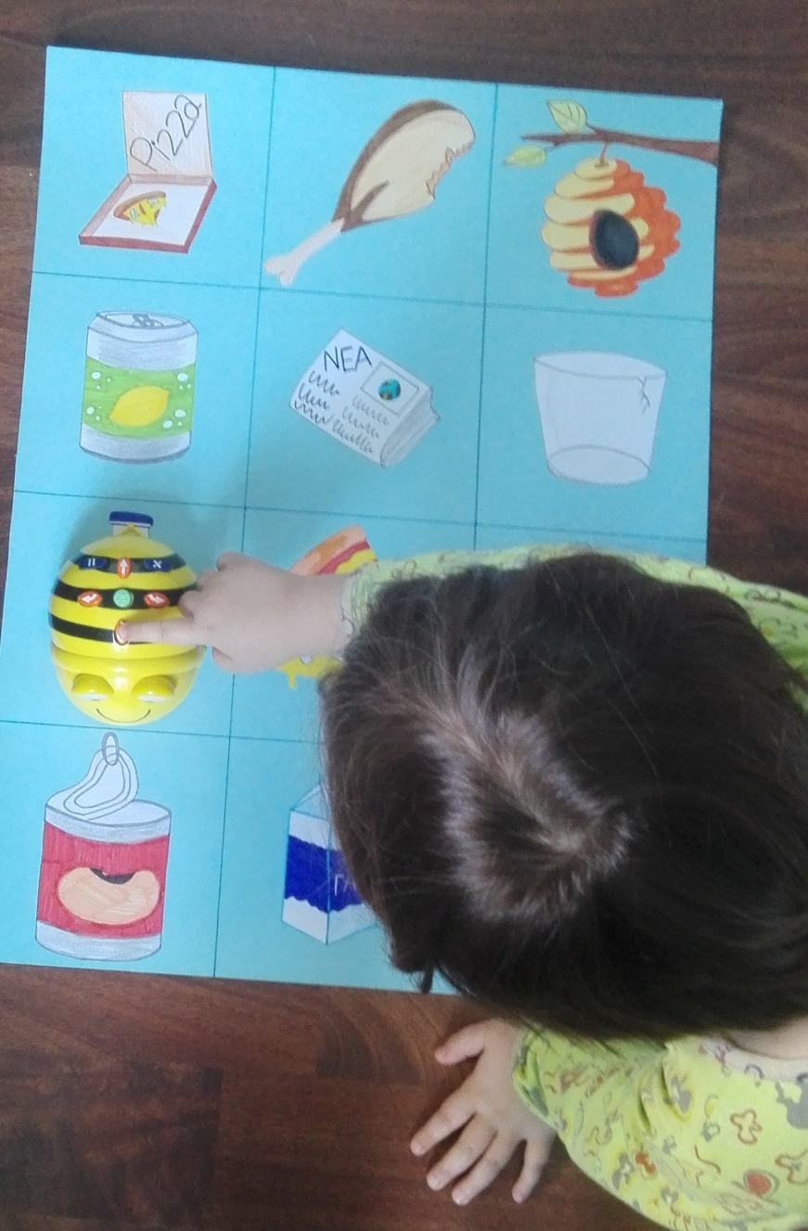
BEEBOT
We helped our beebot to collect all recyclable objects in her way to the recycling factory.

Slide 7
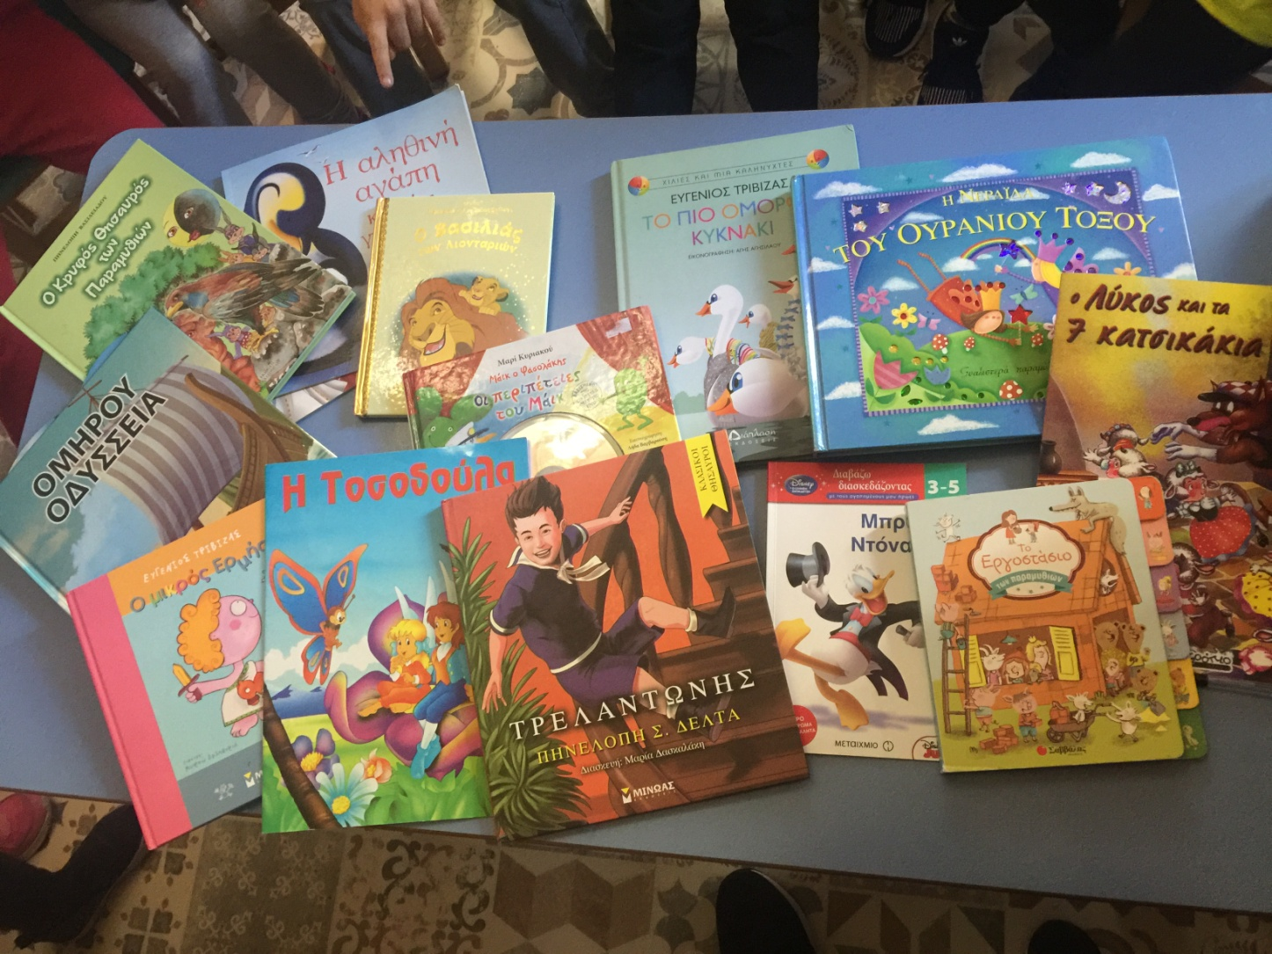
Gathering old Books
We gather all our old and unused books so we could give them new owners, who would enjoy them as much as we did.

Slide 8
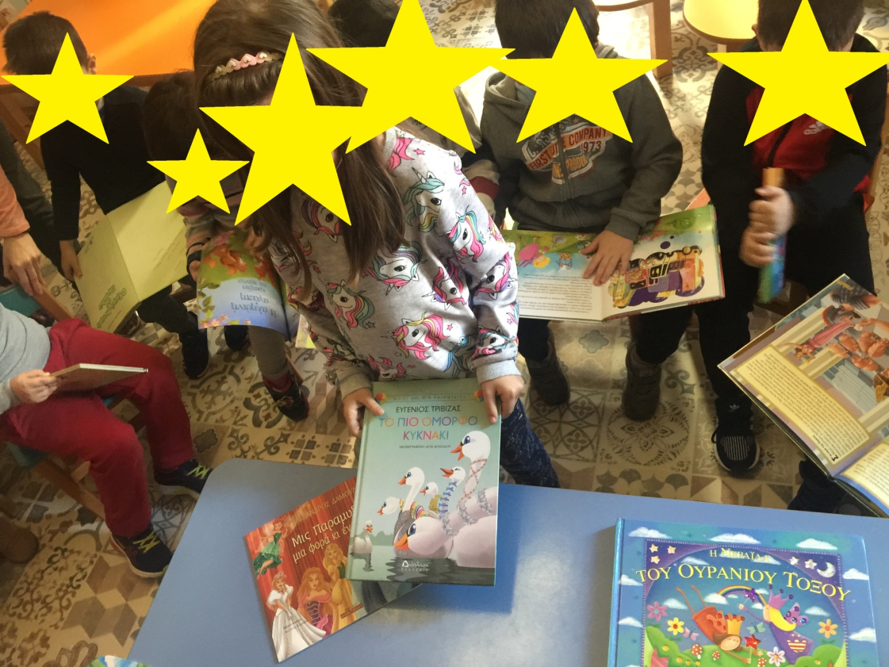
The new owners pick their new books

