Slide 1
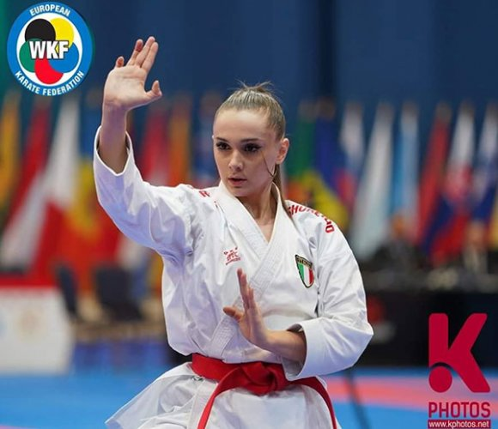
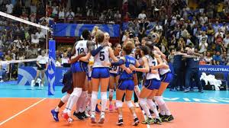
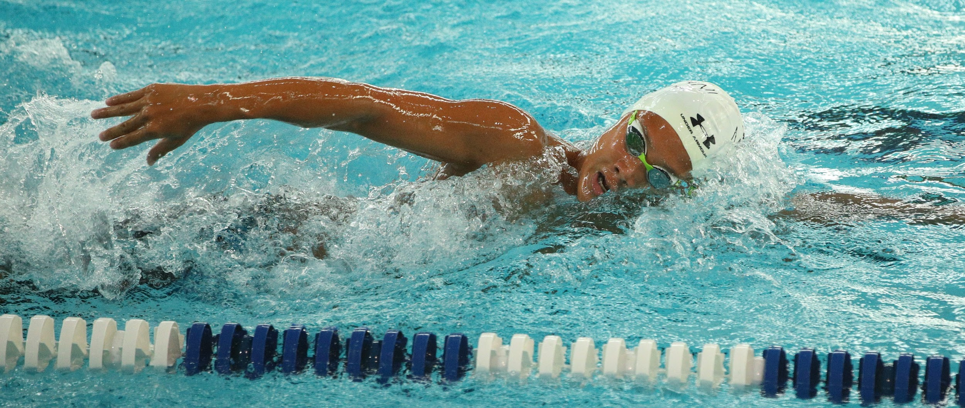
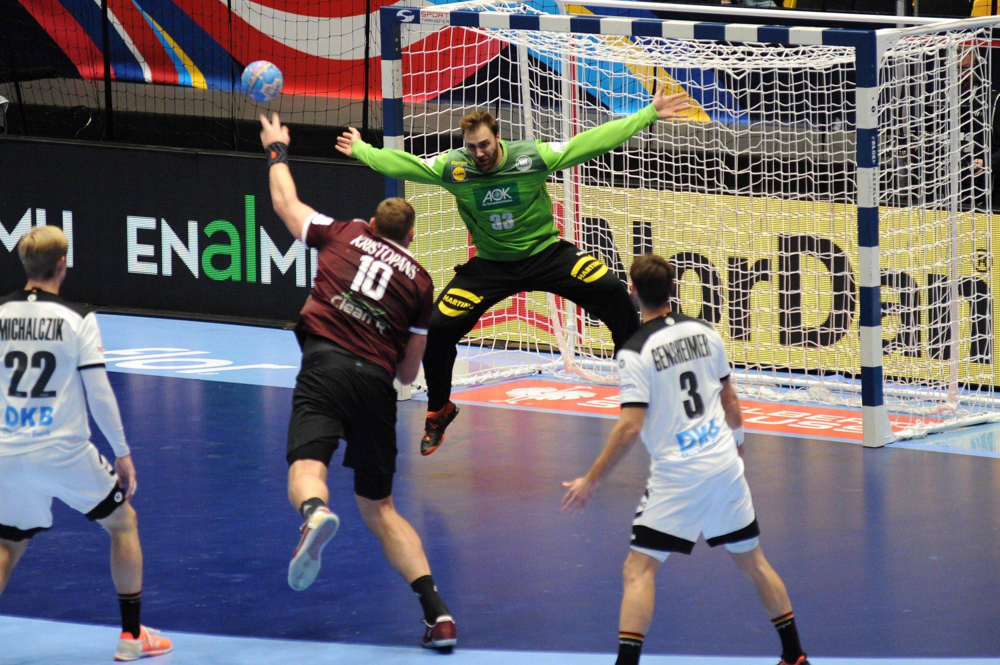
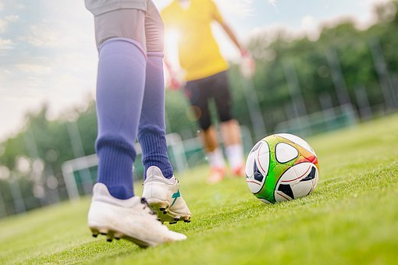
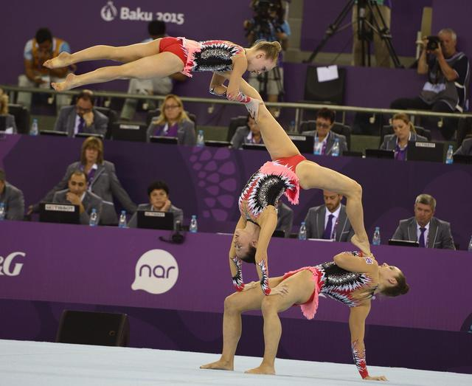
Sports during Corona
Anna Raspugli
Taurisano Ilaria
Vanessa Andreani
Eleonora Calesini
Derian Buhr
Fabian Rielmann
Leon Wommelsdorf
Elyne Vuillaume
Tim Pollmann
Joshua van Gehuchten

Slide 2
How Corona affects our way of doing sports - Italy
Volleyball during quarantine:
during the quarantine every kind of volleyball training has been cancelled. So my brothers and I decided to train every afternoon for 2 hours a day. From 5 pm to 7 pm. We trained all the limbs, one day the legs, one day the arms ... when it started to get warmer we set up the net under the house and after training we went to play outside. So we did a ranking because we wanted to see who, at the end of the quarantine, had the most wins. (vanessa)
Gymnastic acrobatic during quarantine during this quarantine i stopped training because the gyms had closed in the quarantine i worked out at home 3-4 times a week, i used to go running in the park in front of my house, or i often did training home (ilaria)
Karate during quarantine:
during this quarantine I stopped training very early because all the gyms had closed, I didn't train at home because I didn't have much space so I spent a long time without doing sports. one day my teachers decided to do online karate lessons on Mondays and Fridays in order to resume training, I ìwas very happy because even if I was closed at home I was able to carry on my passion (anna)
Rhythmic Gymnasticts during quarantine:
Rhythmic gymnastics was suspended during the quarantine.
Since February, the Rimini association has started to give only online lessons, but I have never attended.
For the first few weeks I stopped doing physical activity, but then I started doing some work out at home, every other day.
(Eleonora)

Slide 3
How Corona affects our way of doing sports - Germany
Handball and gym during corona (Leon):
As handball was cancelled and the gyms were closed I started jogging and working out at home. When our handball training restarted I played it 3-4 times a week until it was cancelled again.
Swimming during corona (Derian):
Due to swimming being cancelled, I went jogging every second day and went to the gym, which is closed now, too. When swimming was reopened for a short period, I trained 3 times a week
Football during corona (Fabian):
When football was cancelled I went running 3 times a week. When football came back for a short time, I had football 4 times a week.
Football during corona (Tim):
When football was cancelled I stopped doing sports for a short time. When football was allowed again (for a short time), I played it 2-3 times a week.

Slide 4
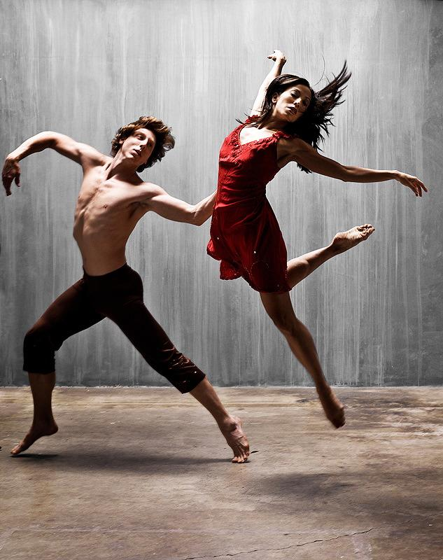
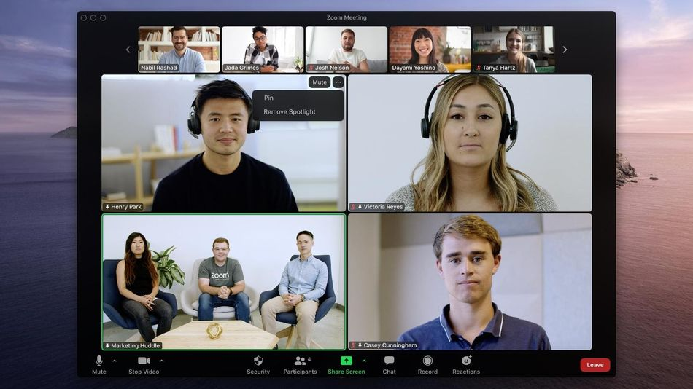
How corona affects our way of doing sports - Corsica
Dance During corona (Elyne) :
Durant this quarantine i stopped the
dance like every other sports in corsica
. So at home I decided to work my dance
And my choreography in addition to my
VideoCall in zoom with my group of dance
And my dance teachers. I was going also walk
1 hours with my mother and do exercise of fitness

Slide 5
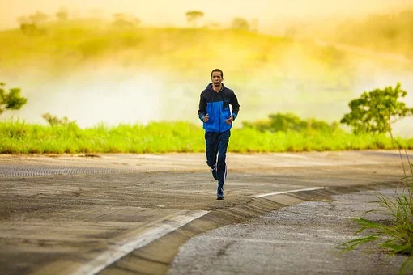
How Corona affects our way of doing sports - Belgium
Handball during Corona (Joshua):
I used to play handbal ,but that is cancelled ofcourse. I couldn't do a lot of sports because i broek my schoulder last Month but i have been jogging a lot lately and before Breaking.

