Slide 1
Twinspace
1- Invite members - Status
2- Communication
3- Upload materials (Pictures, videos, files)
4- Create a page
4.1 Embed
5- Twinboard
6- Create a poll
7- Archive or restore a page
8- Workshop tasks
Task check list

Slide 2
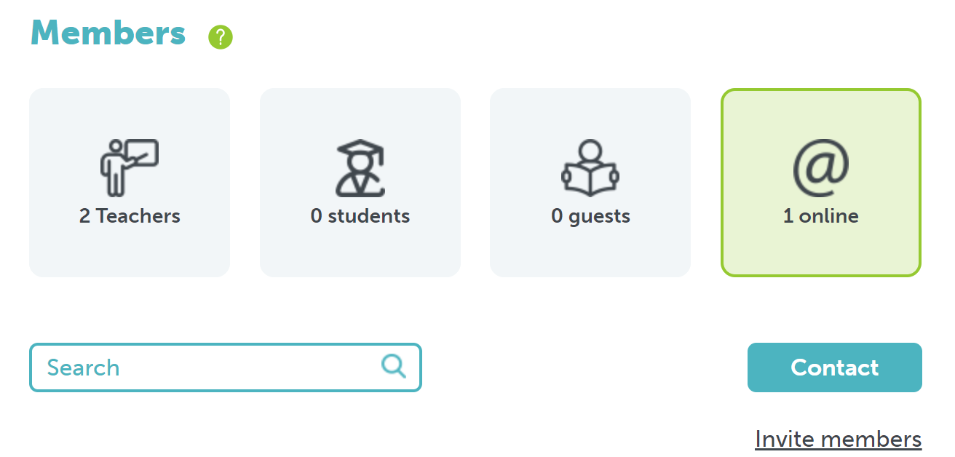
1- Invite members
Home

Slide 3
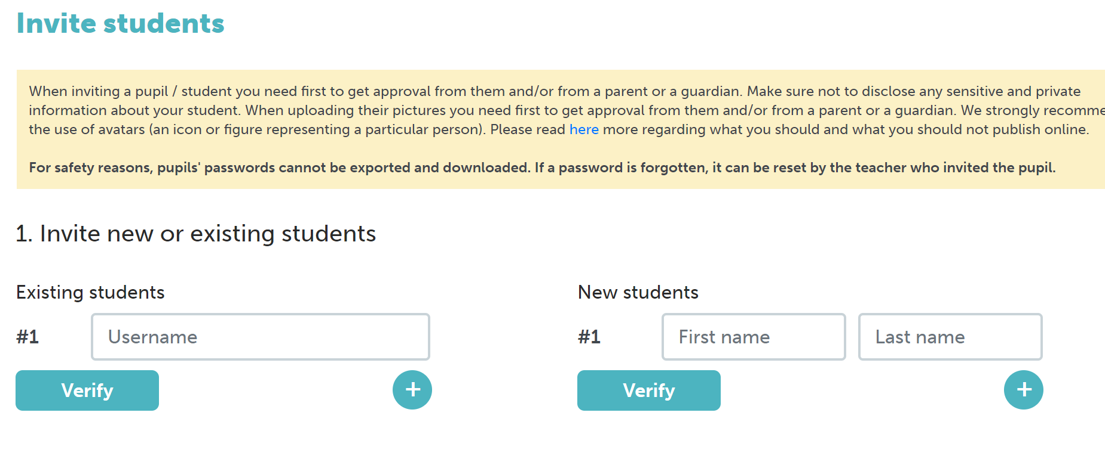
1- Invite members
If student already has an
eTwinning account
If student has no eTwinning account
Home

Slide 4
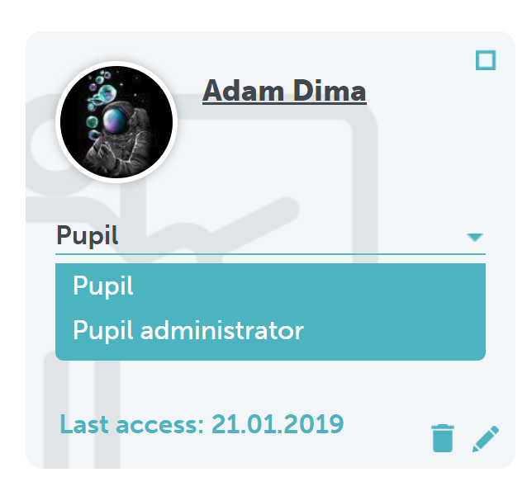
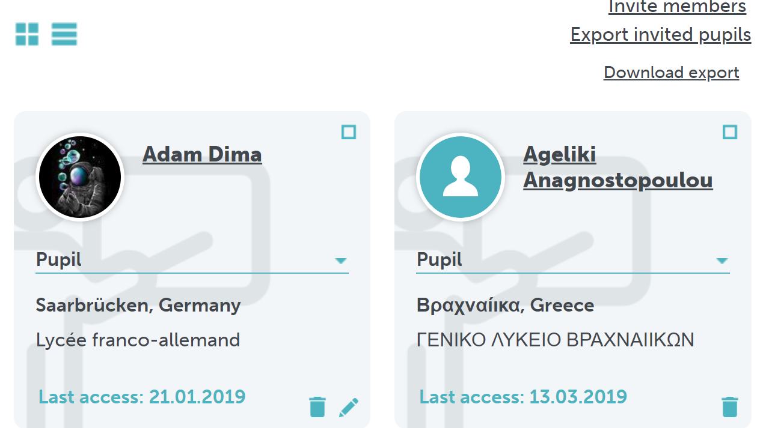
1- Invite members – Select status
Status
Click downarrow – Select new status
Home

Slide 5
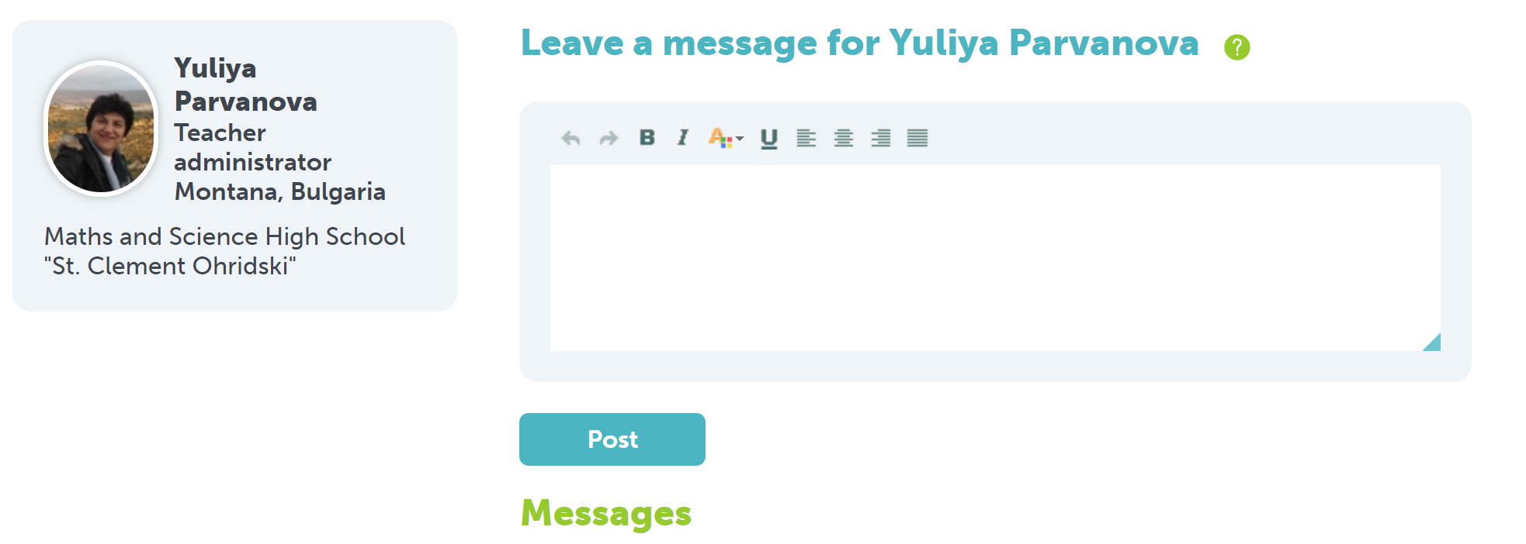
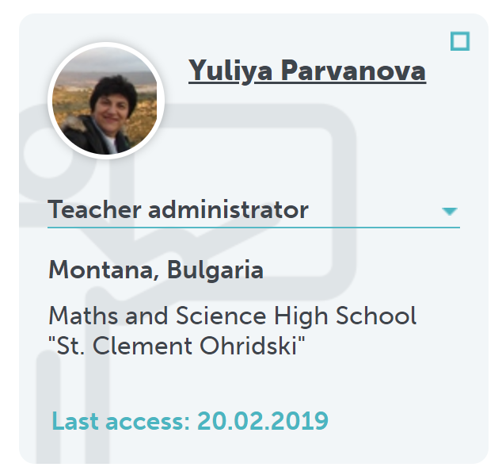
2- Communication
2-1 Leave a message to a single member
Click on the name
Write message
Home

Slide 6
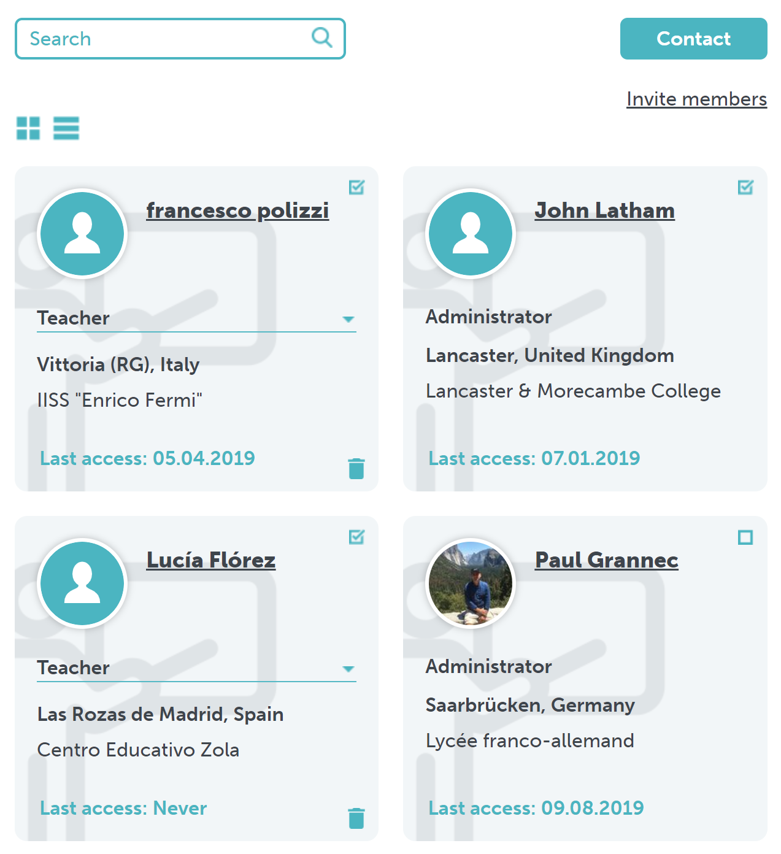
2- Communication
2-1 Leave a message to several members
2- Click contact
1- Select members
Home

Slide 7
2- Communication
2-1 Leave a message to several members
2- Click contact
1- Select members
Home

Slide 8
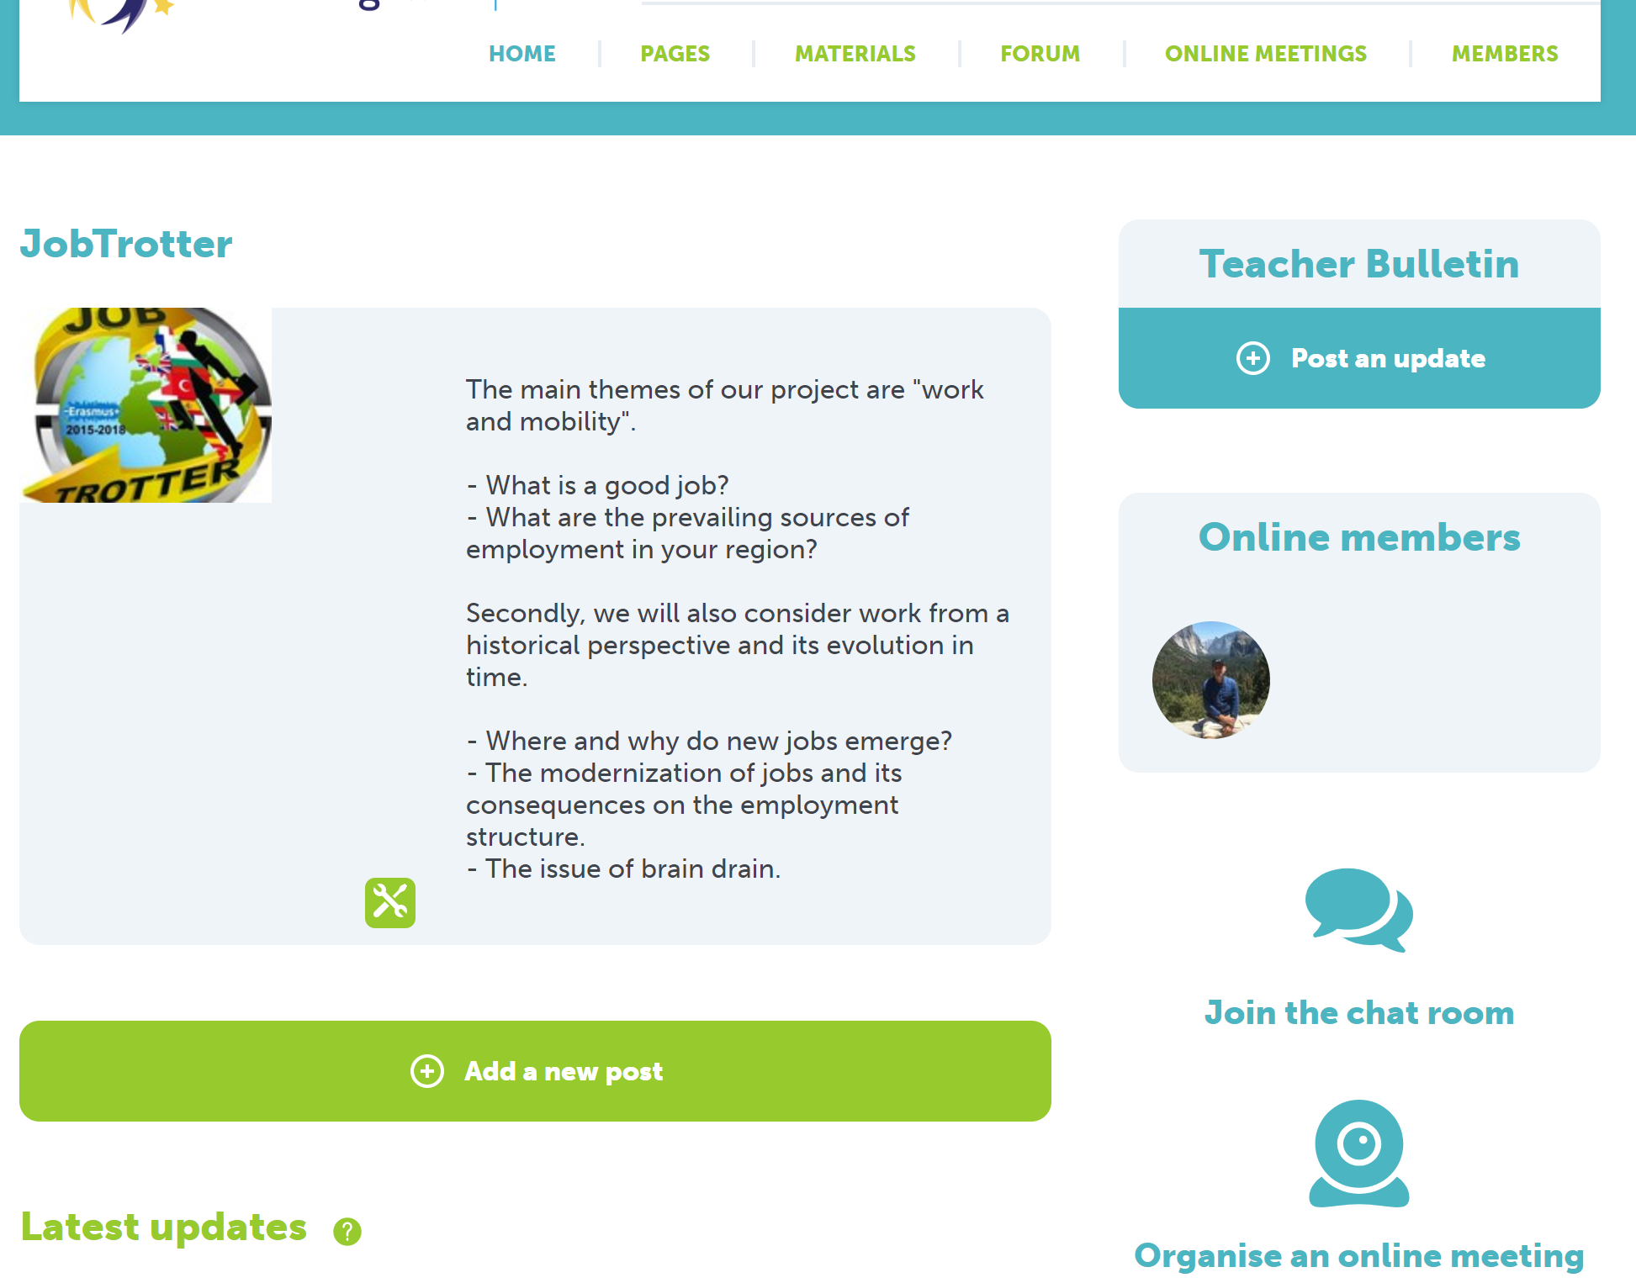
2- Communication
2-2 Homepage
Only visible by teachers
Useful for organisation, questions…
Change the layout
Home

Slide 9
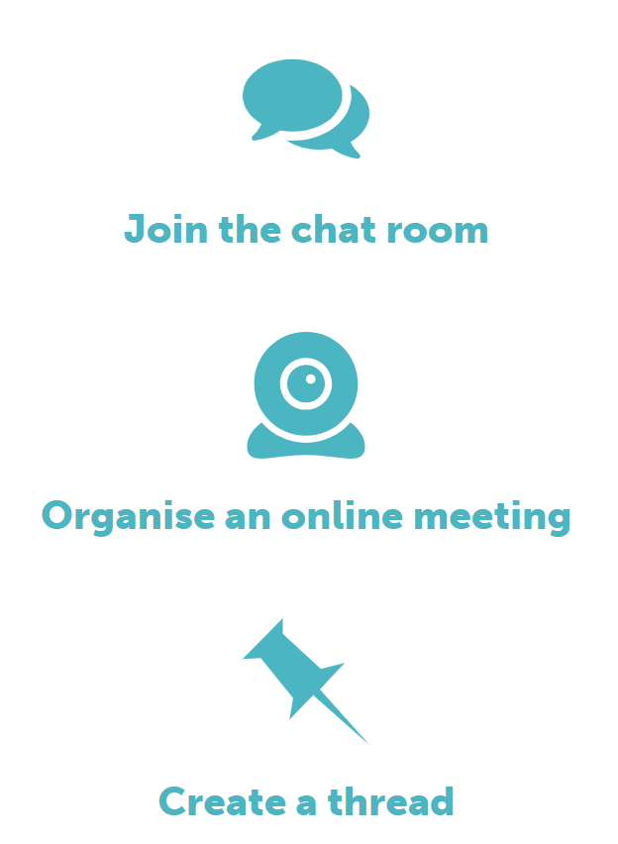
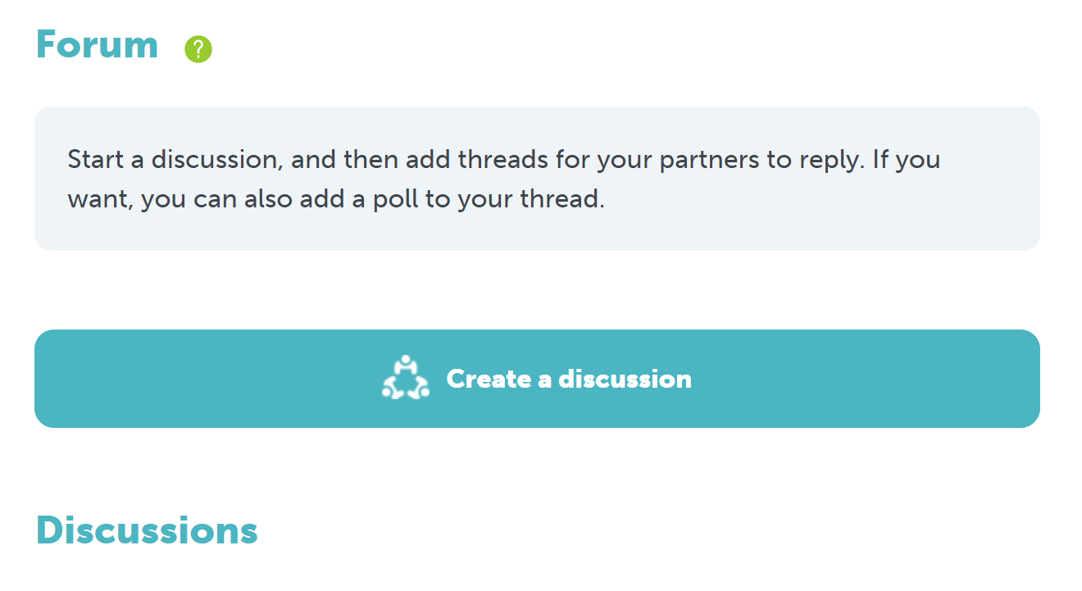
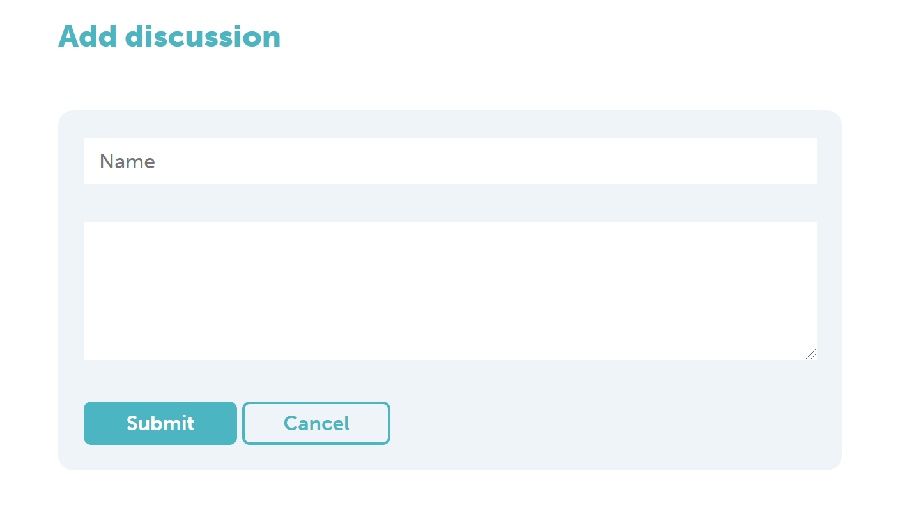
2- Communication
2-3 Forum
2 options
Give title
Type message
Submit
Home

Slide 10
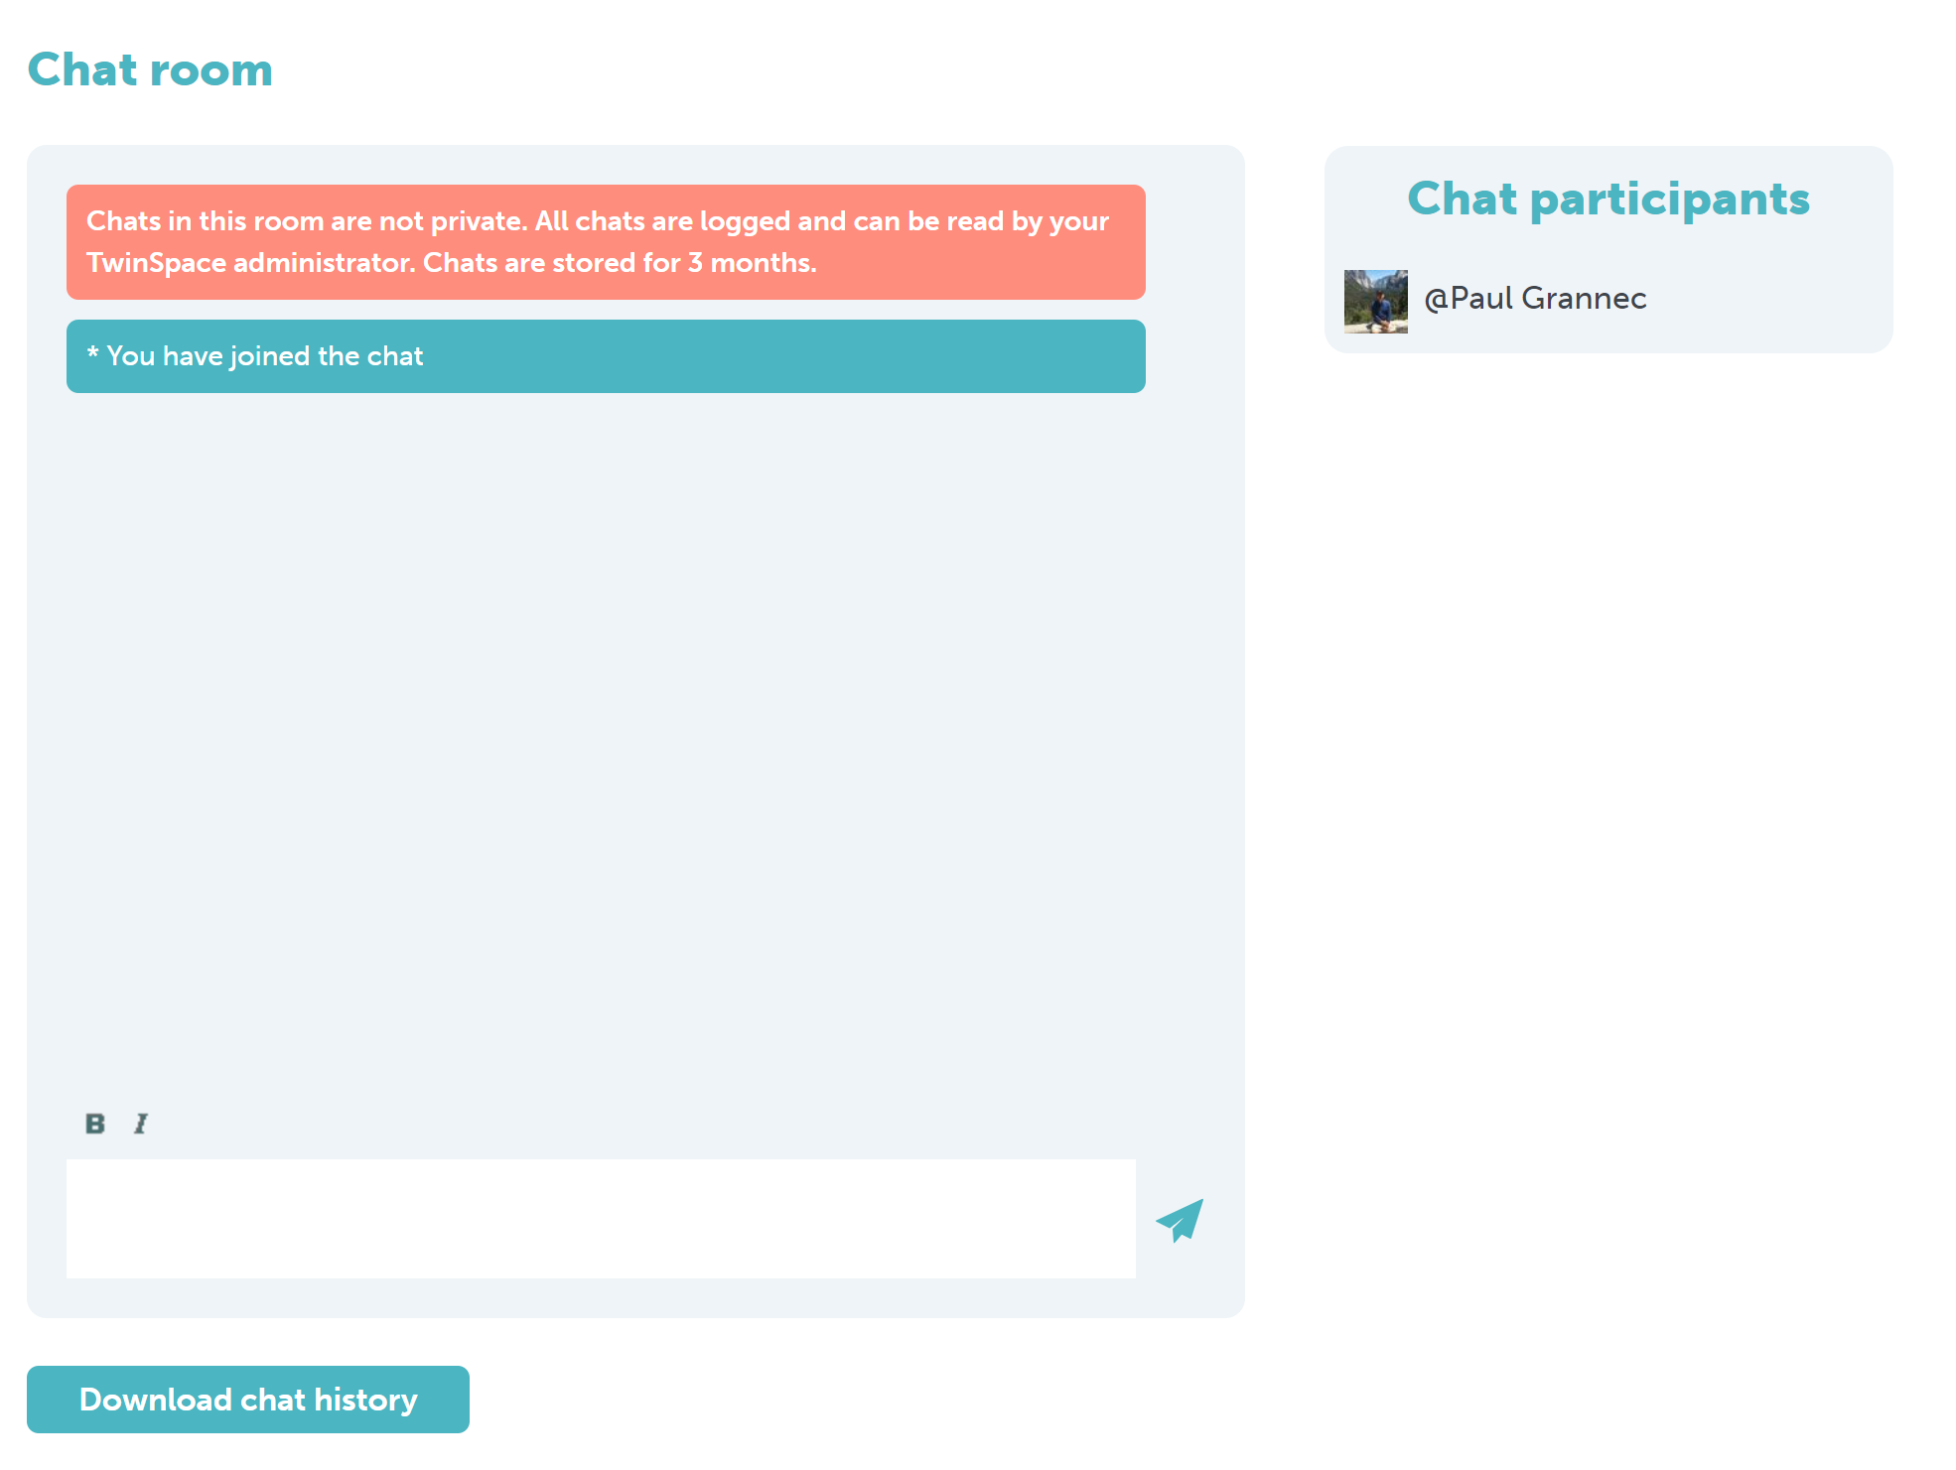
2- Communication
2-4 Video/chat online meeting
Chats are saved for a period of 3 months.
Possible to download chat to check issues.
Home

Slide 11
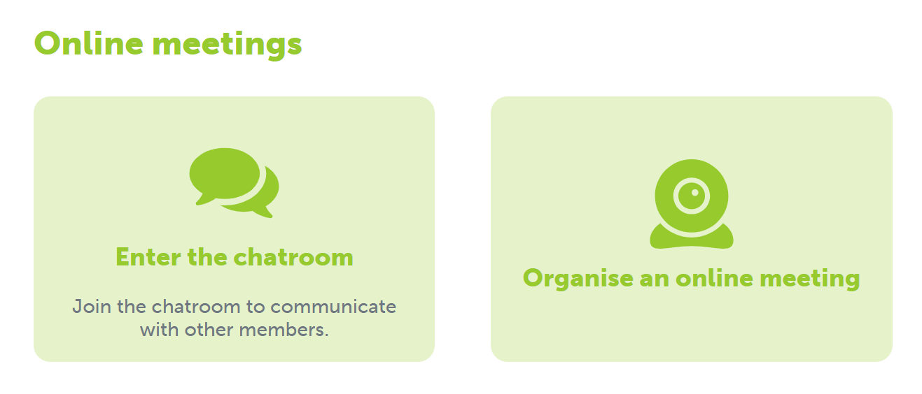
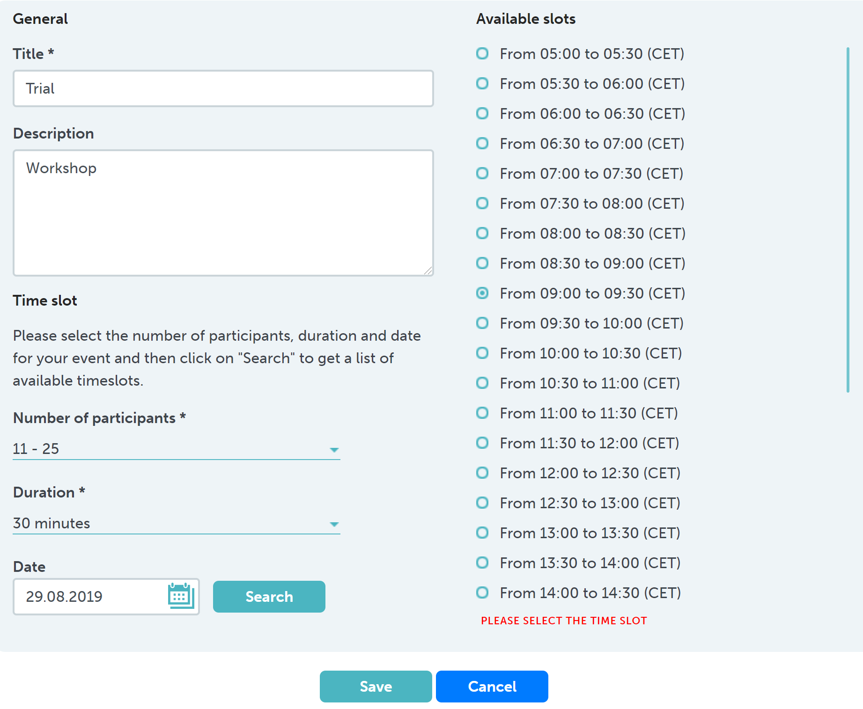
2- Communication
2-4 Video/chat online meeting
Fill in required information and click on « Search » when done.
Then select desired time slot
Home

Slide 12
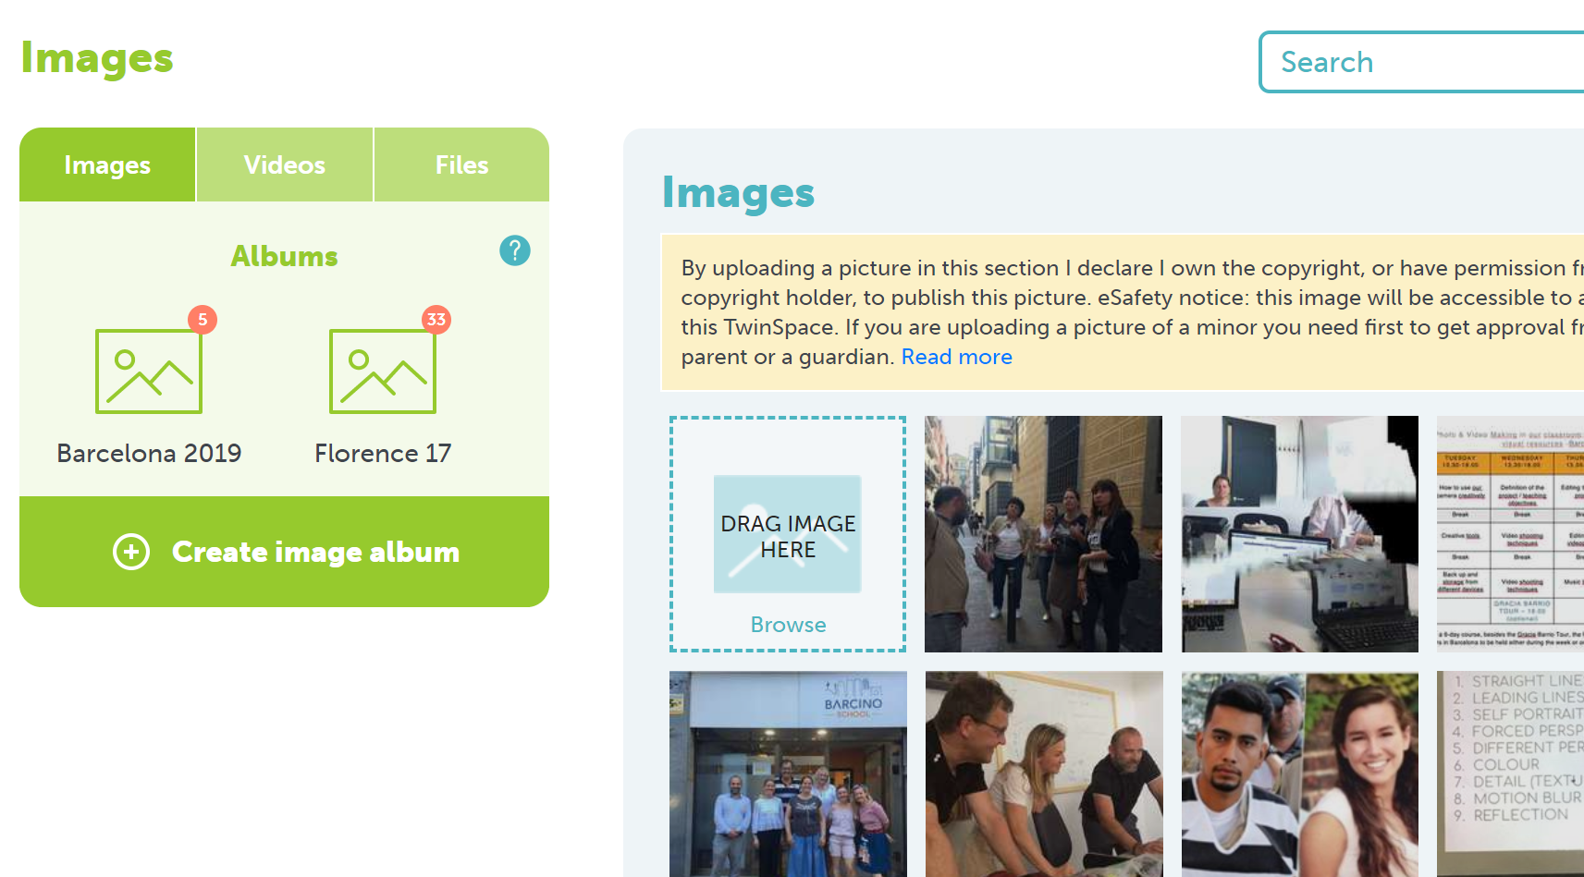
3- Upload materials
- Select type of files
- Drag and drop
Home

Slide 13
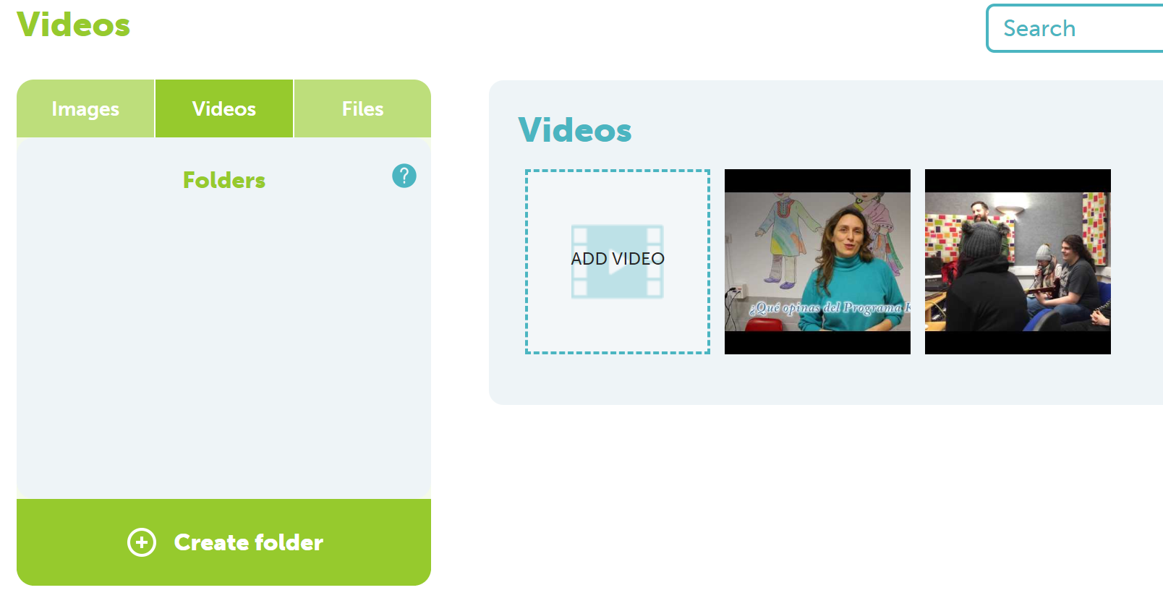
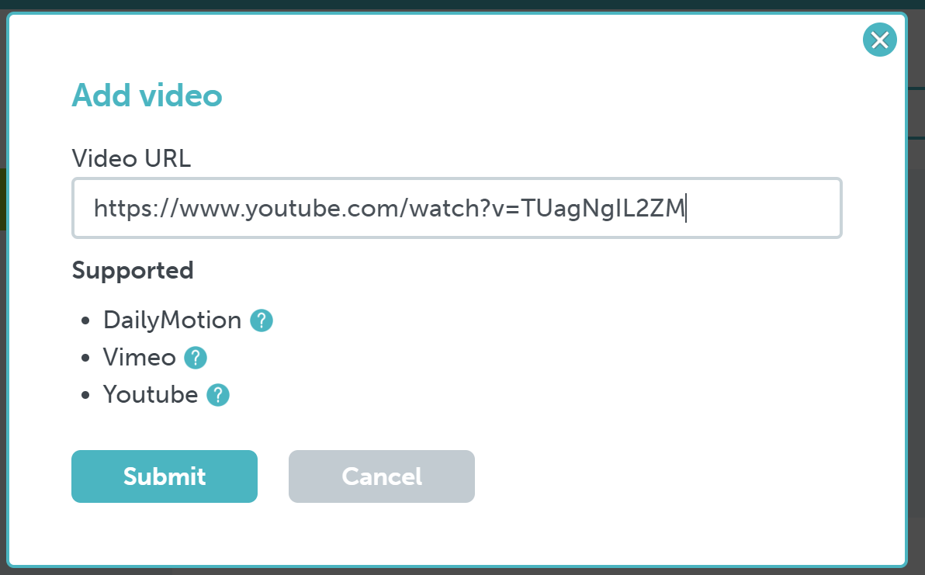
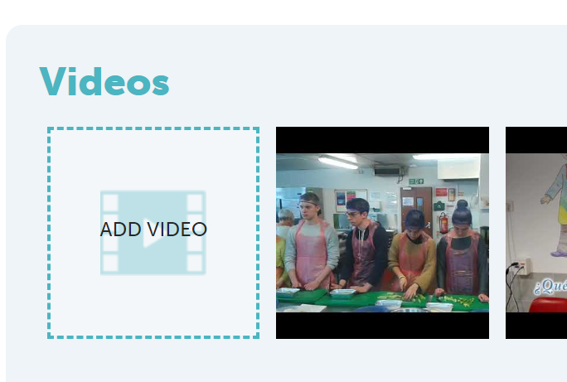
3- Upload materials - Videos
2- Copy and paste link of unlisted video
1
3- Submit
Home

Slide 14
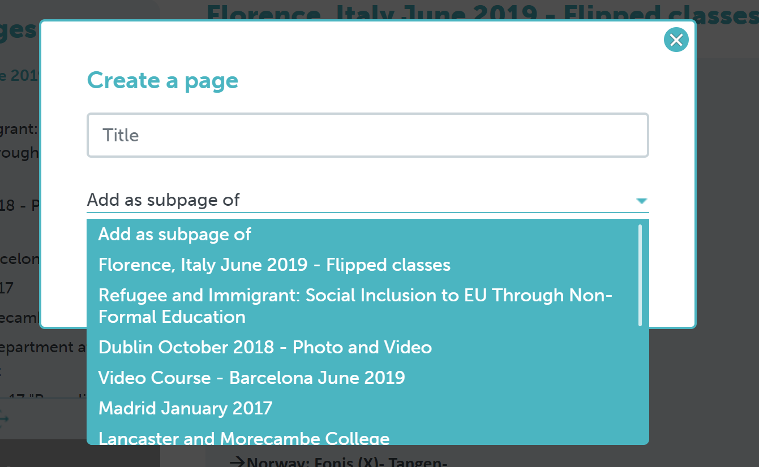
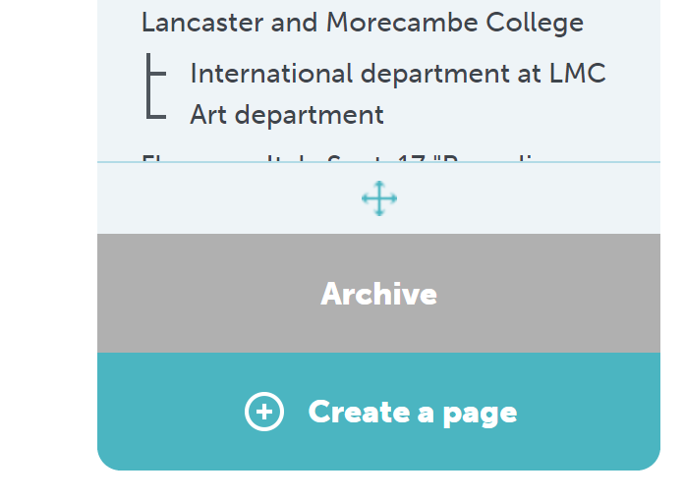
4- Create a page
1
3
4- Choose where you want to place the page in your Twinspace structure. If you do not make it a subpage, it will be added at the end of the list of pages.
2
Home

Slide 15
4- Create a page
1
3
4- Choose where you want to place the page in your Twinspace structure
2
Home

Slide 16
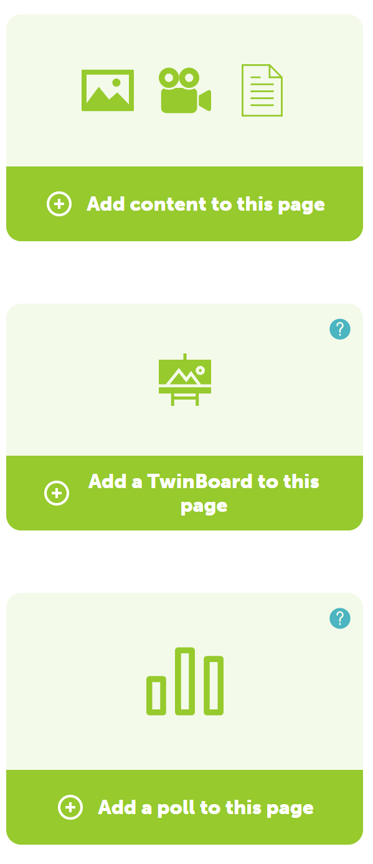
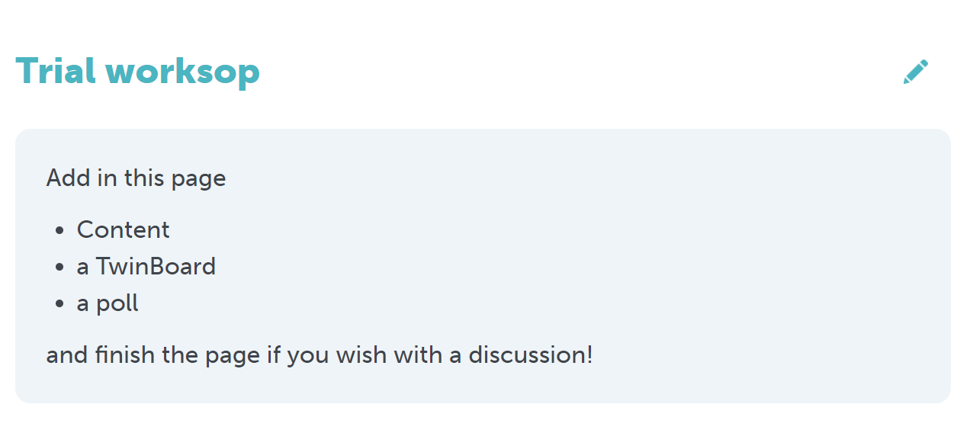
4- Create a page
1- Add tools to your page
2- Select tools
Home

Slide 17
4- Create a page
Links
Files
Videos
Pictures
I-Frame / Embed
Home

Slide 18
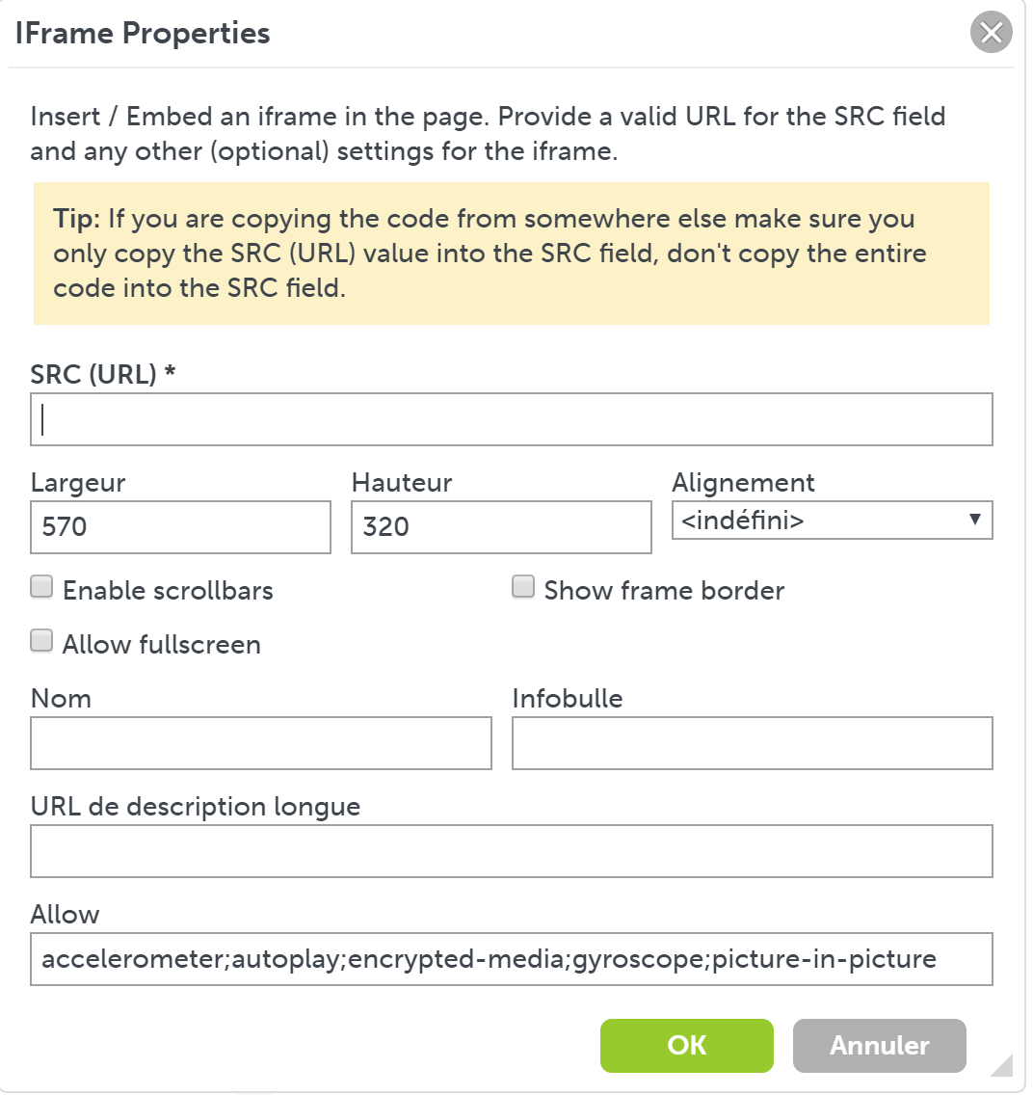
4- Create a page - Embed
Apps
Videos
3- To find the embed code in your video platform or app, first click on « Share » symbol
2- Fill in required information
1
Select symbol on page
4- Then click on « Embed » symbol
Home

Slide 19
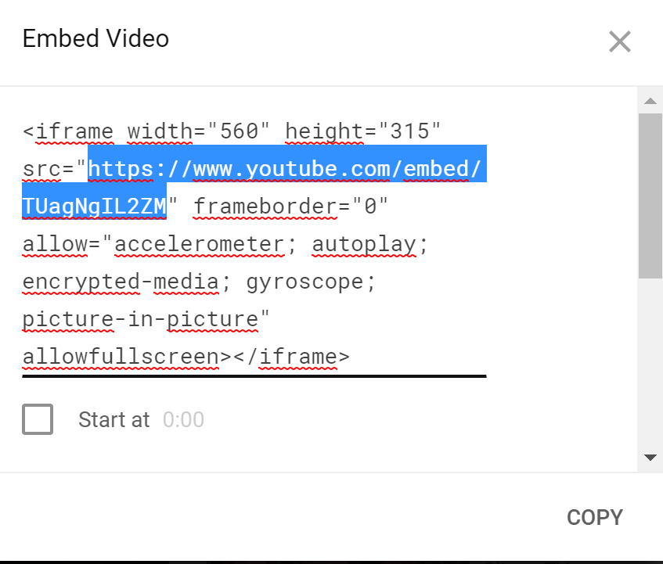
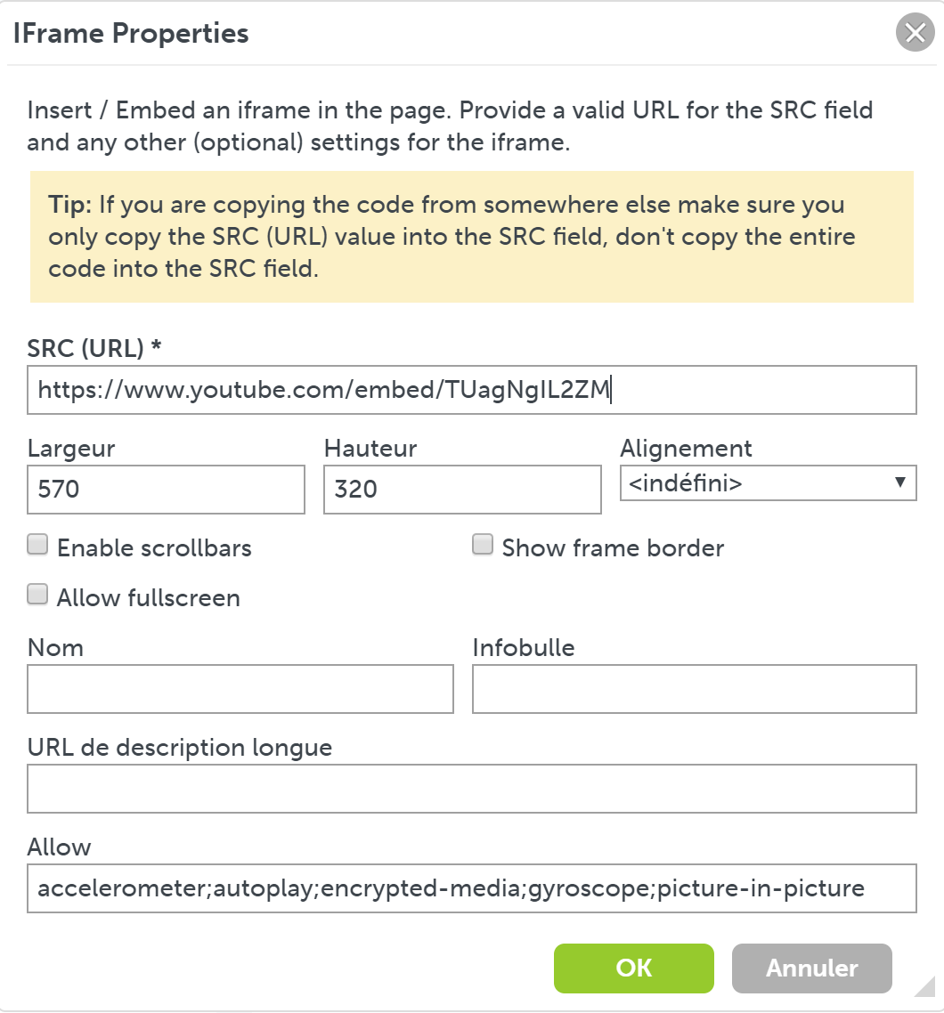
4- Create a page - Embed
1- Only select the part of the code behind src=« .
2- Copy it and paste it in Iframe properties
3- Confirm
Home

Slide 20
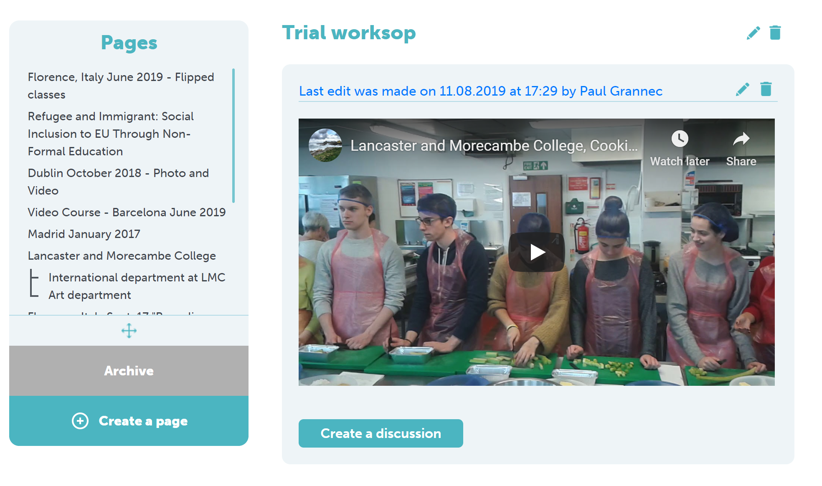
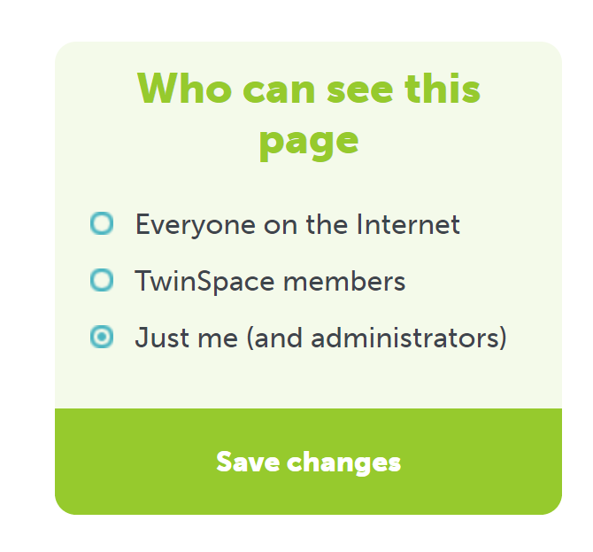
4- Create a page - Embed
5- For the page to become available online, you have to select its settings
(Scroll down, left-hand side of screen)
and save changes.
4- Submit
Home

Slide 21
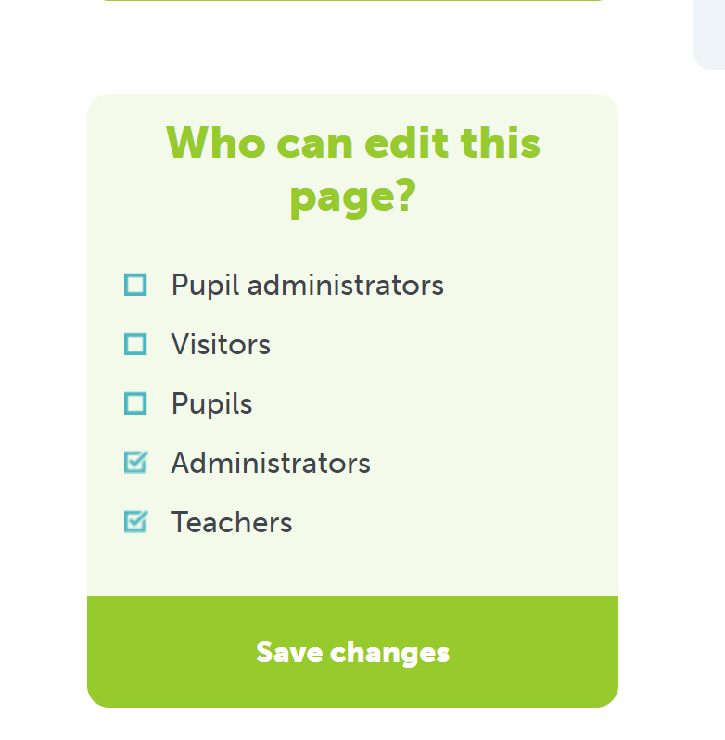
4- Create a page
6- Finally, assign status to participants
Home

Slide 22
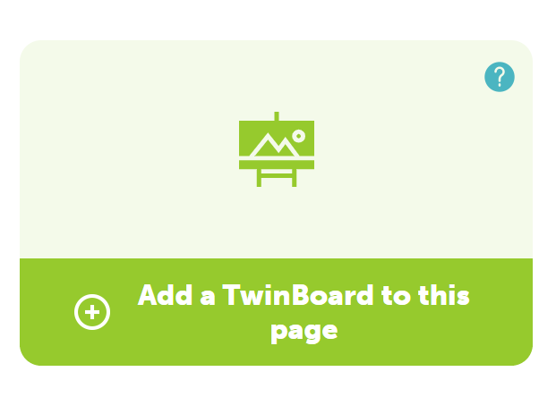
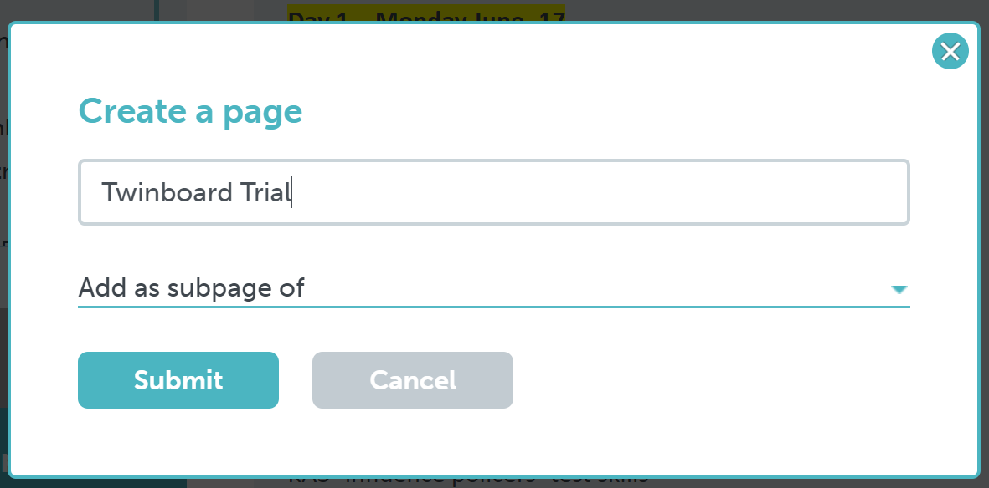
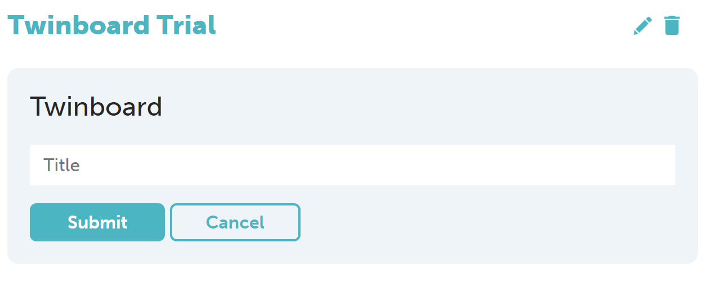
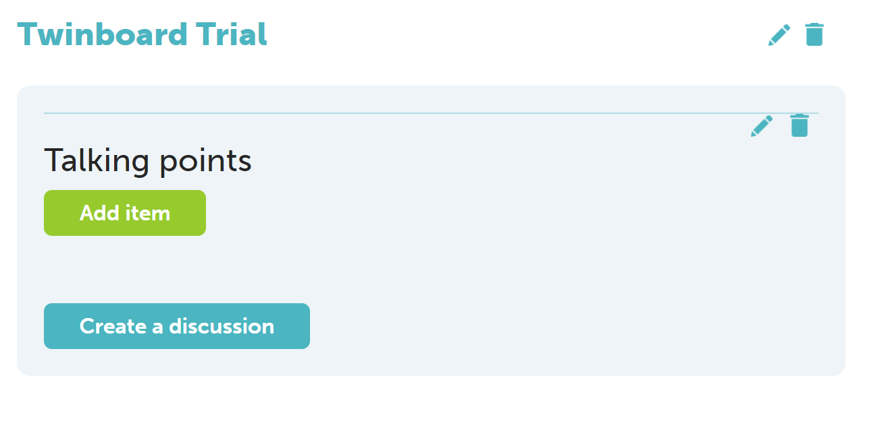
5- Twinboard
Twinboard is a collaborative notice board on which participants can add materials (Text, pictures, videos, polls, links)
You can have a Twinboard as a standalone page or add it to an existing page.
3
Give it a title
1
2
Start adding items
4
Home

Slide 23
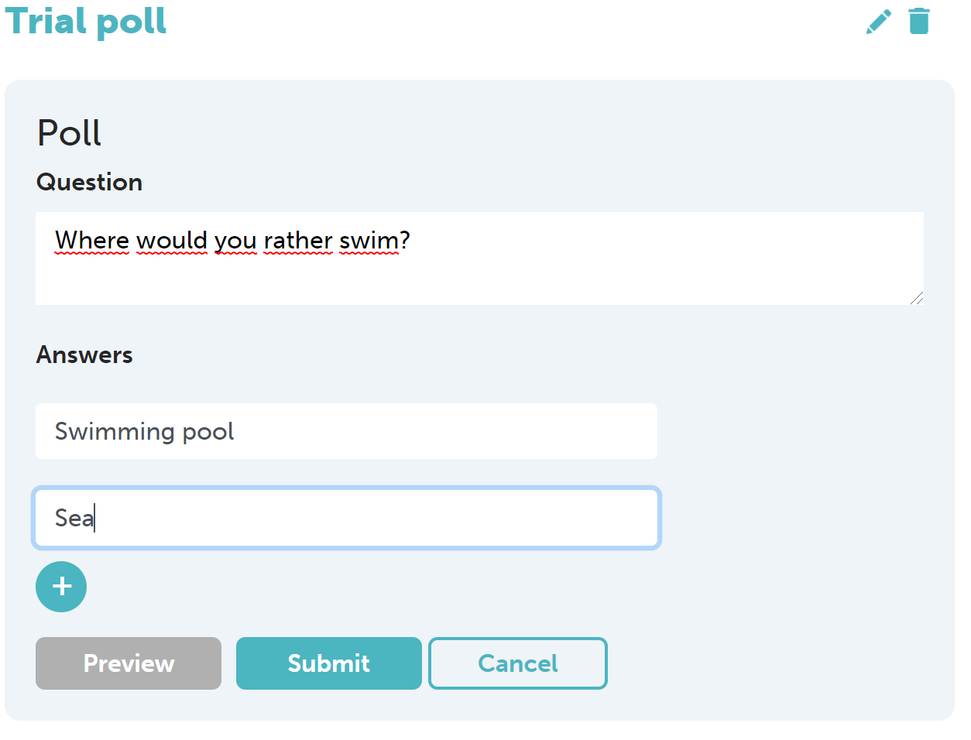
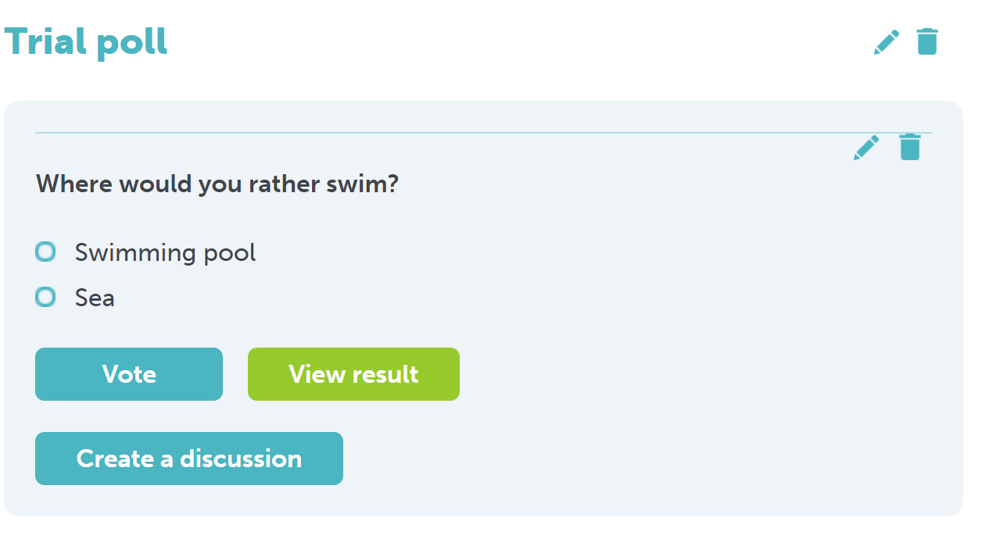
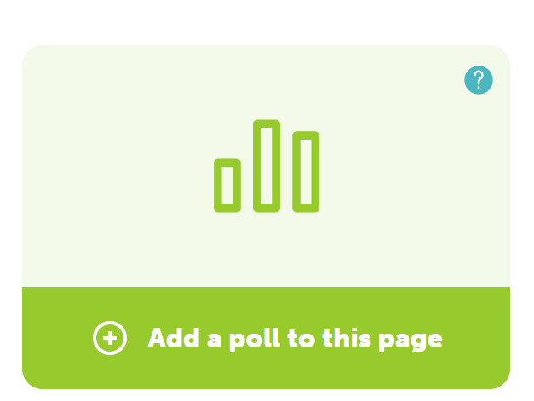
6- Create a poll
A poll: to survey opinions about people’s thoughts on a particular issue or an attempt to find the most suitable time to plan a meeting.
Can also be used to assess an activity and get some feedback from pupils.
1
2
3
Give it a title.
Write up a question and answers.
Answer the question.
Results are directly available.
Home

Slide 24
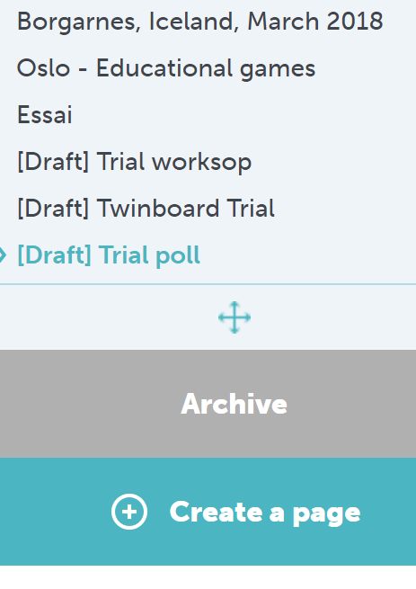
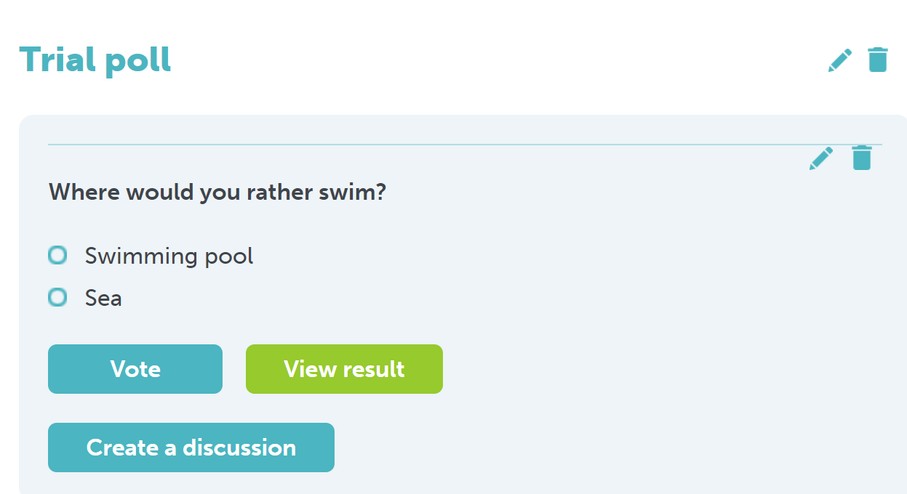
7- Archive or restore a page
You cannot delete a page, but only archive it.
Select the page you want to archive
Click on the bin symbol on the page and confirm
Click on « Archive » to restore a page
Click on « edit »symbol
Home

Slide 25
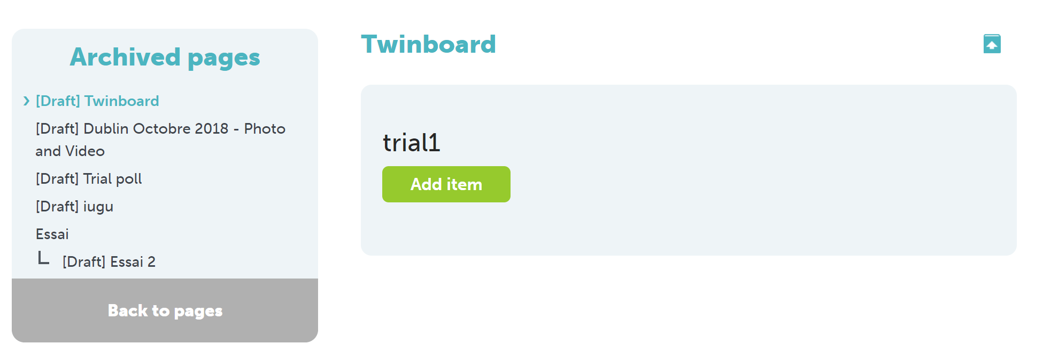
7- Archive or restore a page
Click on « Restore » symbol
Home

Slide 26
8- Workshop tasks
1- Register new members, at least one pupil and one teacher.
Assign « Pupil administrator » status to pupil.
2- Contact one member.
Contact several members at the same time.
3- Create a thread in the forum question. Answer one of the threads.
4- Add a picture (not more than 5 Mb) and a video in the « Materials » section.
5- Create a page and add content: a short text, a picture, a video and a poll.
The page title should be under the format « Trial page – Your name »
Define settings to your page (Who can see this page? Who can edit this page?)
6- Create a subpage to your page and embed a video (Youtube, Vimeo or Dailymotion).
The subpage title should be under the format « Subpage– Your name »
7- Create a page named « Archive – Your name ».
Insert a twinboard with 2 items (A picture and a link).
Archive your subpage.
8- Restore your archived subpage.
Home

