Slide 1
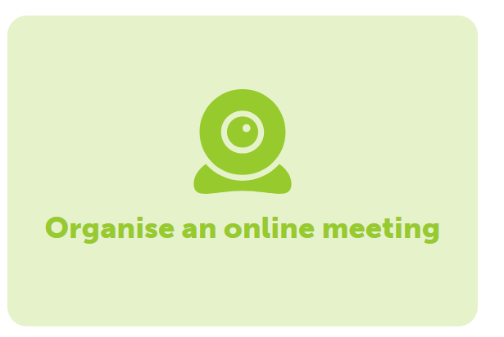
Online Meetings in eTwinning
Adobe Connect

Slide 2
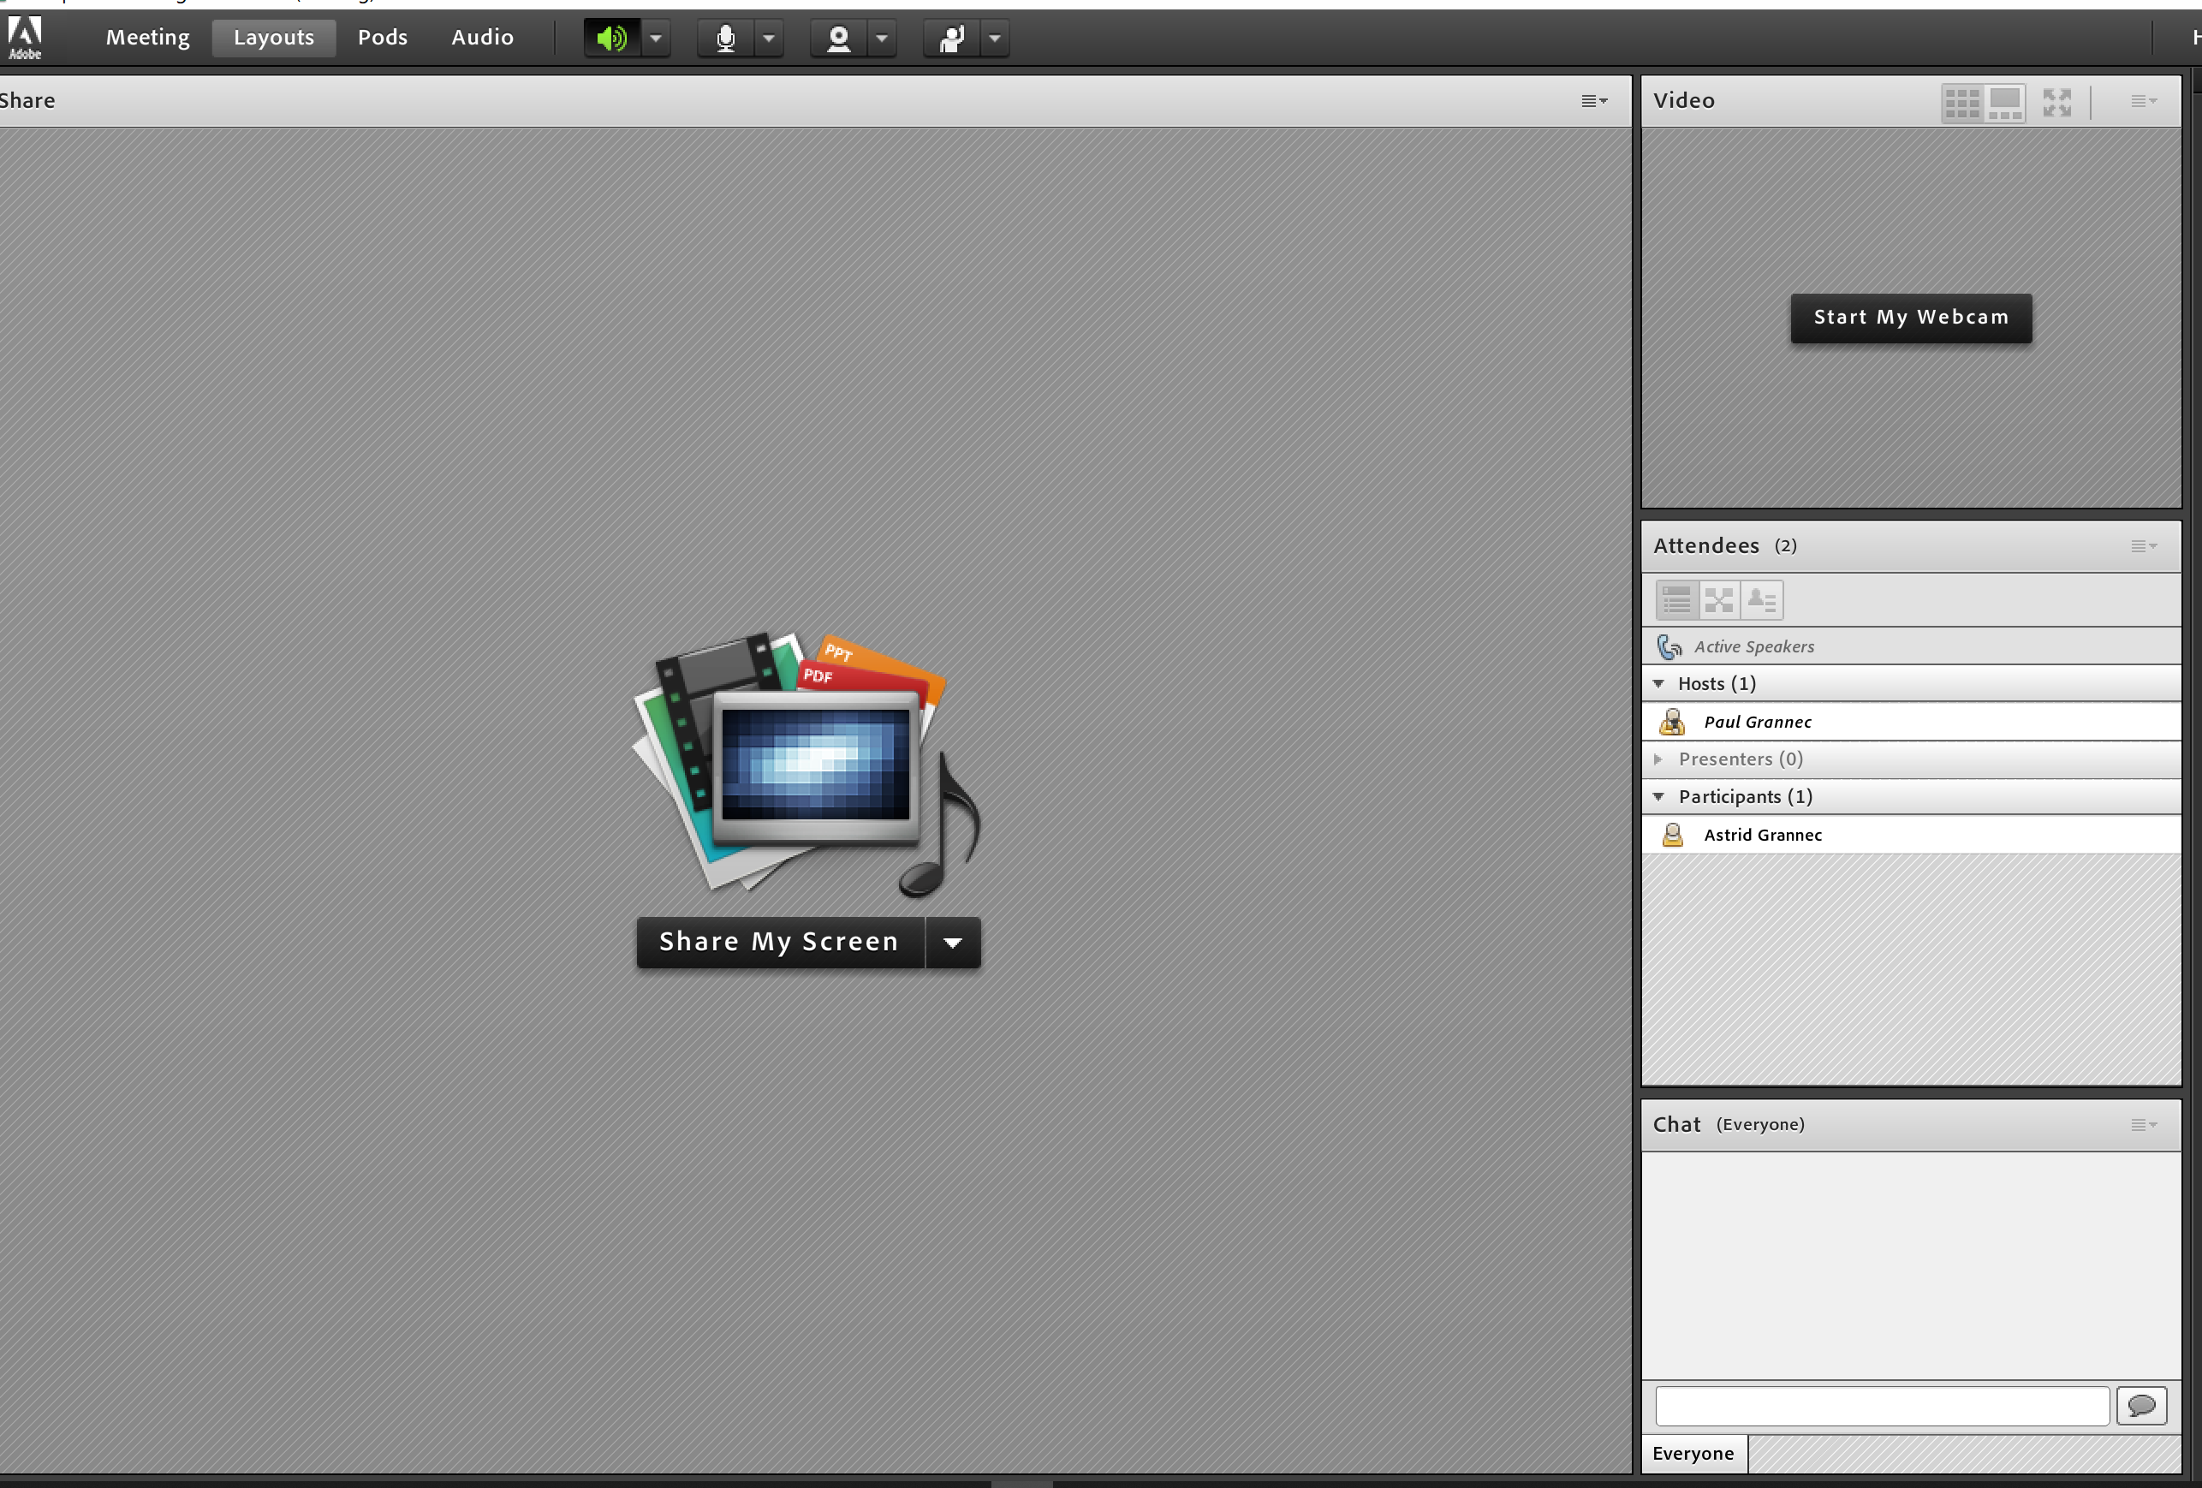
Move participants in « Presenter » status.
Drag and drop

Slide 3
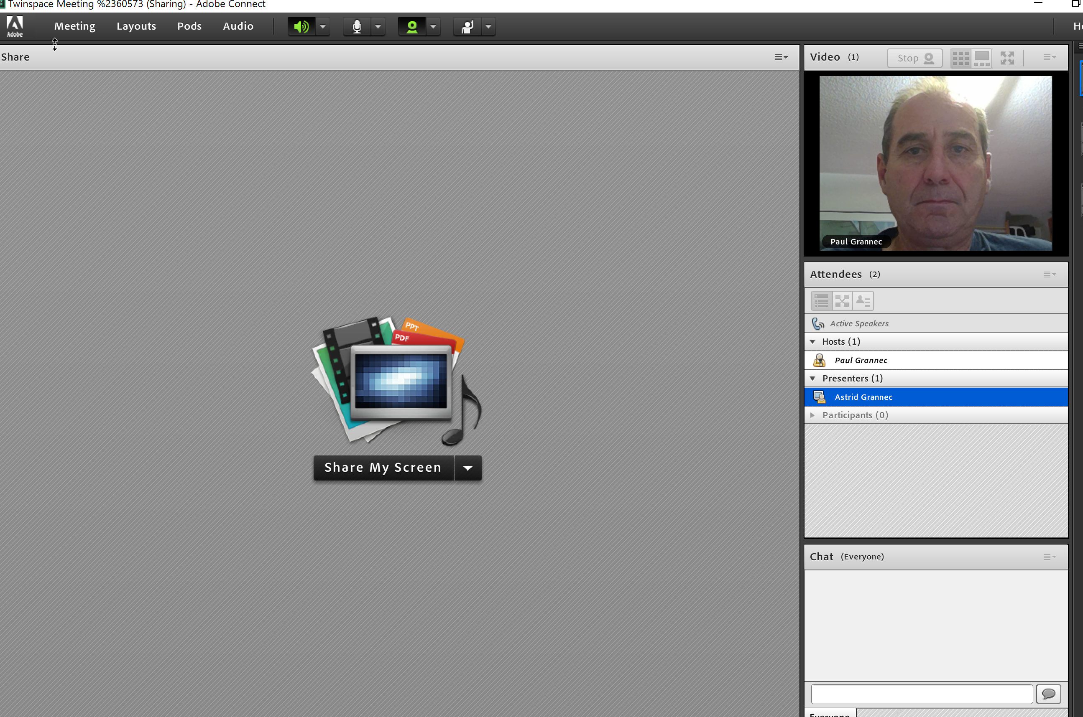
Webcam status
Speakers
Microphone status
Home

Slide 4
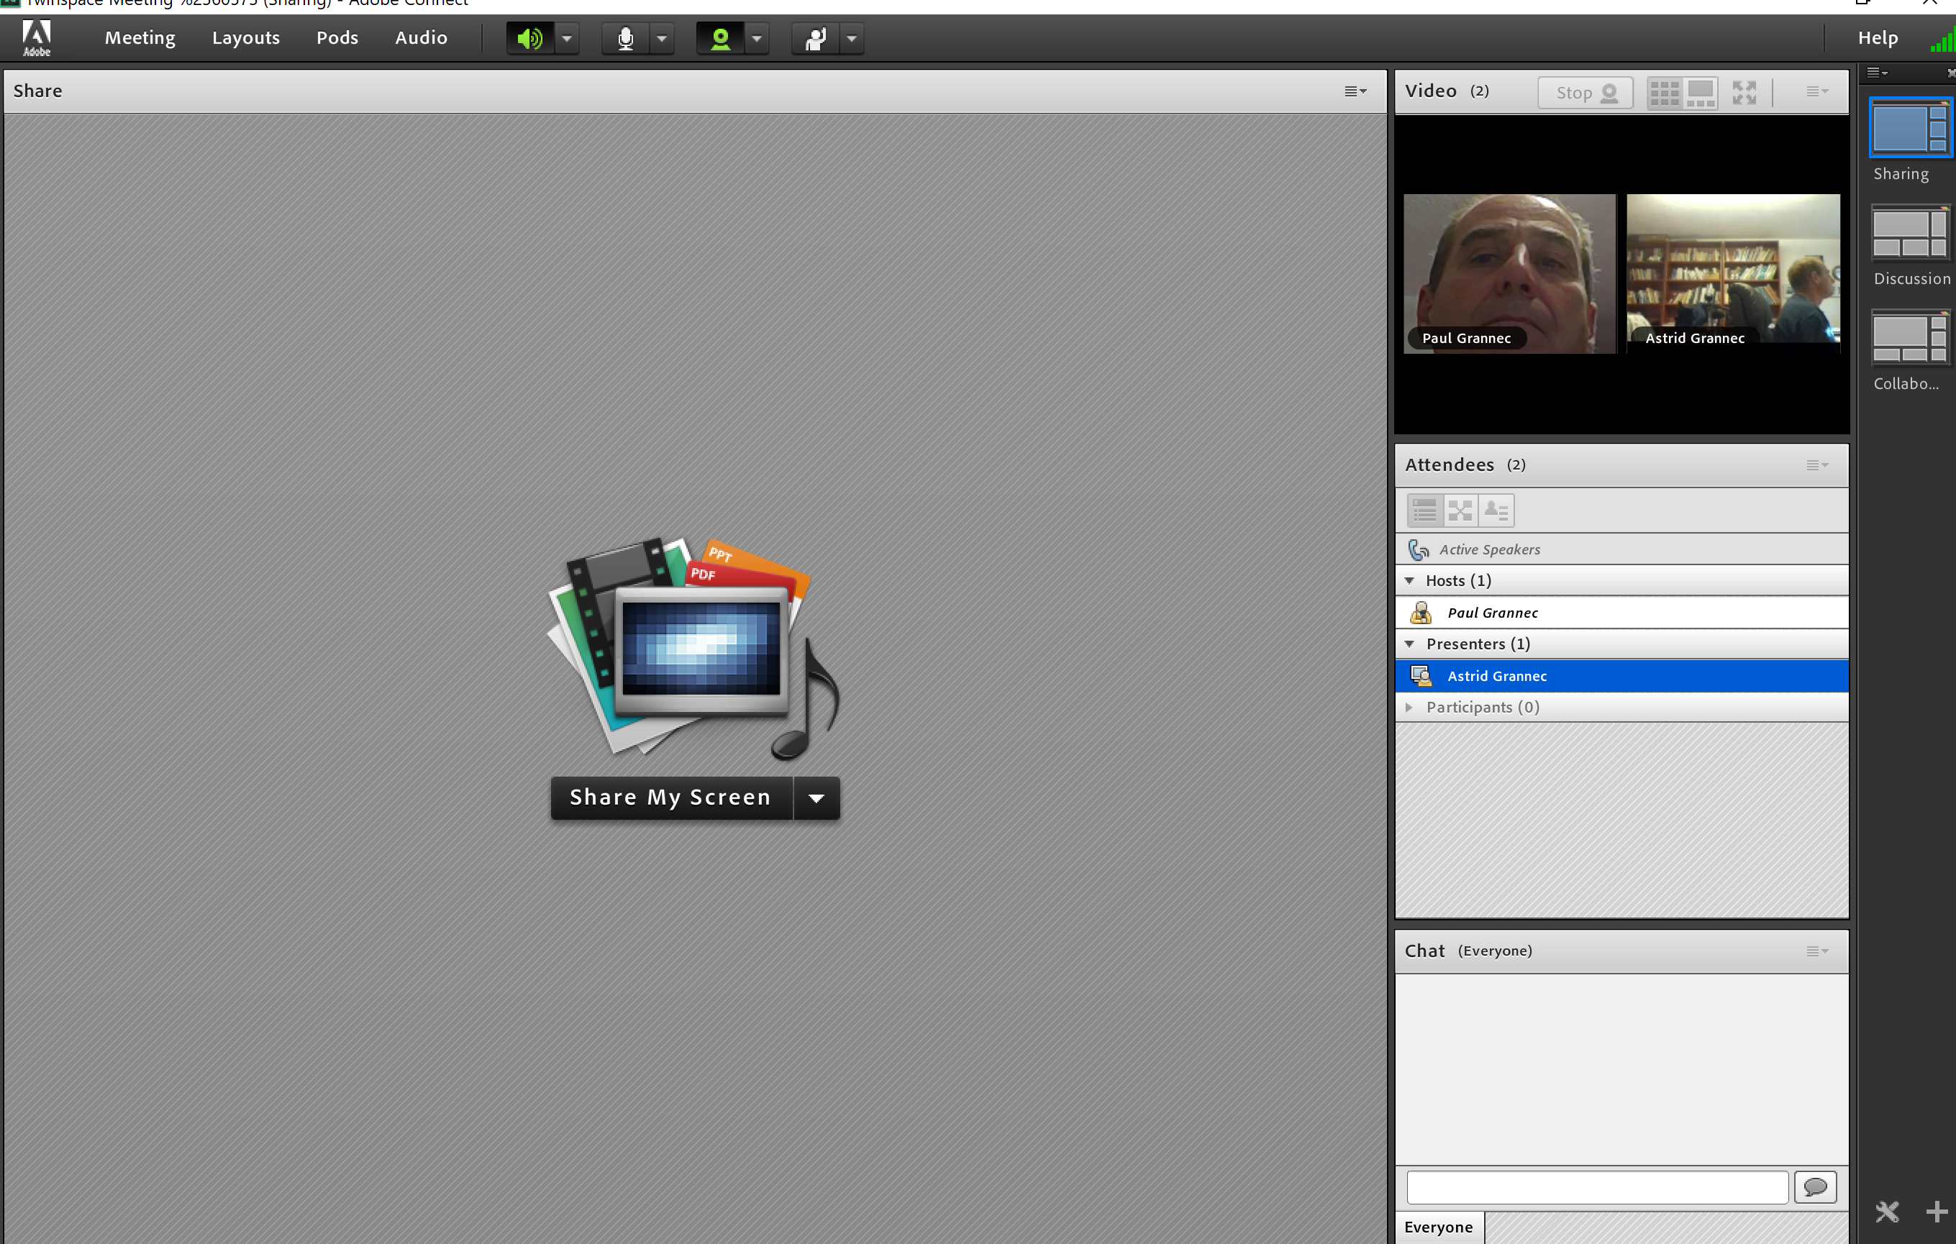
Webcam layout
2
1
3
Home
1- Grid layout 2- Strip layout 3- Full screen

Slide 5
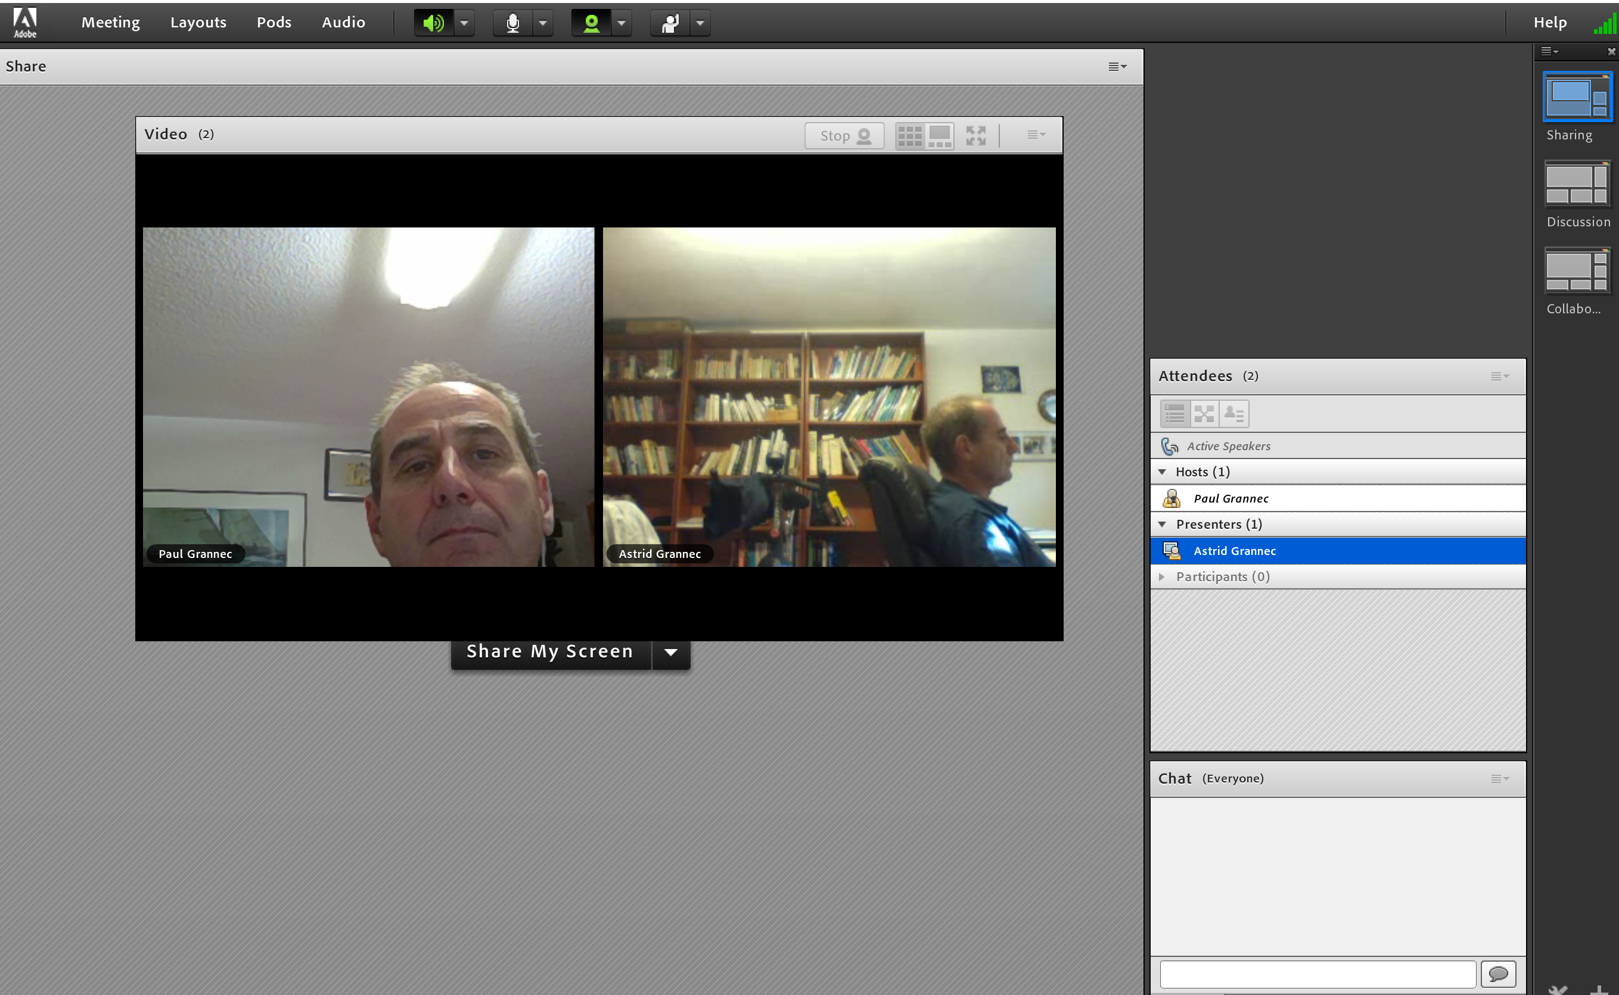
Pods can be resized and moved around, just drag and drop.
Home

Slide 6
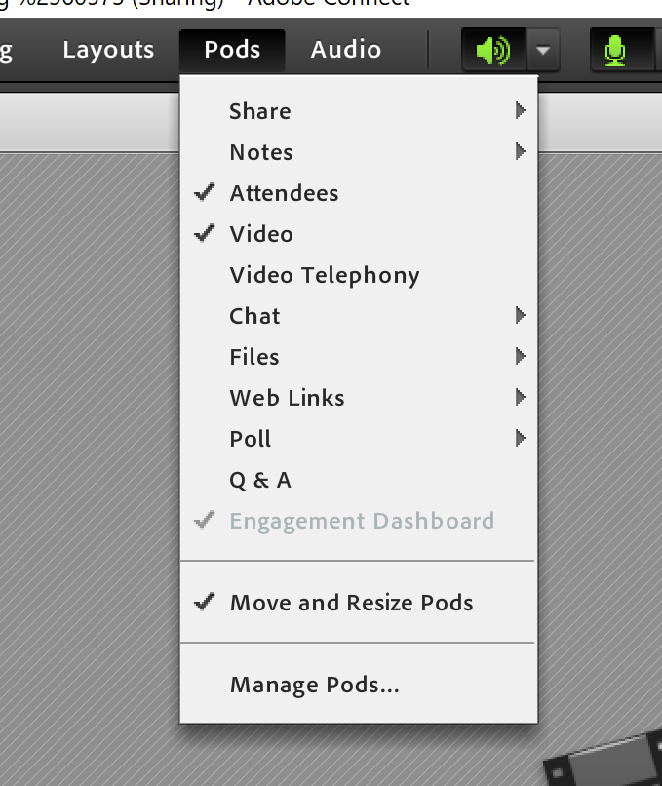
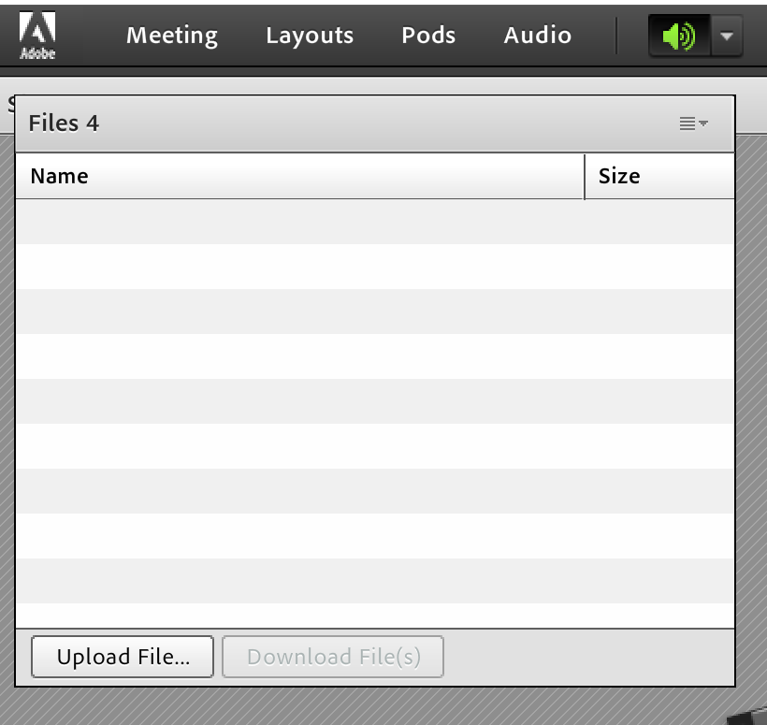
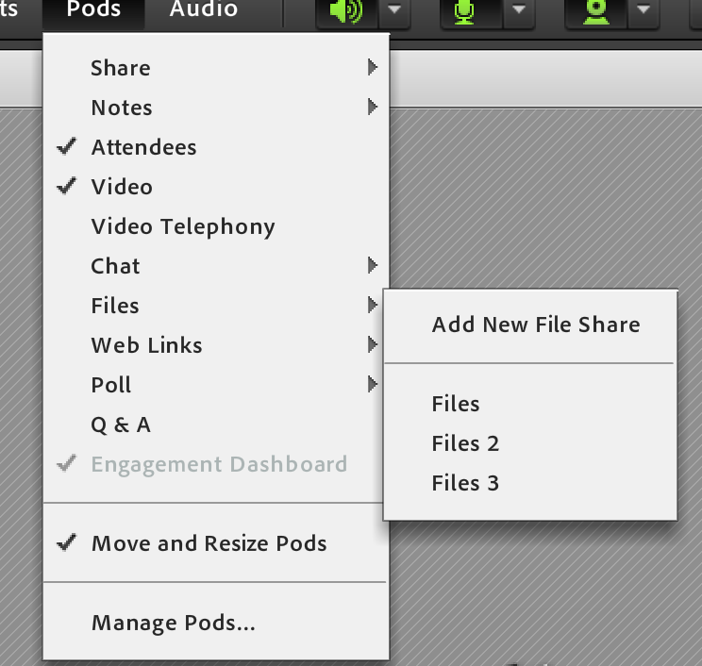
Adding pods (additinal features)
1
3
2
Host can upload file, presenters and particpants can download them
4

Slide 7
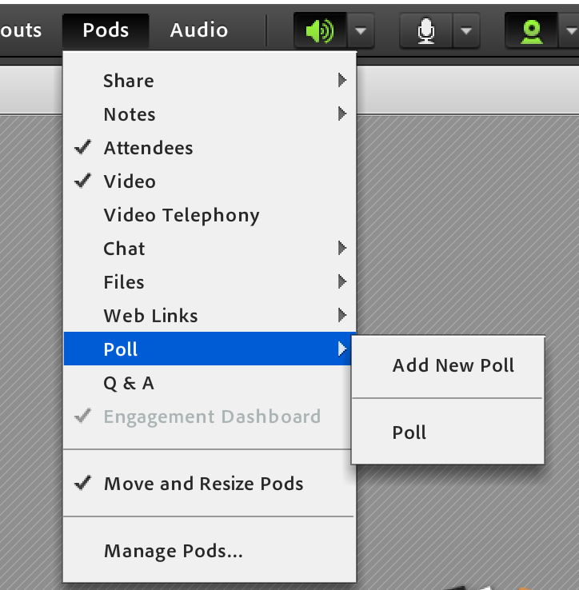
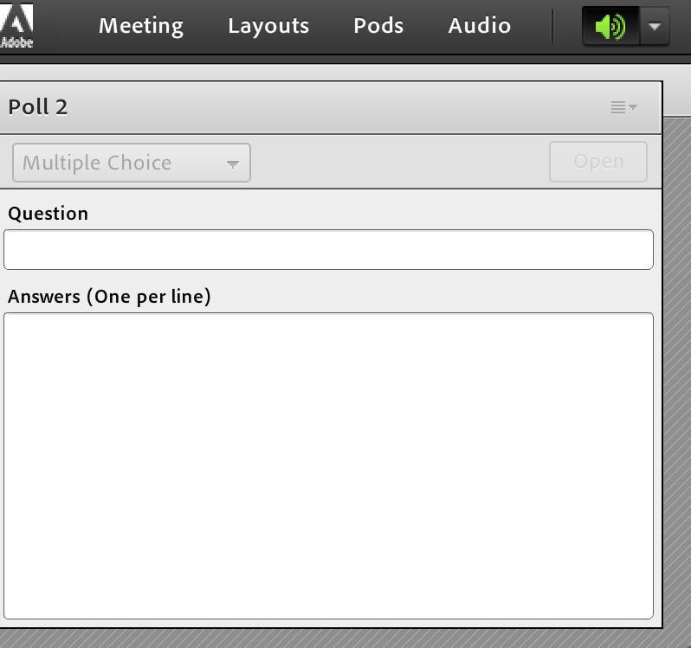
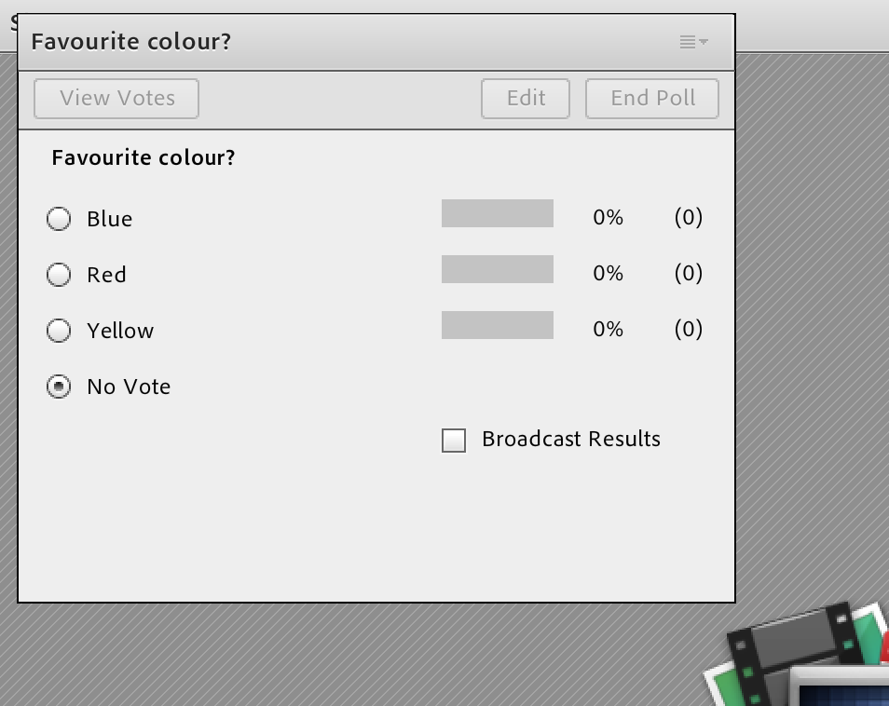
Add a poll to get some feedback
1
3
2
4

Slide 8
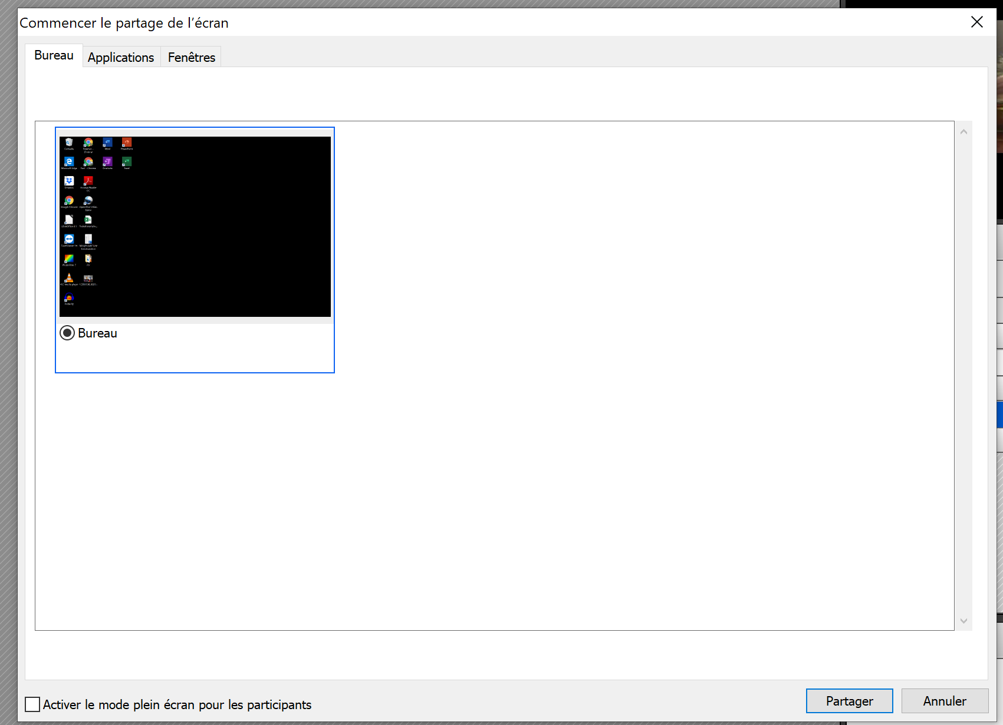
Host or presenters can share screen.
Helpful to show how a programme works.
1
2
Confirm sharing

Slide 9
