Slide 1
eTwinning - Registration
Register
1- Pre-registration at etwinning.net
2- Follow link you received in your email inbox.
3- Provide registration key and information requested.
4- I will send you a contact request that you will accept.
5- I will sign you up to the training Twinspace.

Slide 2
eTwinning - Live
Interesting features
1- Pre-registration
2- Follow link you received in your email inbox.
3- Provide registration key and information requested.
4- I will send you a contact request that you will accept.
5- I will sign you up to the training Twinspace.

Slide 3
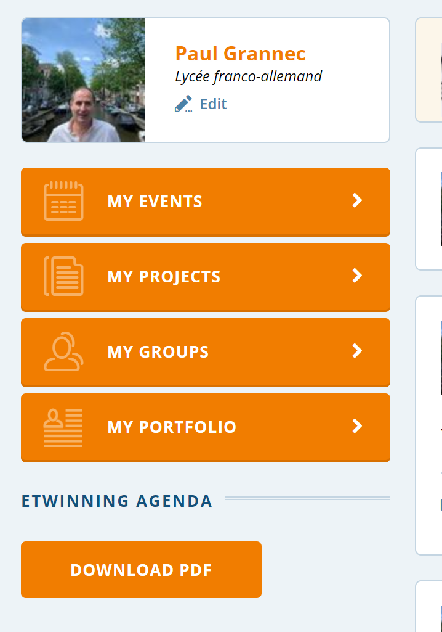
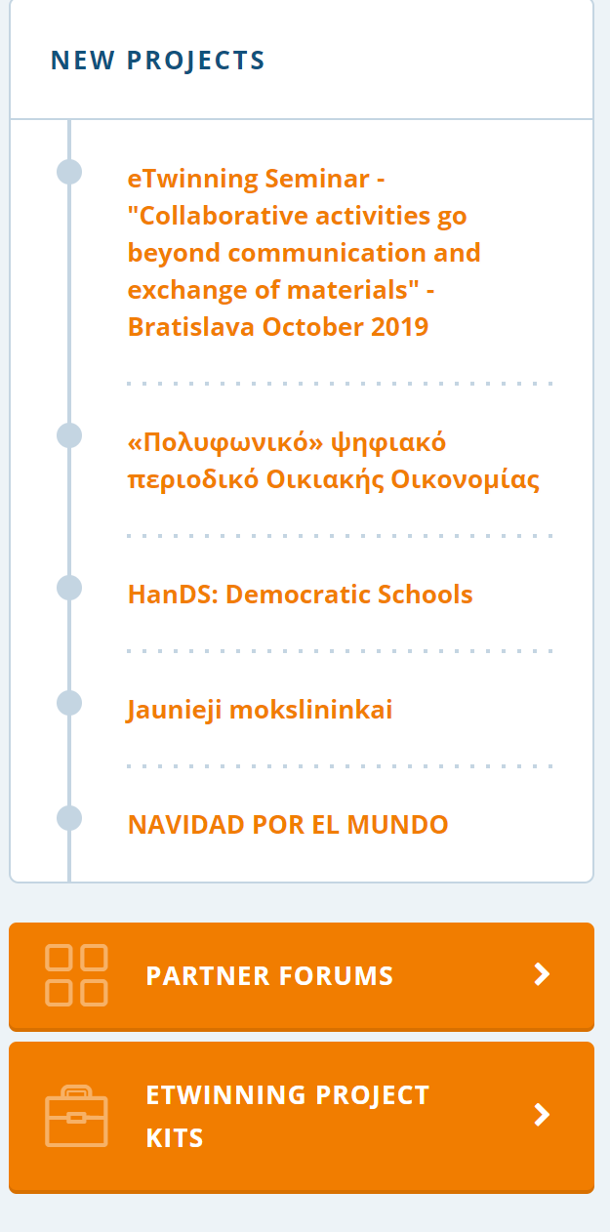
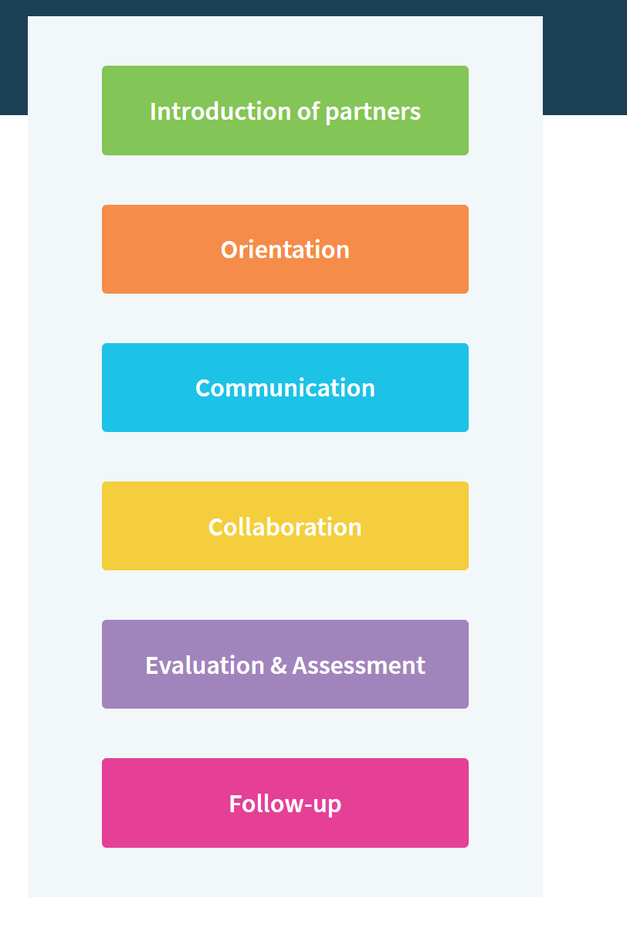
eTwinning – Interesting features
Tips and inspiration for all the stages of your eTwinning project
eTwinning Project Kits
1
2

Slide 4
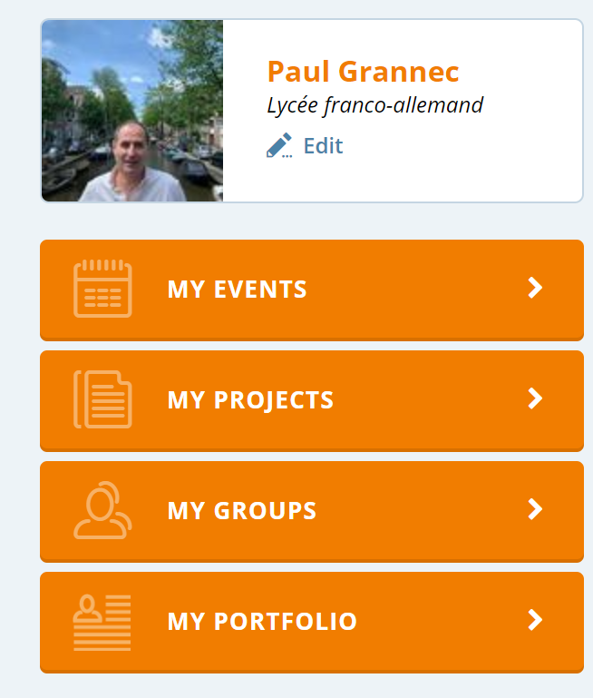
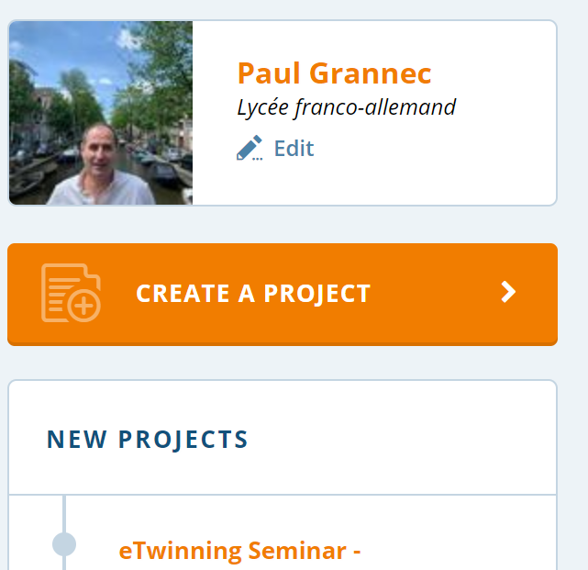
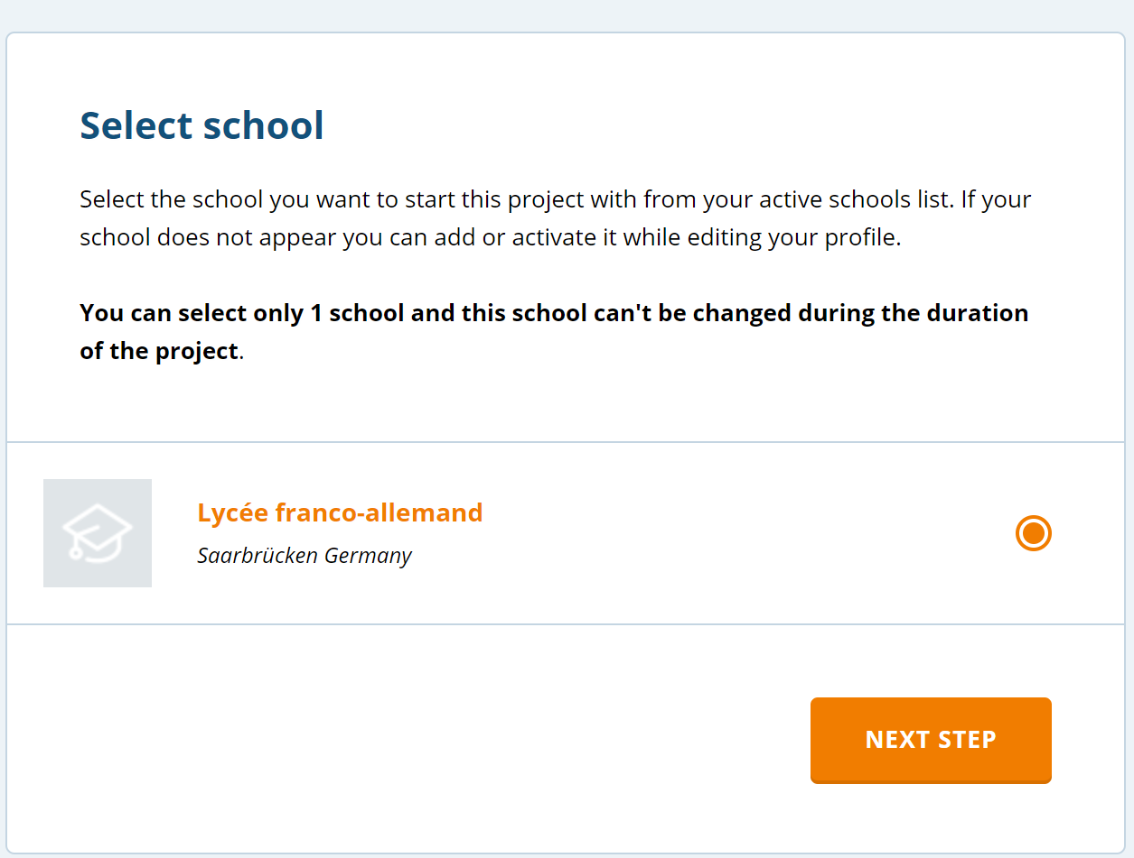
eTwinning – Interesting features
eTwinning – Create a project
Follow the different steps.
Project has to be approved to become active.
2
1

Slide 5
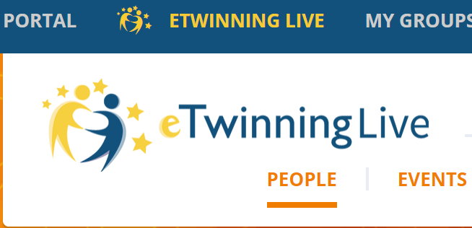
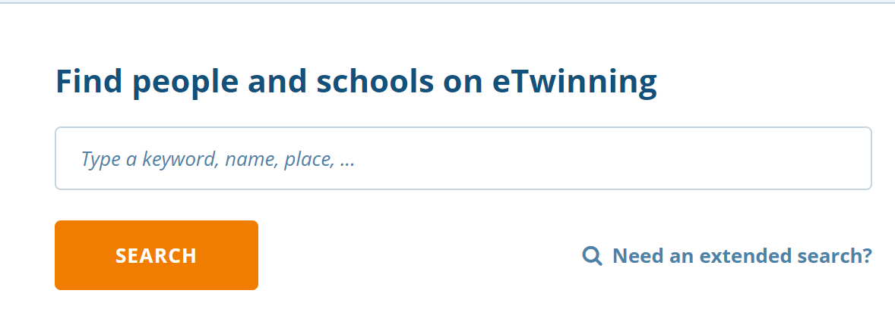
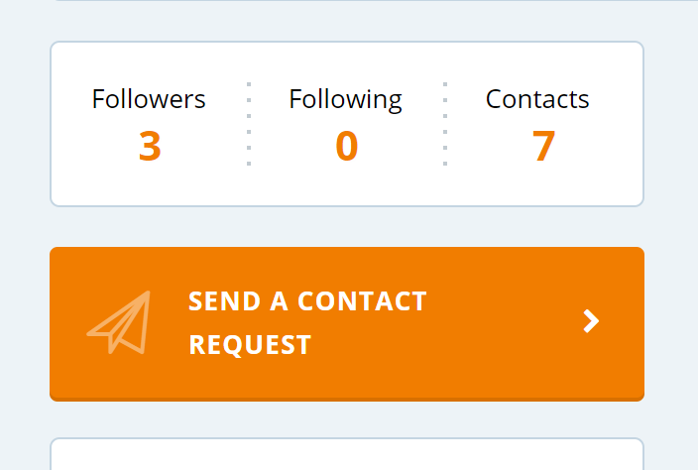
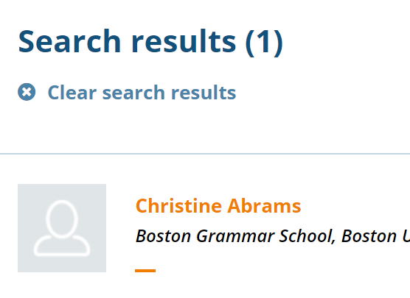
eTwinning – Interesting features
eTwinning – Find people and send contact request
2
1
Send a contact request.
Once the member is one of your contact, you will be able to add him/her to one of your Twinspaces
3
Click on name
4

Slide 6
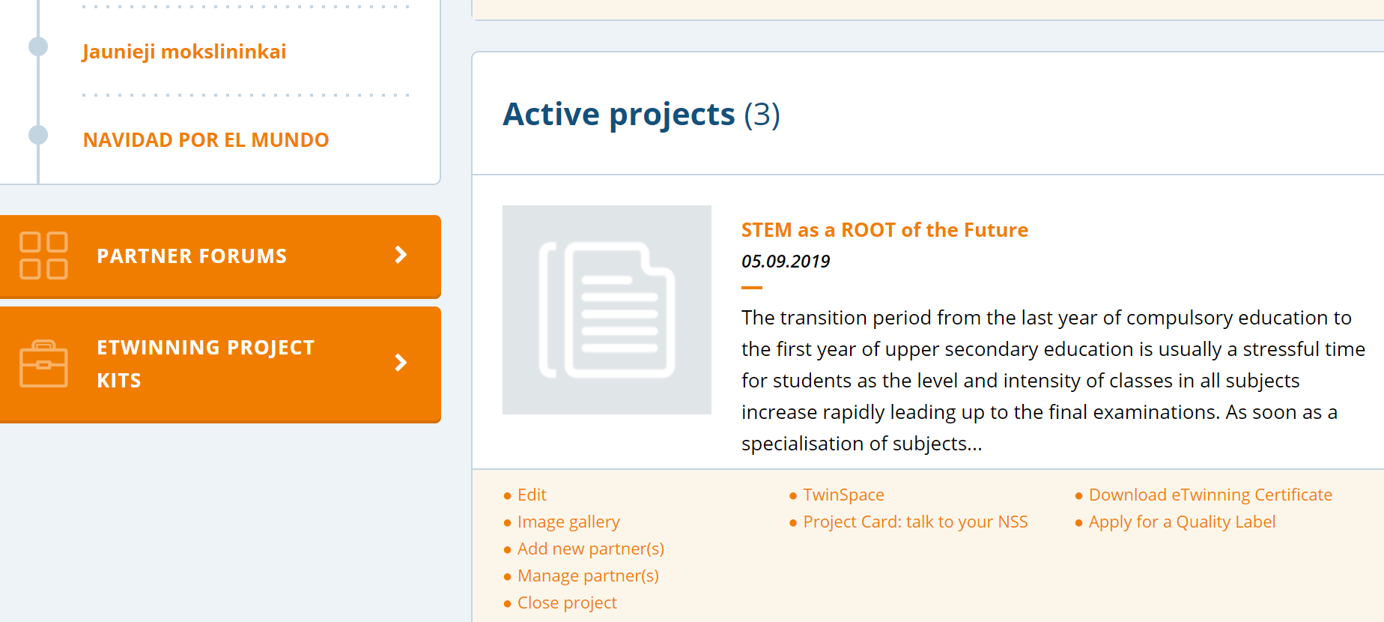
eTwinning – Interesting features
eTwinning – Apply for a quality label
1
- Select your project and apply for quality label
2

Slide 7
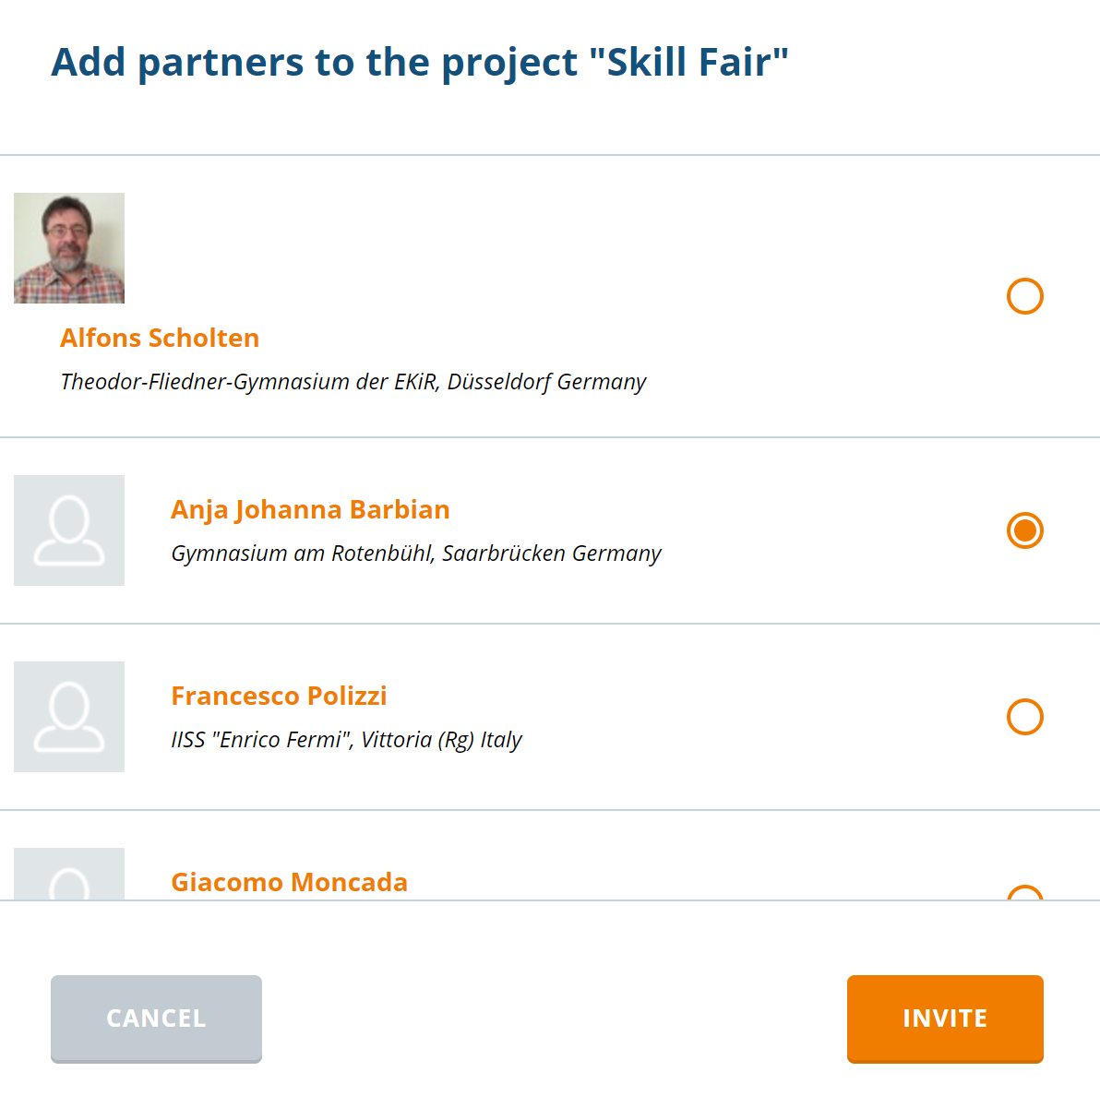
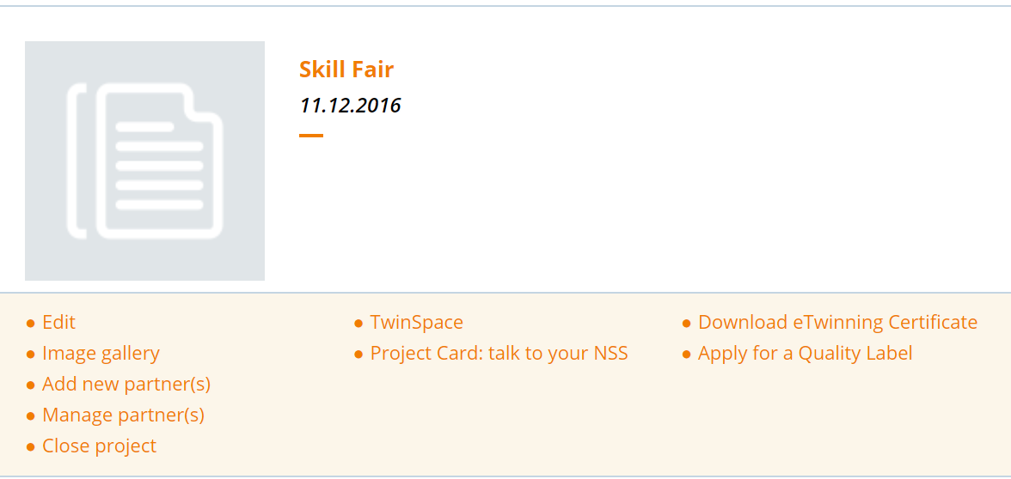
eTwinning – Interesting features
eTwinning – Add partners to your project
1
3- Select contact
Select project
2- Add partner
4- Invite contact

