Slide 1
3rd High School of Ymittos
Athens, Greece
E- twinning group 2015 -2016

Slide 2
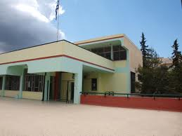
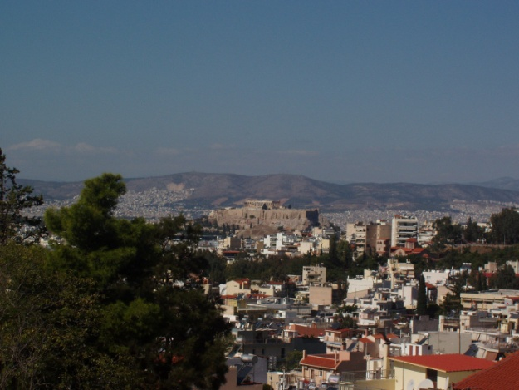
We are the Greek e-twinners ….
Let’s chat and communicate
Let’s share and exchange
Let’s have fun and play
Let’s talk about our digital experiences

Slide 3
Who we are ....... in short!
At the top yard of our school, under the Greek flag, and … the Acropolis in the background!

Slide 4
Our Project for 2015-2016

Slide 5
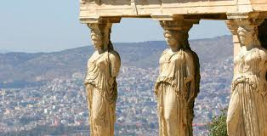
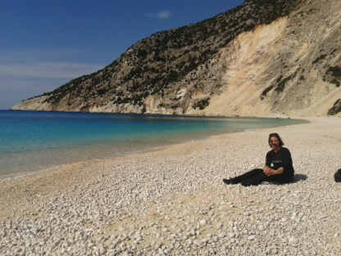
Some members of the e-twinning team 2015-2016
The boys
Theodore
Harris
George
Jim
Stelios
The girls
Stefi
Nasia
Sofia
Anastasia
Marinoe
Marina

Slide 6
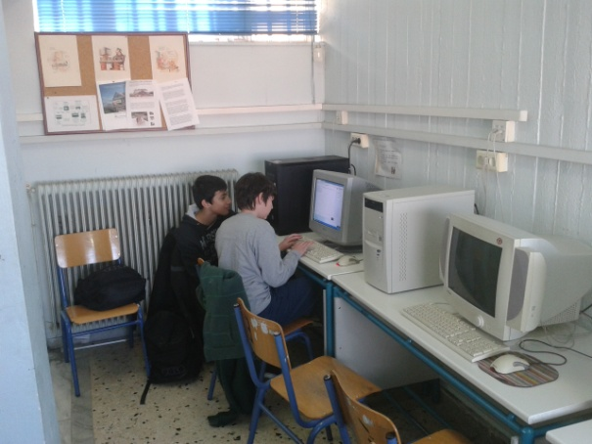
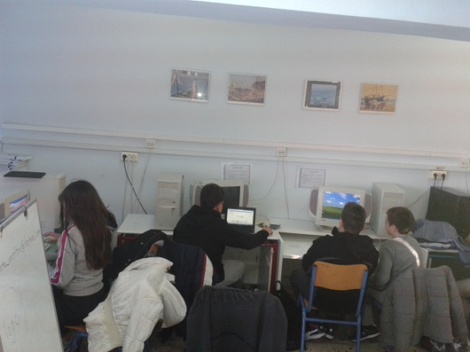
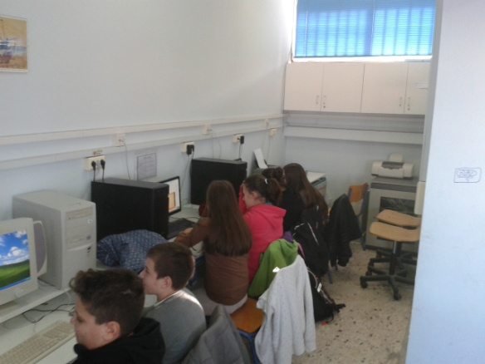
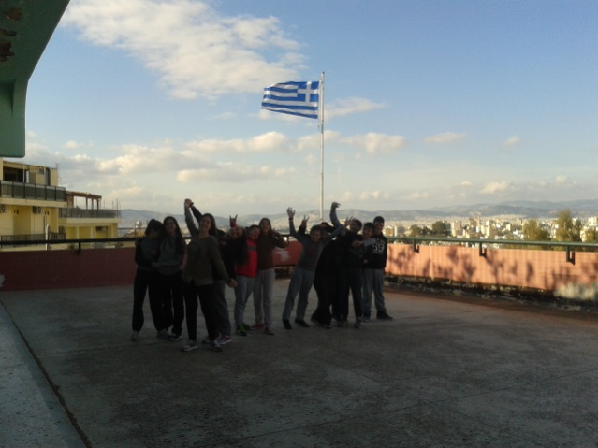
Snaps of our school & our e-twinning life!

Slide 7
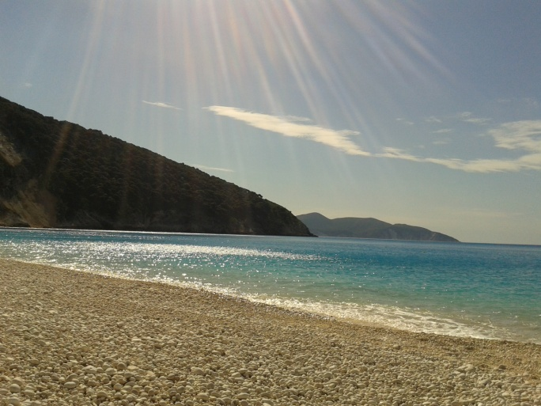
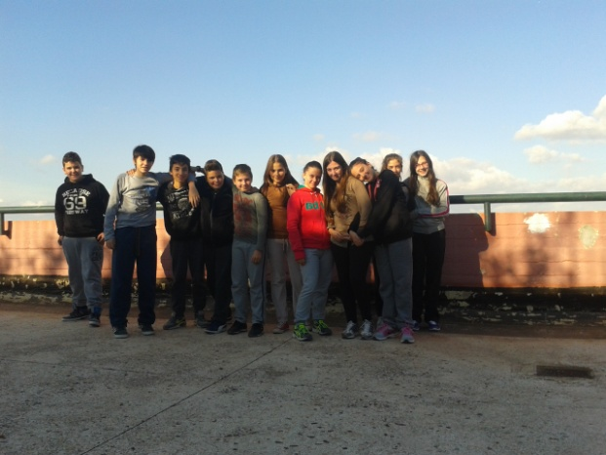
Λεζάντα

Slide 8
Let’s embark on this voyage of sharing, exchanging and communicating ideas ….

Slide 9
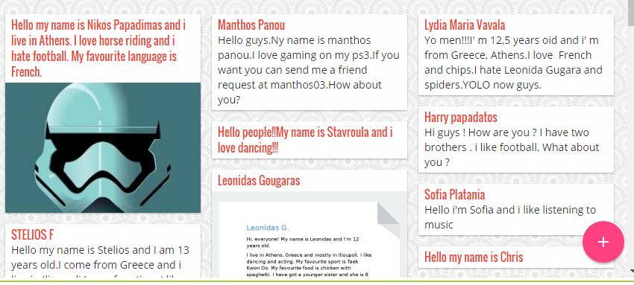

Slide 10
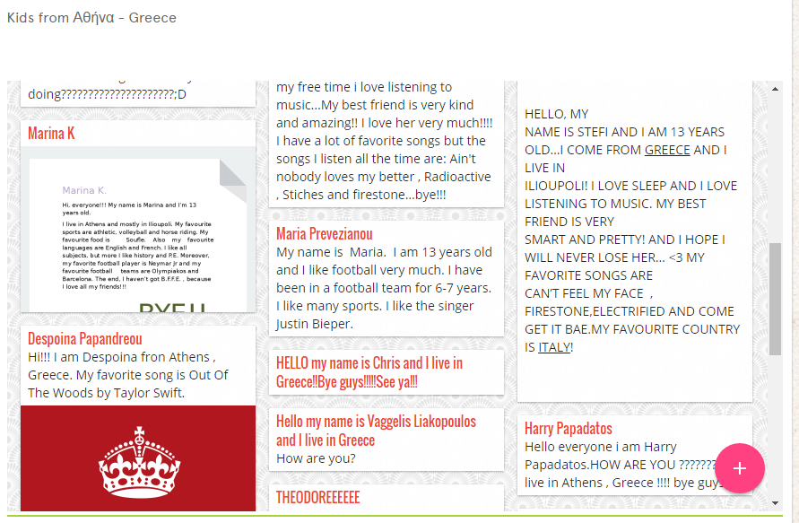

Slide 11
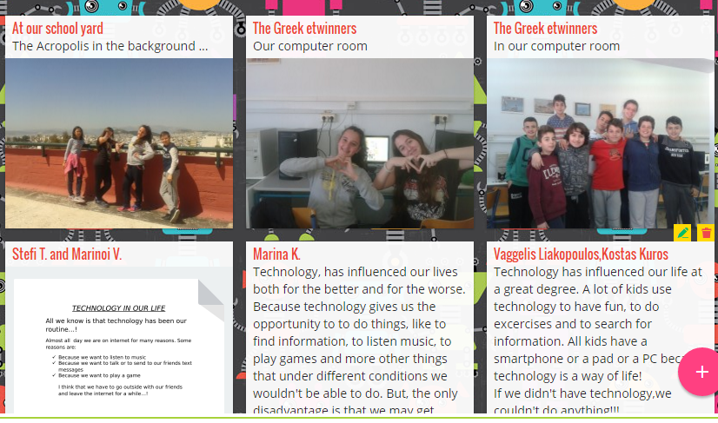

Slide 13
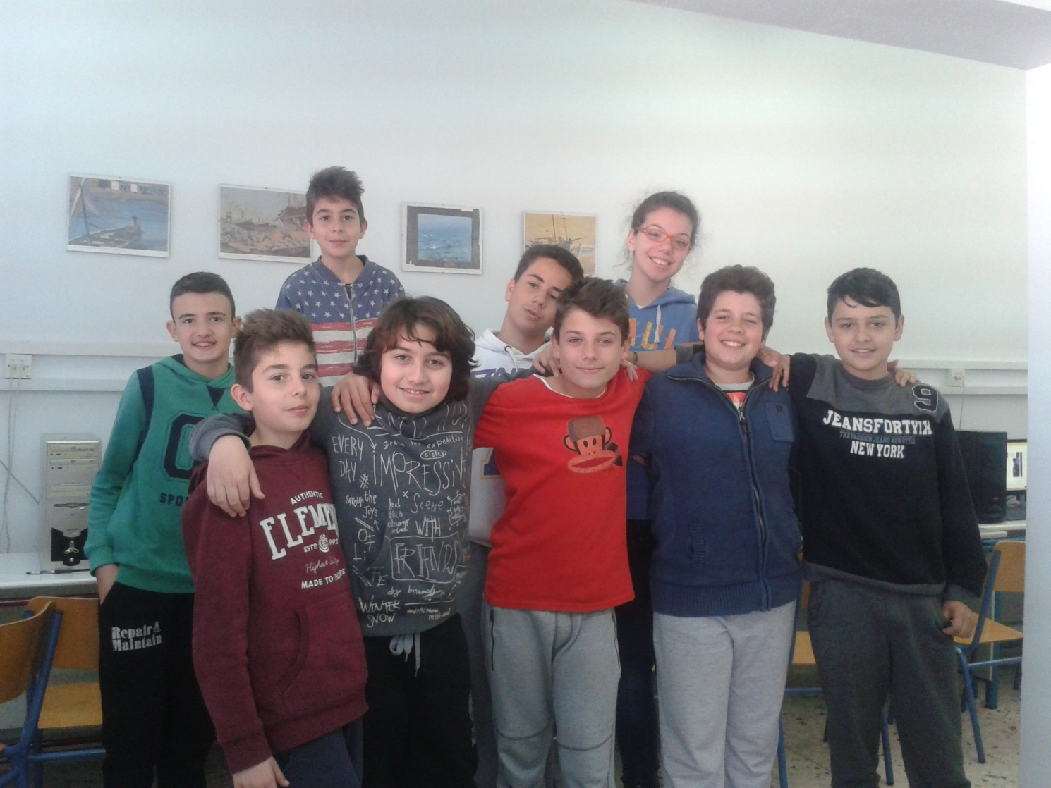

Slide 15
The end …

