Slide 1
How tecnology influence your lives?

Slide 2
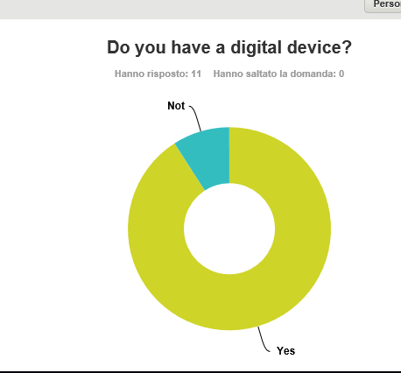
Your digital life

Slide 3
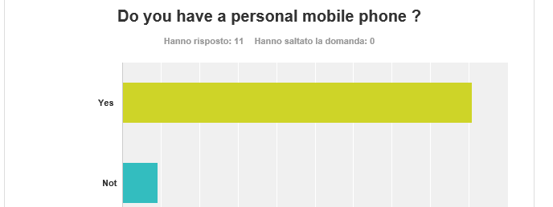
Your digital life

Slide 4
Your digital life

Slide 5
Your digital life

Slide 6
Your digital life

Slide 7
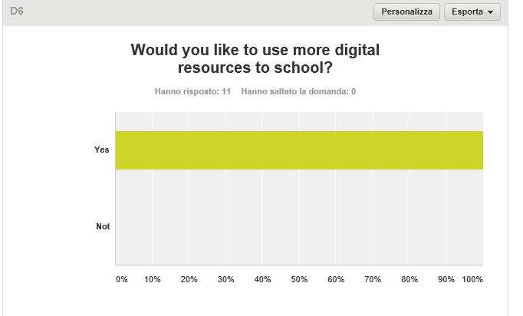
Your digital life

