Slide 1
ΕRASMUS+/KA2 Strategic Partnerships for Schools
Project Title:
«S(t)imulating European Identity _ EUSId»
Piramatiko Geniko Likio Panepistimiou Kritis (Rethymno)
October 2019

Slide 2
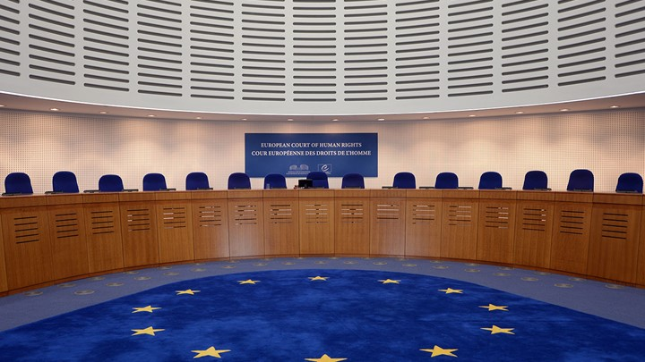
THE Court of Justice of the European Union (CJEU)
By George Fragkidis

Slide 3
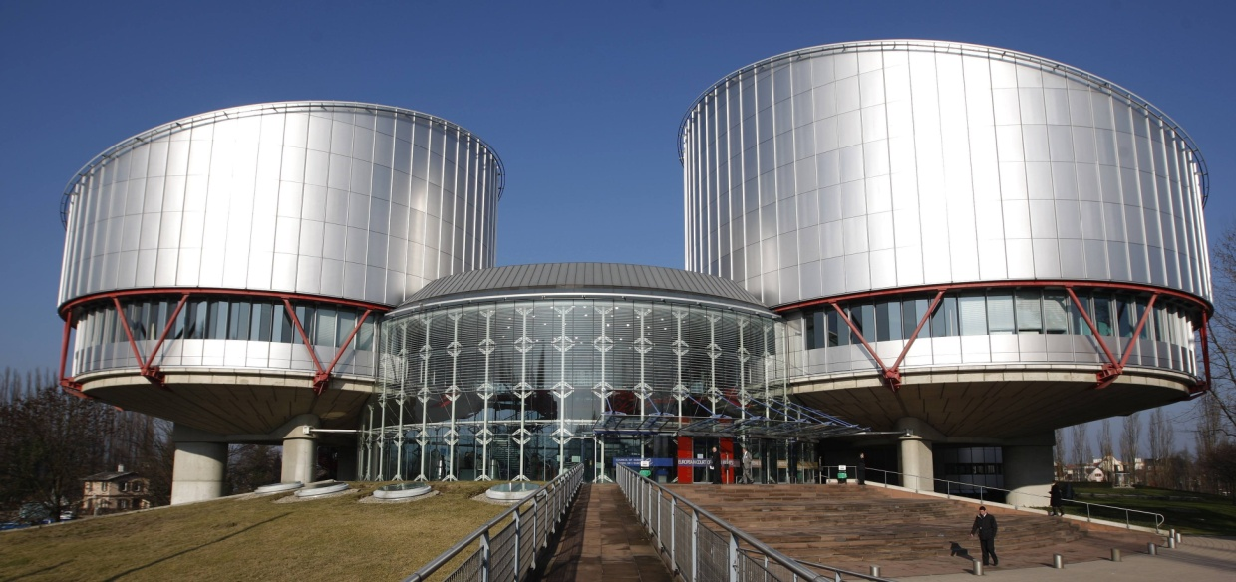
oVERVIEW
The Court of Justice of the European Union (CJEU) is the chief judicial authority of the E.U. that:
oversees the uniform application and interpretation of European Union law, in co-operation with the national judiciary of the member states;
interprets E.U. law to make sure it is applied in the same way in all E.U. countries, and settles legal disputes between national governments and E.U. institutions;
can also, in certain circumstances, be used by individuals, companies or organisations to take action against an E.U. institution, if they feel it has somehow infringed their rights.
It was established in1952.
It is located in Luxembourg.
Notes:
Να ερμηνευθούν σε σχόλιο στα Αγγλικά οι όροι: judicial, judiciary

Slide 4
composition
The CJEU is divided into 2 courts:
the Court of Justice;
the General Court.
The Court of Justice deals with requests for preliminary rulings from national courts, certain actions for annulment and appeals. It has 1 judge per each E.U. country, plus 11 advocates general. Each Judge and Advocate General is appointed for a renewable 6-year term, jointly by national governments.
The General Court rules on actions for annulment brought by individuals, companies and, in some cases, E.U. governments. In practice, this means that this court deals mainly with Competition Law, State Aid, Trade, Agriculture and Trademarks. It has 47 judges. In 2019 this will be increased to 56 (2 judges from each E.U. country).
In each Court, the judges select a President who serves a renewable term of 3 years.
Notes:
Να ερμηνευθούν σε σχόλιο στα Αγγλικά οι όροι: preliminary rulings, annulment, appeal, advocate, Competition Law, Trademark

Slide 5
Types of cases
The CJEU gives rulings on cases brought before it, the most common types of which are:
Preliminary Rulings (i.e. law interpretation): National courts of E.U. countries are required to ensure E.U. law is properly applied, but courts in different countries might interpret it differently. If a national court is in doubt about the interpretation or validity of an E.U. law, it can ask the Court for clarification. The same mechanism can be used to determine whether a national law or practice is compatible with E.U. law.
Infringement Proceedings (i.e. law enforcement): This type of cases are taken against a national government for failing to comply with E.U. law. Such a case can be started by the European Commission or another E.U. country. If the country is found to be at fault, it must put things right at once or risk a second case being brought which may result in a fine.
Actions for Annulment (i.e. E.U. legal act annulment): If an E.U. Act is believed to violate E.U. treaties or fundamental rights, the Court can be asked to annul it by an E.U. government, the Council of the E.U., the European Commission or - in some cases - the European Parliament. Private individuals can also ask the Court to annul an E.U. Act that directly concerns them.
Notes:
Να ερμηνευθούν σε σχόλιο στα Αγγλικά οι όροι: ruling, validity, compatible, Infringement, comply, violate

Slide 6
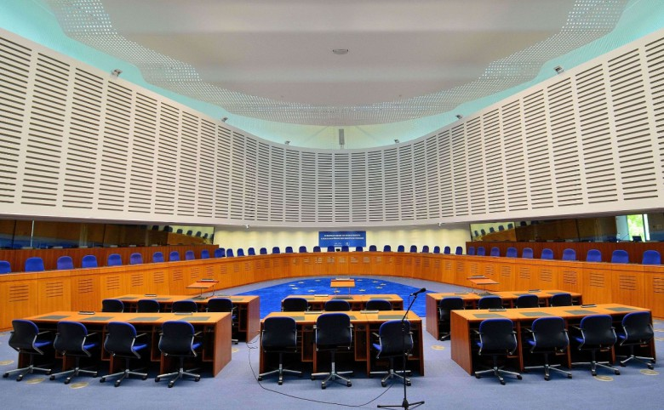
…
Actions for failure to act which ensure that the E.U. takes action: The Parliament, Council and Commission must make certain decisions under certain circumstances. If they don't, E.U. governments, other E.U. institutions or – in some cases - individuals or companies can complain to the Court.
Actions for damages (i.e. E.U. institution sanctioning): Any person or company who has had their interests harmed as a result of the action or inaction of the E.U. or its staff can take action against them through the Court.
Notes:
Να ερμηνευθούν σε σχόλιο στα Αγγλικά οι όροι: sanctioning, action, inaction

Slide 7
Procedure
In the Court of Justice, each case is assigned 1 judge (the “Judge-Rapporteur") and 1 Advocate General. Cases are processed in 2 stages:
Written stage
The parties give written statements to the Court; observations can also be submitted by national authorities, E.U. institutions and sometimes private individuals.
All of this is summarised by the Judge-Rapporteur and then discussed at the Court’s general meeting, which decides:
How many judges will deal with the case depending on its importance and complexity. It is very rare for the whole Court to hear the case.
Whether a hearing, i.e. the oral stage, needs to be held and whether an official opinion from the Advocate General is necessary.
Oral stage (i.e. a public hearing)
Lawyers from both sides can put their case to the judges and Advocate General, who can question them.
If the Court has decided an Opinion of the Advocate General is necessary, this is given some weeks after the hearing.
The judges then deliberate and give their verdict.
General Court procedure is similar, except that most cases are heard by 3 judges and there are no advocates general.
Notes:
Να ερμηνευθούν σε σχόλιο στα Αγγλικά οι όροι: sanctioning, action, inaction, public hearing, deliberate, verdict

Slide 8
Brief information about WHAT The CJEU CAN DO FOR you
If you – as a private individual or as a company – have suffered damage as a result of action or inaction by an E.U. institution or its staff, you can take action against them in the Court, in one of 2 ways:
indirectly through national courts which may decide to refer the case to the Court of Justice;
directly before the General Court – if a decision by an E.U. institution has affected you directly and individually.
If you feel that the authorities in any country have infringed E.U. law, you must follow the official complaints procedure.
Notes:
Να ερμηνευθούν σε σχόλιο στα Αγγλικά οι όροι: the official complaints procedure

Slide 9
References
The Court of Justice of the European Union. Retrieved July 16, 2019, from https://curia.europa.eu/jcms/jcms/Jo2_7052/el/
Court of Justice of the European Union (CJEU). Retrieved July 16, 2019, from https://europa.eu/european-union/about-eu/institutions-bodies/court-justice_el

Slide 10
"The European Commission support for the production of this publication does not constitute an endorsement of the contents which reflects the views only of the authors, and the Commission cannot be held responsible for any use which may be made of the information contained therein".

Slide 11
THE END
Thank you very much for your attention!

