Slide 1
Saint Wenceslas
Duke and Patron of Bohemia

Slide 2
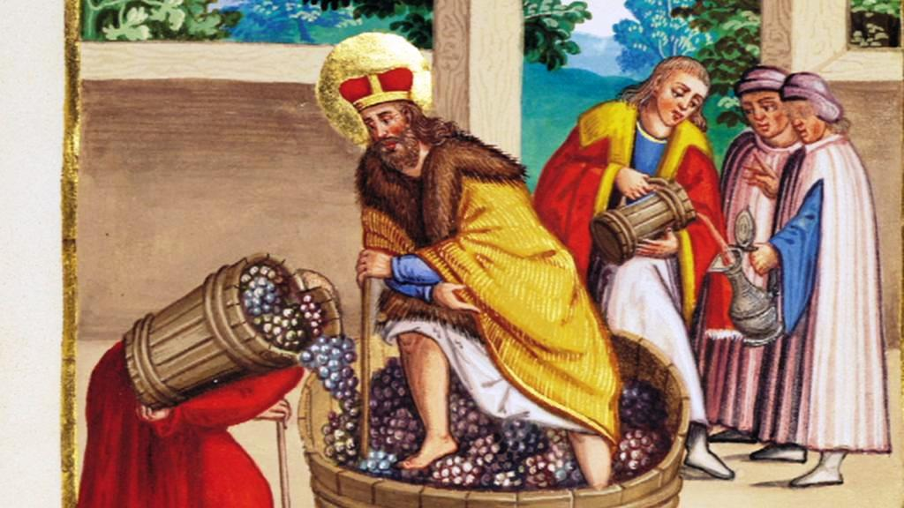

Slide 3
Childhood and youth
Wenceslas was the son of Vratislaus I (younger son of Ludmila and Bořivoj, the first documented Duke of Bohemia) and Drahomíra, the daughter of a tribal chief of the Havelli.
As a date of birth is assumed the year 907.
Wenceslas was raised by his grandmother Saint Ludmila. He studied latin and old-slavonic religious literature at Budeč.
Wenceslas was too young to reign, when his father Vratislaus died and his mother Drahomíra became regent.

Slide 4
Politics
Wenceslas took over the government sometime after 921, after the death of his father, Prince Wrocław, in Central Bohemia around Prague.
We know about high Wenceslas´s position from annals. It was him who was forced to pay a tribute of the whole Bohemia to the Saxon king Henry the Fowler.
Wenceslas had many conflicts with his mother, among other things because his mother hated his grand mother Ludmila so much that she led her murder. When he acceded the throne, he ejected his mother to Budeč.
In later period of his reign Wenceslas had the major conflict with his younger brother Boleslaus the Cruel. Boleslaus was complicit in the Wenceslas´s murder.

Slide 5
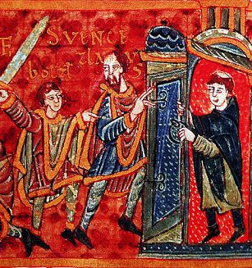
Death
Boleslaus invited his brother Wenceslas to the feast celebrated on the occasion of Saint Cosma and Damian´s holiday. The next day early in the morning, when Wenceslas was going to mass, he was beated by sword by his brother in front of the church. Then Boleslaus´s companions murdered the duke.
Probably, the incident took place near unpreserved church of Saint Cosma and Damian.
The day of Wenceslas´s murder is quoted by legendes as Monday 28th September. The year is probably 929 or 935 when Monday was this day in calendar.

Slide 6
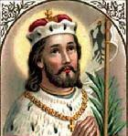
Canonization
Saint Wenceslas is the first Czech canonized person, a member of the first sovereign´s dynasty – the genus of Přemyslids, a symbol of the Czech state and the main patron of Bohemia.
He is one of the most beloved Czech saints, a martyr, a person who helped to create the Czech identity.
Wenceslas is significant as a saint and as a symbol of sovereign.

Slide 7
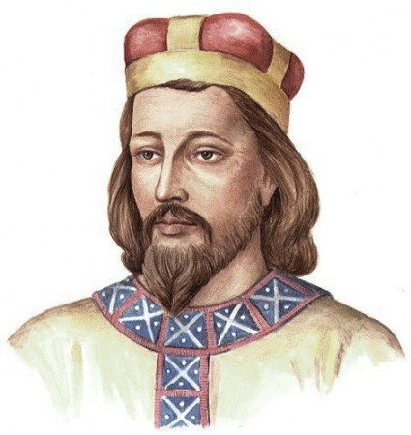
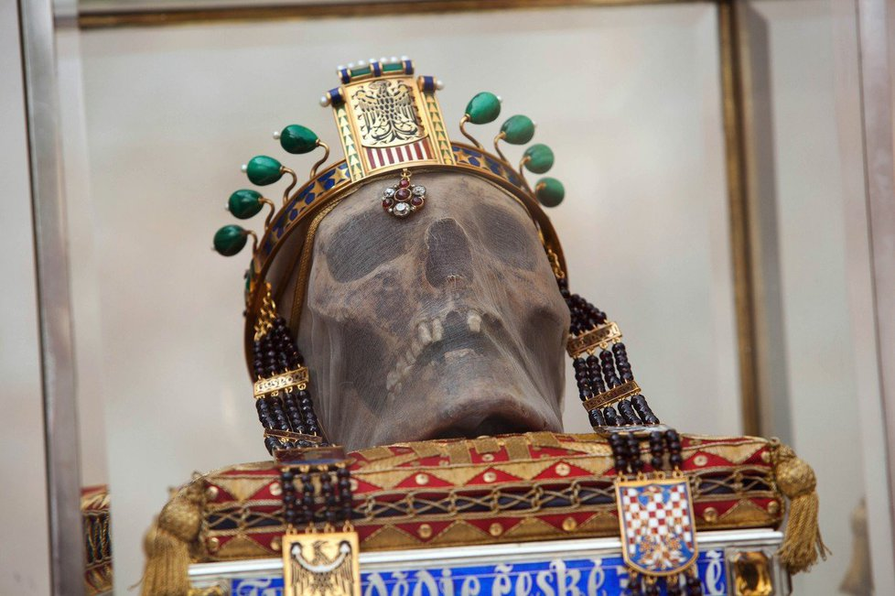
Summary
According to legend, he was raised by his grandmother Ludmila (canonized in the 12th century), he was educated at Budeč.
As a duke, after the defeat by the Saxon king Henry the Fowler, he managed to preserve the sovereignty of the Czech state and founded the rotunda of St. Vitus, the main church of the principality.
He was assassinated in (Old) Boleslav, the seat of his brother Boleslaus, who took over the government thanks to it.
After his death, Wenceslas began to be worshiped as a saint for his piety and posthumous miracles attributed to him in legends.
Later he became a symbol of the Czech state.

