Slide 1




FATIMA HOSPITALITY SCHOOL
Youngsters Nowadays: Where from, Where to
Portugal 10th to 16th March 2019
Environmental Problems in Portugal
Causes & Solutions

Slide 2
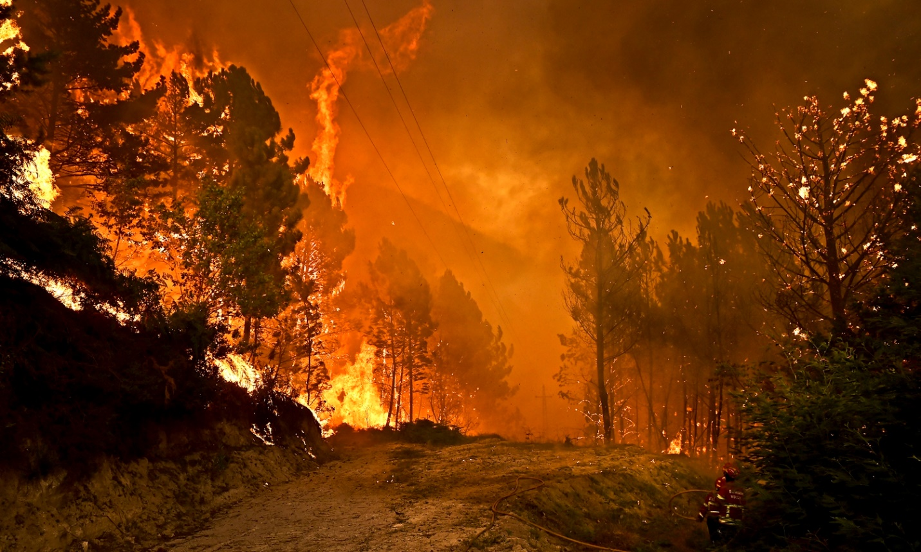
FATIMA HOSPITALITY SCHOOL
Portugal is the European country most affected by fires
Fires are not just destroying hectares of forests and woodlands, they are also taking human lives and destroying livelihoods.

Slide 3
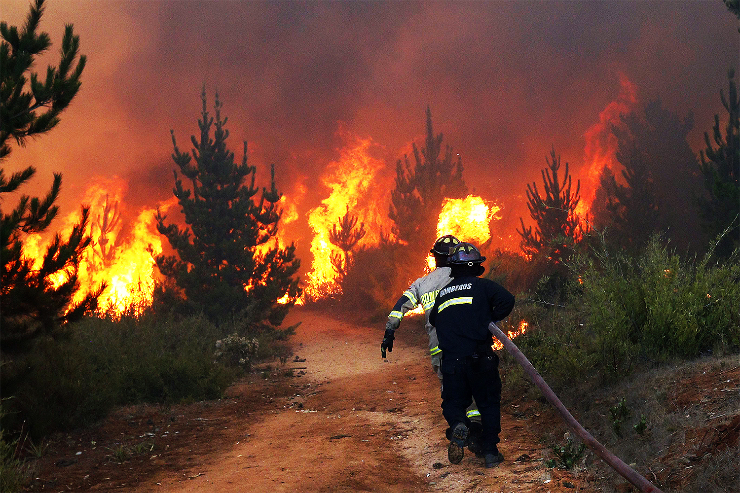
FATIMA HOSPITALITY SCHOOL
Portugal’s fire risks are
aggravated by the impacts of climate change and increasing periods of hot and dry weather but they are not the only relevant factors.
Notes:
change in Portugal’s forest fire suppression, planning, and prevention strategies

Slide 4
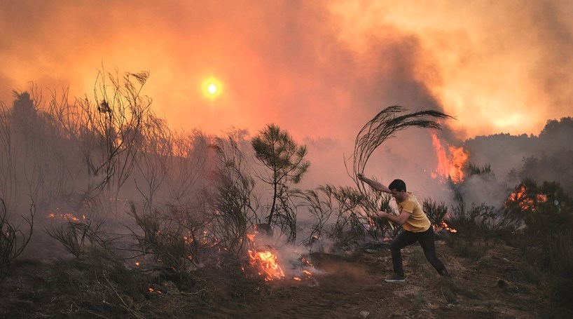
FATIMA HOSPITALITY SCHOOL
Causes
Portugal doesn’t have a specialized professional structure for the prevention and extinction, nor programs of prevention for risky behaviors;
High percentage of unmanaged forest area;
Notes:
As causas dos incêndios florestais prendem-se muito a causas humanas, entre elas ações de qualquer um de nós, feitas por vezes sem intenção, mas por falta de cuidado, como por exemplo pontas de cigarros atiradas para zonas florestais, fogueiras mal apagadas, queimas de lixos e mesmo até incêndios com causas criminosas.

Slide 5
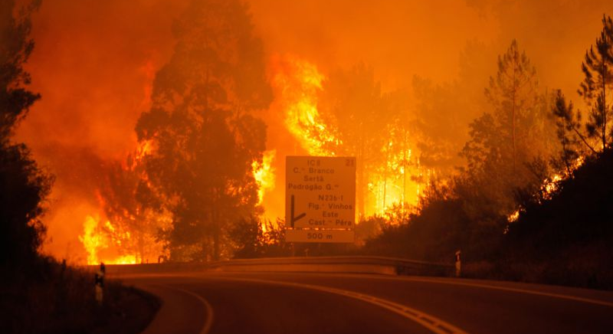
FATIMA HOSPITALITY SCHOOL
Causes
The number of inflammations in moderate-to-grave fire situations;
Negligent use of fire;
Lack of fuel management and fire protection bands;
Ignitions of human origin.

Slide 6
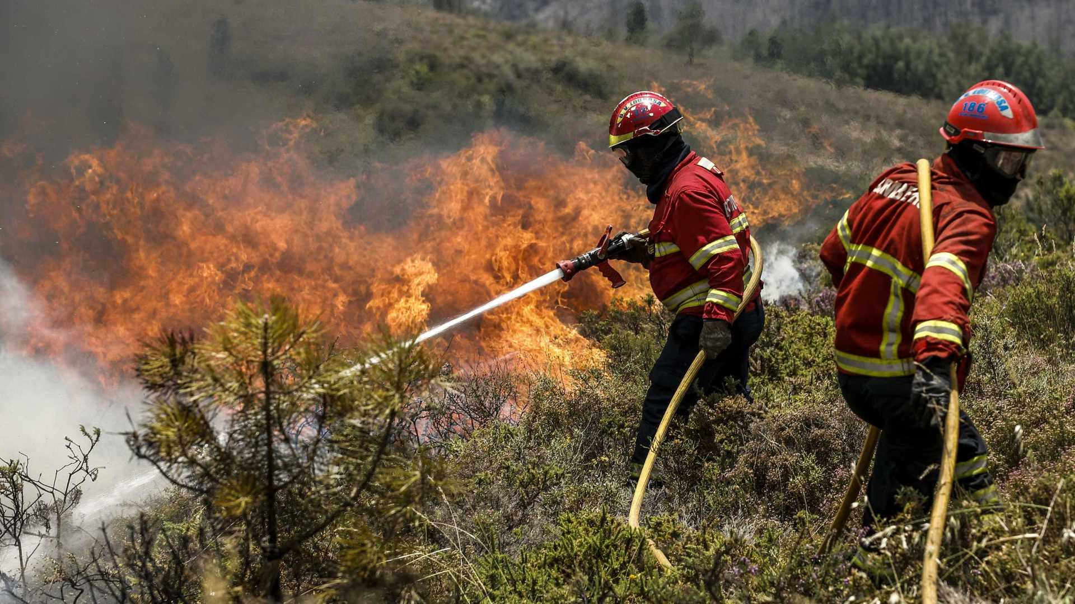
FATIMA HOSPITALITY SCHOOL
Possible Solutions
Characterization and mapping of the areas with high fire risk, with responsible entities to promote the collective management of the territory;
Preventing unplanned human ignitions;
Notes:
change in Portugal’s forest fire suppression, planning, and prevention strategies

Slide 7
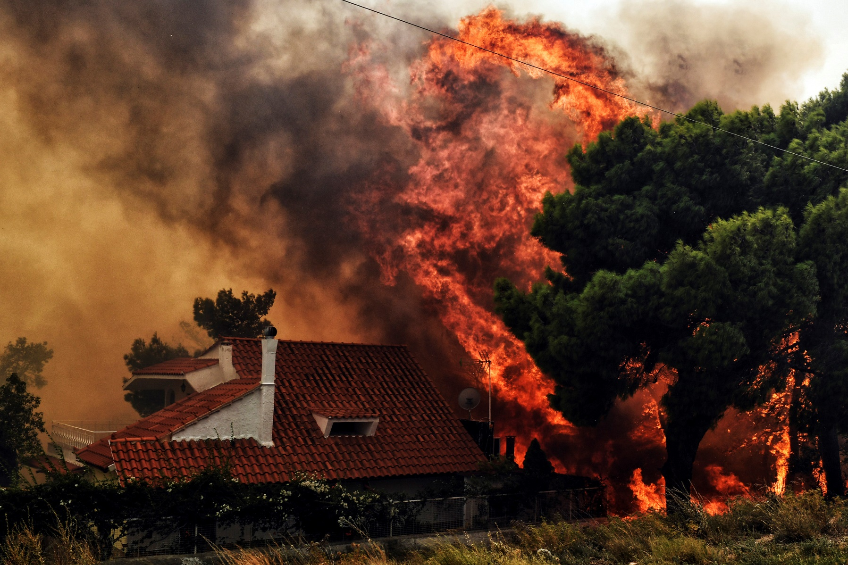
FATIMA HOSPITALITY SCHOOL
Possible Solutions
Creating a structural fire defense system of fuel breaks and by reducing fuel load in critical areas;
Notes:
change in Portugal’s forest fire suppression, planning, and prevention strategies

Slide 8
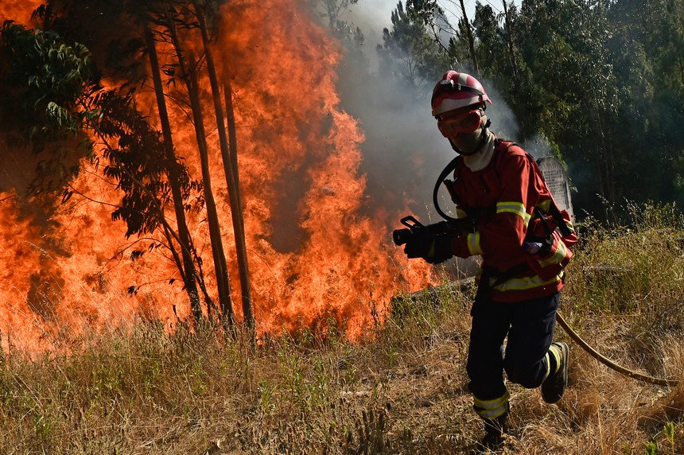
FATIMA HOSPITALITY SCHOOL
Possible Solutions
Improving firefighting capability by implementing perimeter control tactics and large fire management strategies.
Restructuring Portugal’s fire organization.
Notes:
change in Portugal’s forest fire suppression, planning, and prevention strategies

Slide 9
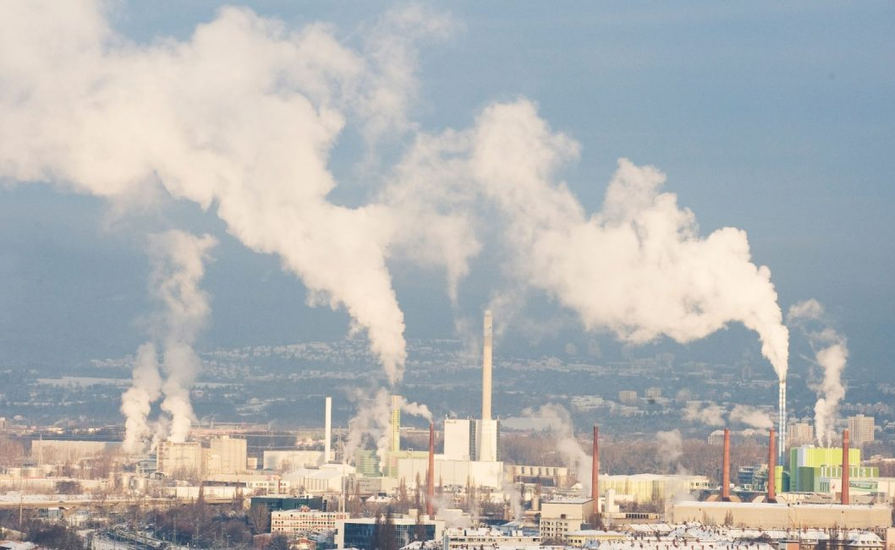
FATIMA HOSPITALITY SCHOOL
Air Polluition
Portugal is becoming increasingly polluting in atmospheric terms.

Slide 10

FATIMA HOSPITALITY SCHOOL
Causes
Exhaust from factories and industries;
Incineration;
Slash and burned farming;
Burning of fossil fuels;
Mining;

Slide 11
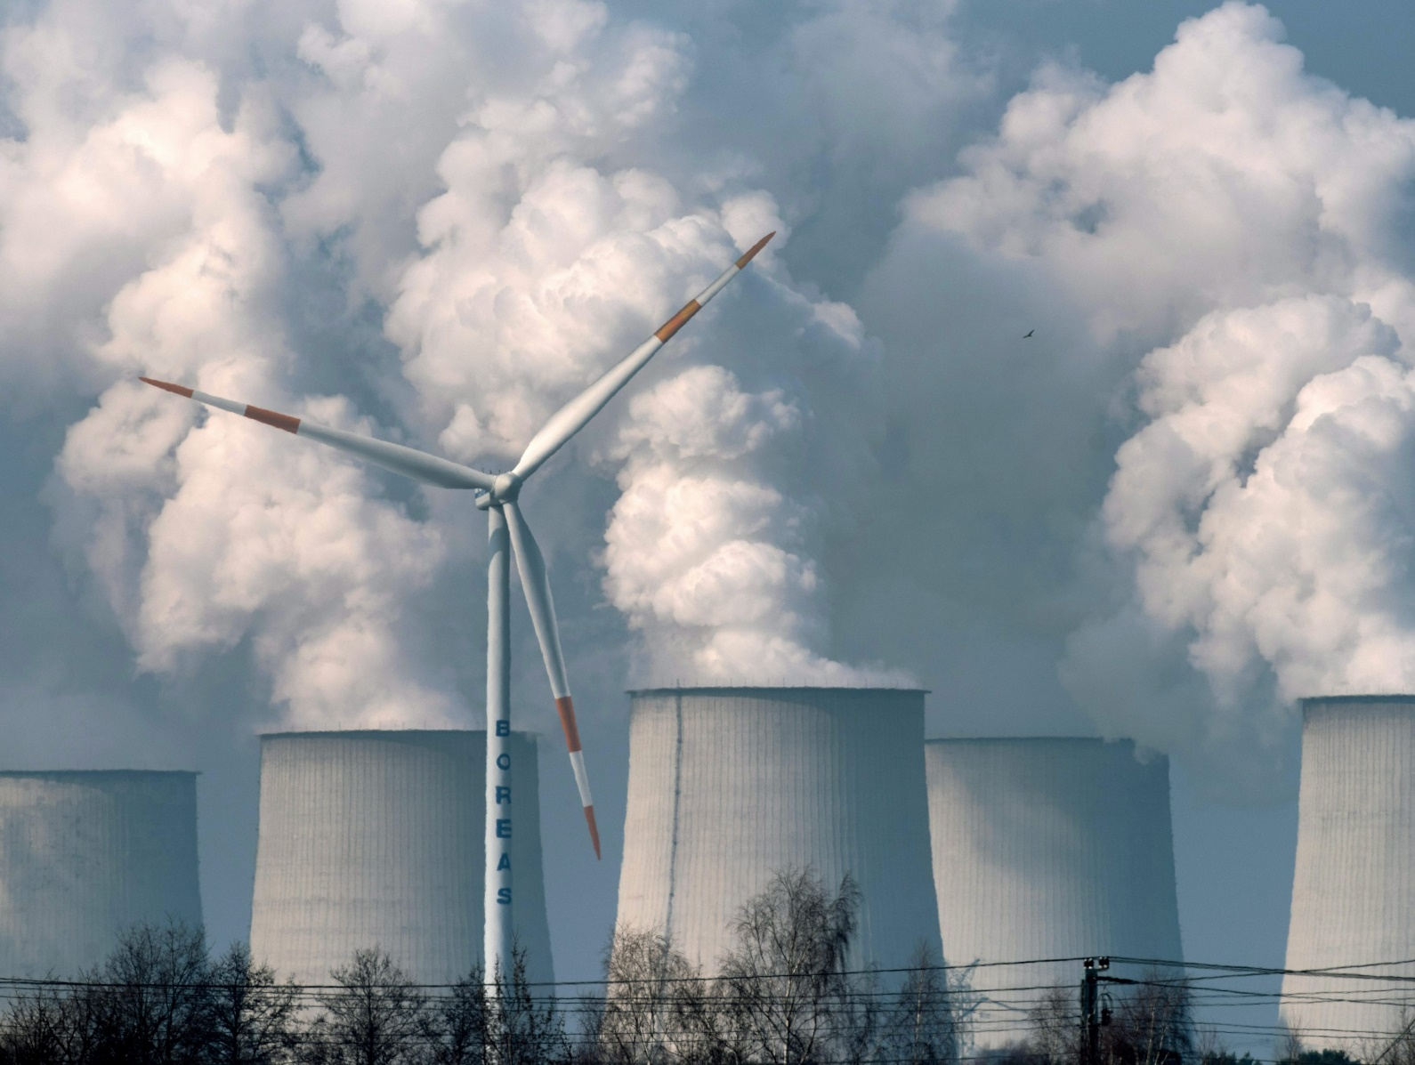
FATIMA HOSPITALITY SCHOOL
Causes
Use of aerosols;
Agricultural activities;
Production of electricity.

Slide 12
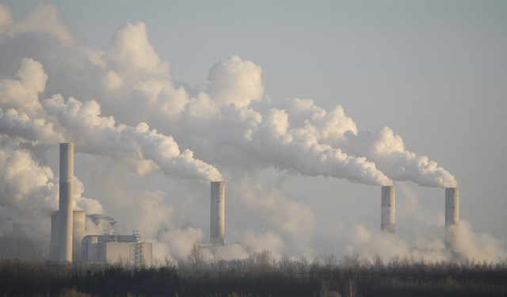
FATIMA HOSPITALITY SCHOOL
Possible Solutions
Establishing clear boundaries for pollution levels;
Promote daily and constant monitoring of air quality;
Notes:
change in Portugal’s forest fire suppression, planning, and prevention strategies

Slide 13

FATIMA HOSPITALITY SCHOOL
Possible Solutions
Regulate criteria for the emission of gaseous pollutants, as well as establishing penalties for those who violate such limits;
Notes:
change in Portugal’s forest fire suppression, planning, and prevention strategies

Slide 14
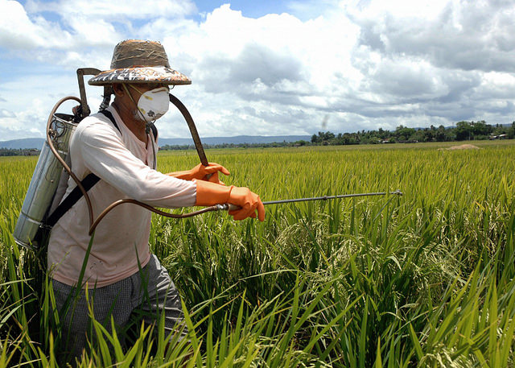
FATIMA HOSPITALITY SCHOOL
Possible Solutions
Reduce the use of agrochemicals and other agricultural chemical inputs, preferably choosing biological alternatives;
Notes:
change in Portugal’s forest fire suppression, planning, and prevention strategies

Slide 15
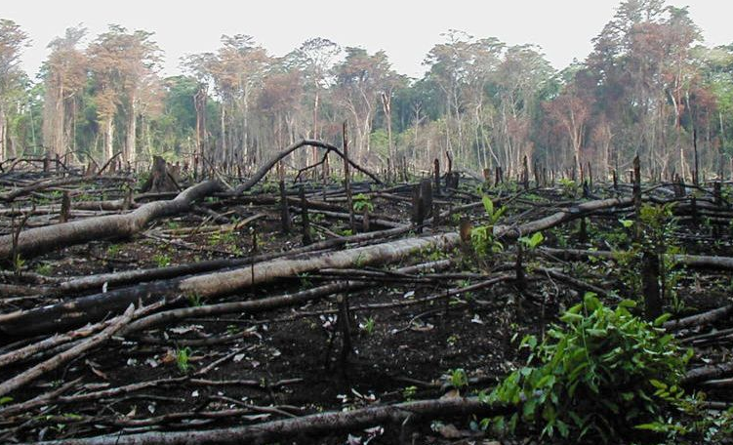
FATIMA HOSPITALITY SCHOOL
Possible Solutions
Promote the conservation and expansion of forest areas, environmental reserves and natural environmental protection areas
Reforest degraded areas;
Notes:
change in Portugal’s forest fire suppression, planning, and prevention strategies

Slide 16
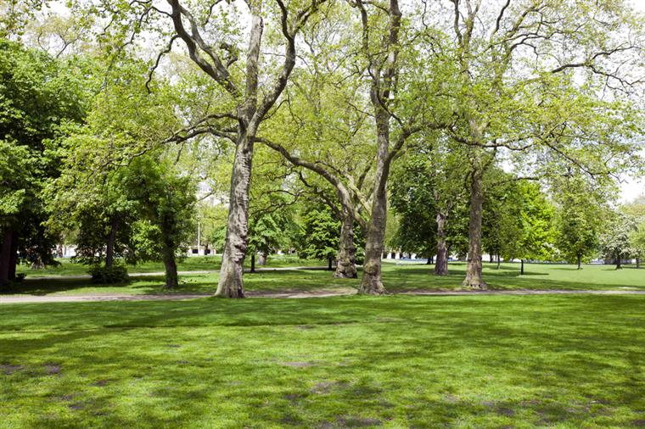
FATIMA HOSPITALITY SCHOOL
Possible Solutions
Maintenance and creation of green areas in urban spaces, such as woods, squares, parks and green corridors;
Notes:
change in Portugal’s forest fire suppression, planning, and prevention strategies

Slide 17
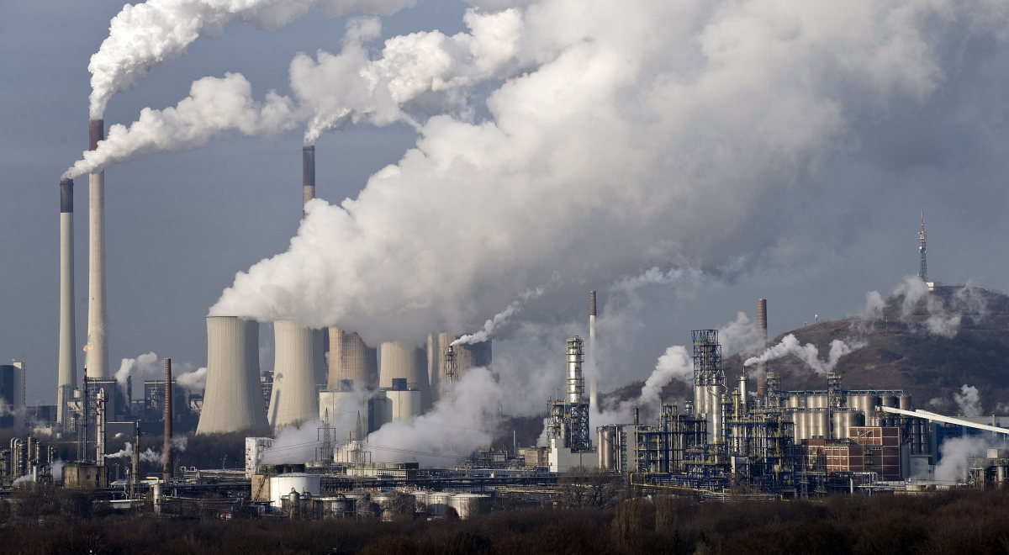
FATIMA HOSPITALITY SCHOOL
Possible Solutions
Encourage the use of instruments that minimize emissions of pollutants in factories, plants and waste treatment, among others.
Notes:
change in Portugal’s forest fire suppression, planning, and prevention strategies

Slide 18
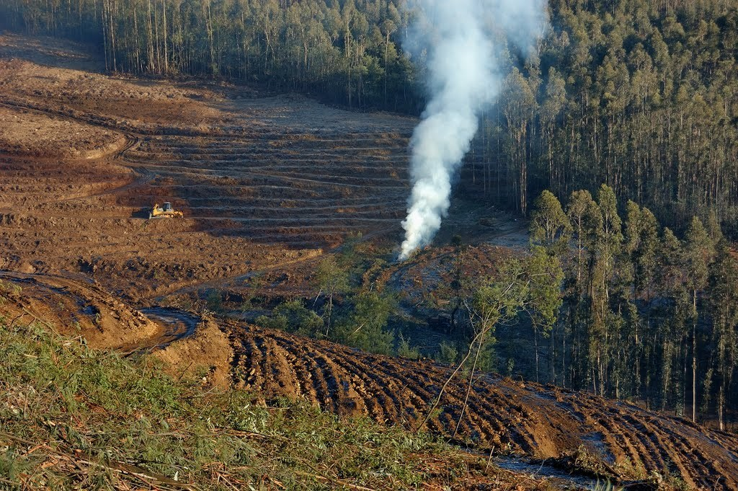
FATIMA HOSPITALITY SCHOOL
Portugal is one of the most deforested countries in the world
If we don’t start making decisions and changing our routines right now, we are going to have even bigger offshoots than we do today.

Slide 19
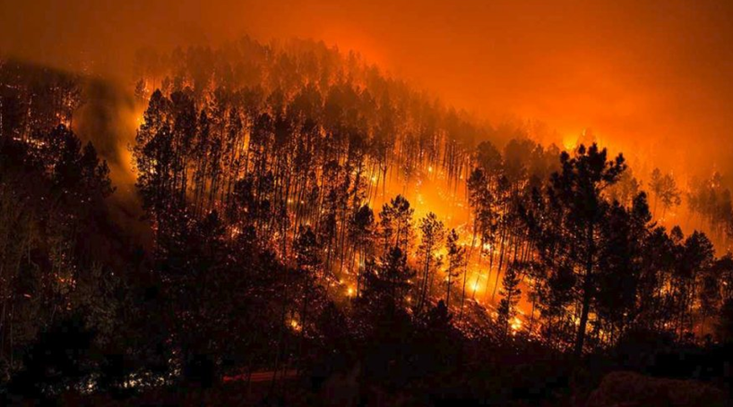
FATIMA HOSPITALITY SCHOOL
Causes
The main cause of deforestation is fires.
Conversions to urban, tourist and industrial areas;

Slide 20
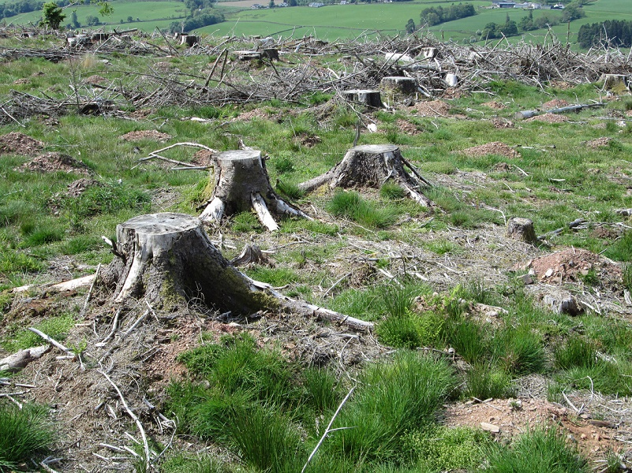
FATIMA HOSPITALITY SCHOOL
Causes
New infrastructures such as motorways and dams;
Paper production;

Slide 21
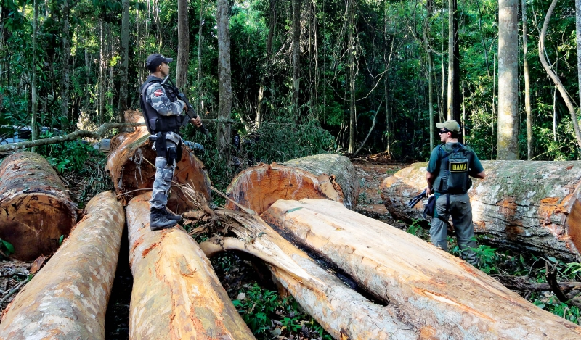
FATIMA HOSPITALITY SCHOOL
Causes
Agricultural projects;
Climatic conditions, such as high temperatures or thunderstorms.

Slide 22
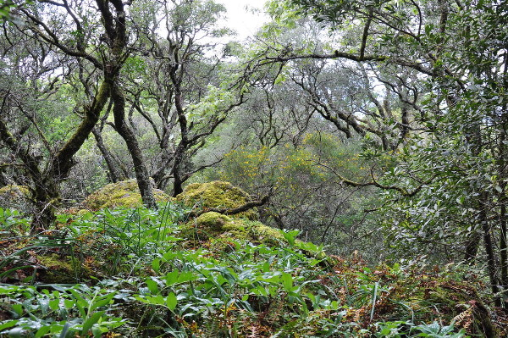
FATIMA HOSPITALITY SCHOOL
Possible Solutions
Non-use of processed wood from exotic species.
Insisting on the creation of natural reserves and forest protection zones;
Notes:
change in Portugal’s forest fire suppression, planning, and prevention strategies

Slide 23
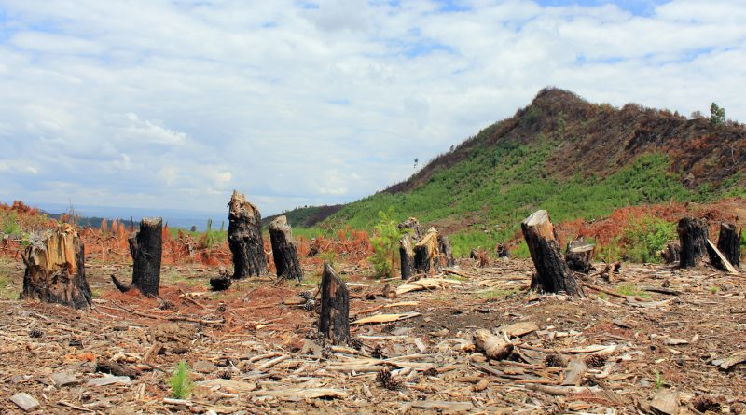
FATIMA HOSPITALITY SCHOOL
Possible Solutions
Contributing to the awareness of increased deforestation;
Recycling of paper;
Notes:
change in Portugal’s forest fire suppression, planning, and prevention strategies

Slide 24
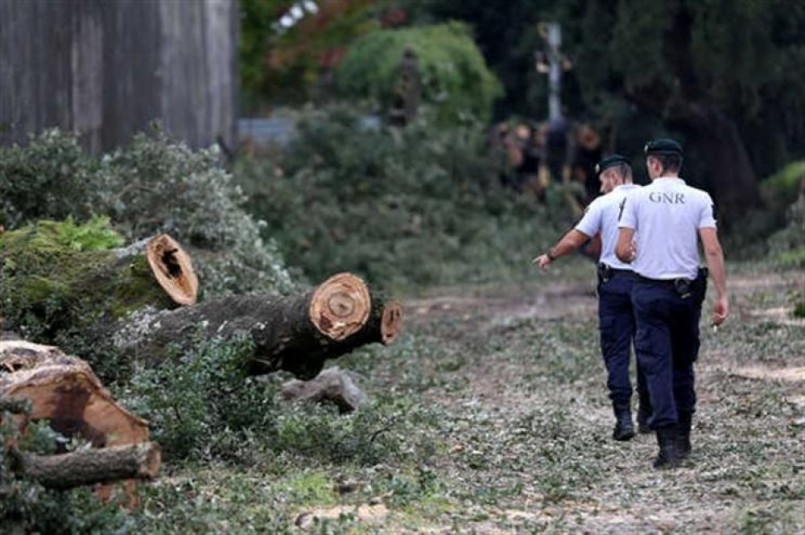
FATIMA HOSPITALITY SCHOOL
Possible Solutions
Rehabilitation of degraded forest areas;
Management of forests, with protective legislation;
Preventing forest fires.

Slide 25
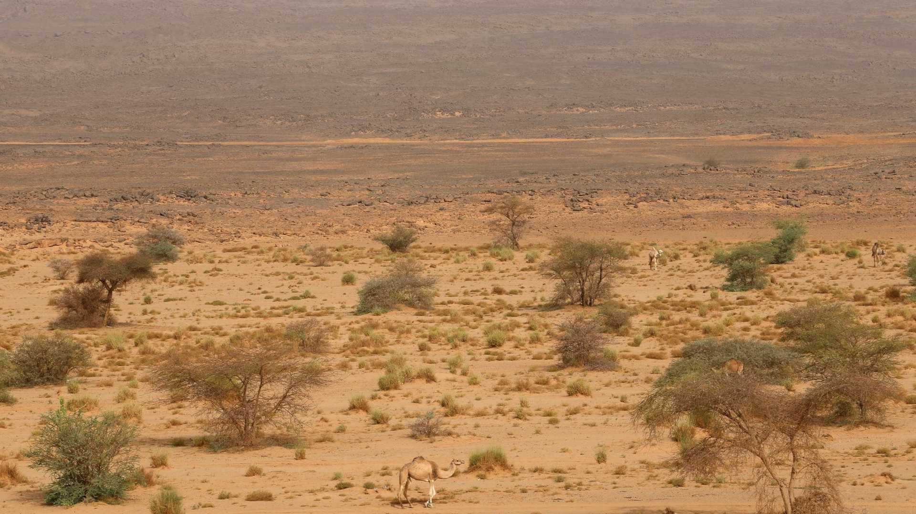
FATIMA HOSPITALITY SCHOOL
More than half of our territory is at risk of desertification
Areas that already have a lack of humidity, when subjected to certain factors - natural or anthropic - become desertified areas.

Slide 26
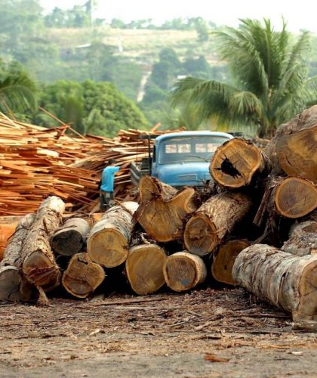
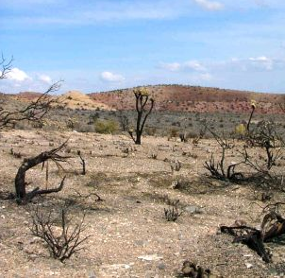
FATIMA HOSPITALITY SCHOOL
Causes
Removing original vegetation cover is perhaps the main human factor of desertification;
Construction of pasture areas for extensive cattle ranching;

Slide 27
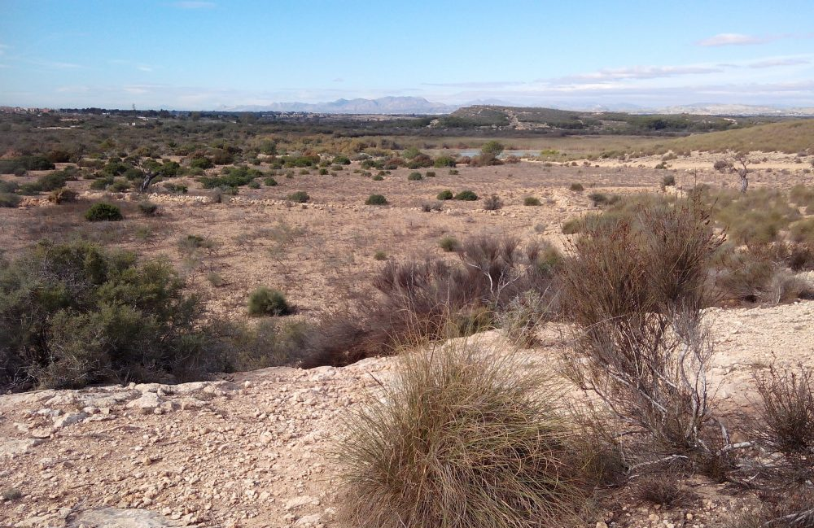
FATIMA HOSPITALITY SCHOOL
Causes
The intensified use of soil in agriculture;
Impoverishment by economic activities;
Depletion of rivers and water resources;

Slide 28
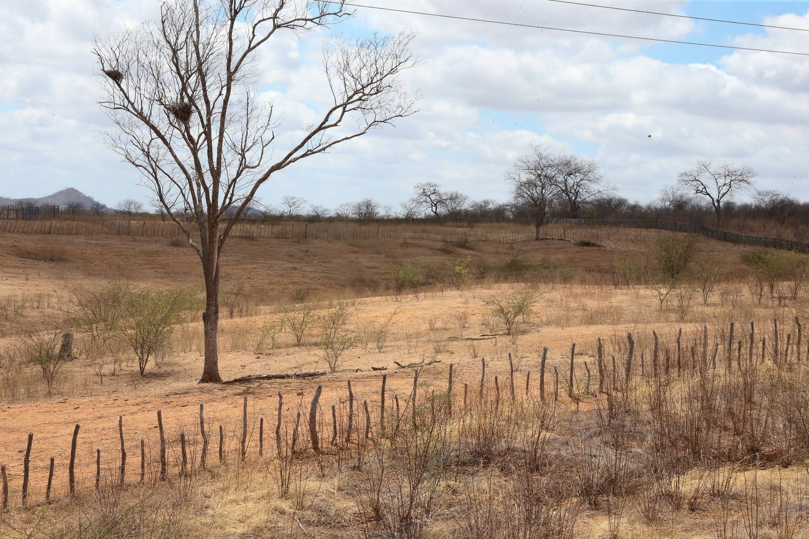
FATIMA HOSPITALITY SCHOOL
Possible Solutions
Cultivating plants and trees that existed there before;
Invest in environmental preservation;
Using sustainable farming techniques;

Slide 29
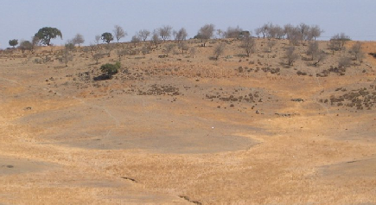
FATIMA HOSPITALITY SCHOOL
Possible Solutions
Promoting environmental education;
Reduce the emission of polluting gases;
Adoption of sustainable land use techniques.

Slide 30
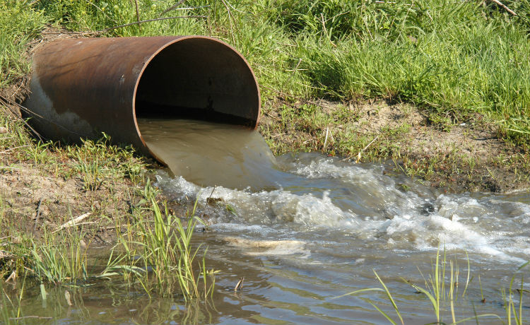
FATIMA HOSPITALITY SCHOOL
Water Resources Pollutions
Water pollution is the degradation of water quality to the point of: harming the health, safety and well-being of the population.

Slide 31
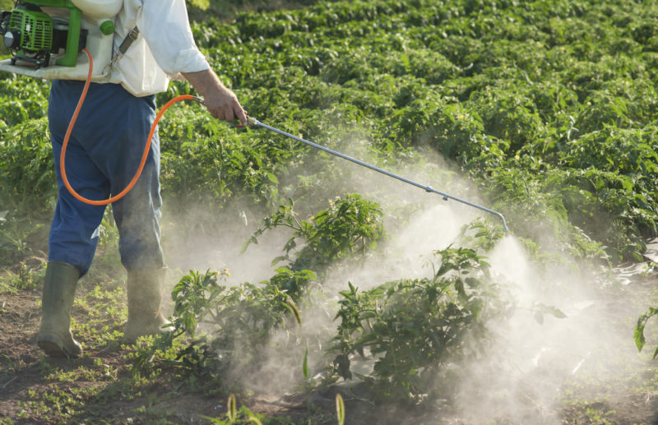
FATIMA HOSPITALITY SCHOOL
Causes
Farming activities, due to the use of pesticides fertilizers and chemicals that seep into the soil, might reach the aquifers;

Slide 32
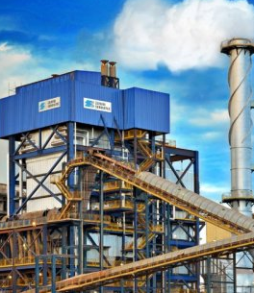
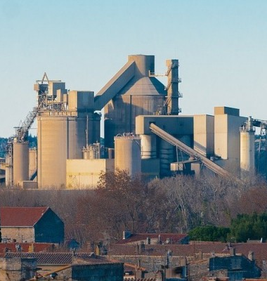
FATIMA HOSPITALITY SCHOOL
Causes
Industrial activities generate several wastes that are often thrown into rivers and seas;

Slide 33
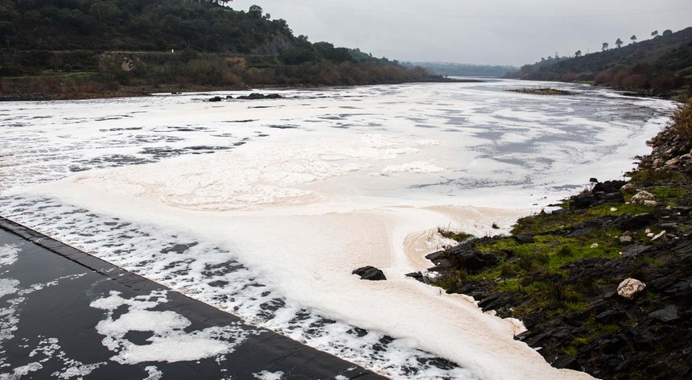
FATIMA HOSPITALITY SCHOOL
Causes
Lack of basic sanitation;
Many of the sewage treatment plants dispose of the waste produced directly in the running water;

Slide 34
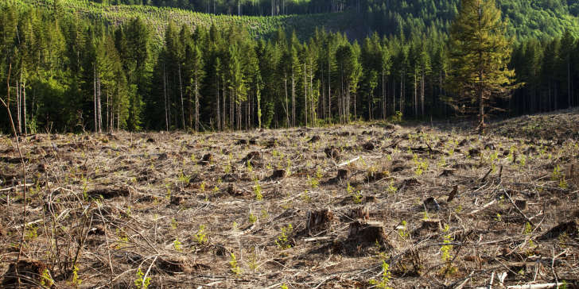
FATIMA HOSPITALITY SCHOOL
Causes
Deforestation in the coastal areas that is usually made for the construction of buildings that need paving that prevents the penetration of water in the soil.

Slide 35
FATIMA HOSPITALITY SCHOOL
Possible Solutions
Reuse of treated wastewater;
Industries must change their processes taking into account the reduction of water consumption;

Slide 36
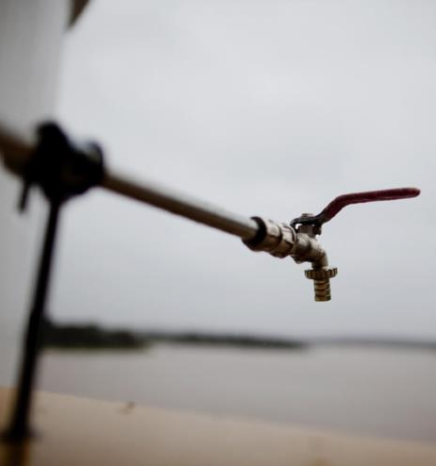
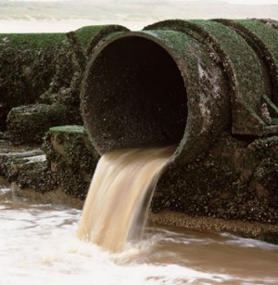
FATIMA HOSPITALITY SCHOOL
Possible Solutions
Correct selection of landfill sites;
Adjustment of the location of facilities producing and storing harmful substances;

