Slide 1
FATIMA HOSPITALITY SCHOOL
Youngsters Nowadays:
Where from, Where to
Romania from 10th to 16th March 2019
“The enviroment between consumption and jobs”

Slide 2
FATIMA HOSPITALITY SCHOOL
Consumption
The act of consumption is essential for humans species.
In order to live a healthy life we need to breathe fresh air; to stay hydrated, we have to consume water; to grow and be healthy we need food.

Slide 3
FATIMA HOSPITALITY SCHOOL
Consumption:
The problem is when the consumption of goods and services is done in an exaggerated way, leading to the excessive exploitation of natural resources causing the damage of the planet.
Consumerism is the act of buying or having something that you really do not need to show status or by the influence of advirtesements.

Slide 4
FATIMA HOSPITALITY SCHOOL
Consumerism:
This consumerism can cause serious environmental problems, because the more we consume, the more it is necessary to produce goods or items and this involves natural resources.

Slide 5
FATIMA HOSPITALITY SCHOOL
How does consumption influence the enviroment?
In a globalized world dominated by capitalism, consumption is directly linked to the development of society.
The more we consume, the greater the development and economic stability of each state and region will grow.

Slide 6
FATIMA HOSPITALITY SCHOOL
How does consumption influence the enviroment?
The problem is that there is a close and strong relationship between consumerism and our planet. Everything that we consume is connected to our environment.

Slide 7
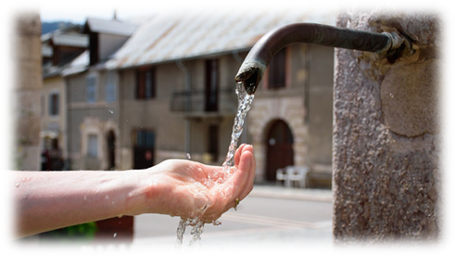
FATIMA HOSPITALITY SCHOOL
How does consumption influence the enviroment?
Due to the great demand of production and consumption it is necessary to remove raw materials from nature, manufacture and transport materials, make great use of electricity and water, among others.

Slide 8
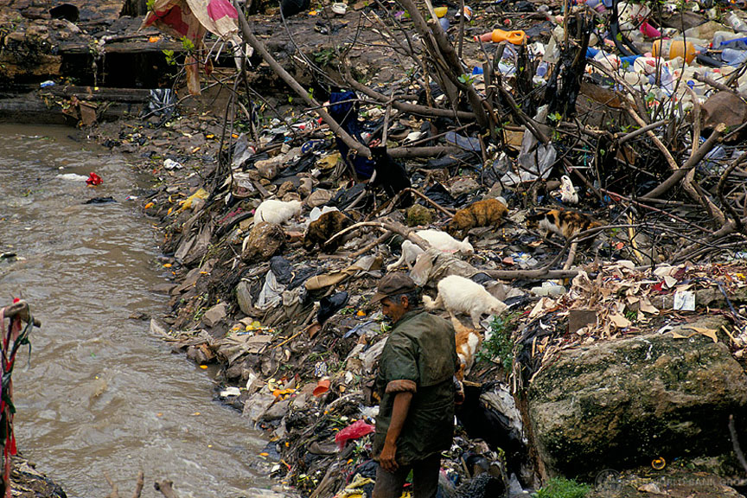
FATIMA HOSPITALITY SCHOOL
How does consumption influence the enviroment?
The amount of consumerism will cause the emission of polluting gases, degradation and environmental devastation and , consequently, the destruction of ecosystems.

Slide 9
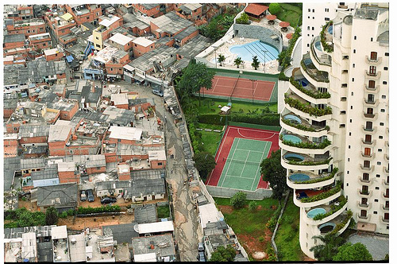
FATIMA HOSPITALITY SCHOOL
How does consumption influence the enviroment?
This relationship between consumption and sustainability, however, goes beyond the production stage.
With the large number of options and the evolution of technology, more and more products have shortservice life and greater difficulty of being repaired, which generates a huge number of electronic devices waste.

Slide 10
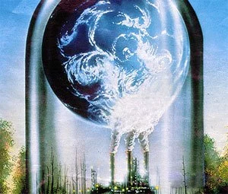
FATIMA HOSPITALITY SCHOOL
How does consumption influence the jobs ?
The world of work, at the same time that organizes and transforms nature, organizes
man himself and his society.

Slide 11
FATIMA HOSPITALITY SCHOOL
How does consumption influence the jobs ?
Some aspects of this process can be understood though transformations brought by the development of information technology and telecommunications, that end up modifying the organization and production capacity within the capitalist system of production.

Slide 12
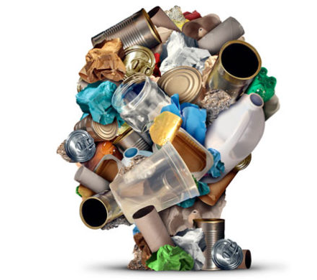
FATIMA HOSPITALITY SCHOOL
How does consumption influence the jobs ?
The same product can be equal produced at the same time, by the same manufacturer in different countries of the world (toys,cars), according to their convenience and profit.

Slide 13
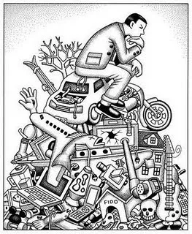
FATIMA HOSPITALITY SCHOOL
How does consumption influence the jobs ?
The speed of information, alongside with the development of transports, the components and the end product are manufactured at different points, dividing the production according to the places where the economic conditions (cost of labour, of the material, regulation, etc.) are more beneficial.

Slide 14
FATIMA HOSPITALITY SCHOOL
Conclusion
With the awareness of increasing environmental problems, governments, companies and organizations come together to look for ways to make sure that each country works for a sustainable way to ensure its progress without compromising the future.

Slide 15
FATIMA HOSPITALITY SCHOOL
Conclusion
Some strategies and policies have been instituted to enable changes in consumption patterns.
Among the several actions that are being introduced is the habit of using recyclable and biodegradable products, such as some supermarket bags.

Slide 16
FATIMA HOSPITALITY SCHOOL
Conclusion
To conclude the environmental education is an important step towards sustainable development.
All the sectors of the society must be aware of the importance of their actions towards the environment. We all should respect our planet if we want to have FUTURE.

