Slide 1
FATIMA HOSPITALITY SCHOOL
Youngsters Nowadays: Where from, Where to
Portugal 4th to 10th March 2018
Let’s do sports

Slide 2
FATIMA HOSPITALITY SCHOOL
Do you believe physical activities can be related to general wellness?
Notes:
Most of the portuguese students agreed that physical activities are related to general wellness.

Slide 3
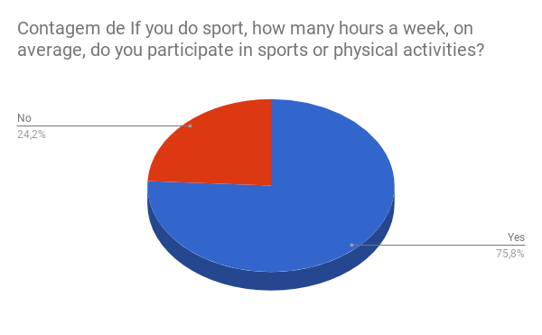
FATIMA HOSPITALITY SCHOOL
Do you usually do sports or physical activities?
Notes:
For this question 115 studens answered ‘yes’ and 37 answered ‘no’

Slide 4
FATIMA HOSPITALITY SCHOOL
If you do sport, how many hours a week, on average, do you participate in sports or physical activities?
Notes:
For this question 14 students answered 2/4 hours, 58 answered ½ hours, 37 answered 2/3 hours, and 26 answered not applicable and 17 answered more than 4 hours.

Slide 5
FATIMA HOSPITALITY SCHOOL
If yes, which sport/sports do you prefer?
Notes:
At this question 17 studensts answered ‘other sports’, 19 answered ‘not applicable’, 9 answered soccer and 8 answered dance.

Slide 6
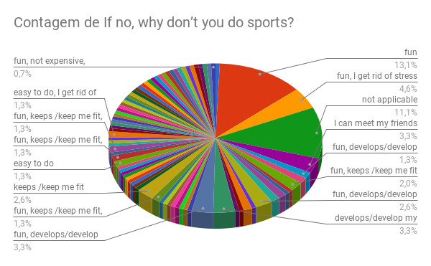
FATIMA HOSPITALITY SCHOOL
Why do you prefer doing this sport/these sports?
Notes:
For this question 20 answered fun, 7 answered fun, I get rid of stress, 17 answered not applicable and 5 answered fun, keeps me fit

Slide 7
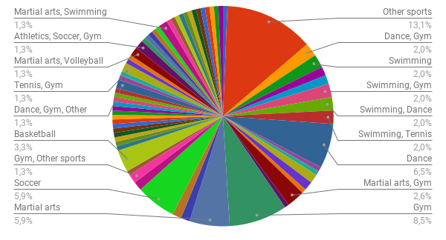
FATIMA HOSPITALITY SCHOOL
If you do not do sports which sports would you like to practise in the future?
Notes:
For this question 20 students answered ‘other sports’, 10 answered ‘dance’, 13 answered ‘gym’, 9 answered ‘martial arts’, 9 answered soccer and 5 answered basketball.

Slide 8
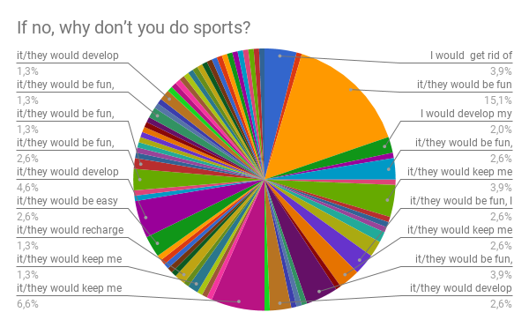
FATIMA HOSPITALITY SCHOOL
Why would you like to take up doing this sport/ these sports?
Notes:
For this question 15.1% answered it would be fun, 6.6% answered would keep me fit, 2.6% answred would develop my goal-setting skills and 4.6% they would be easy to do.

Slide 9
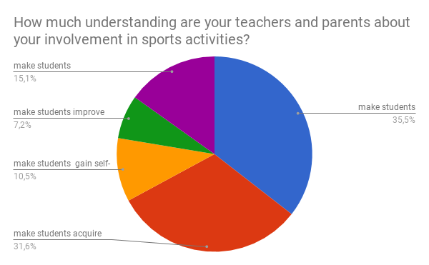
FATIMA HOSPITALITY SCHOOL
What main benefit do you think extra- curricular activities/ school activities/ school projects/ international projects have for students regarding leading a healthy life?
Notes:
For this question 35.5% answered make students understand what a healthy lifestyle is, 31.6% answered make students acquire life-long habits that will keep them physically and mently fit, 15.1% answered make students understand the importance of doing sports, 17 answered make sutends gain self confidence and 16 answered make students improve their teamwork spirit and tolerance.

