Slide 1
Co-financed through the European Union’s Erasmus + project
Youngsters Nowadays
Where from, Where to?
2017-1-RO01-KA219-037190
Workshop for the dissemination of the project results and the final products made under the Teaching, Learning, Training Activity which was held at the partner school in Soverato, Italy, between 01-05 October 2018.
Target Group: Students from the Students Council of C.N.I.C. Moreni.

Slide 2
The workshop took place at the "Ion Luca Caragiale" National Council of Students, Moreni and it aimed at presenting the results of the project and of the two final products: "Youth Literature" and "Free Time Activities" in the second teaching-learning-training course in Italy, October 1-5, 2018. The students from the project team presented to the pupils present methods, techniques of learning and teaching literature, based on a book which was chosen by each partner school in the project (Romania: Lord of the Flies, Italy: Papertowns, Portugal: Anne Frank's diary, Greece: Antigona, Turkey: A reminder for Istanbul), involved students in role- of reading, invited students to answer questions.
The second final product, "Free Time Activities", was presented, which included suggestions for spending leisure time in an efficient, pleasant way, contributing to the development of a healthy lifestyle and personal well-being. Students attended a debate on leisure activities and their importance in personal and professional development.

Slide 3
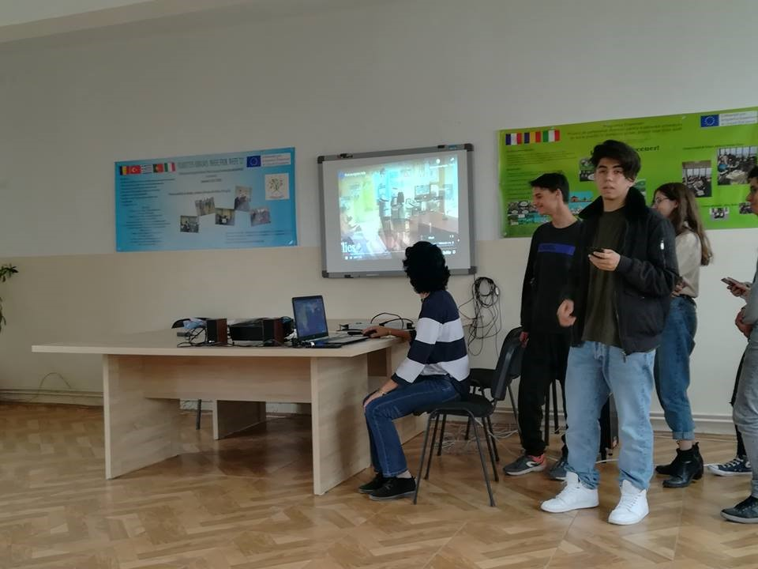
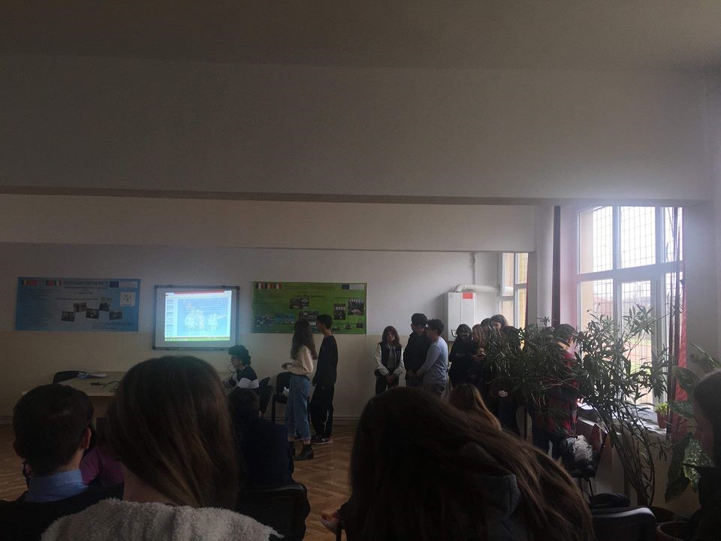

Slide 4
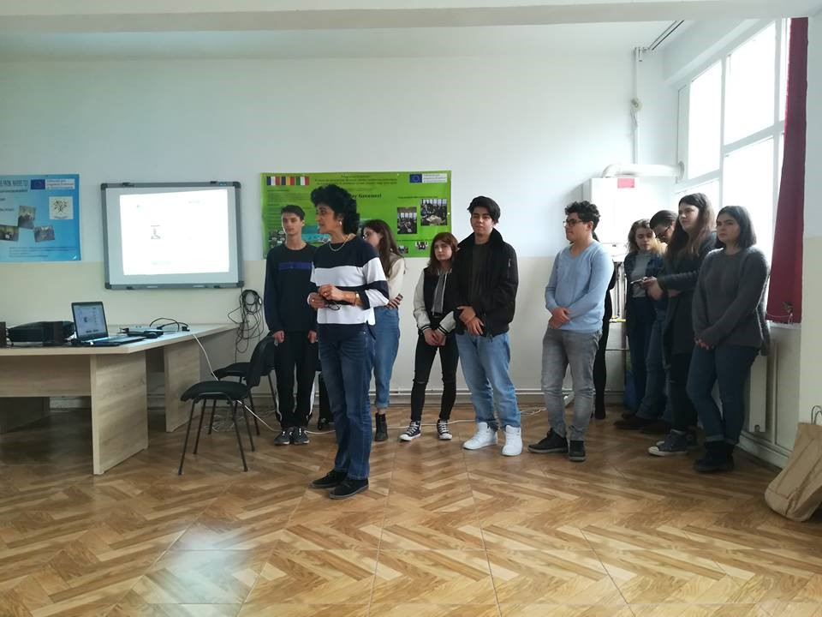
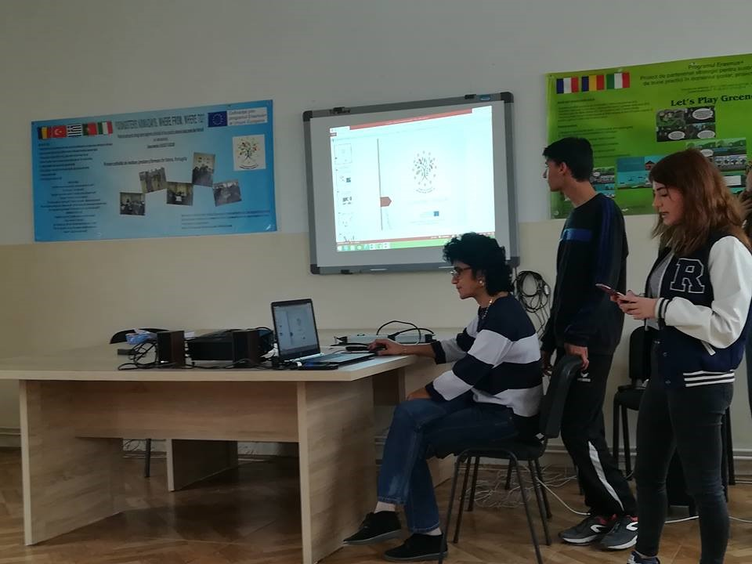

Slide 5
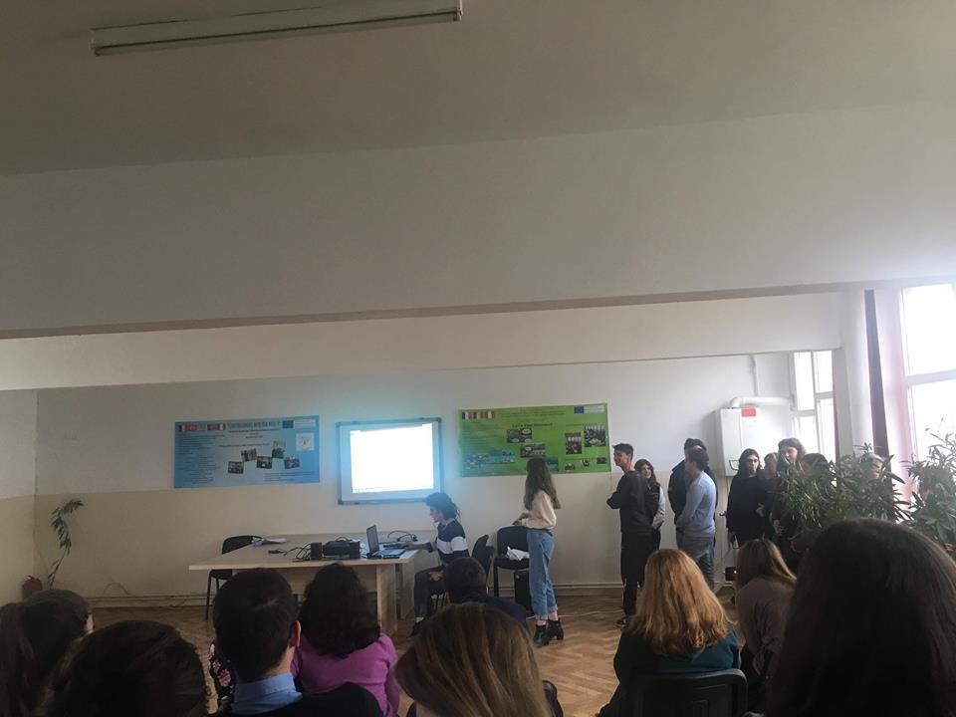
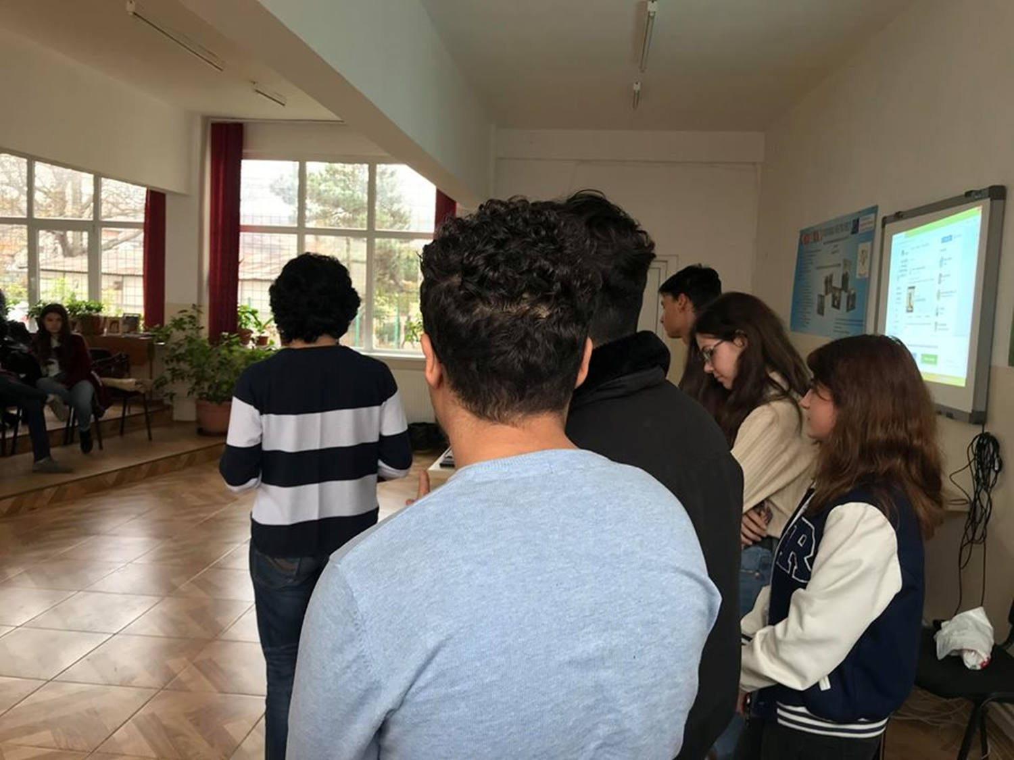

Slide 6
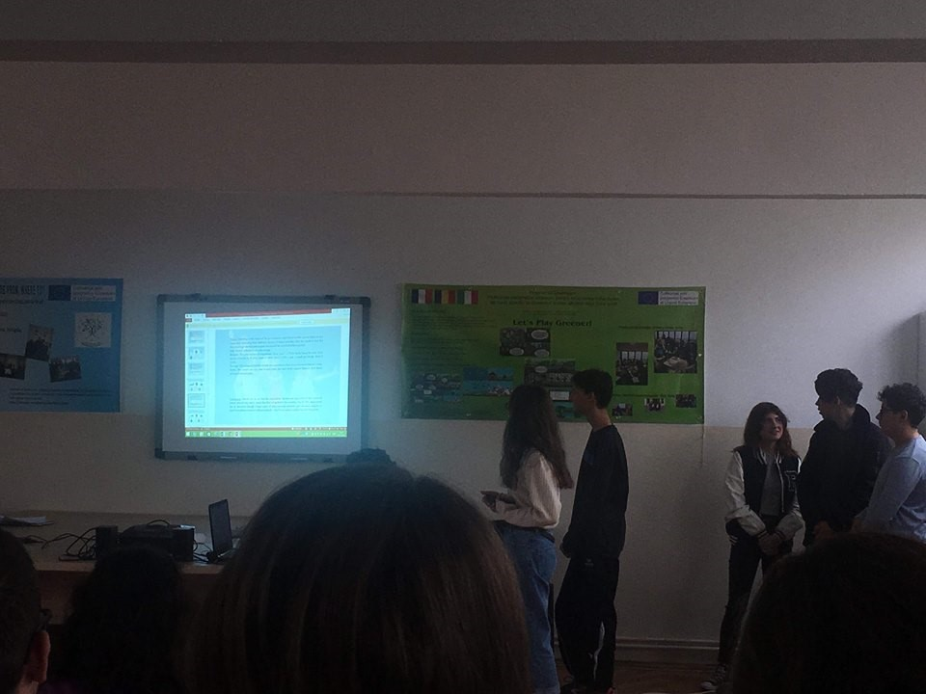
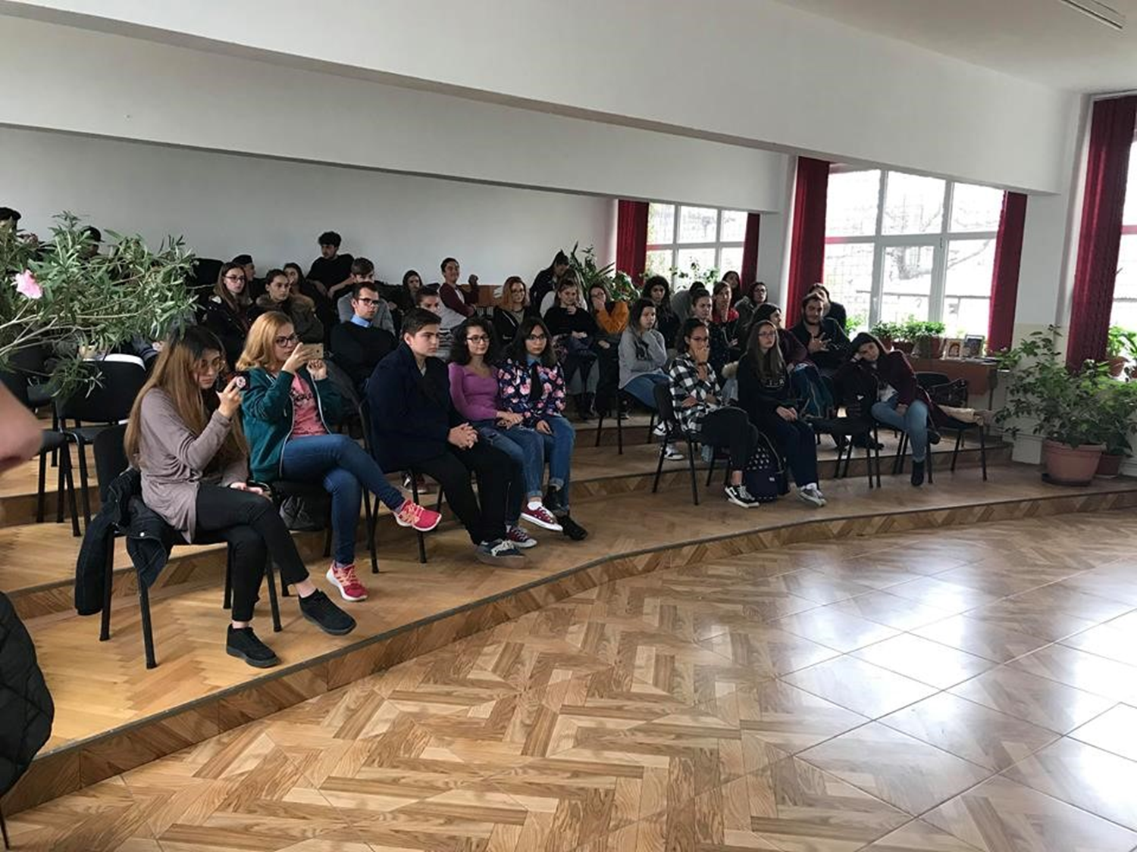

Slide 7
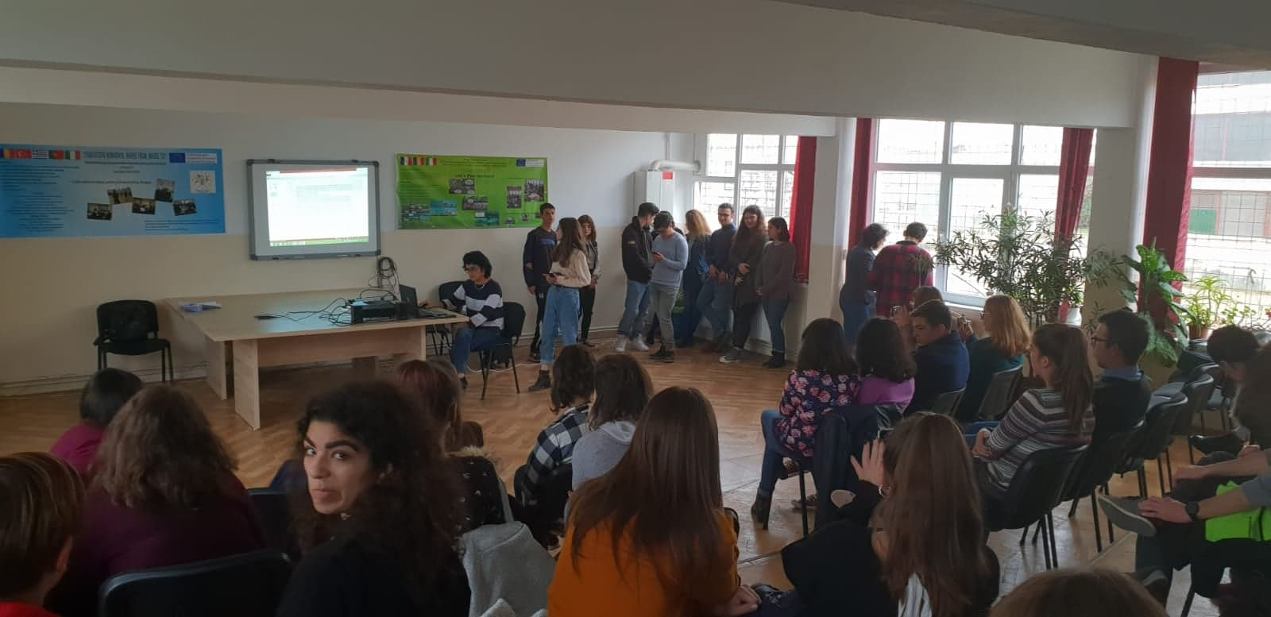
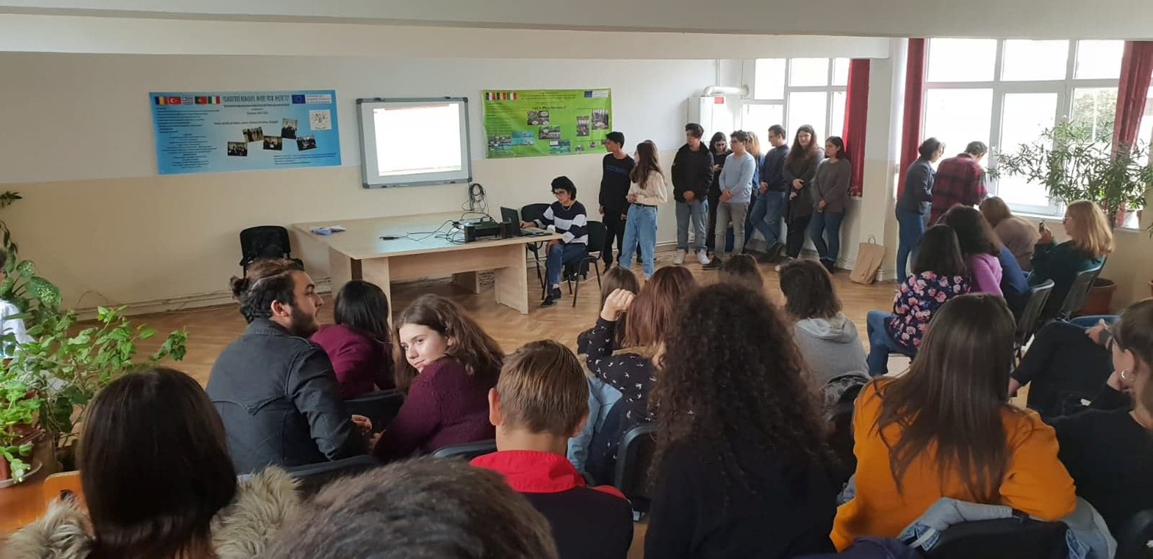

Slide 8
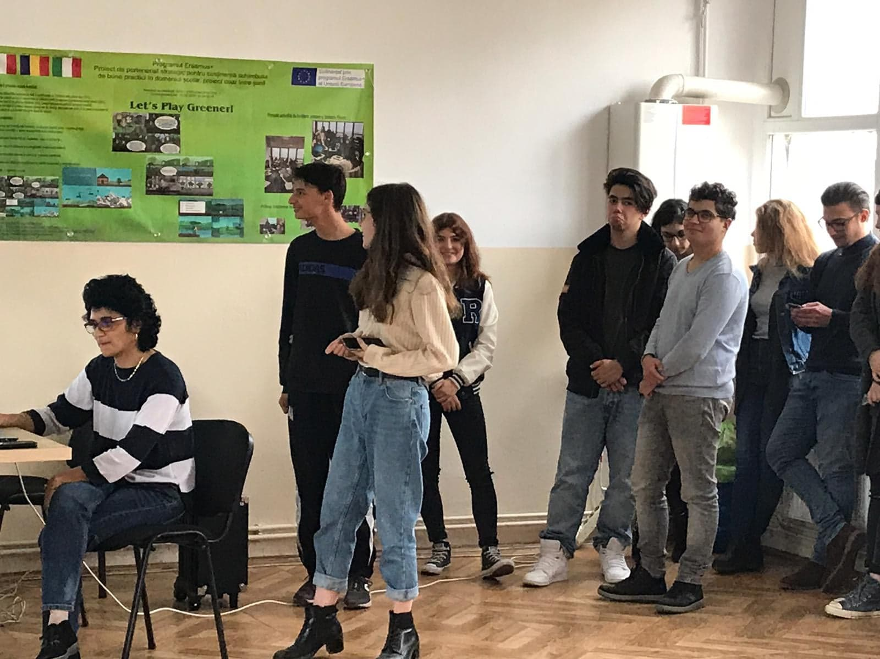
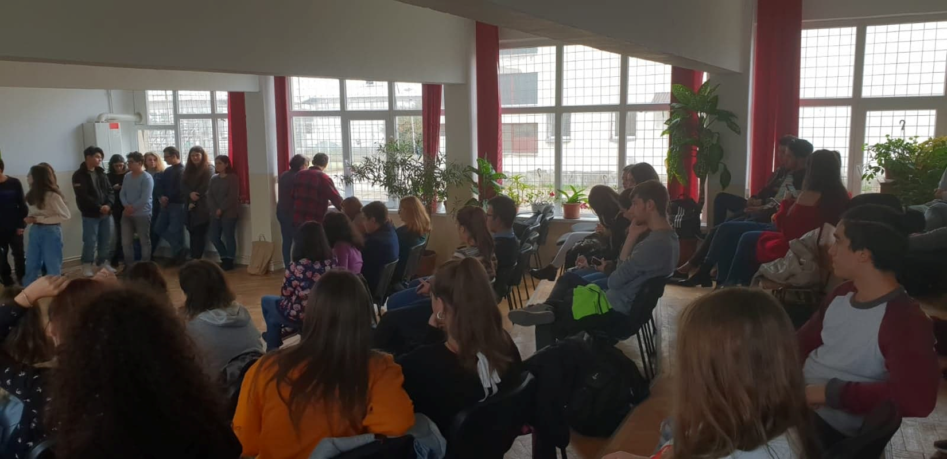

Slide 9
This material was produced with the financial support of the European Commission. The content of this material is the sole responsibility of the authors, and the National Agency and the European Commission are not responsible for how the content of the information will be used.

