Slide 1
ERASMUS+ Youngsters Nowadays.
Where from, Where to?
2017-1-RO01-KA219-037190
A Day of Sports
25/05/2018

Slide 3
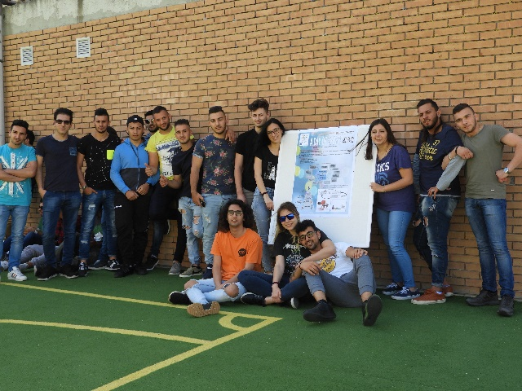
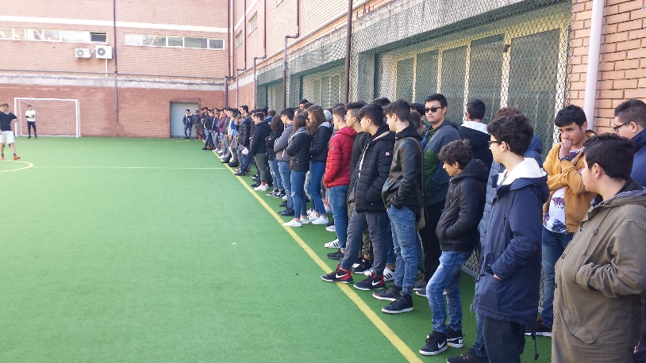
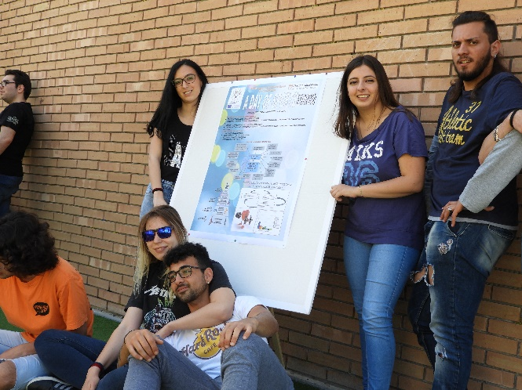
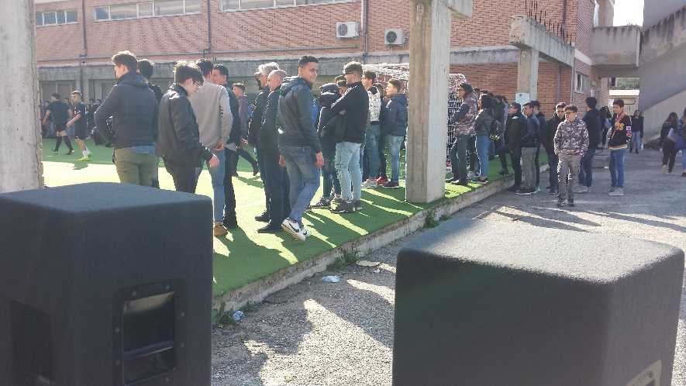
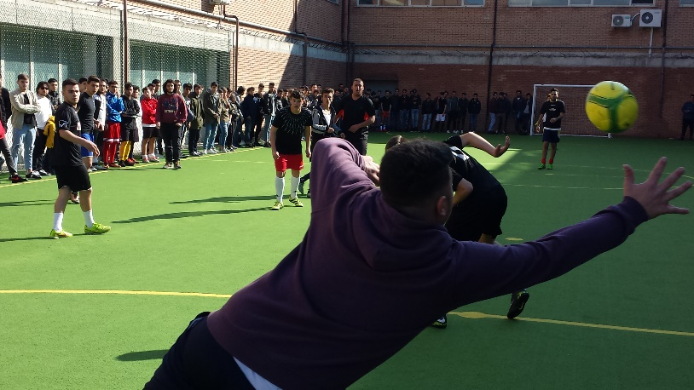
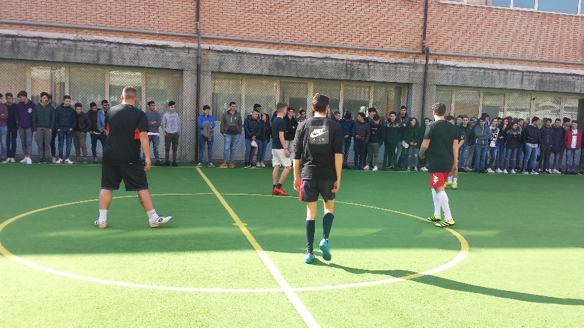
Having Fun, Playing Together
and Promoting Physical Activities

Slide 4
