Slide 1
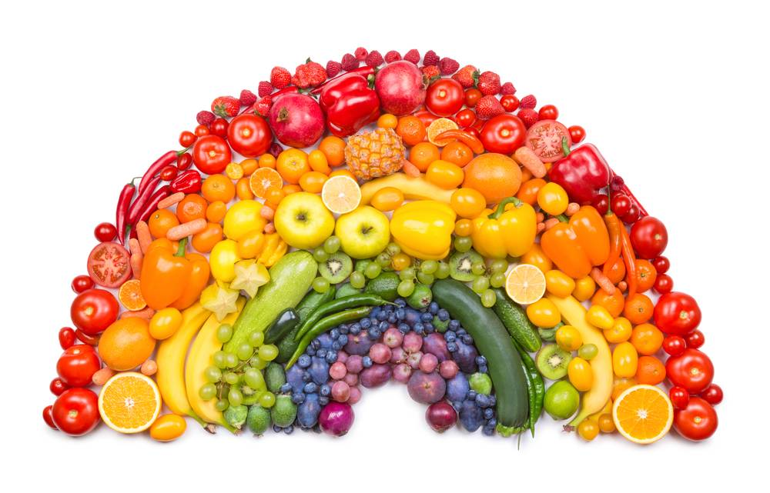
FATIMA HOSPITALITY SCHOOL
Youngsters Nowadays:
Where from, Where to
Portugal 4th to 10th March 2018
Eating Habits
Notes:
Good morning and welcome to Fatima Hospitality School. So I´m going to talk about the questionnaries Eating Habits answered by the portuguese.

Slide 2
FATIMA HOSPITALITY SCHOOL
How many meals do you eat every day during weekdays?
Notes:
For the question “How many meals do you eat every day during weekdays?”, five students answered that have 1 meal a day, twenty six students have 2 meals a day, thirty nine students have 3 meals a day and seventy seven students have more than 3.

Slide 3
FATIMA HOSPITALITY SCHOOL
Which meal(s) do you consider the most important of the day and you always have it/them? You may choose more than one option.
Notes:
For the question “Wich meal do you consider the most important of the day and you always have it?” eighty-seven
Students consider the Breakfat the meal more important, nineteen students consider the lunch, fourteen consider Breakfast and lunch and for last eleven students consider Breakfast, lunch and dinner.

Slide 4
FATIMA HOSPITALITY SCHOOL
Your main meals are:
Notes:
In this question “Your main meals are: “ one hundred and twenty seven students say the main meal is freshly home- cooked, four students answered pre- cooked, microwave, three students answered taken in a restaurant, four students answered fast food, takeaways and nine students answered taken in a cafeteria.

Slide 5
FATIMA HOSPITALITY SCHOOL
Your main meals consist of:
Notes:
In the question “Your main meals consist of:” most students consume soup, cereals, steak, fish, vegetables, salad and dairy products.

Slide 6
FATIMA HOSPITALITY SCHOOL
Do you choose food which is baked, steamed or grilled rather than food that is fried?
Notes:
In this question “ Do you choose food which is baked, steamed or grilled rather than food that is fried?” one hundred and twenty students say yes and twenty seven say no.

Slide 7
FATIMA HOSPITALITY SCHOOL
What do you eat as snacks?
Notes:
For the question “What do you eat as snacks?” most students consume biscuits, chocolate, sandwiches, pastries, fruit and yoghurt.

Slide 8
FATIMA HOSPITALITY SCHOOL
How many servings of vegetables and fruit do you eat every day?
Notes:
In this question “How many servings of vegetables and fruit do you eat every day?” the students answered they eat between two a six fruits per day.

Slide 9
FATIMA HOSPITALITY SCHOOL
How many glasses/cans of fizzy drinks do you have a day?
Notes:
“How many glasses/cans of fizzy drinks do you have a day?” half of the students don´t drink fizzy drinks and the other half drink between one a two glasses.

Slide 10
FATIMA HOSPITALITY SCHOOL
How many glasses of water do you drink every day?
Notes:
“How many glasses of water do you drink every day?” in relation to the former who didn´t drink fizzy drinks, then portuguese students drink a lot glasses of water a day.

Slide 11
FATIMA HOSPITALITY SCHOOL
What sort of food do you buy?
Notes:
“What sort of food do you buy?” most of the students sixty one buy fresh food, twenty eight buy fresh and frozen food.

Slide 12
FATIMA HOSPITALITY SCHOOL
Regarding your diet, is there at least ONE thing you would like to change now?
Notes:
In the last question “Regarding your diet, is there at least one thing you would like to change now?” fourteen students say they eat more fruit, teen students say thay eat less unhealthy food, sixteen students say eat more vegetables, nine students say eat more fruit, drink more water and five students say eat less fast food and have breakfast.

