Slide 1
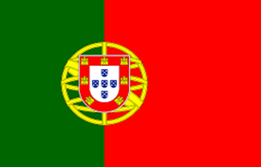
ERASMUS + PROGRAMME- STRATEGIC PARTNERSHIP
‘Youngsters Nowadays. Where from, Where to?’
2017-1-RO01-KA219-037190
Let’s Know What We Eat and Drink!
Part II
Our Traditional Food versus the International One

Slide 2
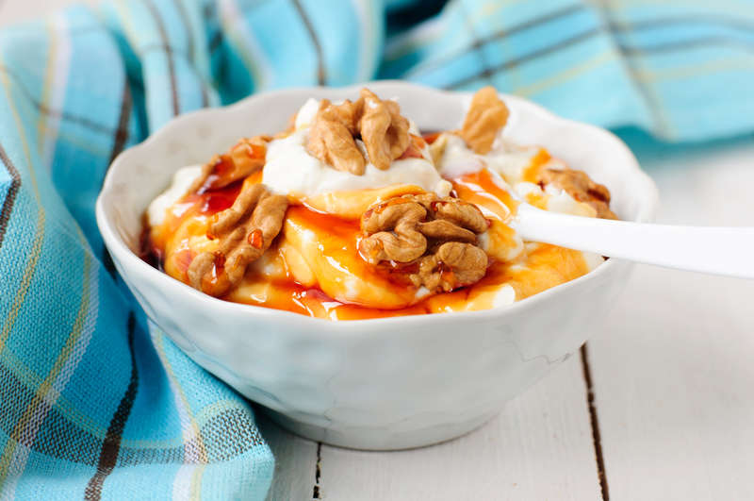
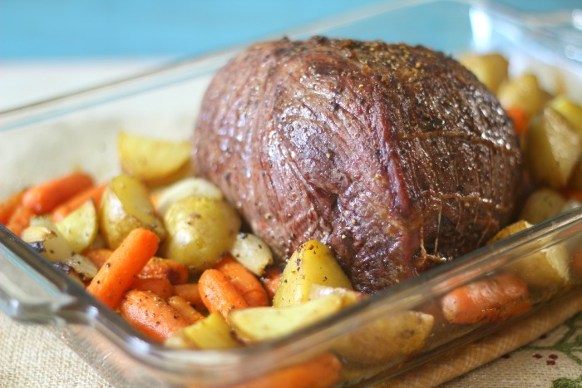
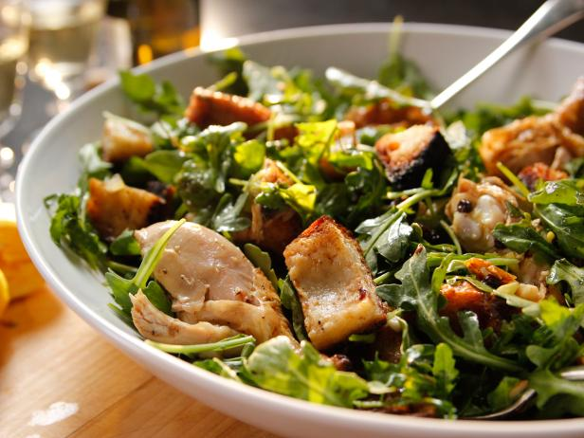
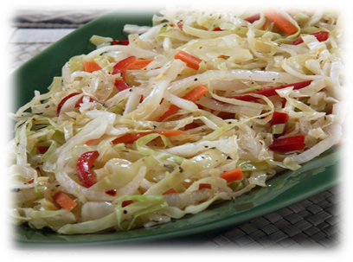
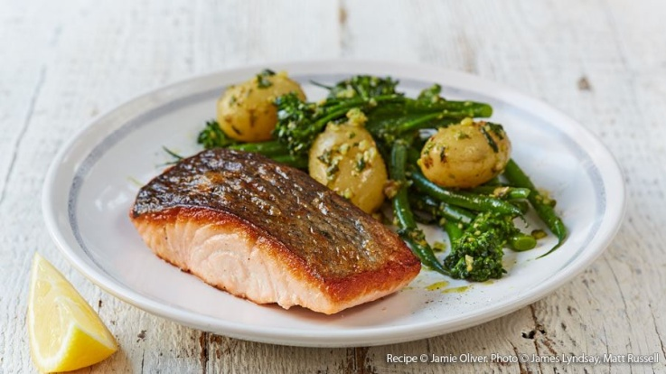
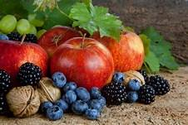
This compendium contains the diet habits of youngsters today, starting from a survey that the partner schools did in their own country. There were 150 students from each school that answered the questionnaire and the students compared and contrasted their eating and drinking habits with their partners, they analysed what they had in common, what was different and what they needed to change for a better life.
The compendium has got 3 parts:
Part I which contains the analyses of the diet habits of the European youngsters;
Part II which is a comparison between the traditional food of the five countries involved in the project and the international one;
Part III which makes suggestions for healthy food and a plan for the perfect diet of the European youngster for a week.

Slide 3
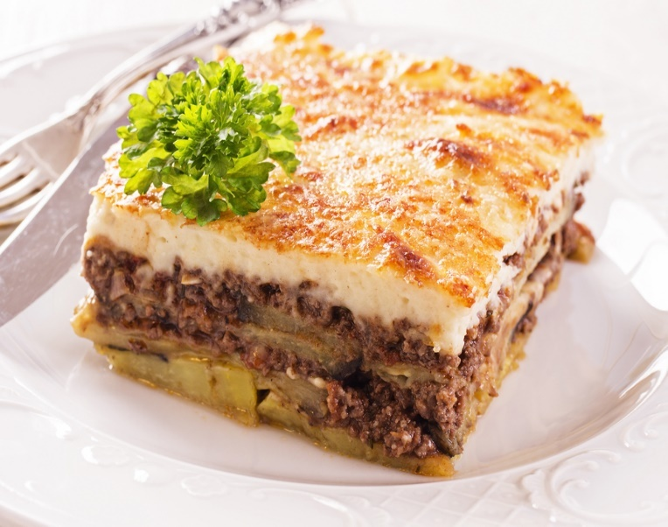
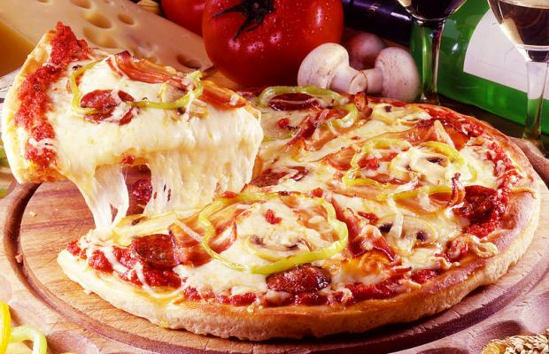
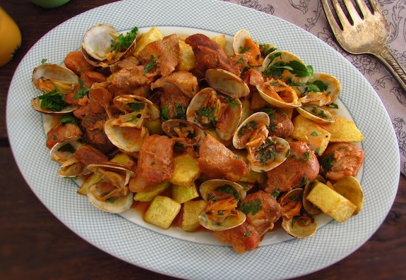
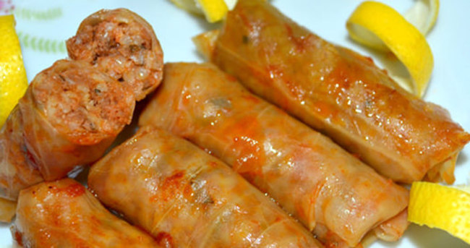
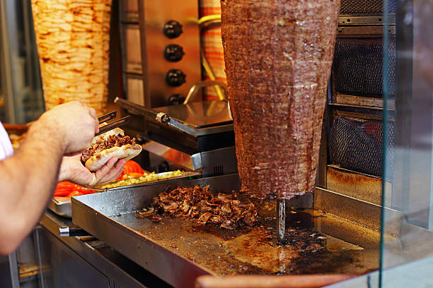
Our Traditional Food versus the International One
Comparing Traditional National Dishes with the International Food

Slide 4
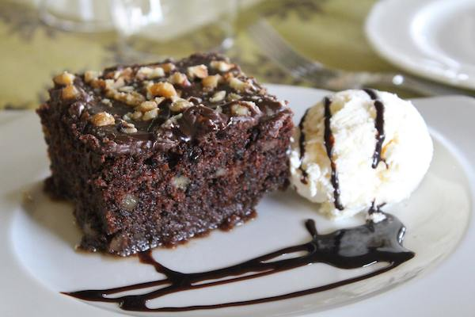
Greek Traditional Food
Moussaka is a traditional dish of Greece, which includes potatoes, minced meat and aubergines.
Karidopita is a dessert containing chopped walnut, bread crumbs and nutmeg.

Slide 5
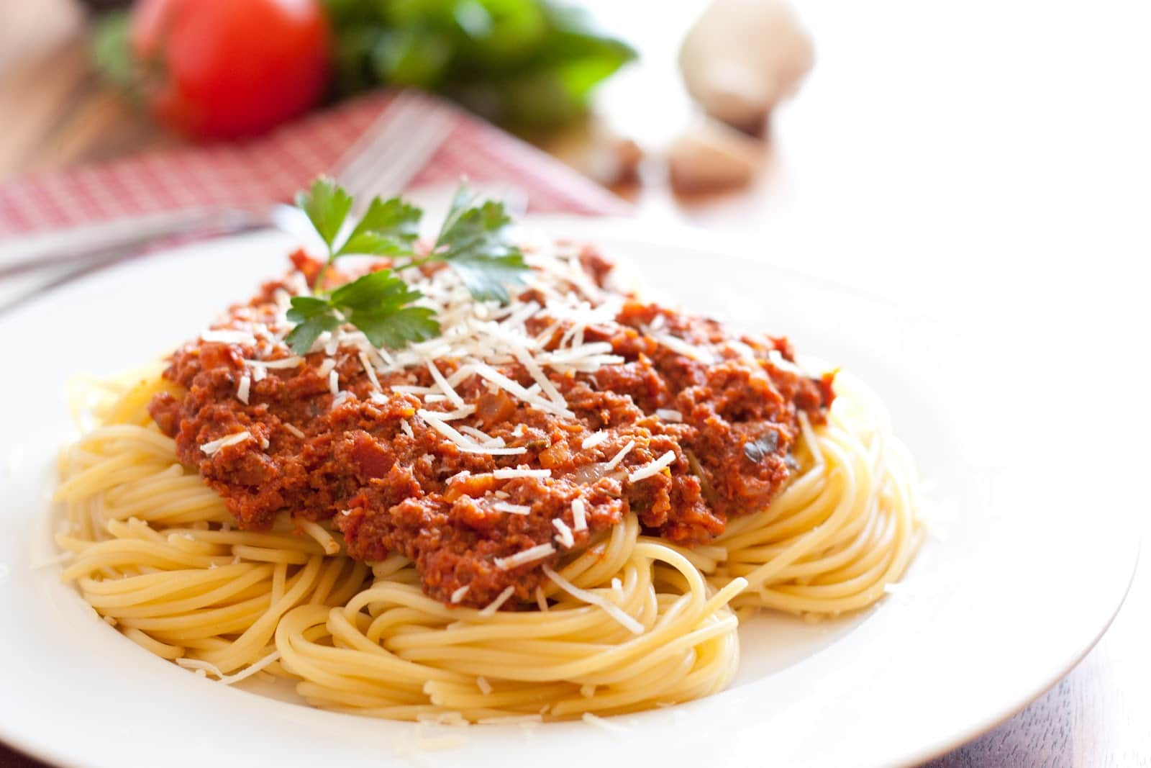
Italian Traditional Food
Pizza is one of the most well-known food in the world. There is no country which has not heard of or tasted it.
Pasta is also very famous all around the world and its homeland is Italy.

Slide 6
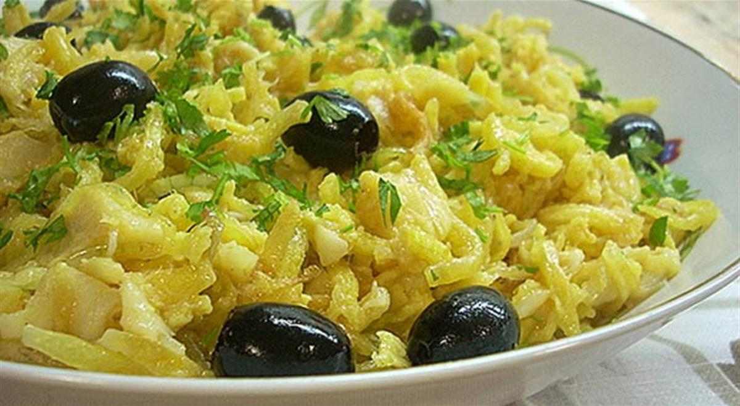
Portuguese Traditional Food
It is a combination of Bacalhau cod pieces mixed together with eggs and olives in a delicious twist of flavours.
Carne de Porco à Alentejana is one of the most traditional Portuguese dishes found on the menus of Portuguese restaurants throughout the world.

Slide 7
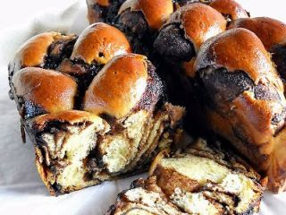
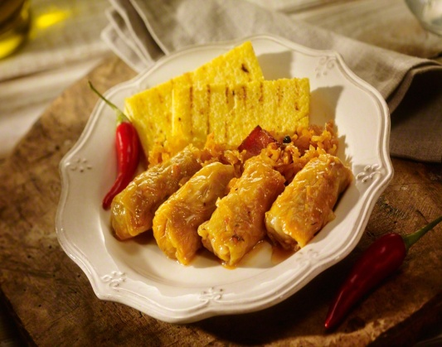
Romanian Traditional Food
Traditional Romanian Cabbage Rolls are made with sour cabbage stuffed with pork and beef and a little bit of bacon, the best cabbage rolls you will ever have.
The traditional Romanian dessert is ‘cozonac’-plum cake, a kind of cake which may contain, according to the personal preference, nuts, raisins, Turkish delight and cocoa.

Slide 8
Turkish Traditional Food
"Kebab" is a category of food which is typically Turkish dating back to the time when the nomadic Turks learned to grill and roast meat over camp fires.
Baklava comes in numerous shapes, sizes, and flavours. Flaky layers of phyllo dough, stacked and brushed with butter and sugar syrup, and then cut into various shapes.

Slide 9
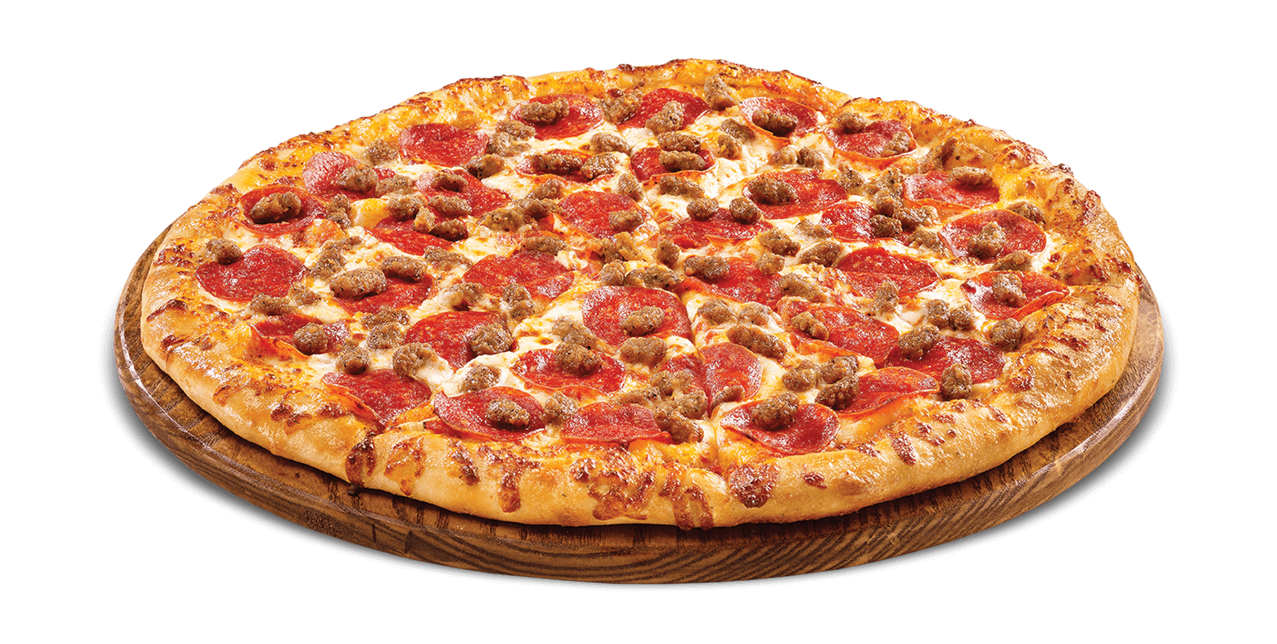
Turkey and Italy have a dough-made traditional food such as pasta and pizza for Italy and Pide and Simit for Turkey. Several traditional food of Italy has already become international, whereas Turkey`s dough-made food are not that popular all around the world. Romania, Greece and Portugal also have some traditional dough-made food, but they`re also not as popular as Italian ones.

Slide 10
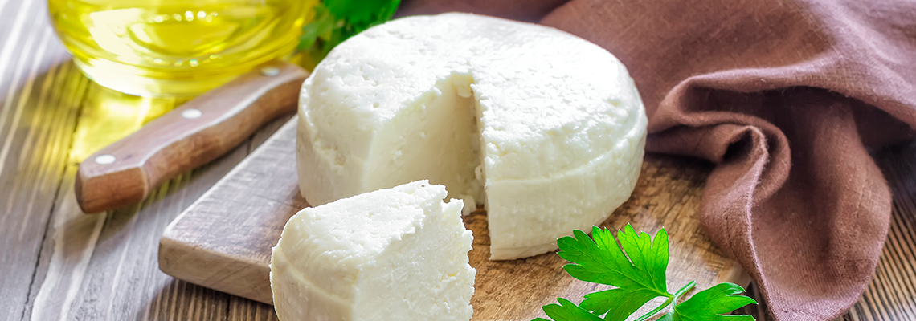
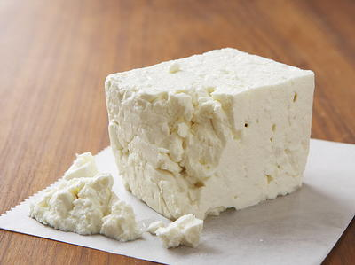
Portugal and Greece share common traditional cheese which is called Queijo Fresco in Portugal and Feta in Greece. They both use any kind of milk (usually goat milk) in order to produce cheese. Although these varieties of cheese are very popular in Portugal and Greece, they haven`t become that popular worldwide.
Romania, Turkey and Italy don`t have any traditional cheese which is similar to the one mentioned above.

Slide 11
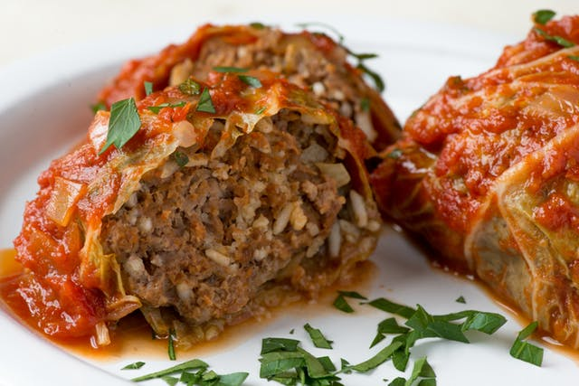
“Cabbage Rolls” is one traditional dish that Turkey, Romania and Greece share in common. Although these are considered regional dishes of the aforementioned countries, still most of the Balkans and Middle East countries include it in their diet. But it has not become an international food yet. The ingredients are different in each country, but in all of them, there is a common recipe in which meat, rice and herbs are added inside it.

Slide 12
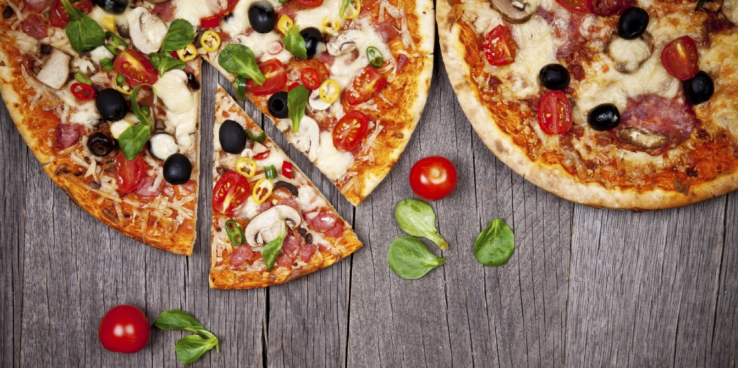
International Food in Portugal, Italy, Greece, Romania and Turkey
Pizza is an international food that is popular all around the world. It`s an Italian traditional food and it is eaten in most of the countries in the world.

Slide 13
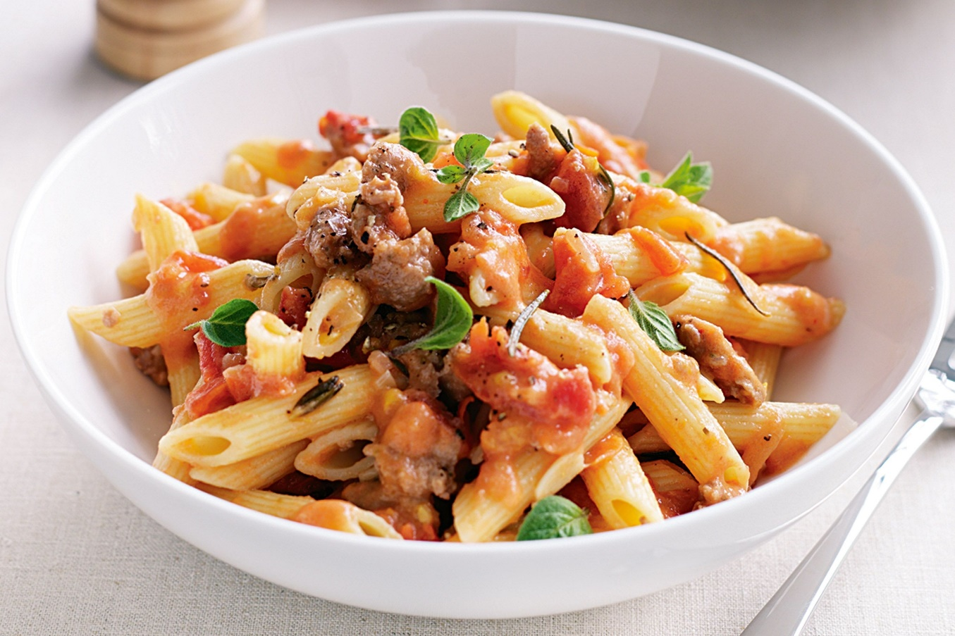
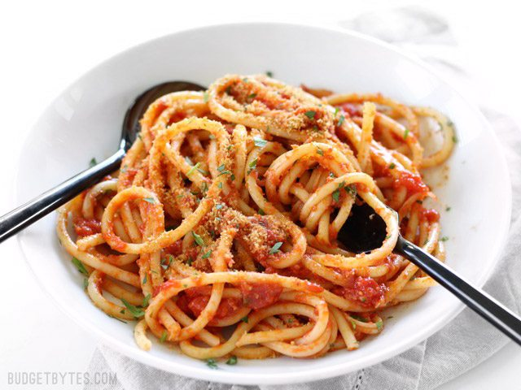
Pasta is also an Italian traditional food which is very popular worldwide. It is in various kinds, and every country has a different version of it. The most popular one is spaghetti and it is usually combined with various sauces or other types of food.

Slide 14
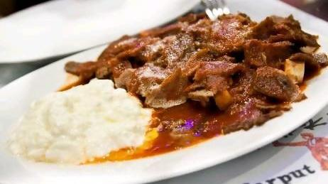
Kebab is the most-known international food coming from Turkey. It tastes in a different way in each country. There are various versions of it and the most popular one is “Doner Kebab”. It is usually made of chicken and beef.

Slide 15
“This project has been funded with support from the European Commission. This publication reflects the views only of the author, and the Commission cannot be held responsible for any use which may be made of the information contained therein.”

