Slide 1
FATIMA HOSPITALITY SCHOOL
EMPLOYMENT OPPORTUNITIES IN PORTUGAL

Slide 2
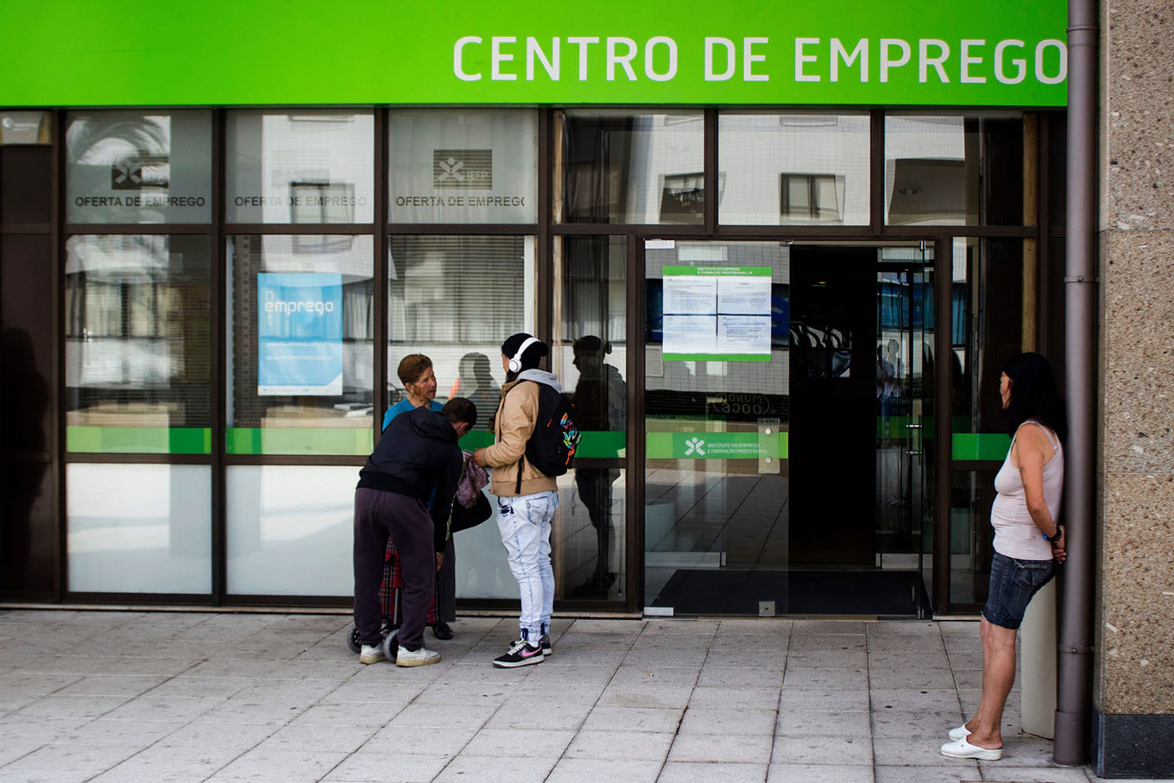
FATIMA HOSPITALITY SCHOOL
Employment state
We’re going to start talking about the portuguese employment situation. Then we’re going to focus on the centre region and finally in the municipality of Ourém, where our school is located.
Notes:
Contextualizar o que vamos falar Portugal-centro-ourém

Slide 3
FATIMA HOSPITALITY SCHOOL
Statistics of Employment
It took 10 years for the recovery of the Portuguese economy to consolidate after the financial crisis and severe debt that began in 2008.
Despite this positive development, the quality of employment and wages remain low, even if statistical studies say that the unemployment rate in Portugal has decreased.
Notes:
Contextualizar o que vamos falar Portugal-centro-ourém

Slide 4
FATIMA HOSPITALITY SCHOOL
The employment in Portugal in 2018
In 2018 employment in Portugal was marked by a more inclusive hiring, because the companies started accepting and appreciating different age groups from the ones they have accepted so far, that is older people started to be appreciated and valued for their knowledge and experience.
Notes:
Contextualizar o que vamos falar Portugal-centro-ourém

Slide 5
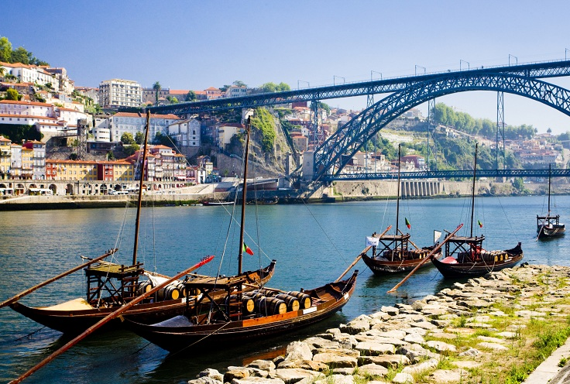
FATIMA HOSPITALITY SCHOOL
Lisbon and Oporto are the areas where there are more jobs opportunities
The cities of Lisbon and Oporto have the largest number of jobs offers, although it is where competition from other candidates is greater.
Notes:
Contextualizar o que vamos falar Portugal-centro-ourém

Slide 6
FATIMA HOSPITALITY SCHOOL
Principal employer areas
Calculations show that the sector where there was more employment in Portugal was education. Trade appears in the next position, followed by health-related activities. In addition, tourism, information technology and engineering are also increasingly offering employment opportunities.
Notes:
Contextualizar o que vamos falar Portugal-centro-ourém

Slide 7
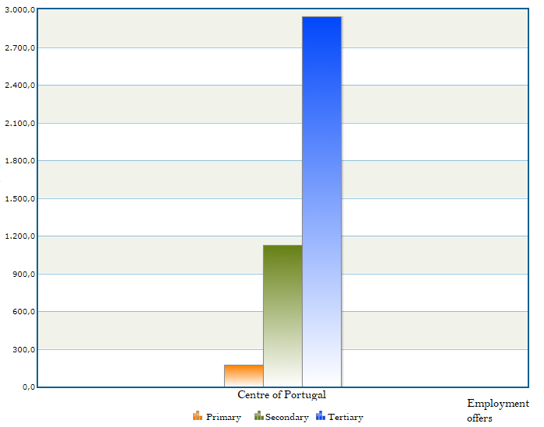
FATIMA HOSPITALITY SCHOOL
The employment in Portugal in 2018
The employment offers predominate in the tertiary sector, with 69% of the offers, being the primary sector the least employer, representing only 4% of the available employment.
69%
27%
4%

Slide 8
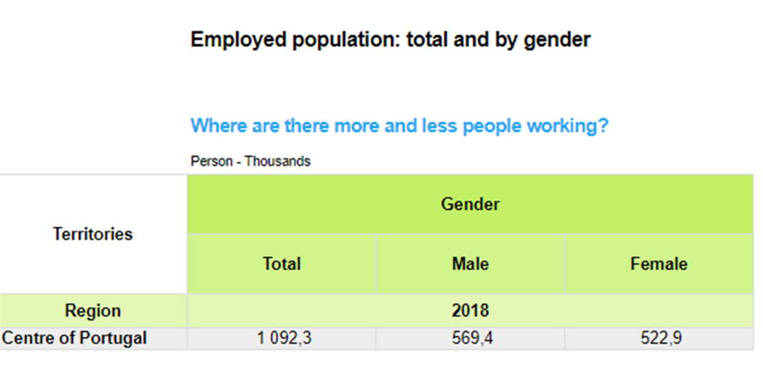
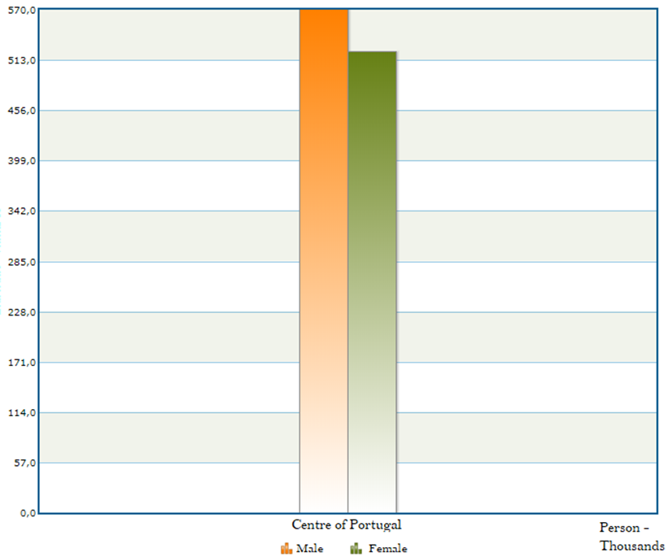
FATIMA HOSPITALITY SCHOOL
The employment in the Centre of Portugal in 2018
In a total of 1092 thousands of employed people in the Centre of Portugal, the majority are men even if the number of employed women is evoluting.
52%
48%

Slide 9
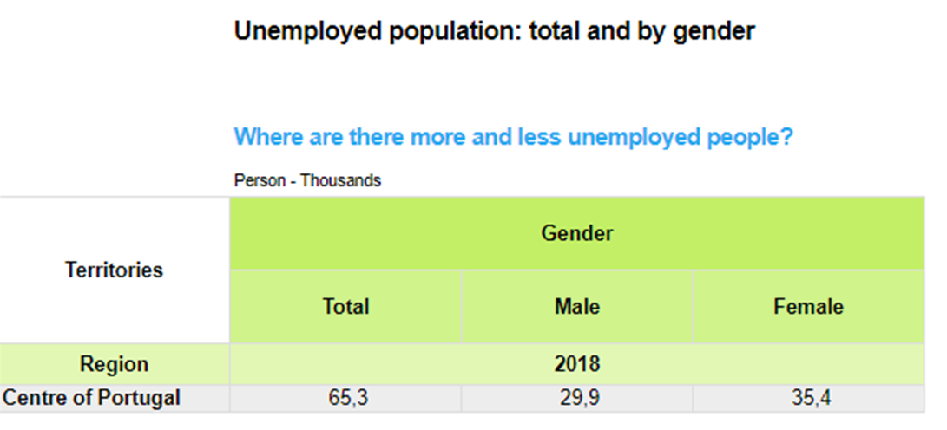
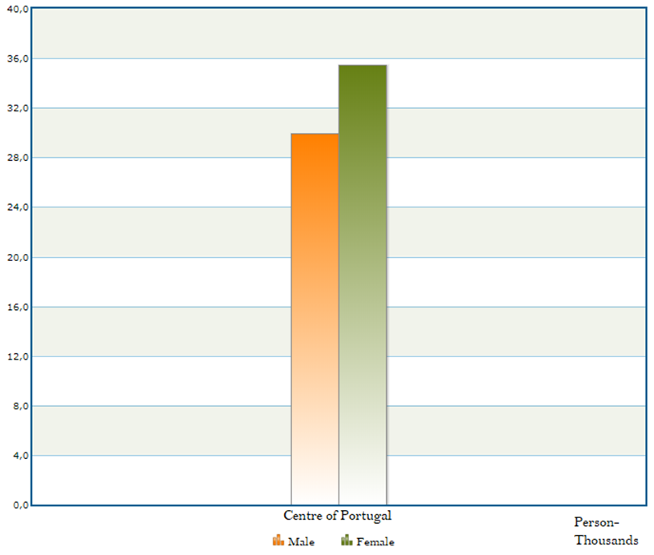
FATIMA HOSPITALITY SCHOOL
The unemployment in the Centre of Portugal in 2018
We can verify that there are more unemployed women because of some reasons. One of them is the bankruptcy of the factories where they have always worked and the difficulty in getting a new job due to their age.
54%
46%

Slide 10
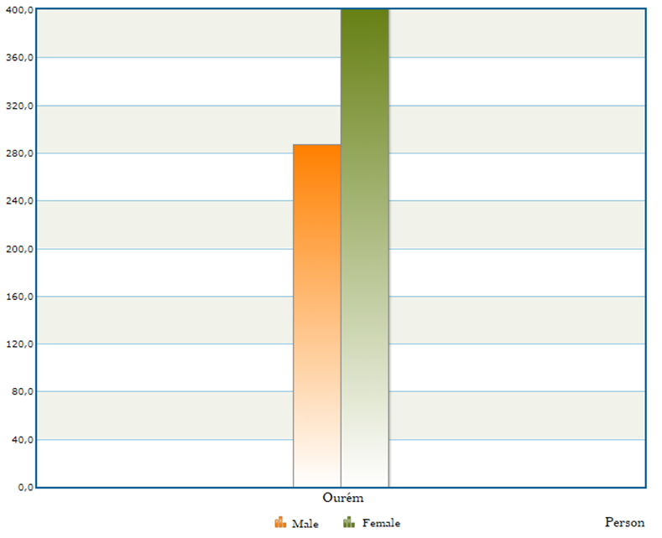
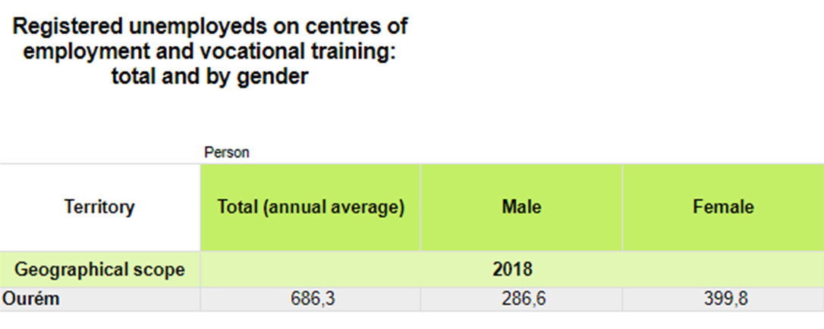
FATIMA HOSPITALITY SCHOOL
The unemployment in Ourém in 2018
Like in the rest of the region and the country, the women of the municipality of Ourém stand out in relation to men for presenting an higher unemployment rate.
58%
42%

Slide 11
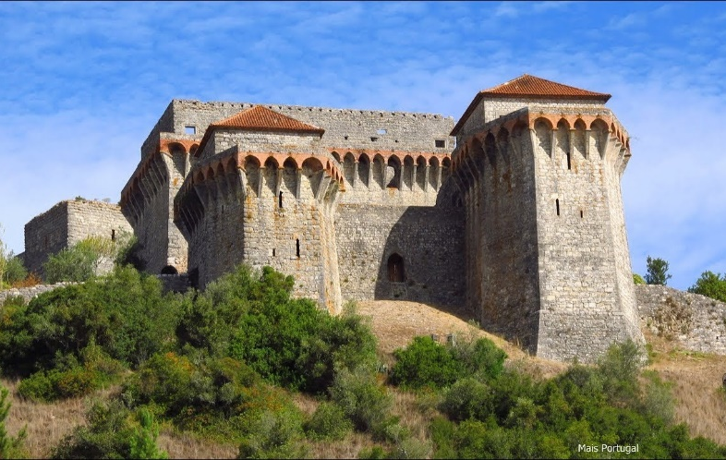
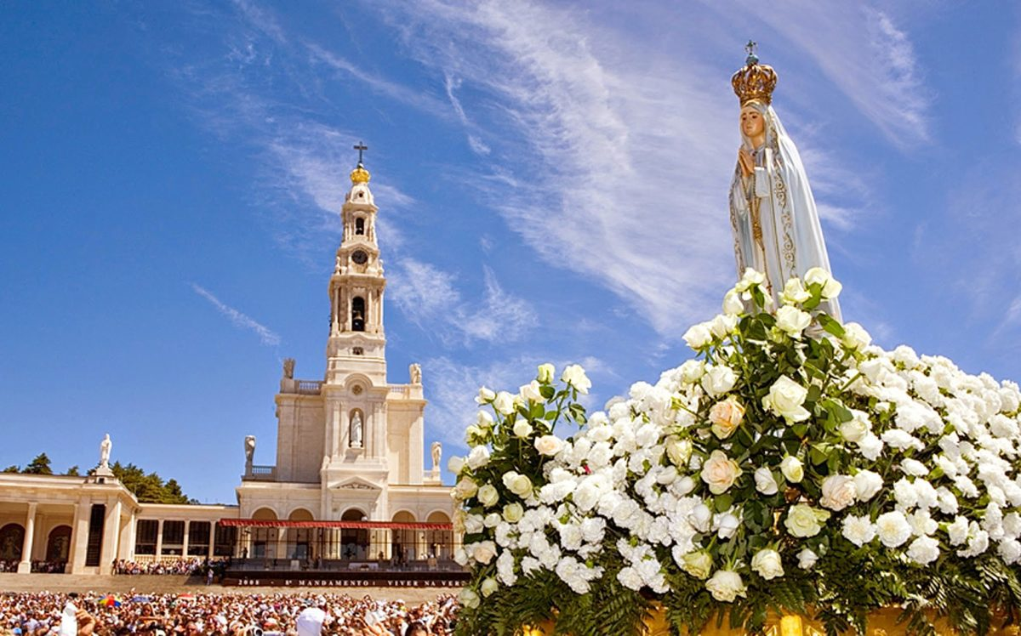
FATIMA HOSPITALITY SCHOOL
What did we conclude?
We conclude that even though the unemployment rate in our municipality and our country is increasing, men still are more employed than women, even if the statistics are evoluting with the time.
Besides that, we see that the employment market in Portugal is developing positively, with more available vacancies and diversity of offers.
Notes:
Contextualizar o que vamos falar Portugal-centro-ourém

