Slide 1
Study on the environment between consumption and jobs
ERASMUS+ PROJECT
Youngsters Nowadays. Where from, Where to?

Slide 2
The world is
changing
Since the beginning of his life on Earth, man has been able to modify the environment by exploiting it in all likely ways. The excessive lack of interest, accumulated over the years, against flora and fauna has caused serious problems for the planet. Today new solutions are being sought to face pollution and even the labor market is affected.

Slide 3
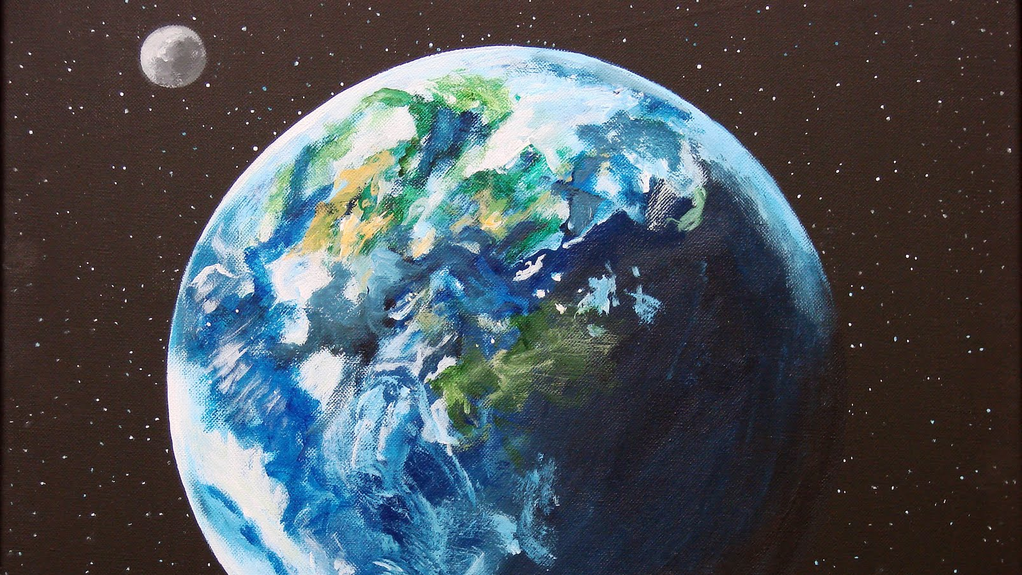
Saving the planet requires not only great cooperation among states, but also a serious information and awareness policy that involves everyone.
After the Second World War in many countries living conditions improved a lot thanks to a notable increase in production. The so-called economic “boom” led to the birth of a society based on consumerism. Consumerism today is a phenomenon that distinguishes all the most developed and industrialized countries. It consists in the desire to always grab new goods and consumer products. The price to pay for this welfare is the deterioration and the ever greater pollution of the environment in which we live. The global temperature given by the continuous emissions of CO2 increases constantly causing the melting of the glaciers and the raising of the waters. The oceans are full of plastic and garbage and the desertion due to deforestation is destroying entire biological ecosystems.

Slide 4
Renewable energies:
Fuels like oil and gas that we currently use to produce energy are the main causes of pollution due to their emissions of harmful substances, so we are constantly looking for alternative sources of energy. We have to invest in Renewable Energies, they not only fight pollution but also offer new areas of research and new jobs.
Solar Energy
Hydroelectric Energy
Wind Energy
Geothermal Energy
Biomass Energy
It is the form of energy produced by the sun.
Solar energy can be used to generate electricity (photovoltaic) or to generate heat (solar thermal)
It is generated by the pressure force of the water itself, through a generator that transforms kinetic and pressure energy into electricity
It is wind energy, or the kinetic energy of a moving mass of air. It is possible to exploit this energy thanks to the use of wind turbines that produce electricity
Geothermal energy is a form of exploitable energy that derives from the heat present in the deeper layers of the earth's crust
It is produced from waste materials of organic origin, through combustion.

Slide 5
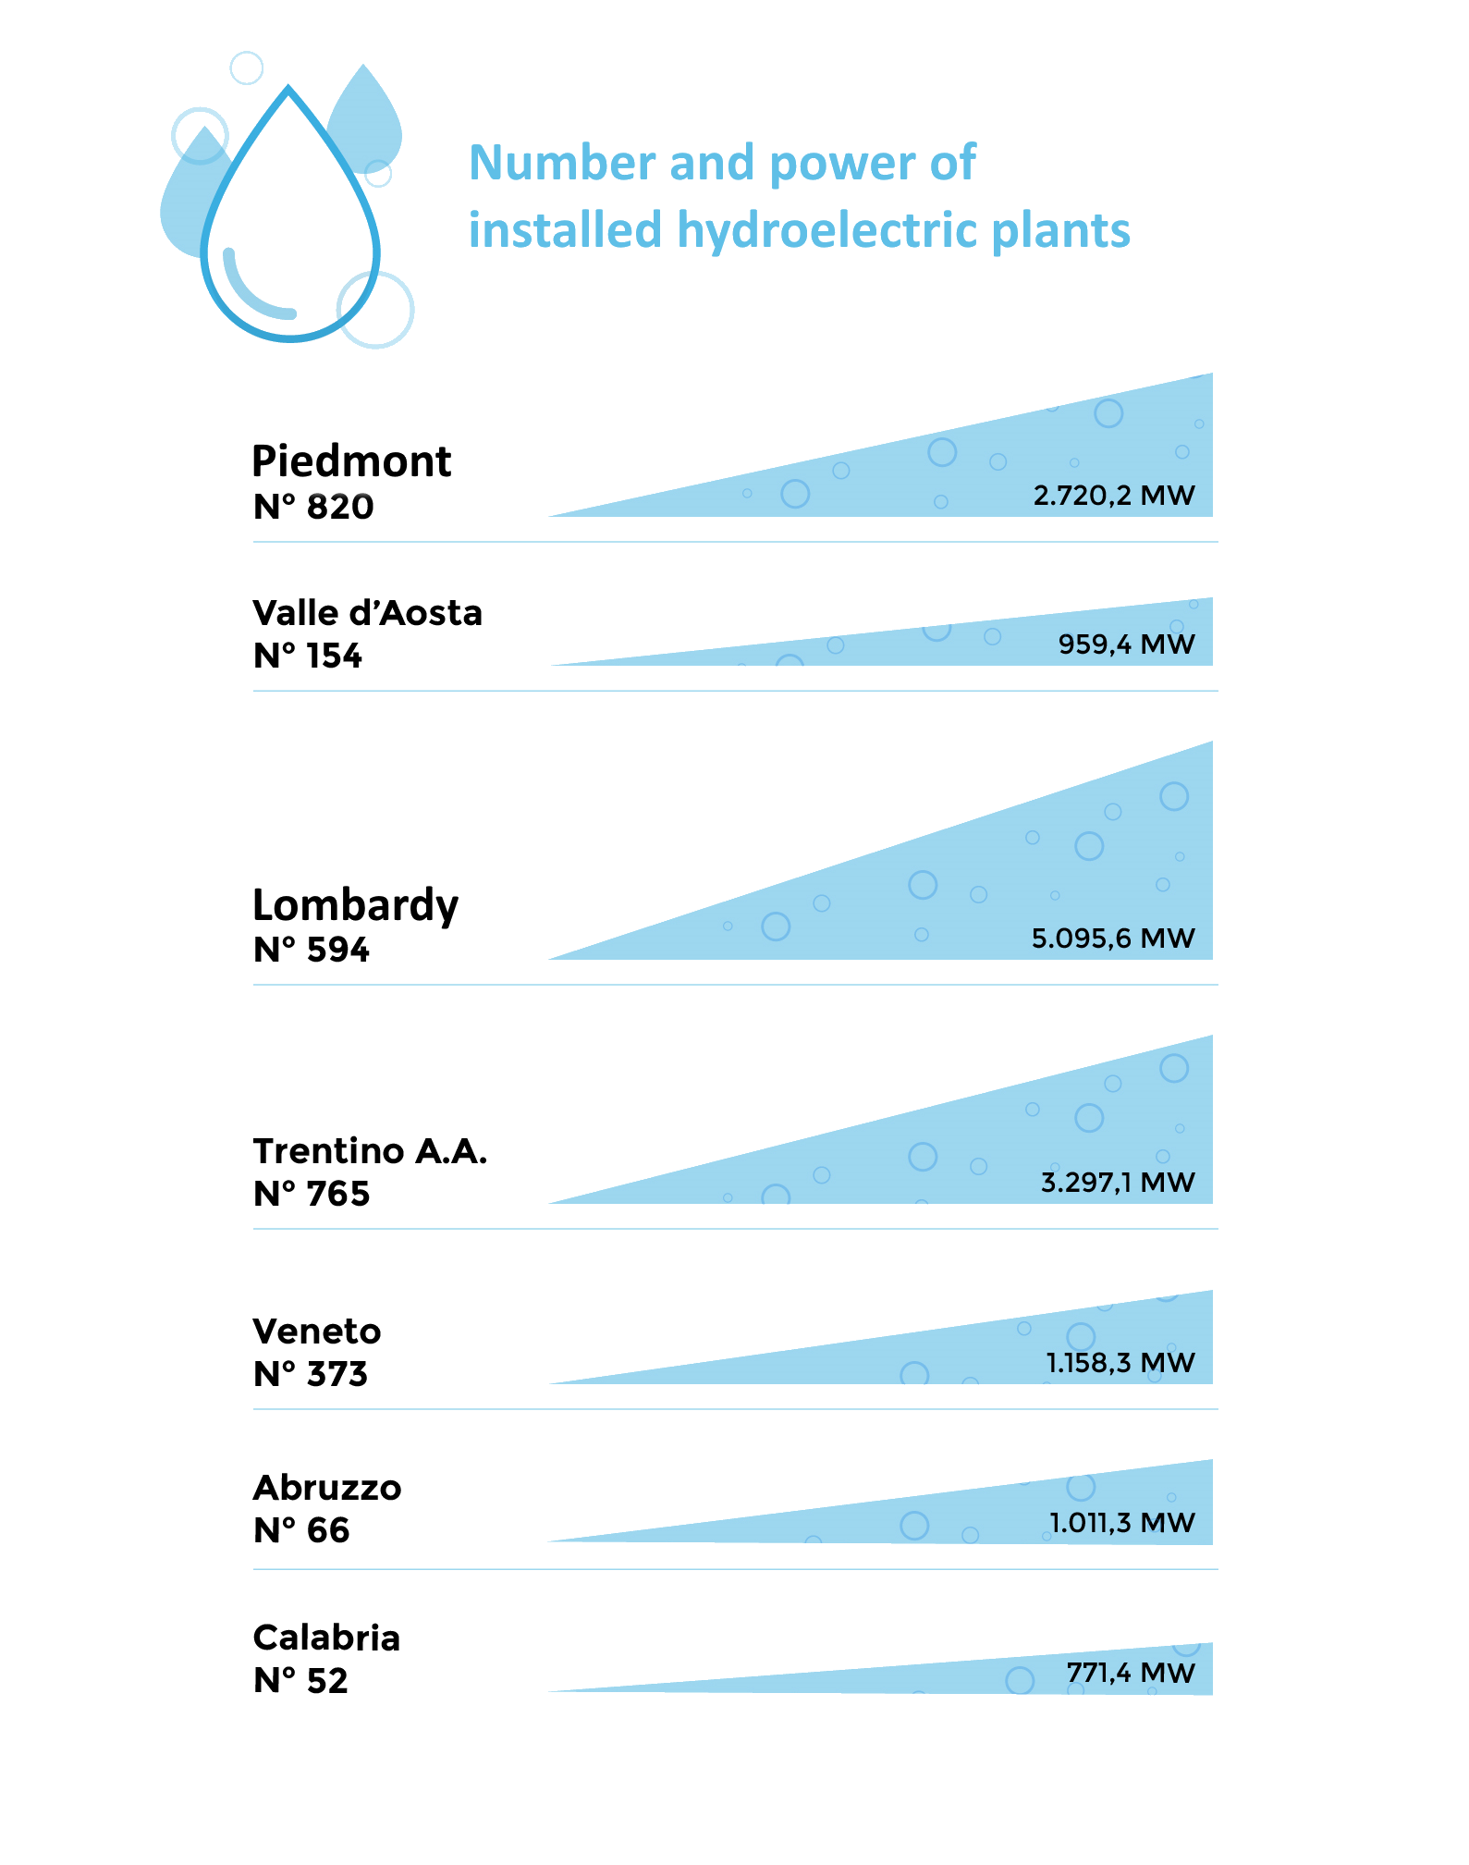
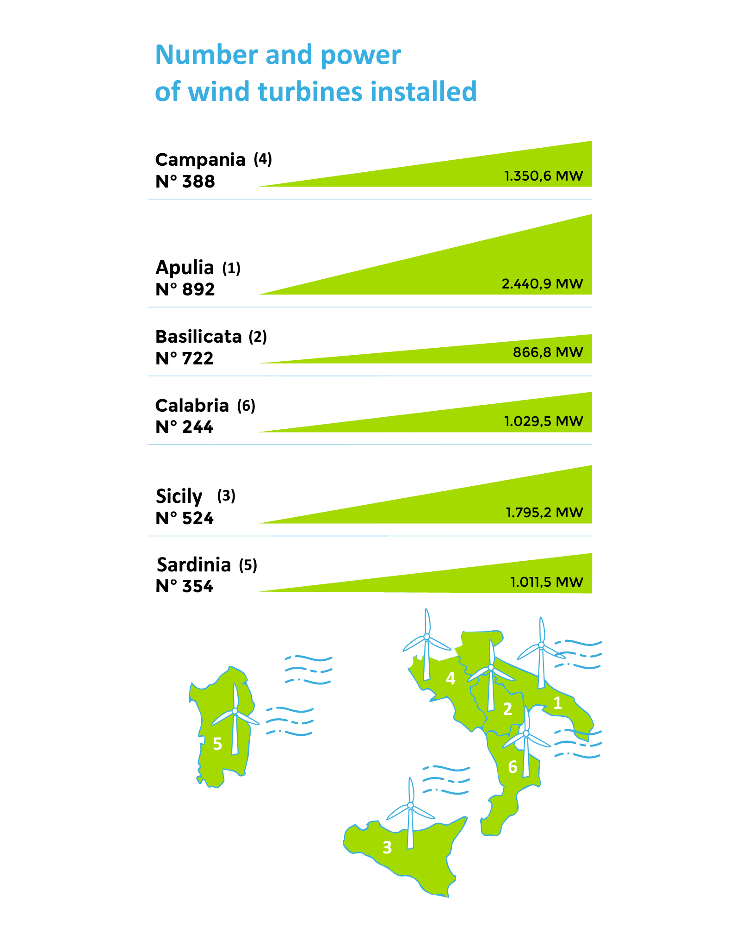
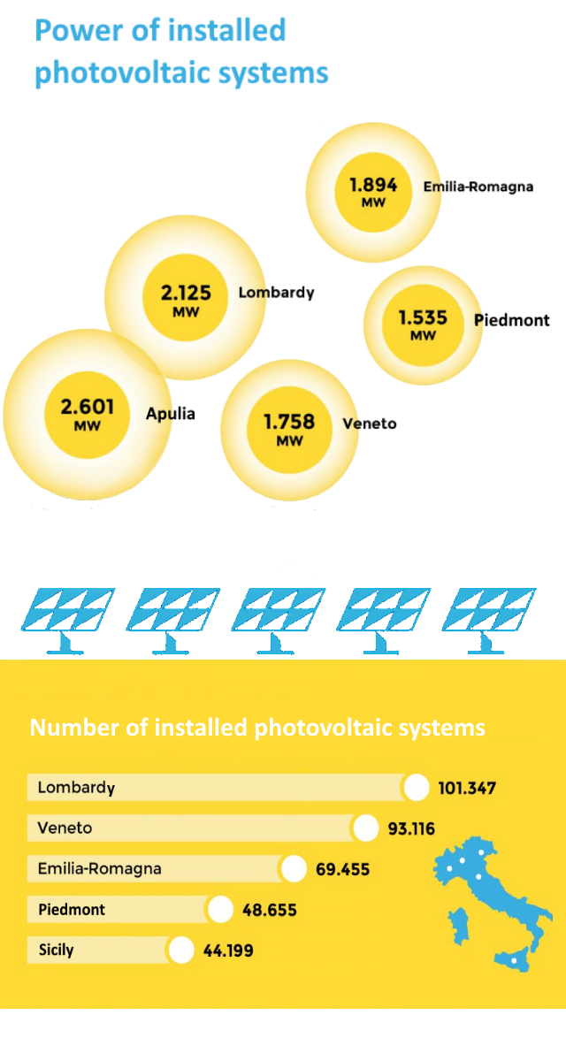
Renewable Energy Sources in Italy:
Even if there is always the possibility of improving, Italy is currently at the top of the renewable energy system.

Slide 6
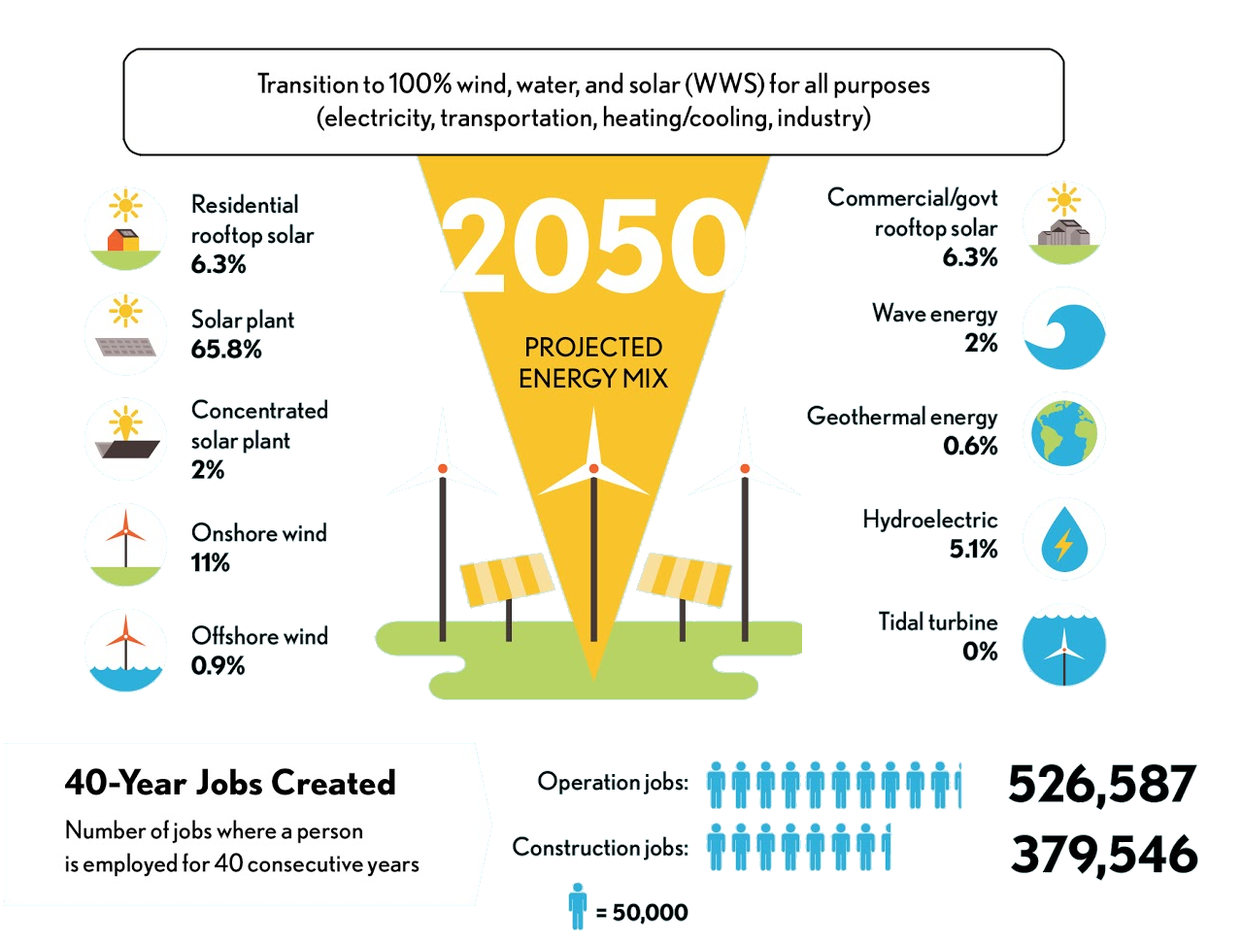
100%
ITALY
Mark Jacobson and Mark Delucchi, researchers at Stanford University, have analyzed 139 countries and have compiled a ranking of those closest to the goal of using 100% green energy by 2050. The two scholars have also hypothesized the 'perfect recipe' to reach the goal. According to the study, Italy should focus on photovoltaics.
At the moment, Italy is at 27th place.

Slide 7
In the future new expert professionals will appear and new jobs especially in the field of energy and environment with particular reference to the scope of consumption reduction will be offered.
A sector affected by this issue is certainly the building one, it will be concerned with sustainable construction all over the world. The building field is responsible for around 40% of energy consumption, emissions of polluting gases and waste production.
Moreover it is scientifically proven that meats contain pesticides and antibiotics that are harmful to humans and that livestock farms have a huge impact on the environment being responsible for 18% of emissions, (a very high percentage compared to emissions from transport, responsible for 13% of emissions, and to energy production, responsible for 26%) so a lot of scientists are looking for new less harmful methods for food production such as in vitro meat for example.

Slide 8
What are the green jobs of the future?
Conservation Biologists
Water Footprint Manager
Traceability Manager
In Vitro Meat Scientist
He deals with the traceability of consumption and expenses, controlling waste and finding solutions to avoid them..
Conservation biologists are concerned with the protection and sustainability of natural resources like air, water, land and wildlife.
He deals with water control, reducing waste and he studies the environmental impact of waste liquids.
He deals with the study of alternative food solutions for meat and in particular with the creation in laboratory without killing any animal.
Green Enginner
Energy Manager
The profile of this engineer is destined to assume a new connotation, his task is to contribute to the research and to the development of solutions for the construction and maintenance of sustainable balances.
Ecobrand Manager
He is now a mandatory figure by law for all Public Entities. He deals with the collection and analysis of data on energy consumption.
Responsible for the design, promotion and production of one or more product lines in an environmentally sustainable manner.

Slide 9
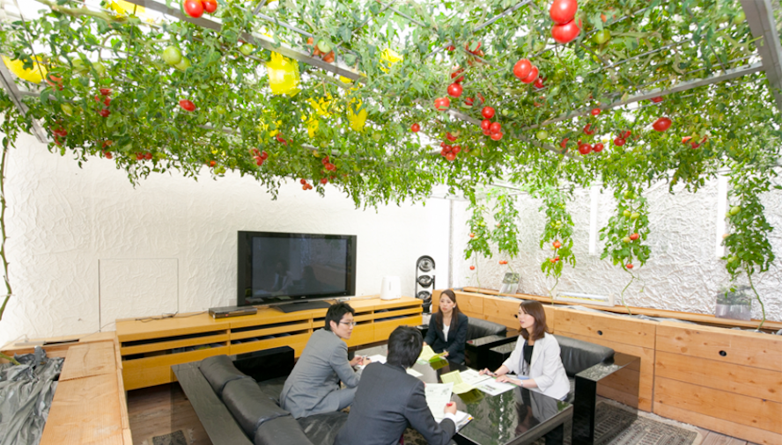
Green companies!
Today more and more companies adopt ecological solutions to intervene on environmental issues; moreover the use of renewable energy involves a considerable saving in cash for the company itself. In fact companies that use environmentally sustainable solutions are increasing and are present all over the world. This office in Tokyo is full of plants and in the picture we can see a room with a vegetable garden on the ceiling.
By improving the quality of the workplace, we also improve employees’ efficiency and we create a good image for the company itself. Finding new solutions and new ideas is the basis of an eco-sustainable company.

Slide 10
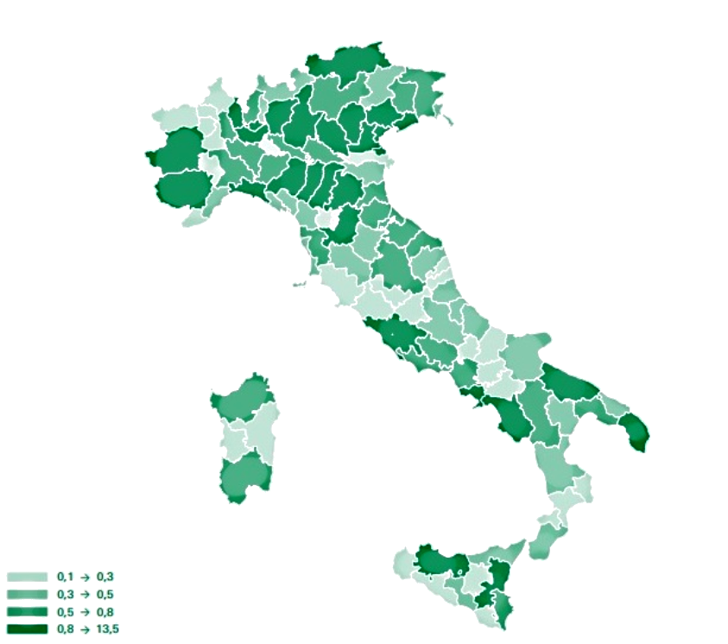
Green jobs in Italy
40%
2017
In Italy we have a high rate of unemployment; a green labor market helps to create new jobs in many sectors and offers new opportunities for young people.
«Our Italian green companies are over 355,000; 27.1% out of the total (share rises to 33.8% in the manufacturing industry); in 2017 we had 320,000 green jobs, equal to about 40% out of the total new jobs in the same year»
Units as a percentage of the total employment assumptions of Italian green companies.

Slide 11
How can a company become eco-sustainable?
Reaching goals like:
Using renewable energy
Using public transport and bicycles to get to work
Creating green areas in the work environment
The reduction of emissions
Avoiding the stand-by of technological devices
Turning off lights in empty rooms and corridors
Using low energy lighting (LED)
The reduction of energy consumption
Doing a correct waste disposal
Recycling
Using objects produced from recycled components
The reduction of waste produced

Slide 12
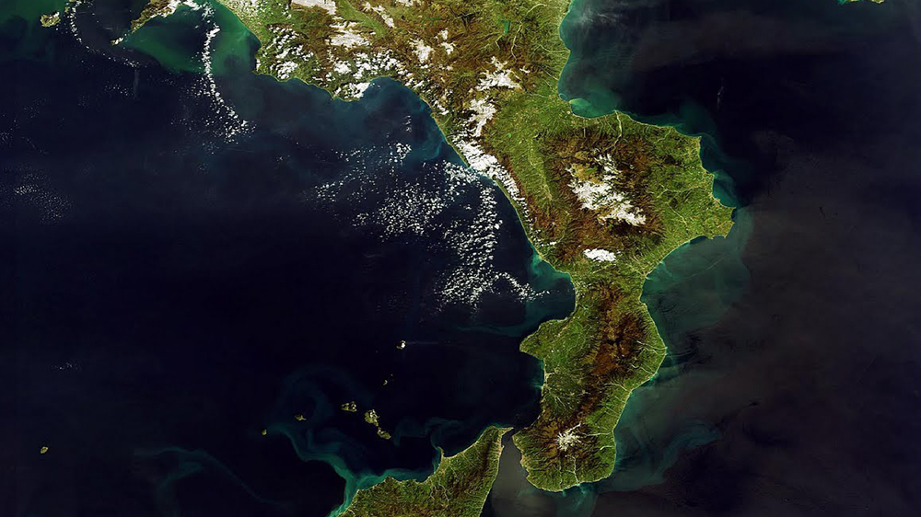
Calabria is an Italian region that unfortunately still relies on non-renewable energies such as oil (about 31.2% out of the regional energy needs) and until a few years ago even recycling was not adopted as a practice. Therefore it is a region that is slowly adapting to the future and has an incredible need for young workers, someone who invests in the Calabrian territory especially in the field of renewable energy such as photovoltaic and wind power.

Slide 13
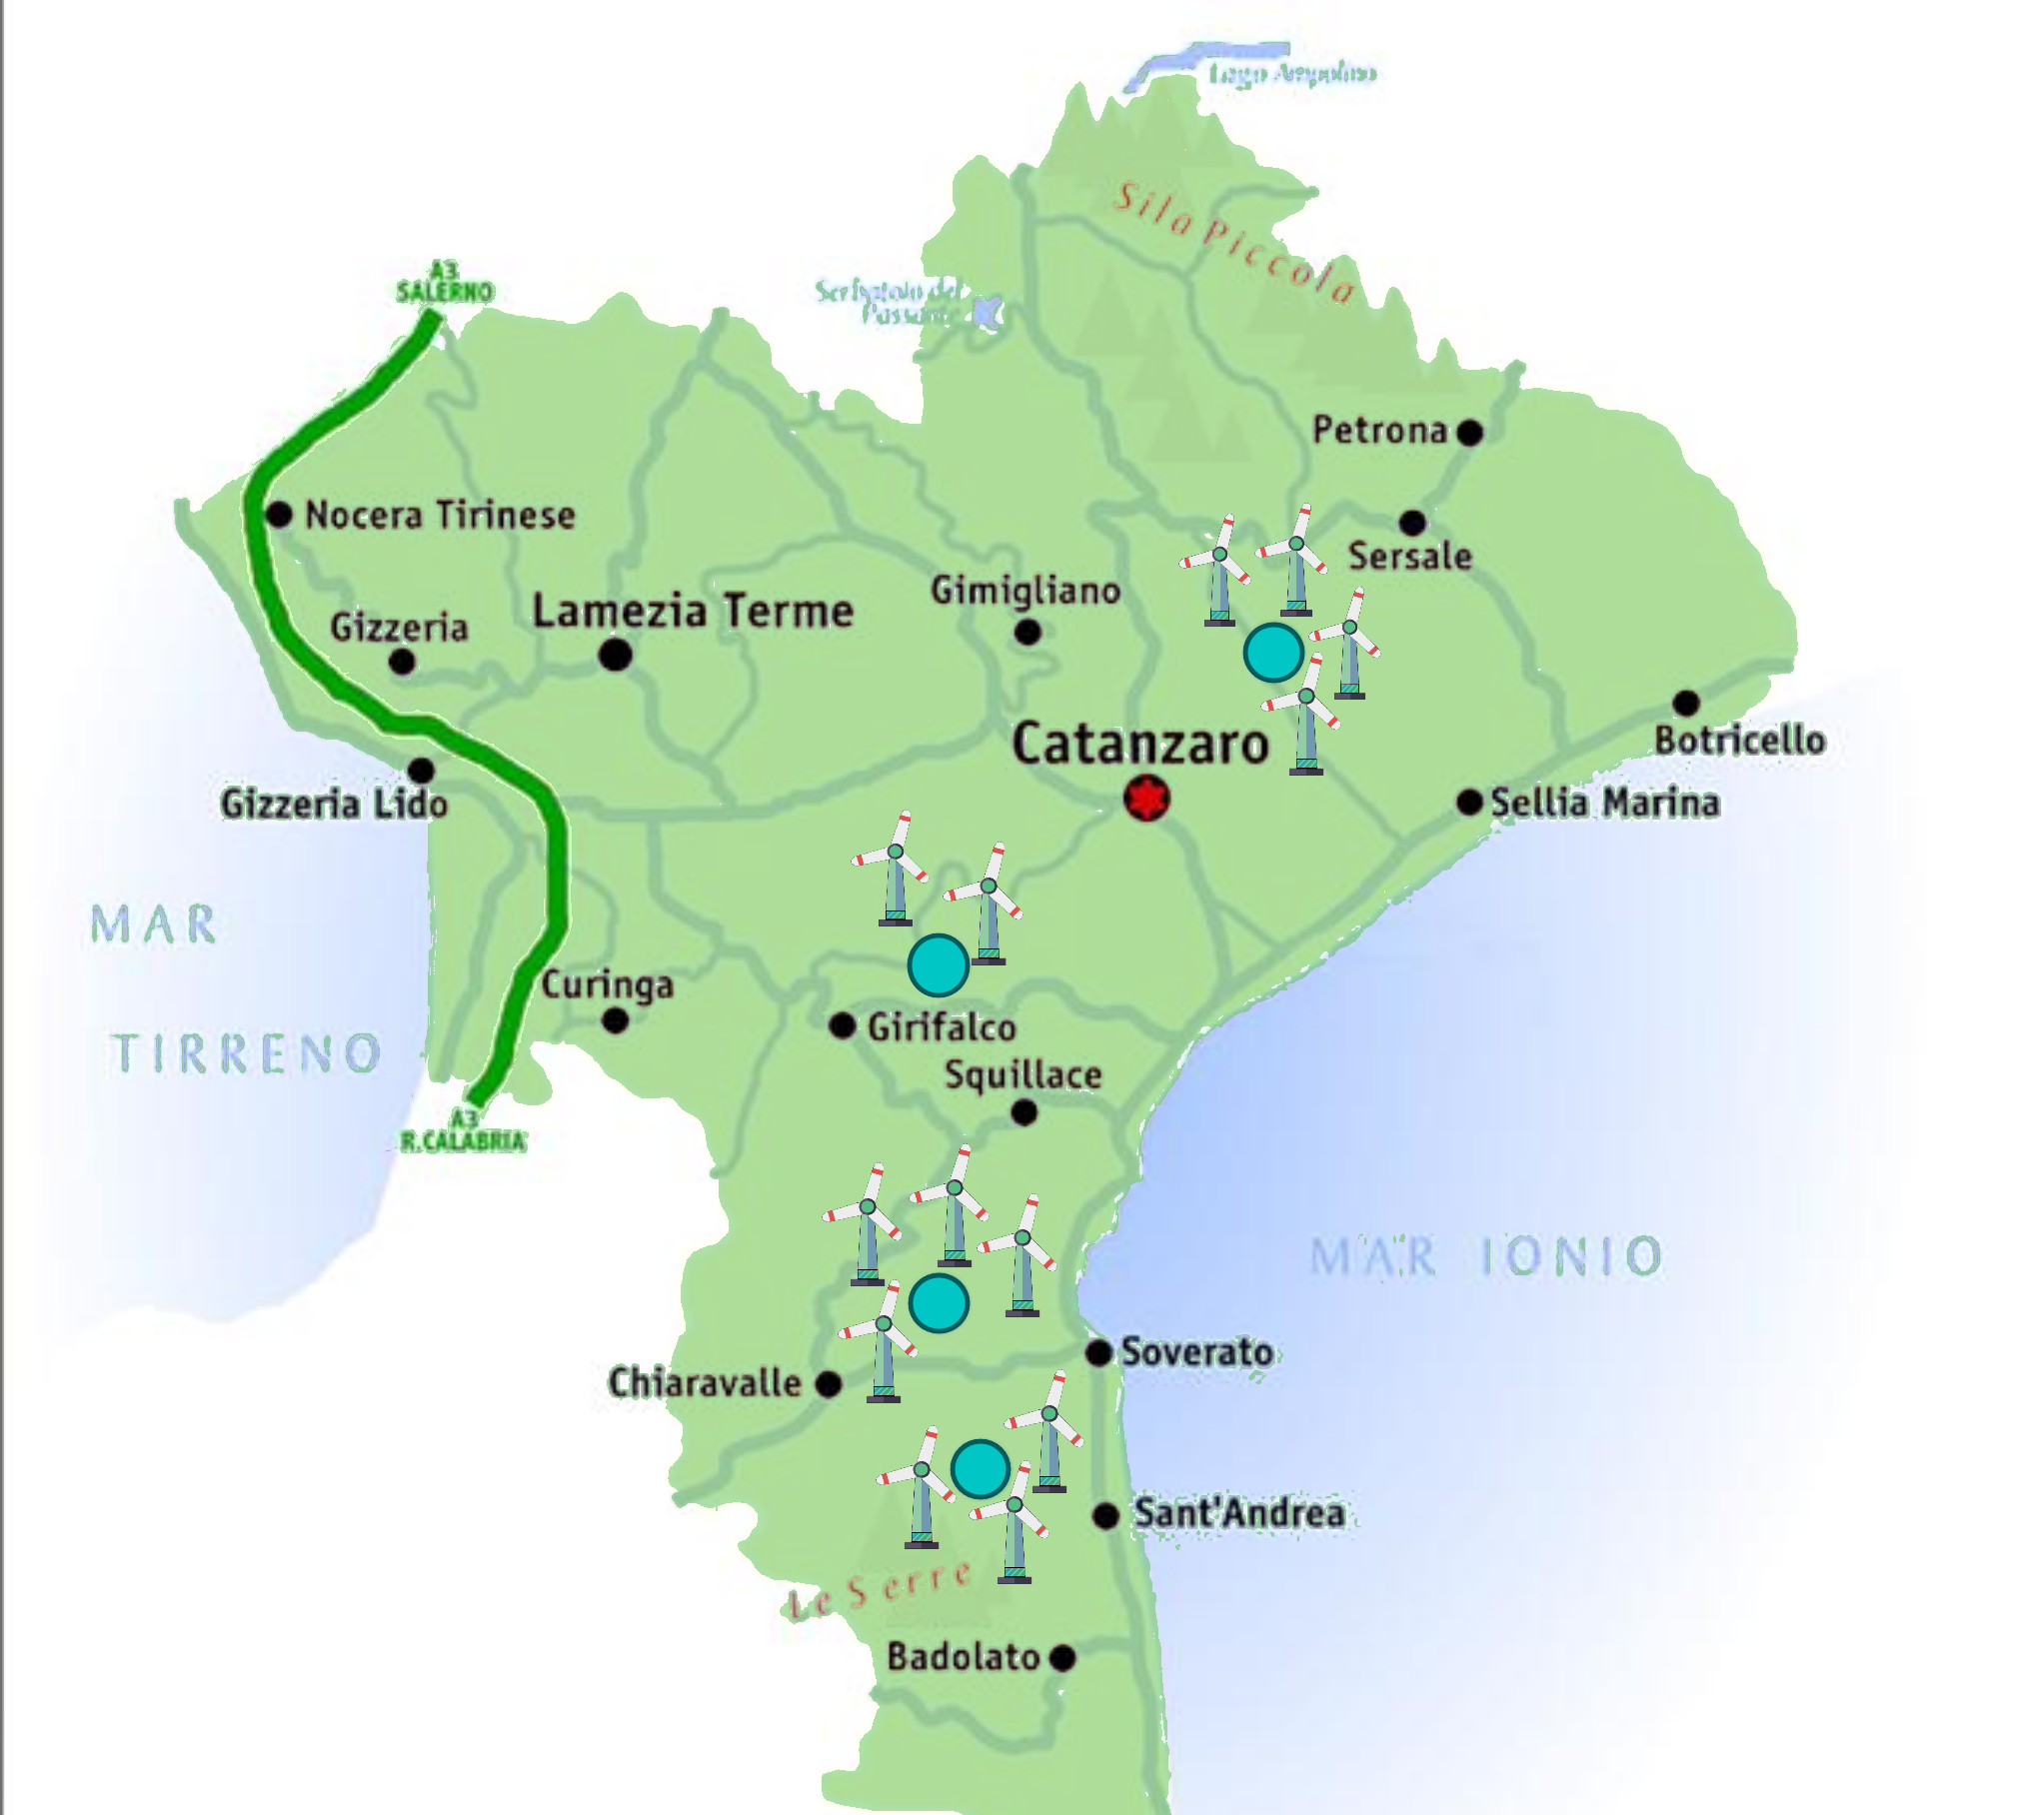
The Catanzaro area
The particular morphology of the territory between Catanzaro and Lamezia implies the constant presence of moderate winds that have allowed, on the territory, the installation of a series of wind farms. The most important ones are located in Girifalco and Sant'Andrea. More and more Calabrian companies are investing in renewable energy and between 2011 and 2017 over 8700 companies have invested in green products and technologies.

Slide 14
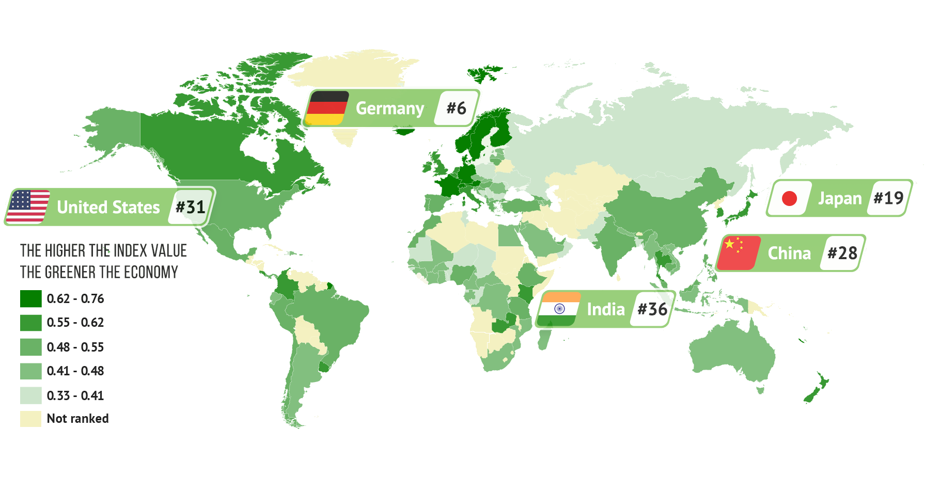
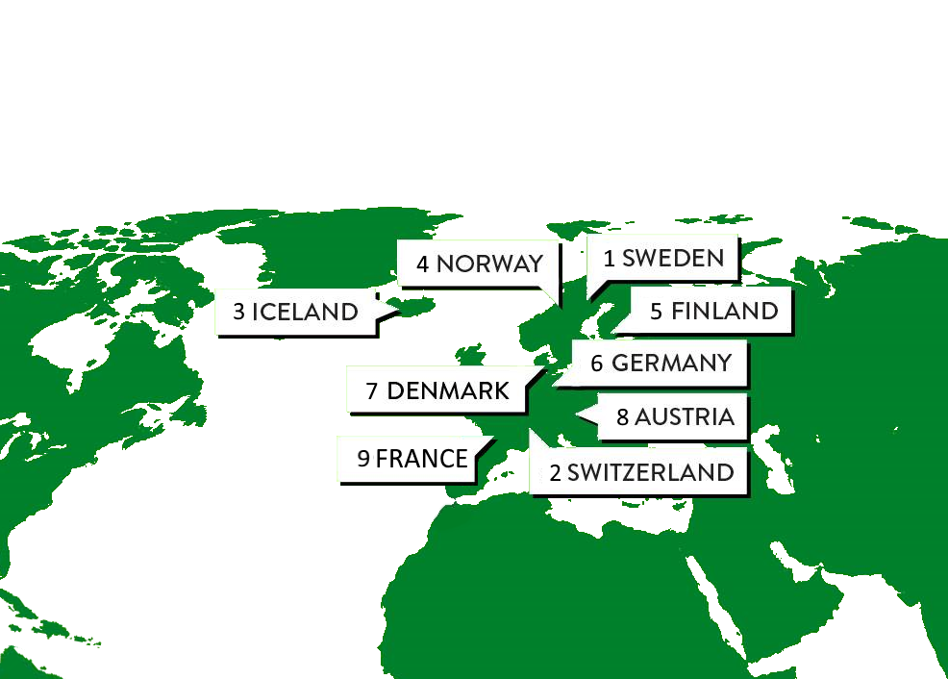
Green Global Economy Index
This is the 2018 ranking of how 130 countries perform in the global green economy, in the first place we find Sweden in the second place Switzerland and in the third place there is Iceland.

Slide 15
Thanks for watching
This project has been funded with support from the European Commission. This publication reflects the views only of the author, and the Commission cannot be held responsible for any use which may be made of the information contained therein.

