Slide 1
ERASMUS + PROGRAMME- STRATEGIC PARTNERSHIP ‘Youngsters Nowadays. Where from, Where to?’ 2017-1-RO01-KA219-037190 The Environment- Our Common Goal Part 2. CHALLENGE:SAVING ENERGY FOR ONE MONTH-
THE ROMANIAN TEAM’S EXPERIMENT

Slide 2
Saving Energy for 1 month challenge
The Romanian team has taken on “ The saving energy for 1 month" challenge and completed it . The members of the team were impressed with the results that they had obtained and wanted to share them with you . Hopefully, they've learned something from this and they challenge you to do the same !!!

Slide 3
DRAGOS C. ’S RESULTS FOR THE 1 MONTH "SAVING ENERGY" CHALLENGE
Last month I told my family that we were going to start a challenge . We wanted to see if we could live with less electricity and water (and with less I mean not to waste it). My father, mother and I did the following in that month : When we brushed our teeth we turned the water tap off , we opened the curtains more and turned off the light, we unplugged unused electronics and we dried our clothes out, naturally.
After just one month we have realized that we overuse a lot of things and waste a lot of water and energy . For example it wasn’t long until our electricity bill was a lot cheaper and that shocked us because we didn’t expect to save money in the process.
With just a little bit of research I have found out that the little things we did helped the planet a lot and if we all do them on a daily basis, our mother nature will thank and help us even more. I’m happy that we completed the challenge and I’m sure that we will continue with it for quite some time to see the good impact that it has .
My family is challenging you to do the same for at least one month to see how much you can help the mother nature .

Slide 4
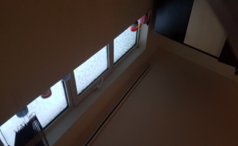
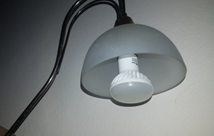
How I saved energy in one month
For me, this month wasn’t too hard to accomplish the challenge but it wasn’t that easy either. I realized how much useless energy I was using daily. At the end of the month me and my family saved about 15% from the energy bill.
First of all, I started to always turn the lights down when I'm leaving a room even if it's a small one. Also, we replaced some light bulbs in the house for some that consume less energy.
I always left the curtains open during daytime and tried to use natural light as much as possible
I tried to keep the doors and windows closed as much as I could so I could keep the rooms warm for longer.
I turned off the tap if I didn’t use it . And that made a big difference in the amount of water we used in one month.
-Mihaela

Slide 5
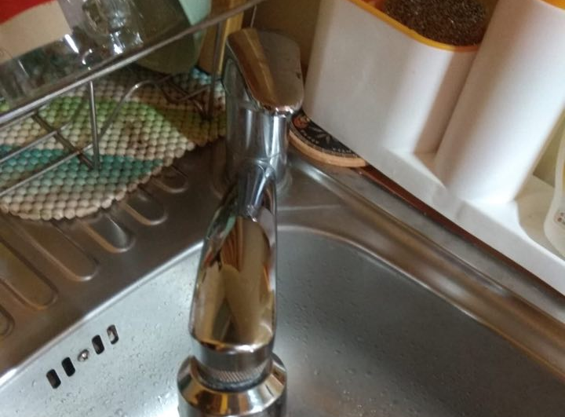
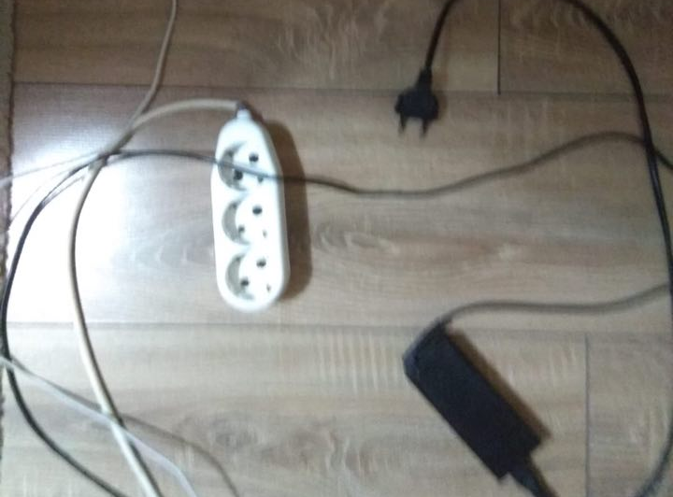
How Emma took the challenge
Means of saving energy
The challenge I had to deal with during one month “ saving energy at your own home” was not only a mandatory task I was supposed to accomplish, but also more as a self-awareness stimulus towards how simple and efficient means of suppressing energy at my home exist.
I handled this by some easy actions, such as: always turning off the lights whenever I left a room, closing the water tap when I was brushing my teeth, using an economic bulb, disconnecting the chargers devices when I did not use them on purpose in order to save electricity, deploying a water saver.
These really proved productive and useful, since the results did not appear slow .
Therefore, I would definitely recommend this ‘challenge’ to anyone willing to make a beneficial change related to both environmental point of view and financial

Slide 6
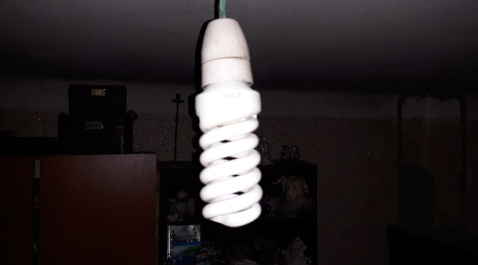
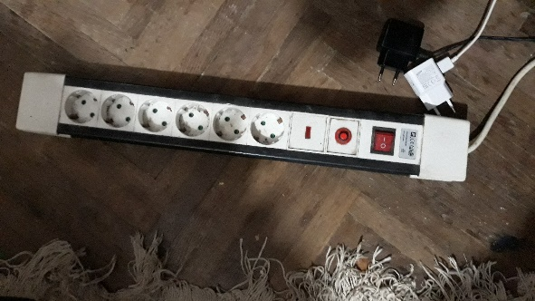
In the last month, my family and I have been trying to save energy through several methods.It was not difficult at all. Without effort we managed to save energy and to reduce pollution.The mothods we used were: 1. When we were not at home, we turn off the lights. We did this to save energy. Another way to save energy was to change the conventional bulbs to economical lightbulbs. 2.For saving water we turned off the tap when we brushed our teeth. The second thing we did to save water was that we took showers instead of baths.3. When washing clothes my family and I selected the shortest washing cycle for the washing machine and we turned on the washing machine only when it was full to save energy and water. When it come to drying we dried the washed clothes outside naturally. 4. To save energy when the weather permitted us we opened the curtain facing the sun to let the natural light enter. With this method we save energy and we also protect the planet because we save the electricity that lightbulbs use. This is how I saved energy and it is not difficult at all , anyone can do it.
Dragos H. "1 month Saving Energy challenge"

Slide 7
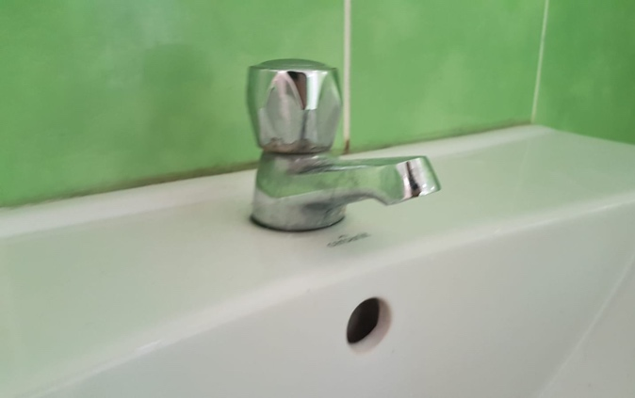
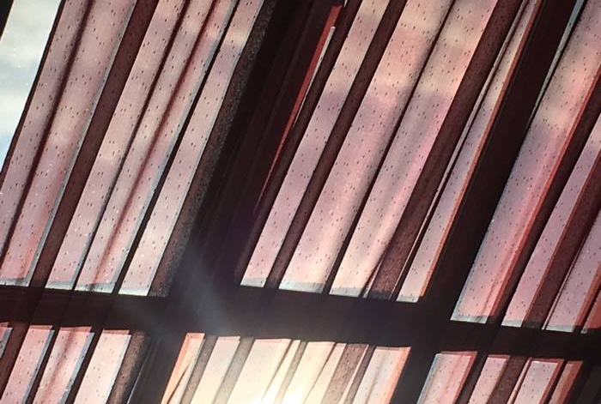
How Cristina and her mother saved energy
My mom and I took on the challenge and decided that we wanted to reduce the cost of our bills and also to see if we could save energy in a pleasant way, so we made a plan.
First of all, we started with something easy to do. We put lids on our pots while we cooked, we open the curtains in the morning to use the natural light instead of using the lightbulb.
We unpluged all the devices that we didn’t use and that was really challenging for us, because we hadn’t done it before.
After that, we moved on to something more efficient. I replaced all of the old bulbs with some LEDs. My mom changed the shower head with a low-flow one and she was so motivated to save as much energy as she could, that she defrost all the food that we needed naturally, without using the microwave.
At the end of this month we save almost 25€, which I think is impressive if we think about the effort that we had made.

Slide 8
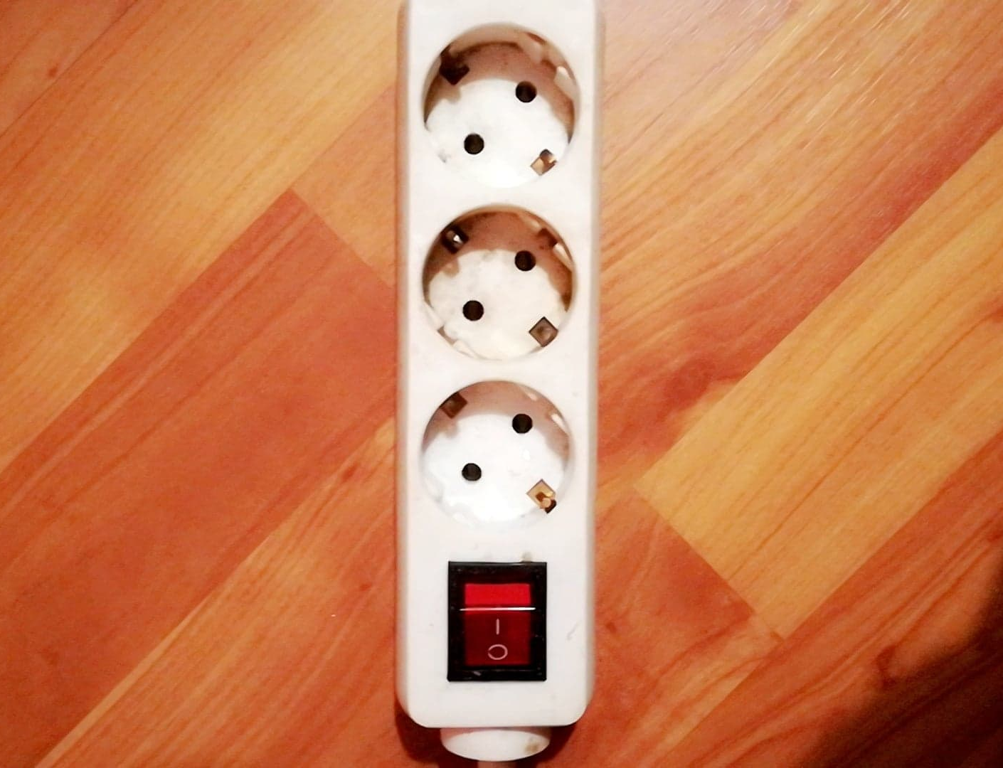
How I accepted and finished the 1 month’s challenge.
Saving energy is something we should all do, for the sake of the environment. This period was a bit difficult for my family, as we are not used to saving much energy, but we managed to get through it.
We turned off the lights every time we left a room, which helped with saving electricity.
By closing the tap water while brushing our teeth and instead of taking long baths , we had short showers.
We also saved electricity by turning off the extension cord every time we didn't use it.
We avoided leaving the computers or TVs on stand by, and turned them off anytime we didn't use them for a long time.
-Andra

Slide 9
Saving Energy
The task itself was quite difficult, as we were not used to saving energy at all, but we managed to fulfill it without too much trouble and it turned out to be fun, while also beneficial.
The first thing me and my family did was trying to keep the curtains opened in order to get more energy from outside, instead of using the lightbulbs.
Water usage significantly decreased, as we started closing the tap water when we brushed our teeth and during baths.
We also took showers, not long baths, in order to reduce the amount of water we used.
The windows were closed all the time, in order to save heat and to reduce the time the heating machine was used.
Electricity was saved as well, as we closed the lights all the time we left a room and avoided leaving the Computer/TV on all the time.
-Eduard

Slide 10
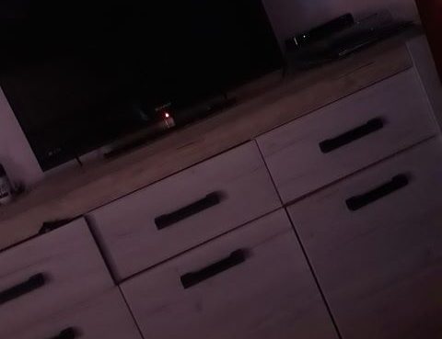
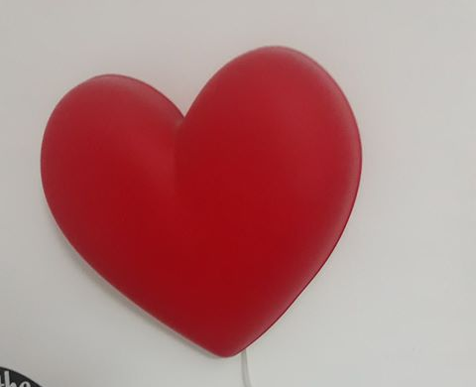
How Danina finished the 1 month’s challenge
During a whole month, my parents and I decided to accept this challenge and try to save energy as much as we can. In order to do that we turned off all the lights from rooms in which we were not staying, we started unplugging the chargers from the plugs when we were not using them and I gave up my night lamp and turned off our TV when we were sleeping. We always shut them off before going to sleep We also changed the basic lightbulbs into ones that are saving more energy . During day time we tried using natural light instead of using artificial light from lightbulbs.
When it comes to reducing water consumption, we began turning off the water when we were brushing our teeth, doing the dishes and we started taking showers more often instead of baths. In this way we managed to reduce the water consumption with 20% percent. To reduce the gas consumption we started reducing the temperature with 1° Celsius while sleeping because it is warm enough, we put lids on pots while cooking, we closed the doors in the rooms when we left them and by doing this we did actually reduce the gas usage by 5 % in the last month.

Slide 11
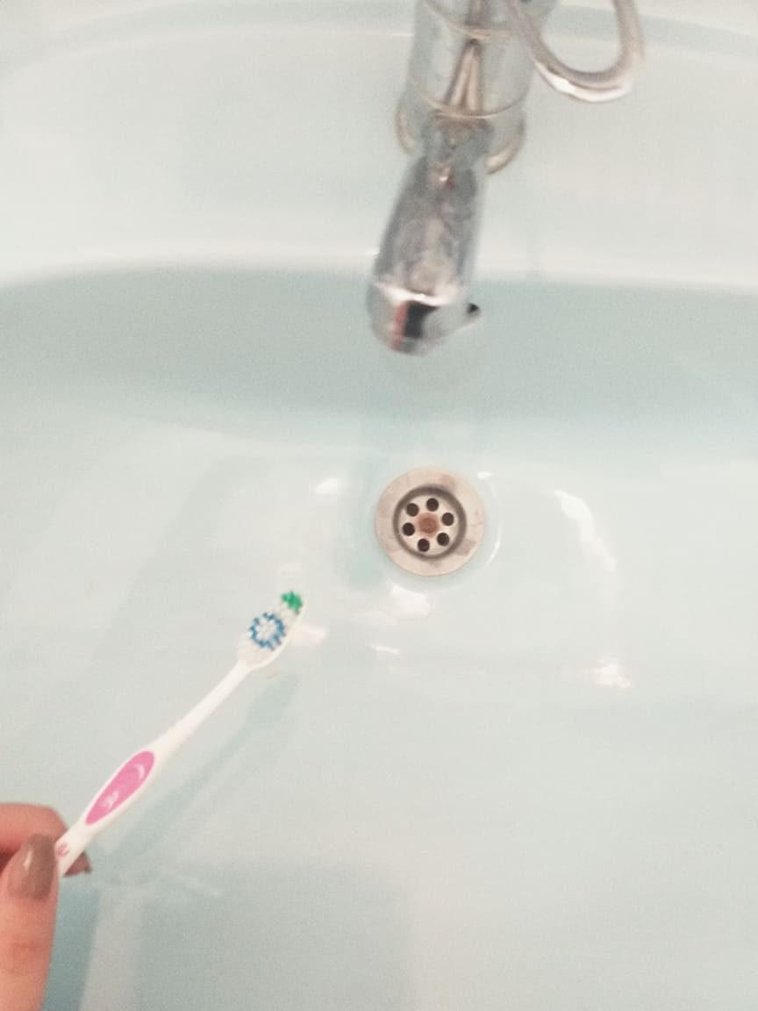
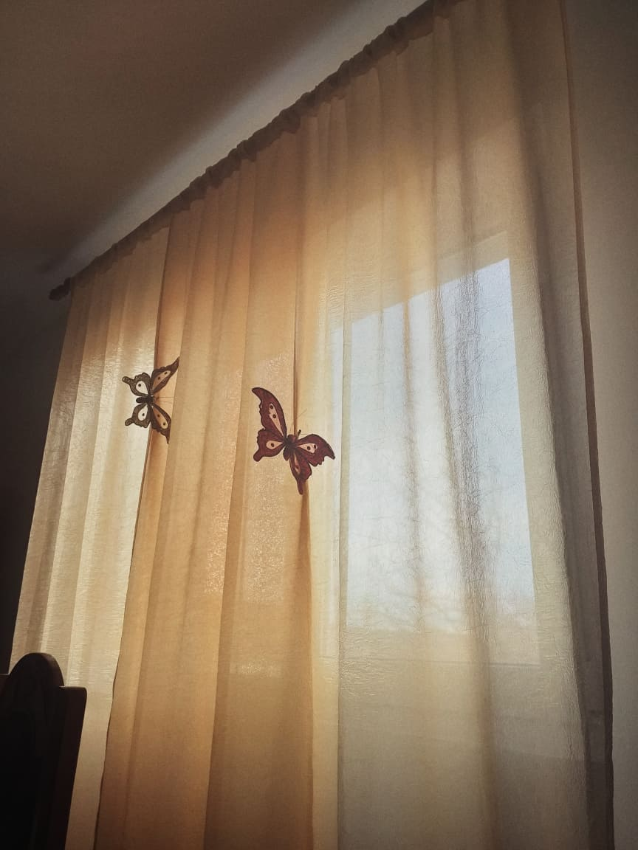
How Ana Maria finished the challenge
SAVING ENERGY "Challenge"
For about a month, my family and I tried this experiment in which we were more careful about how much energy we were using at home and if we used energy in excess.
At first, it seemed difficult because we always forgot to turn off the light or to stop the valve when we brushed our teeth, but as time passed we finally succeeded in getting our job done:
Now it became a habit to stop the valve when we do not need water and to remove the cables from the socket.We also love to use natural lighting now when it is daytime.

Slide 12
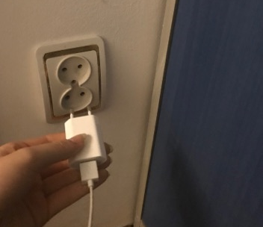
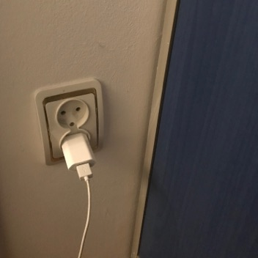
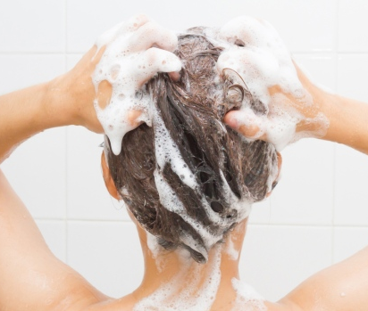
Saving Energy for 1 month "Challenge"
This is how Simona saved energy.
The task was an interesting one, I was not used to saving energy and water. It was a great experience and I hope that I’ll continue doing that for a long, long time.
First of all, I used the natural light as much as possible.
Then, even if it doesn’t make a big difference, after I charge my phone I always pull out the charger from the electrical outlet.
My mom put lids on pots when she cooked.
We changed the lightbulbs with economic ones.
Last but not least, when I wash my hair, I stop the water while I’m using shampoo. You’d be surprised how much water you save by just doing this little thing.

Slide 13
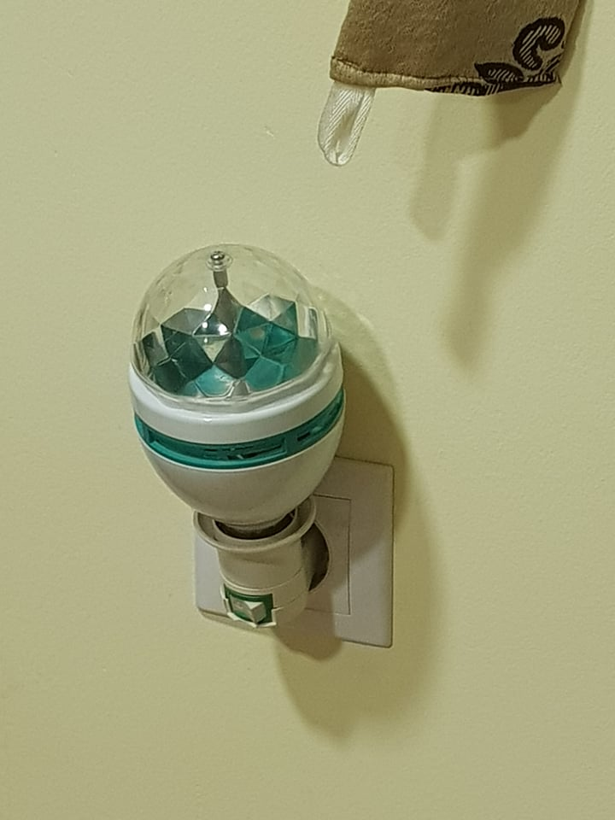
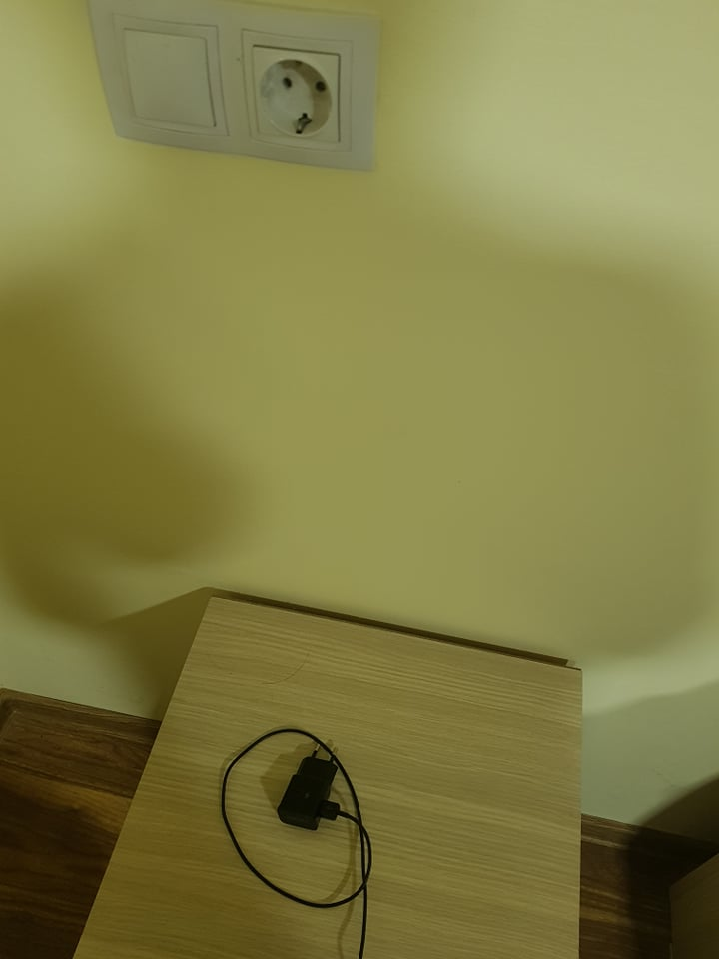
How Daniel used less energy and saved water In the last month, we did our best in order to stop wasting energy. The first couple days were the hardest, since my family and I had to keep reminding ourselves things like ‘’turn off the light’’ or ‘leave the window open’, but after a while we got used to it. The first ( and the easiest) thing we did was giving up the night lamps. Our house is really dark during the night, so we use them in order to move around at midnight. Another thing we did was closing the sink tap when we do not use the water. In order to do so, we placed a sign above it until we got used to it. This made a huge difference in energy usage. We also took showers instead of baths. And finally, the last thing we did was taking the charger out of the plug when we did not use it. This was my father’s idea, since he believes that ‘everything that stays plugged in uses energy. This also made us use our phones less .

Slide 14
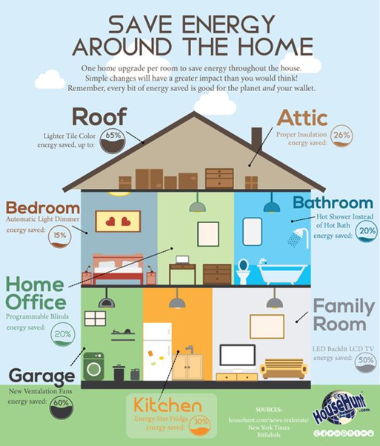
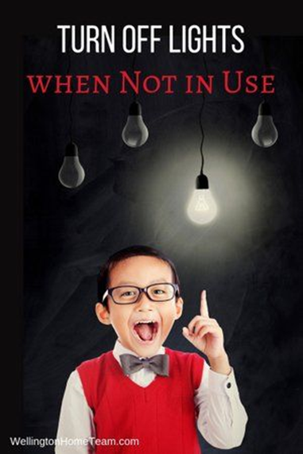
Saving Energy for 1 month "Challenge"
How Ioana and her family saved energy for a month
First of all, I tried to take shorter showers as I had been told that showering accounts for 50% of an average household’s hot water use and it was my family’s case, too. My father switched to an energy-efficient showerhead and this was very useful.
Fortunately, my washing machine is a front loader and these types of washing machines use up to 60% less energy and water than top loaders. We only washed full loads. We also dried the washed clothes naturally, outside.
Something very important about saving the energy that my family and I did was that we never let the light on if you didn’t need it.
We also turned down the heat with two grades when we left home.
In this way, we have seen that saving energy is the best way to spend less money on the bills and we also managed to take a little step to protect the environment
- Ioana

Slide 15
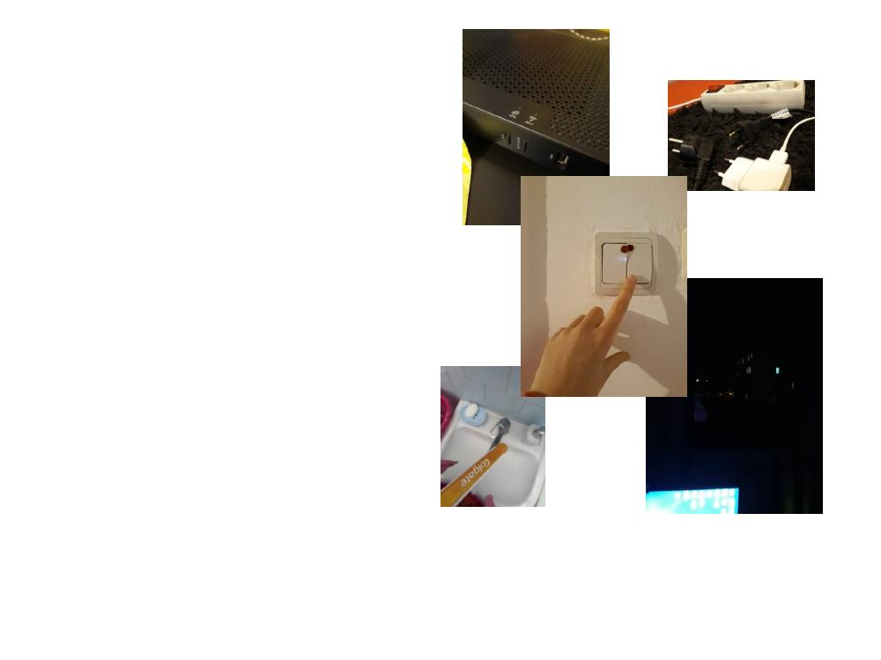
Giulia accepted and completed the 1 month "Saving Energy" Challenge
I want to start by saying that saving energy is one of the most important and easy activities to help improving the environment.
I accepted this challenge to see if I see the difference
This challenge was also attended by my parents, who
changed some normal bulbs through the house, with some economic ones, set the washing machine to quick wash programs, and have water turned off during washing dishes.
We used showers more than baths and we saw that it was possible to save water in this way, and also gas.
Personally, I tried to use my computer and phone less, choosing to participate in other activities like dancing and painting.
I would say that this challenge should be taken into consideration by more
people, and I will personally continue trying all of the above

Slide 16
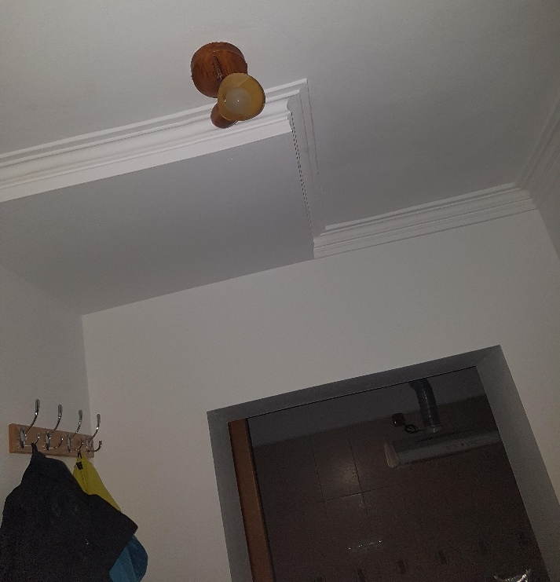
"How I saved energy for one month" by Denisa
Last month me and my family tried to save energy during the challenge that we took on through this project and we saw that we reduced the cost of our bills. It was not very difficult for us because we were motivated by environmental issues and the challenge to do this .At first we started to take showers instead of baths when we could, we tried to turn off the tap whenever we were brushing our teeth or taking a shower or a bath. Then we wanted to use more natural light rather than artificial one so we weren't using the lights very often and they were almost always turned off during the day and for the shortest period of time when they were on, we changed the light bulbs to be economical ones. After 1 week, we were using only the shortest washing cycle for the washing machine and washing only full loads of clothes. After they were washed ,we dried the clothes naturally. We would shut the doors for the areas we did not use and turn the heating down when we went out for a few hours. At the end of the month the differences were very obvious and the bills surely approved that we saved energy for one month.

Slide 17
All students considered that the experiment was beneficial for their families’ budget and for the raise of
their families’ awareness regarding the environmental issues. They are all committed to make use of
these ‘good habits’ in the future, too and to persuade as many people as possible to succeed in doing this.
"This project has been funded with support from the European Commission. This publication reflects the views only of
the author, and the Commission cannot be held responsible for any use which may be made of the information contained therein."

