Slide 1
ERASMUS + PROGRAMME- STRATEGIC PARTNERSHIP
‘Youngsters Nowadays. Where from, Where to?’
2017-1-RO01-KA219-037190
Let’s Know What We Eat and Drink!
Part I

Slide 2
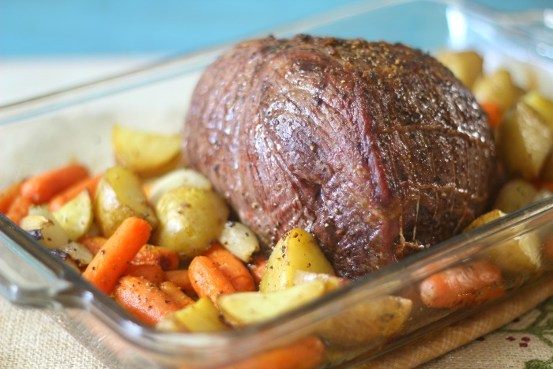
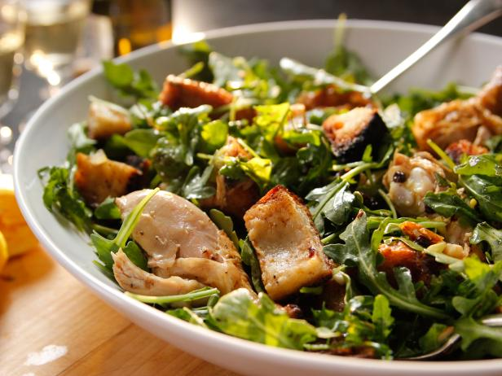
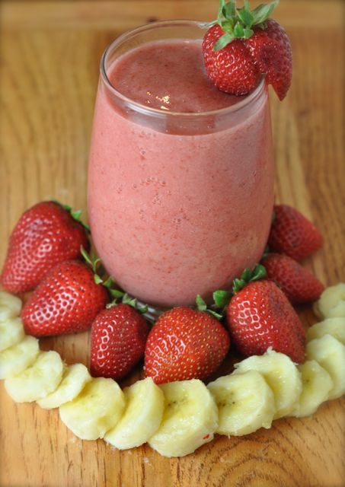
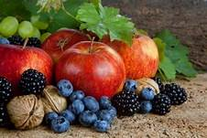
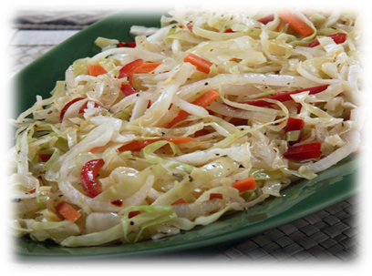
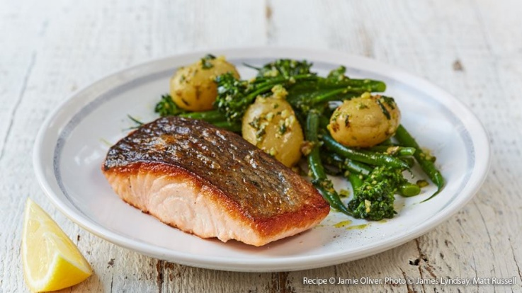
This compendium contains the diet habits of youngsters today, starting from a survey that the partner schools did in their own country. There were 150 students from each school that answered the questionnaire and the students compared and contrasted their eating and drinking habits with their partners, they analysed what they had in common, what was different and what they needed to change for a better life.
The compendium has got 3 parts:
Part I which contains the analyses of the diet habits of the European youngsters;
Part II which is a comparison between the traditional food of the five countries involved in the project and the international one;
Part III which makes suggestions for healthy food and a plan for the perfect diet of the European youngster for a week.

Slide 3
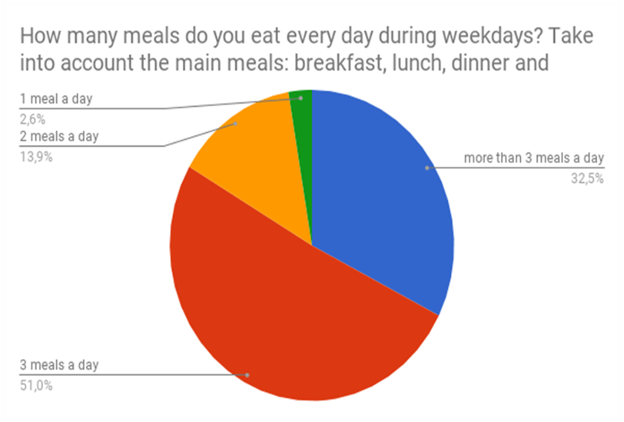
How many meals do you eat every day during weekdays?
Greece
Italy
According to the findings of the research, almost half of the Greek youngsters (45%) are used to eating three meals a day, while 27% of them prefer having more than three. 23% of them usually have 2 meals per day and hopefully just 5% is found to have only one meal per day.
The same pattern is found to be followed during weekends as well.
The most common habit is eating 3 meals a day.

Slide 4
Portugal
Romania
For the question “How many meals do you eat every day during weekdays?”, 4.1% of the students answered that have 1 meal a day, 10,2% said they have 2 meals a day, 27,2% have 3 meals a day and 58,5% have more than 3 meals a day.
In Romania, 7% of the respondents say they eat 1 meal a day during weekdays, 34% admit they eat 2 meals a day, 46% have 3 meals a day and 13% confess they have more than 3 meals during a weekday.

Slide 5
Turkey
In Turkey, most of the students, 86 people, representing 57,33%, eat three meals a day during weekdays.
Conclusion: According to the questionnaires` results almost all the students from all the countries have in common the fact that they eat three meals a day and the least chosen answer is 1 meal a day. So this means that the students are taking determined steps to a healthy life style.

Slide 6
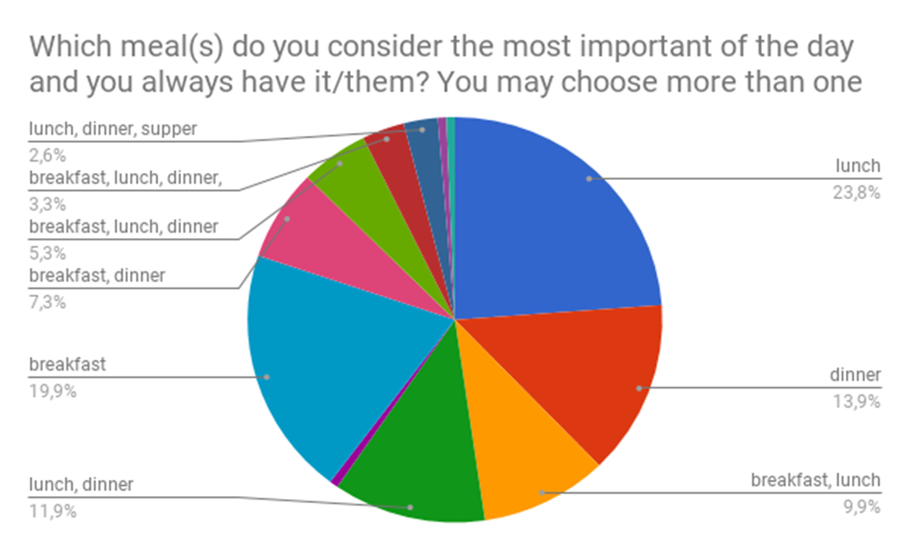
Which meal(s) do you consider the most important of the day and you always have it/them?
Greece
Italy
Thirty-five percent of Greek youngsters seem to consider breakfast the most important meal of the day, though lunch appears to be considered highly important as well according to 23% of the respondents. Also, a remarkable percentage of about 10% of youngsters consider both breakfast and lunch equally important meals of our daily diet. As far as daily meals are concerned, 35% of youngsters have hot meals twice a day, 30% have just one, while very few of them have more than that.
Although lunch is important, we can notice that breakfast and dinner have a remarkable impact on eating habits.

Slide 7
Portugal
Romania
For the question, “Which meal do you consider the most important of the day and you always have it?”, 59,2 % students consider breakfast the most important meal,12.9% consider lunch, 9,5% think breakfast and lunch and 7,5% students think breakfast, lunch and dinner are very important.
At this question, 49% respondents consider that breakfast is the most important meal of the day, 4% say that they have breakfast and dinner every day, 7% choose to have breakfast and lunch, 3% have all 3 meals every day, 7% say that dinner is the most important, 25% always have lunch, 3% say they have lunch and dinner every day and 2% choose to have supper every day.

Slide 8
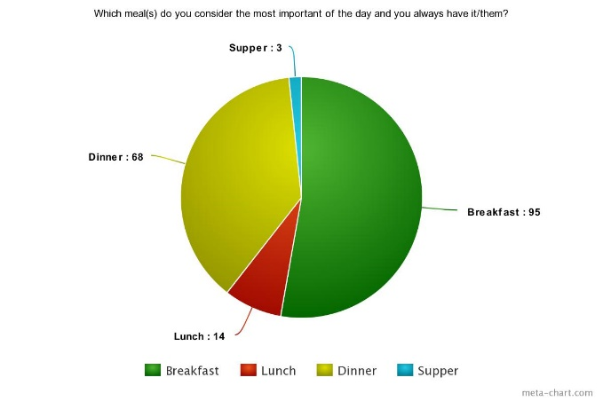
Turkey
Most of the Turkish students believe that the most important meal of the days is either breakfast or dinner.
Conclusion: The students from Greece, Portugal, Romania and Turkey believe that the most important meal of the day is breakfast, followed by lunch whereas for the Italian respondents, lunch is considered the most important meal.

Slide 9
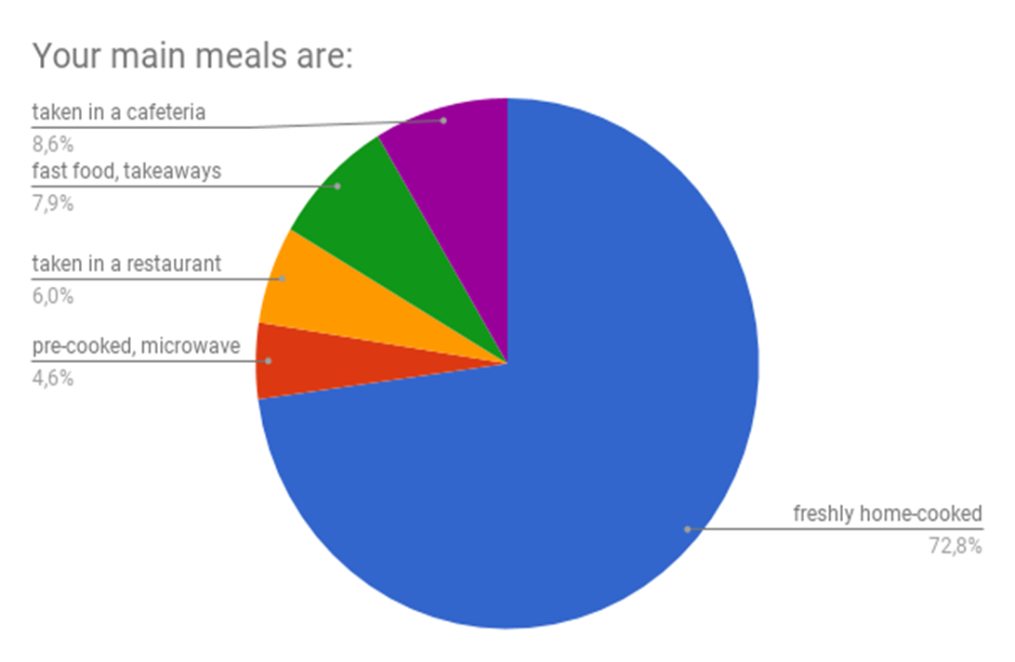
Your meals are:
Greece
Italy
Hopefully, youngsters in Greece appear to care about the quality of their main meals. That’s why 90% of them opt for home-made food. However, as anticipated, youngsters love junk food and Greeks do not appear to be an exception. The main reason for that according to 66% of the respondents is that junk food is tasty, another 14% claim that it offers a variety of options while 8% finds it convenient.
Most of the meals are eaten at home.

Slide 10
Romania
Portugal
For the question “Your main meals are: “ 86,4% students say the main meal is freshly home-cooked, 2,7% students answered pre-cooked, microwave, 2% students answered taken in a restaurant, 2,7% students answered fast food, takeaways and 6,1% students answered taken in a cafeteria.
In Romania, 4% of the students admit their main meals are fast food, 88% say that they mostly have freshly home-cooked food, 6% choose to have pre-cooked meals and only 2% usually eat at a restaurant.

Slide 11
Turkey
The main meals of the students from Turkey are freshly home- cooked, representing 134 answers 89,33% out of the total of 150 replies (100%).
89.33% 1.33% 2.66%
Conclusion: The vast majority of the students from the countries involved in the partnership prefer eating freshly home- cooked meals which means that they are aware of the necessity of leading a healthy life and at the same time, it means that in families, healthy lifestyle is targeted, in general.

Slide 12
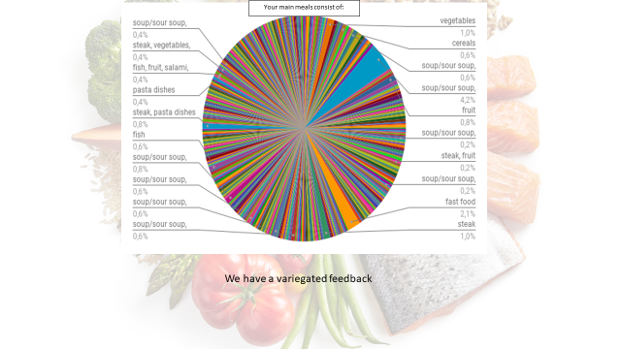
Your main meals consist of:
Greece
Italy
The results of the questionnaire show that the 47% of Greeks’ main meals consist of a wide variety including soup, fish, meat, rice, dairy products, while 20% of Greek teenagers do include fruit as part of their meals. However, fast food appears to be part of the 27% of the respondents’ diet.
We have a variegated feedback.

Slide 13
Portugal
Romania
Regarding the type of food the youngsters eat, 4% of the Romanian students admit their main meals are fast food, 88% say that they mostly have freshly home-cooked food, 6% choose to have pre-cooked meals and only 2% usually eat at a restaurant.
At this question 9% say their main meals are sour soup 7% choose dairy products as their main meals, 5% eat mostly fast food, 5% admit they eat a lot of fish, 8% still eat salad as their main meals, 5% admit they eat bologna, 6% eat a lot of bacon, 5% pick salami as their main meal, 6% admit they eat cereals as their main meals, 9% say their main meals consist of fruits, 6% eat a lot of pasta dishes, 9% choose vegetables, 2% pick rice dishes as their main meals, 5% admit they consume lots of ham, 6% say their main meals consist of sausages and 7% pick stake as their main meals.
For the question “Your main meals consist of” most students say they consume soup, cereals, steak, fish, vegetables, salad and dairy products.
.

Slide 14
Turkey
The meals Turkish students eat usually consist of soup, steak, salad, vegetables, dairy products, fruit and pasta dishes.
Conclusion: Soup/sour soup, steak, fish, vegetables, salad, cereals, dairy products (milk, yogurt, cheese, butter), fruit, salami, bologna, ham, bacon, sausages, fast food, pasta dishes, rice dishes are highly preferred in every country. The students’ diet is very diverse even though not everything is completely healthy.

Slide 15
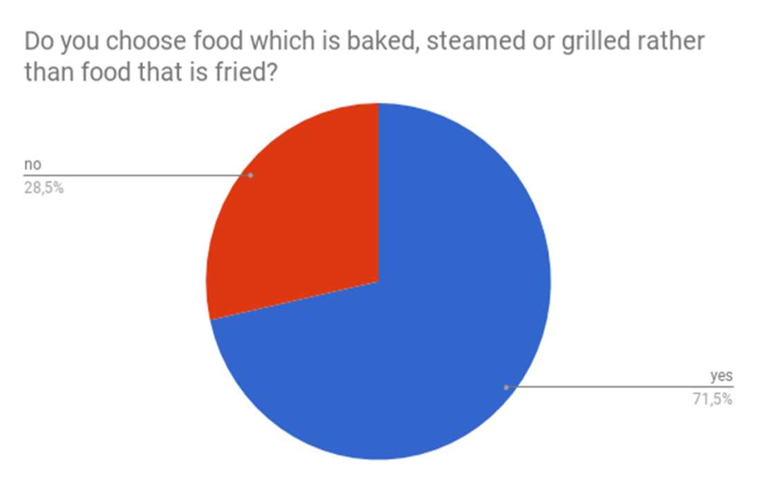
Do you choose food which is baked, steamed or grilled rather than food that is fried?
Greece
Italy
Interestingly, although fried food is tastier than other ways of cooking, still 80 % of youngsters and their families avoid frying, with fried meals being confined to 2 or 3 times per week for 55% of them or even just once for 15% of Greek families. Still, there are exceptions representing 8% of youngsters’ population that has the tendency to overdo it.
Dessert, also seems to be confined to once or twice a week for 56% of youngsters, while 19% of them claim that they rarely have one. In a similar “healthy” vein, 66% of Greek youngsters do opt for low fat products whenever there is such an option.
Baked food is preferred to the fried one.

Slide 16
Portugal
Romania
.
At this question, 78% admit they choose baked, steamed or grilled food over fried food and 22% pick the opposite.
For the question, “Do you choose food which is baked, steamed or grilled rather than food that is fried?” 81,6% students say ‘yes’ and 18,4% say ‘no’.

Slide 17
Turkey
In Turkey, 118 (78,66%)) of 150 students from the respondents prefer baked, steamed or grilled food, whereas 32(21,33%) do not eat food cooked in this way when they can.
78.66% 22.33%
Conclusion: The respondents from each country think that steamed, grilled or baked food is better than the fried food even though fried food is tastier to eat. Students know it is not as healthy as the other styles of food.

Slide 18
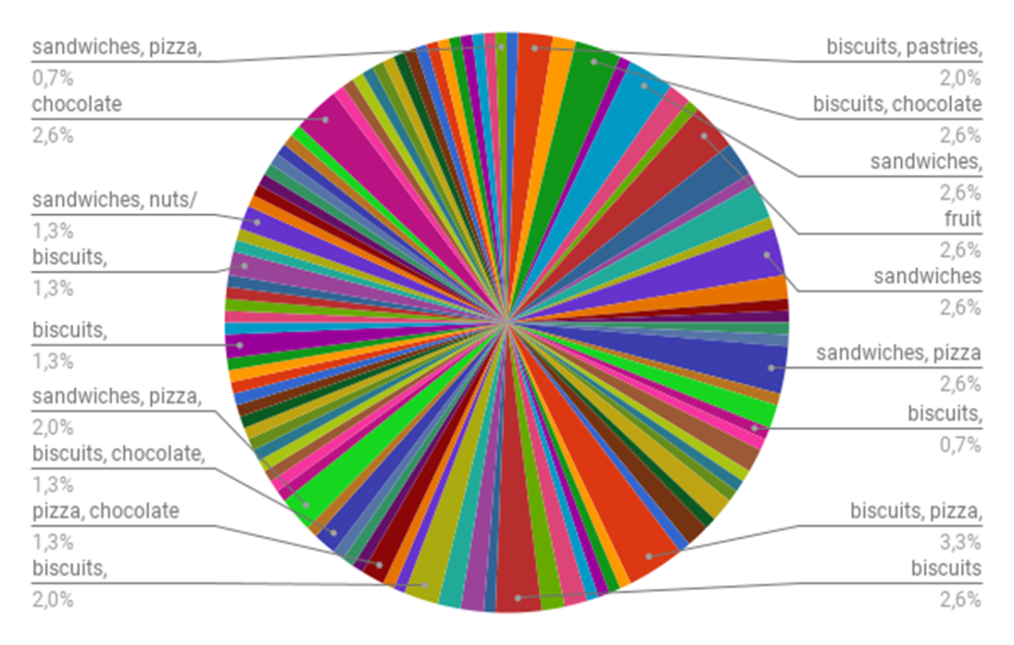
What do you eat as snacks?
Greece
Italy
According to the survey, 63% of Greek youngsters were found to have 1 to 2 snacks per day in-between their main meals. Other 22% appear to consume three or more.
Concerning snacking habits, the first place in their list of preferences is fruit reaching up to 30%, sandwiches and fruit are to follow with 21% which go hand in hand with a more enriched “snack pool” including pizza, chocolate, biscuits and yoghurt.
An encouraging finding that came to light and should be underlined, though, is that fruit is the most popular snack; being part of every single Greek youngster’s snacking habits..
Biscuits and pizza predominate by a few lengths.

Slide 19
Portugal
Romania
For the question “What do you eat as snacks?”, most students consume biscuits, chocolate, sandwiches, pastries, fruit and yoghurt.
15% choose biscuits as their snacks, 8% admit they usually eat candies, 8% pick nuts or peanuts, 15% choose to eat fruit as their snack, 16% think that chocolate is the best snack, 8% eat a lot of yoghurt as their snack, 3% say that they eat veggies 3% pick pastries, 13% make a sandwich every time they want a snack and 11% pick pizza as the best snack choice.
.

Slide 20
Turkey
On average 2/3 of the Turkish students eat biscuits, chocolate and fruit as snacks and half of them eat sandwiches, nuts and yoghurt.
66% 11.33% 35.33% 23.33% 78% 24.66%
Conclusion: Except for Italian students who prefer pizza, which is their traditional food, and Greek students who prefer different types of fruit, which are healthier, the other countries` students prefer chocolate as a snack.

Slide 21
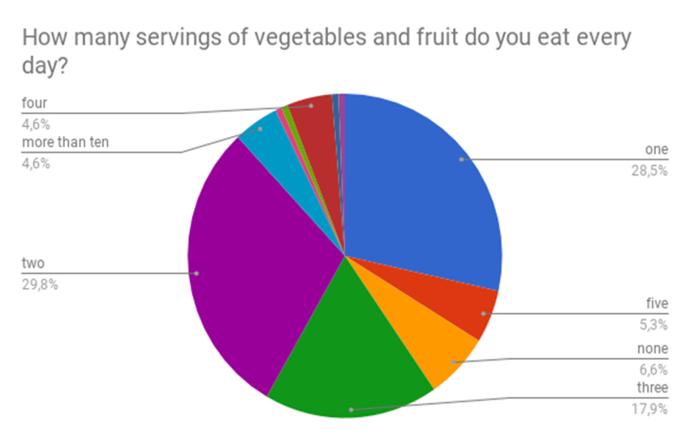
How many servings of vegetables and fruits do you eat every day?
Greece
Italy
According to the findings of the research, 50% of Greek youngsters appear to have two to three servings of vegetables and fruit on a daily basis, while 28% of them have more than that. Luckily, just 18% of youngsters have none or just one serving per day.
Fruit and vegetables are appreciated by the Italian students.

Slide 22
Portugal
Romania
At this question, 4% say they eat 5 servings of vegetables and fruit every day, 13% admit they eat 4 servings,19% confess they eat only 1 serving, 2% eat 7 servings of fruit and veggies, 2% eat 6 servings, 1% eats 10 servings of veggies and fruit, 17% pick 3 servings as their answers, 42% admit they eat only 2 servings of vegetables and fruit.
For the question “How many servings of vegetables and fruit do you eat every day?”, the students answered they eat between two a six servings of fruit per day.

Slide 23
Turkey
Most of the students in Turkey eat 1-3 servings of veggies and fruits.
Conclusion: The Greek, Romanian, Portuguese and Italian students consume two servings of fruit or vegetables each day whereas Turkish students consume one serving. This means that they are one step away from a healthier lifestyle.

Slide 24
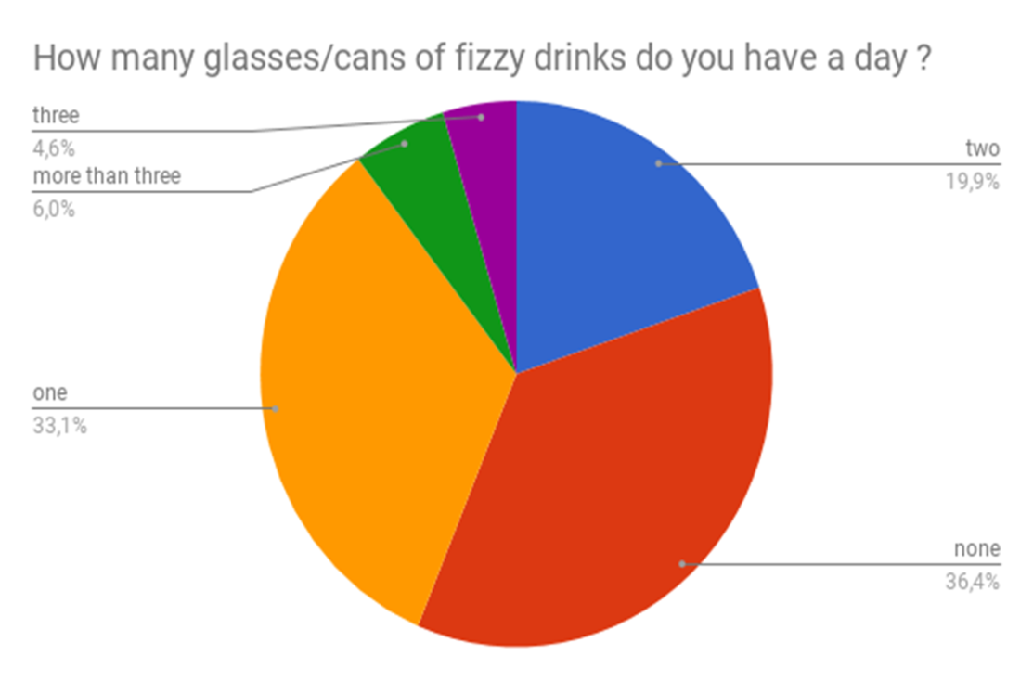
How many glasses/cans of fizzy drinks do you have a day?
Greece
Italy
Fortunately, the vast majority representing 81% of youngsters in Greece being at school age have none or just one glass of coffee, tea or fizzy drinks. Still, there are some students to be the exception to the rule that get two (13%) or three (5%) servings per day.
Fizzy drinks are common.

Slide 25
Portugal
Romania
At the question, “How many glasses/cans of fizzy drinks do you have a day?”, we have seen that half of the students don´t drink fizzy drinks and the other half drink between one a two glasses.
In Romania, 9% of the students admit they drink more than 3 cans of fizzy drinks a day, 49% say they don't drink fizzy drinks, 22% choose to drink only 1 glass of fizzy drinks, 3% drink 3 glasses and 17% admit they drink 2 cups of fizzy drinks.

Slide 26
Turkey
Most of the students drink either only one glass of fizzy drink or none.
Conclusion: This question´s results show us that most of the Greek and Turkish students drink one glass of fizzy drink or they don’t drink this beverage at all; in Romania almost half of the respondents don’t drink fizzy drinks and in Italy and Portugal, there are more than half the students who drink between 1 and 2 glasses per day.

Slide 27
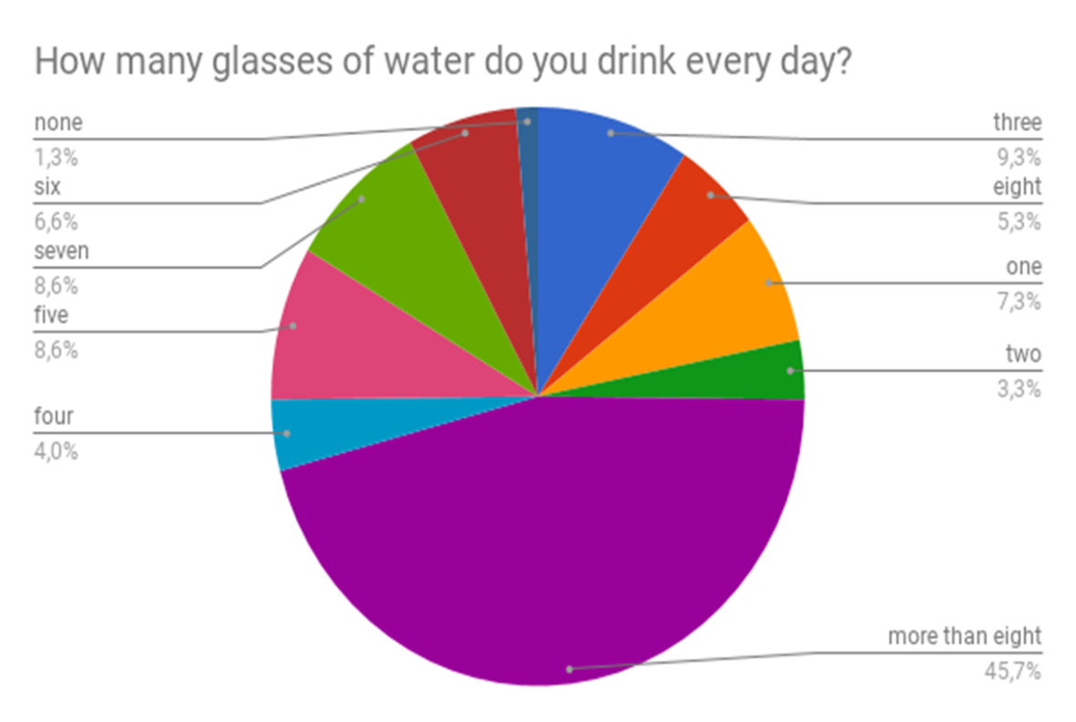
How many glasses of water do you drink every day?
Greece
Italy
On the contrary, Greeks do drink lots of water every day. More specifically, 35% of Greek youngsters drink 6 to 8 glasses of water, while 41% of them do drink a lot more than that on a daily basis.
Most of the students drink enough water and there are half of them who drink eight or more than eight glasses of water per day..

Slide 28
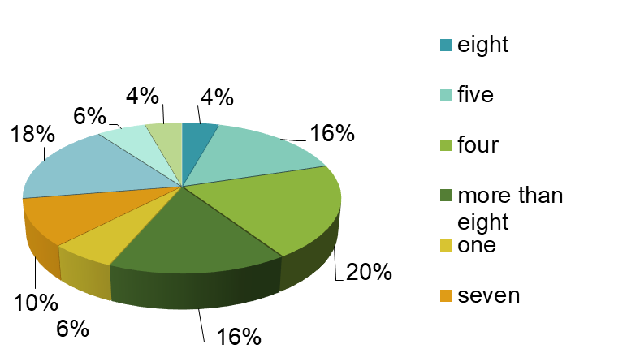
Portugal
Romania
At this question, 4% of the respondents say they drink 8 glasses of water every day, 16% say they drink 5 cups, 20% admit they drink 4 glasses of water a day, 16% choose to drink more than 8 cups of water a day, 6% drink only 1 glass of water, 10% drink 7 cups of water, 18% think that it is a great idea to drink 6 cups, 6% drink 3 glasses of water every day and only 4% say they drink 2 cups of water a day.
In relation to the former answers where the students have said they don’t drink fizzy drinks, the Portuguese students drink a lot glasses of water a day.

Slide 29
In Turkey,1/4 of the students drink 3-5 glasses of water, 1/3 of the students drink 6-8 glasses of water and 37 of 150 students drink more than 8 glasses of water per day.
Turkey
7.33% 24.66%
Conclusion: Except for the Romanian students where only 24 % say they drink 8 or more than 8 glasses of water per day, the students from the other countries drink enough amounts of water to be able to keep their bodies healthy.

Slide 30
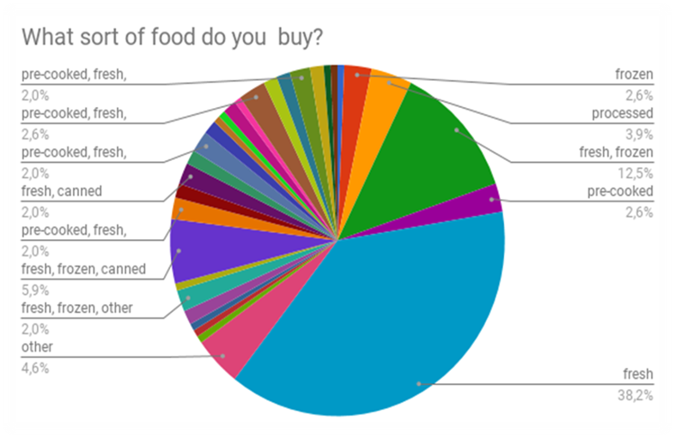
What sort of food do you buy?
Greece
Italy
In a “healthy” vein, Greek families show a clear preference to fresh food reaching up to 75 % of the respondents. A combination of fresh, frozen and canned food represents an equally important percentage of 24% of Greek families’ food purchasing habits. As far as shopping is concerned, supermarket is by far the first choice on the list of preferences of the respondents in their entirety (97%). An equally important percentage of 78% takes also the choice of markets as well. Sadly, just 16% of Greek families do include organic food stores as part of their groceries shopping habits, which as a fact may be partly explained by the high cost of organic products.
Fresh food prevails.

Slide 31
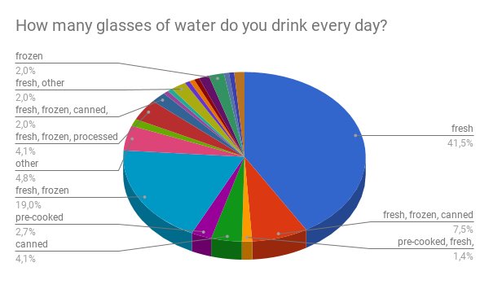
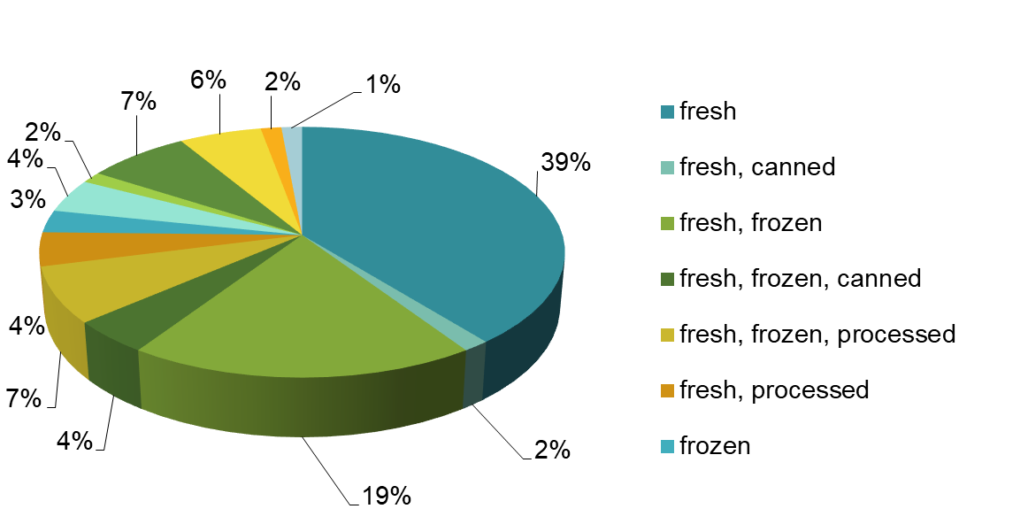
Portugal
Romania
In Romania, 39% of the respondents say they buy only fresh food, 2% buy fresh and canned food, 19% choose to buy fresh and frozen food, 4% opt for fresh, frozen and canned food, 7% buy fresh, frozen and processed food, 4% say they buy fresh and processed food, 3% admit they buy only frozen food, only 2% buy pre-cooked food, 7% confess they buy pre-cooked and fresh food, 6% admit they buy pre-cooked, fresh and frozen food, 2% buy only pre-cooked, fresh and processed food, 1% picks to buy pre-cooked and frozen food and 4% buy other types of food.
“What sort of food do you buy?” Most of the students buy fresh food, then 7,5% buy fresh, frozen food and canned one.

Slide 32
Turkey
Most of the students prefer fresh food when they buy.
Conclusion: The students from all the countries prefer fresh food instead of canned and pre-cooked one. It shows that this type of food is healthier and even more delicious than the others.

Slide 33
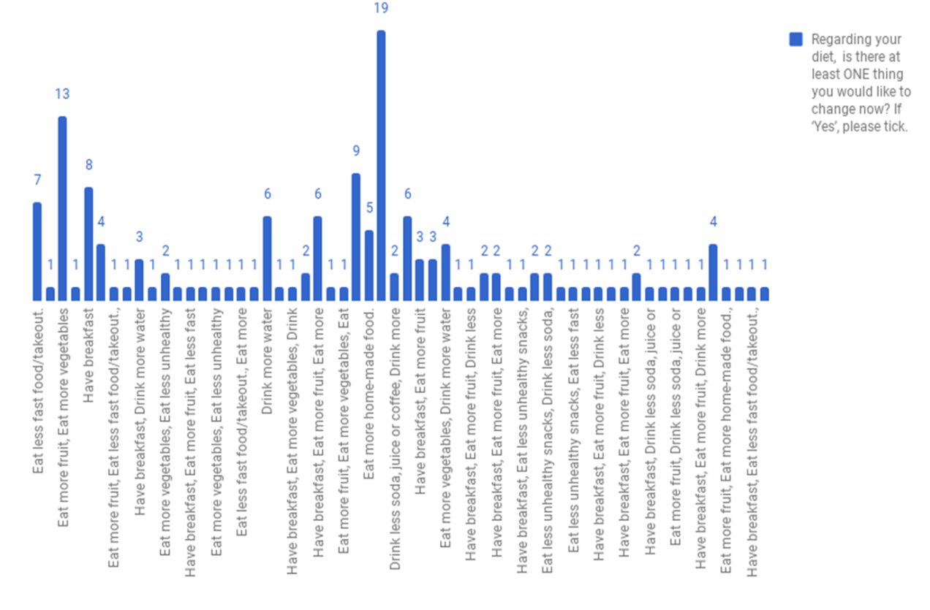
Regarding your diet, is there at least ONE thing you would like to change now?
Greece
Italy
Concerning healthy eating, it was found that 26% of Greek youngsters always mind what they eat, while 40% usually opt for healthy eating. Hopefully, according to the research, the vast majority does appear to care about healthy diet and pays attention to what they eat most of the times. Towards this direction, Greek youngsters claim that they would like to change their eating habits towards healthier ones. More specifically, 30% of them state their willingness to cut down on unhealthy snacks, another 30% would like to avoid skipping breakfast and 40% of them wish they ate more fruit. It should be stated, though, that Greek youngsters do not have an obsession with healthy eating, but still they try to do their best.
Likely changes in the future are oriented towards eating greater quantities of food and vegetables.

Slide 34
Portugal
Romania
At this question 7% respondents admit they would like to drink less soda, 7% would like to drink less juice or coffee, 14% think it would be a great idea to drink more water, 9% want to eat less fast food, 10% confess they would like to eat less unhealthy snacks, 21% say they would like to eat more food, 4% would prefer to eat more home-made food, 15% admit they would like to eat more vegetables and 13% would like to have breakfast.
In the last question, “Regarding your diet, is there at least one thing you would like to change now?”, the students would like to eat more fruit and vegetables, to eat less fast food and they would like to have breakfast on a regular basis.

Slide 35
Turkey
Regarding the things that the Turkish students would change in their diets, 43 have said that they would like to change their eating habits by eating more vegetable or 31 by eating more fruit, 66 students by eating less unhealthy food, 29 by eating less fast food/takeout, 85 students by drinking either less soda or more water and 67 students by either having breakfast or eating more home-cooked food.
Conclusion: The answers to this question show that the students from the five schools involved in the project are aware of the fact that they should have a healthier diet and they would like to have breakfast regularly, to eat more fruit and vegetables and to cut down on the types or amounts of unhealthy food or beverages they eat or drink.

Slide 36
Final conclusions on the youngsters’ diet habits
Almost all the students from all the countries involved in the partnership have in common the fact that they eat three meals a day;
For the students from Greece, Portugal, Romania and Turkey, the most important meal of the day is breakfast, followed by lunch and for the Italians, lunch is the most important meal;
Most students prefer eating freshly home-cooked meals which means that they are aware of the necessity of leading a healthy life although sometimes, they eat fast food, but not on a regular basis;
Soup/sour soup, steak, fish, vegetables, salad, cereals, dairy products, fruit, salami, bologna, ham, bacon, sausages, fast food, pasta dishes, rice dishes are highly preferred in every country. The students eat diversified food although not everything is completely healthy;
The youngsters believe that steamed, grilled or baked food is better than the fried food even though fried food is tastier to eat;
For a snack, the Italian students prefer pizza, the Greek students prefer different types of fruit, and the Portuguese, Romanian and Turkish students prefer chocolate;
The Greek, Romanian, Portuguese and Italian students consume two servings of fruit or vegetables each day whereas Turkish students consume one serving;
The Greek and Turkish students drink one glass of fizzy drink or they don’t drink this beverage at all. Almost half of the Romanian students don’t drink fizzy drinks at all whereas more than half of the Italian and Portuguese students drink between 1 and 2 glasses per day;
The students from Greece, Italy, Portugal and Turkey drink enough amounts of water and only a quarter of the Romanian students drink 8 or more than 8 glasses of water per day;
Most students from all the countries prefer fresh food instead of canned and pre-cooked one;
The students would like to have breakfast regularly, to eat more fruit and vegetables and to cut down on the unhealthy food or beverages;
The students are aware of the fact that they should have a healthier diet and they are trying to take determined steps to a healthy life style.

Slide 37
“This project has been funded with support from the European Commission. This publication reflects the views only of the author, and the Commission cannot be held responsible for any use which may be made of the information contained therein.”

