Slide 1
“Youngsters Nowadays. Where from, Where to?”
2017-1-RO01-KA219-037190
Am I Prepared for the Job Market?

Slide 2
This material, ‘Am I Prepared for the Job Market?’, is a study of the job opportunities and the trend of employment in each country from our Erasmus+ project,‘Youngsters Nowadays. Where from, Where to?’. It presents suggestions of how to behave at a interview, how to write a CV, a letter of application or a letter of intent and how to deliver a speech in public.

Slide 3
Greece: Job Opportunities and the Trend of Employment in Greece & in Sterea Ellada

Slide 4
Economic Recession in Greece
The last ten years have been particularly hard for Greeks, as the economy is suffering from a serious and protracted recession. Since the beginning of the crisis (2008), private consumption has fallen sharply due to falling incomes and a decline in consumer credit. As the recession unfolded, labor market conditions have deteriorated dramatically. The unemployment rate more than tripled from 7.6 % in 2008 to 24.2% in 2012, affecting primarily the young people. A significant and growing proportion of youth, even among those who would have found jobs in good times, are at risk of prolonged unemployment or inactivity, with potentially long-term negative consequences for their careers. Under these circumstances, the Greek economy faces two major challenges.
The first is the need for strong economic recovery to increase vacancy creation, hiring, and create a sustained jobs expansion. The second is the need for policies to address structural labor market problems to improve the matching of job seekers to new job openings and to assist in the labor market adjustments of the long-term unemployed, so as to prevent the large increase in unemployment becoming structural.

Slide 5
Socio-economic Profile of Sterea Ellada
Sterea Ellada is the second largest administrative region in Greece in total area (15,549.31 km2), where 5.2% of the country's population is concentrated. It is a manufacturing hotspot, developed mainly due to its proximity to the region of Attiki. According to the available Eurostat figures, in 2016 the region accounted for 4.5% (€7,926m) of the country's gross domestic product (GDP), ranking in fifth position between the regions of west Greece(€7.847m) and Kriti (€8,654m). GDP growth rates have been negative since 2008 (€10,879m), having slightly increased since last year. In terms of GDP per capita in purchasing power standards (PPS), which accounted for €17,400 in 2016, the region was positioned fifth among the 13 Greek regions, below both the national (€19,700) and only 60 % of the EU28 average (Eurostat, 2018).

Slide 6
Sterea Ellada Labor Market
Sterea Ellada is rich in mineral resources and also possesses a developed agricultural sector, a relatively developed tourism infrastructure and a growing services sector. However, the region is characterized by geographical and economic heterogeneity, with urban areas being more developed than the rural and mountainous zones. Agricultural and livestock production is a key source of income and employment for most of the population of the region.

Slide 7
Sterea Ellada Labor Market
The secondary sector is crucial for the regional economy and in 2015 accounted for 35.2% of the regional Gross Value Added (GVA), which totaled €6.941m, while the services sector share was 56.2% and that of the primary one was 8.6% (Hellenic Statistical Authority, 2018). In 2017, the region employed 5.0% (187,7 thousands) of the country's workforce: 57.9% of which in the tertiary sector, 19.8% in the secondary sector and 22.4% in the primary sector (Eurostat, 2018).

Slide 8
Sterea Ellada Labor Market
Within the services sector the most dynamic segments are real estate, renting and business activities, public services, transport services, trade and the growing tourism and financial services sectors. Around the area of Boeotia, are located some of the largest production units of the country, such as the manufacture of electrical machinery and apparatus, manufacture of basic metals, manufacture of other non-metallic mineral products, manufacture of rubber and plastic products and manufacture of wood and of products of wood and cork.

Slide 9
Entrepreneurship in Viotia County
The County of Viotia, even though it presents a significant dependence in the secondary production sector and accommodates a great part of the total manufacturing activity of the country, with enterprises that determine the national industrial and financial map, it does not have organized and suitable spaces to welcome manufacturing and industrial plants. On the contrary, the industrial space of the region in the area of Oinofyta – Schimatari, is developed without any planning at all, not insuring a rational administration of industrial waste and downgrading the natural environment and the quality of life of the population. Besides, it is astonishing how high are the rates of unemployment and underemployment of Viotia (of the highest in Greece), no matter the industrial development.
Our County is neighboring that of Attica. The short distance from Athens gives the opportunity to offer goods and services to a wide market and to a very large consuming audience. But at the same time, this neighboring creates problems to the autonomous development of companies that provide services whereas it intensifies the problem of competition due to the great number of producers citied in the geographic region of Attica.

Slide 10
Entrepreneurship in Viotia County
The fertile soil of Kopaida offers many possibilities for the cultivation and disposal of agricultural goods to the wide consumers group of Attica. Evidently though, the continuous and intense cultivation and production of saturated agricultural products is a dead end. Agriculture has to change its course, towards the production of goods that are of higher demand in the international markets, such as biological and ecological products etc. The popular rural axis of Athens – Arachova – Delpi, the great number of archeological sites, churches and sites of exceptional beauty, if combined with other sites (such as of Thiva, Levadia, Chaironia) to be promoted, it could attract a large amount of tourists.

Slide 11
Unemployment in Continental Greece
The unemployment rate in 2017 decreased to 20.9% (Eurostat, 2018), as compared to 25% in 2016, and a figure significantly lower compared to the 2013 level (28.2%). This positions the region in seventh place for the highest unemployment rate among the 13 Greek regions, below the national average (21.5%) and above the EU28 (7.6%) average.
In the Regional Unit of Viotia unemployment is highest among unskilled building workers, unskilled workers in construction and industry and office workers, followed by personal service workers (hairdressers, cooks, waiters, housekeepers, etc.), sales staff for shops or outdoor locations, salespersons, domestic workers and cleaners, caretakers, porters and guards. Smaller numbers are available among sales specialists and business service providers (secretaries, accounting assistants, and personnel for financial services, sales and related professions), musicians, drivers and mobile plant operators.

Slide 12
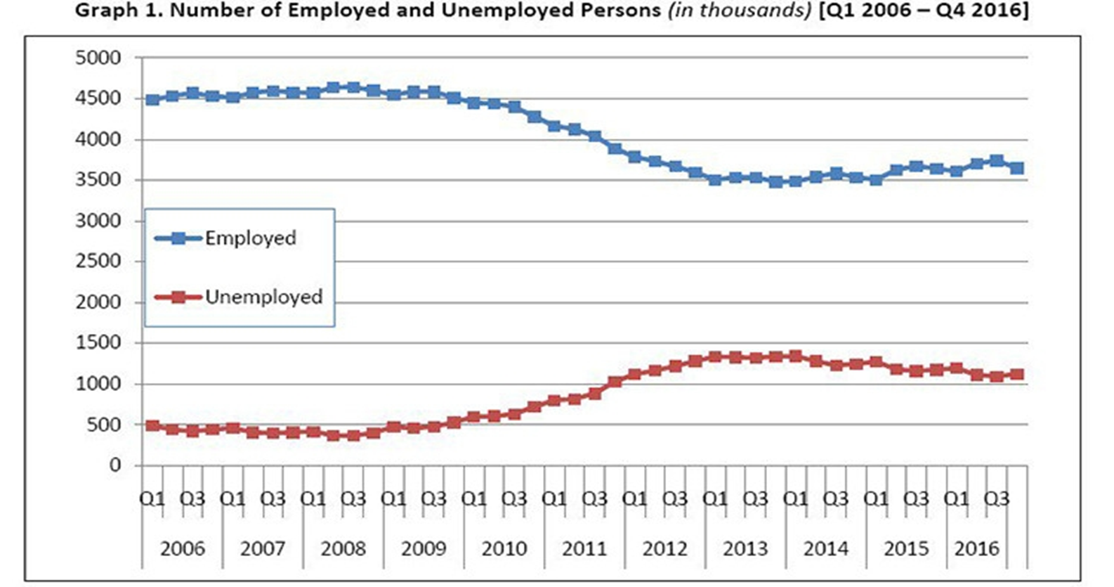

Slide 13
Unemployment in Continental Greece
Greece’s unemployment rate fell to 20.2% in July-to-September, from 21.1% in the second quarter, data from the country’s statistics service ELSTAT. About 75.6% of Greece’s 970,000 jobless are long-term unemployed, meaning they have been out of work for at least 12 months, the figures showed.
One significant reason for the drop in overall unemployment is the rise of part-time and low-pay jobs in the private sector. The average wage of such positions is below €400.
Greece’s highest unemployment rate was recorded in the first quarter of 2014, when joblessness hit 27.8%.

Slide 14
Italy: Job Opportunities and the Trend of Employment in Calabria

Slide 15
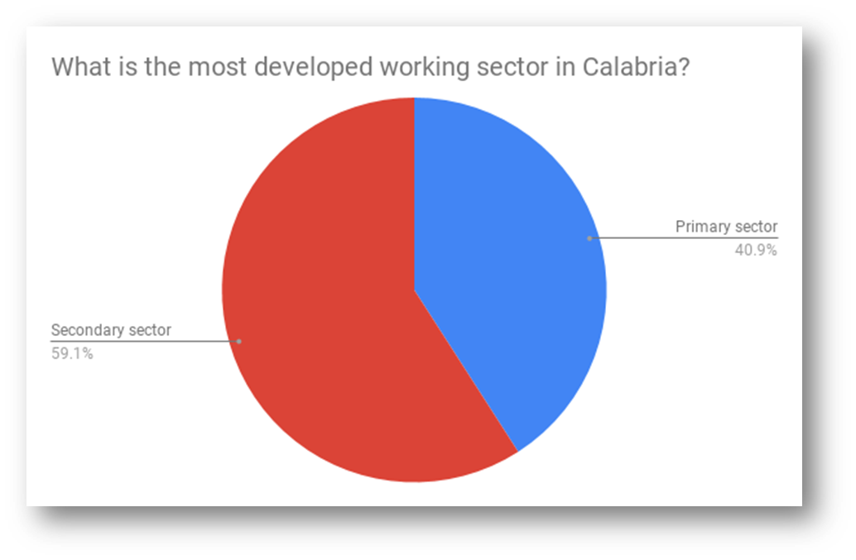
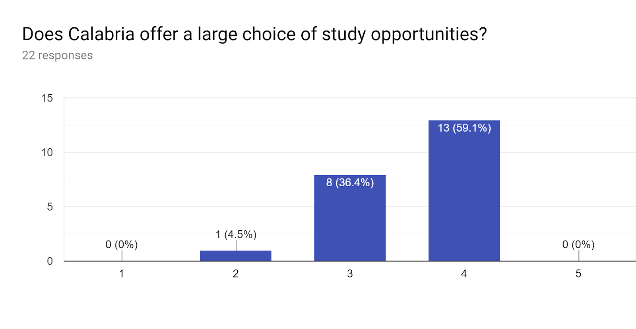
Does Calabria offer a large choice of study opportunities?
What the Job Opportunities and Trends in Calabria are according to ITT( Instituto Tecnico Tecnologico)Students
What is the most developed working sector in Calabria?
1 Strongly disagree 5 Strongly agree
University offer is various.
Economy is based on the secondary sector.

Slide 16
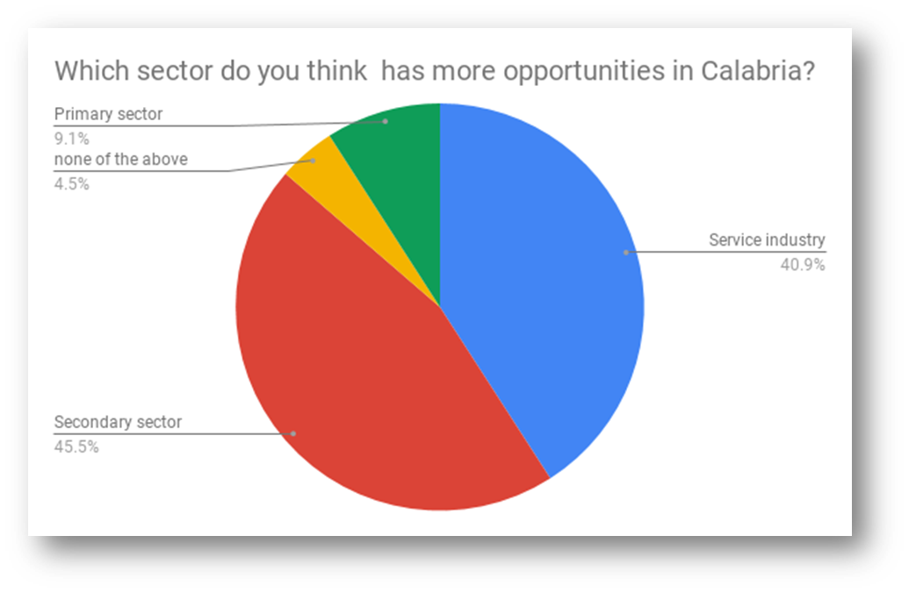
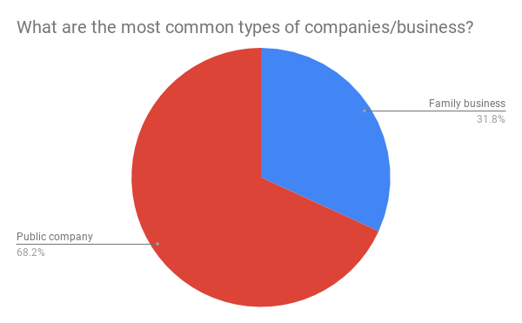
What are the most common types of companies/business?
Which sector do you think has more opportunities in Calabria?
Jobs are concentrated in the public field.
There are good chances in the secondary sector and in service industry.

Slide 17
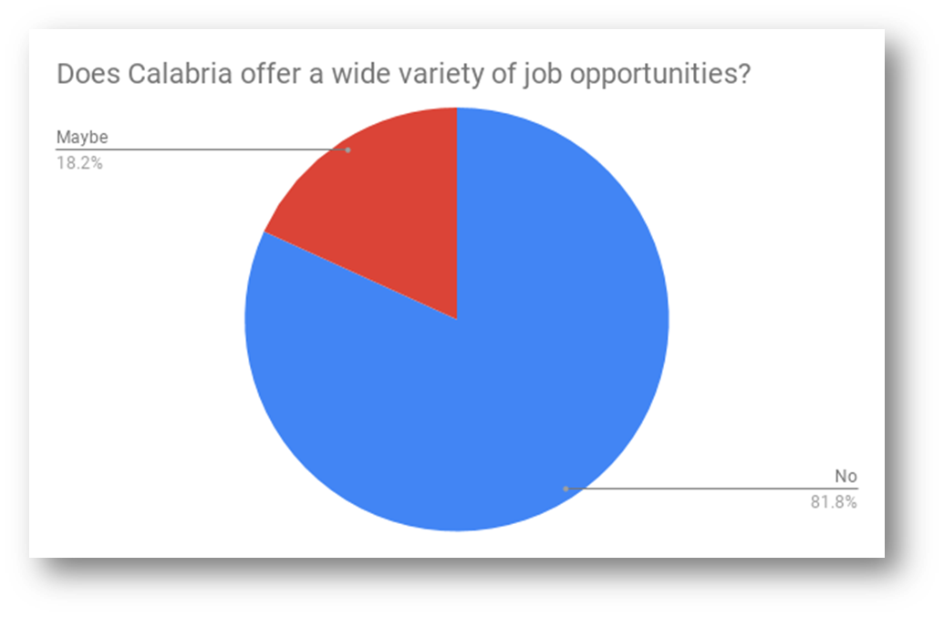
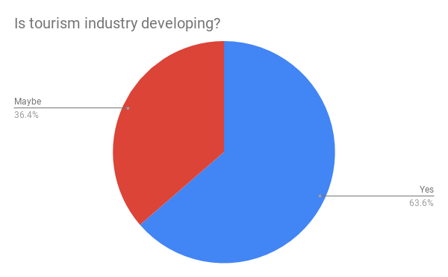
Is tourism industry developing?
Does Calabria offer a wide variety of job opportunities?
ITT students believe tourism is increasing.
There is an evident state of disillusionment.

Slide 18
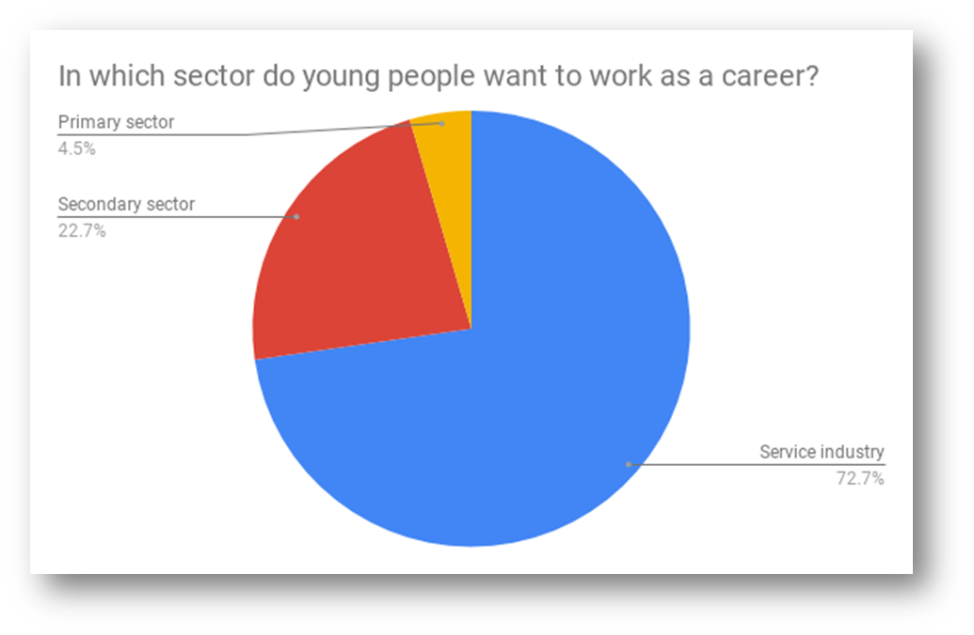
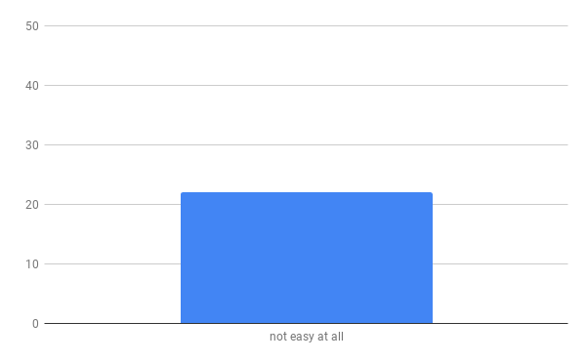
How easy is for a young person to find a job in Calabria?
In which sector do young people want to work as a career?
All students find it very hard to find a job in Calabria.
Most students would like to be employed in the service industry.

Slide 19
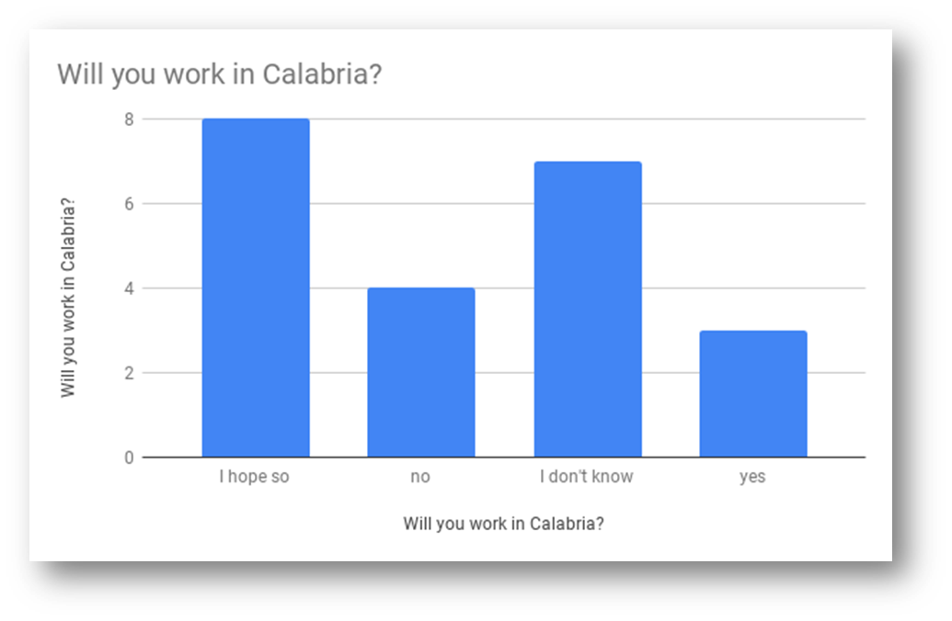
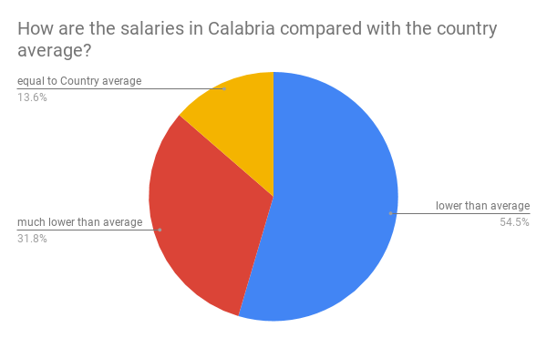
How are the salaries in Calabria compared with the country average?
Will you work in Calabria?
Most students believe salaries are not in line with the others in other parts of Italy.
Answers reveal a heterogenous situation.

Slide 20
Portugal: Job Opportunities and theTrend of Employment in Portugal

Slide 21
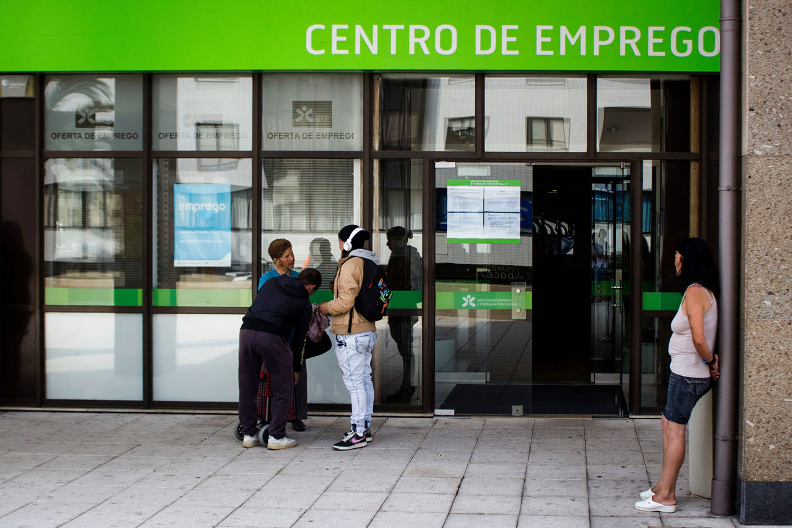
The Employment State
Our study presents the Portuguese employment situation in general, then it focuses on the central region and on in the Municipality of Ourém, where our school is located.
Statistics of Employment
It took 10 years for the recovery of the Portuguese economy to consolidate after the financial crisis and severe debt that began in 2008.
Despite this positive development, the quality of employment and wages remain low, even if statistical studies say that the unemployment rate in Portugal has decreased.

Slide 22
The Employment in Portugal in 2018
In 2018, employment in Portugal was marked by a more inclusive hiring, because the companies started accepting and appreciating different age groups from the ones they have accepted so far, which means that older people started to be appreciated and valued for their knowledge and experience.

Slide 23
Lisbon and Oporto are the areas where there are more jobs opportunities
The cities of Lisbon and Oporto have the largest number of jobs offers, although it is where competition from other candidates is greater.

Slide 24
Principal Employers’ Areas
Calculations show that the sector where there was more employment in Portugal was education. Trade appears in the next position, followed by health-related activities. In addition, tourism, information technology and engineering are also increasingly offering employment opportunities.

Slide 25
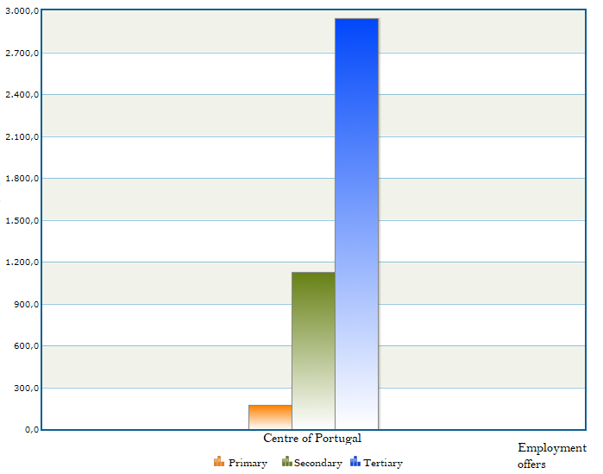
The Employment in Portugal in 2018
The employment offers predominate in the tertiary sector, with 69% of the offers, being the primary sector the least employer, representing only 4% of the available employment.

Slide 26
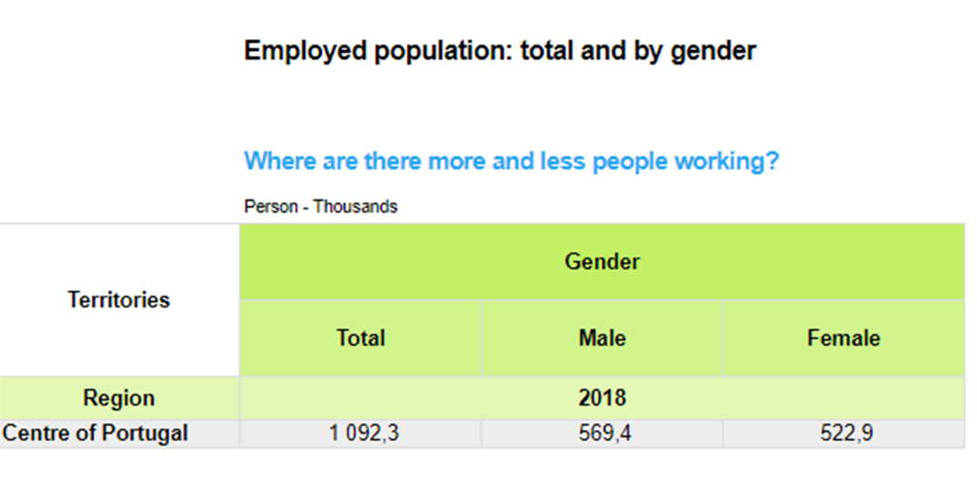
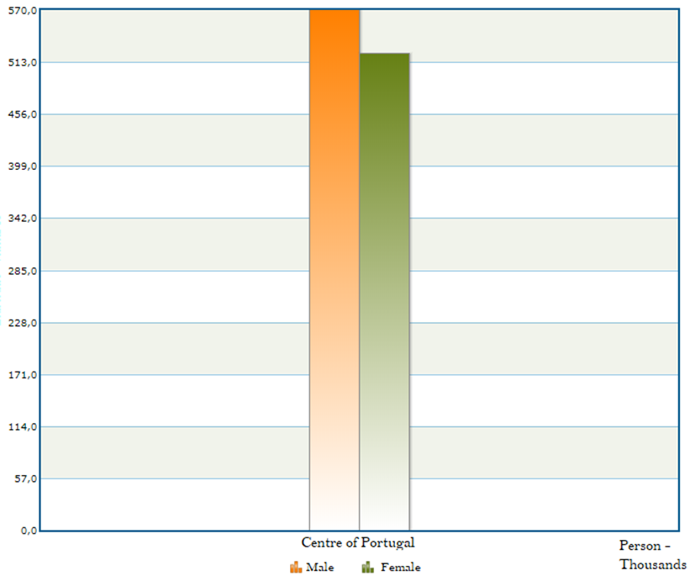
The Employment in the Centre of Portugal in 2018
In a total of 1092 thousand of employed people in the Centre of Portugal, the majority are men even if the number of employed women is increasing.
52%
48%

Slide 27
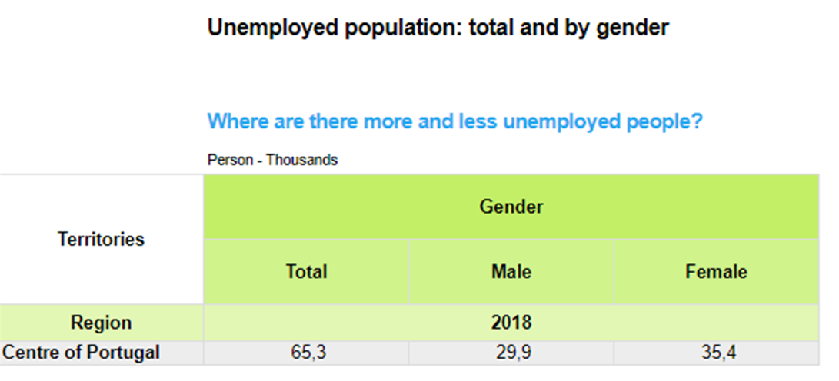
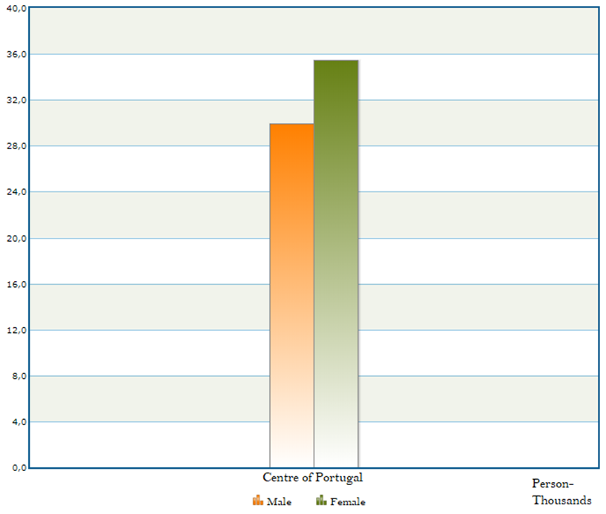
The Unemployment in the Centre of Portugal in 2018
We can verify that there are more unemployed women because of some reasons. One of them is the bankruptcy of the factories where they have always worked and the difficulty in getting a new job due to their age.
54%
46%

Slide 28
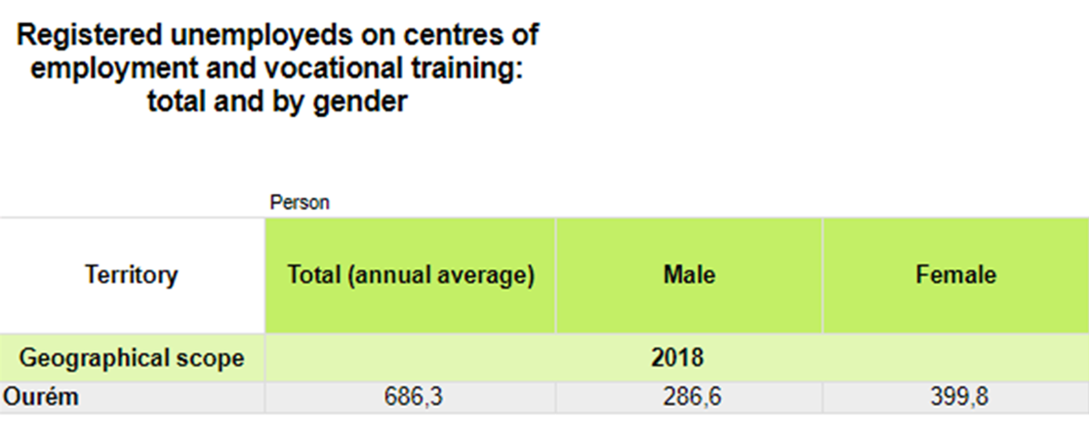
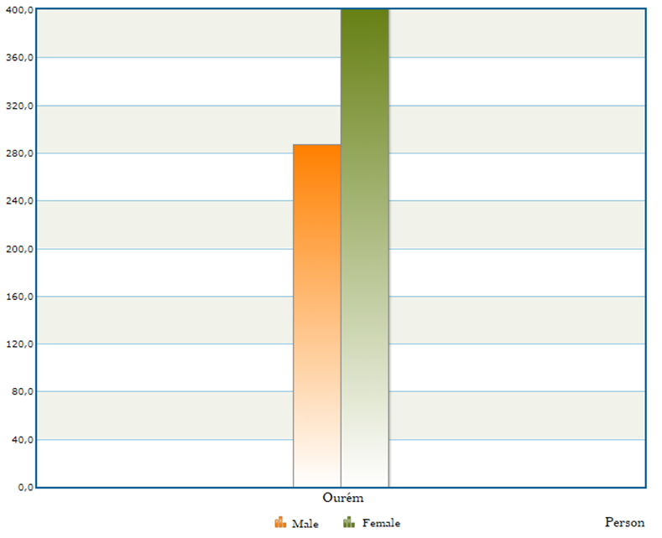
The Unemployment in Ourém in 2018
Like in the rest of the region and the country, the women of the municipality of Ourém stand out in relation to men for presenting an higher unemployment rate.
58%
42%

Slide 29
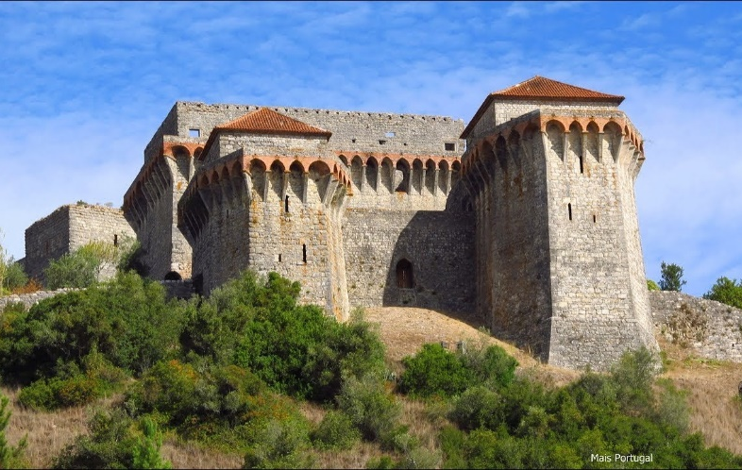
What do we conclude?
We conclude that even though the unemployment rate in our municipality and our country is increasing, men are still more employed than women, even if the statistics show that the number of women getting employed is increasing in time.
Besides that, we see that the employment market in Portugal is developing positively, with more available vacancies and diversity of offers.

Slide 30
Romania: Job Opportunities and the Trend of Employment in Romania

Slide 31
The Survey on the Romanian Job Market
In Romania, the situation of the job market is to be viewed as a process between the qualifications that people have, the salaries that are offered, the new positions that are made available in the companies that manage to find suitable contracts for their products on the European market which is in a continuous change.
The average annual rate of job vacancies according to the economic activity in 2017
Information and communication | 4%
Education | 5%
Administrative and support services | 6%
Transportation and storage | 6%
Wholesale or retail automobile repair and motorcycles | 10%
Public administration and defense | 17%
Health and social assistence activities | 18%
Industry | 31%
Constructions | 3%

Slide 32
Annual Average Rate of Job Vacancies Depending on the Economic Activity.
The first and the last industries in this ranking, differences 2017 vs 2008
Other job activities | 249.4%
Art and Entertaining | 90.9%
Transport and Storage | 88.1%
Public Administration and Defence | -57.2%
Mining and Quarries | -64.8%
Constructions | -69.2%
Agriculture Silviculture and Fishing | -59.8%
Information and Communication | 199.9%

Slide 33
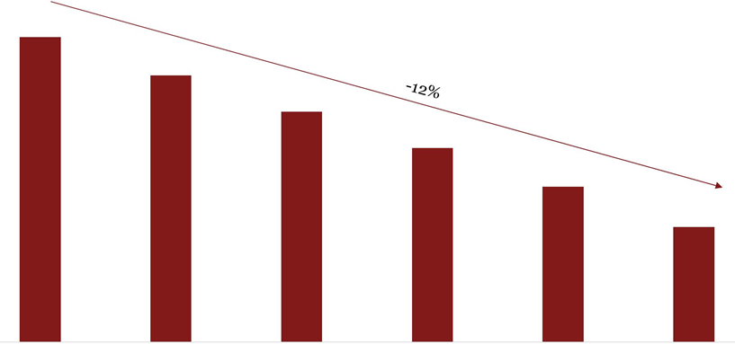
Population Evolution and Prognostics
- Figures in Thousands
19,877
19,388
18,927
18,464
17,974
17,463
Source: The United Nation Organisation
2015 |  | 2020 | 2025 | 2030 | 2035 | 2040
 |  |  | Sursa: Organizația Națiunilor Unite - Prognozele populației bazate pe Perspectivele Populației Mondiale: Revizuirea din 2017
Analiza pieței muncii |  |  |  |  |  | 15
In terms of job offer, it is noticeable that the population will continue declining with about 10% in comparison with last 20 years.

Slide 34
Emigration- a Problem to the Romanian Economy
Emigration is one of the causes of population decline: in 2017, it was officially estimated that over 3.5 million Romanians live abroad but the number seemed to be hugely more, with the latest statistics from 2019 stating that there are 9.7 million. This has a tremendously negative impact on the work force and the economy from our country.
Country | The total number of Romanians abroad in 2017 - thousands
Italy | 1,024
Spain | 628
Germany | 547
The UK | 306
Hungary | 208
The number of the unemployed people in Romania has decreased due to this emigration, the diminishing of the population, in general and to the fact that the economy has recovered after the economic crisis.

Slide 35
The Number of Employees: Private vs Public
Figures In Thousands
Year | Public | Private
2016 | 1227 (26%) | 3532
2012 | 1266 (28%) | 3177
2008 | 1454 (29%) | 3592
The percentage of the employees from the public sector out of the total number of employees- 2016
37%
34%
27%
27%
24% | 24%
22%
21%
North- West | Centre | North- East | South- East | South | București - | South- East | West
 |  |  |  | Muntenia | Ilfov | Oltenia
Analiza pieței muncii |  |  |  |  |  |  | 18
Source: INSSE - Tempo Online

Slide 36
The Productivity Index adjusted to the Salary Level 2015 vs 2008
Administrative and Support activities | -19%
Professional, Scientific and Technical Activities | -24%
Real Estate | -27%
Information and Communication | -29%
Accommodation Activities and Food Services | -26%
Transport and Storage | 6%
Wholesale or Retail Trading, Vehicle or Motorcycle Repair | -17%
Construction | 0%
Water supply, Sewarage, Waste Management, and Fixing Activities | -14%
Electric Energy Supply, gas, steam and Air Conditioning | 31%
Industry | -13%
Mining | 0%
North-West | 24%
Center | 24%
Nord-East | 34%
South-East | 27%
South-Wallachia | 27%
Bucharest-Ilfov | 21%
South-West Oltenia | 37%
West | 22%
The Work-Productivity Rate adjusted to the salary equals the resulting amount divided by the personal costs. It is afterwards adjusted to the number of paid workers.

Slide 37
The Possibility to Work Remotely that the Companies Give
Top Industries According to Wages Offered in 2019
Work Fields | Salaries (Ron)
Service activity in information technology, computer service activities | 6.380
Air transport | 5.390
Financial intermediation and insurance | 4.654
Telecomunications | 3.902
Extractive industry | 3.700
10-15 days | 3.53%
2 days | 8.00%
3 days | 8.03%
More than 5 days | 8.03%
Other | 10.61%
1 day | 11.25%
It’s not efficient in our organization | 24.75%
We don’t offer | 26.04%
Jobs linked to ICT offer the best salaries.
Half of the companies said they gave the possibility to higher education employees to work remotely.

Slide 38
How Will the Number of Employees in a Company Change in 2019?
Drop | 3%
Remain constant | 23%
Increase below 10% | 34%
Increase under 10% | 40%
For 2 consecutive years, only 3% of companies estimate that the number of employees in the company will drop.

Slide 39
What Kind of Candidates Are Most Important in 2019?
The percentage of jobs for juniors increased by 5% in 2019. The distribution of jobs for eperienced specialists and managers is similar to last years’s.
Managers (team leader, department manager) | 12%
Specialists (over 3 years experience) | 38%
Juniors (students, under 3 years experience) | 50%

Slide 40
Which Are the Fields Most Likely to Make Recruitments for Jobs in 2019?
Legal | 1,36%
Acquisitions | 3,98%
IT hardware | 4,66%
Marketing-PR-Advertising | 5,11%
Others | 5,45%
Administrative | 6,48%
Production | 7,39%
Human Resources-Training | 8,41%
Engineering-Technical | 9,00%
Accounting-Finances | 10,00%
Customer Support-Client Service | 12,00%
Sales | 13,00%
IT software | 13,18%
After 3 consecutive years of its maintenance in top, SALES have declined on the second position, being surpassed by the IT Software domain. These are followed by Customer Support- Client section.
In addition, the area focused on Accountancy-Finances has flourshingly risen on the 4th position reported to the one from the previous year.

Slide 41
How Many Internship/ Training Programs Will Be Open in 2019?
Answers | Percentages
We want to find more over 10 interns | 15%
We want to find between 3 to 10 interns | 21%
We want to find maximum 3 interns | 27%
No | 37%
From the point of view of the employers' initiatives, one of the most obvious trends is the creation of special training programs for young people. These can be carried out either at the headquarters of these companies or within universities, in partnership with students’ associations. Banks and multinationals in the industry of consumer goods have been the most active in this regard till now. It is expected that the initiatives will increase along with the employers’ need to recruit young people who if are not experienced, at least they are familiar with the basic concepts of the respective activity domain.
Statistics show that 63% of the companies which had taken part in this survey declared they would recruit interns in the year 2019.

Slide 42
What the Most Important Qualities for Recruting Juniors Are
Past work experience | 20.04%
Internship | 18.76%
Faculty specialization | 12.82%
Extracurricular activities | 10.38%
Involvement in student NGO | 10.48%
Bilingualism | 10.00%
Possession of certifications | 5.47%
Studies abroad | 4.31%
Other | 3.84%
Good academic results | 3.72%
In the last three years internship programs were on top of the requirements for hiring, and this year past work experience is the most important quality that will count on hiring.
The percentage of the companies that care about certifications doubled.

Slide 43
How Many Trainees Stay in the Company at the End of an Internship
Percentage of trainees that stay in the company | Number of employers that responded
5% | 4%
5-10% | 10.60%
10-30% | 16.80%
30-50% | 17.70%
70-90% | 34.00%
90-100% | 13.20%
It can be seen that 34% of the employers want to hire over 70% of the trainees that were involved in one of the internship or trainee programs of their company.

Slide 44
The Steps for Recruitment Process
Forty-two percent of the employers have declared that the process of recruitment takes about 1 month.
Interview with the manager | 23,98%
Interview with the recrutier | 23,29%
Trial test | 18,20%
Phone interview | 12,76%
Skype Interview | 6,98%
Group Interview | 4,14%
Psychological test | 3,96%
Assesment Center | 3%
Others | 1,98%
A day at the offcice | 1,81%
Other answers: technical interview, verification of references, going through videos of the E-learning platform.
Almost half of the companies include the interview with the manager and the interview with the recrutier in the process of recruitment.

Slide 45
The “Soft Skills” Abilities the Recruters Want
Flexibility, adaptation | 15,21%
Communication skills | 14,67%
Proactivity | 10%
The orientation towards results | 9,70%
Continuous learning capacity | 9,38%
Teamwork | 7,55%
Problems solving | 6,14%
Efficiency | 5,07%
Analyzing capacity | 4,31%
Time and priorities management | 3,77%
Social intelligence | 3,66%
Multitasking | 2,48%
Stress management | 2,48%
Independent work capacity | 2,26%
Project management ability | 1,83%
Leadership | 1,29%
Others | 0,21%
In 2019, the flexibility and adaptation requirement reached the first position followed by the communication skills on the second place in TOP 3.
The least important requirments are: leadership, project management and independent work.
The communication skills and the social ones, remain the most important requirement on the basis of which companies will choose their future employeers in 2019.
Continuous learning capacity is for the first time in top with a procent of 9,38%, which is determined by the fact that the majority of jobs come with a period of development in the work environment.

Slide 46
Turkey: Job Opportunities and the Trend of Employment in Turkey

Slide 47
Nowadays, these are the most demanded jobs in Turkey.
Textile workers
Sales representatives
Physical workers
Waiters
Drivers
Security
Cleaning jobs
Accountants
Financial jobs: trade, export, financial experts
Experienced and quality people are sought in:
manufacturing
IT
Creative Industries
Academics
Business Management
Language Learning and Translation
Aviation and Defense

Slide 48
Employment Outlook
Turkey’s unemployment rate stands at 11.8%, but its employment forecast is positive, with slight employment increases predicted for the following year. The long-term employment forecast predicts an almost 8% employment increase by 2020.
Many Turkish women work at low-paying, insecure jobs, and very few are employed in management roles. However, the International Labour Organization (ILO) and the Turkish Employment Agency (İŞKUR) have launched a new project to promote women’s employment and improve their job opportunities.
Short Term Outlook
The country continues to suffer from a lack of qualified local talent in certain fields, which makes the job market exceptionally attractive to qualified foreign nationals. The most optimistic hiring plans come from employers in Turkey’s construction, finance, insurance, real estate and business services sectors. Significant hiring is expected in the electricity, gas and water supply sectors.

Slide 49
Long Term Outlook
Emerging Sectors:
• Information technology • E-commerce • Digital marketing • Energy • Construction • Retail

Slide 50
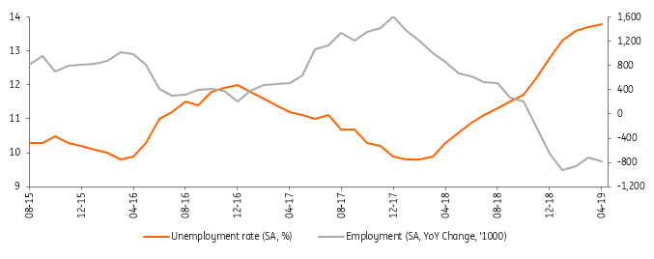
Turkey: Labour Market Deteriorates Further
Recent labour market trends show a continuing deterioration with the seasonally adjusted unemployment rate up to 11.2% in August, the highest since May 2017
Unemployment vs Participation rate in SA terms

Slide 51
Following a significant downtrend in 2017 due to high economic growth, unemployment has changed course this year with the seasonally adjusted (SA) rate standing at 11.2% as of August, the highest since May 2017, from 9.9% at the end of last year. This is also due to a recent acceleration in the participation rate (SA), which has climbed to an all-time high of 53.5%. The non-agricultural unemployment rate (SA), on the other hand, has climbed from 11.8% in February 2018 to 13.0% in May. The data shows that the tightening in labour market conditions makes matching the growing labour force more difficult.
The unadjusted unemployment rate, on the other hand, was 11.1%, marking the second YoY increase in a row, another sign of momentum loss in annual employment generation, with ongoing difficulties in the labour market.

Slide 52
Job Creation by Sectors (SA)

Slide 53
On a sequential basis, job creation in August was positive (151K), driven mainly by services (156K), while industry and construction provided modest contributions with 27K and 4K. Only agriculture was a drag at -36K.
On the other hand, employment generation on a year-to-date basis was barely positive at 39K. Services added 358K and industry gained 216K thanks to government incentives promoting employment, especially in SMEs and the manufacturing sector. Construction felt the impact of recent financial volatility, recording a 207K year-to-date decline in employment, along with a -328K decline in agriculture.
All in all, the summer volatility and consequent tightening in policies to restore confidence have resulted in a faster rebalancing of the economy. This outlook points to significant upside risks for current unemployment trends in the period ahead.

Slide 54
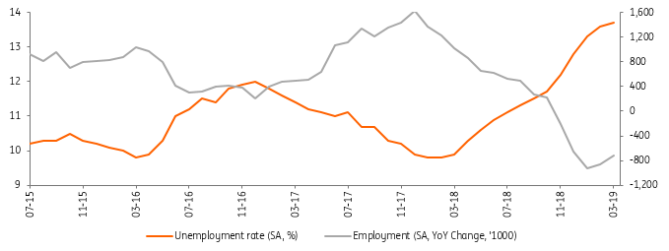
Turkey: More Positive Signs from the Job Market
The seasonally adjusted unemployment rate has slightly increased to 13.7% in March, but the pace of the increase has lost momentum amid supportive government actions and recovering economic activity.
Employment Generation & Unemployment Rate

Slide 55
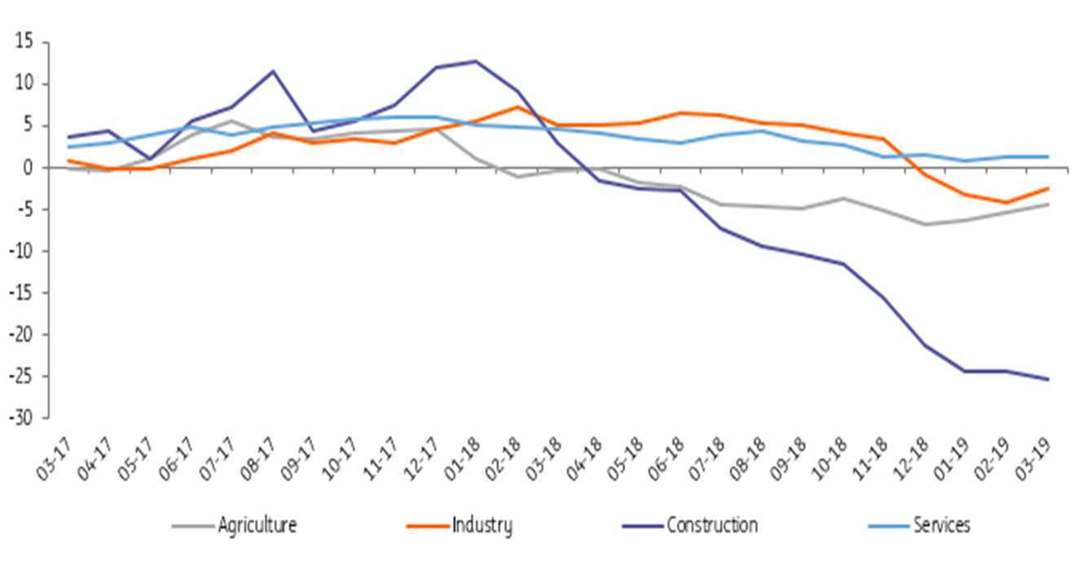
The pace of increase in Turkey's unemployment rate (on seasonally adjusted basis) lost further momentum in March, with just a small increase to 13.7% (though still the highest since the global financial crisis) from 13.6% a month ago. This follows a rapid rise between October and January, from 11.7% to 13.3%. Employment generation has turned positive in the last two months, standing at 72K in March thanks to 1) agriculture posting 78K job gains 2) industry employment rising to 94K for the first time, after six months of contraction 3) Employment growth in services to 37K after a strong 108K in February. On the flip side, construction has continued to see job losses for 14 straight months, at -53K in March.
Job creation by sectors (SA, % YoY)

Slide 56
Despite some positive developments, the unemployment rate (on seasonally adjusted basis) continued to move higher- a trend in place throughout the whole of 2018. Labour force participation (SA), which fell from an all-time high of 53.5% in the final quarter of 2018, rose in February and again in March to 53.3%. The unadjusted unemployment rate came in at 14.1% vs 10.1% in the same month of 2018.
Overall, unemployment data hints at some further recovery in the labour market. Sequential economic growth has rebounded following three quarters of contraction and government actions have helped, including additional subsidies to the social security contributions of large firms. However, employment conditions will likely remain challenging in the near term. It is not yet certain that the 1Q performance can be sustained given renewed volatility in financial markets in 2Q as well as political and geopolitical issues, which signal some downside risks to the recovery.
As a consequence of technological developments, globalization and regionalization trends and adoption of neoliberal policies, traditional relations of labour, legal processes and practices have become obselescent and been questioned for last two decades. Especially the developments in technological sphere have changed the characteristics of labour and labourers; at the hearth of such a change there have been the filexibility of labour markets. In this respect, there has been an increasing demand for amendments in labour laws. While the developed countries immediately respond to such demands, developing countries confront with difficulties.

Slide 57
Turkey had initiated the legalization process in the first years of last century and promulgated first labour law in 1936. The model of that law and later regulations were the laws of European countries. Nowadays, as a consequence of concrete steps towards adaptation to free market, protection of competition, regulation of un-standard working forms, adjustment to ILO norms and EU regulations, some new modifications have come into agenda in the labour laws. In the light of those concerns, the Labour Law which promulgated in 1971 with law number 1475 was replaced with a new Labour Law with number 4857, which accepts EU norms. The foremost characteristic of the new law is that it acknowledges flexible working.
The patterns widespreadly used in the world like part-time working, working based on invitation, short term working and temporary working were practiced in Turkey as well; however they had not any legal basis. Hence, through the new Labour Law Turkey on the one hand attempts to adjust its labour market policies with those of EU, on the other hand establishes the basis of modern labour relations. However, it is argued that the new labour law may also bring itself some ambiguities. Especially due to the excessive uncontrolled employment, weakness of organizations and high unemployment rates increase serious doubts about the implementation of the law. It leads to such widespread arguments that the law is not congruent with the realities of Turkey. On the other hand, the law makers and some academics support that it would satisfy the demands for the standards in labour markets. In this paper, the trends towards the flexibility in labour markets in Turkey will be analyzed in detail with special reference to the EU and ILO standards; and its effects on labour market

Slide 58
Unemployment rates are not defined as those out of work, but calculated through those seeking jobs actively. Thus the data is not capable of projecting the issue with all sides. When youth comes into the question among other vulnerable groups the numbers are further from representing the reality. In order to shed some lights on the population excluded by the statistics, more units of analysis are required. The category of young people who are " not in education, employment or training (NEET) " is a relatively new classification designed to address those with " no status " and who are also excluded from statistics. The recent official youth unemployment rate in Turkey (for those aged between 15-24) indicates a ratio of 17,9, although one third of youth population is neither at school nor working (2014). Turkey has the highest proportion of NEET (15-29 years old) among the other OECD countries, 35 percent compared to average of 16 percent according to OECD (2013).
In this regard, this paper aims to, firstly, investigate the general tendencies of youth unemployment in Turkey, using quantitative data of Turkish Statistical Institute. We aim to depict the continuities and discontinuities in last 30 years which corresponds to transition to Post-Fordism and neo-liberal economic policies in Turkey. Secondly, we intend to have a deeper insight of youth unemployment through young people's own narratives. The qualitative data was obtained by interviews in a radio program, named Gençlik ve Gelecek [Youth and Future] which is supervised by one of the co-authors broadcast on one of the state-owned radio station. The interviews were conducted with mostly university-graduated young people who were unemployed (actively seeking jobs), who had no status (NEET) and who have recently found jobs. During the interviews, the main matter of inquiry was on interviewees' own experiences concerning entry to labor market.

Slide 59
Which Industries Create Most Jobs in Turkey

Slide 60
As expected, the role the construction played in creating jobs is absolutely nonignorable. Concerns around prosperity bubble are rising in Turkey which would ultimately lead the labor market to collapse. Since Jan 2009, the employment in construction has grown by 65% adding 655k new jobs.
More than 20% of the workforce is employed in agriculture in Turkey proving the country has a lot of challenges to face to be able to reach its high-tech export targets. Relatively, South Korea only employs 7% of its workforce in agriculture according to the World bank data.
Finally, and most importantly, Turkey’s civil service is continuing its steady expansion making the Turkish public sector’s weight on the country’s economy is quite considerable when compared to other nations. According to Mehmet Simsek, Turkish public sector accounts for 3.37 million people as of the end of June. Tragically securing a government job in Turkey is not an easy task thanks to the high level of politicization.

Slide 61
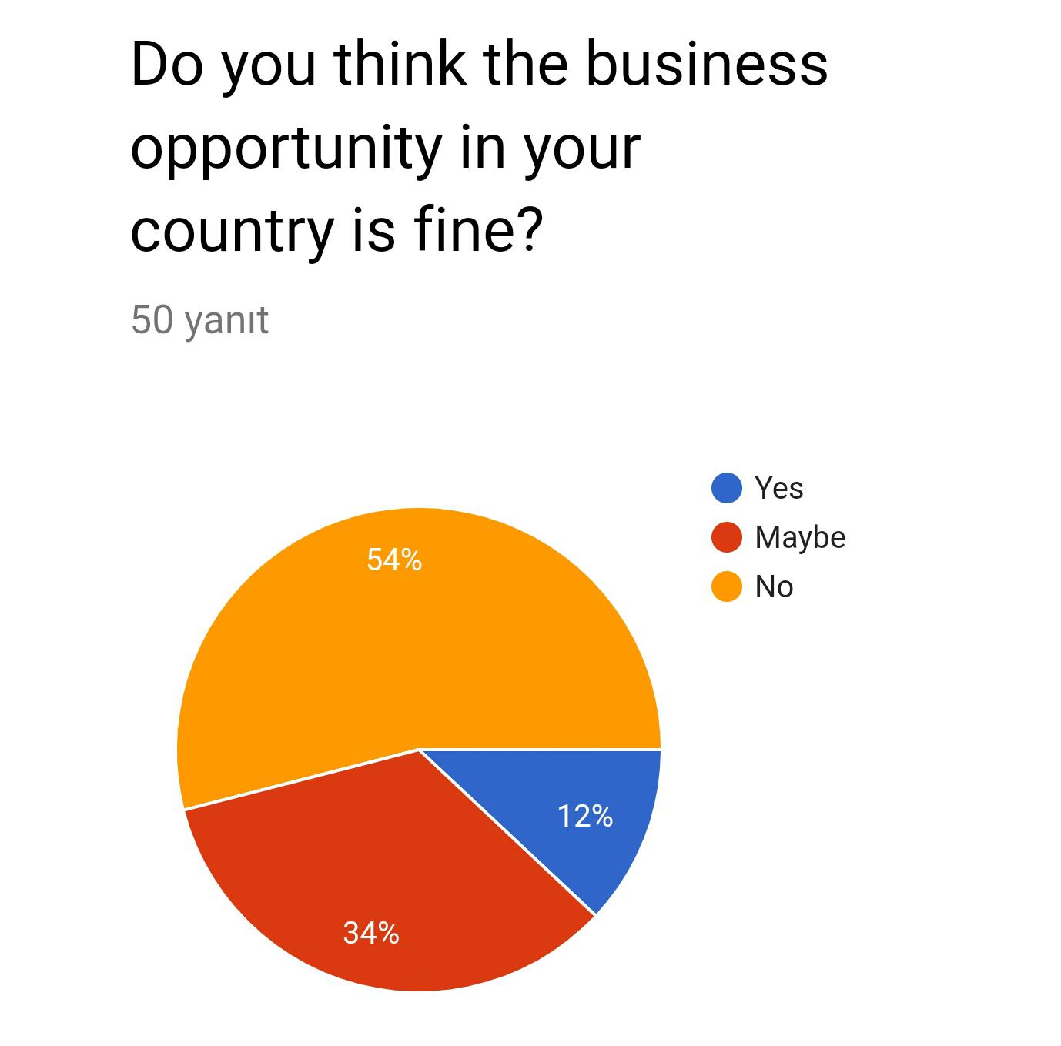
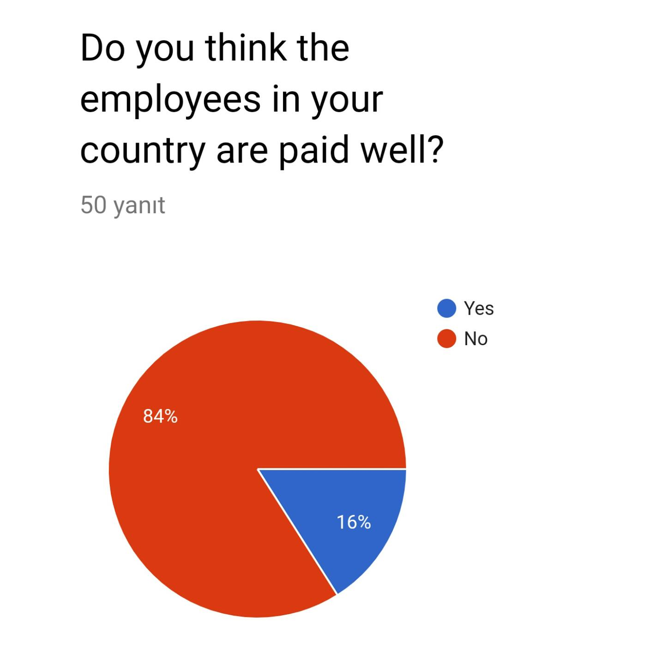
A Short Survey about Busıness Opportunıty

Slide 62
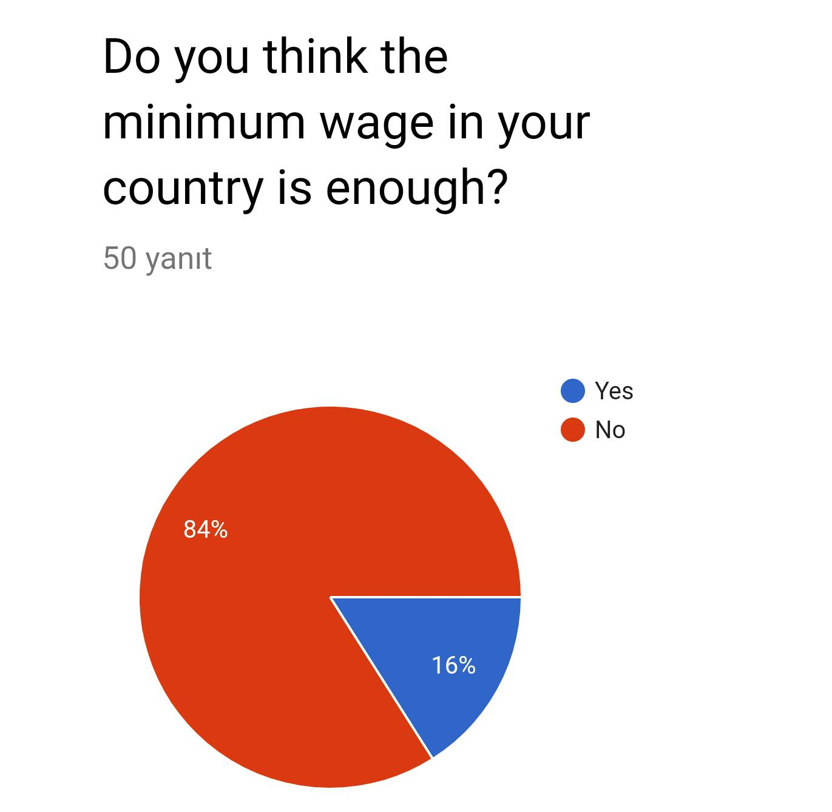
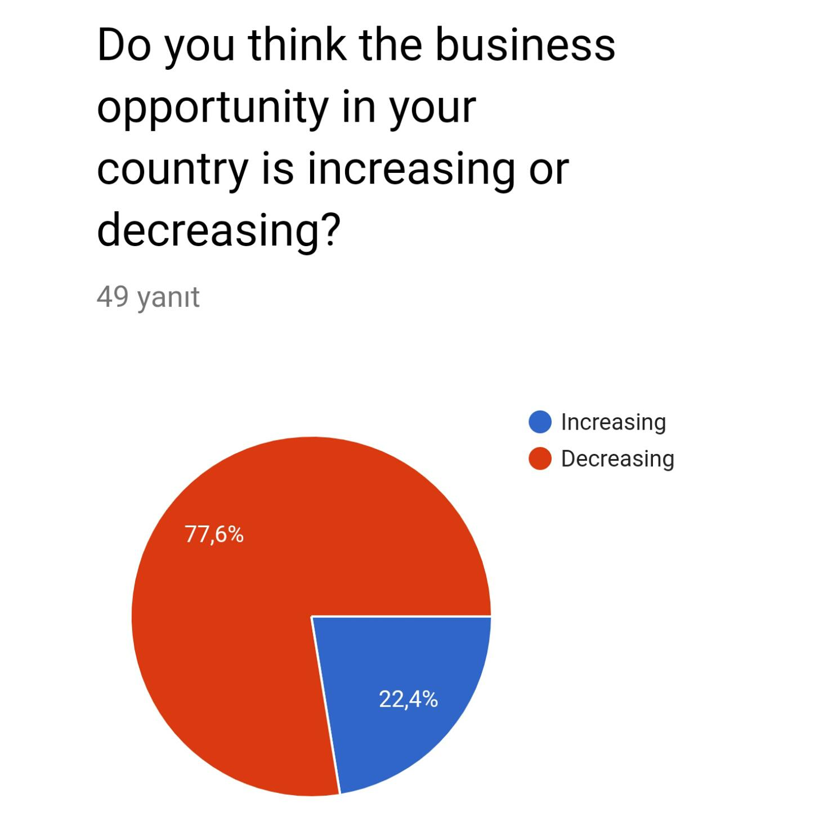

Slide 63
How to Write a CV How to Write a Letter of Intent How to Behave at an Interview

Slide 64
According to the recommendations that are contained in the European Commission’s current documents, today's entrepreneurship education must be materialised through the development of a general set of competencies which are applicable to the all aspects of the students’ later professional life.
The activities that are unfolded in group projects are ways of learning, education and training that contribute to creating the spirit, skills and entrepreneurial behaviour.
Real-life experience, problem-based learning and exchange of experience become a practical entrepreneurial experience in education before graduation. Entrepreneurial competence and skills can only be acquired or formed through practical and real-life learning activities
One of the most important activities in the acquisition of entrepreneurial skills is the design of the documents that will help any young person to build up an image, a "portrait" through which to objectively represent his/her skills and aptitudes.
Two of these documents are the CV and letter of intent.

Slide 65
How to Write a Curriculum Vitae
The CV is an instrument through which a candidate can "sell" his/her skills to a potential employer. Sometimes it takes only a few minutes for an experienced job hunter/recruiter to decide whether or not it is worth asking a candidate to come for the interview. Thus, candidates have to make sure that their CVs highlight their qualities and achievements in a concise and clear manner.
The CV is the starting point in any selection process. It usually mediates the interview between the candidate who offers his / her services and competences, and the representatives of the employer / organisation that will, at a later stage, conduct the selection interview.
The CV - curriculum vitae is considered to be one of the most "handy" assessment procedures, based on biographical information. The data included in the CV should be easy to understand and interpret, being the document by which the person who selects gets persuaded that the applicant is the most suitable person for the job. Therefore, a curriculum vitae is not an autobiography, it is a functional document that should give the applicant the chance to participate in the interview, which is another stage of any selection process.
In a contemporary context, there exists the Europass CV, whose features largely standardise the composition and information that should be included in a CV.

Slide 66
The Main Elements of a Europass CV Are:
Personal Information
the work position for which the candidate is applying or the studies for which he/she is applying
Professional Experience
Education and Training
Personal skills:
- foreign languages;
- communication skills;
- organisational / managerial skills;
Skills acquired in the workplace
- computer skills;
- other skills;
- driver's license;
More information: Annexes (documents, diplomas, evidence of the activities mentioned in the CV)

Slide 67
The students are taught the criteria to be followed in writing a CV. They learn that the chronological life curriculum is the most used type in which the headings are organized in stages from the current period and they continue, in reverse order, to the farthest period.
The other type of CV, the functional life one, is the type of CV that emphasises, especially the candidate’s personal and professional achievements, without taking into account chronology.
Special attention is given to the way the students write the CV content.

Slide 68
A Letter of Intent
The students learn how to write a letter of intent. The letter of intent is also known as the letter of motivation or presentation. It is the first contact that is established with the employer and it represents the link between the CV (resume) and the work placement.
Many employers do not even consider a CV unless they are accompanied by a letter of intent. Due to the content of the letter of intent, this presents a greater chance to highlight the candidate’s personality and the "strong points".
Such a letter should be conceived exclusively for the employing organisation; it is the first chance to remark and express the special interest for the organisation and the position you aim at.
Although the CV contains the most personal information, studies, and previous jobs, it is the letter of intent that will make the employer choose an applicant over the other candidates due to the personality and qualities that are reflected in it. It is proof of the work done during the previous career.

Slide 69
What to Include in a Letter of Intent
Opening Remarks - We should begin with a professional salutation. For this we need to find out the name of the employer or hiring manager and include it in your opening remarks.
Body Paragraph 1: Introduction - We should begin our letter by introducing ourselves and explaining the reason why we are writing. If we want to respond to a specific job listing, we will mention this, whereas if we do not, we will simply explain that we are interested in working for the company. We should explain what type of work we are interested in, but in this case, we should not too specific.
Body Paragraph 2: Highlight Relevant Skills - Here it is where we connect our skills and abilities to the job listing. We should spend some time to properly review the job description and the requirements listed in it. We should also mention one or two important requirements of the job, and explain how we can meet these requirements. We will need to provide specific examples from our past work experiences. We might divide this section into two paragraphs, this depending on the number of skills we want to mention.

Slide 70
Body Paragraph 3: Call to Action – We should conclude our letter with a brief paragraph on how we will follow up. If the job listing states not to follow up, we should simply say that we look forward to hearing from the employer.
Closing remarks - We should end the letter of intent with a professional closing such as ‘Yours faithfully’ or ‘Yours sincerely’, depending on the fact that we know the name of the person to whom we address the letter or we do not know the name. If we are submitting a printed letter, we should include a handwritten signature followed by our typed name. If we are emailing the letter, we should conclude with our email signature.
The students should also participate in interviews with real managers so that they should acquire real life skills of how to behave during an interview.

Slide 71
How to Behave at an Interview:
Before the Interview
1. Start by researching the company and your interviewers.
2. Practise your answers to common interview questions.
3. Re-read the job description.
4. Prepare to be asked about times in the past when you used a specific skill.
5. Recruit a friend to practise answering questions.
6. Prepare a list of references.
7. Be prepared with examples of your work.
8. Prepare smart questions for your interviewers.
9. Plan your interview attire the night before.
10. Bring copies of your resume, a notebook and pen.
11. Plan your schedule so that you can arrive 10–15 minutes early.

Slide 72
During the Interview
1. Treat everyone you encounter with respect.
2. Practise good manners and body language.
3. Win them over with your authenticity and positivity.
4. Respond truthfully to the questions asked.
5. Make a great first impression.
6. Link your answers back to your skills and accomplishments.
7. Keep your answers concise and focused. 8. Do not speak negatively about your previous employers.

Slide 73
The representatives of the companies have said that they appreciate the candidates who are curious not only about the job responsibilities and how they can grow in the company, but who also want to know about the company's culture, about the values ​​or principles they follow in the respective company, who have to find out about what kind of team there is in the company and about the way of working. It is also important if the representatives are asked about different projects the candidates have seen on the company website or online, or whether they are open to new ideas or proposals from them. Candidates who do their homework well before coming to the interview are at advantage.
After the Interview
1. Ask about next steps.
2. Send a personalised thank you letter after the interview.

Slide 74
Interview Mistakes
1. Dressing inappropriately
2. Arriving late
3. Bringing a drink with you
4. Using your phone during the interview
5. Not knowing enough about the company you are interviewing with.
6. Fuzzy resume facts
7. Not paying attention
8. Talking too much
9. Not being prepared to answer questions
10. Not making eye contact with the interviewer.
11. Criticizing your last company or boss.
12. Not remembering the job you applied for.
13.Telling the interviewer that you really need the job.
14.Telling the interviewer that you need the money.
15.Asking about time off in your first interview.
16. Asking about salary and benefits right away
17. Neglecting to thank the interviewer for the opportunity to meet with him or her.
18. Not sending a thank –you- note after the interviewer.

Slide 75
How to Deliver a Speech in Public

Slide 76
What to Do When You Deliver a Speech in Public
Set your goals
Prepare the material
Reserch for a model and study it
Begin with the strongest points
5. Learn your material.
6. Tell compelling stories
7. Practise, practise, practise!
8. Know the audience.
9. Relax.
10. Visualise yourself giving your speech.
11. Realise that people want you to succeed.
12. Don’t apologise for any nervousness or problem.
13. Concentrate on the message, not the medium.
14. Deliver a performance, rather than a speech.
15. Use the power of eye contact.
16. Posture matters.
17. Vary your cadence.
18. Speak about what you know and care about.

Slide 77
"This project has been funded with support from the European Commission. This publication reflects the views only of the author, and the Commission cannot be held responsible for any use which may be made of the information contained therein."

