Slide 1
READING STRATEGIES
Youngsters Nowadays. Where from, Where to?
2017-1-RO01-KA219-037190

Slide 2
STRATEGIES FOR BEFORE, DURING AND AFTER READING
BEFORE READING:
ask students what they know about the topic
make predictions about the probable meaning of the text
DURING READING
monitor understanding by questioning, thinking about, and reflecting on the ideas and information in the text.
AFTER READING
reflect upon the ideas and information in the text.
relate what they have read to their own experiences and knowledge.
clarify their understanding of the text.
extend their understanding in critical and creative ways.

Slide 3
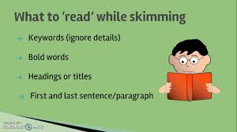
SKIMMING
Skimming refers to looking only for the general or main ideas.
Students should get the information they need quickly without wasting any time.
Skimming takes place while reading and allows to look for details in addition to the main ideas.

Slide 4
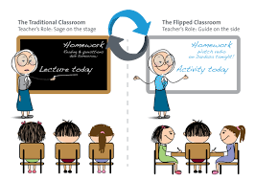
Flipped Classroom
In the flipped lesson ("upside-down lesson"), the teacher, provides students with her assistance in the classroom to make significant observations and considerations that emerge through websites given before.

Slide 5
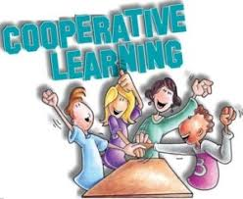
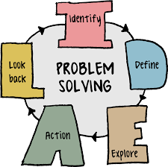
Analysis of the text
The students work through cooperative learning and problem solving.

Slide 6
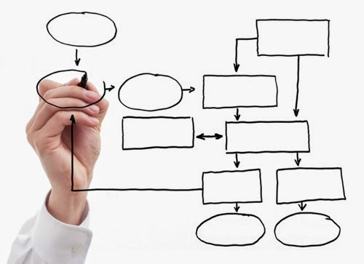
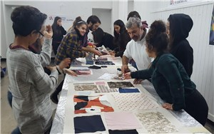
Consolidation Phase
Building of maps and schemes

Slide 7
Expansion Phase
Vision of the movie: http://www1.fmovies.sc/watch/paper-towns-2015-online.html
Debate about film adaptation

