Slide 1
Youngsters Nowadays Where from , Where to?
2017-1-RO01-KA219-037190_1
Workshop for the dissemination of the project results and the final products achieved during the project second Teaching, Learning and Training Activities, held at the partner school in Soverato, Italy, between 1st-5th October 2018.
Target group: Students and teachers from Colegiul Național. "Ion Luca Caragiale", Moreni.
Date: 02.11.2018

Slide 2
The workshop aimed at presenting the results of the project and of the two final products: "Youngsters’ Literature" and “Leisure Time Activities", carried out during the second Teaching-Learning-Training Activities held at the partner school from Soverato, Italy, from 1st to 5th October 2018. The students of the project team presented to colleagues and teachers present at the activity, the support course with the literature teaching techniques, based on a novel / novella chosen by each partner school. They exemplified these techniques of teaching different sequences in the book, organized role plays, watched some sequences of screenings that were made on the basis of the book chosen by each school.
The resulting product "Youngsters’ Literature" is very important for the project, as it is a course with literature teaching techniques in a pleasant way that will be used in English classes and contributes to the development of the interest in reading for young people, both as a way of spending leisure time, but also for their personal development.
The final product “Leisure time activities for young people" was presented, which included suggestions for spending leisure time in a pleasant, efficient way for personal development. In a debate, based on this presentation, the present students identified similarities and differences between what is different and what is common / similar in their habits and young people from other countries. They have made suggestions on how they can benefit from free time activities and they gave arguments. The conclusion was that free time spent in reading, sports, outdoor exercise, documentary visits, or witing travel journals, etc. contributes to a healthy lifestyle, to the well-being and personal development of young people. They understand that reading improves their general knowledge, and the reading techniques developed help them develop their critical thinking.

Slide 3
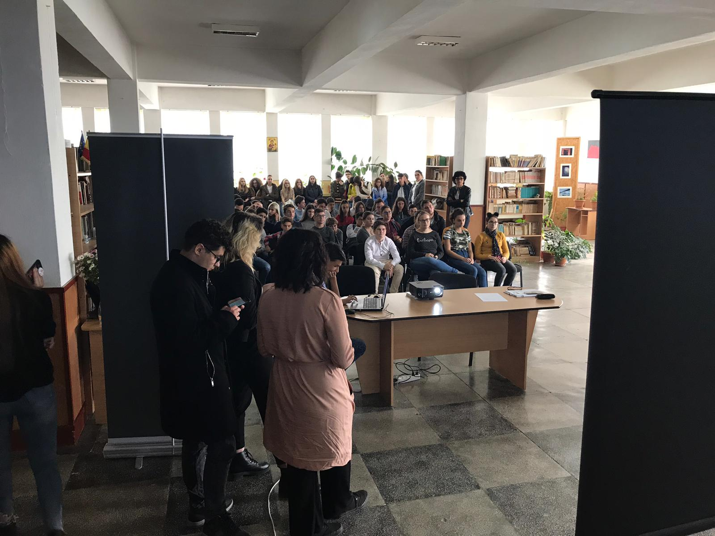

Slide 4
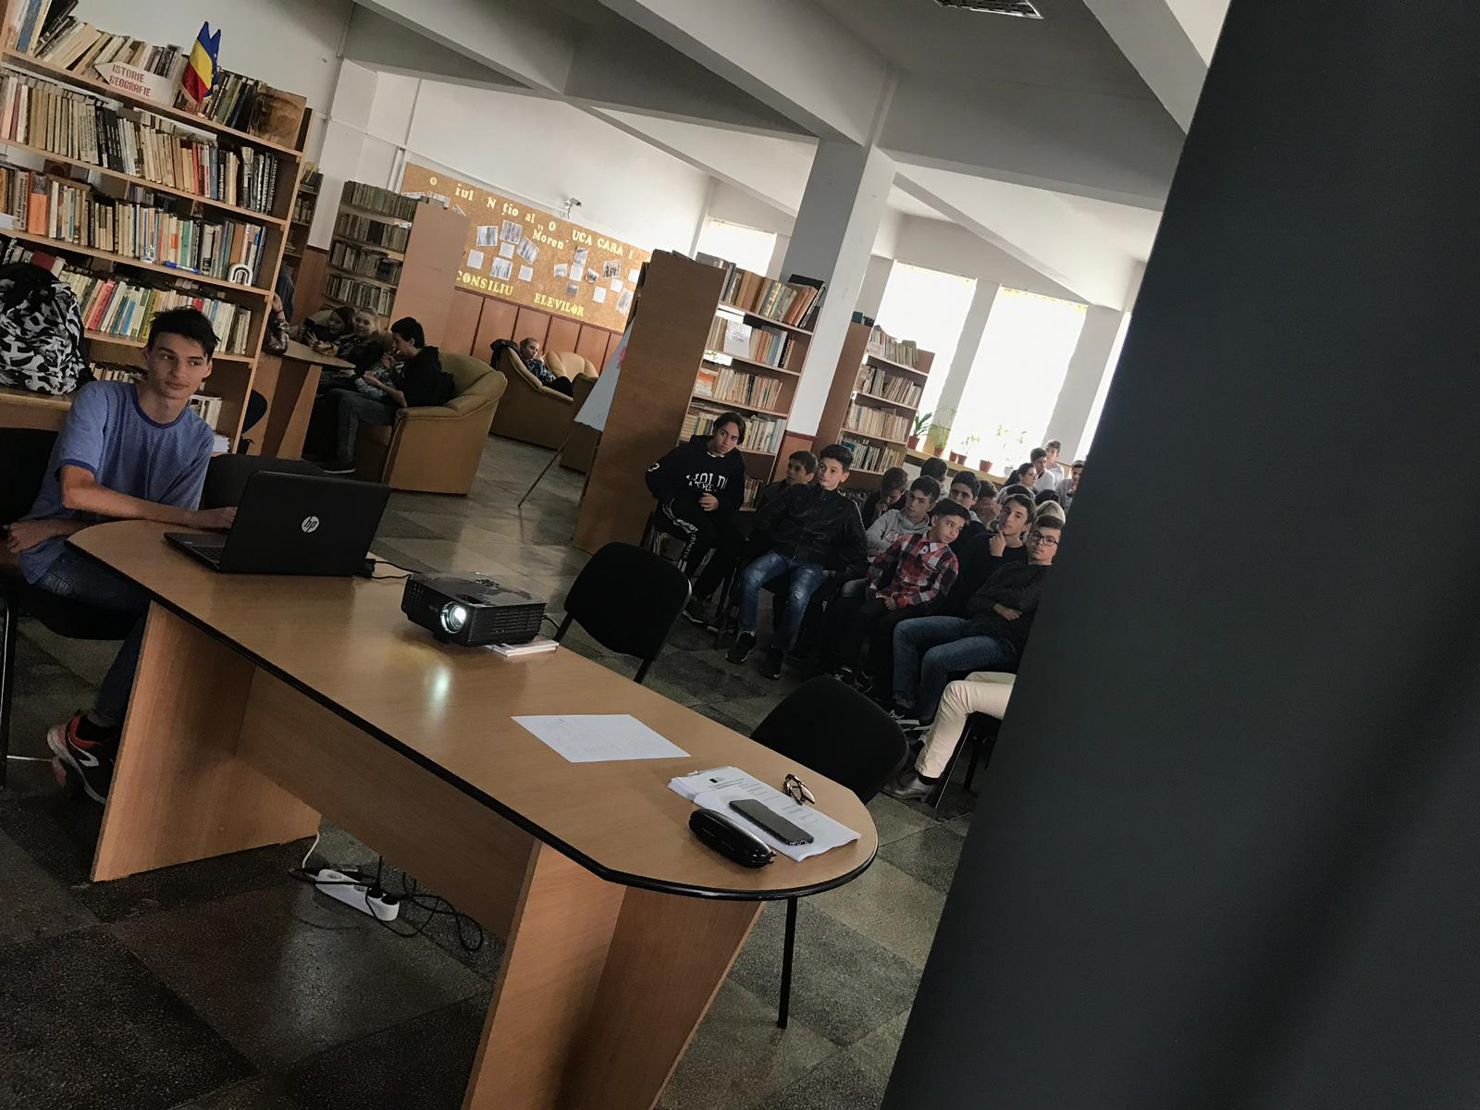
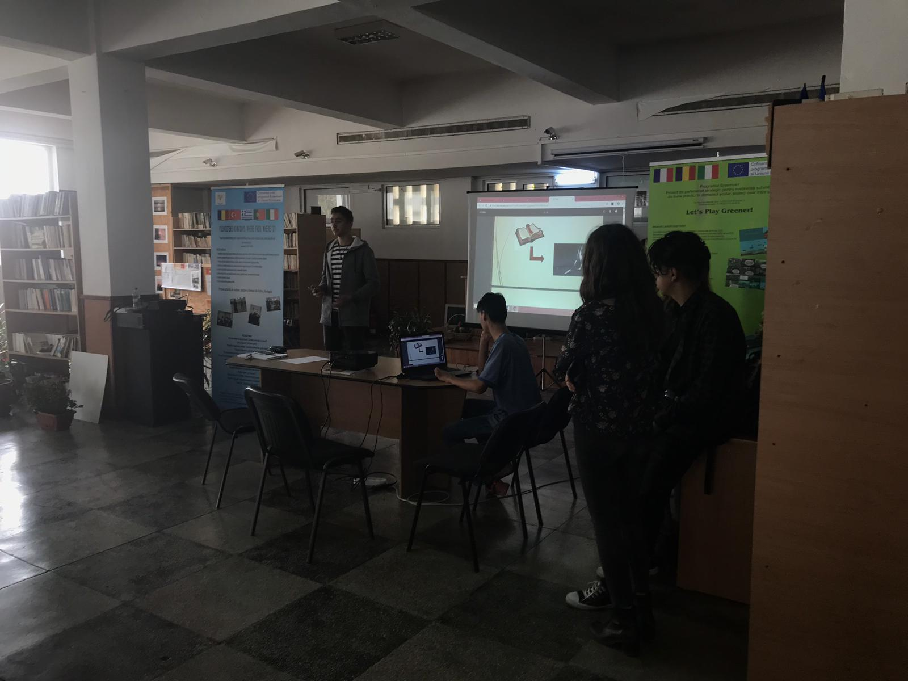

Slide 5
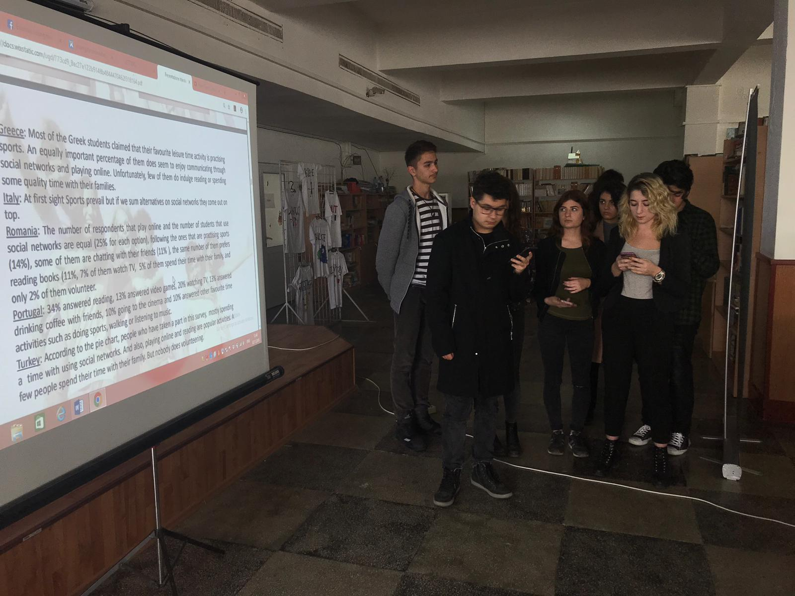

Slide 6
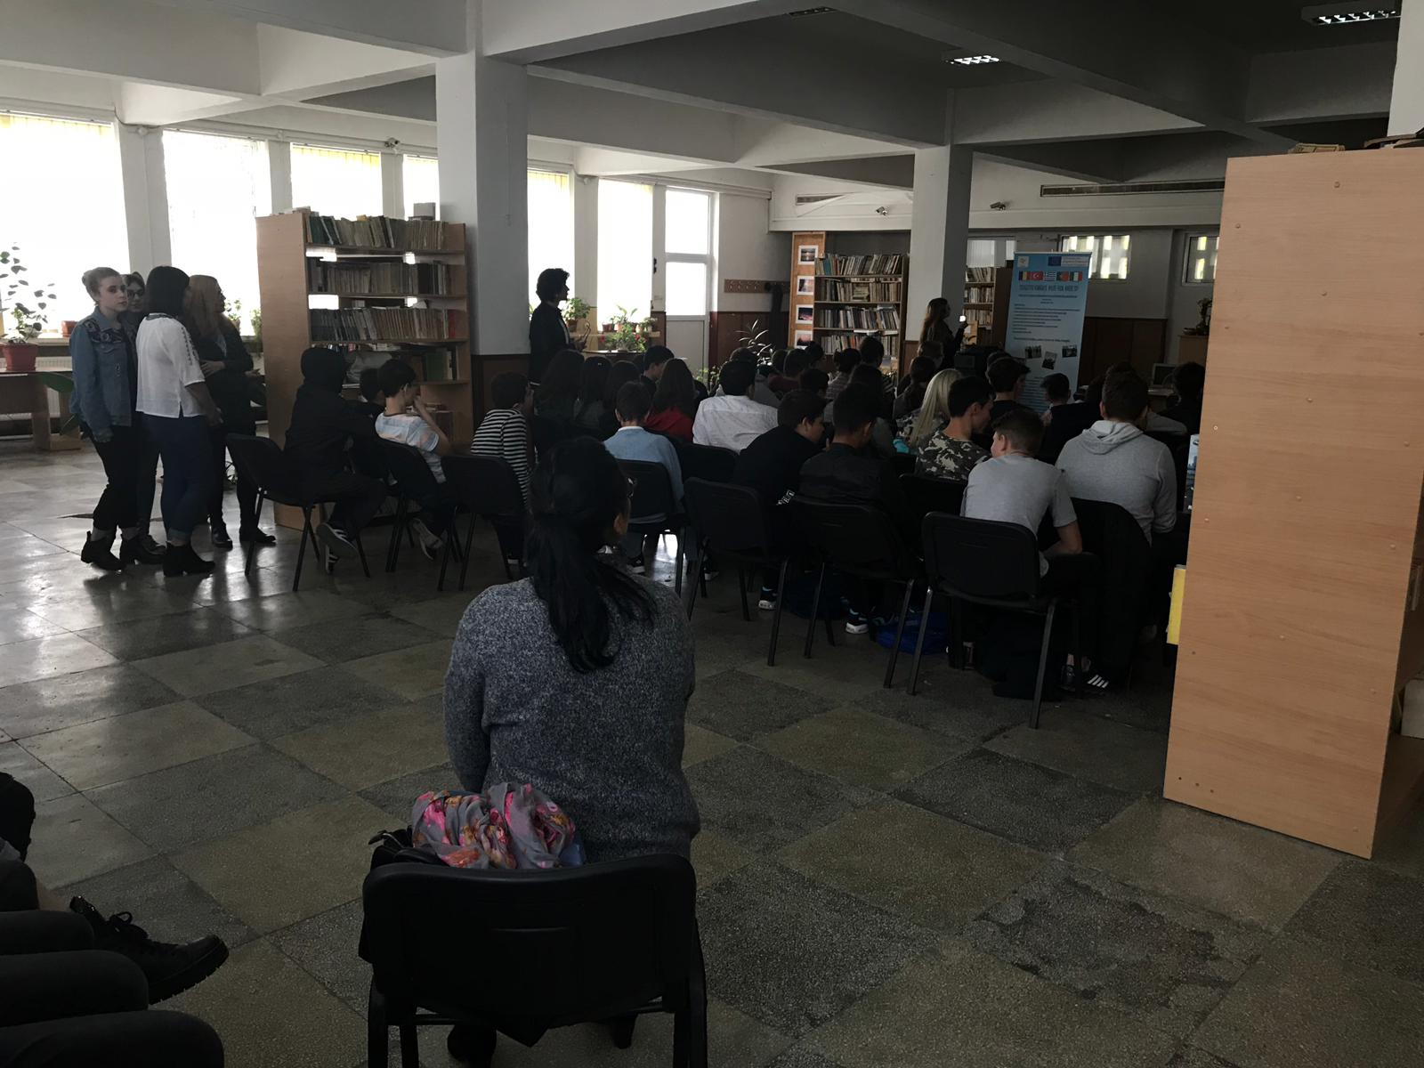

Slide 7
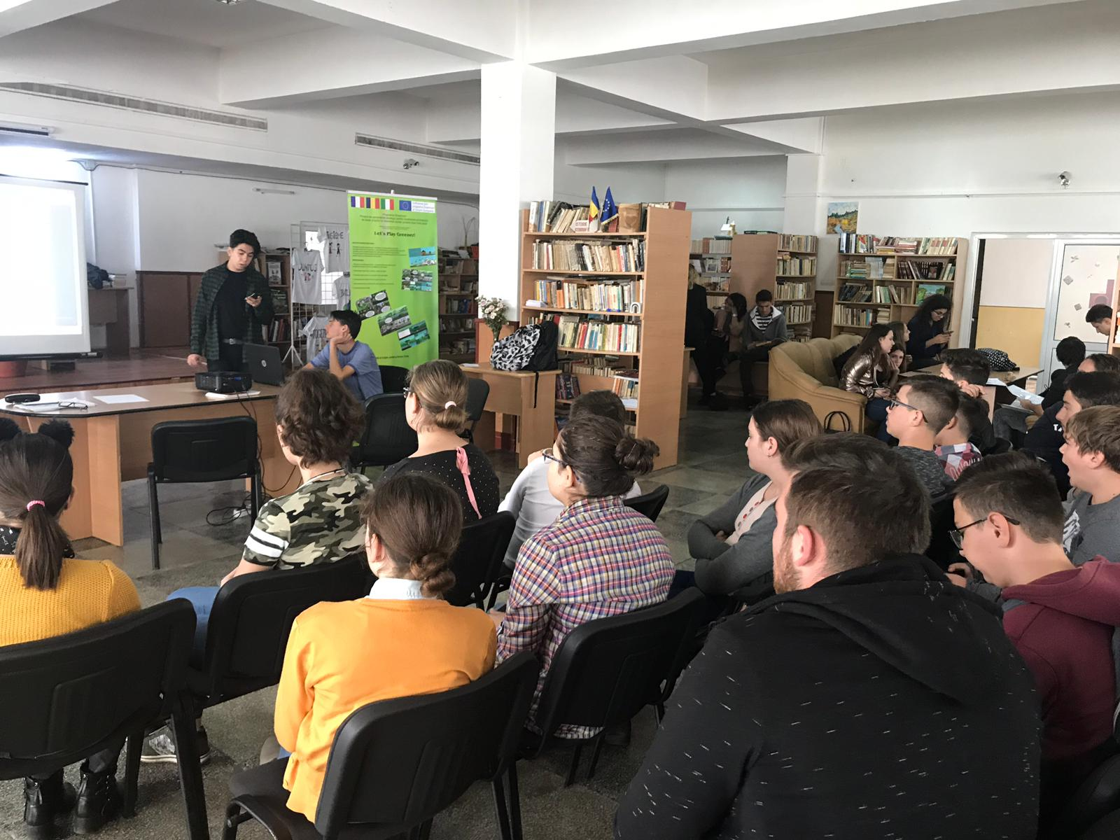
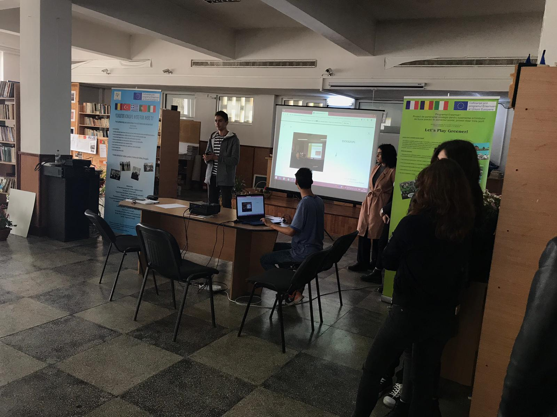

Slide 8
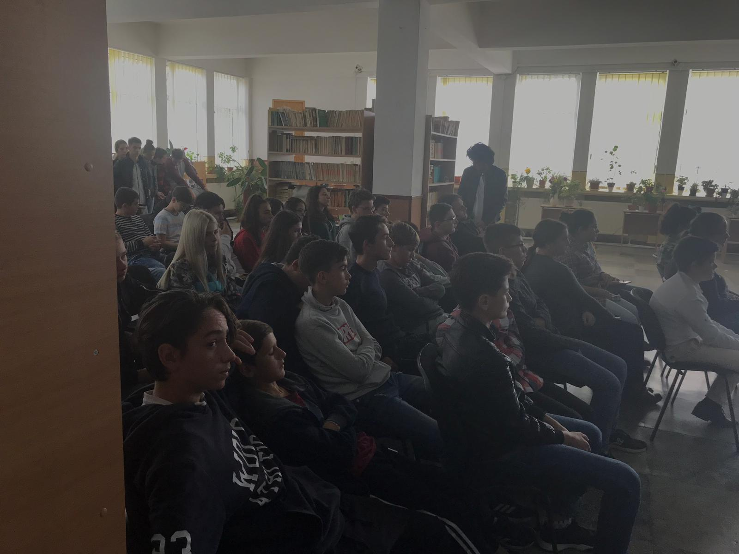
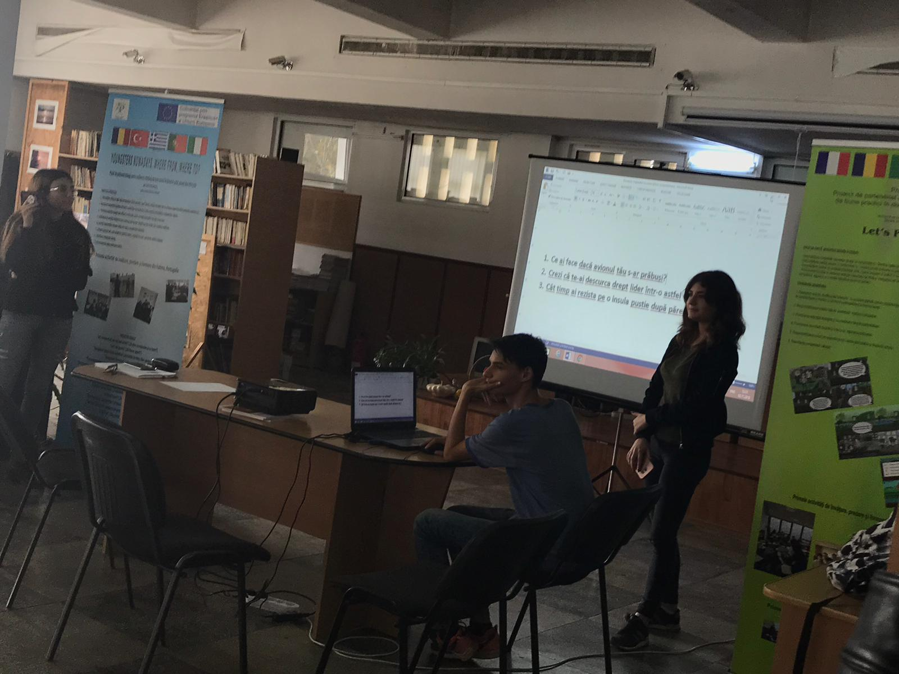

Slide 9
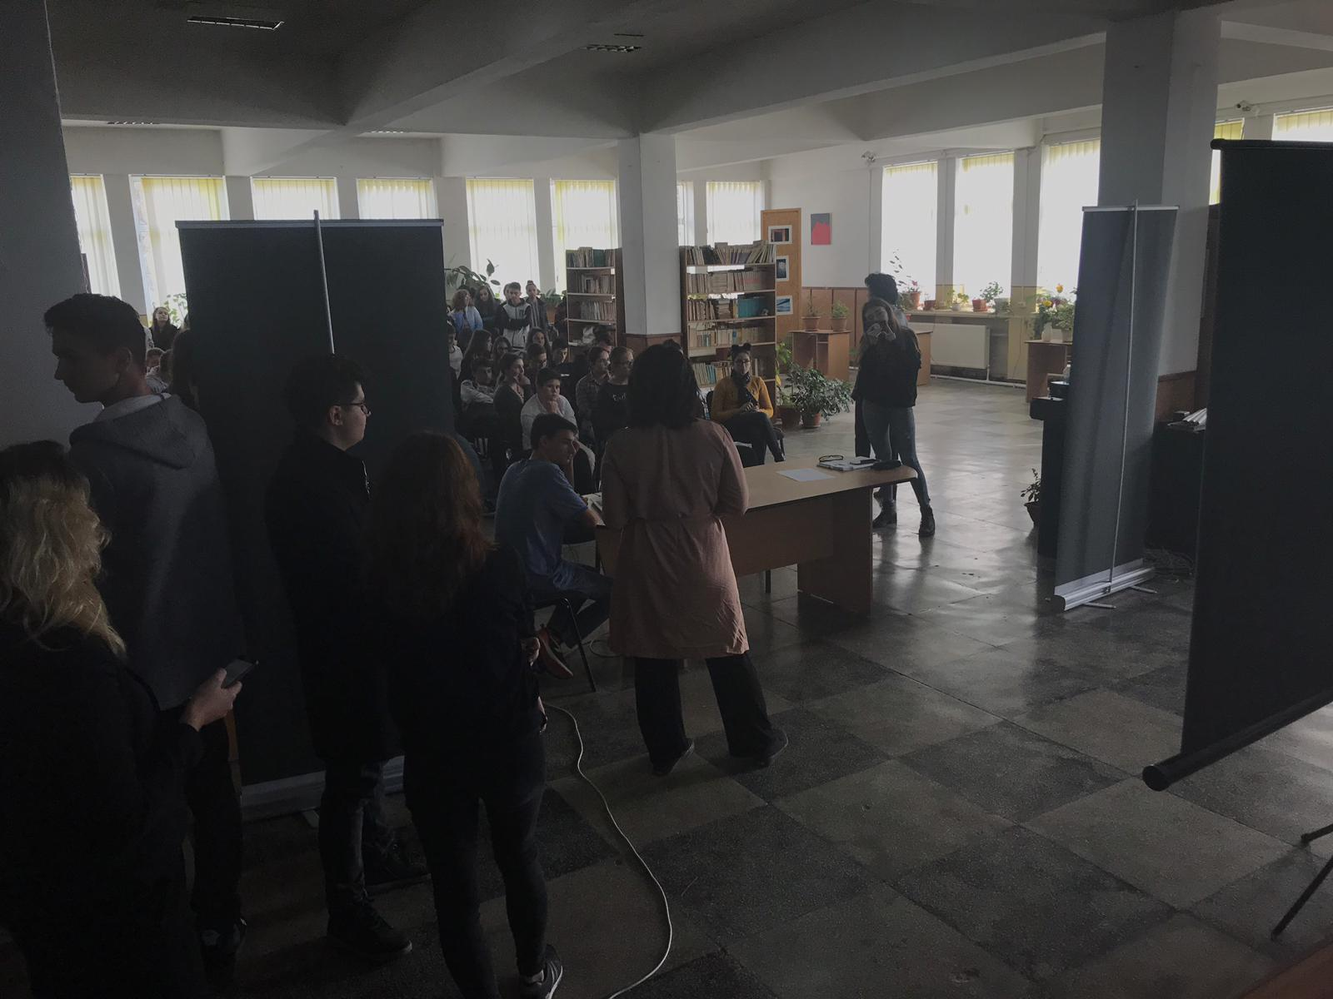

Slide 10
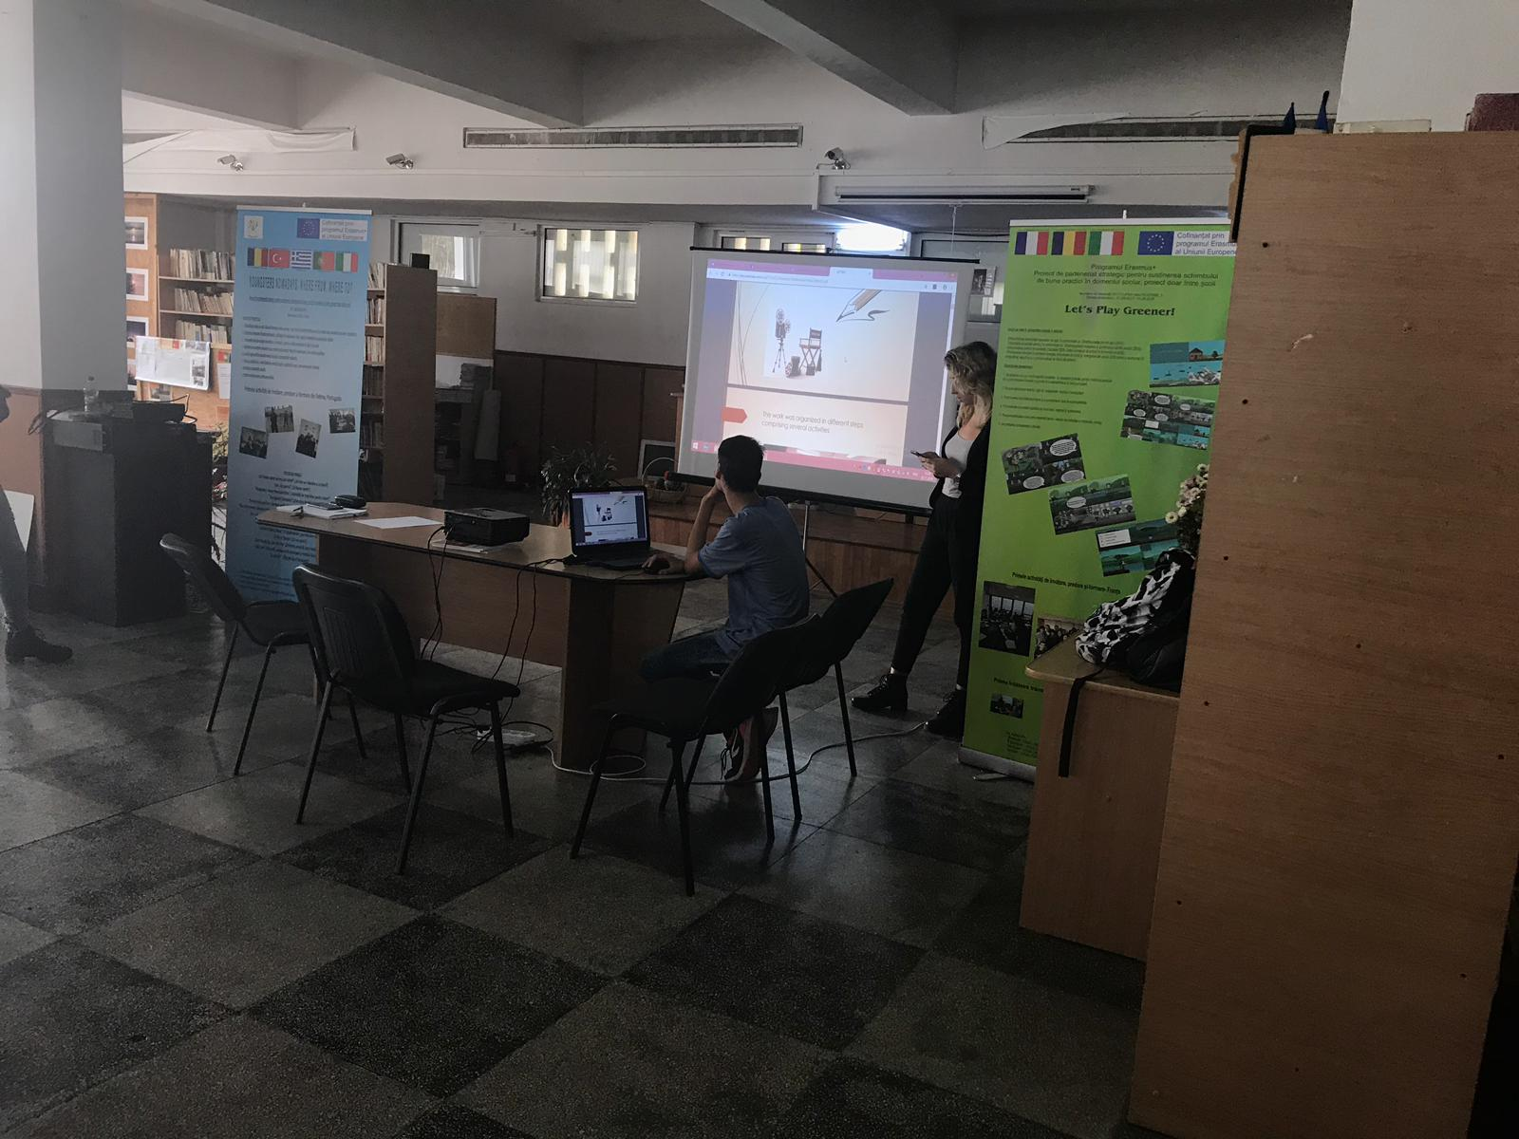

Slide 11
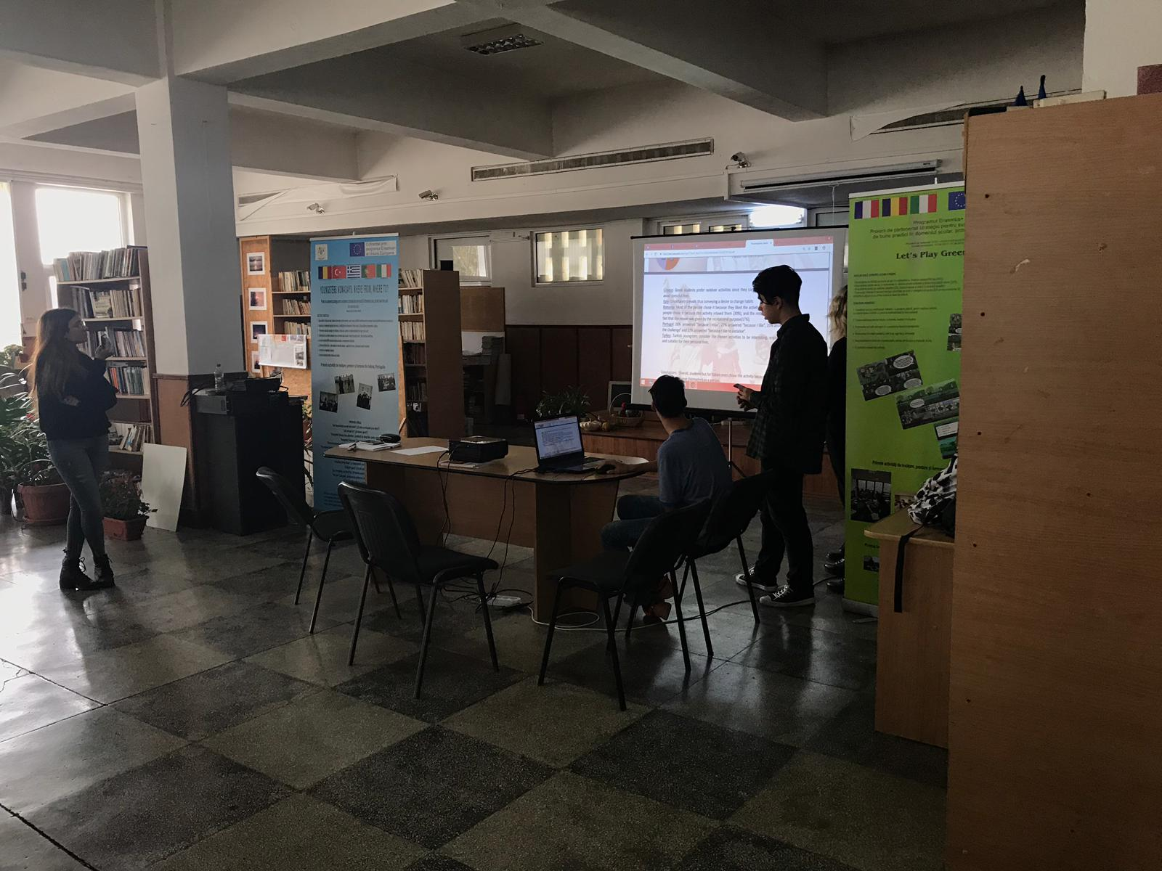
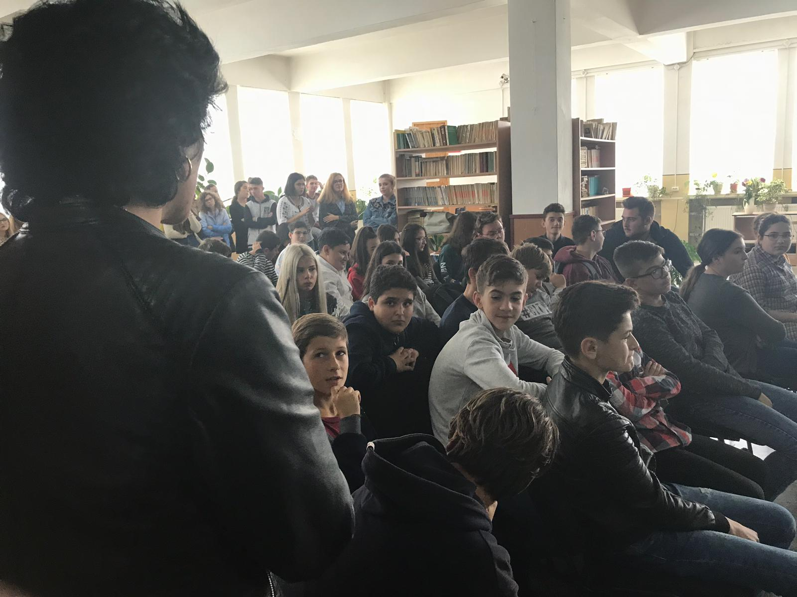

Slide 12
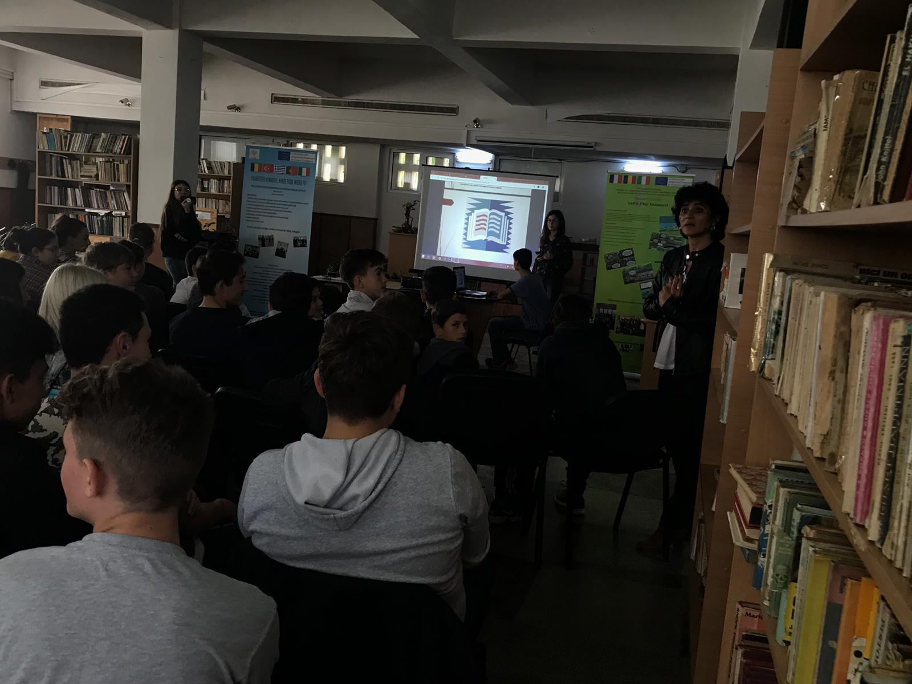
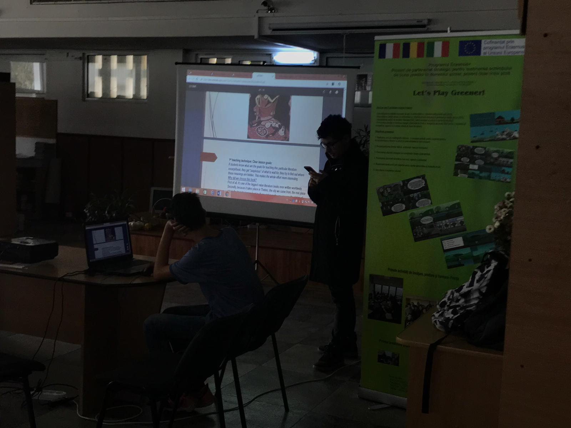

Slide 13
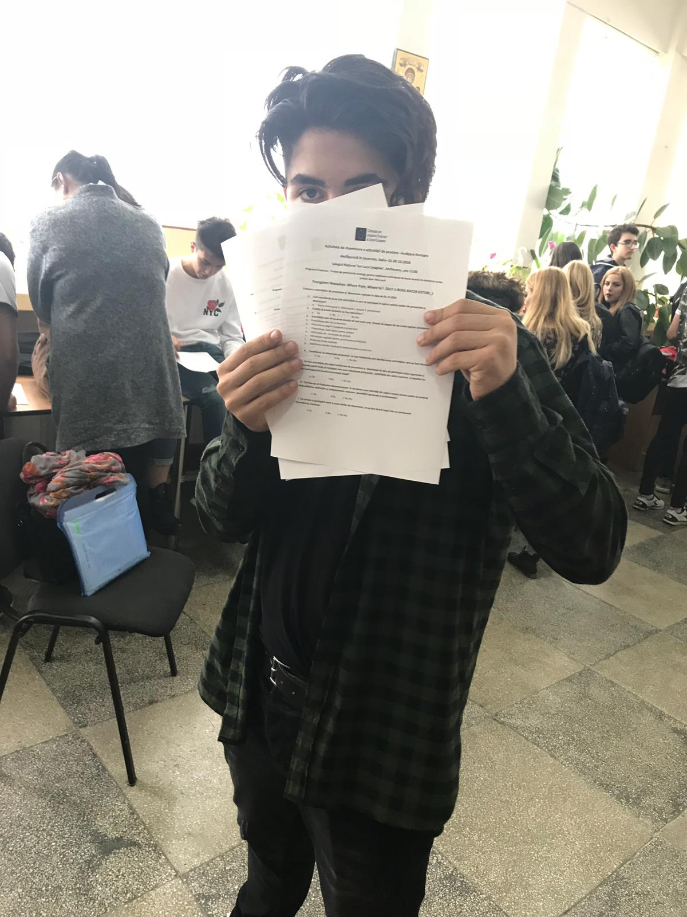

Slide 14
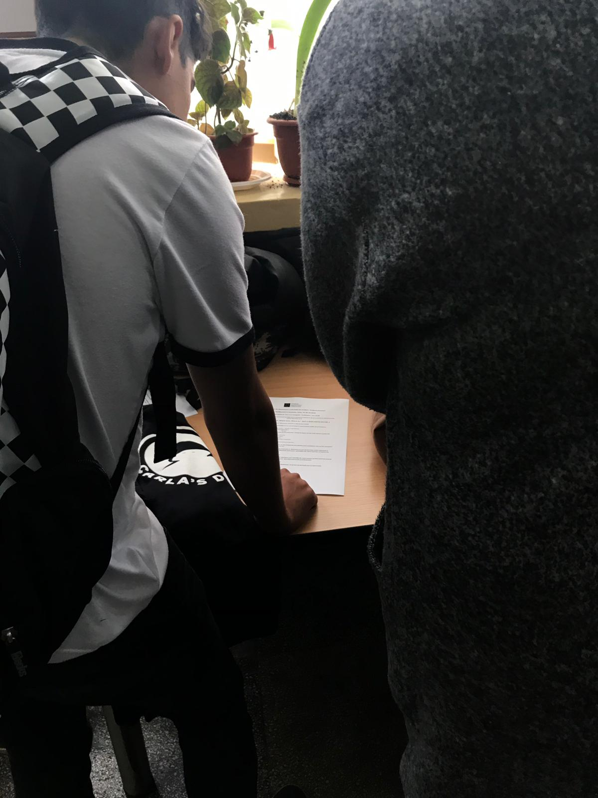
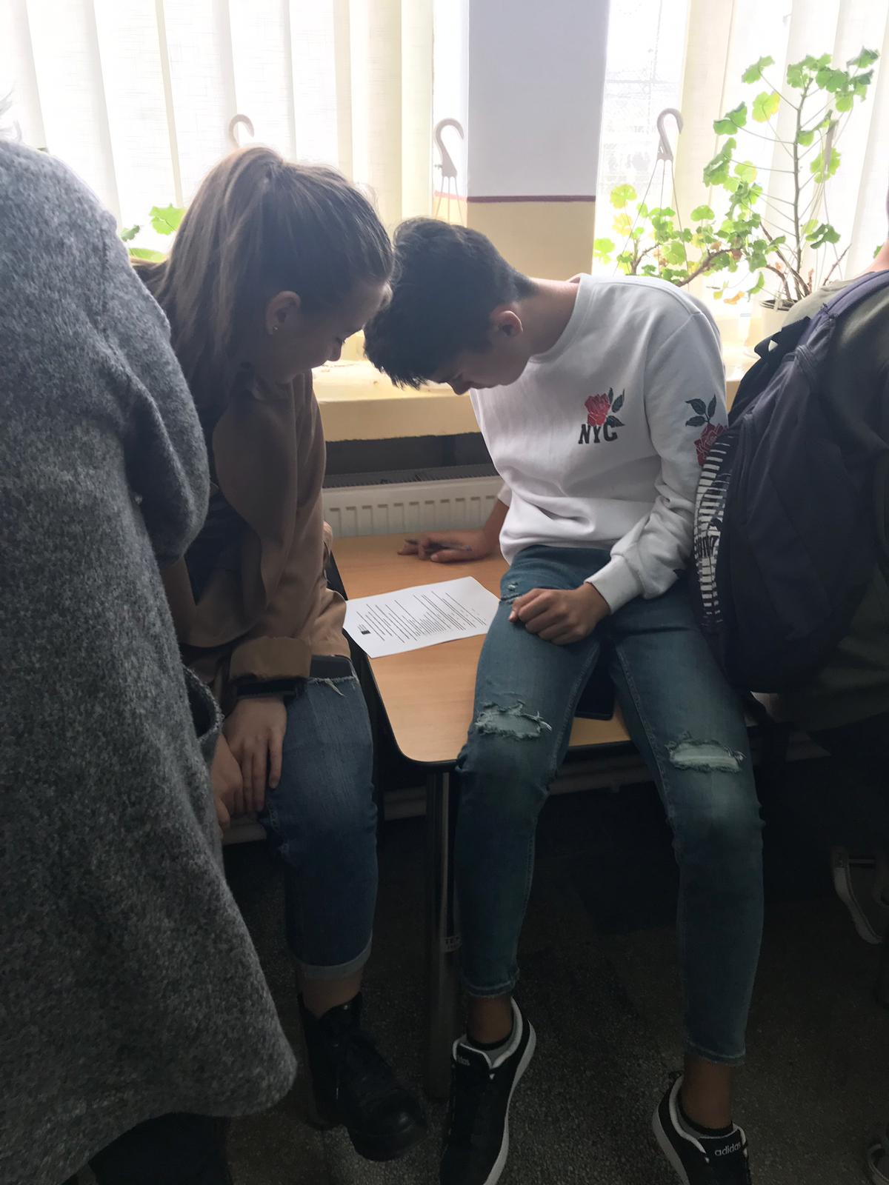

Slide 15
’This project has been funded with support from the European Commission. This publication reflects the views only of the author, and the Commission cannot be held responsible for any use which may be made of the information contained therein.’

