Slide 1
ERASMUS + PROGRAMME- STRATEGIC PARTNERSHIP
‘Youngsters Nowadays. Where from, Where to?’
2017-1-RO01-KA219-037190
The Romanian project team presents:
Samples of the Romanian traditional food

Slide 2
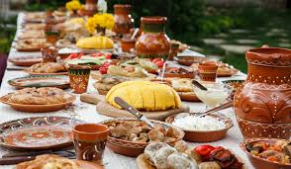

Slide 3
Let’s make a short introduction…
Romanian traditional food is represented by various kinds of dishes, generally based on adding cooked vegetables to fried, boiled or grilled meat, especially pork and beef.
We like to make our food spicy, so we use a lot of paprika, pepper, thyme and other condiments.
We usually eat a bowl of any kind of soup before the main course.

Slide 4
THE APPETIZER
What we put first on the table is made of meat and out of milk, so we eat ham pork, salami, different kinds of cheese, near which we add olives, green onion and other fresh vegetables like tomatoes or cucumbers. We drink ‘țuică’ (plum brandy) or ‘palincă’ (double distilled plum brandy), a traditional strong drink which is made of plums, but they can also be made of apples or pears.

Slide 5
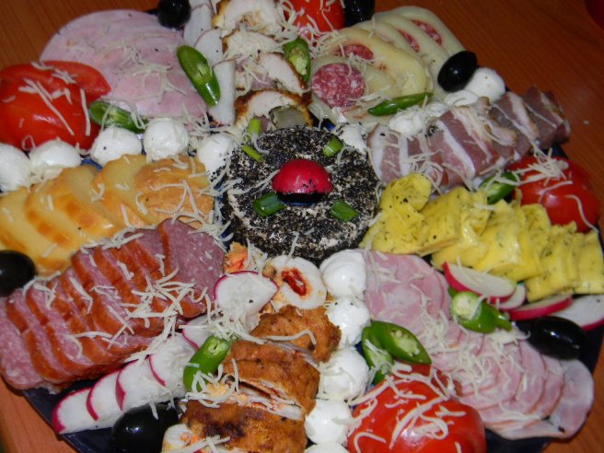
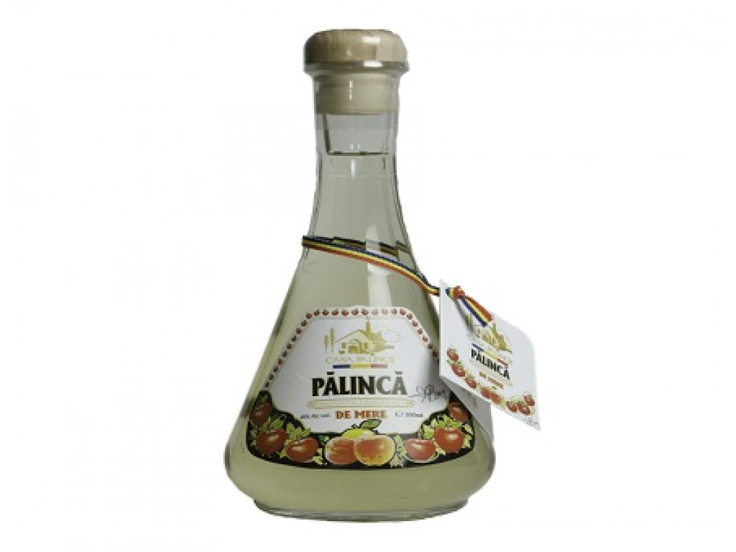
THE APPETIZER - pictures

Slide 6
THE MAIN COURSE
Before the “heavy food”, we like to eat meatball soup, which we call ‘ciorbă de perisoare’.
The most significant Romanian main course is represented by ‘sarmale’ ( stuffed cabbage rolls- a mixture of minced pork, beef and onion, rice and herbs such as thyme, cooked in leaves of vine or sour cabbage leaves), which we eat with ‘mămăligă’ (boiled corn flour – corn porridge/polenta), sour cream and with hot pepper.

Slide 7
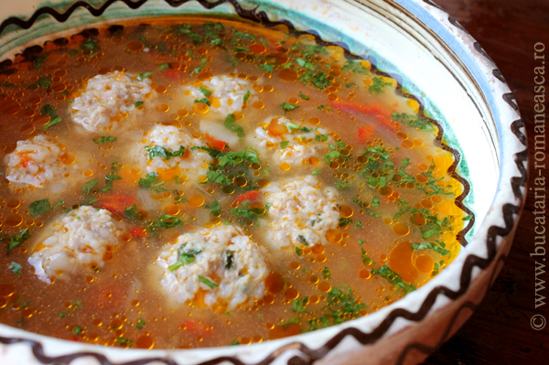
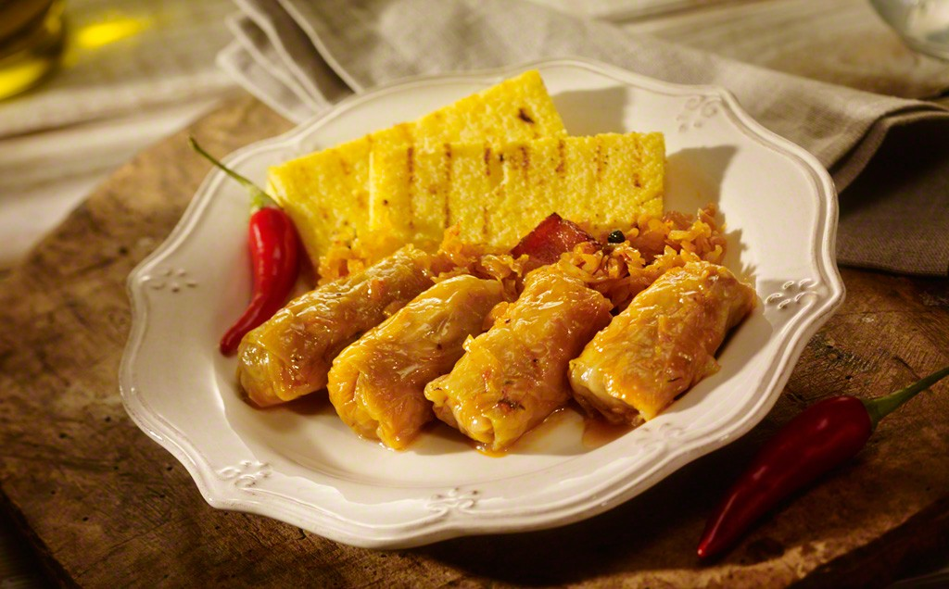
THE MAIN COURSE - pictures

Slide 8
THE DESSERT
The traditional Romanian dessert is ‘cozonac’-plum cake, a kind of cake which may contain according to the personal preference nuts, raisins, Turkish delight and cocoa. We also have many types of cheese and fruit jam pies named ‘poale-n brâu’.

Slide 9
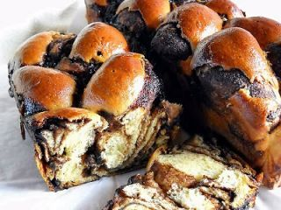
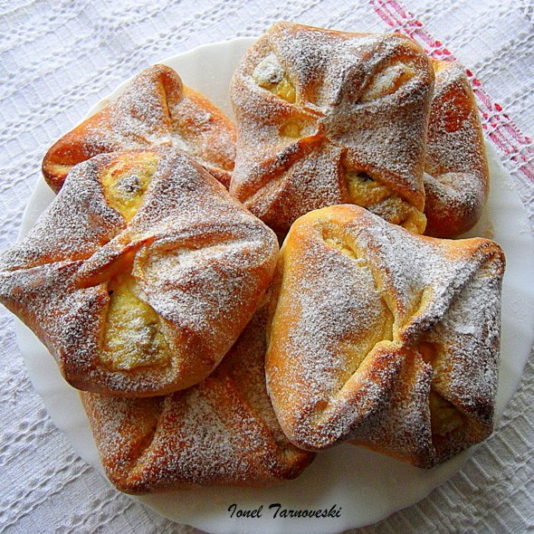
THE DESSERT - pictures

Slide 10
TASTY OR NOT?
All the tourists who had had the opportunity to taste Romanian food believed that it deserved praise and they promised to always recommend it to anyone who wanted to visit a new country or to eat something good.
You should also try it!

Slide 11
"This project has been funded with support from the European Commission. This publication reflects the views only of the author, and the Commission cannot be held responsible for any use which may be made of the information contained therein."

