Slide 1
Italian Traditional Game

Slide 2
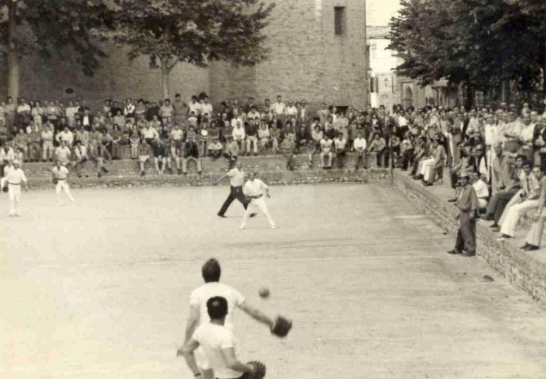
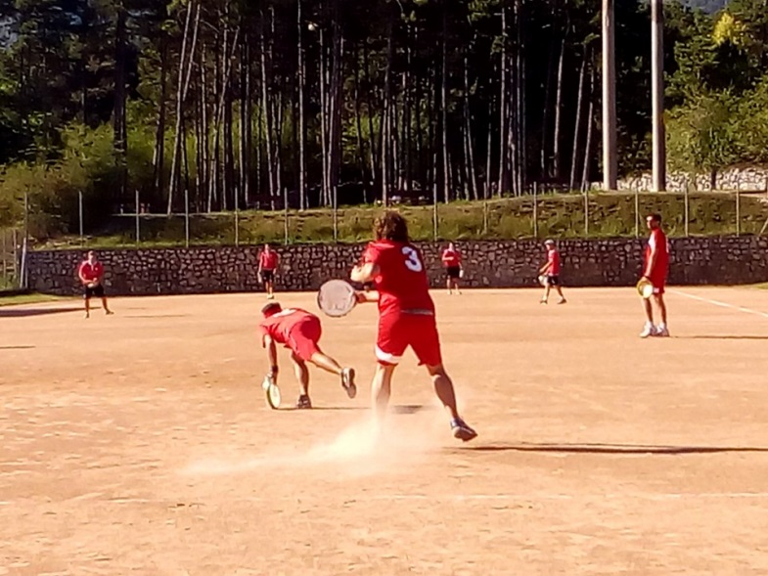
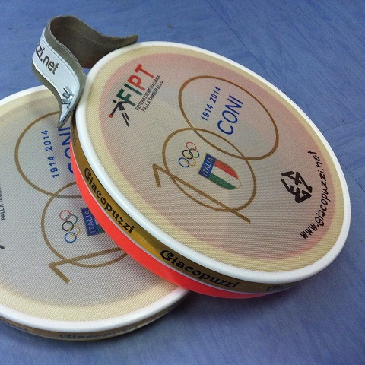
(PALLA TAMBURELLO)
Tamburello is a court game born in the northern provinces of Italy during the 16th century. It is a development of the ancient game “pallone col bracciale” (a wooden cylinder bracelet)

Slide 3
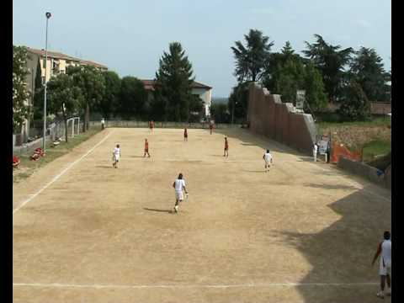
DESCRIPTION
Five players for each of the two sides, carrying a tamburello (a round frame of wood over which a horsehide cover is tightly stretched).
A rubber ball generally larger than a tennis ball is used.

Slide 4
rULES
There are two varieties of the game: the former taking place in a sphaeristerium endowed with a side wall which lets rebounding; the latter being played in an open field
A full-sized tamburello court is 82 to 91 meter long; its width is proportionally the half. A line (cordino) divides it into two equal spaces, the battuta and the rimessa. One of the players opens the service (battuta) which begins from a small square called the trampolino, situated at one corner of the battuta outside the court. The service launch must go over the middle line. Afterwards the ball is hit from side to side over the line: the side failing to return it or sending it out of court losing a point. The game is scored like lawn tennis, four points constituting a game, counting 15+15+10+10.
The team is composed of a maximum of 9 players (nine):
- five (5) players on the playing surface;
- four (4) substitutes in bench.

Slide 5
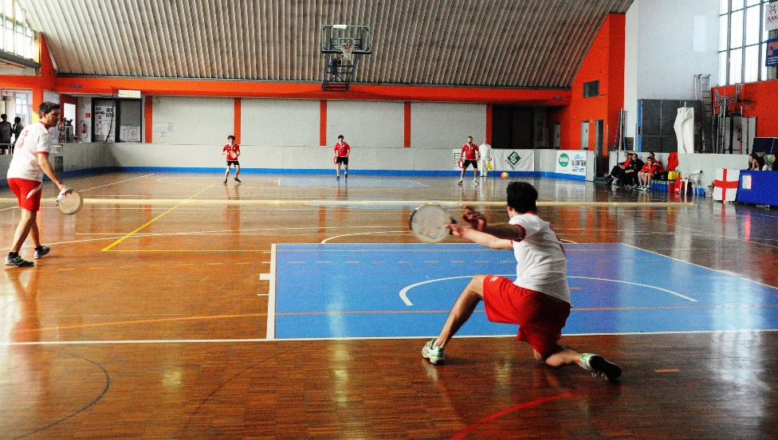
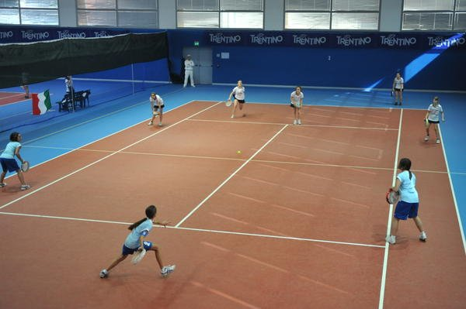
Indoor is practiced in an enclosed space such as a sports hall or a school gym on a smaller field and each team has maximum 8 players out of which 3 in the field. The ball in this case cannot be made of rubber, because too fast, so a depressurized tennis ball type is used.
INDOOR

Slide 6
A video of the game

