Slide 1
Job opportunities and trends in Calabria
ERASMUS+ PROJECT
Youngsters Nowadays. Where from, Where to?
What are the job opportunities and trends in Calabria according to ITT Students

Slide 2
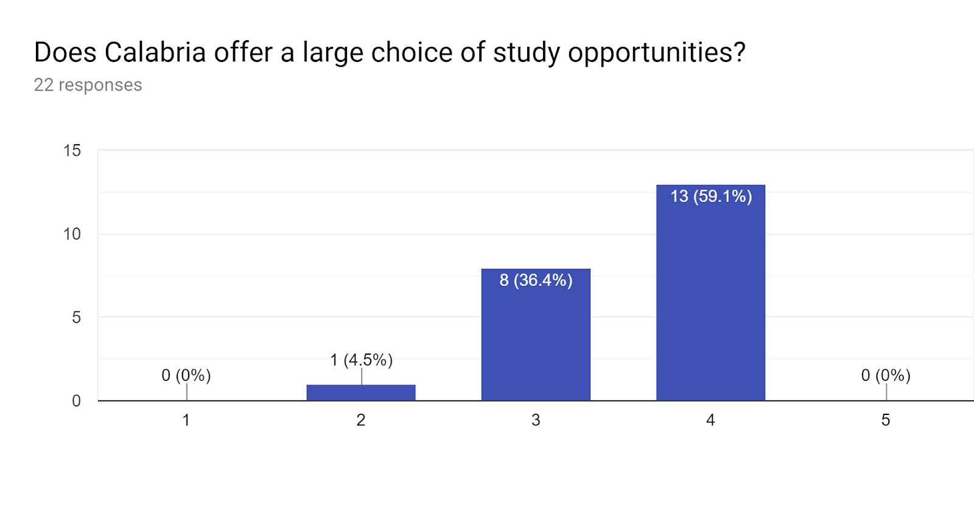
Does Calabria offer a large choice of study opportunities?
1 Strongly disagree 5 Strongly agree
University offer is various

Slide 3
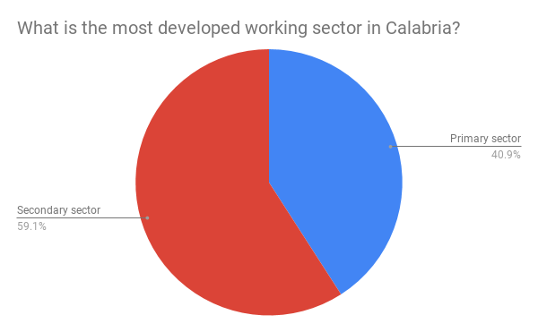
What is the most developed working sector in Calabria?
Economy is based on secondary sector

Slide 4
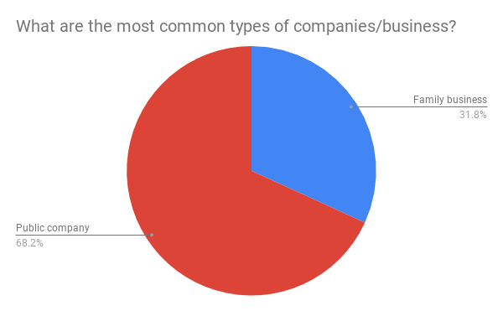
What are the most common types of companies/business?
Jobs are concentrated in the public field

Slide 5
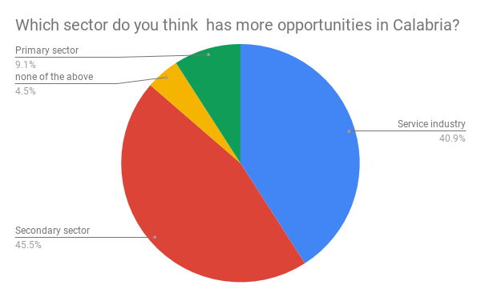
Which sector do you think has more opportunities in Calabria?
There are good chances in the secondary sector and in service industry

Slide 6
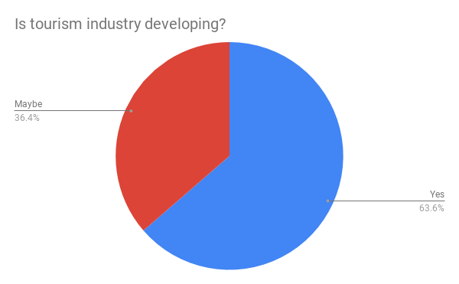
Is tourism industry developing?
Itt students believe tourism is increasing

Slide 7
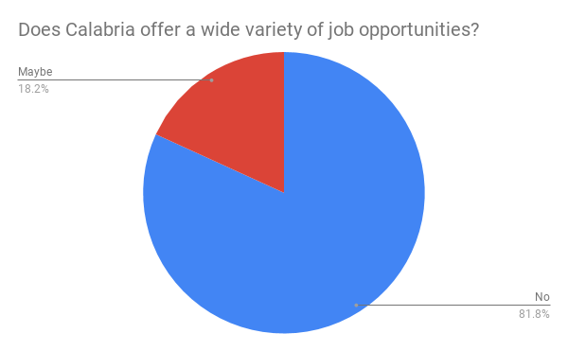
Does Calabria offer a wide variety of job opportunities?
There is an evident state of disillusionment

Slide 8
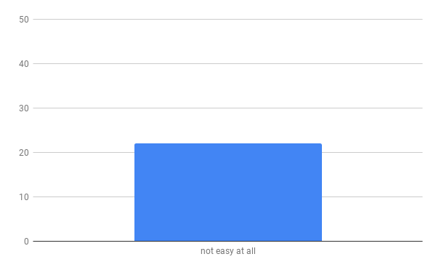
How easy is for a young person to find a job in Calabria?
All students find it very hard to find a job in Calabria

Slide 9
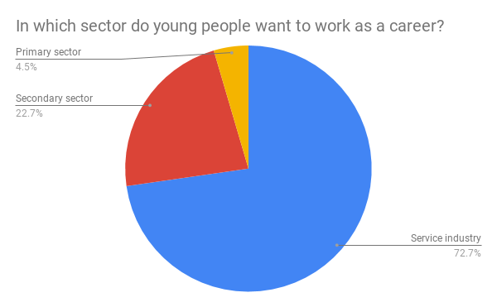
In which sector do young people want to work as a career?
Most students would like to be employed in the service industry

Slide 10
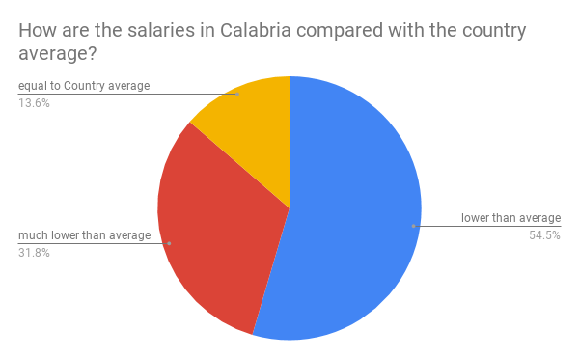
How are the salaries in Calabria compared with the country average?
Most students believe salaries are not on line with the others in other parts of Italy

Slide 11
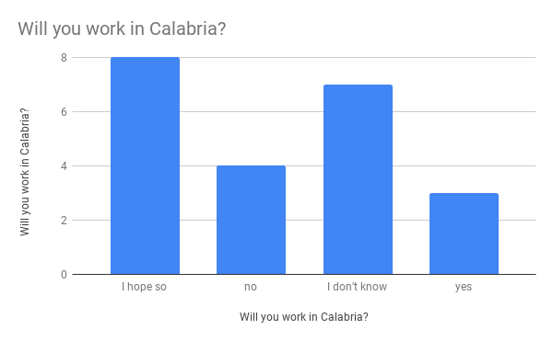
Will you work in Calabria?
Answers reveal a heterogenous situation

Slide 12
Thanks for watching
This project has been funded with support from the European Commission. This publication reflects the views only of the author, and the Commission cannot be held responsible for any use which may be made of the information contained therein.

