Slide 1
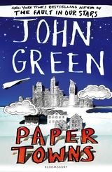
PAPER TOWNS
A book by John Green

Slide 2
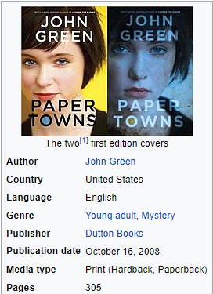
It is a book that speaks of appearance and reality, but also tells of all the upsets and anxieties that affect a very special period of life. It has a pressing reading and arouses suspense and tension into the reader.

Slide 3
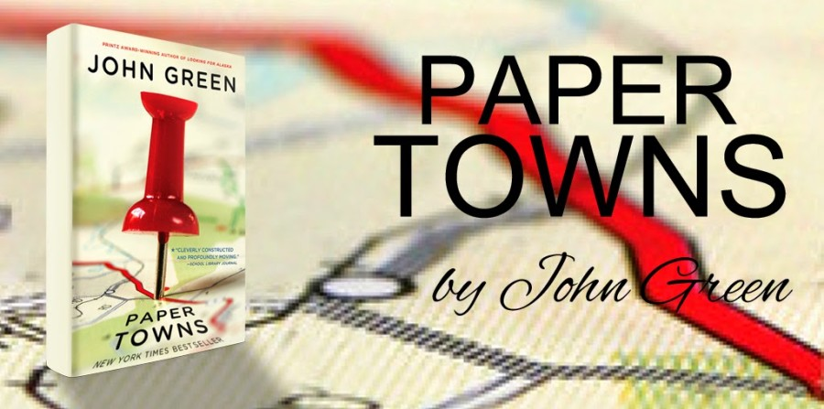
Paper towns by John Green is the story of Quentin Jacobsen and Margo Roth Spiegelman, two teenagers on the threshold of adult life. Quentin has always been in love with Margo, ever since they were both children, but then with the passing of time, their special bond has faded, until the day before graduation, when Margo shows up at Quentin's window and drags him into a night of adventure.

Slide 4
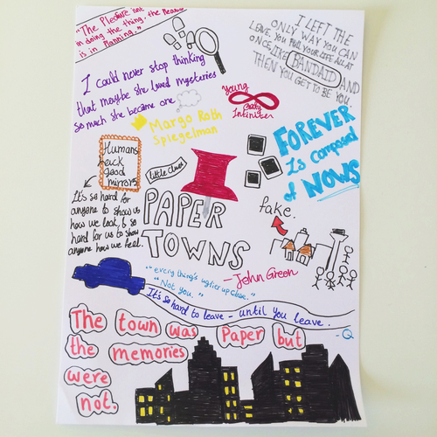
The next morning, Margo disappears in a mysterious way, but nobody cares. Thus the search for Quentin and his friends Ben, Radar and Lacey began, not only a search for Margo, but also a research on themselves, a journey to discover what in life is true and what is instead "paper", what is real and what is only perception, mask.

Slide 5
It is a fantastic book to read in one breath. John Green never disappoints: whatever the story is, everything comes to life at the end such as places and emotions. And in a moment readers are catapulted on a journey in search of Margo. Yet in reality it is much more than a simple journey. It is a journey of self-discovery. Step by step the pieces of the puzzle come together because "you have to get lost before finding yourself again”
Why you should read this book

Slide 6
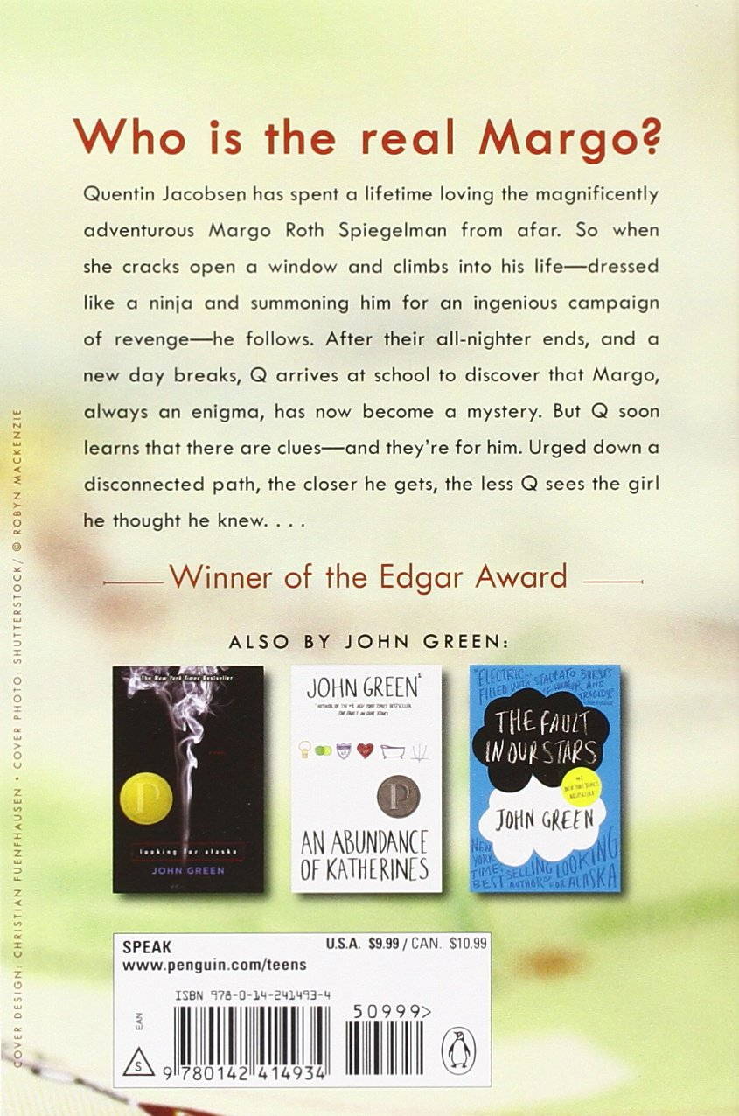
Reading a book has many advantages, it keeps the mind trained.
It is a mental training that reduces stress and also increases cultural knowledge.
Another advantage is the expansion of one's own vocabulary, the more one reads, the more words one learns.
Reading also helps a lot of memory, because while reading a lot of information is stored.

Slide 7
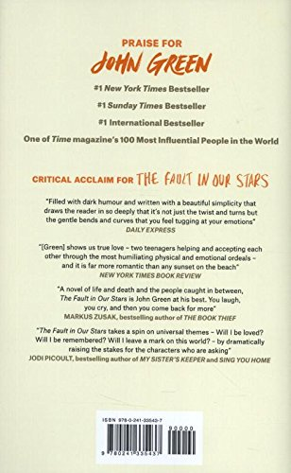
"Margo was not a miracle. She was not an adventure. She was not a fine and precious thing. She was a girl” - says Quentin.
Paper Towns is a novel about imagining people complexly and explores the idea that we are not as strong as we come off.
The author ponders on the interconnectedness of imagination and perception, of mirrors and windows, of illusion and reality"

Slide 8
Taken from this novel, in 2015 the film “Paper town" was also made
directed by Jake Schreier.
there is the movie trailer:
https://www.youtube.com/watch?v=rFGiHm5WMLk

