Slide 1
ERASMUS + PROGRAMME- STRATEGIC PARTNERSHIP ‘Youngsters Nowadays. Where from, Where to?’ 2017-1-RO01-KA219-037190_1
The Romanian project team presents:
A YOUNGSTER’S HEALTHY MEALS FOR A WEEK

Slide 2
What is diet and what about nutrition?
Diet . Is it just a 4 - letter word or a way of life in someway? How you feed your body can determine how your body runs and works . If you eat only fast food and sweets you have to realize that after some time you will get some problems like : increased cholesterol , diabetes and heart problems. But if you eat meat, fruits, vegetables, fish for the most part you won’t have that type of problems.
Dieting can help you in many ways. It can make you gain or lose weight and it can prevent some diseases that you might get if you eat a lot of unhealthy things.

Slide 3
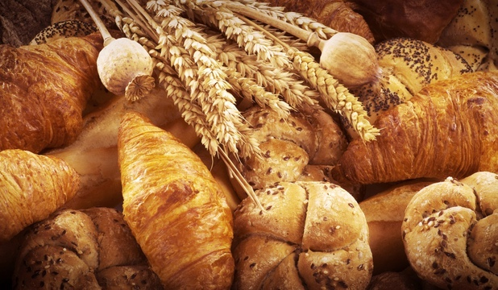
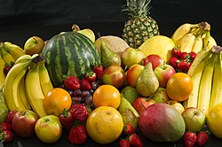
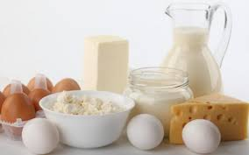
A normal diet consists of 3 primary meals and 2 snacks.
For breakfast you should eat some sort of carbohydrates to get your body running properly and some proteins . For carbohydrates you have : bread, oatmeal, fruits , beans and for protein you : eggs, milk and cereals. You should take it easier with meat in the morning , it's not the best thing for your body.

Slide 4
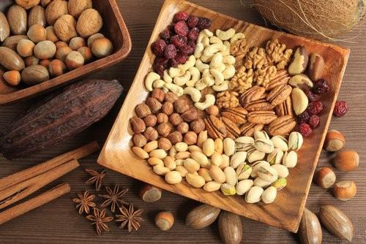
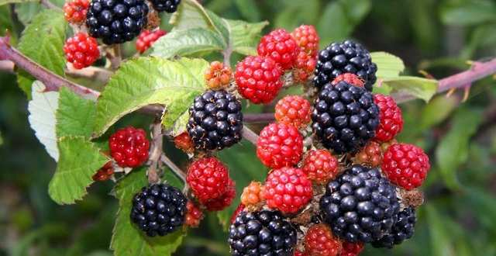
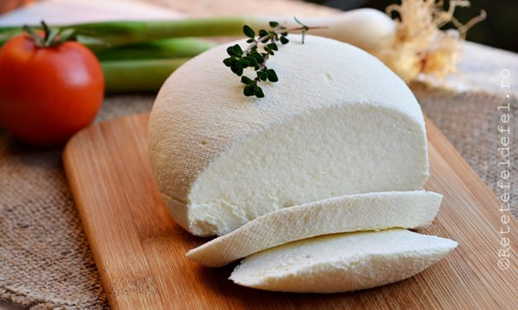
For snacks you have : fruits , almonds, walnuts, cottage cheese, berries, low fat cheese. Pick one and eat it only when you are hungry. (After a big meal)

Slide 5
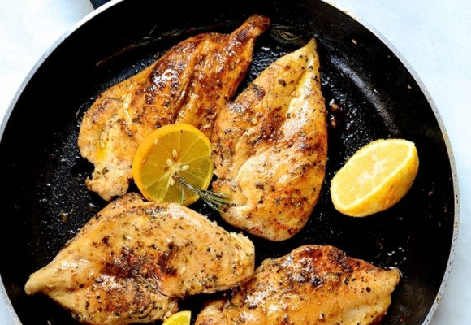
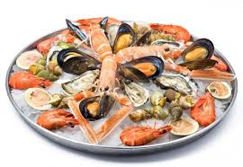
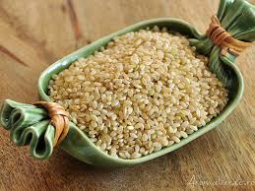
For lunch you should eat a lot of protein and some light carbohydrates : steak, chicken breast, fish or sea food. And for light carbohydrates you have : brown rice and integral bread.

Slide 6
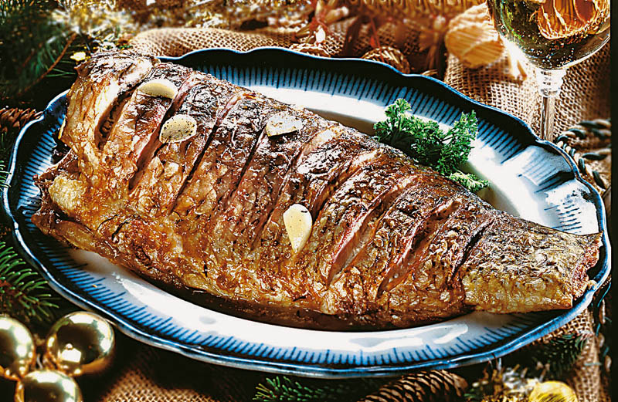
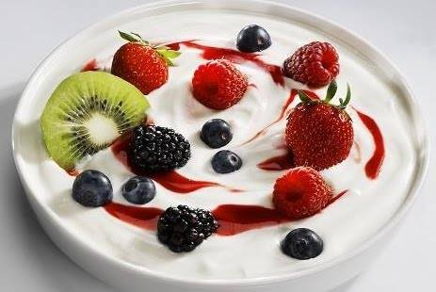
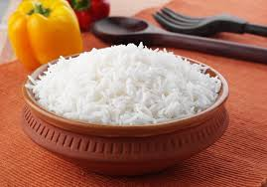
For dinner you should eat something light (something easy to digest) like : white rice, fish, yogurt, sweet potatoes.

Slide 7
MONDAY
Breakfast
Because we want to start the week with a good and delicious meal, we will have Greek yogurt with oatmeal and 1 banana .
Lunch
For lunch we will have a meal that is high in protein and high in carbohydrates (to keep us going for the rest of the day). Chicken breast with rice .
Dinner
For dinner I recommend you to eat something that is light in protein and light in carbohydrates.
Because of that we will have a salad with tuna.

Slide 8
TUESDAY
Breakfast
Today we are going to have something else for breakfast . 4 eggs with 5 slices of toasted bread and a tomato.
Lunch
We had chicken breast yesterday so today we want pasta. It's fully up to you how you want them . For example I like them with bacon and sour cream (carbonara style).
Dinner
For this dinner we want soup. Any soup is good.

Slide 9
WEDNESDAY
Breakfast
For this breakfast we will have a liquid breakfast , a smoothie drink to be precise. It will contain milk , peanut butter and bananas.
Lunch
For lunch we are going to eat Caesar salad. (It contains chicken breast , mustard, green salad, eggs and a lot of healthy foods)
Dinner
This night , we are going to eat a heavy protein meal. Pork that is cooked in the oven with sweet potato puree and sweet sauce.

Slide 10
THURSDAY
Breakfast
A classic breakfast for kids but still healthy is : milk with oatmeal . It is high in carbohydrates and high in fibers.
Lunch
Thursday lunch = a happy meal to get you through the rest of the week. Grilled salmon with avocado and onions.
Dinner
We ate a heavy protein meal last night, today we are going to take it easily with just cooked rice with vegetables.

Slide 11
FRIDAY
Breakfast
The 'magic' day when you get of work , school and all that good stuff. For this morning we are going to eat yogurt with blueberries , strawberries and bananas . We put all of them in the blender or just mix then with a fork.
Lunch
Because is the 'magic' day , we are going to eat something that we didn't eat this week. Broccoli and cheese soup. A healthy and delicious lunch .
Dinner
For lunch we had a pretty big meal so we are going to eat something light like a salad .

Slide 12
SATURDAY
Breakfast
Weekend is finally here . For this breakfast we are going to eat a little more 'time consuming' meal. Blueberry Muffins made in the oven (Healthy but with a lot of calories , careful with how many you eat).
Lunch
For this lunch we want a tuna salad (healthy and delicious).
Dinner
We will have turkey breast with vegetables.

Slide 13
SUNDAY
Breakfast
Today we are going to take it easy with every meal , we are going to eat light foods with easy to digest ingredients. For this breakfast we will eat 3 egg whites and 1 ripe banana.
Lunch
Once again we want something light like boiled potatoes with lean meat. (any type of meat that doesn’t have fat ).
Dinner
For this dinner we are going to eat fish. Any fish is good but you have to choose a LEAN FISH (cod, haddock, tilapia).

Slide 14
"This project has been funded with support from the European Commission. This publication reflects the views only of the author, and the Commission cannot be held responsible for any use which may be made of the information contained therein."

