Slide 1
ERASMUS + PROGRAMME- STRATEGIC PARTNERSHIP
‘Youngsters Nowadays. Where from, Where to?’
2017-1-RO01-KA219-037190
Let’s Know What We Eat and Drink!
Part III

Slide 2
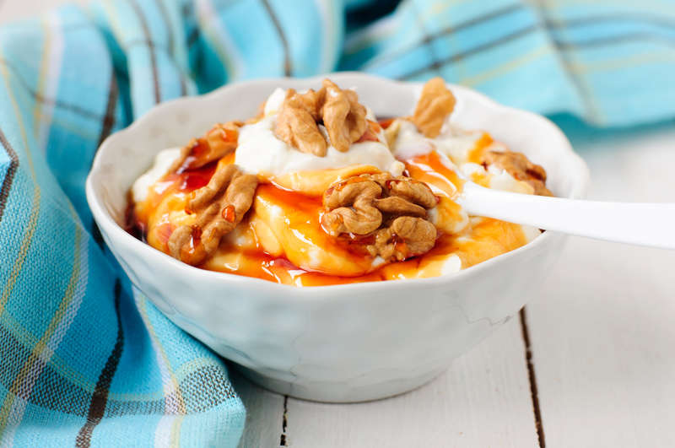
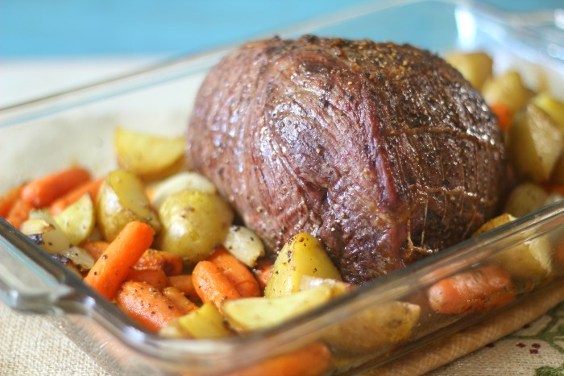
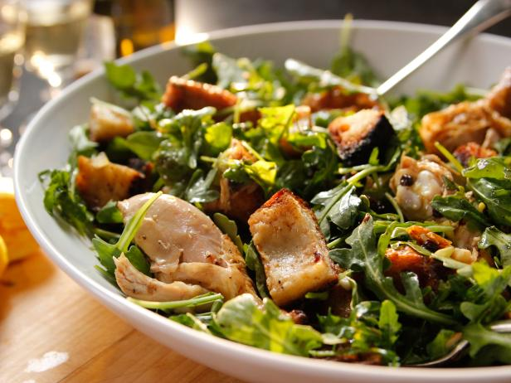
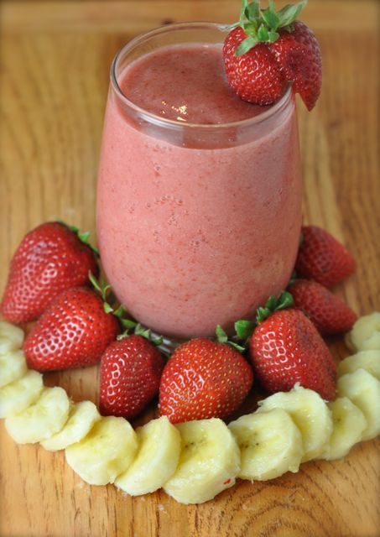
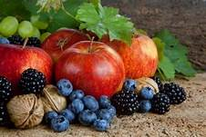
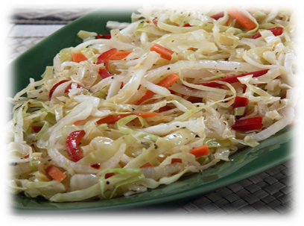
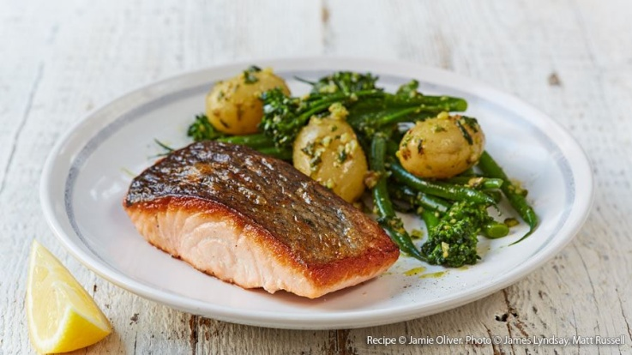
This compendium contains the diet habits of youngsters today, starting from a survey that the partner schools did in their own country. There were 150 students from each school that answered the questionnaire and the students compared and contrasted their eating and drinking habits with their partners, they analysed what they had in common, what was different and what they needed to change for a better life.
This material contains the analyses of the diet habits in each country that were based on the interpretation of the survey’s results, a comparison between the traditional food of the five countries involved in the project and the international one, suggestions for healthy food and a plan for the perfect diet of the European youngster for a week.
The compendium has got 3 parts:
Part I which contains the analyses of the diet habits of the European youngsters;
Part II which is a comparison between the traditional food of the five countries involved in the project and the international one;
Part III which makes suggestions for healthy food and a plan for the perfect diet of the European youngster for a week.

Slide 3
The Perfect Diet of the European Youngster for a Week
Let’s Know What We Eat and Drink!

Slide 4
Suggestions for eating healthy food
Eat lots of fruit and vegetables;
Eat more fish, including a portion of oily fish (salmon, herring, fresh tuna, sardines etc.);
Cut down on saturated fat and sugar (cakes, biscuits, sausages, butter, pies );
Cut down on sugary fizzy drinks, alcoholic drinks, sugary breakfast cereals;
Eat less salt;
Don't skip breakfast. It is indicated to eat something consistent in the morning;
Have fruit-based snacks throughout the day;
Make your day with milk products;
Eat protein at every meal;
Choose whole-grain bread;
Cut portions by a quarter;
Drink 2 glasses of milk daily;
Drink lots of water.

Slide 5
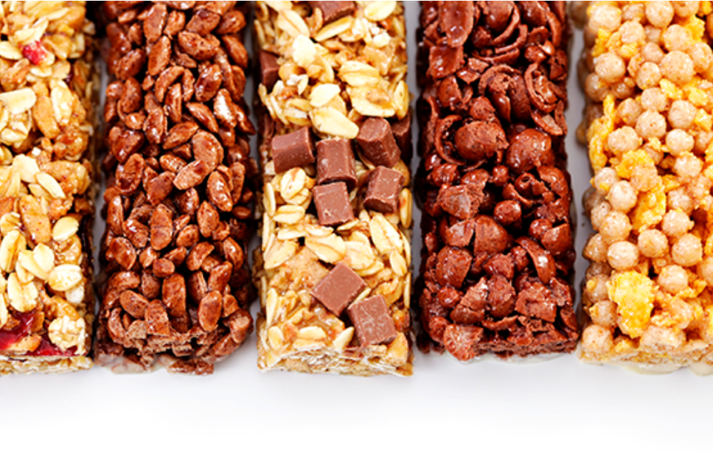
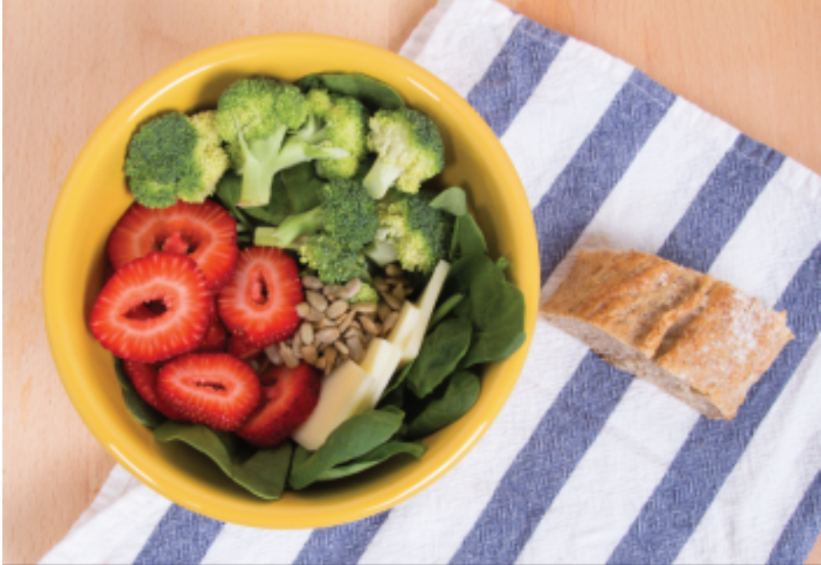
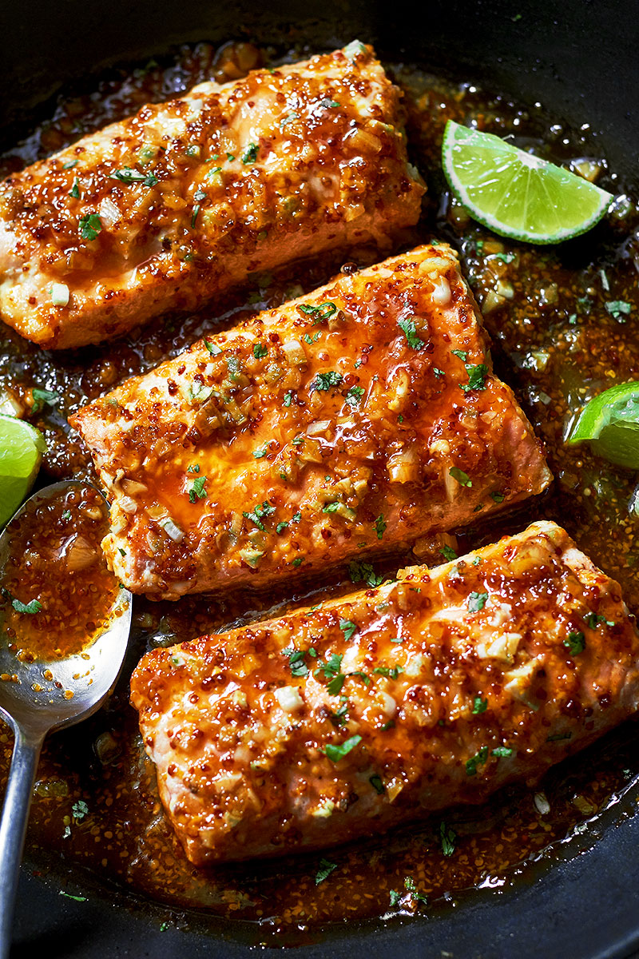
Eating the right foods can give you energy and prevent you from eating too much during the rest of the day.
Healthy eating is not about strict dietary limitations, staying unrealistically thin, or depriving yourself of the foods you love. Rather, it’s about feeling great, having more energy, improving your health, and stabilising your mood. There is conflicting nutrition and diet advice, but by using these simple suggestions, you can learn how to create a tasty, varied, and nutritious diet that is as good for your mind as it is for your body.
Food ideas
Breakfast: Energy Bars - to substitute for a meal, an energy bar should have at least 3 to 5 grams of fiber and 10 grams of protein.
Lunch : Strawberry Spinach Salad -strawberries are filled with antioxidants, and can sweeten up any salad!
Dinner: Honey garlic salmon - is perfect for a quick weekday evening.

Slide 6
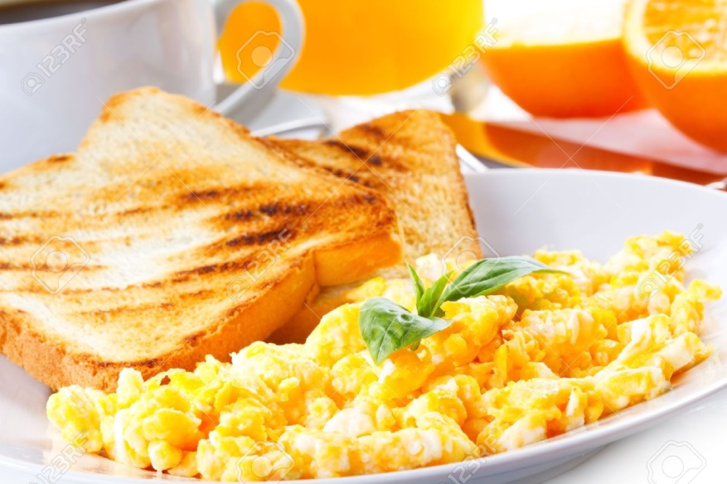
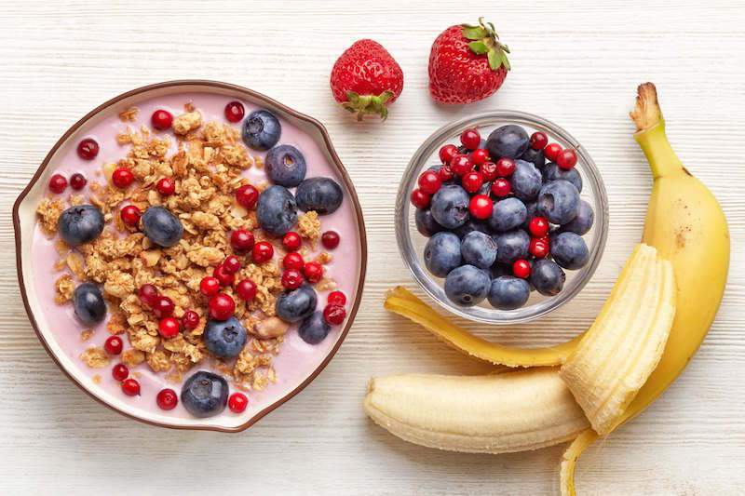
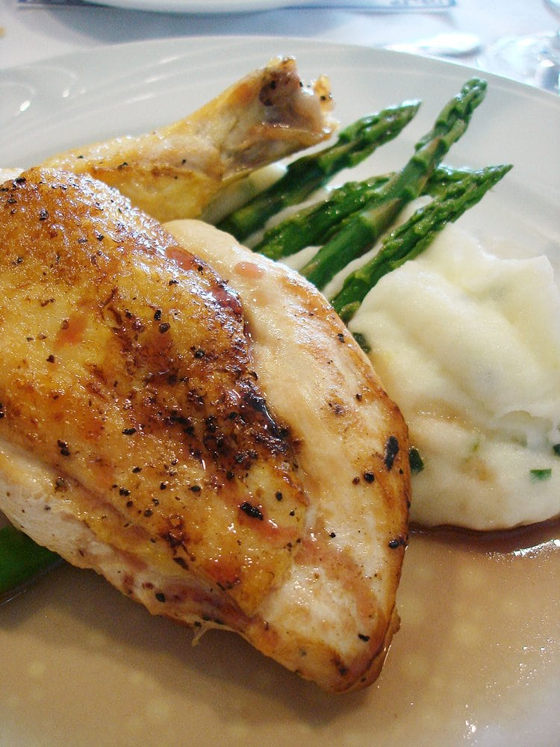
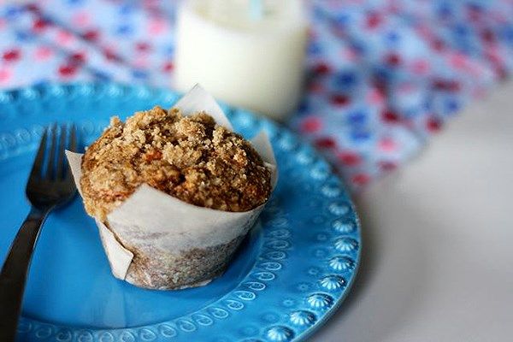
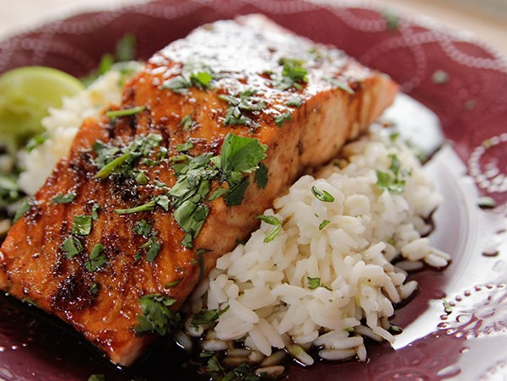
MONDAY
Breakfast | Snacks | Lunch | Afternoon snacks | Dinner
Orange juice with scrambled eggs plus toast | Natural Yoghurt Red Fruits Nuts | Roasted Chicken with Mashed potatoes | Apple, Carrot and Flax Muffins with Streusel Topping | Cilantro Lime Salmon

Slide 7
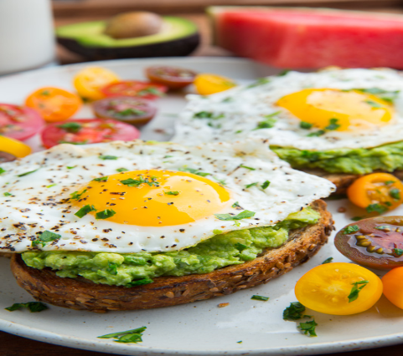
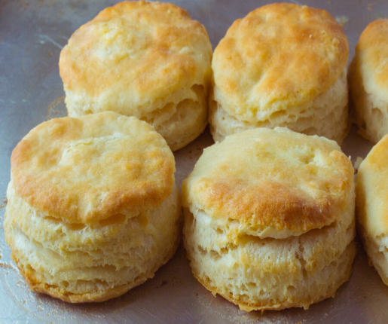
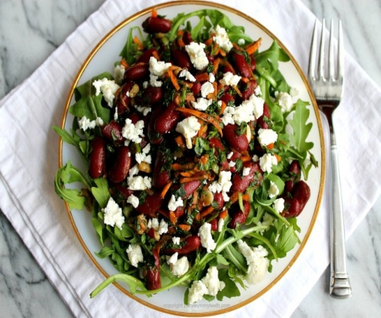
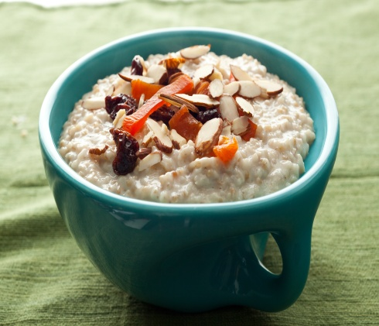
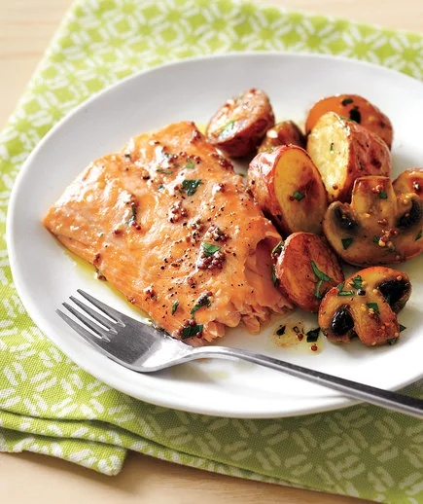
TUESDAY
Breakfast | Snacks | Lunch | Afternoon snacks | Dinner
Avocado toast with eggs Milk | Biscuits | Bean and tomato salad | Oatmeal with milk | Oven-baked potatoes and salmon

Slide 8
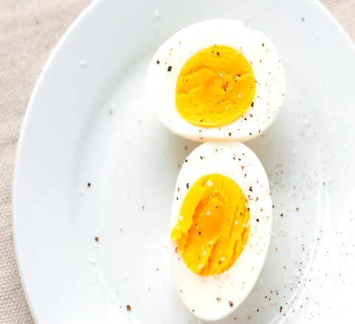
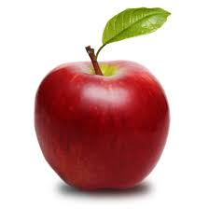
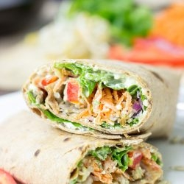
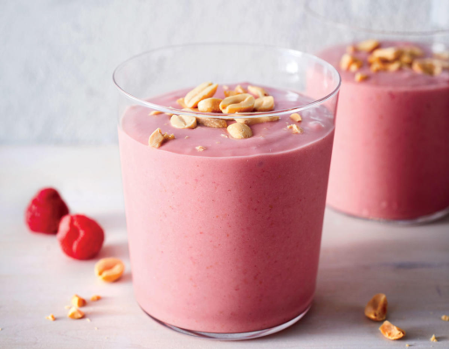
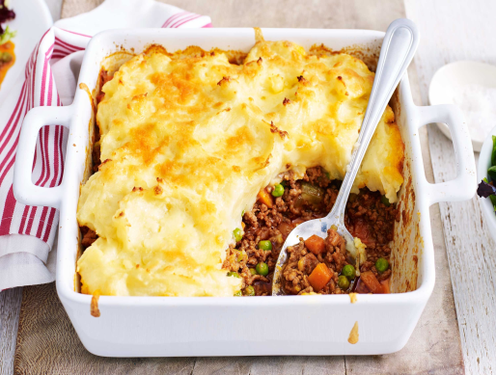
WEDNESDAY
Breakfast | Snacks | Lunch | Afternoon snacks | Dinner
Yogurt Boiled eggs | Fruits(Apple) | Tangy veggie wrap | Smoothie | Shepherd’s Pie

Slide 9
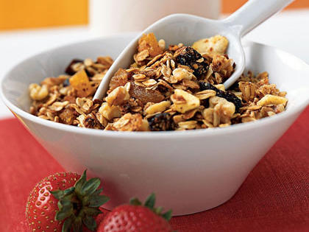
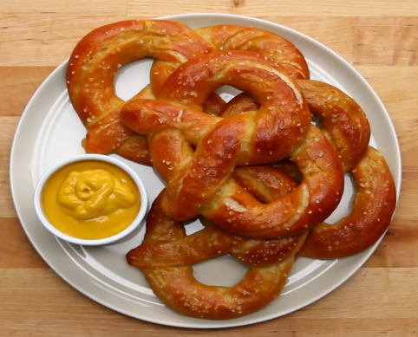
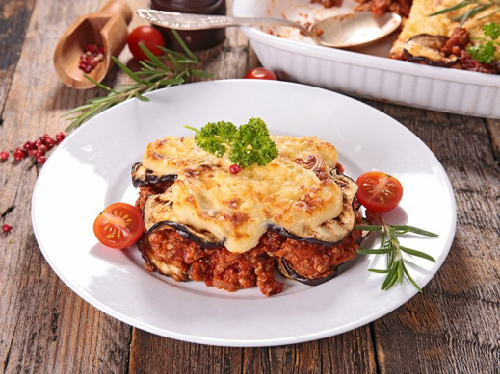
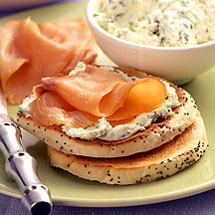
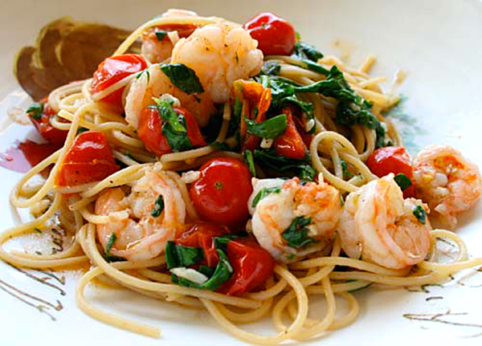
THURSDAY
Breakfast | Snacks | Lunch | Afternoon snacks | Dinner
Cereal with milk Fruits | Pretzel Chips | Moussaka | Bagel with Ricotta | Pasta with shrimps

Slide 10
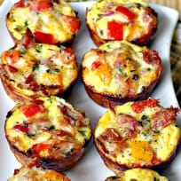
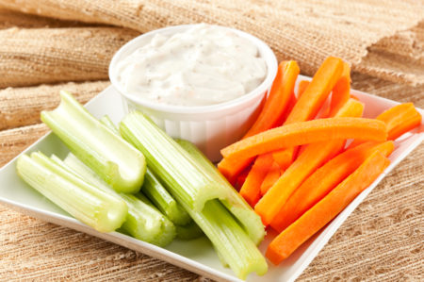
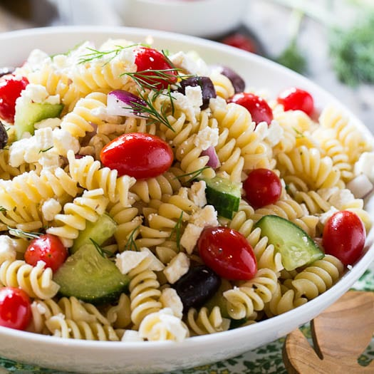
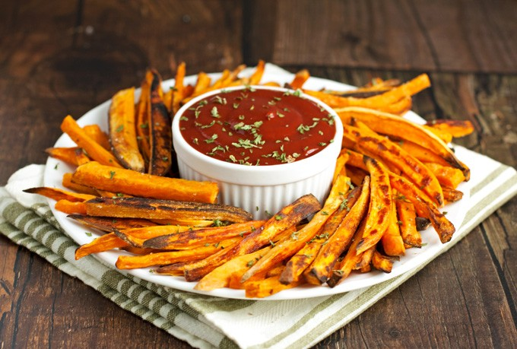
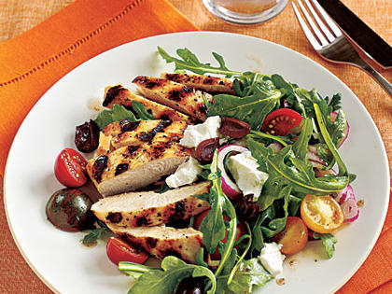
FRIDAY
Breakfast | Snacks | Lunch | Afternoon snacks | Dinner
Egg muffins Natural Juice | Celery and carrot sticks with hummus | Pasta salad | Sweet potato fries | Grilled chicken with tomato salad

Slide 11
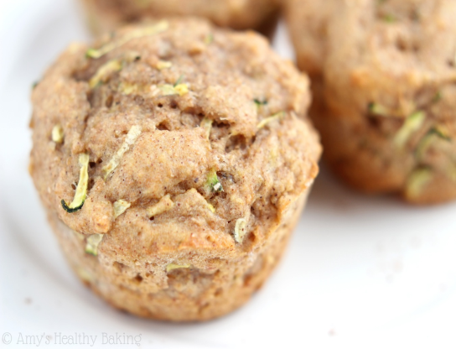
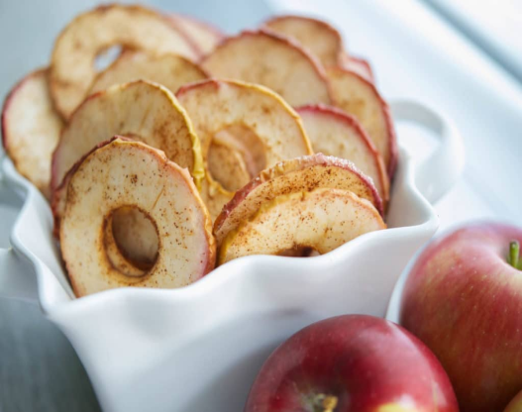
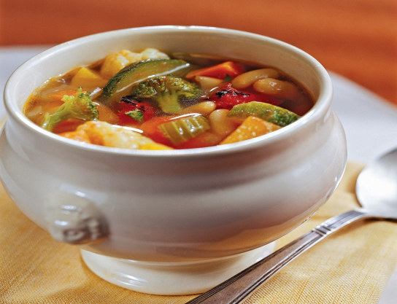
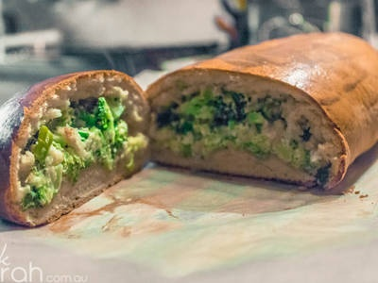
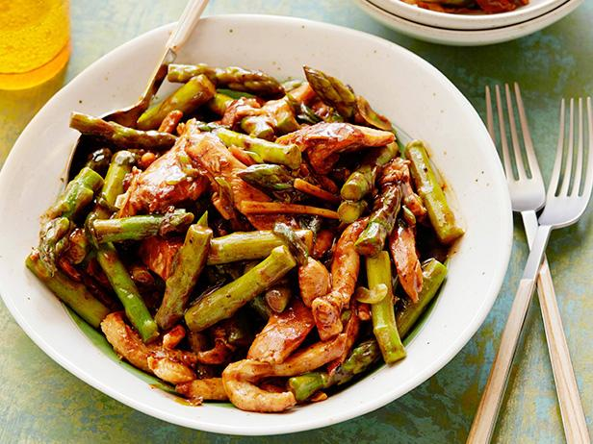
SATURDAY
Breakfast | Snacks | Lunch | Afternoon snacks | Dinner
Zucchini and banana muffins Apple juice | Apple chips | Roasted tomato and vegetable soup | Broccoli cheesy bread | Asparagus and chicken stir-fry

Slide 12
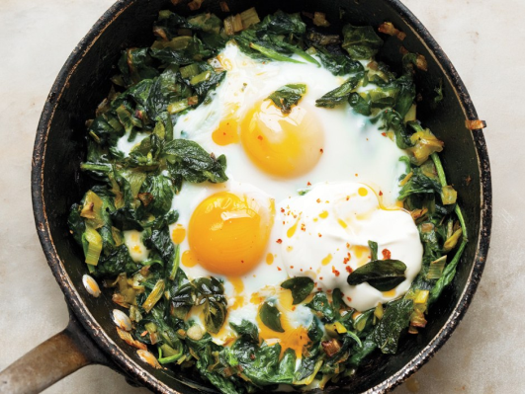
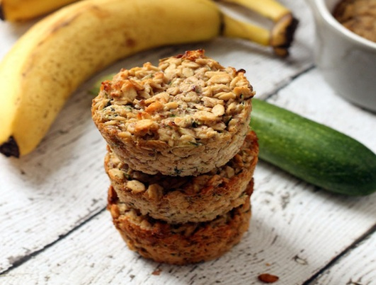
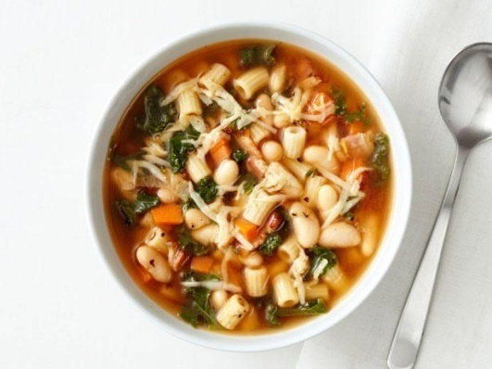
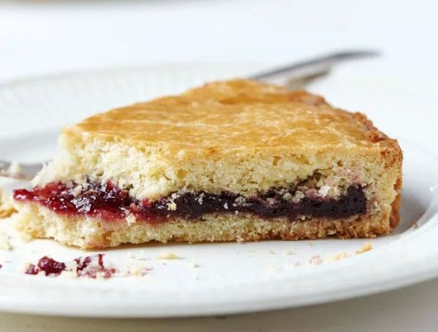
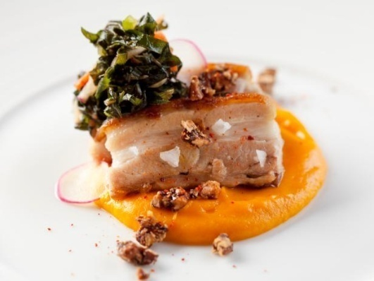
SUNDAY
Breakfast | Snacks | Lunch | Afternoon snacks | Dinner
Cheesy spinach baked eggs | Banana zucchini oatmeal cups | White bean soup | Strawberry jam Compote waffles | Pork cooked in oven Sweet potato mash

Slide 13
“This project has been funded with support from the European Commission. This publication reflects the views only of the author, and the Commission cannot be held responsible for any use which may be made of the information contained therein.”

