Slide 1
READING STRATEGIES
Youngsters Nowadays. Where from, Where to?
2017-1-RO01-KA219-037190

Slide 2
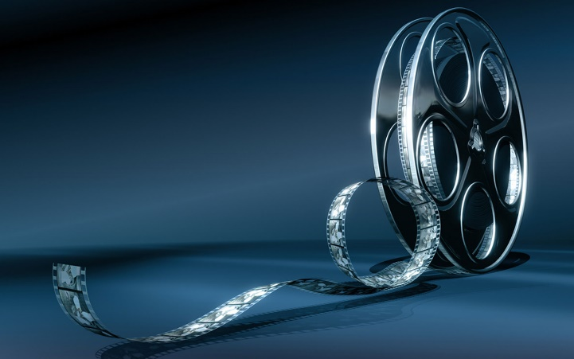
From Reading to Movies
The activity carried out has the intent to demonstrate that a film and a book, even if they tell the same story, are not necessarily the copy of each other; indeed they can assume different implications thus becoming two original works.

Slide 3
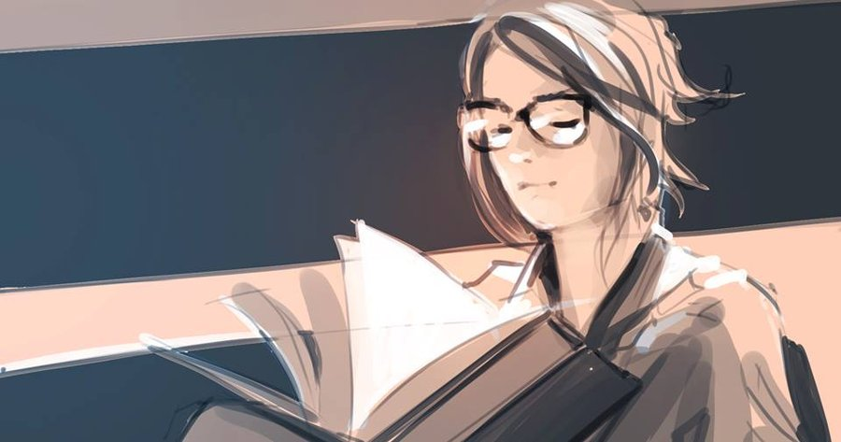
According to this theory reading the book and watching the film should be considered two distinct experiences and it is advisable to watch the film only after having read the book.

Slide 4
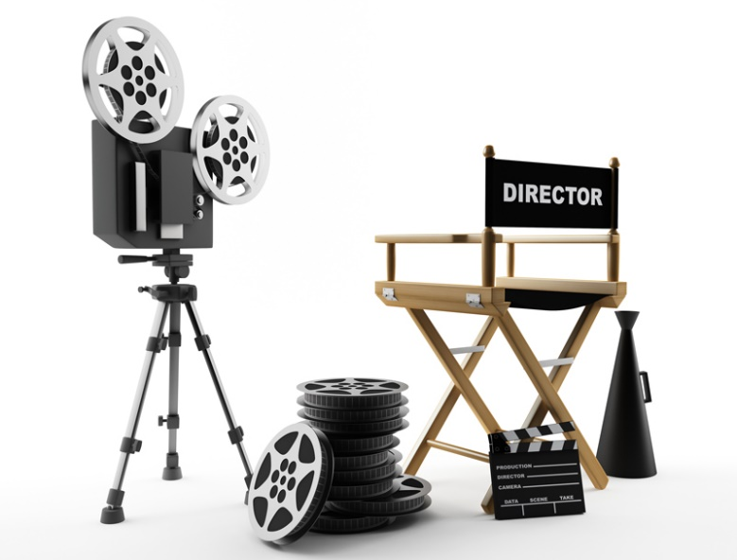
The objective was to compare two different types of language, the written and the visual ones.

Slide 5
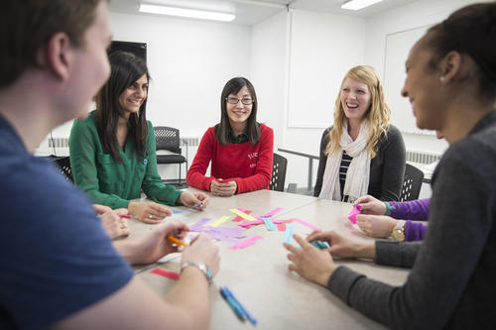
The work was organized in different steps comprising several activities

Slide 6
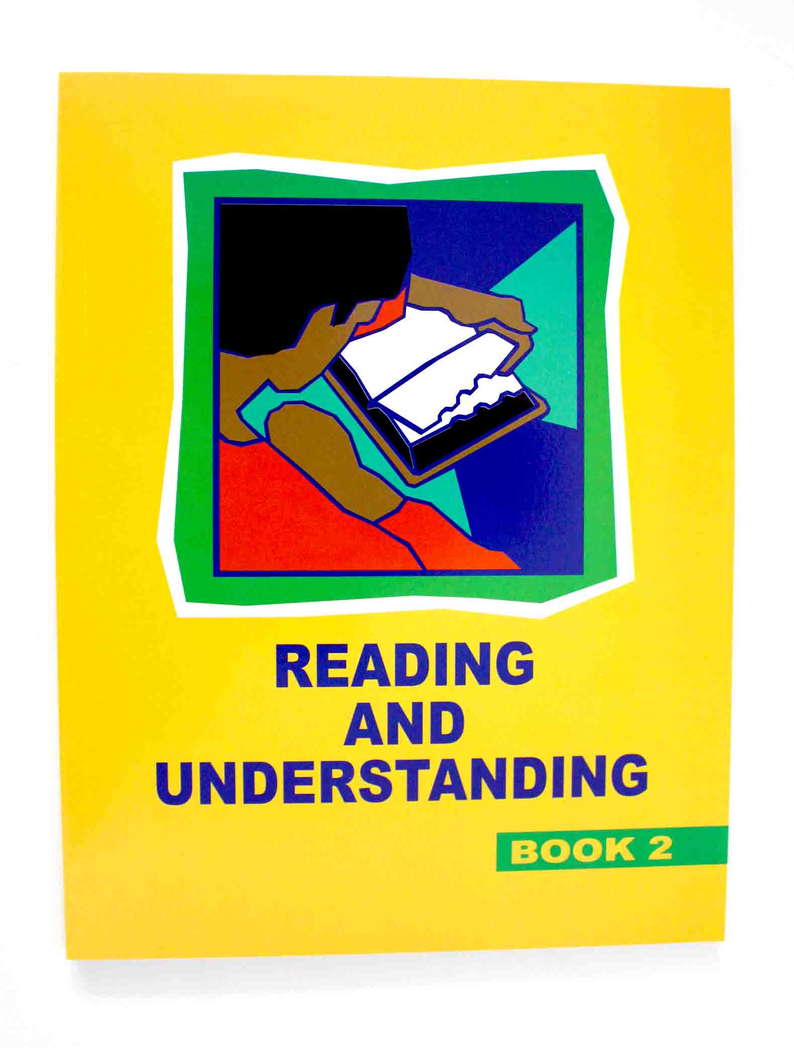
1st Activity: Reading and Understanding the content.
The youngsters were asked to identify the most significant passages, to convey their feelings and to underline the sentences that affected them more.

Slide 7
2nd Activity: Identifying the main characters and their roles

Slide 8
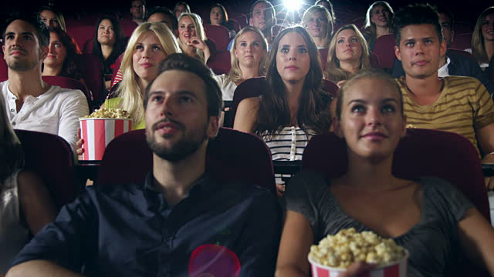
3rd activity: Watching and Analyzing the film
Some reviews of the film have been read and commented
Questions:
Are the characters the same you imagined?
Would you have chosen different actors?

Slide 9
4th activity: Identifying Analogies and Differences

Slide 10
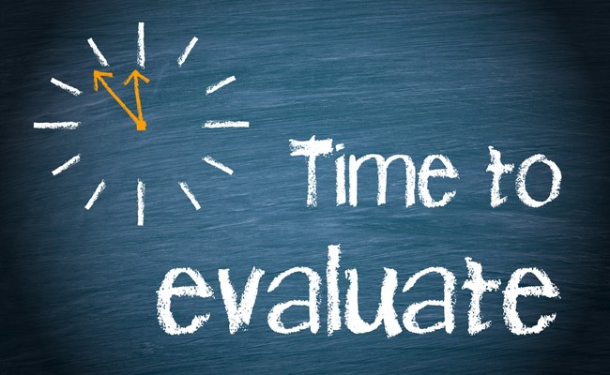
Evaluation - Describe Quentin’s relationships with the other guys in the group - What do you think about Margo? - Do you think the book leaves something unfinished? - If you were Quentin, how would you behave? - How did the movie involve you? - Which scene you preferred?

