Slide 1
ERASMUS + PROGRAMME- STRATEGIC PARTNERSHIP ‘Youngsters Nowadays. Where from, Where to?’ 2017-1-RO01-KA219-037190_1
The Romanian project team presents:
Tips for eating healthy food

Slide 2
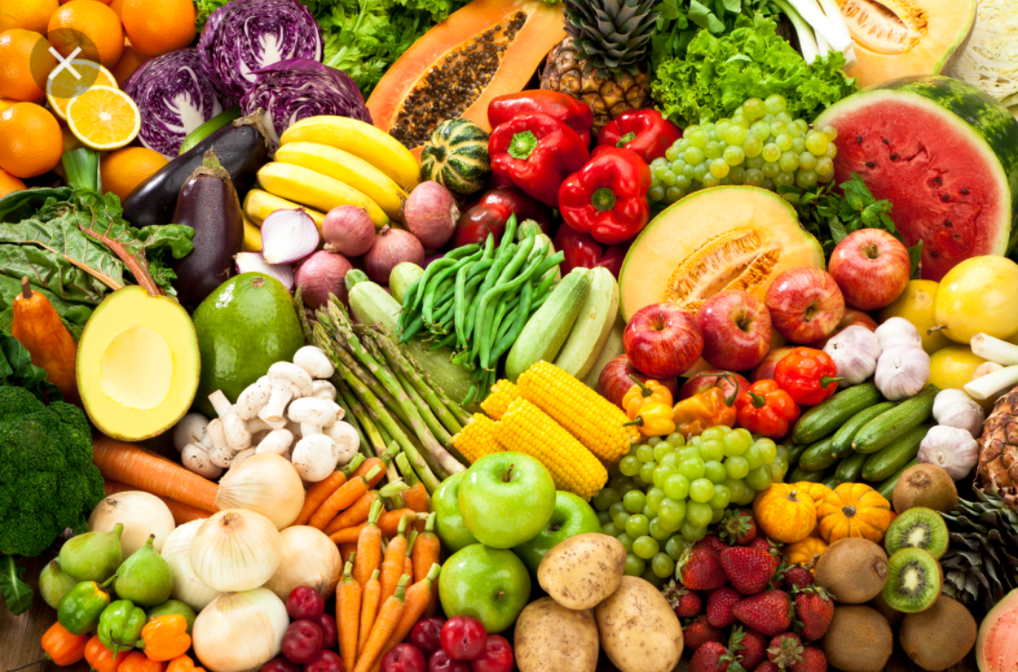

Slide 3
Eat lots of fruit and vegetables;
Eat more fish, including a portion of oily fish
( salmon, herring, fresh tuna, sardines etc. );
Cut down on saturated fat and sugar (cakes, biscuits, sausages, butter, pies );
Cut down on sugary fizzy drinks, alcoholic drinks, sugary breakfast cereals;
Eat less salt;
Don't skip breakfast. It is indicated to eat something consistent in the morning;

Slide 4
Have fruit-based snacks throughout the day
Make your day with milk products
Eat protein at every meal
Choose whole-grain bread
Cut portions by a quarter
Drink 2 glasses of milk daily
Drink lots of water

Slide 5
Food ideas
Breakfast
Energy Bars - to substitute for a meal, an energy bar should have at least 3 to 5 grams of fiber and 10 grams of protein.

Slide 6
Lunch
Strawberry Spinach Salad -strawberries are filled with antioxidants, and can sweeten up any salad!
Dinner
Honey garlic salmon - is perfect for a quick weekday evening.

Slide 7
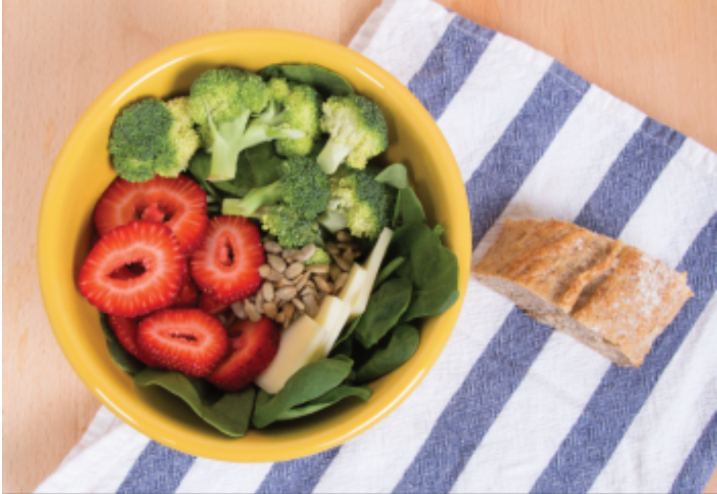
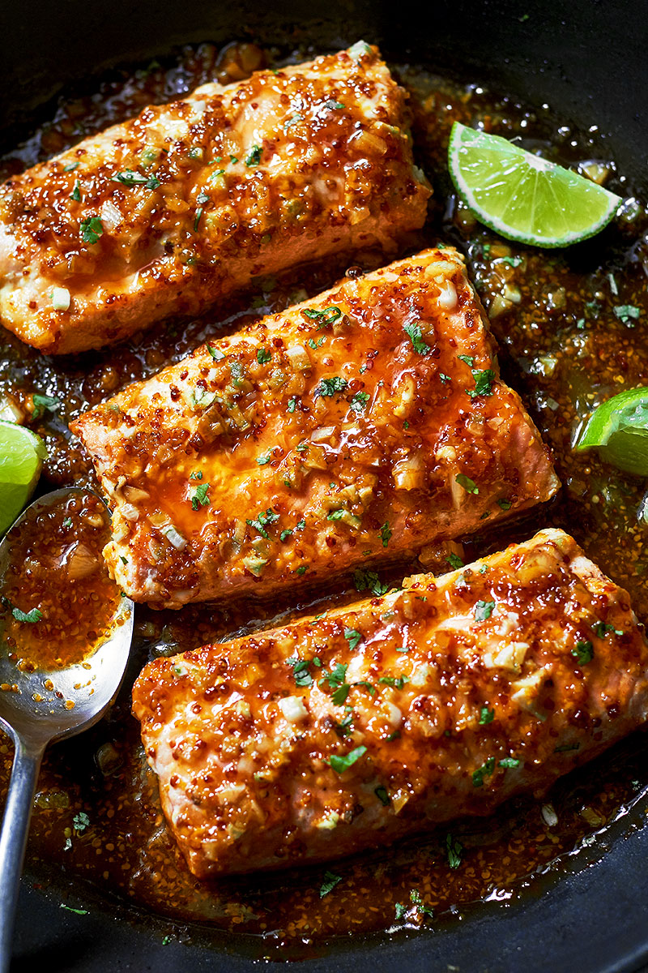
Breakfast
Lunch
Dinner

Slide 8
Some pieces of advice
Eating the right foods can give you energy and prevent you from eating too much during the rest of the day.
Healthy eating is not about strict dietary limitations, staying unrealistically thin, or depriving yourself of the foods you love. Rather, it’s about feeling great, having more energy, improving your health, and stabilizing your mood. There is conflicting nutrition and diet advice, but by using these simple tips, you can cut through the confusion and learn how to create a tasty, varied, and nutritious diet that is as good for your mind as it is for your body.

Slide 9
"This project has been funded with support from the European Commission. This publication reflects the views only of the author, and the Commission cannot be held responsible for any use which may be made of the information contained therein."

