Slide 1
Italian National Food
ITT G. MALAFARINA
A traditional Italian meal

Slide 2
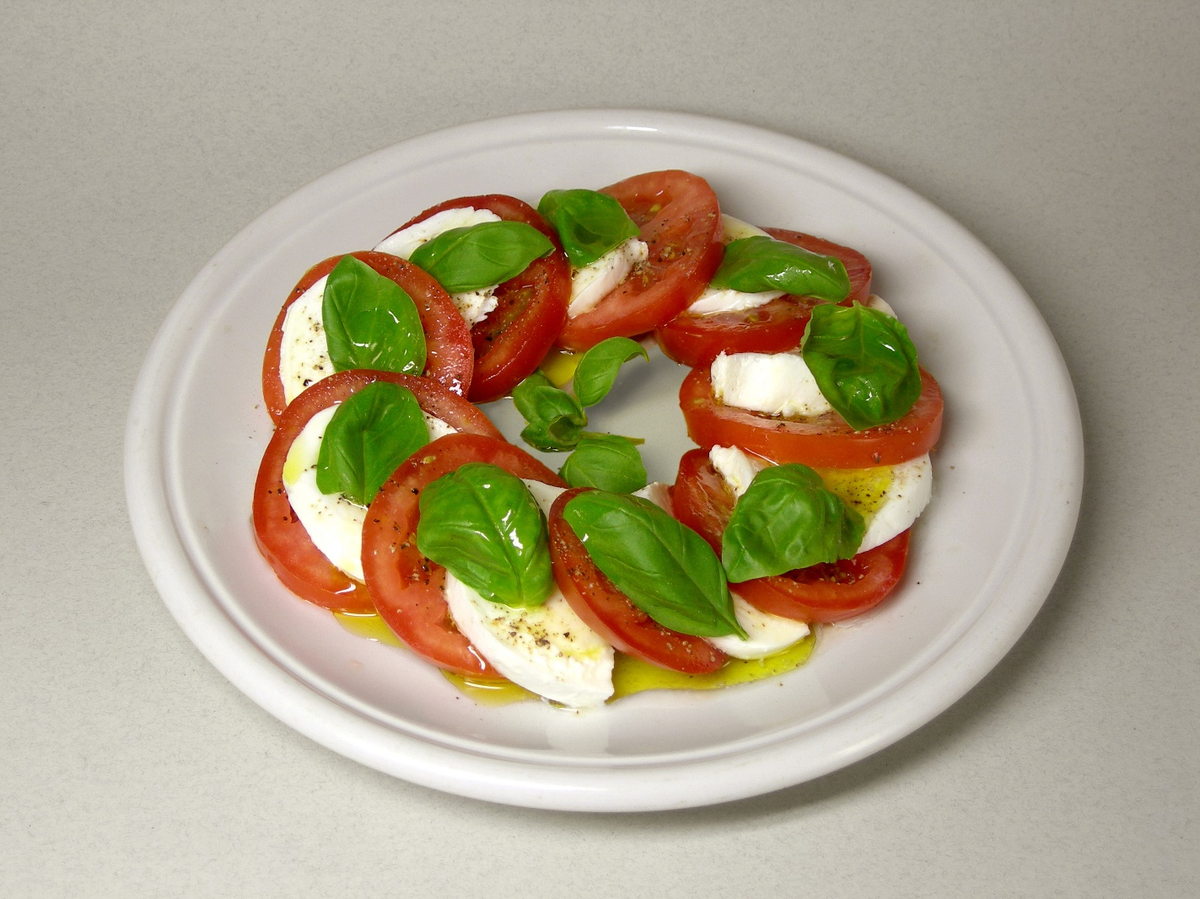
Starter- Caprese
Ingredients
4 large ripe tomatoes, sliced thick
1 pound fresh mozzarella cheese, sliced thick
1/3 cup fresh basil leaves
3 tablespoons extra virgin olive oil
sea salt to taste
freshly ground black pepper to taste
Directions
On a large platter, alternate and overlap the tomato slices, mozzarella cheese slices, and basil leaves. Drizzle with olive oil. Season with sea salt and pepper.
Insalata Caprese is a simple Italian salad, made of sliced fresh mozzarella, tomatoes, and sweet basil, seasoned with salt and olive oil. It features the colors of the Italian flag: green, white, and red.

Slide 3
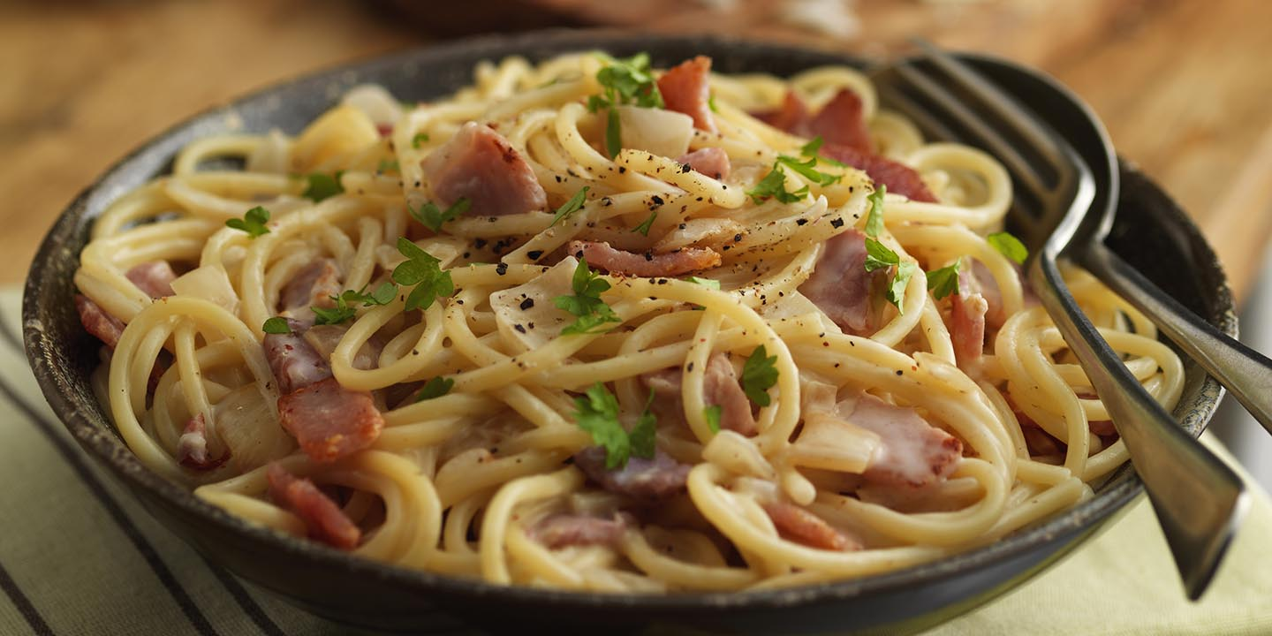
Carbonara Spaghetti
Ingredients
2 teaspoons olive oil
1 pound guanciale (cured pork cheek), diced
500g spaghetti
3 eggs
10 tablespoons grated pecorino Romano cheese
salt to taste
ground black pepper to taste
Directions
Heat olive oil in a large skillet over medium heat; add guanciale. Cook, turning occasionally, until evenly browned and crispy, 5 to 10 minutes. Remove from heat and drain on paper towels.
Bring a large pot of salted water to a boil. Cook spaghetti in the boiling water, stirring occasionally until tender yet firm to the bite, about 9 minutes. Drain and return to the pot. Let cool, stirring occasionally, about 5 minutes.
Whisk eggs, 5 tablespoons pecorino Romano cheese, and some black pepper in a bowl until smooth and creamy. Pour egg mixture over pasta, stirring quickly, until creamy and slightly cooled. Stir in guanciale. Top with remaining 5 tablespoons pecorino Romano cheese and more ground black pepper.
Spaghetti alla Carbonara, a rich tangle of pasta, pancetta (bacon) and eggs

Slide 4
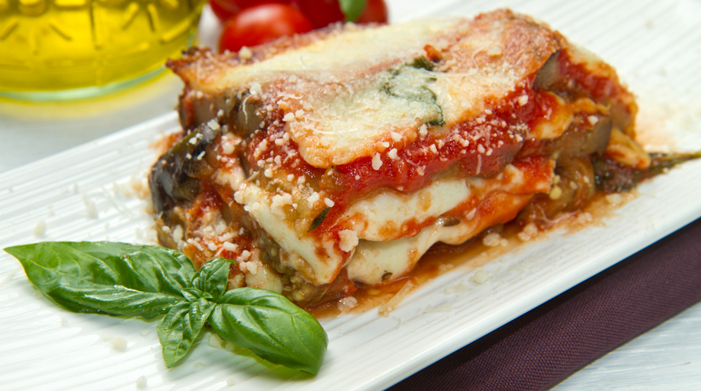
Ingredients
1 kg large eggplants, sliced lengthwise into medium thick slices
2 tablespoons coarse salt
5 cups vegetable oil for frying
2 tablespoons flour for dredging
tomato Sauce
2 tablespoons extra-virgin olive oil
1/2 onion, finely chopped
3 cloves garlic,
8 leaves fresh basil leaves
salt to taste
½ kg fresh mozzarella cheese, sliced
100g freshly grated Parmigiano cheese
Directions
Place single layers of eggplant slices in a colander sitting on a plate and sprinkle with coarse salt, add a weight to put pressure on the eggplant slices. Let stand at room temperature for about 1 hour. Rinse eggplant slices under running cold water to wash off all the salt, dry all sides with paper towels. Heat oil in a deep skillet over medium-high heat. Dredge eggplant slices in flour on both sides and add to the hot oil, working in batches. Deep fry eggplant until golden, 2 to 3 minutes per side. Drain on paper towels. Heat olive oil in a large pot over medium heat; cook garlic and onion until soft and translucent, about 5 minutes. Add tomato puree, 4 basil leaves, and salt. Cook, stirring often, until sauce starts to thicken, about 20 minutes. Remove sauce from heat. Discard garlic and stir in remaining 4 leaves basil. Preheat oven to 175 degrees. Spread a layer of tomato sauce over the bottom of a baking dish. Cover with a single layer of eggplant slices. Top with more sauce, mozzarella slices, and Parmigiano cheese. Continue making layers, a total of 3 to 5, finishing with tomato sauce and grated Parmigiano cheese. Bake in the preheated oven until heated through and bubbling, 30 to 40 minutes. Remove from oven and let stand for 20 minutes before serving.
Parmigiana
It is a classic baked recipe with tomato, aubergine, mozzarella and Parmigiano cheese topping.
It combines three layers of fantastic flavours

Slide 5
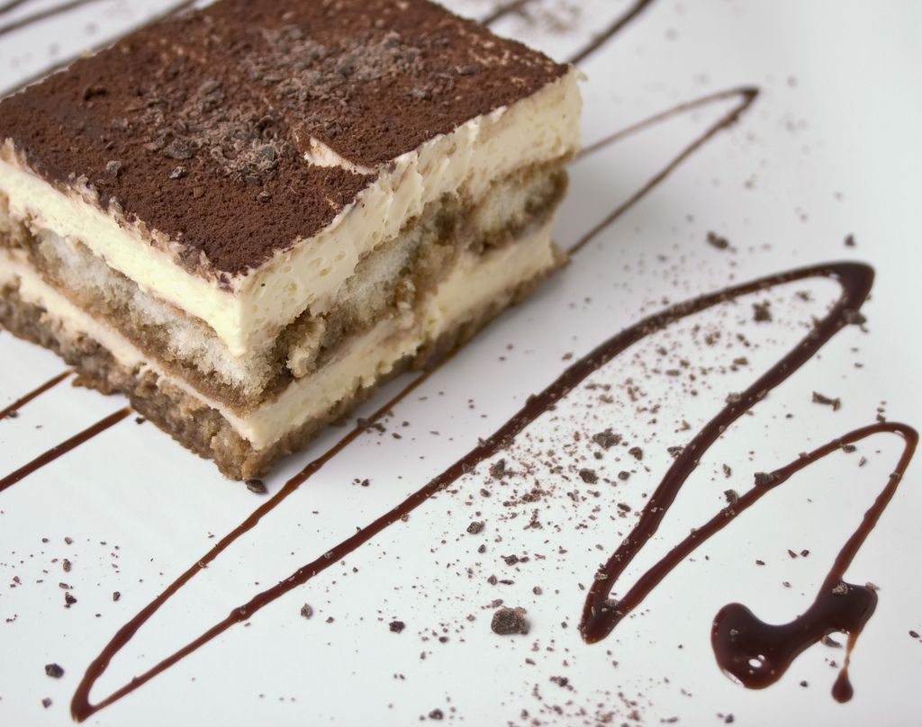
Dessert- Tiramisu
Ingredients
400 gr Italian mascarpone cheese
4 eggs
120 gr sugar + 3 tablespoon for espresso coffee
400 Italian Savoiardi cookies
125ml espresso or extra strong coffee
2 tablespoon cream whisky
unsweetened cocoa
Directions
in a bowl, whisk, egg yolks, sugar and half of the whisky cream. Whip fast to thicken. Then, spoon by spoon fold in mascarpone. Mixture should be a little softer than the consistency of mayonnaise. If mixture isn’t thick enough and comes out runny, use a hand blender with whipping blades to thicken. Whip the egg whites and add them to the mascarpone cream, stirring from bottom to top. On a small plate, mix espresso plus the rest of brandy. Quickly dip each side of the biscuits (do not completely soak), then add a layer to the bottom of your serving dish. Top with mascarpone mixture, then repeat for three times and top with the rest of the mixture. Cover and rest in fridge for 4 hours or overnight. Sprinkle cocoa on top before serving.
Tiramisu is a popular coffee-flavoured Italian dessert. It is made of Italian Savoiardi cookies dipped in coffee, layered with a whipped mixture of eggs, sugar, and mascarpone cheese, flavoured with cocoa

