Slide 1
The dissemination workshop for the project activities and results that we unfolded during 01.09.2017- 29.01.2019 Target group: Local community Date of the activity: January 29th 2019
Youngsters Nowadays .
Where from , Where to?
2017-1-RO01-KA219-037190_1

Slide 2
The presentation shows the activities that were carried out during the workshop that was organised to disseminate the project results to the local community from Moreni. This activity was organised according to the plan of dissemination from the application form. We talked about the final products, how we had achieved them, about the skills that we acquired, about how the Learning , Teaching and Training activities had unfolded. We presented the website, the Facebook page and we addressed questions about what we had shown. We also conducted an evaluation of the dissemination activity. The people who attended this workshop were students and teachers from our school, parents, representatives of the Town Hall and of the town library.

Slide 3
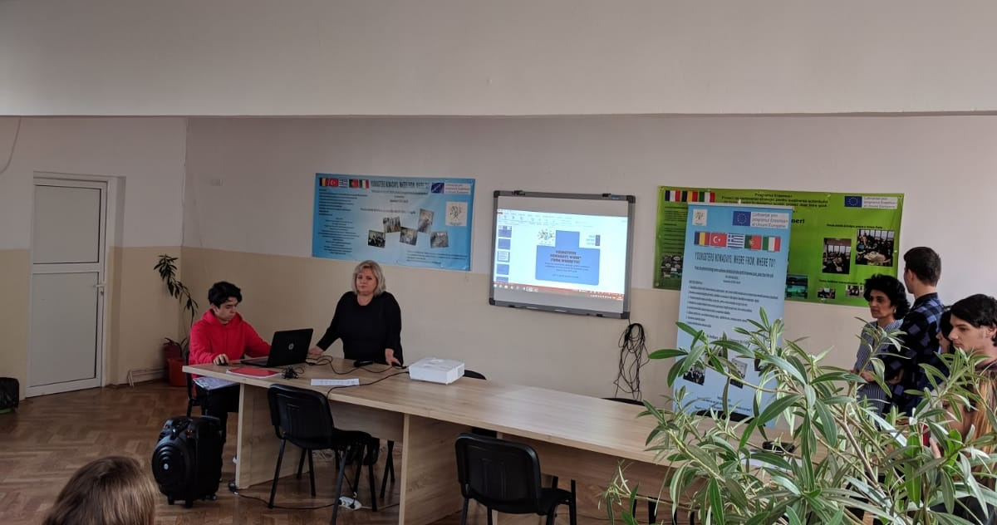

Slide 4
We informed of the activities for the first LTT Activities ( C1- at the Portuguese school) , the second LTT Activities ( C2- at the Italian school), of the campaigns ‘A Healthy Eating Week’ and ‘A Day of Sports’, that we did at local level. We talked about the way we made the selection of the teams for the meetings according to the selection criteria published at the beginning of the preparatory work for the each meeting, how we prepared the materials and organised our safe participation. We informed about the final products, we presented them and asked the participants specific questions about traditional food, national sports, reading habits, leisure time activities, reading habits, we talked about how we can make students read more through teaching literature in a pleasant.
We also presented the project website, Facebook community and Twinspace.

Slide 5
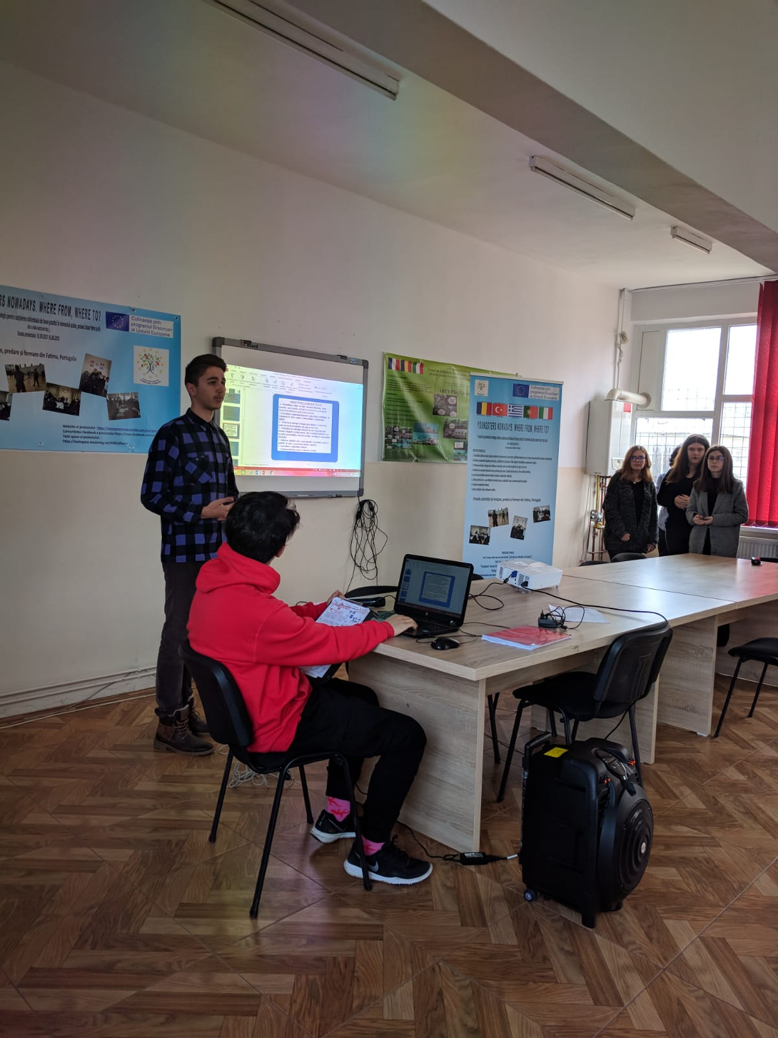
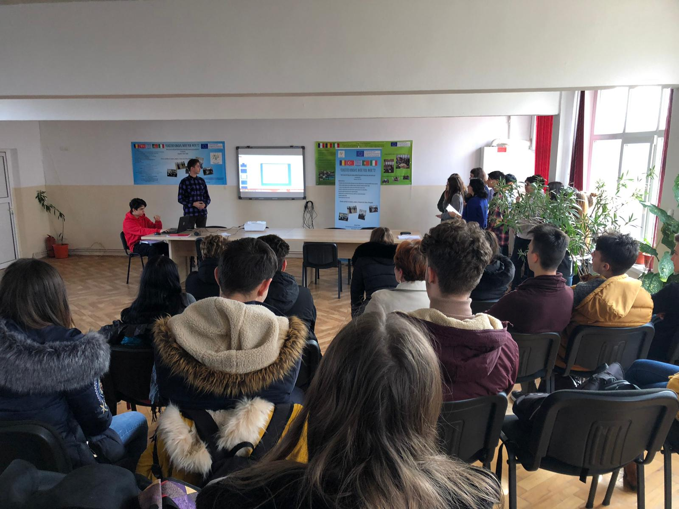

Slide 6
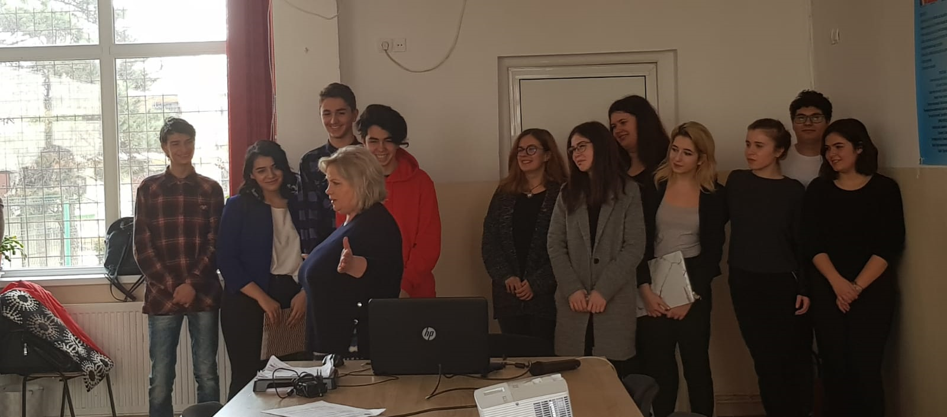

Slide 7
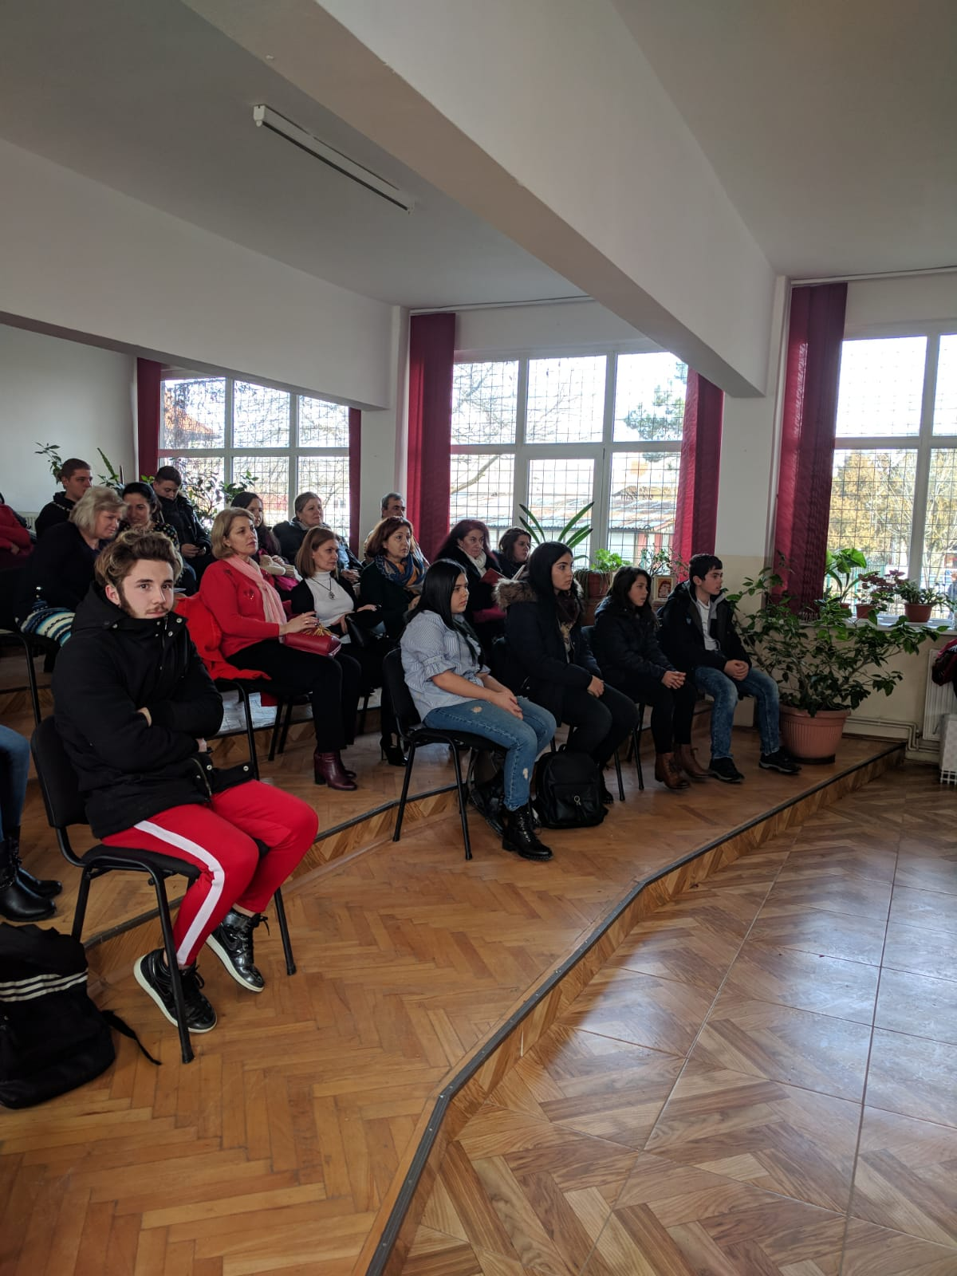
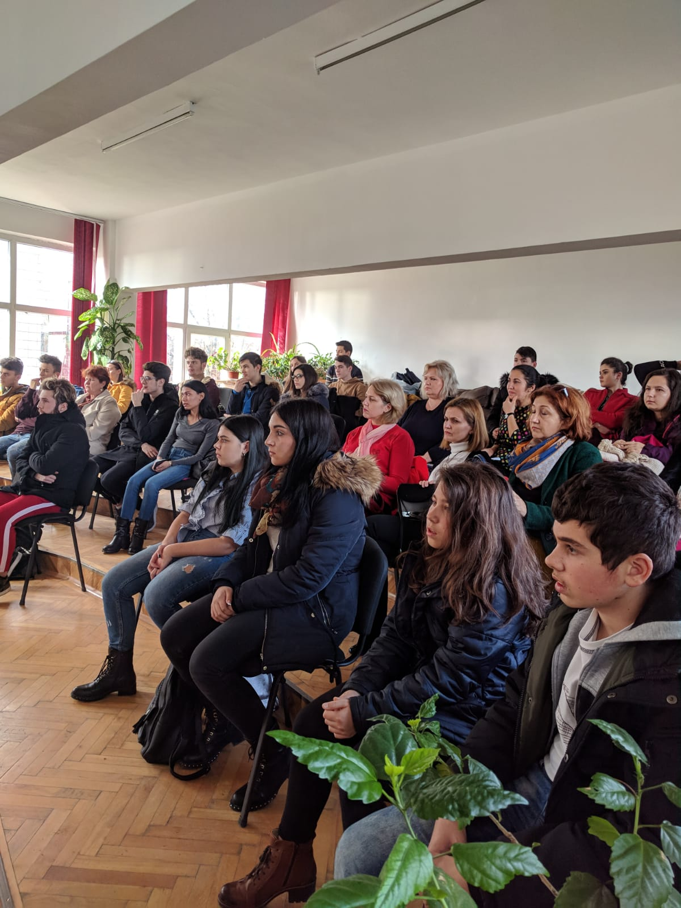

Slide 8
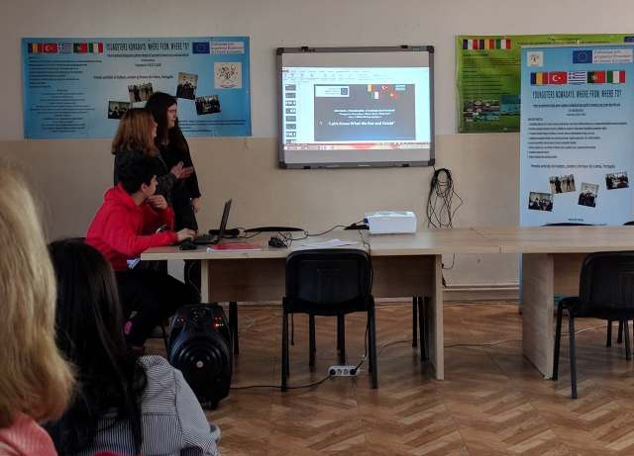

Slide 9
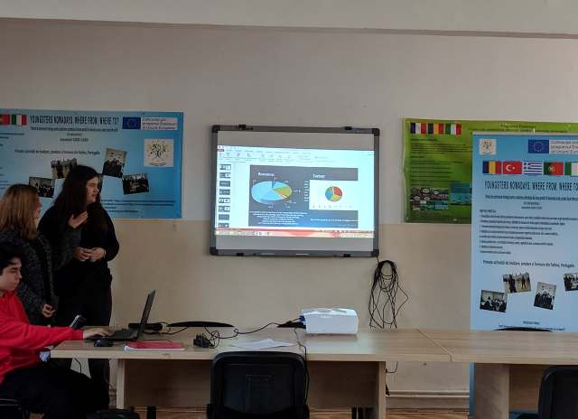

Slide 11
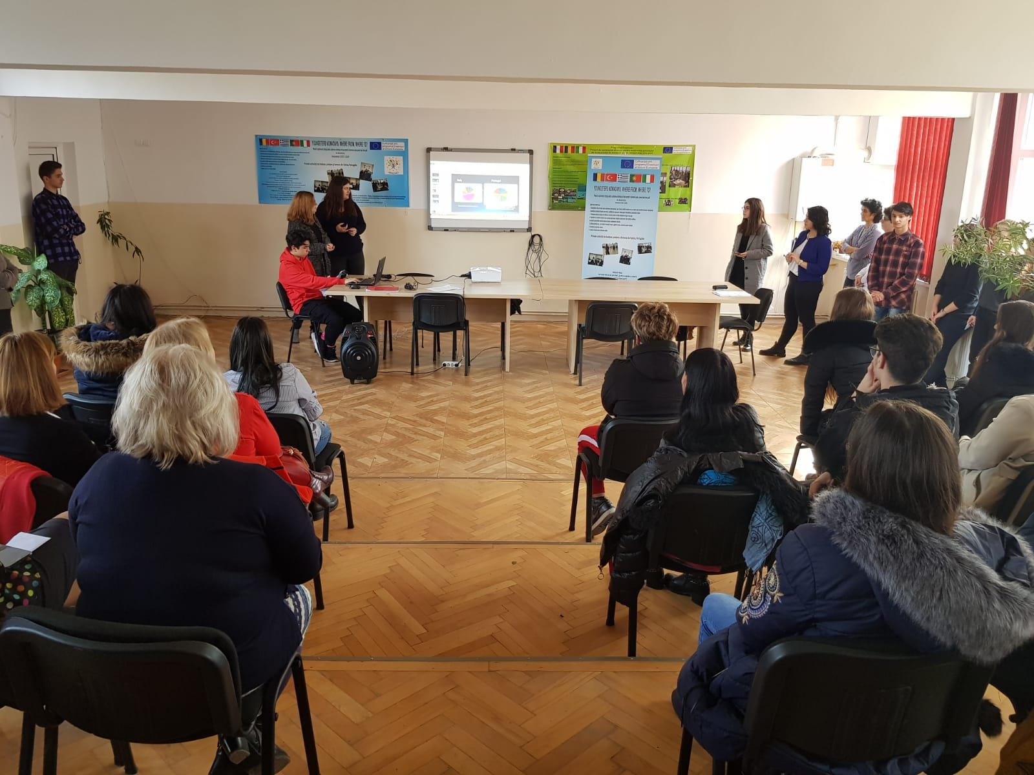

Slide 12
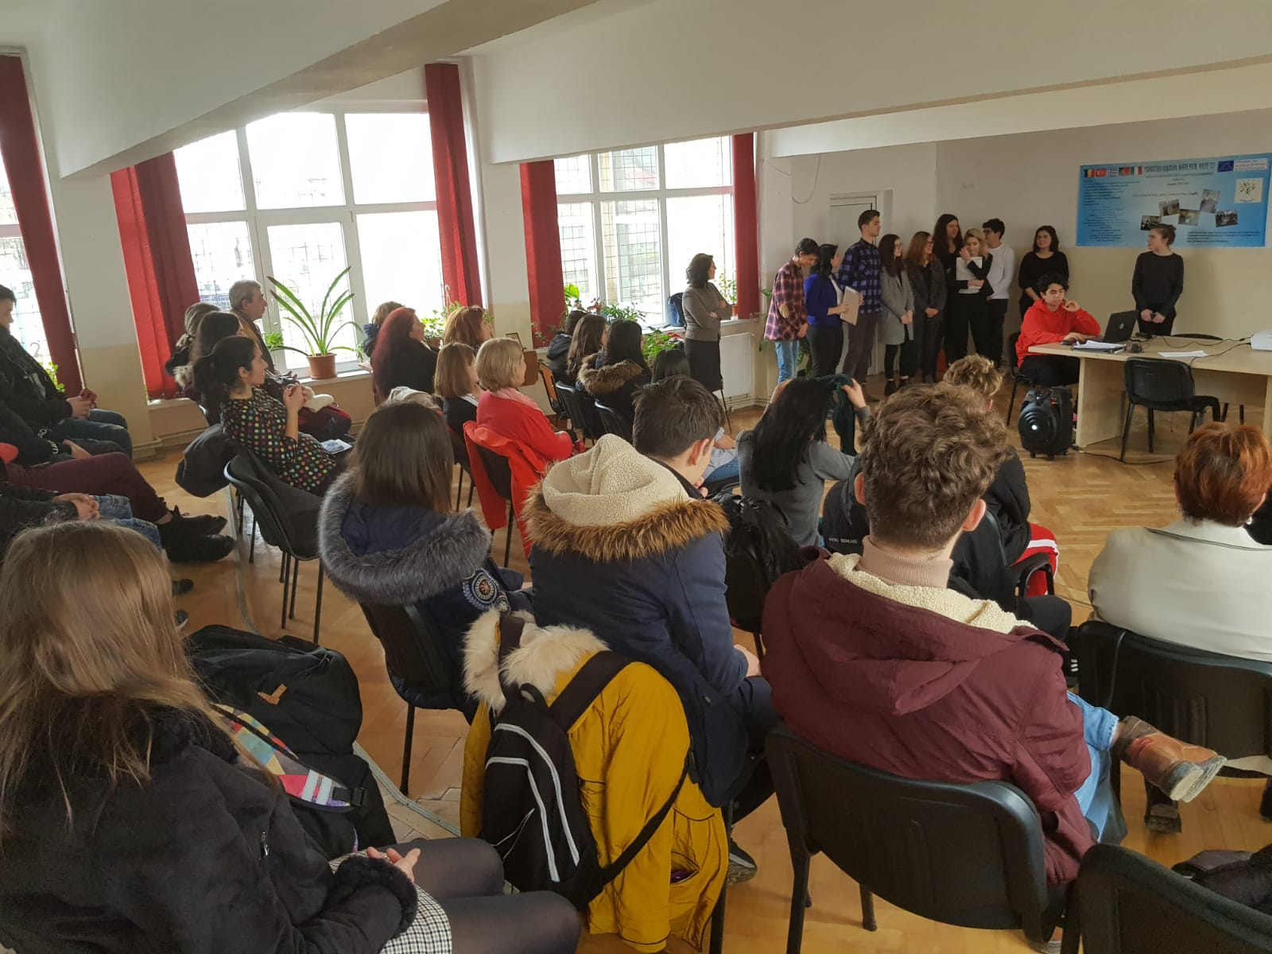

Slide 13
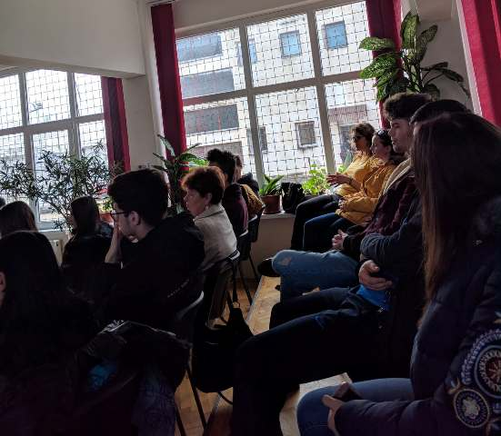

Slide 14
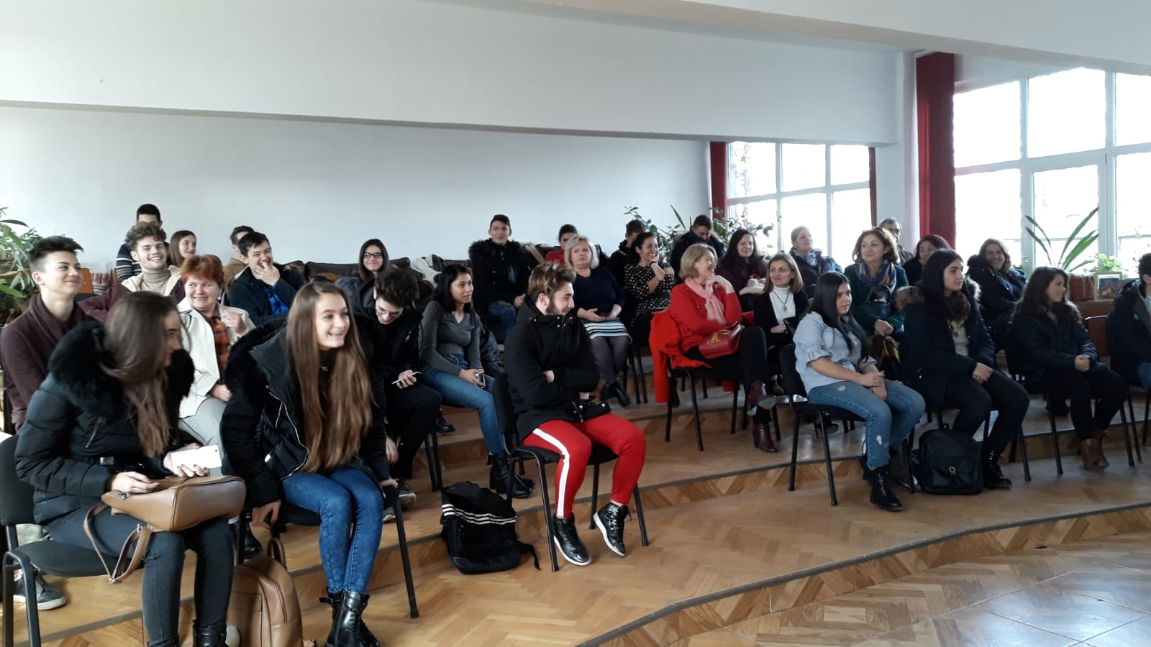
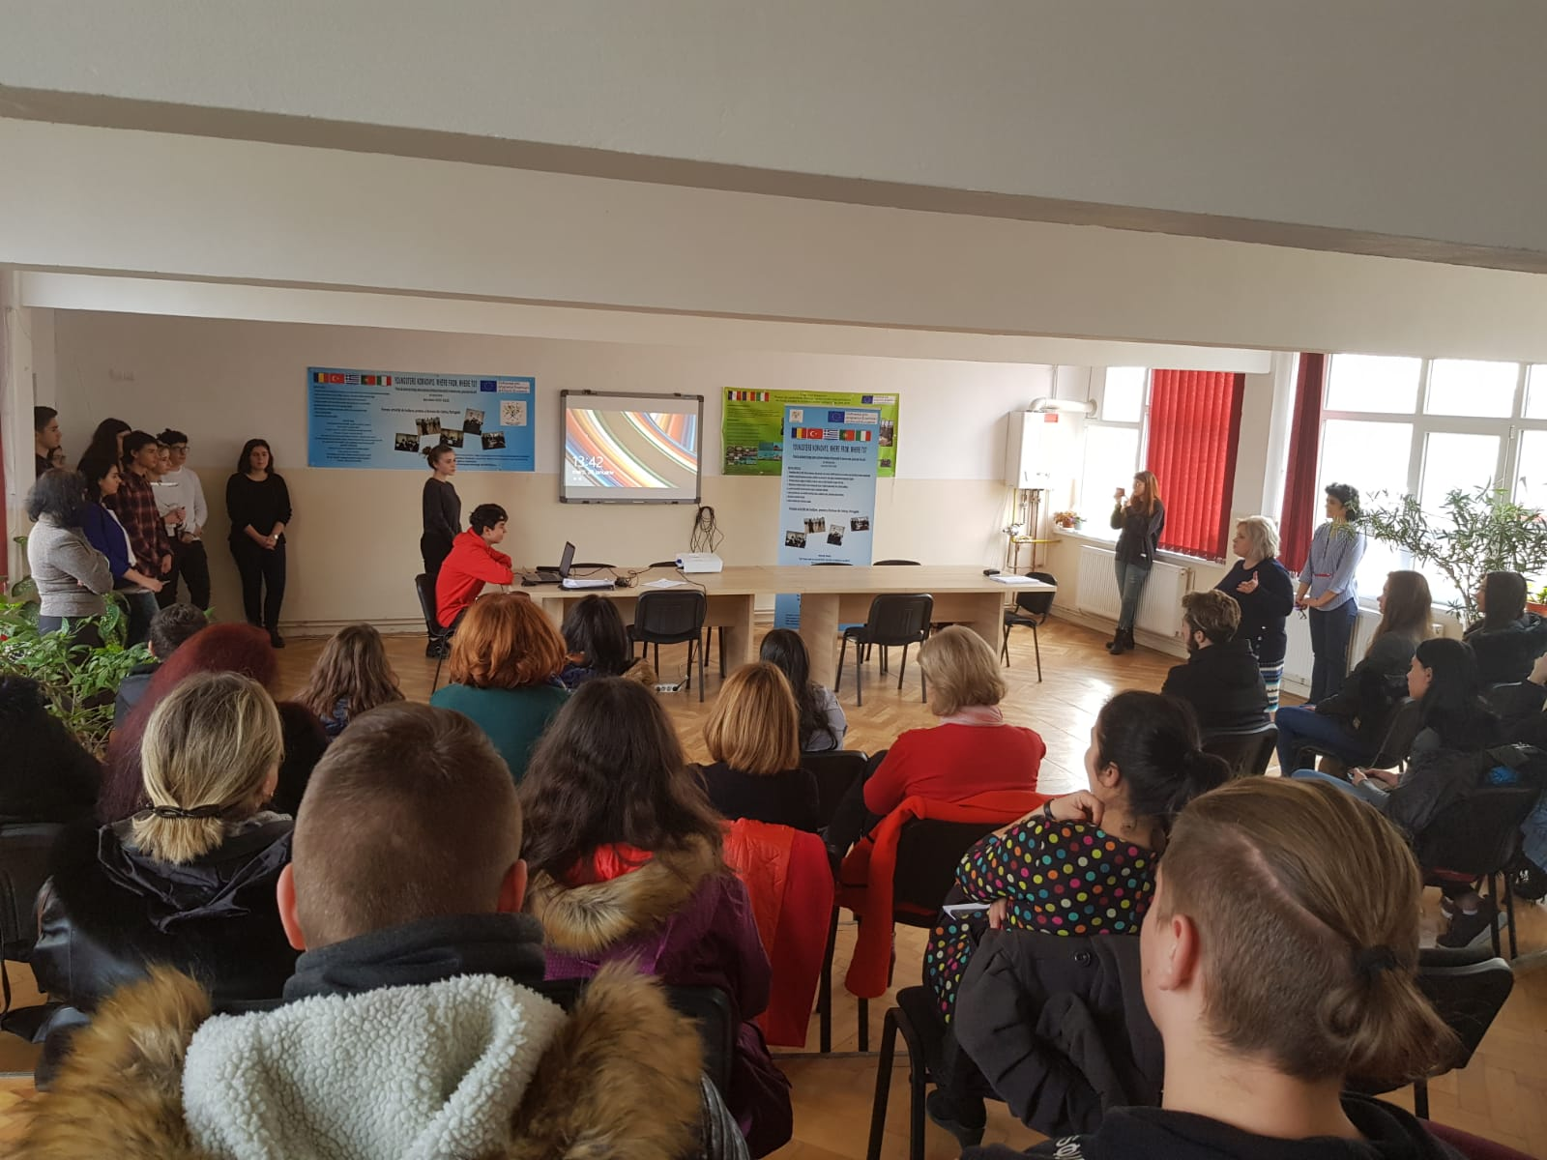

Slide 15
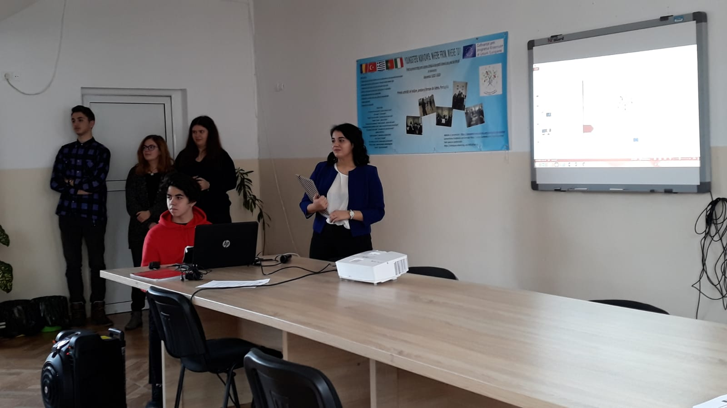

Slide 16
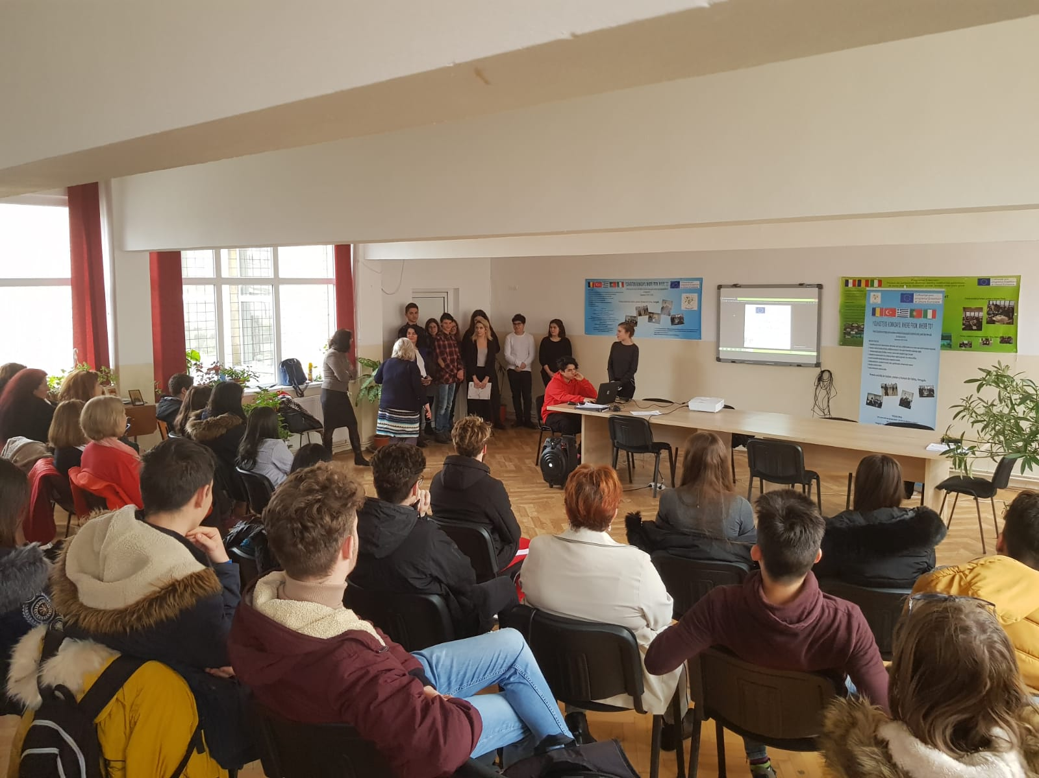

Slide 17
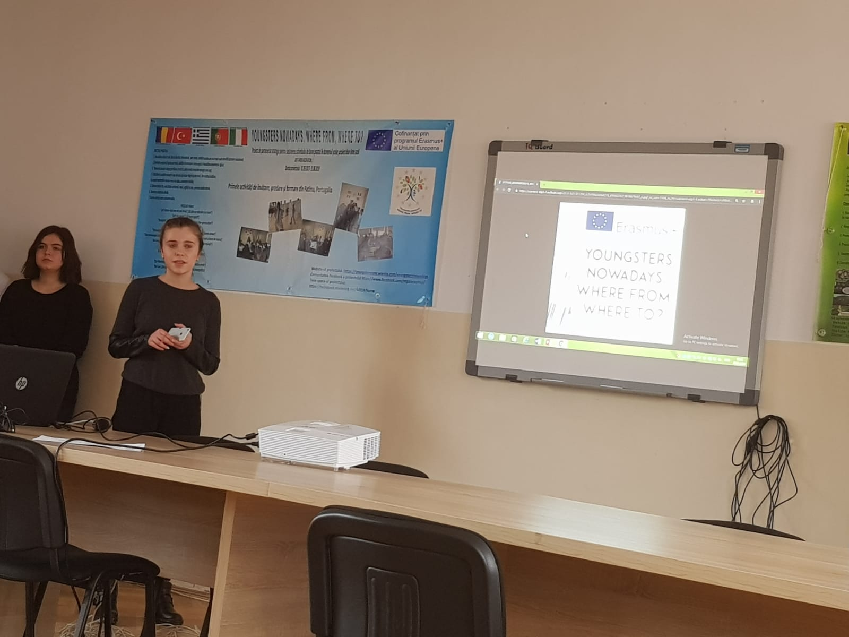
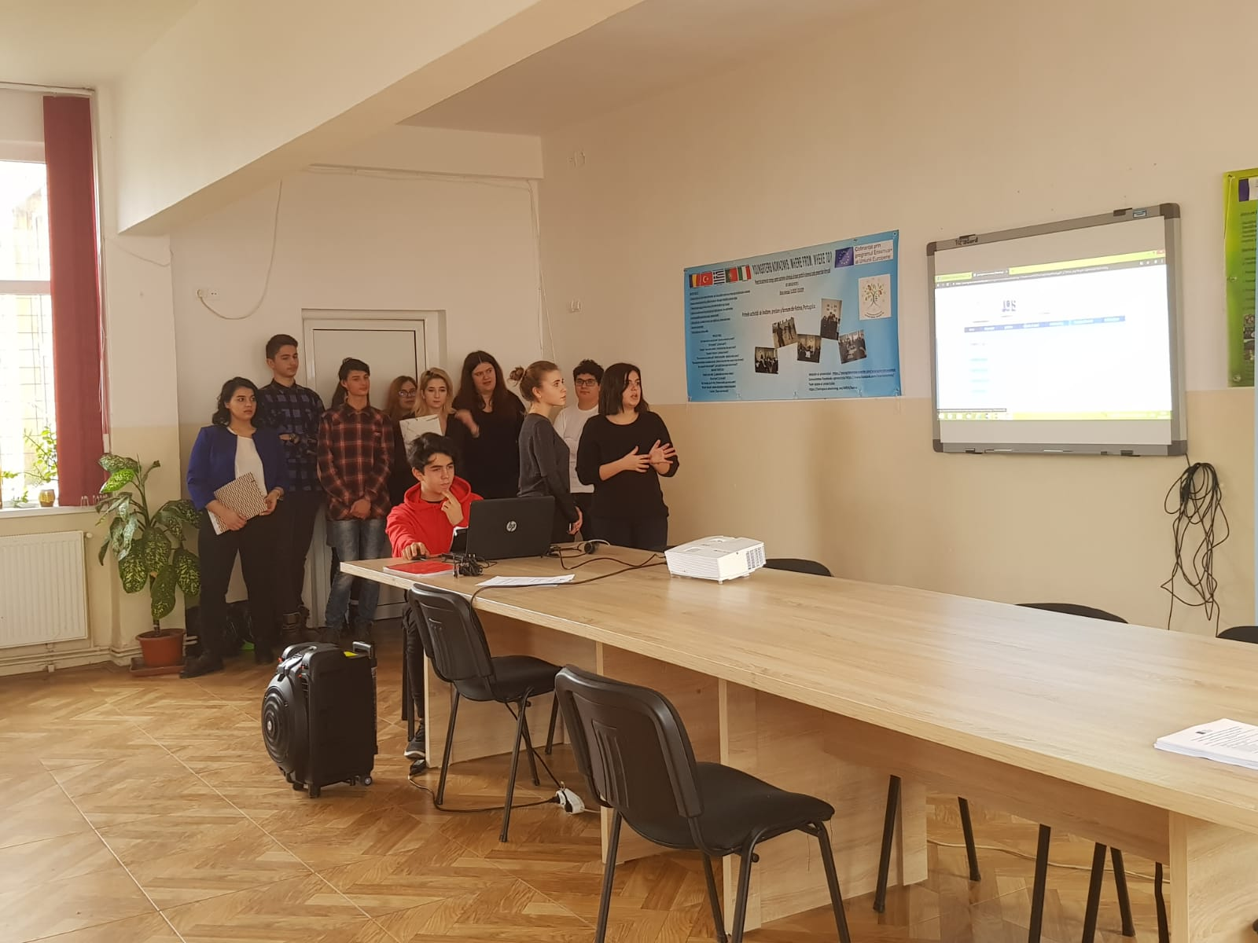

Slide 18
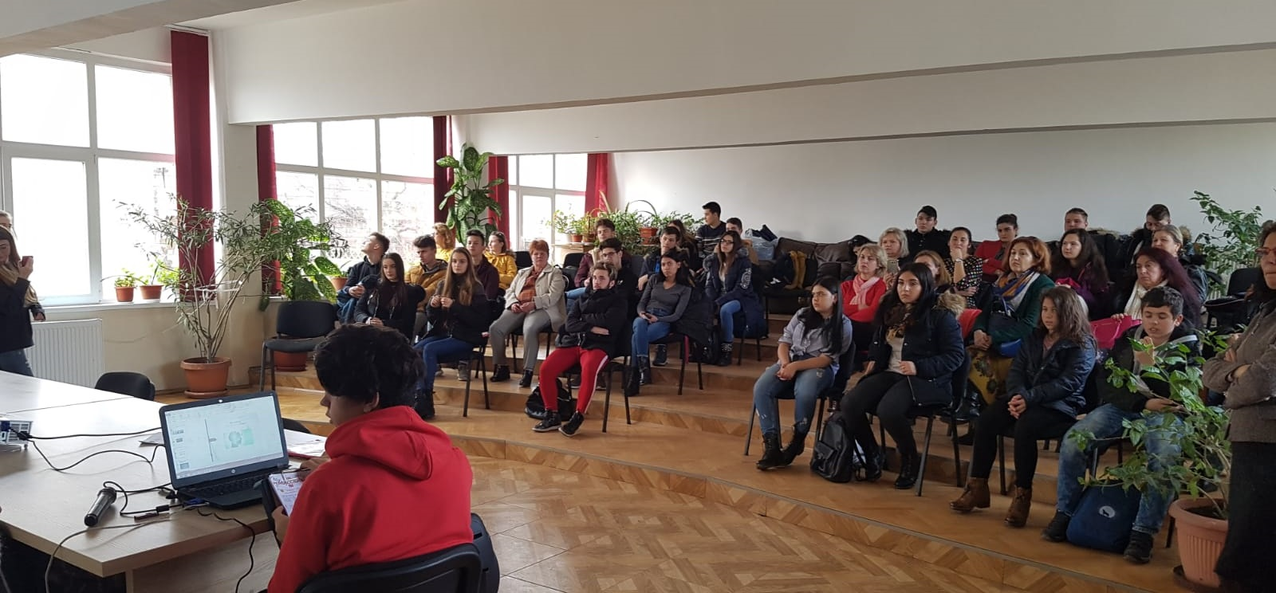
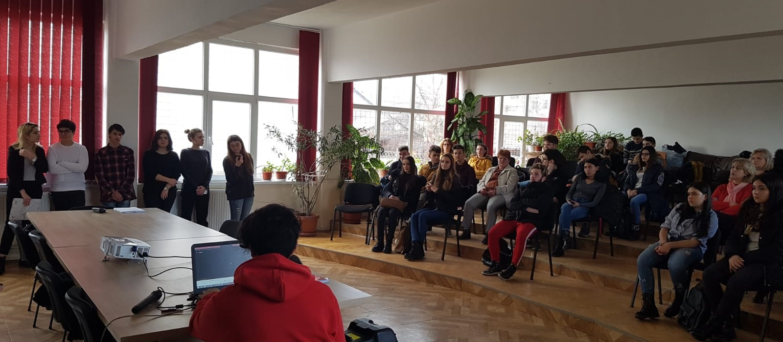

Slide 19
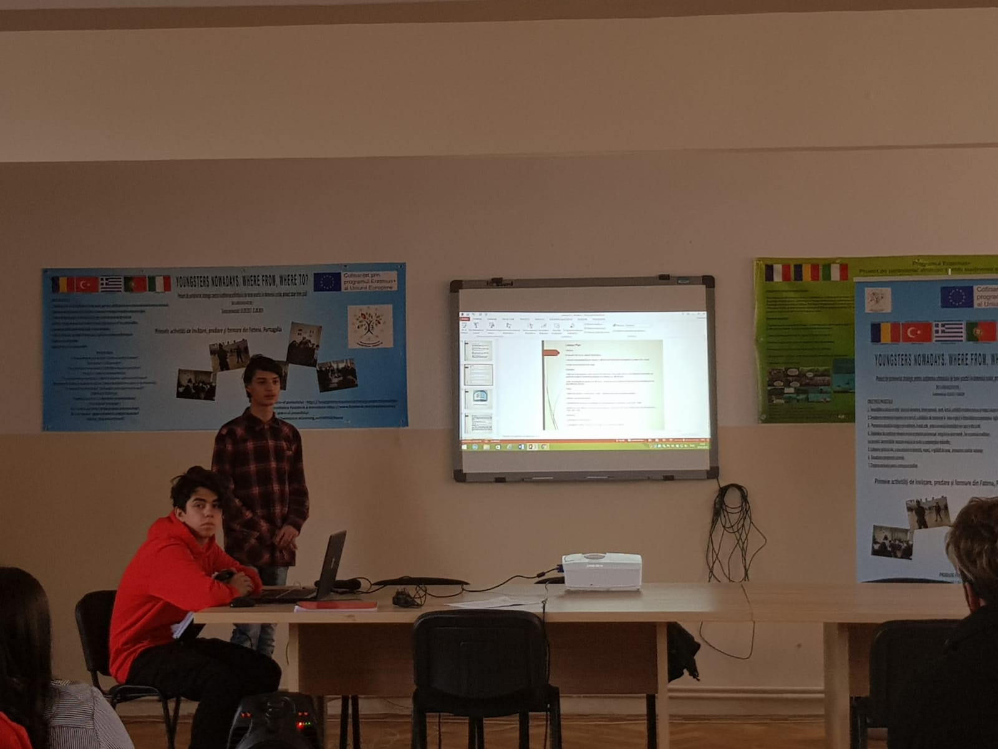

Slide 20
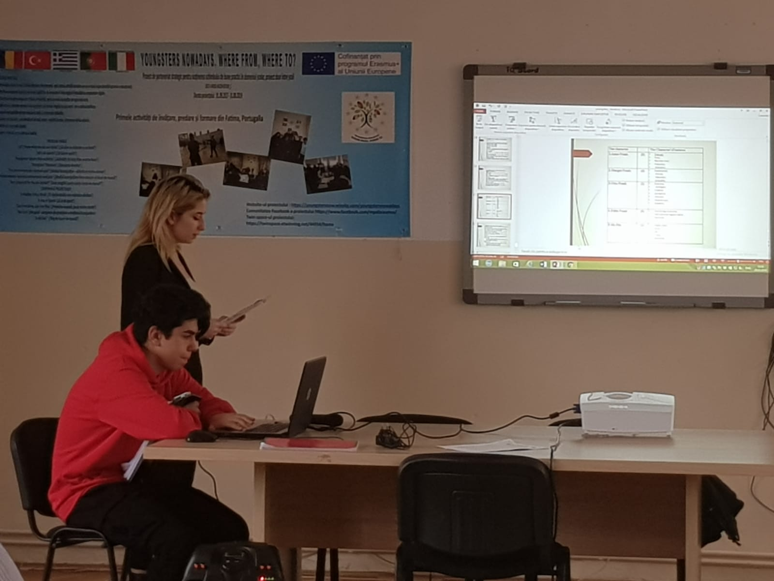

Slide 21
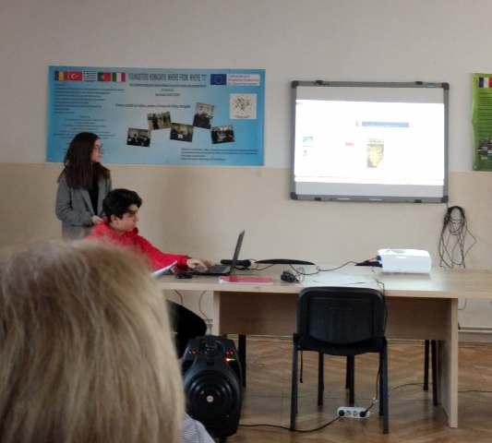
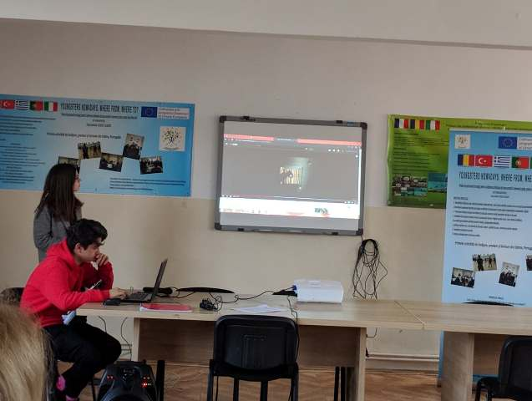

Slide 22
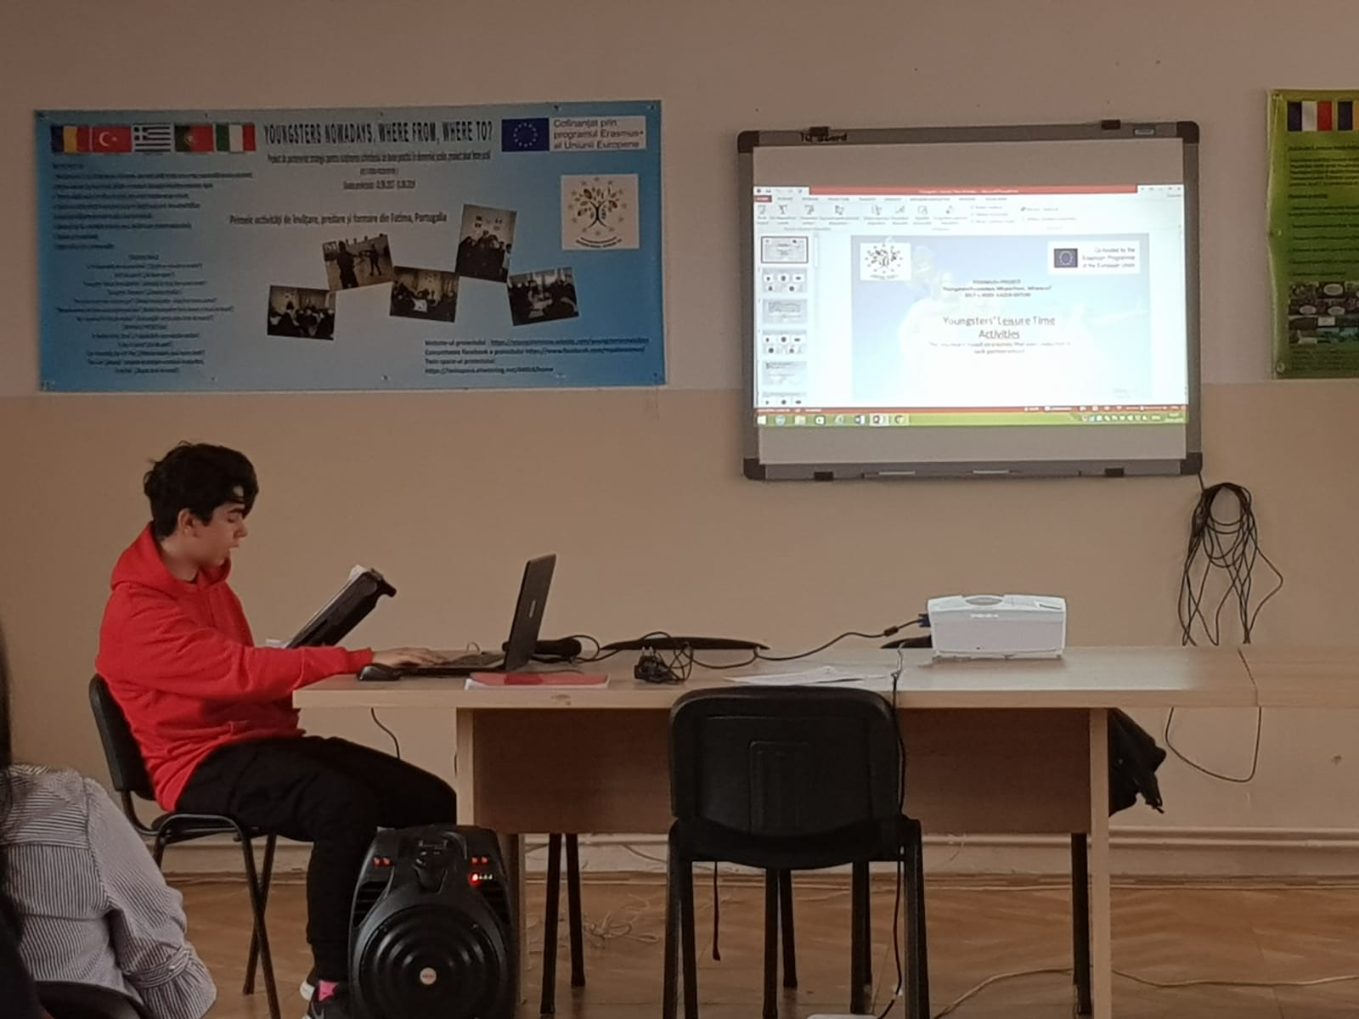

Slide 23
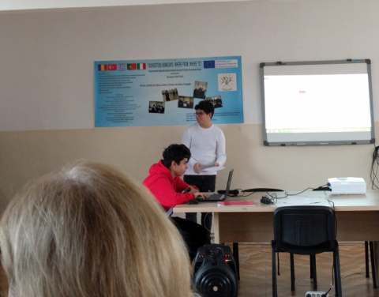
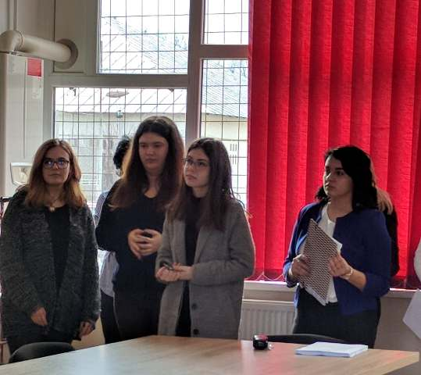

Slide 24
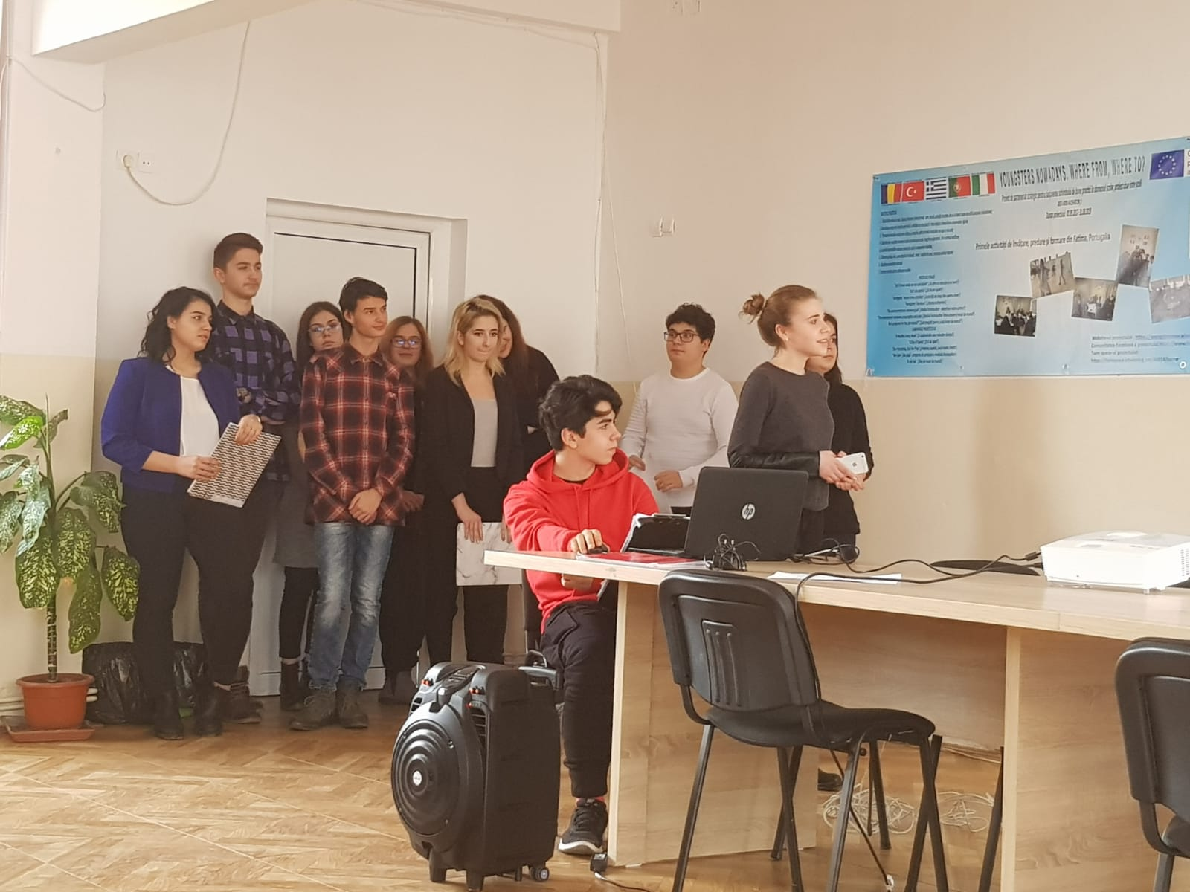

Slide 25
The participants in the project activities told the audience that through the project activities, the target group had increased their health and wellbeing through healthy eating and sports, they had campaigned directly towards a healthy lifestyle and they had influenced the community to eat healthily. They started to spend their leisure time by doing sports, reading, visiting places that represent our national heritage. They raised their cultural awareness, increased their tolerance and respect for the other cultures and civilisations and they militated against social exclusion. They developed their ICT and English skills. They acquired and developed their leadership, teamwork and organizational skills

Slide 26
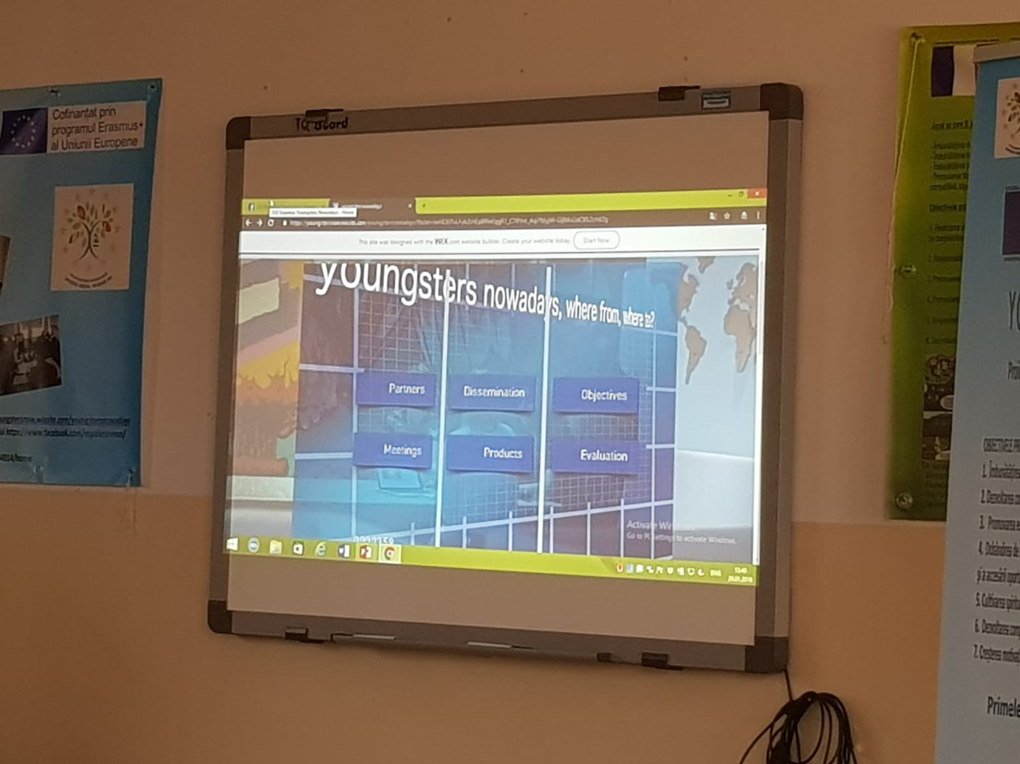

Slide 27
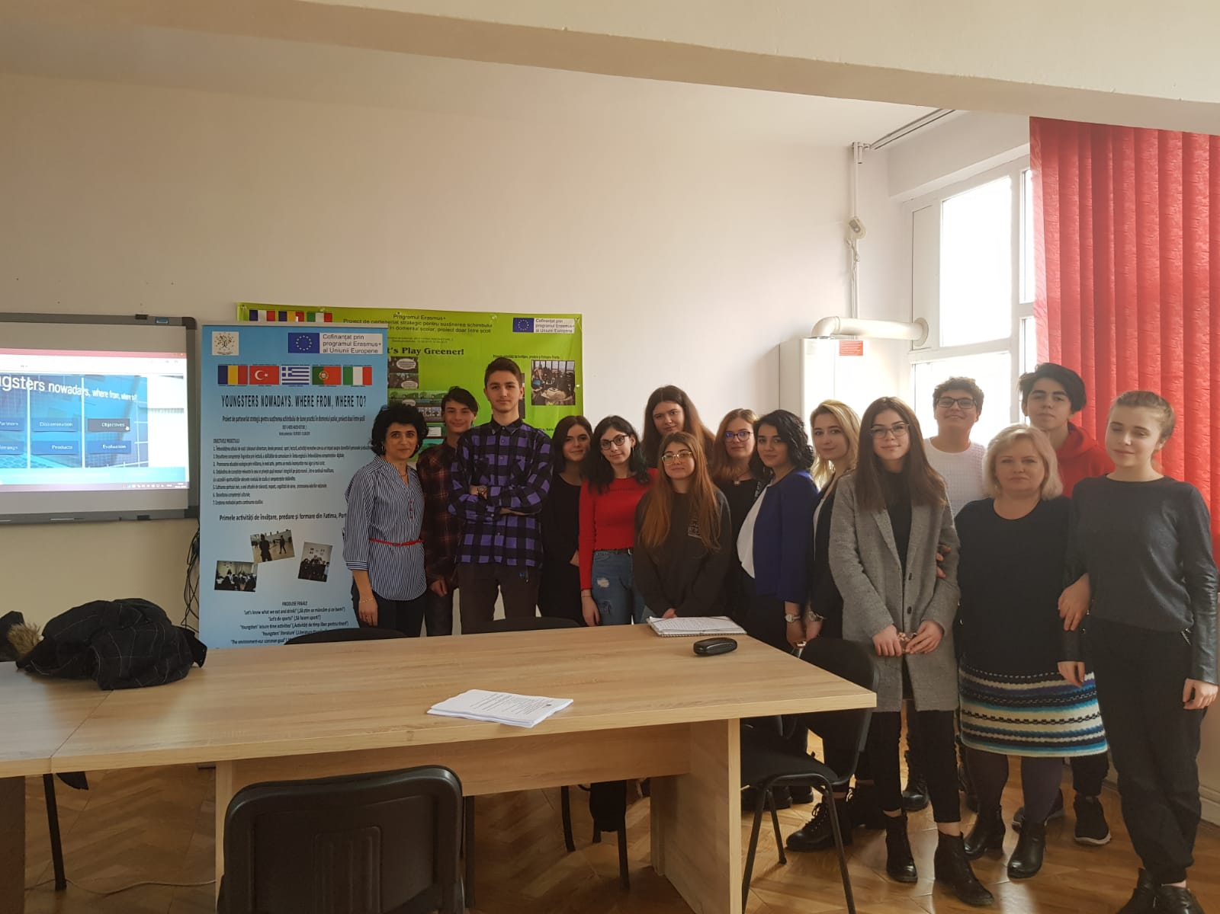

Slide 29
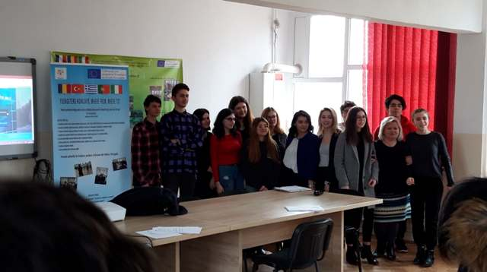

Slide 30
This project has been funded with support from the European Commission. This publication reflects the views only of the author, and the Commission cannot be held responsible for any use which may be made of the information contained therein.

