Slide 1


Youngsters Nowadays. Where from, Where to?
2017-1-RO01-KA219-037190
YOUNGSTERS’ LITERATURE
Techniques for Teaching Literature in a Pleasant Way

Slide 2
Partner Schools:
1. Colegiul Național ,,Ion Luca Caragiale”-Moreni, Romania- coordinator
2. Gymnasion Me Lykeiakes Taxeis Asopias-Assopia, Greece
3. Istituto Tecnico Tecnologico "G. Malafarina- Soverato, Italy
4. Insignare – Associacao De Ensino E Formacao Ouerem, Portugal
5. Ahmet Erdem Anadolu Lisesi-Bursa, Turkey

Slide 3
Contents
1. The Italian Team: From Reading to Movies , ‘Paper Town’ by John Green…………………..1
2. The Romanian Team: ‘Lord of the Flies’ by William Golding……………………………….14
3. The Greek Team: Teaching an Ancient Greek Tragedy ‘Antigone’ by Sophocles…………....91
4. The Turkish Team: ‘A Memento for Istanbul’ by Ahmet Ümit……………………..……….112
5. The Portuguese Team: ‘Anne Frank. The Diary of a Young Girl’..........................................138

Slide 4




The Italian Team’s Techniques for Teaching Literature:
From Reading to Movies
‘Paper Town’ by John Green
The activity carried out has the intent to demonstrate that a film and a book, even if they tell the same story, are not necessarily the copy of each other; indeed they can assume different implications thus becoming two original works. We have chosen ‘Paper Town’ by John Green.

Slide 5

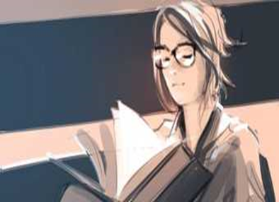

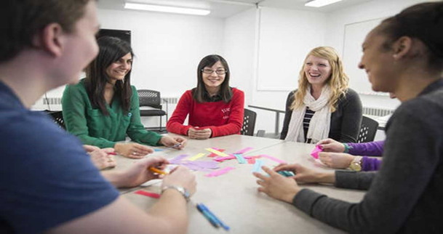
According to this theory reading the book and watching the film should be considered two distinct experiences and it is advisable to watch the film only after having read the book. The objective was to compare two different types of language, the written and the visual ones.
Our work was organised in different steps comprising several activities.
Activity 1. Prediction. The students were asked to predict what the quote ‘The town was paper, but the memories were not” means.
Activity 2. Research. The students had to do research on the novel and its author.
“Paper Towns” is a novel written by John Green, primarily for an audience of young adults. It was published on October 16th 2008 and the movie was released on July 24th 2015.
The novel is about the coming-of-age of the protagonist, Quentin "Q" Jacobsen and his search for Margo Roth Spiegelman, his neighbour and childhood sweetheart.
John Green drew inspiration for this book from his experience and knowledge of “Paper Towns“ during a road journey through South Dakota.

Slide 6
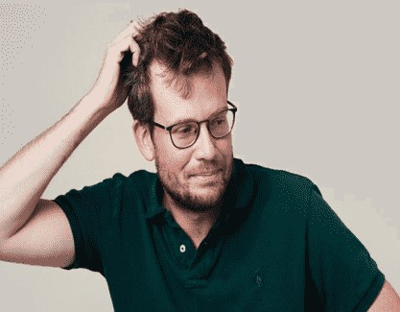
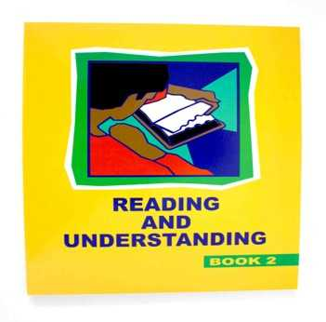
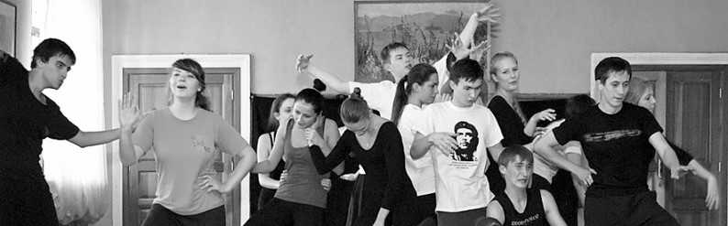
John Michael Green (born August 24th 1977) is an American author, vlogger, writer, producer, actor, editor and educator. In 2014, Green was included in Time magazine's list of ‘The 100 Most Influential People in the World’ and his novel “Paper Towns” debuted in international cinema. Aside from being a novelist, Green is also well known for his YouTube ventures. In 2007 he launched the VlogBrothers channel with his brother, Hank Green. Since then, John and Hank have launched events such as Project for Awesome and VidCon and created a total of 11 online series, including Crash Course, an educational channel teaching Literature, History, and Science, later joined by fourteen other courses.
John Michael Green
Activity 3. Reading and understanding the content
The youngsters were asked to identify the most significant passages, to convey their feelings and to underline the sentences that affected them more.
Activity 4. Identifying the main characters and their roles

Slide 7
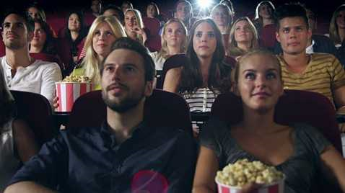
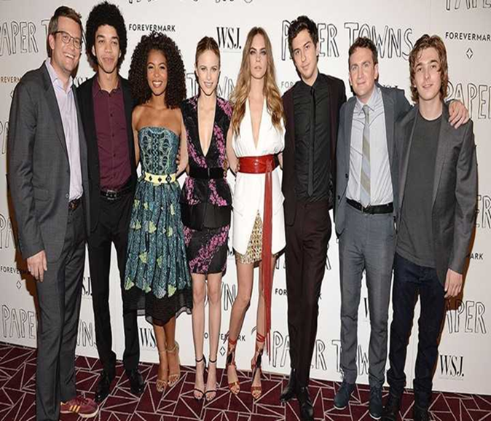
Activity 5. Watching and analysing the film
Some reviews of the film have been read and commented
Questions:
Are the characters the same you imagined?
Would you have chosen different actors?
Activity 6. Providing information on the main cast
1. Nat Wolff as Quentin "Q" Jacobsen, the film's lead protagonist.
2. Cara Delevingne as Margo Roth Spiegelman, Quentin's childhood friend and the object of his affection.
3. Halston Sage as Lacey Pemberton, Margo's best friend, she later becomes one of Quentin's friends and Benjamin's prom date.
4. Abrams as Benjamin "Ben" Starling, one of Quentin's best friends.
5. Justice Smith as Marcus "Radar" Lincoln, one of Quentin's best friends.
6. Jaz Sinclair as Angela, Marcus's girlfriend, and prom date, who later joins Quentin's circle of friends

Slide 8
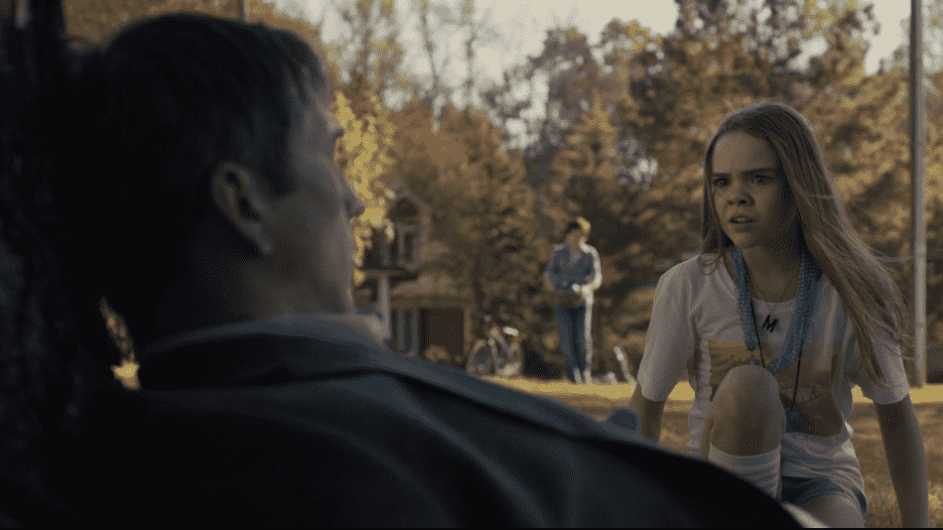
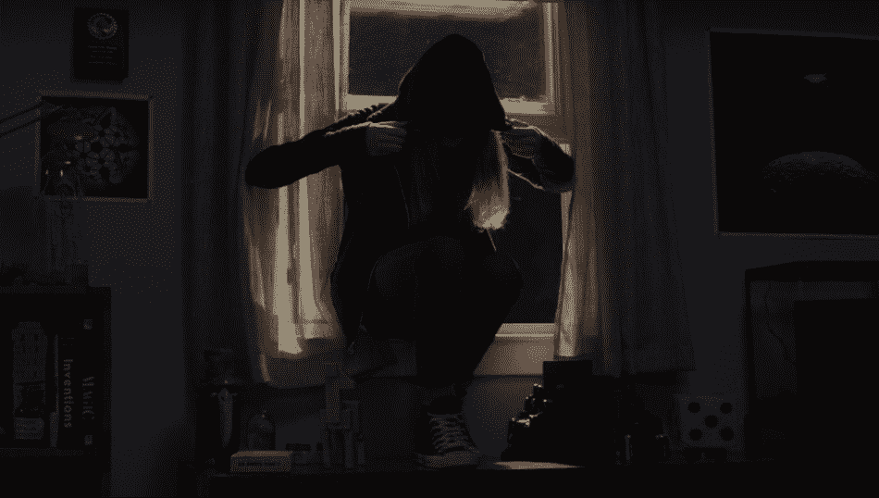
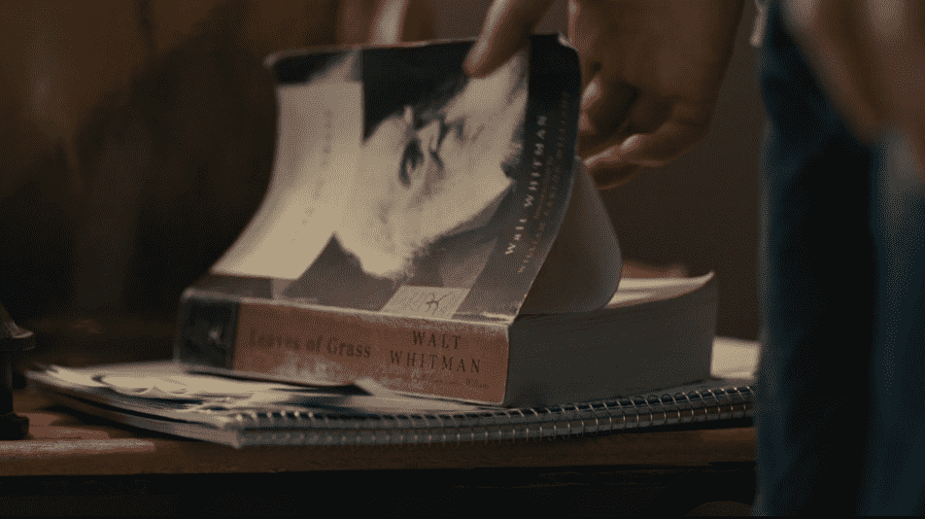
Activity 7. Giving a brief summary of the novel
Quentin Jacobsen is a seventeen-year-old living in an Orlando-area high school. He has been in love with his childhood best friend, Margo, his entire life. Quentin is an intelligent boy and Margo has a reputation for being tough and cool. When they were nine years old, he and Margo shared a discovery that changed their lives forever. While walking through a park, they found a man named Robert Joyner who had killed himself. Since that night, he and Margo went separate ways. Fortunately, Quentin’s parents are therapists and but for that tragedy, Quentin has lived a balanced and well-adjusted life with few risks and little drama.
A few weeks before high school graduation, Margo appears at Quentin’s window in the middle of the night. She asks him to accompany her on an all-nighter of pranks. Margo is on a litany of revenge that includes spray paint, blackmail, and breaking into Sea World. Quentin thinks that this night will bring he and Margo together again as friends. However, Margo runs away soon after their adventures. Quentin turns to his friends Radar and Ben, and to Margo’s friend, Lacy, for help in an attempt to find her. They eventually skip their high school graduation and go on a cross-country trip to find or “save her.” Margo has left clues in a volume of Walt Whitman’s “Leaves of Grass” in the hope that he will find her. Along the way, Quentin realises that Margo is not really the person he believed.

Slide 9


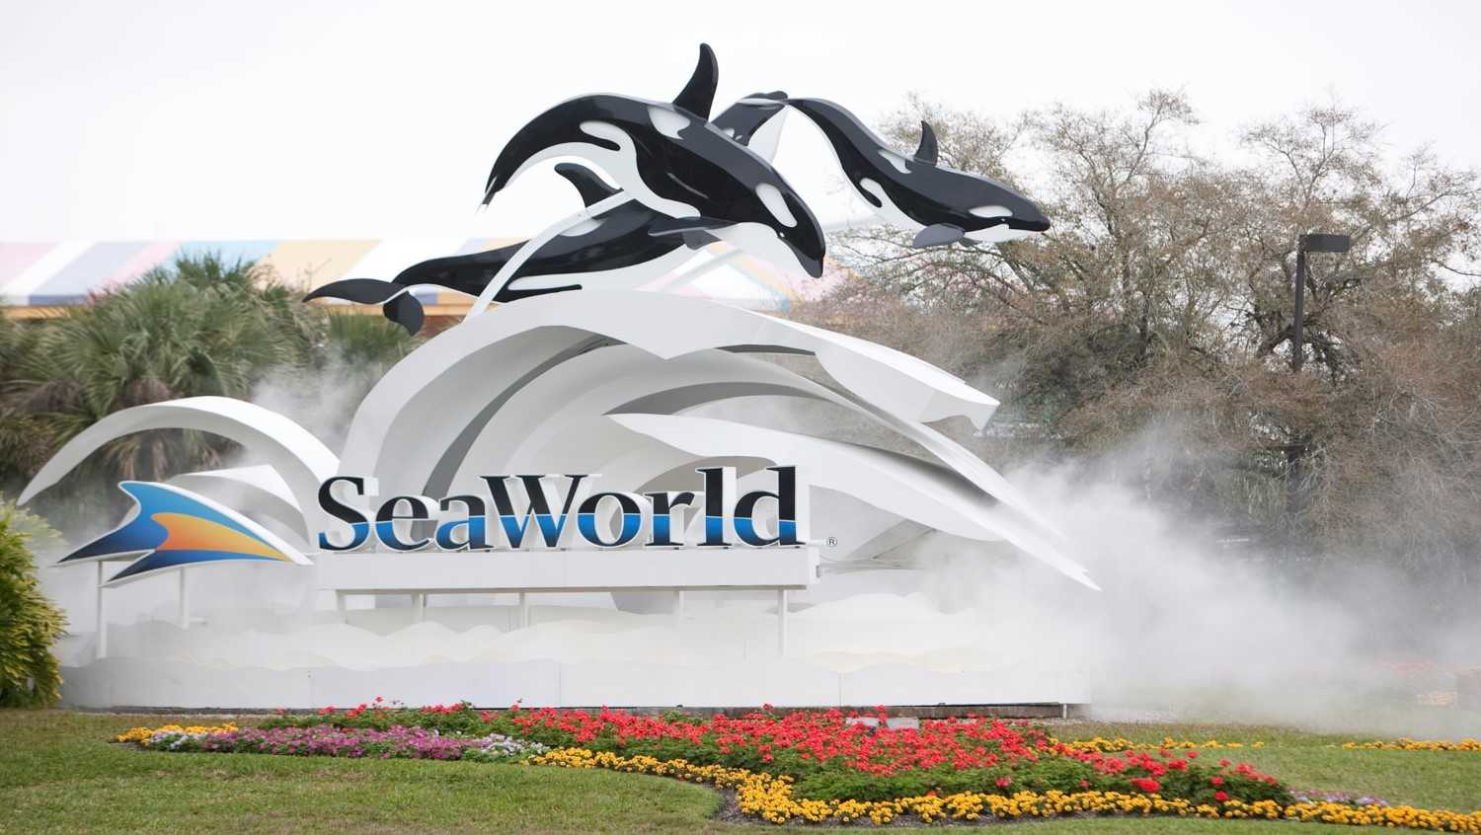
Activity 8. Book vs. Movie- Spotting differences
The story follows Quentin Jacobson (Nat Wolff), who spends the entire film trying to track down Margo Roth Spiegelman (Cara Delevingne), his elusive crush, who disappears after the two spend a mischievous night, pranking their high school classmates. Yet, if readers are expecting the movie to be exactly like the book, that’s not exactly what they’ll get.
1. Sea World
In the book: Margo and Quentin break into Sea World, the only theme park Margo says she’s never broken into. Margo gets bitten by a snake, leading Quentin to try to suck the poison out.
In the movie: SeaWorld is never mentioned, which John Green acknowledged on YouTube, saying “no one was anxious to pay Sea World for the chance to give them good publicity.”

Slide 10
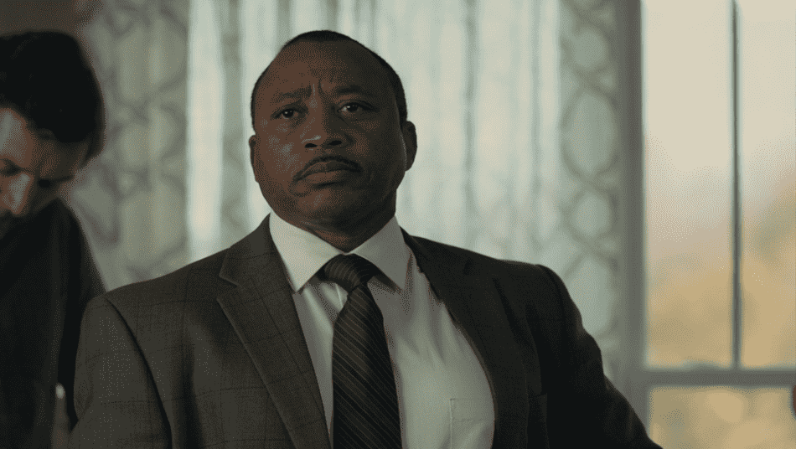
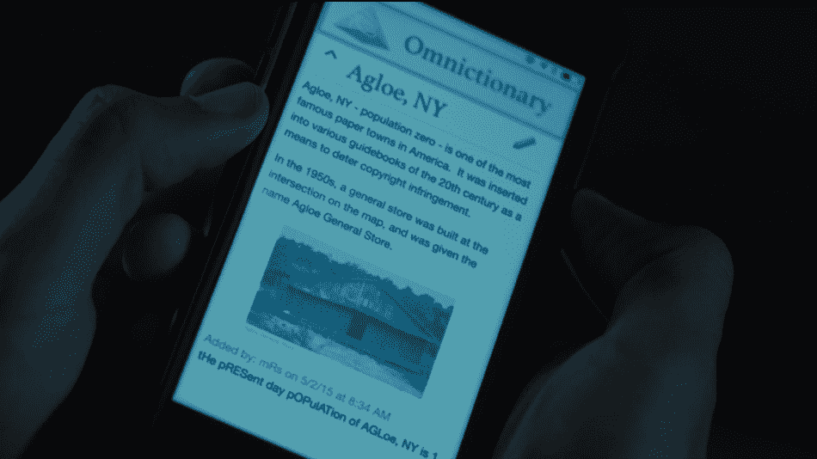
2. Detective Warren
In the book: Quentin meets Detective Warren 48 hours after Margo’s disappearance, admits he was with her on Wednesday night, speaks privately with him and later calls him after he’s discovered the mini mall.
In the movie: We see a Detective Warren, nearly exactly as Green describes him in the book, but that’s the last we see of him.
3. Omnictionary
In the book: Radar spends a ton of time editing an “online user-created reference source called Omnictionary,” noticeably similar to Wikipedia. His knowledge comes into play when researching some of Margo’s potential whereabouts.
In the movie: We see Radar and other characters using Omnictionary, but there’s no mention of Radar’s involvement, and the shot is so quick that it just looks like Wikipedia.

Slide 11
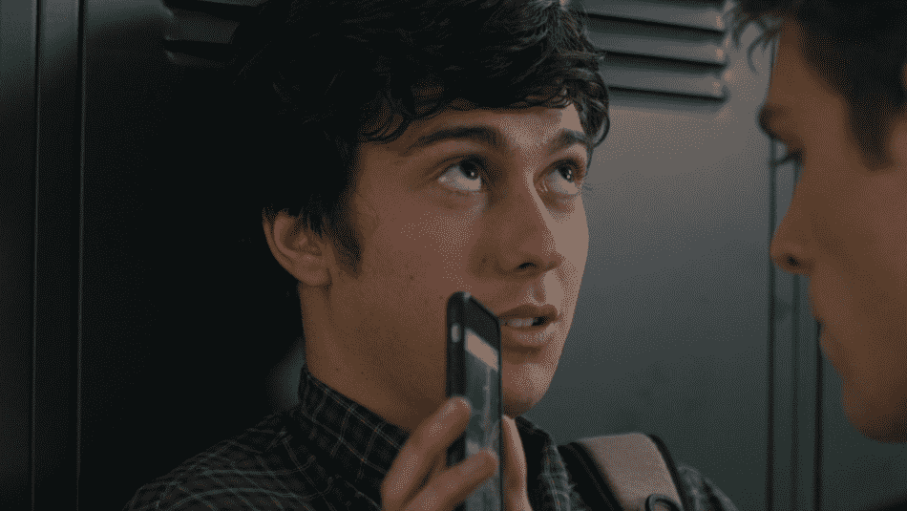
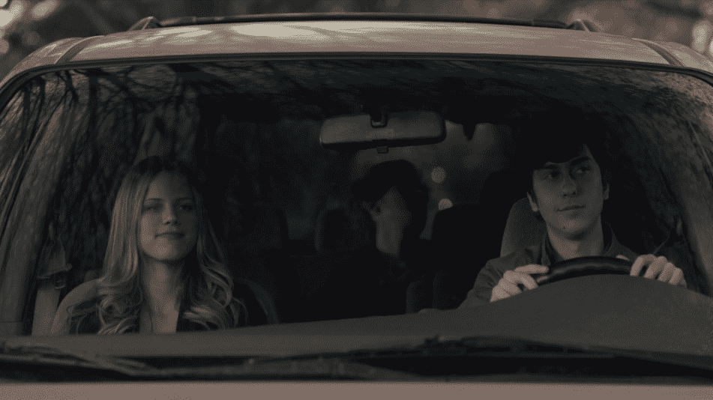
4. Instant Messages
In the book: We get to see the characters’ instant message (IM) conversations, including their screen names. Quentin’s is QTHERESURRECTION. Radar goes by OMNICTIONARIAN96 and Ben’s reads ITWASAKIDNEYINFECTION, in reference to the “Bloody Ben” nickname he earned from a disturbing kidney infection that left him peeing blood.
In the movie: No IMing that we see, which makes sense, considering the ‘Fault’ and ‘Paper Towns’ screenwriters took out most of the video game playing in Fault. Both would have shown the beloved characters simply staring at screens.
5. The Road Trip
In the book: Quentin, Ben, Radar and Lacey decide to road trip to Agloe, N.Y. and Angela is left behind, unhappy with Radar as they were “scheduled to do something very special” after graduation. They also get in a car accident, almost hitting some cows, but spin off the road as Ben turns the wheel to save the group. There’s minimal damage to the car, just a big gash in the side panel that Radar looks up, estimating it’ll cost $300 plus paint to repair, what Quentin decides is “a small price to pay for Margo.”
In the movie: Quentin, Ben, Radar, Lacey and Angela decide to road trip to Agloe, N.Y., after discovering online that someone has edited the Agloe description. The group wants to rush up to Agloe and back to get home in time for prom. Ben desperately has to pee, using a beer can to do so, but spills it on himself and Radar, that’s why they need new shirts. The car accident is roughly the same as in the book, but there’s only one cow in the road, no one cries and a tire is blown out, which leads to an overnight stay on the side of the road.
Having Angela on the trip gave everyone involved a fun opportunity: For Radar to lose his virginity, for the world to meet Jazz Sinclair and for Green to admit he wishes he’d included her on the road trip in the book.

Slide 12
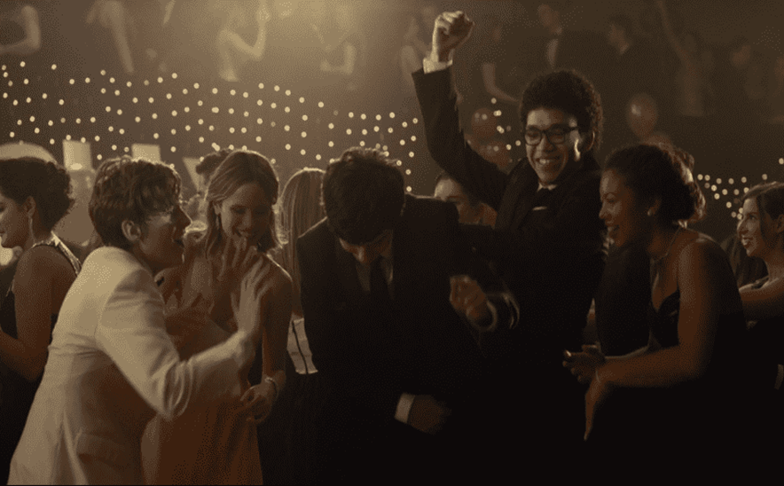
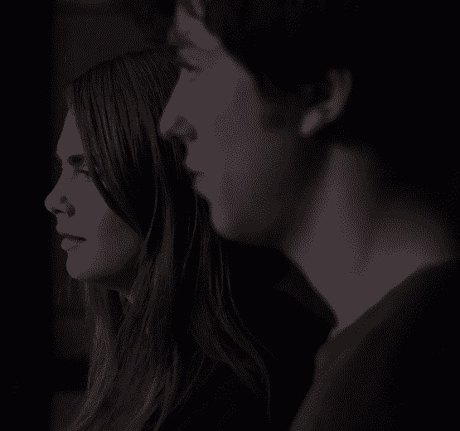
6. Prom Night
In the book: Quentin lies to his mom that he’s going to prom alone but instead he spends the night trying to find Margo by going to a pseudo-vision and then in the mini mall filled with more of her clues.
In the movie: After reeling from his conversation with Margo, Quentin takes a bus back to Orlando and heads to prom.
Activity 9. Identifying analogies between the novel and the film.
Activity 10. Which one do you prefer, the novel or the film? Why?
Possible answer: Clearly, we much prefer the book to the movie, but it’s still a fun film. Quentin is a charming lead, Ben and Radar make great impressions as his best friends and there are loads of touching coming-of-age scenarios to connect to and enjoy, but there’s just no way this story can strike as strong a chord when reduced to 109 minutes of screen time. Margo didn’t just run away from home for a bit. She cut off communication with her parents and Q was completely consumed by his need to find her for an entire month of their lives. Both sacrificed so much to find what they were looking for and by paring down the details of that journey and the effect it had on those around them, the movie winds up reducing the value of the entire story. Again, Paper Towns is a solid movie that you will likely watch and enjoy time and time again, but you’ll also fairly certain that there was absolutely no way to squeeze enough of the book into the movie to ensure it would be as effective.

Slide 13
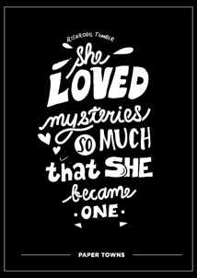
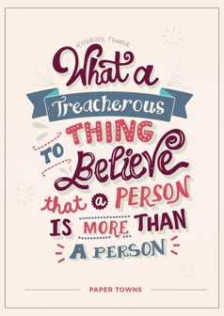

Activity 11. Explaining famous ‘Paper Towns’ Quotes
Possible answers:
Margo’s curiosity about the dead man's mystery that she and Q had found in the garden basically pushed her to live her life in that way and that's why she disappears so that she could do whatever she wants without being a burden on anyone. She becomes a mystery for him.
This line is a reflection of the tendency to see someone as very different from what they really are. You choose to overlook their flaws. They can do no wrong. You’ll never cease to defend them. But what have they done for you? This is the ongoing, blind-sided reality that we face with those we see as more than a person. It’s easy to get caught up in the lust, until they treat us like we never imagined they would. Like receiving your first pair of glasses, you finally see their flaws. You finally see their intentions which you previously misperceived.
This image of strings being cut, leaving children adrift, runs through the book. Detective Otis Warren, who is investigating Margo’s disappearance, tells Quentin about kids like Margo: “These kids, they’re like tied-down helium balloons. They strain against the string and they strain against it, and then something happens, and that string gets cut, and they just float away. … Once that string gets cut, kid, you can’t uncut it.”

Slide 14
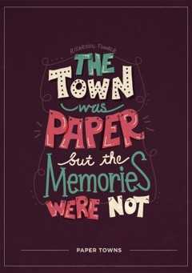
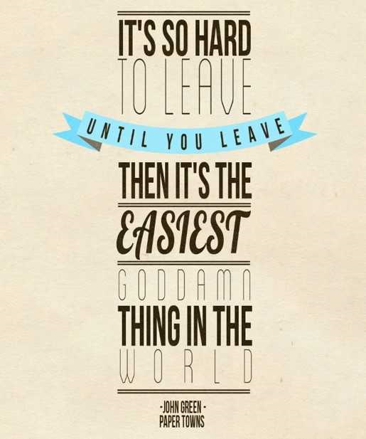
The quote comes as Q’s graduation date draws near. He realizes that, although the people around him have been indeed materialistic and “unreal”, he still treasures the memories he has with them. That’s precisely why graduating makes him feel a little sad.
Sometimes leaving something/someone can be the only way to set yourself free. It's hard to leave when you have so many reasons to stay, but once you do, you won't look back.
Activity 12. Read the following honorable mentions from the novel and explain what they mean taking into account the plot and at the same time, your own life experience.
“Stop looking at the sky, otherwise one day you will lower your eyes and you will notice that you also flew away.”
“If you don't imagine, nothing ever happens at all.”
“Humans lack good mirrors. It’s so hard for anyone to show us how we look, and so hard for us to show anyone how we feel.”
“I thought I was made out of paper. That I was the light and fragile one, not the others. Here is where the problem laid.”

Slide 15
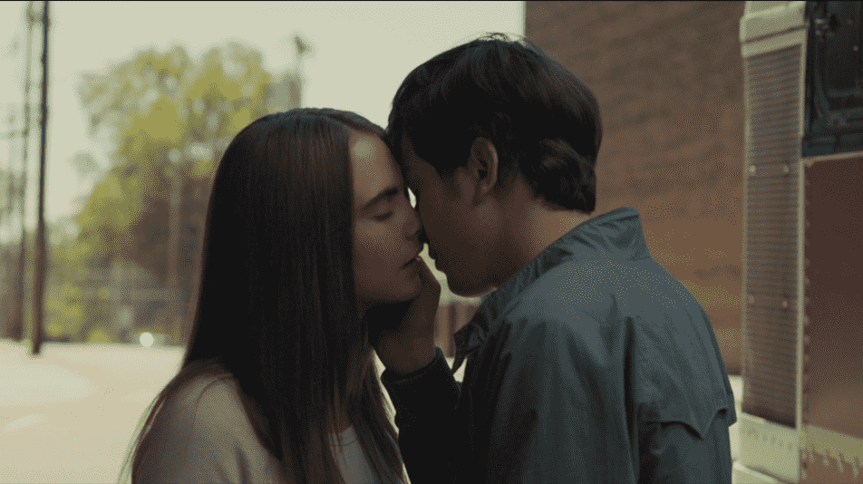
Activity 13. What do the final lines tell us? -Final Monologues
When he finds her, she says that she doesn't want to be found. Well that's a letdown. When he asks her to come home with him, she says no. But he, at least gets to make out with her in a parking lot before they part ways. After they kiss, Quentin gives us the last line of the novel:
“Yes, I can see her almost perfectly in this cracked darkness”.
His staring at her reminds us of when they stared at each other in the darkness when they were kids. And the last line makes us recall another line from earlier in the book: Quentin says: "Margo's beauty was a kind of sealed vessel of perfection—uncracked and uncrackable“. But by the end of the novel, he sees that she isn't perfect.
Margo never wanted to appear as a perfect figure based on suppositions raised by her exterior appearance. This doesn't scare Quentin away though. He seems to accept her for who she really is, instead of trying to make her into something she's not.
Quentin, therefore, offers a really important life virtue: “Not everyone can live a miracle, we must try to give importance to what we have: family, friends and love itself”.

Slide 16

Activity 14. Evaluation
- Describe Quentin’s relationships with the other guys in the group.
- What do you think about Margo?
- Do you think the book leaves something unfinished?
- If you were Quentin, how would you behave?
- How did the movie involve you?
- Which scene do you prefer?

Slide 17

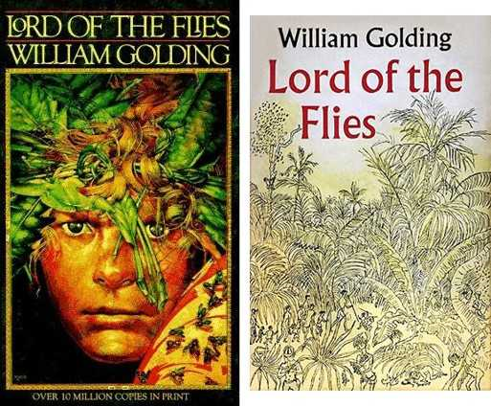
The Romanian Team’s Techniques for Teaching Literature:
‘Lord of the Flies’ by William Golding

Slide 18
1st sequence of techniques
Activity1.
1.1. This activity can be done after the students have read the novel. At first, the teacher proposes an "ice breaking" exercise, which is represented by watching a fragment from the novel screening. The teacher plays the sequence of the film.
”Jack held up the head and jammed the soft throat down on the pointed end of the stick which pierced through into the mouth. He stood back and the head hung there, a little blood dribbling down the stick. Instinctively the boys drew back too; and the forest was very still. They listened, and the loudest noise was the buzzing of flies over the spilled guts. Jack spoke in a whisper.
"Pick up the pig."
Maurice and Robert skewered the carcass, lifted the dead weight, and stood ready. In the silence, and standing over the dry blood, they looked suddenly furtive. Jack spoke loudly.
"This head is for the beast. It's a gift." The silence accepted the gift and awed them. The head remained there, dim-eyed, grinning faintly, blood blackening between the teeth. All at once they were running away, as fast as they could, through the forest toward the open beach.
1.2 The students are asked to identify the moment that corresponds to the short sequence from the film.

Slide 19
The expected answer is that the sequence is to be found in Chapter VII, when Jack's group of hunters kills a pig, and the leader impales the animal's head in a spear, as a sacrifice to the frightening ‘Beast’ that they think that is living on the island.
Activity 2.
In the next sequence of the lesson, the students will be grouped in pairs. They are asked to write on some sheets of paper, two questions about the text, for which their colleagues provide their own answers, accompanied by fragments from the novel. The condition to be met by the questions is to reflect the most important / relevant moments in the development of the plot.
Question 1. How do children organise themselves when they realise they are stranded on an island?
Possible answer: When they realise that they are stranded on an island, the children organised themselves in groups, according to their age and concerns (the little ones, the boys in the choir and the big boys.)
Chapter 1. Piggy muttered the name to himself and then shouted it to Ralph, who was not interested because he was still blowing. His face was dark with the violent pleasure of making this stupendous noise, and his heart was making the stretched shirt shake. The shouting in the forest was nearer. Signs of life were visible now on the beach. The sand, trembling beneath the heat haze, concealed many figures in its miles of length; boys were making their way toward the platform through the hot, dumb sand..

Slide 20
Three small children, no older than Johnny, appeared from startlingly close at hand, where they had been gorging fruit in the forest. A dark little boy, not much younger than Piggy, parted a tangle of undergrowth, walked on to the platform, and smiled cheerfully at everybody. More and more of them came. Taking their cue from the innocent Johnny, they sat down on the fallen palm trunks and waited. Ralph continued to blow short, penetrating blasts. Piggy moved among the crowd, asking names and frowning to remember them. The children gave him the same simple obedience that they had given to the men with megaphones.
Some were naked and carrying their clothes; others half-naked, or more or less dressed, in school uniforms, grey, blue, fawn, jacketed, or jerseyed. There were badges, mottoes even, stripes of color in stockings and pullovers. Their heads clustered above the trunks in the green shade; heads brown, fair, black, chestnut, sandy, mouse-colored; heads muttering, whispering, heads full of eyes that watched Ralph and speculated. Something was being done. The children who came along the beach, singly or in twos, leapt into visibility when they crossed the line from heat haze to nearer sand. Here, the eye was first attracted to a black, bat-like creature that danced on the sand, and only later perceived the body above it. The bat was the child's shadow, shrunk by the vertical sun to a patch between the hurrying feet. Even while he blew, Ralph noticed the last pair of bodies that reached the platform above a fluttering patch of black. The two boys, bullet-headed and with hair like tow, flung themselves down and lay grinning and panting at Ralph like dogs. They were twins, and the eye was shocked and incredulous at such cheery duplication.

Slide 21
They breathed together, they grinned together, they were chunky and vital. They raised wet lips at Ralph, for they seemed provided with not quite enough skin, so that their profiles were blurred and their mouths pulled open. Piggy bent his flashing glasses to them and could be heard between the blasts, repeating their names.
"Sam, Eric, Sam, Eric." Then he got muddled; the twins shook their heads and pointed at each other and the crowd laughed. At last Ralph ceased to blow and sat there, the conch trailing from one hand, his head bowed on his knees. As the echoes died away so did the laughter, and there was silence. Within the diamond haze of the beach something dark was fumbling along. Ralph saw it first, and watched till the intentness of his gaze drew all eyes that way. Then the creature stepped from mirage on to clear sand, and they saw that the darkness was not all shadow but mostly clothing.
The creature was a party of boys, marching approximately in step in two parallel lines and dressed in strangely eccentric clothing. Shorts, shirts, and different garments they carried in their hands; but each boy wore a square black cap with a silver badge on it. Their bodies, from throat to ankle, were hidden by black cloaks which bore a long silver cross on the left breast and each neck was finished off with a hambone frill. The heat of the tropics, the descent, the search for food, and now this sweaty march along the blazing beach had given them the complexions of newly washed plums. The boy who controlled them was dressed in the same way though his cap badge was golden. When his party was about ten yards from the platform he shouted an order and they halted, gasping, sweating, swaying in the fierce light.

Slide 22
The boy himself came forward, vaulted on to the platform with his cloak flying, and peered into what to him was almost complete darkness.
Question 2. What is the moment when Ralph and Jack decide to organise and get into two separate groups?
Possible answer: Ralph and Jack decide tthis when the boys who had to maintain the fire burning, fail to do this and in this way, the sailors on the ship that could have seen them did not spot them because the children were hunting.
Chapter 4. The hunters were more silent now, but at this they buzzed again. Ralph flung back his hair. One arm pointed at the empty horizon. His voice was loud and savage, and struck them into silence. "There was aship." Jack, faced at once with too many awful implications, ducked away from them. He laid a hand on the pig and drew his knife. Ralph brought his arm down, fist clenched, and his voice shook. "There was a ship. Out there. You said you'd keep the fire going and you let it out!" He took a step toward Jack, who turned and faced him. "They might have seen us. We might have gone home--" This was too bitter for Piggy, who forgot his timidity in the agony of his loss. He began to cry out, shrilly:
"You and your blood, Jack Merridew! You and your hunting! We might have gone home--" Ralph pushed Piggy to one side. "I was chief, and you were going to do what I said. You talk. But you can't even build huts--then you go off hunting and let out the fire--" He turned away, silent for a moment. Then his voice came again on a peak of feeling. "There was a ship-”.

Slide 23
One of the smaller hunters began to wail. The dismal truth was filtering through to everybody. Jack went very red as he hacked and pulled at the pig. "The job was too much. We needed everyone.„
Question 3. With what episode from the plot can you associate the meaning of the title?
Posssible answer: The meaning of the title is associated with the episode from the end of Chapter 7 when Simon sees the pig’s head in a spear and this is the moment his imagination overwhelms him. The child starts to talk with the Lord of the Flies that tells him that the beast that they all talk about is in each person, in its inner self and there will be a time in which everyone will suffer.
Chapter 7. Simon's head wobbled. His eyes were half closed as though he were imitating the obscene thing on the stick. He knew that one of his times was coming on. The Lord of the Flies was expanding like a balloon.
"This is ridiculous. You know perfectly well you'll only meet me down there--so don't try to escape!" Simon's body was arched and stiff. The Lord of the Flies spoke in the voice of a schoolmaster. "This has gone quite far enough. My poor, misguided child, do you think you know better than I do?" There was a pause. "I'm warning you. I'm going to get angry. D'you see? You're not wanted. Understand? We are going to have fun on this island. Understand?
We are going to have fun on this island! So don't try it on, my poor misguided boy, or else--" Simon found he was looking into a vast mouth. There was blackness within, a blackness that spread. "--Or else," said the Lord of the Flies, "we shall do you? See? Jack and Roger and Maurice and Robert and Bill and Piggy and Ralph. Do you. See?"

Slide 24
Activity 3. Puzzle
The teacher prepares a set of sentences with some of the main ideas of the text. These are written on separate sheets of paper, they are jumbled, and the students’ task is to put the given ideas in a chronological order.
For example,
-Ralph and Jack disputed their leading role when all the stranded children managed to meet on the coral cliffs;
-Simon discovers that the "beast" in the woods, that they all feared, is a dead parachutist and he runs to Jack's group to announce this, but unfortunately, he is confused with the beast by the children who were in a ritual, and is killed;
-The forest is burnt, Ralph seeks solutions to escape the pursuers from Jack's camp, and gets to the beach where he meets the soldiers arriving on the island by a cruise ship, thanks to the smoke produced by the fire;
-The place where the boys meet is a coral-bound rocky platform, having a water pool created by the flux-reflux phenomenon;
-The children vote for Ralph to be their leader, and the rule is that the one who holds the conch can speak.
Activity 4. Whom would you choose as a leader? Give arguments to sustain your opinion.

Slide 25
2nd sequence of techniques
Activity 1. Alternative titles.
1.1 The teacher asks the students to give an alternative title for the book and to explain why it is appropriate. They should give arguments to support their ideas.
1.2 In groups, the students give alternative titles for each chapter and explain their choice.
Activity 2. Let’s be creative! In groups, the students are asked to write a scene that would have changed the outcome of the book. They will read the scene to their colleagues and they will explain how everything could have been changed. The class will vote for the best scene. Would this new scene have changed the title of the novel?
3rd sequence of techniques
Activity 1. Interviews, interviewers and interviewees. The class will be divided into two groups. Each group will write a set of ten questions to interview either Jack or Ralph. Two confident students will impersonate the two characters and the interview will be conducted so that the interviewee’s feelings, thoughts and reasons should be evident.

Slide 26
Activity 2. A letter to a main character. The students will write an informal letter to one of the main characters of the novel in which they will protest against a situation that the character created, they will ask questions and they will make suggestions. They will read the letters in front of the whole class.
Chapter 1. The Sound of the Shell
The 1st sequence of techniques
1. Pre- reading Activity: Prediction
1.1 Taking into account the title of the book, do you think that it is a happy ending one?
1.2 What do you think the book is about?
2. While- reading Activity: Comprehension Questions
2.1 What is the main conflict of the book at symbolic level?
Possible answer: ‘Lord of the Flies’ dramatises the conflict between the civilising instinct and the barbarising one that all human beings have.
2.2 Why are there only boys between the ages of 12 and 6?

Slide 27
Possible answer: The fact that the characters are only boys is significant because they are not completely developed, they appear to be half way between civilisation and savagery, and in this way they represent the central conflict of the novel.
2.3 Why do the boys choose Ralph as their leader?
Possible answer: He showed his leadership ability when he blew in the conch shell to summon the boys and also because the boys were distracted by his appearance when they first saw him as he was a good- looking tall boy.
2.4 What does the conch shell represent?
Possible answer: The conch shell is the symbol of civilisation which is represented by law, order and political legitimacy, as it is used to summon the boys when they are scattered on the island, and at the same time, it grants the boy who holds it the right to speak in front of the other members of the group.
3. Post- Reading Activity: Answer the following questions:
1. Do you think you would survive on the island with the boys? Justify your answer.
2. Would the savagery take control of you?
3. How would you organise the group if you were on the island?
4. How would the situation be different if there were at least a grown-up with them?

Slide 28
The 2nd sequence of techniques
Activity 1. Group Work. Brainstorming Activity: Give as many answers as possible for each question at a time. Each group of four chooses a spokesperson who will read out the answers.
1. Where do you think a plane can crash?
Possible answer: We think a plane can crash into the ocean, in a tropical forest, a busy city or on an island.
2. If you were involved in a plane crash, what would you do?
Possible answer: We will try to find other survivors and make contact with competent authorities like police fire department paramedics.
3. If the plane crashed on an island, what would you do first?
Possible answer: First we would look for supplies and a place where to build a shelter.
4. What would you take from the remaining resources that you could find?
Possible answer: We would take food, first aid kits and an axe if we found one.
5. What would you do if you were not the only survivor?
Possible answer: We will try to convince the survivors to work together to get saved more quickly and to protect one another.

Slide 29
Activity 2. Pre-reading Activity.
2.1 The following excerpt from the first chapter is given to students on worksheets. The students are told to:
- scan the text to see how many people there are and what their names are;
-skim the text for the gist.
‘Ralph had stopped smiling and was pointing into the lagoon. Something creamy lay among the ferny weeds. "A stone." "No. A shell." Suddenly Piggy was a-bubble with decorous excitement. "S'right. It's a shell! I seen one like that before. On someone's back wall. A conch he called it. He used to blow it and then his mum would come. It's ever so valuable---" Near to Ralph's elbow a palm sapling leaned out over the lagoon. Indeed, the weight was already pulling a lump from the poor soil and soon it would fall. He tore out the stem and began to poke about in the water, while the brilliant fish flicked away on this side and that. Piggy leaned dangerously. "Careful! You'll break it--" "Shut up." Ralph spoke absently. The shell was interesting and pretty and a worthy plaything; but the vivid phantoms of his day-dream still interposed between him and Piggy, who in this context was an irrelevance. The palm sapling, bending, pushed the shell across the weeds. Ralph used one hand as a fulcrum and pressed down with the other till the shell rose, dripping, and Piggy could make a grab. Now the shell was no longer a thing seen but not to be touched, Ralph too became excited. Piggy babbled: "-a conch; ever so expensive.

Slide 30
I bet if you wanted to buy one, you'd have to pay pounds and pounds and pounds-he had it on his garden wall, and my auntie--" Ralph took the shell from Piggy and a little water ran down his arm. In color the shell was deep cream, touched here and there with fading pink. Between the point, worn away into a little hole, and the pink lips of the mouth, lay eighteen inches of shell with a slight spiral twist and covered with a delicate, embossed pattern. Ralph shook sand out of the deep tube. "--mooed like a cow," he said. "He had some white stones too, an' a bird cage with a green parrot. He didn't blow the white stones, of course, an' he said--" Piggy paused for breath and stroked the glistening thing that lay in Ralph's hands. "Ralph!" Ralph looked up. "We can use this to call the others. Have a meeting. They'll come when they hear us--" He beamed at Ralph. "That was what you meant, didn't you? That's why you got the conch out of the water?" Ralph pushed back his fair hair. "How did your friend blow the conch?" "He kind of spat," said Piggy. "My auntie wouldn't let me blow on account of my asthma. He said you blew from down here." Piggy laid a hand on his jutting abdomen. "You try, Ralph. You'll call the others." Doubtfully, Ralph laid the small end of the shell against his mouth and blew. There came a rushing sound from its mouth but nothing more. Ralph wiped the salt water off his lips and tried again, but the shell remained silent. "He kind of spat." Ralph pursed his lips and squirted air into the shell, which emitted a low, farting noise. This amused both boys so much that Ralph went on squirting for some minutes between bouts of laughter. "He blew from down here." Ralph grasped the idea and hit the shell with air from his diaphragm. Immediately the thing sounded.

Slide 31
A deep, harsh note boomed under the palms, spread through the intricacies of the forest and echoed back from the pink granite of the mountain’
Activity 3 While- reading Activity:
3.1 Find synonyms for the words: shell, conch, meeting, vivid phantoms
Answers: conch = shell; meeting=a place where many people meet; vivid phantoms = ghosts
3.2 Comprehension Questions.
Using the text above, answer the questions.
1.Where was Ralph pointing at?
2.What did the boys find in the sand?
3. For what did the boys use the shell?
4. What did Ralph do to make the shell emit sounds?
Answers:
1. Ralph was pointing at the lagoon.; 2. They found a shell.; 3. They used the shell to call the others.
4. Ralph hit the shell with air from his diaphragm.
Activity 4. Post- reading Activity
Debate on the following statement.’The conch proves more valuable on the island than on someone's back wall’.

Slide 32
The 3rd sequence of techniques
Activity 1. While -reading Activity: Read the text silently. Choose the variant that is correct for each question.
1. How did the children get on the island?
a. their pane was shut down over the ocean b. their ship was sunk c. we don’t know
2. How do Piggy and Ralph call the other boys?
a. They blow into a conch shell b. they set up a fire c. they wave a piece of cloth
3. What does Jack’s group become?
a. the hunters b. the littluns c. the gatherers
4. Who is the boys’ leader ?
a. Jack b. Piggy c. Ralph
Answers : 1a; 2a;3a; 4c
Activity 2. While -reading Activity: Read out the following excerpt and tell.
1. What feelings are shown;
2. How the two boys react to the event;
3. Which one seems merciful.
‘They found a piglet caught in a curtain of creepers, throwing itself at the elastic traces in all the madness of extreme terror. Its voice was thin, needle-sharp and insistent;

Slide 33
The three boys rushed forward and Jack drew his knife again with a flourish. He raised his arm in the air. There came a pause, a hiatus, the pig continued to scream and the creepers to jerk, and the blade continued to flash at the end of a bony arm
The pause was only long enough for them to understand what an enormity the downward stroke would be. Then the piglet tore loose from the creepers and scurried into the undergrowth. They were left looking at each other and the place of terror. Jack's face was white under the freckles. He noticed that he still held the knife aloft and brought his arm down replacing the blade in the sheath. Then they all three laughed ashamedly and began to climb back to the track. "I was choosing a place," said Jack. "I was just waiting for a moment to decide where to stab him." "You should stick a pig," said Ralph fiercely. "They always talk about sticking a pig." "You cut a pig's throat to let the blood out," said Jack, "otherwise you can't eat the meat."
Activity 3. Post – reading Activity
Answer the following questions:
1. Why do you think Jack didn’t kill the wild pig?
Possible answer: I think Jack hesitated to kill the pig because he is too young. As he is so young he still has feelings of mercy and he needs time to be emotionally prepared to do this. Moreover, his words “I was choosing a place“ show that he only masked his inability to kill the pig.
2. What would you do if you were Jack? Why?

Slide 34
Chapter 2. Fire on the Mountain
The 1st sequence of techniques
Activity 1. Pre-reading Activity. Brainstorming
Knowing what the children do in the first chapter, what do you think that they will do next?
Activity 2.While- reading Activity.
2.1 The following text is given to students and they are asked to
1. skim the text for the gist
2. identify the sentences that show the purpose of the children’s action
"There's another thing. We can help them to find us. If a ship comes near the island they may not notice us. So we must make smoke on top of the mountain. We must make a fire." "A fire! Make a fire!" At once half the boys were on their feet. Jack clamored among them, the conch forgotten. "Come on! Follow me!" The space under the palm trees was full of noise and movement. Ralph was on his feet too, shouting for quiet, but no one heard him. All at once the crowd swayed toward the island and was gone--following Jack. Even the tiny children went and did their best among the leaves and broken branches.

Slide 35
Ralph was left, holding the conch, with no one but Piggy. Piggy's breathing was quite restored. "Like kids!" he said scornfully. "Acting like a crowd of kids!" Ralph looked at him doubtfully and laid the conch on the tree trunk. "I bet it's gone tea-time," said Piggy. "What do they think they're going to do on that mountain?" He caressed the shell respectfully, then stopped and looked up. "Ralph! Hey! Where you going?" Ralph was already clambering over the first smashed swathes of the scar. A long way ahead of him was crashing and laughter. Piggy watched him in disgust. "Like a crowd of kids--" He sighed, bent, and laced up his shoes. The noise of the errant assembly faded up the mountain. Then, with the martyred expression of a parent who has to keep up with the senseless ebullience of the children, he picked up the conch, turned toward the forest, and began to pick his way over the tumbled scar. Below the other side of the mountain top was a platform of forest. Once more Ralph found himself making the cupping gesture. "Down there we could get as much wood as we want." Jack nodded and pulled at his underlip. Starting perhaps a hundred feet below them on the steeper side of the mountain, the patch might have been designed expressly for fuel. Trees, forced by the damp heat, found too little soil for full growth, fell early and decayed: creepers cradled them, and new saplings searched a way up. Jack turned to the choir, who stood ready. Their black caps of maintenance were slid over one ear like berets. "We'll build a pile. Come on." They found the likeliest path down and began tugging at the dead wood. And the small boys who had reached the top came sliding too till everyone but Piggy was busy.

Slide 36
Most of the wood was so rotten that when they pulled, it broke up into a shower of fragments and woodlice and decay; but some trunks came out in one piece. The twins, Sam 'n Eric, were the first to get a likely log but they could do nothing till Ralph, Jack, Simon, Roger and Maurice found room for a hand-hold. Then they inched the grotesque dead thing up the rock and toppled it over on top.
2.2 Comprehension Questions. Using the text above, answer the following questions:
1. Who helped the twins to get the log?
Answer: The characters that helped Sam and Eric are Jack, Ralph , Simon, Roger and Maurice.
2. How did they plan to signal the ships and planes so that they could get rescued ?
Answer: They planned to build a fire.
3. How most of the wood was?
Answer: The wood was very rotten.
4. What happened with the rotten wood when they tried to pull it out?
Answer: The rotten wood started to break into pieces.
5. How did Piggy think the boys acted like ?
Answer: Piggy thought they acted like kids, “like a crowd of kids”.
6. Who were the first to find a likely log?
Answer: Sam and Eric were the first to get a likely log.

Slide 37
2.3 Choose the correct variant.
1. What do they use to light the fire?
a. a piece of glass found in the forest b. flint c. Piggy’s glasses
2. Who gets to speak at the meeting?
a. who wants b. who is asked by Ralph c. who is holding the conch
3. Who says that the most important thing is to keep a signal fire going so they can be rescued?
a. Ralph b. Piggy c. Eric
4. Who was the boy that disappeared?
a. Jack b. the boy that told them about the snake-beast c. one of the hunters
5. Where is the signal fire placed?
a. On top of the island’s central mountain b. on the beach c. in the middle of the forest.
Answers: 1c; 2c; 3a; 4b; 5a
Activity 3. Post–reading Activity. Express your opinion about the place chosen by the boys for the signal fire. Is it good or bad ? Justify your choice.
Possible answers:
I think the place chosen by the boys is good because the fire signal can be seen from a plane or an approaching boat.

Slide 38
The 2nd sequence of techniques
Activity 1. While- Reading Activity
The students are divided into groups of four. They should read the text below and do the tasks. The tasks are, as follows:
1.1 1. Identify who the person who summoned the hoys is.
2. How were the boys sitting and how may this be indicative of the following events?
3. How did Ralph feel at first when he wanted to speak? How did things change? Why?
4. What did Jack say and do and how would this indicate his future actions.? Explain.
‘By the time Ralph finished blowing the conch the platform was crowded. There were differences between this meeting and the one held in the morning. The afternoon sun slanted in from the other side of the platform and most of the children, feeling too late the smart of sunburn, had put their clothes on. The choir, less of a group, had discarded their cloaks.
Ralph sat on a fallen trunk, his left side to the sun. On his right were most of the choir; on his left the larger boys who had not known each other before the evacuation; before him small children squatted in the grass.
Silence now. Ralph lifted the cream and pink shell to his knees and a sudden breeze scattered light over the platform. He was uncertain whether to stand up or remain sitting.

Slide 39
He looked sideways to his left, toward the bathing pool. Piggy was sitting near but giving no help. Ralph cleared his throat.
"Well then."
All at once he found he could talk fluently and explain what he had to say. He passed a hand through his fair hair and spoke.
"We're on an island. We've been on the mountain top and seen water all round. We
saw no houses, no smoke, no footprints, no boats, no people. We're on an uninhabited island with no other people on it."
Jack broke in.
"All the same you need an army--for hunting. Hunting pigs--"
"Yes. There are pigs on the island."
All three of them tried to convey the sense of the pink live thing struggling in the
creepers.
"We saw--"
"Squealing--"
"It broke away--"
"Before I could kill it--but--next time!"
Jack slammed his knife into a trunk and looked round challengingly.

Slide 40
The meeting settled down again.
"So you see," said Ralph, "We need hunters to get us meat. And another thing." 1.2 Read the following questions and answer with ‘True’ or ‘False’.
1. When Ralph finished blowing the conch, the platform was not crowded at all. True/ False
2. They were on an uninhabited island with no other people on it. True/ False
3. They didn’t need hunters to get them meat because they were able to find it by themselves. True /False
4. All three of them tried to convey the sense of the pink live thing struggling in the creepers. True/ False
Answers: a. F; b. T; c. F; d. T
1.3 Give synonyms or explain the following words from the context: evacuation, conch, uninhabited, Answers: evacuation = shifting, expulsion; conch=shell, oyster; uninhabited= unpopulated, unsettled; squatted- lowered body by bending knee; broke away- escaped/fled
1.4 Choose the correct answer:
1. ………….slammed his knife into a trunk and looked round challengingly.
a Jack b. Ralph c. Piggy
2. ……………was sitting near but giving no help.
a. Piggy b. Simon c. the choir

Slide 41
3. What animals were there on the island?
sheep b. cows c. pigs Answers: 1a; 2a; 3c
Activity 2. Post–reading Activity
2.1 Express your opinion. What do you think? Answer these questions and let your classmates know what your point of view is on what happened on the island.
1. Why was Piggy excluded and not considered a leader? Do you believe that things would have been different if the other boys had respected his ideas and actions?
2. How do you think that the abusive leadership style that Jack had, could have affected the situation even more?
3. Suppose that the plot of ‘Lord of the Flies’ involved a mixed group of girls and boys, instead of all boys. Do you think the same violent and cruel tendencies would have emerged on the island?
2.2 Giving solutions to problems. Justify your answers.
1. Imagine that your group of friends and you get stuck in a similar situation to that of the boys from the island. How would you act to save both your life and your friends’? ( 50/100 words)
2.3 Debate. Defend and/or criticize Ralph's actions as a leader. What were his motivations? Give your opinion on his actions.
“We'll have rules!" he cried excitedly. "Lots of rules! Then when anyone breaks 'em--""Whee--oh!" Do we really need rules? Do we really need to break them?

Slide 42
Chapter 3. Huts on the Beach
The students read this chapter before the class starts. So, they know that in this chapter, we can see how the conflict between Ralph and Jack, the two main characters, develops. When Ralph accuses Jack of using his hunting duty as an excuse for wasting time instead of helping him build a shelter, Jack tries to reason that all the boys need meat and this should be their priority. But while Jack has more boys to help him, the only boy who helps Ralph is Simon.
Activity 1. Multiple- choice Exercise. Answer the following questions. Expand on the chosen answer with more reasons justifying your opinion with arguments from what you have read.
1. Who do you agree with?
a. With Ralph, because if they don’t have where to sleep then they could be in danger.
b. With Jack, because they can’t eat only fruit forever. They need meat.
c. I have a different opinion.
2. Why do you think nobody but Simon helps Ralph?
a. He isn’t a good leader.
b. All the boys want to help Jack.
c. They don’t think that the shelters are that important.

Slide 43
3. How could' Ralph and Jack have avoided the fight?
a. First, they should have helped Ralph and then go hunting.
b. They should have hunted first and then go help Ralph.
c. They should have divided into halves for the two tasks.
Activity 2. Drawing Conclusions.
From this part of the chapter we understand that the boys, now stranded on the island, have different opinions of how they should try to stay alive, Jack and Ralph being the best example as they both want to be the leader of the group.
The teacher asks the students to answer the following question: Do you think that the conflict can be applied at a bigger scale? Sustain your answers with arguments.
Possible answer: The conflict between the two of them can also be applied at a bigger scale to the “real” world because, on the one hand, there has been a permanent fight between our desire to give in to our natural instincts, to have power and to be selfish, and on the other hand, to follow the rules we are taught so that we could live in peace and order.
Activity 2. Let’s see who Simon is. The teacher focuses the attention on another character, Simon.
2.1 In pairs, the students answer the following questions and sustain their answers with arguments.
1. What kind of person is Simon ?
2. Where does he feel happier and more secure, in nature or with the other boys?

Slide 44
The teacher elicits the answers that throughout the chapter, Simon is presented a little more than before, the author showing us a new part of him. We can see the bond between Simon and nature, that he is the single one who is willing to help Ralph to build the shelter and the only one that does not make fun of the little ones.
2.2 Choose one of the two variants. Give one more reason for the variant you chose and another one that made you reject the other answer.
1. Do you think that maybe Simon should be the leader?
a. Yes, because he could bring peace and the group will no longer fight.
b. No, because his role is not to be a leader.
2. Do you think Simon was taught to be kind, but eventually will end up like Jack and his friends?
a. Yes, he will eventually give in and be like the others.
b. No, he was not taught to be kind, this is the way he is.
Conclusion. Simon is a reminder that even when the “world” is in a constant fight, there is still kindness and generosity. He does not have to be a leader as his goodness already makes a big difference.
2.3 Answer the True (T)/ False (F) sentences.
1. Ralph and Jack are good friends.
2. Jack is the leader of the hunting group.
3. Jack wants to be the leader.

Slide 45
4. Simon is not helpful at all.
5. Everybody helped Ralph to build shelters.
6. Simon hates the little ones.
7. Jack thinks that bringing meat should be the priority.
Answers: 1. F; 2. T; 3 T; 4 F; 5 F; 6 F; 7 T
Activity 3. Making choices and giving arguments for supporting them.
Complete the sentences and justify the choice you make.
1. In this chapter I can relate more to …… .
2. I think …… should be the leader.
3. …… is my favorite character.
4. If I were on a deserted island, my priority will be …… .
5. I would survive only …… on that island.
6. f I had been the leader, I could have made things …… .

Slide 46
Chapter 4. Painted Faces and Long Hair
The 1st sequence of techniques
Activity 1. Team Work. The teacher has given the students the assignment to read Chapter 4, and in three groups that form team A and other three groups that form team B, they will find the following information:
Team A:
1. The main idea;
2. The most important events in the chapter;
3. How the facts and actions from this chapter support the main idea that you have mentioned.
Team B:
1. The most important detail;
2. The aspect that you consider the most interesting of all;
3. The most striking detail from the chapter.
Each team gathers and the three groups exchange information and compare notes after they have completed the task. The students read their findings in front of the others.

Slide 47
Activity 2. Asking for details in order to reach a consensus on the previous task.
The teacher asks the students about how the details that they have mentioned have led them to the conclusions they have reached. Each group from the two teams explains. Each team asks the other one different questions about their findings so that the task should be solved. The teacher intervenes from time to time and leads them to the right answers.
The 2nd sequence of techniques
Activity 1. The students are asked to sum up the main events of this chapter.
Possible answer: In this chapter, the boys have already formed a routine in which, every day is the same. But the little ones believe that a beast is hiding in the woods. While Jack is focused on the idea of killing a pig, he forgets about the signal fire, which has gone out. Meanwhile, Piggy and Ralph see a ship on the horizon but because of the fire, they have missed their chance to escape.
Activity 2. Expressing opinions. The students have to choose one of the two variants and enlarge upon the statement they have chosen.
1. Do you think that Jack is too obsessed with the task to bring meat to the boys?
a. Yes, but he should think of other things as well.
b. No, meat is very important for survival so he should be like this.

Slide 48
2. Do you think that Jack’s mistake should have consequences?
a. Yes, he should pay for his mistake.
b. No, he did not intend to have the fire put out.
3. Taking into account the facts that when Jack and the hunting group return from the woods with a dead pig, Ralph tries to argue with jack that it is his fault they missed the ship and when Piggy joins Ralph to reason with them as well, he is slapped by Jack, causing one of his lenses to break, do you think that Jack should be forgiven for his action because he brought meat? Enlarge upon your choice.
a. Yes, at least if he forgot about the fire, he has food.
b. No, the priority is to get off the island.
Activity 3. Debate on the right course of action for Jack and Ralph.
Activity 4. Pair work.
4.1 The students are divided into pairs and they have to mention three main features of the following characters. They students need to justify their answers with examples from the text.
Jack is 1………/2………/3………….
Ralph is 1………/2………/3………….
Piggy is 1………/2………/3………….
Possible answers: (kind, a good hunter, smart, a good leader, loyal, mean, helpful, ignorant, well-organised)

Slide 49
4.2 The students read their answers and exchange opinions.
Activity 5. Identify the character who said the following: Piggy, Ralph or Jack.
1. "For hunting. Like in the war. You know--dazzle paint. Like things trying to look like something else--Like moths on a tree trunk."
2. "We got a lot of sticks. We could have a sundial each. Then we should know what the time was."
3. "There was a ship. Out there. You said you'd keep the fire going and you let it out!"
Activity 6. Put the sentences in the right order.
a. Jack slapped Piggy.
b. Ralph and Piggy see the ship.
c. Ralph and Jack fight.
d. Jack brings the meat.
e. Ralph notices that the fire has gone out.
Activity 7. Take action! Pair Work.
One of the students is Ralph and the other is Jack. In pairs, decide what you would do if you were one of them. Explain why.

Slide 50
Chapters 3 and 4
The 1st sequence of techniques
Activity 1.
1.1 Identify the main ideas. What makes you think so? Support your opinion with arguments.
1.2 State what the fire stands for. How about the pig? What helps you decide that they are the symbols of the civilisation and wilderness respectively?
Comment: In chapter three and four the differences between the boys are getting bigger and bigger and we need to understand the reasons why they take a certain type of action, why they react the way they do and if they have certain values that guide their actions.
The conflict between civilisation and wilderness is represented by the fire and the pig.
Activity3.
3.1 Express your opinion. The students are given 2 minutes for each question to write the answer, and then they read out.
1. What does civilisation mean to you?
Possible answer: The level of material and spiritual development of a society in an era given to the inhabitants of a country, a state, etc.

Slide 51
2. Do you think that in our lifetime it is possible for our civilisation to collapse? Justify your answers.
Possible answers: Yes, as our world is fragile, there are so many nuclear weapons and so many conflicting interests./ No, because we are too strongly connected to one another and we can make the necessary decisions in due time to prevent this from happening.
The teacher writes down the key words from what the students say.
3. What are the elements in common that you have mentioned for each question?
Activity 4. Symbols
The teacher explains that in this story, through the characters actions, we can witness the fight that is within human nature and also the fight that is openly shown in the desire for dominance. All these struggles and transformations are shown through the characters’ actions, but at the same time, they appear at symbolic level.
Pair work. Name 3 symbols that are used in the text.
The students give their answers and these ones are written down on the blackboard/whiteboard/flipchart.
What civilisation means | Reasons why our civilisation may collapse | Reasons why it is impossible for our civilisation to collapse

Slide 52
Possible answers:
1. Piggy’s glasses: As Piggy is the most intelligent and rational boy on the island, his glasses may represent the power that both science and intellectual development possess in a society.
2. The conch shell: It may be seen as the symbol of civilisation and the necessity of order, as it is the shell whose holding grants the boy’s right to speak during their meetings. In this way, the shell may be perceived as the embodiment of democracy and political legitimacy.
3. The signal fire: It can be viewed as the barometer of the level at which the boys connect to civilisation. In the earliest stage of the novel, the boys manage to keep the fire to signal that they really want their return to civilisation, that they are eager to be rescued and return to society, whereas the moment the fire goes out, the boys embrace their savage lives and lose their desire to be saved from the island. So, the signal fire measures how powerful the instinct of living in a civilised society is at certain moments of the plot unfolding.
Activity 5. Game Time.
5.1 Let’s imagine that your classmates and you will have to spend 3 months on a deserted island. Exactly as in this novel, things might get wrong regarding human relationships. In order to feel protected, you have the right to choose 2 human values, such as honesty, respect, trust, hope, cooperation, compassion, friendship, forgiveness, wisdom that give you strength and that will be respected by all the other people on the island.

Slide 53
You will form four tribes and together with the members of your tribe, you will negotiate to choose only 2 human values to keep from the list that each person has. There will be two representatives selected from each tribe who will negotiate with the other tribes the final two human values to be kept.
During the process of negotiation, the students will use arguments to tell why a certain value is more important than the others, given the circumstances.
5.2 The students will express their opinion on how these two human values that they have chosen would have changed the actions of characters from ‘Lord of the Flies’.

Slide 54
Chapter 5. Beast from Water
The 1st sequence of techniques
Comment: This chapter points out the boys' failure to respect the group's rules and how Jack starts to turn the children against their leader, Ralph. After the beast is brought into discussion at a meeting which Ralph summoned, everybody is scared and flees with Jack.
Activity 1. Comprehension questions. Answer the following questions.
1. What is the meaning of the boys' actions?
2. Why do you think the boys leave Ralph for Jack?
3. What would you do if you were in this situation? Would you join Jack or Ralph?
Possible answer: The boys’ fear of the beast becomes an important aspect of their lives, and it is growing by the day. By leaving Ralph and joining Jack, the children clearly show that their loyalty to Ralph is decreasing and they have started to put their faith in Jack.
4. What is Jack's purpose?
Possible answers: By hinting at the beast's existence, Jack manipulates the children to his advantage. In this way, the beast becomes Jack's main source of power, by enabling the children to act themselves as the beast and rip their humanity away.

Slide 55
5. What do you think that would happen if Jack and Ralph cooperated?
6. What questions remain unanswered?
7. Do you believe that the beast exists? Which one of the boys is right?
8. What does Simon think?
Possible answers: Nobody knows for sure if the beast really exists. The two main protagonists have different approaches to how they handle the situations: Jack insists on the beast’s existence whereas Ralph tries to keep the boys calm.
9. Is Simon right? Explain what makes him think this way about the beast's existence.
Possible answer: Simon believes that the beast is something that exists not only in the jungle, but in fact, it is already inside each boy, in his mind and soul and it can be referred to as this inner savagery and evil that slowly but surely take control of them.
10. What does Ralph do next?
11. Why doesn't Ralph blow the conch?
Answer: Ralph wants to blow the conch so he can call the children back, but he doesn't.
12. Would the children return if Ralph blew the conch?
13. What would you do if you were in Ralph's situation?
Activity 2. Working on the text.
2.1 Mark the words that show the child's terror of the beast.

Slide 56
"Last night I had a dream, a horrid dream, fighting with things. I was outside the shelter by myself, fighting with things, those twisty things in the trees." He paused, and the other littluns laughed in horrified sympathy. "Then I was frightened and I woke up. And I was outside the shelter by myself in the dark and the twisty things had gone away." The vivid horror of this, so possible and so nakedly terrifying, held them all silent. The child's voice went piping on from behind the white conch.
"And I was frightened and started to call out for Ralph and then I saw something moving among the trees, something big and horrid."
Answers: horrid dream; horrified; frightened; horror; terrifying; something big and horrid
2.2. Unjumble the text. Put the following sentences into the correct order.
1. Ralph chose the firm strip as a path because he needed to think, and only here could he allow his feet to move without having to watch them.
2. Suddenly, pacing by the water, he was overcome with astonishment.
3. He found himself understanding the wearisomeness of this life.
4. The tide was coming in and there was only a narrow strip of firm beach between the water and the white, stumbling stuff near the palm terrace.
Answers: 4, 1, 2, 3

Slide 57
2.3 Draw lines to connect the correct sentences.
1. He spread his arms wide a. to the chief's seat.
2. Jack paused b. how time was passing.
3. This meeting must not be fun c. and turned to the whole triangle.
4. Ralph turned d. but business.
5. The sun in his eyes reminded him e. and turned to his hunters.
Answers: 1-c; 2-e; 3-d;4-a; 5-b
2.4 True (T) or False (F)
1. Jack is willing to cooperate with Ralph. T/F
2. The children are terrified of the beast. T/F
3. Piggy and Simon flee with the other children. T/F
4. Jack manipulates the children. T/F
5. Ralph blows the conch to summon the boys back to the group. T/F
Answer: 1F; 2T; 3F; 4T; 5F
2.5. Place the correct words in the text.
Ralph moved _1________. The trouble was, if you were a _2_____ you had to think, you had to be _3____. And then the occasion __4______ by so that you had to grab at a decision.

Slide 58
This made you think; because thought was a _5_______ thing, that got results.
Given words: chief, slipped, valuable, wise, impatiently.
Answer: 1.impatiently; 2. chief; 3. wise; 4. slipped; 5. valuable
Activity 5. Explanation time
5.1
1. Explain Ralph's vision of the group's goals and how they work, based on the text and your own interpretation.
2. Explain Jack's vision of the group's goals and how they work based on the text and your own interpretation.
3. Explain how their leadership goals are different or similar.
5.2. Explain the following quote, taking into account the two questions:
1. What's Ralph's vision of the situation?
2. Why do you think that everything is falling apart?
"Things are breaking up. I don't understand why. We began well; we were happy. And then--" He moved the conch gently, looking beyond them at nothing, remembering the beastie, the snake, the fire, the talk of fear. "Then people started getting frightened“.
Activity 6. Prediction Time. Predict how their conflict will grow and what the consequences may be.

Slide 59
Activity 7. Role play - groups of 4.
Imagine you are Ralph, Jack, Piggy and Simon. Act like you have just landed on this deserted island. What would you do in this situation? Cooperate with the others by playing the characters given and acting like them.
The 2nd sequence of techniques
Comment: We can also name this chapter "Order vs. Chaos" because the more Ralph tries to maintain order, the ruder and crueller Jack will become. Firstly, the boys think there is a beast that comes from water on the island, but then they are talking about being a ghost on the island and how afraid they are.
Simon says, “…maybe there is a beast…What I mean is…maybe it’s only us.”, line, which in fact points at dehumanisation. The boys forget to be humans, every single boy is on his own, and they only want to survive, even if this means turning against the others.
The monster on the island is imagined by the younger boys and by the fear that they can feel every single moment. It becomes apparent they should worry about the monsters within each of them.
The main idea of the chapter is presented by the conflict between the rules that Ralph tries to set up while he learns to be a good leader who can make rules and can establish tasks that everyone will respect, and the disorder that Jack provokes through the prevalence of savage instincts.

Slide 60
Jake asks "Am I a hunter or am I not?"
Activity 1. Activities on the text.
1.1 Pair Work. Discuss the question: If you were in this situation presented by chapter 5, would you act like Ralph or like Jack? Explain your answer. Make comparisons.
1.2 Choose the right answer:
1. Who said this: "I've been alone. By myself I went, thinking what's what. I know what we need. An assembly to put things straight. And first of all, I'm speaking." ?
a) Piggy b) Ralph c) Jack d) Simon
2. Jack is constantly fighting. "Who cares what you believe,….?”:
a) Simon b) Percival c) Maurice d) Piggy
3. When the boys were thinking about a ghost on the island, Piggy said something like:
a) "Then I was frightened and I woke up. And was outside the shelter by myself in the dark and the twisty things had gone away."
b) "Last night I had a dream, a horrid dream, fighting with things. I was outside the shelter by myself, fighting with things, those twisty things in the trees.“
c) "And I was frightened and started to call out for Ralph and then I saw something moving among the trees, something big and horrid."
d) "I don't believe in no ghosts--ever!"

Slide 61
Answers: 1.b; 2.d; 3.d
1.3 Read the following excerpts from chapter 5 and add suffixes or prefixes to the words in the brackets so that each of them should be correct in the context.
a) Ralph lifted the conch and peered into the gloom. The (1. LIGHT)……… thing was the pale beach. Surely the littluns were nearer? Yes—there was no doubt about it, they were huddled into a tight knot of bodies in the central grass. A flurry of wind made the palms talk and the noise (2 SEEM)……. very loud now that (3… DARK)……and silence made it so (4 NOTICE)……. Two grey trunks rubbed each other with an evil speaking that no one had noticed by day.
Answers: 1.LIGHTEST; 2. SEEMED; 3. DARKNESS; 4. NOTICEABLE
b) At that he walked faster, a ware all at once of (1. URGENT)……and the declining sun and a little wind created by his speed that breathed about his face. This wind pressed his grey shirt (2 AGAIN).…..his chest so that he noticed--in this new mood of comprehension—how the folds were stiff like cardboard, and unpleasant; noticed too how the frayed edges of his shorts were making an (3. COMFORT)...., pink area on the front of his thighs. With a convulsion of the mind, Ralph discovered dirt and decay, understood how much he disliked perpetually flicking the tangled hair out of his eyes, and at last, when the sun was gone, rolling (4. NOISE)…to rest among dry leaves. At that he began to trot.
Answers: 1.URGENCY; 2.AGAINST; 3.UNCONFORTABLE; 4.NOISILY

Slide 62
Activity 2. Give your opinion on the following. Use relevant arguments to sustain your idea.
1.How do you think you would react if you were the leader of the group and “a monster” attacked you?
2. What is your opinion about dehumanisation? What would you do to solve that?
3. Do you think it is good to lead a group when you have the belief that nothing is going to stop you?
Activity 3. Based on what you learn from this chapter, write an essay with the following introduction: "All this I meant to say. Now I've said it. You voted me for chief. Now you do what I say” (150-200 words)
Chapter 6. Beast from Air
The 1st sequence of techniques
Activity 1. Prediction Activity
1.1 The teacher asks the students to predict what the beast from the title might be.
1.2 The students are given some words or phrases from an excerpt and in groups they will predict what happens.

Slide 63
The words are: horizon, path of light, lights, moved fast, battle, bright explosion, darkness, parachute, dangling limbs, wind the mountain-side, tangle and festoon, shattered rocks, the figure bows forward
The students read their short compositions.
Activity 2.
2.1 Checking predictions. Read the text below and tell if your predictions were right.
‘A sliver of moon rose over the horizon, hardly large enough to make a path of light even when it sat right down on the water; but there were other lights in the sky, that moved fast, winked, or went out, though not even a faint popping came down from the battle fought at ten miles' height. But a sign came down from the world of grownups, though at the time there was no child awake to read it. There was a sudden bright explosion and corkscrew trail across the sky; then darkness again and stars. There was a speck above the island, a figure dropping swiftly beneath a parachute, a figure that hung with dangling limbs. The changing winds of various altitudes took the figure where they would. Then, three miles up, the wind steadied and bore it in a descending curve round the sky and swept it in a great slant across the reef and the lagoon toward the mountain. The figure fell and crumpled among the blue flowers of the mountain-side, but now there was a gentle breeze at this height too and the parachute flopped and banged and pulled. So the figure, with feet that dragged behind it, slid up the mountain. Yard by yard, puff by puff, the breeze hauled the figure through the blue flowers, over the boulders and red stones, till it lay huddled among the shattered rocks of the mountain-top.

Slide 64
Here the breeze was fitful and allowed the strings of the parachute to tangle and festoon; and the figure sat, its helmeted head between its knees, held by a complication of lines. When the breeze blew, the lines would strain taut and some accident of this pull lifted
the head and chest upright so that the figure seemed to peer across the brow of the mountain.
Then, each time the wind dropped, the lines would slacken and the figure bow forward again, sinking its head between its knees. So as the stars moved across the sky, the figure sat on the
mountain-top and bowed and sank and bowed again.’
2.2 Pair Work.
1. Tell what the general atmosphere in the selected text is.
2. What do you think that this parachutist will mean for the boys’ plight?
3. What does the air battle remind us of?
4. What is the similarity between the conflict on the island and the conflict in the outside world, the place the boys come from?
Activity 3.
3.1 Group Work. Predicting. Students read the following extract and are asked to predict what happens next.
‘Ralph was dreaming. He had fallen asleep after what seemed hours of tossing and turning noisily among the dry leaves.

Slide 65
Even the sounds of nightmare from the other shelters no longer reached him, for he was back to where he came from, feeding the ponies with sugar over the garden wall. Then someone was shaking his arm, telling him that it was time for tea.
"Ralph! Wake up!"
The leaves were roaring like the sea.
"Ralph, wake up!"
"What's the matter?"
"We saw--"
"--the beast--"
"--plain!"
"Who are you? The twins?"
"We saw the beast--"
"Quiet. Piggy!"
The leaves were roaring still. Piggy bumped into him and a twin grabbed him as he made for the oblong of paling stars.
"You can't go out--it's horrible!"
"Piggy--where are the spears?"
"I can hear the--"
"Quiet then. Lie still."

Slide 66
The students read out their answers. The teacher asks one of the students to read the next excerpt from the novel so that the students should see if their predictions have been right.
They discuss which prediction is close to the real storyline.
3.2 Explain why you think that Ralph has this sweet dream.
3.3 Explain the difference between reality and dream in Ralph’s case.
The 2nd sequence of techniques.
Activity 1. Pair Work. Read the following extract. What do you think that had happened before, that made Ralph speak like that.
‘-Ralph struck the skin off his knuckles. They did not seem to hurt.
"I'm chief. We've got to make certain. Can't you see the mountain? There's no signal showing. There may be a ship out there. Are you all off your rockers?“
Mutinously, the boys fell silent or muttering.
Jack led the way down the rock and across the bridge. ‘–
Explain how characters act. What makes them behave in this way?

Slide 67
Activity 2. Expressing opinions.
1. What do you think is the reason why the democracy didn’t work on the island?
2. What do you think that is the reason why the boys chose Jack over Ralph?
3. What is your opinion about Jack? What about Ralph?
4. Do you think that Jack may have some good side?
Activity 3.
3.1 Explain what the words below mean and talk about how much meaning these words get in the context of the novel.:
Lagoon; Hunter; Unharmed; Chief; Team; Darkness
Possible answers: Lagoon: a stretch of salt water separated from the sea by a low sand bank or coral reef.
Hunter: a person who hunts game or other wild animals for food or in sport.
Unharmed: physical injury or mental damage, hurt
Chief: the head or leader of an organised body of people; the person highest in authority
Team: a number of persons forming one of the sides in a game or contest
Darkness:1. the state or quality of being dark; 2. absence or deficiency of light; 3. The darkness of night; 4. wickedness or evil.

Slide 68
3.2 From the words written under the text, form words that best suit the context for each gap.
They lay there 1….., at first with doubt but then with terror to the description the twins breathed at them between bouts of extreme silence. Soon the 2….was full of claws, full of the awful unknown and menace. An interminable dawn faded the stars out, and at last light, sad and grey, filtered into the shelter. They began to stir though still the world outside the shelter was 3…..dangerous. The maze of the darkness sorted into near and far, and at the highpoint of the sky the 4…..were warmed with color. A single sea bird flapped upwards with a hoarse cry that was echoed presently, and something squawked in the forest. Now streaks of cloud near the horizon 5…..to glow rosily, and the 6……tops of the palms were green.
1. LISTEN; 2. DARK; 3. POSSIBLE; 4. CLOUD; 5. BEGIN; 6. FEATHER
Answer: 1.LISTENING; 2.DARKNESS; 3. IMPOSSIBLY; 4. CLOUDLETS; 5. BEGAN; 6. FEATHERY

Slide 69
Chapter 7. Shadows and Tall Trees
Activity 1. Identifying
1.1 Read the text and identify what the sea represents for Ralph.
1.2 Identify the words that make Ralph feel in this way.
1.3 Identify the words that Simon uses to comfort Ralph.
“Wave after wave, Ralph followed the rise and fall until something of the remoteness of
the sea numbed his brain. Then gradually the almost infinite size of this water forced itself on
his attention. This was the divider, the barrier. On the other side of the island, swathed at
midday with mirage, defended by the shield of the quiet lagoon, one might dream of rescue;
but here, faced by the brute obtuseness of the ocean, the miles of division, one was clamped
down, one was helpless, one was condemned, one was-Simon was speaking almost in his ear. Ralph found that he had rock painfully gripped in both hands, found his body arched, the muscles of his neck stiff, his mouth strained open.
"You'll get back to where you came from."
Simon nodded as he spoke. He was kneeling on one knee, looking down from a higher
rock which he held with both hands; his other leg stretched down to Ralph's level.
Ralph was puzzled and searched Simon's face for a clue.

Slide 70
"It's so big, I mean--"
Simon nodded.
"All the same. You'll get back all right. I think so, anyway."
Activity 2. Answering questions
1. Is Ralph behaving like a leader in this selected text? Support your answer with evidence from the text.
2. The teacher says that in this paragraph, we can see Ralph’s vulnerable side. He is the leader and he opens up to Simon when he tells him how he longs for his home. Do you think that a leader can show that he is vulnerable? Does this mean that he is a bad leader? Why?
3. Do you think Simon chose correctly to support Ralph? What would you do if you were in Simon’s place?
Activity 3. Personal Experience.
3.1 Pair Work. The students’ task is to express their opinions on the given sentences and explain why these things happen.
”By now, Ralph had no self-consciousness in public thinking but would treat the day's decisions as though he were playing chess. The only trouble was that he would never be a very good chess player.”
”Ralph looked at the sun critically. "Early evening. After tea-time, at any rate." "We can't leave the littluns alone with Piggy. Not all night." The other boys said nothing but stood round, watching him. ”

Slide 71
Activity 4. Imagine you were in Ralph’s place. Do you think that being on that island can affect your mental health? Give examples to sustain your answers.
Activity 5.
5.1 Pair Work. One of you is the reporter and the other partner needs to give true answers.
Have you or has one of your acquaintances ever….
1. been a victim of an accident?
2. experienced something traumatising?
Explain what has happened and how the person coped with the respective situation.
5.2 How would have you reacted if this had been about you?
Activity 6. Word formation
Use the word given in brackets to form a word that best fits in the respective gap.
The bushes crashed ahead of them. Boys flung themselves 1.……..(wild) from the pig track and scrabbled in the creepers, 2. …….(scream). Ralph saw Jack nudged aside and fall.
Then there was a creature bounding along the pig track toward him, with tusks gleaming and an 3. ………(to intimidate) grunt. Ralph found he was able to measure the distance coldly and take aim. With the boar only five yards away, he flung the foolish wooden stick that he carried,4. …….(see) it hit the great snout and hang there for a moment. The boar's note changed to a squeal and it swerved aside into the covert. The pig-run filled with shouting boys again, Jack came 5. ……..(run) back, and poked about in the undergrowth.

Slide 72
Answers: 1. wildly; 2. screaming; 3. intimidating; 4. saw; 5. running
Chapter 8. Gift for the Darkness
Comment: The key element is the allegory, a fable in which the characters are symbols for abstract ideas. The main themes in the book are POWER, the novel exploring the struggle for power and control that ensues after the boys form a new society and the HUMAN NATURE, the constant tension between civilisation and power providing insights into the darker side of human nature.
Activity 1. Warm up. Let’s start with an imagination exercise!
1.1 Let’s say that you are forced to go on a deserted island. What would you take? ( Please, select only 4 items). The students write down their answers.
1.2 Group Work. Select from the items that have been mentioned, four items that seem the most important for your survival.
Each team elects a spokesperson to negotiate with the other groups about the most important items to be chosen at class level.
Activity 2. The students are asked questions about the symbols that the author used.

Slide 73
At symbolic level the book investigates what happens to civilised people when the structures of civilisation disappear.
1.What do you think the conch symbolises? 2.What about the fire?
3.With which Bible character do you associate Simon?
Answers: The conch represents the order.; The fire symbolises hope.; Simon is Jesus under another form.
Activity 3. In pairs, the students answer a ‘True or False’ exercise
1. Ralph kicked out Jack from his tribe. T F
2. The beast lives in the sea. T F
3. They built another fire on the mountain. T F
4. Jack died at the end of the chapter. T F
5. Jack calls a meeting on the beach. T F
Activity 4 Understanding how the character would act or react.
Which character do you think believes/ says/ did or does the following?
1. Back on the beach, … can't believe the beast is real.
2… says his hunters could kill the beast.
3… suggests they climb the mountain. … considers the suggestion insane.
4... has wandered alone into the forest. He enters a secret glade and sits there in the sun. Though he gets thirstier and thirstier, he continues to sit.

Slide 74
5… emerges from the forest into …'s camp. As his followers steal fire from the signal fire, he invites Ralph's group to come to his feast, then disappears.
Answers: 1. Piggy; 2. Jack; 3. Simon/Piggy; 4. Simon; 5. Jack, Ralph
Activity 5. Comprehension questions. The students answer the following questions in groups and then compare their answers.
1. What gift does Jack offer to help pacify the Beast?
2. What is "The Lord of the Flies?"
3. What does Piggy suggest they should do since they can't return to the mountain to build a fire?
4. How does Jack respond when Ralph calls his hunters "boys armed with sticks?“
5. What do you think Ralph and Jack represent?
6. Why do some boys followed either Ralph or Jack?
7. Which one would you personally follow? Why?
8. Are you a leader or a follower?
Answers: 1.Jack offers the sow's head, he and his hunters had killed; 2. A pig’s head on a stick; 3. Piggy suggests that since they cannot have a fire on the mountain they should have it on the beach; 4. In "Lord of the Flies" when Ralph calls Jack's hunters "boys armed with sticks“, Jack is offended and returns to his friends to twist Ralph's words, claiming that he called the hunters cowards. Jack also believes Ralph is not a proper chief.

Slide 75
Activity 6.
6.1 The students do the quiz and then they compare the answers with the partner
Whom would you choose to…. | Ralph | Simon | Jack | Piggy
be your best friend?
spend an entire day with?
keep a secret?
help you with your homework?
kick out of the group?
cheer you up when you’re down?
adopt into your family?
6.2 The students justify their answers with evidence from the novel.
6.3. The students match the two columns and talk about why they have chosen in this way.
Glasses Jack
Sow Ralph
Conch Piggy
Hunt Lord of the Flies

Slide 76
6.4 The students are given a multiple choice exercise and justify their choices orally.
1. Jack decides that … wasn’t a proper chief.
a. Roger b. Ralph c. Piggy
2. Lord of the Flies was…
a. Sam b. the sow c. a snake
3. They built a fire …
a. on the mountain b. in the jungle c. on the beach
4. Every “biggun” left Ralph’s group except …
a. Piggy, Roger, Sam and Eric
b. Simon, Roger, Bill
c. Simon, Piggy, Sam and Eric
Activity 7. Composition. The students will write a short composition (100 words) about the dialogue between Simon and the beast.
Activity 8. Role play. Characters: Ralph and Jack
Pretend that one of you is Jack, who tries to be the chief, fighting Ralph. What will you do? Why?
Activity 9. Comprehension Questions. Read the following text and answer the following questions.
"You are a silly little boy," said the Lord of the Flies, "just an ignorant, silly little boy." Simon moved his swollen tongue but said nothing. "Don't you agree?" said the Lord of the Flies.

Slide 77
"Aren't you just a silly little boy?" Simon answered him in the same silent voice. "Well then," said the Lord of the Flies, "you'd better run off and play with the others. They think you're batty. You don't want Ralph to think you're batty, do you? You like Ralph a lot, don't you? And Piggy, and Jack?" Simon's head was tilted slightly up. His eyes could not break away and the Lord of the Flies hung in space before him. "What are you doing out here all alone? Aren't you afraid of me?" Simon shook. "There isn't anyone to help you. Only me. And I'm the Beast." Simon's mouth labored, brought forth audible words. "Pig's head on a stick." "Fancy thinking the Beast was something you could hunt and kill!" said the head. For a moment or two the forest and all the other dimly appreciated places echoed with the parody of laughter. "You knew, didn't you? I'm part of you? Close, close, close! I'm the reason why it's no go? Why things are what they are?" The laughter shivered again. "Come now," said the Lord of the Flies. "Get back to the others and we'll forget the whole thing." Simon's head wobbled. His eyes were half closed as though he were imitating the obscene thing on the stick. He knew that one of his times was coming on. The Lord of the Flies was expanding like a balloon. "This is ridiculous. You know perfectly well you'll only meet me down there--so don't try to escape!" Simon's body was arched and stiff. The Lord of the Flies spoke in the voice of a schoolmaster. "This has gone quite far enough. My poor, misguided child, do you think you know better than I do?" There was a pause. "I'm warning you. I'm going to get angry. D'you see? You're not wanted. Understand? We are going to have fun on this island. Understand? We are going to have fun on this island!

Slide 78
So don't try it on, my poor misguided boy, or else--" Simon found he was looking into a vast mouth. There was blackness within, a blackness that spread. "--Or else," said the Lord of the Flies, "we shall do you? See? Jack and Roger and Maurice and Robert and Bill and Piggy and Ralph. Do you. See?" Simon was inside the mouth. He fell down and lost consciousness.
1. What do you think about the dialogue?
Speak about it for 1-2 minutes.
2. Do you consider it disturbing or inspiring? Why?
3. Why do you think the author chose Simon for this task?
4. Interpret the text at metaphorical level.
Chapter 9. Lord of the Flies
Activity 1. The students have had as a task to read this chapter and answer the following questions. They read out what they have answered and exchange opinions. They justify their answers with arguments from the text.
1. What are the main central themes approached in the novel, coming out of Chapter 9?
Possible answers:
-the relation between good and bad converted into a real analysis of the individual psychology to the

Slide 79
collective one by the tendency of human nature to revert violently to the instincts when has to face certain conditions ;
- the conflict between civilisation and savagery;
- the instinct of savagery is far more primal and fundamental to the human psyche than the instinct of civilisation;
- loss of innocence.
2. What is the main idea from the chapter?
Possible answer: As it can be clearly emerged, Chapter 9 is critical to reveal the central theme associated with the idea of innate human evil which finds expression in several important symbols, most notably the beast and the sow’s head on the stake.
3. What/ Who is the main character of this chapter? Write down a characterisation and make sure you make reference to his portrayal by giving examples from the text.
Possible answer: The protagonist from Chapter 9 is Simon, who embodies a kind of innate, spiritual human goodness that is deeply connected with nature and, in its own way, as primal as Jack’s evil. Unlike all the other boys on the island, Simon acts morally not out of guilt or shame but because he believes in the inherent value of morality. He behaves kindly towards the younger children, and he is the first to realise the problem posed by the beast and the ‘Lord of the Flies’—that is, that the monster on the island is not a real, physical beast but rather a savagery that lurks within each human being.

Slide 80
Activity 2.
2.1 There is given the following text. Answer the following question: What artistic process can you recognise? Give some examples to support your argument.
“Simon was crying out something about a dead man on a hill… The sticks fell and the mouth of the new circle crunched and screamed. The beast was on its knees in the center, its arms folded over its face. It was crying out against the abominable noise, something about a body on the hill… At once the crowd surged after it, poured down the rock, leapt on to the beast, screamed, struck, bit, tore” – scene narrative-descriptive that depicts the fundamental moral feature assigned to Simon( power of wisdom) in order to shatter the psychological involuntary misconceptions of an existent beast, yet his attempts of explanation to the boys the “ secret” he has just found out, were all turned out into ashes.
Possible answer: Allegory highly sustained by the use of some “masks” in possession of fictive characters who represent important ideas or themes and also embody some little boys appearance, but lacked by any form of human values, so as to hide the real human beings’ moral disadvantages, utilised by the narrator on a satirical, preachy purpose. In addition, symbols are frequently used and the most salient is the imaginary beast that frightens all the boys which stands for the primal instinct of savagery that exists within all human beings. The boys are afraid of the beast, but only Simon reaches the realisation that they fear the beast because it exists within each of them. As the boys grow more savage, their belief in the beast grows stronger.

Slide 81
By the end of the novel, the boys are leaving it sacrifices and treating it as a totemic god. The boys’ behaviour is what brings the beast into existence, so the more savagely the boys act, the more real the beast seems to become.
Chapter 11. Castle Rock
Activity 1. Read the following excerpt from Chapter 11 and in pairs, answer the following tasks.
“You’ll get hurt.
‘What can he do more than he has? I’ll tell him what’s what. You let me carry the conch, Ralph. I’ll show him the one thing he hasn’t got.”
1.1 In about 30 words, explain the meaning behind this dialogue.
Possible answer: It is foreshadowing, the conversation between the two is supposed to be an ironic comment meant to suggest that something worse could happen, that ‘something’ being, of course, Piggy’s murder by Roger.
1.2 What would you do if somebody told you ‘ I’ll tell him what’s what’:
a. at school?
b. within your group of acquaintances?
c. at home?

Slide 82
d. in a similar situation that the boys in the novel have?
Activity 2. Read the text and in pairs do the asks.
‘‘In the short chill of dawn the four boys gathered round the black smudge where the fire had been, while Ralph knelt and blew. Grey, feathery ashes scurried hither and thither at his breath but no spark shone among them. The twins watched anxiously and Piggy sat expressionless behind the luminous wall of his myopia. Ralph continued to blow till his ears were singing with the effort, but then the first breeze of dawn took the job off his hands and blinded him with ashes.
He squatted back, swore, and rubbed water out of his eyes.’’
2.1 Find synonyms for the following words found in the given paragraph: anxiously; expressionless; dawn; smudge; luminous
Answers: anxiously- tensely; expressionless- empty; dawn- morning; smudge- dirt, smear; luminous- transparent
2,2 Put the following events in the right order.
a) Piggy is killed by a massive boulder.
b) Ralph tries to separate Jack’s savage side from him by blowing the shell.
c) Ralph runs away.
d) Sam and Eric are forced to join Jack’s camp.
Activity 3. Read the following lines from the text and answer.
‘Jack glanced back at Ralph and then at the twins.

Slide 83
“Grab them!”, he shouted ‘
3.1 Would you have joined Jack’s camp or would you have stayed by Ralph’s side? Explain why.
Possible answer: Most people probably think staying with Ralph is the rational decision, but in this case, they aren’t taking into consideration the fact that making this decision puts them at the risk of having the same faith as Simon. Of course, this only counts if somebody had a choice, since the twins were forced to do it.
3.2 “Don’t you understand, you painted fools?
What’s the meaning behind the boys’ paint?
Possible answer: The paint turns out to be more than camouflage. It doesn't just make Jack look like something else (say, part of the forest); it actually makes him into something else. It makes him into a savage, and then the chief. When his face is finished, "the mask was a thing of its own, behind which Jack hid, liberated from shame and self-consciousness". With the paint on his face, Jack isn’t the choir-leader Jack anymore; he's a savage ready to be chief and the other boys, his minions.
3.3 “I just take the conch to say this. I can’t see no more and I got to get my glasses back. Awful things have been done on this island. I voted for you for chief.’
What does the conch symbolise?
Possible answer: The conch symbolises leadership and civilisation throughout the story.

Slide 84
In the beginning, Ralph uses it as an extension of his power. Its destruction coinciding with Piggy’s death, represents the end of abstract authority and rational thought on the island, and the end of the moral authority and social standards that the boys had.
Activity 4. Explain.
4.1 What's the significance of Piggy's glasses?
Possible answer: Piggy's glasses are significant to the boys as they are the means with which the boys are able to get a fire started. Symbolically, the glasses are significant because they represent the intellectual and ordered side of humanity. The breaking of the glasses and the destruction of the conch, represent one of the breakings of the last tie to humanity that the boys have. After this event, it is a downward spiral into primal and animalistic behaviour.
4.2. Explain the contrast between Jack and Ralph.
Possible answer: Ralph really represents responsible leadership. He organises assemblies, creates rules and devises a democratic process.. Ralph quickly matures on the island. He becomes a 12–year-old boy with a conscience. It is interesting to watch Ralph muse about responsibility and leadership in the later chapters. Unfortunately, most of the boys are not looking for a responsible leader. The boys want to be told what to do; they want to have "fun" and they are easily manipulated. Ralph tries hard to establish some kind of working order. He is truly respectful of most of the boys. To be fair to Ralph, he spent most of the time trying to prevent Jack from turning their island into a living hell..

Slide 85
As stated before, most of the boys did not want to invest energy into Ralph's ideas like shelters or signal fire .Ralph is not forceful by nature and could not manipulate like Jack could. Although Ralph is a good leader, Jack is more effective. Jack is naturally aggressive. Early in the book we see this through his repeated stabbings of trees. Later he learns to channel his aggression through rather clever manipulation. He learns to give and withhold when it benefits him, such as the giving of meat to Ralph. Jack learns that ruling by fear is much more effective than leading through consensus.
Chapter 12. Cry of the Hunters
Activity 1. Read the text and answer:
‘’Ralph lay in a covert, wondering about his wounds. The bruised flesh was inches in diameter over his right ribs, with a swollen and bloody scar where the spear had hit him. His hair was full of dirt and tapped like the tendrils of a creeper. All over he was scratched and bruised from his flight through the forest. By the time his breathing was normal again, he had worked out that bathing these injuries would have to wait. How could you listen for naked feet if you were splashing in water? How could you be safe by the little stream or on the open beach?’’
1.1 In 20-30 words , explain the meaning of the phrase ‘’ How could you be safe by the little stream or the open beach?’’

Slide 86
Possible answer: From this phrase we learn the fact that ironically, Ralph himself has become the prey, while Jack and everyone else are the hunters.
1.2 Read the paragraph and find synonyms for the following words: circular, frond, fern, sneak, impenetrable
“The afternoon died away; the circular spots of sunlight moved steadily over green fronds and brown fiber but no sound came from behind the rock. At last Ralph wormed out of the ferns and sneaked forward to the edge of that impenetrable thicket that fronted the neck of land.’’
Answers: circular-round; frond-petal; fern- thicket; sneak-creep; impenetrable- impassable
Activity 2. Put the following events in the right order.
a. Ralph is saved in the last moment.
b. Ralph destroys the Lord of the Flies.
c. Jack burns down the island.
d. Ralph gives up.
Answers: 1-b; 2-c; 3-d; 4-a
Activity3.
3.1 Skim the text for the gist.
‘’Ralph nearly flung himself behind a tree when he saw something standing in the center; but then he saw that the white face was bone and that the pig's skull grinned at him from the top of a stick.

Slide 87
He walked slowly into the middle of the clearing and looked steadily at the skull that gleamed as white as ever the conch had done and seemed to jeer at him cynically.
An inquisitive ant was busy in one of the eye sockets but otherwise the thing was lifeless. Or was it?
The skull regarded Ralph like one who knows all the answers and won't tell. A sick fear and rage swept him. Fiercely he hit out at the filthy thing in front of him that bobbed like a toy and came back, still grinning into his face, so that he lashed and cried out in loathing. He wrenched the quivering stick from the crack and held it as a spear between him and the white pieces.’’
3.2.What does the Lord of the Flies represent?
Possible answer: The Lord of the Flies is another name for Beelzebub or the devil. Thus, the pig's head with flies around it symbolically represents the force of evil that exists in all men. It symbolises the savagery that the boys now exhibit outwardly.
3.3 Draw the parallel between the Lord of the Flies and the conch.
Possible answers: The conch symbolises a civilised society that regulates itself through democratic engagement while the head of the pig is the exact opposite of that. The destruction of both of those is supposed to be a clash between the two.
3.4 Read the text and solve the following tasks.
1. Tell what the naval officer represents.

Slide 88
‘A naval officer stood on the sand, looking down at Ralph in wary astonishment. "Are there any adults--any grownups with you?"
Dumbly, Ralph shook his head. He turned a half-pace on the sand. A semicircle of little boys, their bodies streaked with colored clay, sharp sticks in their hands, were standing on the beach making no noise at all.
"Fun and games," said the officer.
The fire reached the coconut palms by the beach and swallowed them noisily. A flame, seemingly detached, swung like an acrobat and licked up the palm heads on the platform. The sky was black. The officer grinned cheerfully at Ralph.
"We saw your smoke. What have you been doing? Having a war or something?"
Ralph nodded.
The officer inspected the little scarecrow in front of him. The kid needed a bath, a haircut, a nose-wipe and a good deal of ointment.
"Nobody killed, I hope? Any dead bodies?“
"Only two. And they've gone."
The officer leaned down and looked closely at Ralph. "Two? Killed?"
Possible answer: The Naval Officer represents the chance of rescue to the stranded boys. He surveys the war-painted and dirty children holding ‘sharp sticks’ but initially dismisses their activities as ‘fun and games’.

Slide 89
When Ralph explains about the two dead bodies, the officer begins to understand what has happened. The author’s allegory of war is fully realised in this scene when the officer chastises the boys for their behaviour before eventually resting his eyes on ‘the trim cruiser in the distance’. Of course, the Naval Officer is currently engaged in his own adult and very savage war.
2. Find antonyms for the following words: war, dead, closely.
Answers: war-peace; dead-alive; closely-afar
Activity 4. In about 100 words, create a continuation for the story after the boys have been rescued.
Possible answer: They sat in an idle silence, as the boat slowly chugged through the still blue ocean. Ralph glared at his hands, covered in dirt and splinters. The crew members busied themselves with all kinds of things, without sparing but a glance for them. Jack looked around as if he had just been frightened, is hands quivering and his face even more pale than usual. Roger seemed unaffected by the situation, he waltzed about the deck pondering what shall happen to them. Ralph held his head in his hands, weeping for all that had happened but at the same time his relief consumed him, his life had been spared. The ship neared coastline, the waves slowly washing away the shore. The boys all felt worried of their future. Would they be safe? Their innocence lost, hearts wilted they shambled across the bridge onto the deck. Ralph glanced at Jack, but Jack just bowed his head. After the death's of Simon, Piggy and the loss of the boy with the birth-mark across his face was confirmed, it was to be held in court who was responsible. Jack and Ralph had both been leaders, so they were both liable.

Slide 90
However court was postponed until they had both reached the age of 18, so they may be trialed as adults.
‘The Cube Method’
This method is used to explore a topic from multiple perspectives. It offers a complex and integrative approach to the learning process through which the teacher helps the learners to divide the given task into manageable parts so that they can do it from a certain perspective.
Steps:
1. Suggest the theme of the activity
2. Divide the group of students into 6 groups
3. Provide students with explanations:
The teacher will build a paper cube on which he / she will write the requirements, using each of his / her six surfaces: Explain!; Compare!; Associate!; Analyse!; Apply!; Arguments pros and cons!
Solution tasks:
1. Each of the six groups will treat the proposed theme from a certain perspective, as follows:
Group 1: Explain
Group 2: Compare
Group 3: Associate
Group 4: Analyse
Group 5: Apply

Slide 91
Group 6: Arguments- pros and cons
2. Each team will present the theme from the perspective of that has been assigned.
3. Final discussions on the topic
Aims:
1. Developing the students’ analytic and argumentative skills;
2. Developing a global view of the issue;
3. Better understanding of the issue, taking into account the six perspectives that are aimed at;
4. Developing communicative skills
The students are divided into six groups. Each group gets a task for whose solving a time limit is given.
1. Describe: The shell, monster, Lord of the Flies, the ship as symbols
2. Compare: The children’s organisation on the island - The organisation of the current society
Possible answer: The book can be regarded as a satire to George Orwell's " Animal Farm" form of social organisation. Fortunately, in ‘Lord of the Flies’ the rescuers arrive, but these children have to pay an expensive price: the lost innocence that will never be regained. There is a critical view of the democratic society, which in these boys' circle is seen through stereotypes, revolt and aggression. The way these events unfold, on the deserted island, tells us of the absurd way in which people tend to behave when they are confronted with unexpected and difficult situations that influence their perspective of the world.

Slide 92
It can be said that at symbolic level, the book is one of conflicts, where we can perceive the clashes between civilisation and wildness, love and hate, altruism and selfishness, order and chaos and last but not least, between law and anarchy, conflicts that will be solved at the end of the book, as all evil will be cleansed.
3. Associate: Dehumanisation and the consequences of the Second World War. How can the message of the novel be interpreted?
Possible answer: Step by step, the need of food and the urge to the hunt for food turn into the need of power and they seek power. In fact, this yearning for power and the people’s sheer fear are factors that trigger changes in people even though they might be only children. The novel shows that innocence does not have any chances of survival if those involved struggle for power. Although the protagonists are only children and they are without any adults’ supervision or guidance, they try to recreate a society, as the need of civilization is embedded in them through education, but in time, when the restrictions of the world they grew up in, starts to fade from their memory, and only the necessity of survival persists, their savage inner self tends to take control and out of this need, even children can concoct evil plans. So, the desire for power is not age- oriented, it is inherent in human nature.
The atrocities that the World War II made people experience represent at a larger scale what the ones without moral concepts can cause to the innocent ones, exactly like the clash between the two groups from the novel.

Slide 93
4.Analyse: William Golding used the symbol of fire and played with it: Fire–reason; Fire–rescue; Fire–destruction. Explain how this symbol is indicated in the book.
5.Apply: Identify two elements of "dystopia" in the novel.
dystopia-an imaginary place where people lead dehumanised and often fearful lives. In the dystopian world, the social order which prevails is the negative one.
Possible answers: Jack and Roger are representatives of what chaos means as they display a morbid behaviour and they are indicative of all the savagery in all the human beings, at the level of the basic instinct.
The hunters are the elements that are characteristic to dystopia as they display brutality, authority, dominance and selfishness in a world that could be the idyllic setting for creating a utopian society.
6. Give arguments: ‘Is absolute freedom the road to paradise?’ Give pros and cons.
Possible answer: These children experience absolute freedom, but this does not seem to be the best choice to build a better world. They have the necessity to be organised in order to survive, but this organisation requires rules which automatically lead to power. Where there is power, there is a fight for it and in this way, people will be the ones who rule and the ones who are ruled, the strong and the weak.
After the time spent in preparation for the task has passed, one representative from each of the six groups shows the result of his/her group and the listeners take notes. A debate activity will ensue on the topics that have been discussed.

Slide 94
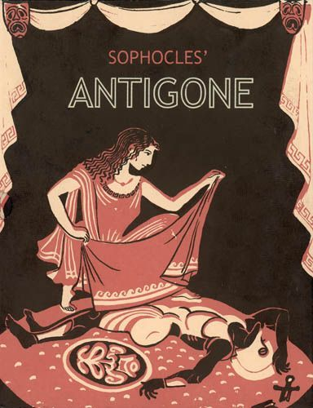
Gymnasion Me Lykeiakes Taxeis Asopias, Assopia
The Greek Team’s Techniques for Teaching Literature:
Teaching an Ancient Greek Tragedy
‘Antigone’ by Sophocles

Slide 95
1st teaching technique: Clear lesson goals.
If students know what the goals for teaching this particular literature excerpt/book are, they get “suspicious” of what to wait for, they try to find out where these meanings are hidden. This makes the whole effort more interesting.
They will answer the following question: Why did we choose this book?
Possible answer: First of all, it’s one of the biggest value literature books ever written worldwide. Secondly, because it takes place in Thebes, the city we come from, the real place where the tragedy heroes lived in. If you visit our city, you can see the debris of Antigone’s tomb, Oedipus fountain and so on. Last but not least, because the play investigates more universal issues about humanity and has both ancient and modern aspects, a situation that presents unique opportunities and challenges for all readers.
2nd teaching technique: Show and tell.
Telling involves sharing information or knowledge with your students while showing involves modelling how to do something. In this case, showing can be done in an interesting and playful way. Mind maps are a very good idea for a “joyful” presentation.
First, students are given some general information about the historical background, the ancient theatre in Greece and the plot of this tragedy so as to help them understand. Then, you read all together the passage of the book and analyze it.

Slide 96
The historical background
The world we know as Ancient Greece is a diverse and complex place and has a long history ranging over millennia. ‘Greece’ comprised individual city-states (polis) which could band together in defense against a common enemy (as in the Persian Wars) or could be gathered together under the protection and power of another city-state (as with ‘imperial’ Athens). For the most part, though, city-states remained separate, often with their own cultural and political institutions. Ancient Greek people were diverse in several ways—for example, regional dialects of Greek were spoken and written-and inhabited different areas of the ancient Mediterranean. In addition to mainland Greece and the Peloponnese, Greeks lived throughout the Aegean, along the coast of Asia Minor (modern day Turkey), colonized throughout the western Mediterranean, and had contact with other major civilizations. Perhaps most familiar to modern students of antiquity are the Greek gods and goddesses and the many myths and stories that trace their interaction with the human world. Although no Greek gods appear as characters in the Antigone, they fill the back-stories of Thebes, and Greek religious practices are fundamental to the action of the play.
The ancient Greek theatre
In Ancient Greece, the theatre was a very important aspect of society. Crowds of 15,000 people would gather to see a play. Theatre was so important to the ancient Greeks that prisoners would be released from jail temporarily so they could attend. Every town had at least one theatre.
The ancient Greeks held drama competitions with winners for playwriting and performing. These competitions were not only held in their own towns, but also in competition with other towns.

Slide 97
Large outdoor theatres were built on hillsides to accommodate the large number of people that attended.
Theatres were built on hillsides because it allowed the audience to see what was going on in the orchestra pit - the stage area.
The entire seating section was called the Theatron, which is the origin of our word theatre. Part of the reason plays were so important is that originally plays were performed to honour the God Dionysus. However, over time, many different gods got in the act especially the 12 Olympians - the major gods of ancient Greece. The Greeks were always weaving the gods into their theatre stories. Sophocles was the most famous ancient Greek playwright. He wrote 120 plays. However, there were many Greek playwrights because plays were so popular.
Types of theatre plays
There were three types of plays:
1. Tragedies: The first type they invented was the tragedy. In tragedies, one or more major characters always suffered a disastrous end.
2. Comedies: Comedies were invented next. In comedies, plays always had a happy end. The third type was the satire.
3. Satires: Satires were plays that made fun of mortal legends and of real people. In ancient Greece, you did not poke fun at the gods - not in a play, not in real life, not ever. But you could poke fun at your leaders. And that was uniquely Greek.

Slide 98
Satires in ancient Greece were often political in nature, and could indeed affect people's opinions about current events. Greek theatres
Greek theatres were large and semi-circular, with rows of tiered seating.
The centre was circular with an altar dedicated to Dionysus.
The stage was raised within the circle – this shape made sure all the audience could see and helped amplify the sound. Very important visitors would sit in the front seats.
The plays
-Women could attend the plays, but all the actors were men (even playing the parts of women!).
-Some famous playwrights include: Aeschylus, Sophocles and Euripides (who wrote tragedies) and Aristophanes (who wrote comedies).
The audience
-The audience would throw food and a stone if they thought the acting wasn’t good enough!
-The actors wore masks, bright colours for comedies and dark colours for tragedies.
-You could see if someone was happy or sad by the shape of their mask.
-The masks were made from fabric, stiffened with plaster.
The basic traits of Greek Tragedies
-Late point of attack
-Violence and death offstage
-Frequent use of messengers to relate information

Slide 99
-Stories based on myth or history, but varied interpretations of events
-Usually continuous time of action
-Usually single place
-Focus on psychological /ethical attributes of characters, rather than physical and sociological.
-The protagonist commits terrible crime, he is foolish and arrogant and when he realizes his error the world crumbles around him
-The topics of Greek tragedies are Love, loss, pride, abuse of power and fraught relationships between men and gods.
The Structure of Greek Tragedy
-Prologue, which described the situation and set the scene
-Parados, an ode sung by the chorus as it made its entrance
Five dramatic scenes, each followed by a Komos, an exchange of laments by the chorus and the protagonist
-Exodus, the climax and conclusion
-Tragedies were often presented in trilogies. Interspersed between the three plays in the trilogy were satyr plays, in which satyrs (men dressed as half-goats) made fun of the characters in the surrounding tragedies.
Tragic flaw
-a flaw or mistake that brings about the downfall of the hero of a tragedy

Slide 100
-The Greek term "harmartia, " typically translated as "tragic flaw, " actually is closer in meaning to a "mistake" or an "error, " "failing, " rather than an innate flaw.
-The character's flaw must result from something that is also a central part of their virtue, which goes somewhat awry, usually due to a lack of knowledge.
The chorus
Functions of the chorus
-an agent: gives advice, asks, takes part
-establishes ethical framework, sets up standard by which action will be judged
-ideal spectator - reacts as playwright hopes audience would -sets mood and heightens dramatic effects
-adds movement, spectacle, song, and dance
-rhythmical function - pauses / paces the action so that the audience can reflect.
In order to analyze the particular excerpt of the book, students should know the whole story of the book.
The story of the book
‘Antigone’ is a tragedy by Sophocles written in or before 441 BC.
Chronologically it is the third of the three Theban plays , but was the first written. The play expands on the Theban legend that predated it and picks up where Aeschylus' ‘Seven Against Thebes’ ends.
‘Antigone’ picks up in the same place that ‘Oedipus at Colonus’ leaves off. Oedipus has just passed away in Colonus, and Antigone and her sister decide to return to Thebes with the intention of helping their brothers, Eteocles and Polyneices, avoid a prophecy that predicts they will kill each other in a

Slide 101
battle for the throne of Thebes.
But upon her arrival in Thebes, Antigone learns that both of her brothers are dead. Eteocles has been given a proper burial, but Creon, Antigone's uncle who has inherited the throne, has issued a royal edict banning the burial of Polyneices, who he believes was a traitor. Antigone defies the law, buries her brother, and is caught. When Creon locks her away in prison, she kills herself.
Meanwhile, not realizing Antigone has taken her own life, the blind prophet Teiresias, Creon's son and Antigone's fiancé Haemon, and the Chorus plead with Creon to release her. Creon finally relents, but in an instance of too-late-timing, finds her dead in her jail cell. Out of despair, Haemon and Creon’s wife have by now also killed themselves, and Creon is left in distress and sorrow.
The excerpt of the book to study is the introduction, verses 1-99. You read it aloud and then, try to find out the different universal meanings hidden behind the words. But before that, it is necessary to know a few things about the women’s’ status in ancient Athens of 5th century so as to be able to understand Antigone’s reaction and decision to bury her brother against the king’s orders.
Athenian citizen women were kept sheltered, and nearly every aspect of their lives was controlled by male guardians (e.g. her husband or father); however, women were very important to the health of the oikos (the family, the household, and all its goods) and of the polis, primarily through their ability to create legitimate children and heirs. The normative roles for females, then, involved supporting the strength of the oikos (via dowries –bride’s money, good- and producing heirs) and participation in

Slide 102
certain religious rituals, including the funeral. Antigone’s motives and values in this play are driven by these female roles that are focused on the oikos and on ritual. The culmination of a young woman’s socialization was her marriage which usually took place at the age of fourteen or fifteen. Marriage did not require a young bride’s consent, as she was simply passed from the protection of her father to that of her husband. A young woman in Classical Athens lacked any rights of citizenship, and could only be described as the wife of an Athenian citizen. However, a bride brought to her marriage a dowry that was not available for the husband to spend. In fact, on the rare occasion that the marriage failed, the dowry was returned to the wife’s father. The consummation of marriage signaled the end of a young woman’s status as a kore, or young maiden, as she was then classified as a nymphe, or bride, until the birth of her first child, when she became a gyne, or woman. The life expectancy of the average woman was about forty years old.
So as to understand the story, it is also important to know about the burial rituals at the time.
The Greeks believed that at the moment of death, the «psyche», or spirit of the dead, left the body as a little breath. The deceased was then prepared for burial according to the time-honored rituals. Ancient literary sources emphasize the necessity of a proper burial and refer to the omission of burial rites as an insult to human dignity. Relatives of the deceased, primarily women, conducted the elaborate burial rituals that were customarily of three parts: the «prothesis» (laying out of the body, the «ekphora» (funeral procession), and the interment of the body or cremated remains of the deceased. After being washed and anointed with oil, the body was dressed and placed on a high bed within the house.

Slide 103
During the «prothesis», relatives and friends came to mourn and pay their respects. Following the prothesis, the deceased was brought to the cemetery in a procession, the «ekphora», which usually took place just before dawn. Very few objects were actually placed in the grave, but monumental earth mounds, rectangular built tombs, and elaborate marble «stelai» and statues were often erected to mark the grave and to ensure that the deceased would not be forgotten.
What is the objective of our lesson?
Introduce Antigone as a character in the play, as well as the many cultural factors that influence her decisions and internal makeup.
You read aloud the 99 verses of the play to understand the story and then analyze the meanings that stem from it.
3rd teaching technique: Socratic Method.
For the analyses of the play we will follow the Socratic Method, a Greek philosopher’s dialectic method of inquiry. To solve a problem, it would be broken down into a series of questions, the answers to which gradually distill the answer a person would seek.
4th teaching technique: Questioning to check understanding.
Students are asked to find out in the text the answers to your questions and thus, following the Socratic method, to find answers, on their own, to these questions.
1st question: When and where does this scene take place?

Slide 104
Answer: The scene takes place at the royal house of Thebes. It is still night, and the invading armies of Argos have just been driven from the city. Fighting on opposite sides, the sons of Oedipus, Eteocles and Polynices, have killed each other in combat. Their uncle, Creon, is now king of Thebes. Enter ‘Antigone’, slipping through the central doors of the palace. She motions to her sister, Ismene, who follows her cautiously toward an altar at the center of the stage.
2nd question: Which persons are present in the Introduction (Prologue) of this drama play and what is the relationship among them?
Answers: Antigone- daughter of Oedipus and Jocasta and Ismene- sister of Antigone
3rd question: Which elements of their family’s tragedy are revealed through the text?
Answers: The info we get is that Ismene and Antigone’ both brothers, Eteocles and Polynices have been killed during their duel. However, this family has a more tragic fate. So students must know it and understand the tragic state of Antigone and Ismene.
At this point, students can create the story of the family in a “playful” way, through comic strips. Storyboard is a nice tool to present a story through pictures so as to make it less boring. It attracts students’ attention. Of course, students are those who have to prepare it. You give them the information and they choose how to do it. Students are always innovative when it comes to informatics and technology!

Slide 105
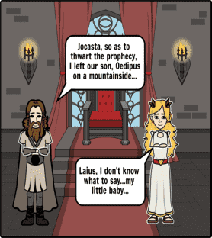
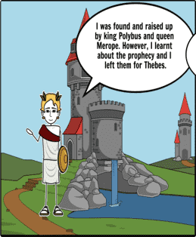

Slide 106
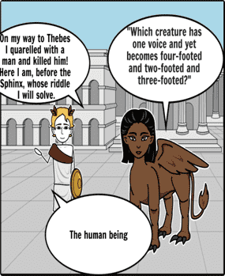
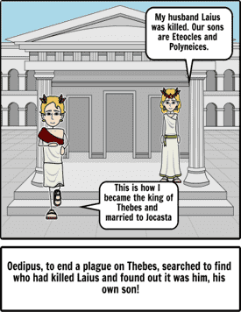
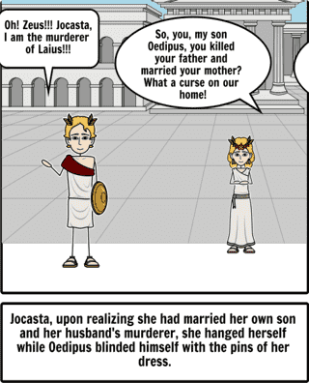
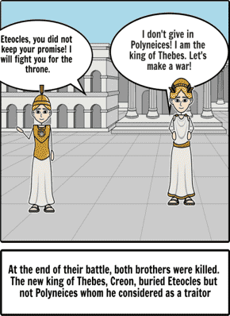

Slide 107
And here is the story of the family to be given to students in order to create the comic strip.
In the most well-known version of the myth, Oedipus was born to King Laius and Queen Jocasta. Laius wished to thwart a prophecy, so he left Oedipus to die on a mountainside. However, the baby was found by shepherds and raised by King Polybus and Queen Merope as their own. Oedipus learned from the oracle at Delphi of the prophecy that he would end up killing his father and marrying his mother but, unaware of his true parentage, believed he was fated to murder Polybus and marry Merope, so left for Thebes. On his way he met an older man and quarreled, and Oedipus killed the stranger. Continuing on to Thebes, he found that the king of the city (Laius) had been recently killed, and that the city was at the mercy of the Sphinx. Oedipus answered the monster's riddle correctly, defeating it and winning the throne of the dead king – and the hand in marriage of the king's widow, and (unbeknownst to him) his mother Jocasta.
Years later, to end a plague on Thebes, Oedipus searched to find who had killed Laius, and discovered that he himself was responsible. Jocasta, upon realizing that she had married both her own son and her husband's murderer, hanged herself. Oedipus then seized two pins from her dress and blinded himself with them.
Oedipus' two sons, Eteocles and Polynices, arranged to share the kingdom, each taking an alternating one-year reign. However, Eteocles refused to cede his throne after his year as king. Polynices brought in an army to oust Eteocles from his position and a battle ensued.

Slide 108
At the end of the battle the brothers killed each other after which Jocasta's brother, Creon, took the throne. He decided that Polynices was a "traitor," and should not be given burial rites. Defying this edict, Antigone attempted to bury her brother. In Sophocles' Antigone, Creon had her buried in a rock cavern for defying him, whereupon she hanged herself.
Continuing, you go on with the questions to understand the problem and the way the heroes face it.
4th question: What is the problem?
Answer: Creon, the current king of Thebes, after both Eteocles and Polynices death, forbids anyone to bury Polynices as a traitor. Moreover, who disobeys, will die by stoning inside the city walls.
So as to scrutinize the text, along with the questions you give students the verses to look for the answers. So you don’t waste time.
Facing the problem
5th question: What is Antigone’s suggestion to Ismene for solving the problem? (verses 50-56)
Answer: She suggests Ismene to help her bury the body of their brother Polynices despite the martial law of the king who forbids such and act.
6th question: What is Ismene’s reaction and what are her arguments to support her opinion? (verses 60-80)
Answer:
-Ismene is afraid of violating the law.

Slide 109
-She follows the voice of logic: not to obey the law, not to suffer a dishonorable death.
-She is aware of her position as a woman in the city who has no right to disobey to men.
-She is aware of her position as an underling who has no right to disobey to the king.
-She does not want to be extreme.
-She accepts her fate; she believes she is forced to act like that.
-She does not have the moral strength to do such an illegal act (verse 93)
Now, you can go on with a deeper analysis of the excerpt so that students find out the moral issues treated in this excerpt (and book).
Moral issues
7th question: Antigone – despite her sister’s efforts – refuses to resile from her decision to bury the corpse of her brother Polynices. According to her argumentation, find the principles on which she founds her decision on.
Answer: Antigone is a character who seems to act more like a Heroic hero than the typical Athenian elite female. Antigone displays offense at Creon's order. She will risk her life to honor her brother, a loyalty connected through blood. First and foremost, she takes it as a personal rebuke against herself. But she also sees the civil order as forbidding her participation in a rite reserved for women, thus denying her fundamental role in society. Antigone's anger and determination, though, does not ignite her sister to rebellion. Passive and resigned, Ismene sees her own womanhood as relative weakness.

Slide 110
As women and subjects, Ismene demurs, there is nothing they can do. In rejecting Ismene's passive obedience to the state, Antigone responds to a higher, religious law, a power that overrules even Creon's authority, because leaving the dead unburied — for any reason — offends the gods. To her sister, Antigone makes her declaration that she will obey the gods before the state at whatever cost, even her own life. Antigone will deliver the same passionate, strident speech throughout the drama, unmoved by either pleadings or threats. In her defiance and her disregard for her own life, Antigone declares her love for the dead, and even, it seems, her love for death itself.
8th question: On the other hand, Ismene has a different view. Based on her arguments, find out the principles and opinions about women’s status in ancient Greece as well as a citizen’s obligations.
Answer: Antigone takes the side of loyalty and emotion while Ismene takes the side of reason and authority. Ismene references the 'public good,' reminding Antigone that laws are created for good reason. Again, the divide between reason and emotion grows. Ismene's ignorance of Antigone's devotion to their brother increases as she says she will keep this secret for her. In turn, Antigone's anger increases; she wants people to know her true character and that of her sister's as well. Ismene can't understand why anyone would want to break the law and openly tell people about this crime. But after this encounter, Ismene begins to reflect on Antigone's brazen behavior when the thought of losing her sister becomes a reality after Antigone buries Polyneices' body. After the sisters' first conversation, we don't hear from Ismene again until the King orders her into custody, thinking Ismene must know of Antigone's plan.

Slide 111
It is during this time that Ismene has a change of heart. When she is brought in front of the King, she wishes to be charged with the crime, a crime she wanted no part of the day before. Ismene states she now understands what Antigone meant by honoring her brother, a truth she seemed to comprehend only at the thought of her sister's death. Ismene pleads that she does not want to live without Antigone, showing compassion and loyalty to her sister, but the question of Ismene's integrity arises from the timing of her confession.
9th question: Creon – the new king of the city - although he is not present, he is mentioned in the text. He is the one who ordered that Polynices stays unburied and ordered as a punishment for whom might disobey him the public flagellation (stoning to death). On which ideal does he base his decision? Do you justify it or not and why?
Answer: The powerfully built King Creon is a weary, wrinkled man suffering the burdens of rule. Before the deaths of Oedipus and his sons, he dedicated himself to art patronage but has now surrendered himself entirely to the throne.
A practical man, he firmly distances himself from the tragic aspirations of Oedipus and his line. As he tells Antigone, his only interest is in political and social order. Creon is bound to ideas of good sense, simplicity, and the banal happiness of everyday life. Uninterested in playing the villain in his niece's tragedy, Creon has no desire to sentence Antigone to death. Antigone is far more useful to Thebes as mother to its heir than as its martyr, and he orders her crime covered-up.

Slide 112
Though fond of Antigone, Creon will have no choice but to execute her. As the recalcitrant Antigone makes clear, by saying "yes" to state power, Creon has committed himself to acts he finds loathsome if the order of the state demands it. Antigone's insistence on her desire in face of state power brings ruin into Thebes and to Creon specifically. With the death of his family, Creon is left utterly alone in the palace. His throne even robs him of his mourning, the king and his pace sadly shuttling off to a cabinet meeting after the announcement of the family's deaths.
Coming to the end of the analysis of the excerpt, students have to comment on the characters of the play. They summarize all the information given and keep only the traits of the characters.
The heroes’ characters
10th question: Who could give the basic traits of the tragic heroine Antigone?
Answer: Antigone is a strong person, or someone who is confident and strong-willed. She is outspoken, passionate, and confident. Even though her brother was just retaliating for being banished, she knows the right thing to do is give him a proper burial, honoring his life, their culture, and the gods.
She looks past Polyneices's flaws and puts his soul to rest. She sees the problems arising from power running rampant in her city and ignores the politics surrounding the brotherly battle.
11th question: Who can understand Ismene? What is her character that justifies her reaction?
Answer: Antigone's last surviving sibling, Ismene is the foil for her stronger sister. In comparison to Antigone she has almost no agency, primarily because she is utterly terrified of disobeying men in power..

Slide 113
She does not believe that women should ever violate the laws of men, since they are stronger and deserve subservience .Ismene does not help to bury Polyneices, but tries to claim responsibility for the burial later so that she can die with Antigone. Antigone refuses her help and Ismene is spared. This reflects both her great love for her family and her place as a symbol of the status quo who is rewarded for remembering her place.
12th question: Creon, the power, the king of the city, can he be justified for his decision? What traits do you find in him?
Answer: The ruler of Thebes in the wake of war, Creon cherishes order and loyalty above all else. He cannot bear to be defied any more than he can bear to watch the laws of the state defied. He has Polyneices' body defiled while Eteocles is honored because he feels that he cannot give equal to share to both brothers when one was a traitor and the other was loyal. He does not recognize that other forms of justice exist, and in his pride he condemns Antigone, defies the gods, and brings ruin on himself.
5th and 6th teaching techniques. Plenty of Practice & Provide Feedback: A quiz on the studied excerpt is the best way to check students’ understanding and at the same time provide feedback in case they haven’t clearly understood something. Kahoot is a nice tool to make quizzes and students really enjoy playing quizzes.

Slide 114
7th teaching technique. Get students working together.
There are many different ways to make students work together. We have already done it when preparing the tragic story of the family with the comic strips. After the completion of the excerpts’ teaching, the best way to check the students’ understanding, provide feedback again, if necessary and make students work together, is to organize a debate. Students form groups according to the person of the play they support. They try to persuade the other groups about their person’s decision to act like that. For example, one group supports Antigone, the other Ismene. So, a fruitful dialogue among the students begins and you can find out their understanding of the text as well as their personal ideas.
Another, very demanding but really lively and effective technique for learning and working together is the “Play role” technique: students learn the words of the heroes and present a play. This can be homework: students learn their roles and they present the play the next time.
Another technique is to show students a theatre play. In Greece, almost every year, we have ancient Greek tragedy plays on. Students will really enjoy to attend ‘Antigone’ as a play if they know the story and have already analyzed it. If that is not possible, they could watch, at school, a filmed presentation of ‘Antigone’.
We found a BBC production of 1886.
https://www.youtube.com/watch?v=8bSnnufOx80&list=PLjAYlUiAhOZ5xJhxtxojqCKFnZs5-lzCh

Slide 115


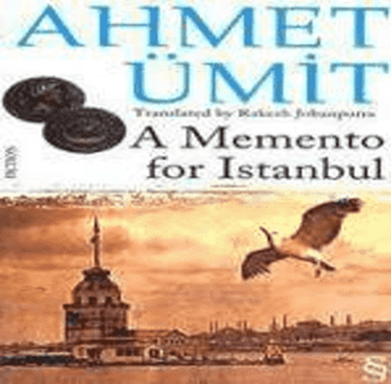
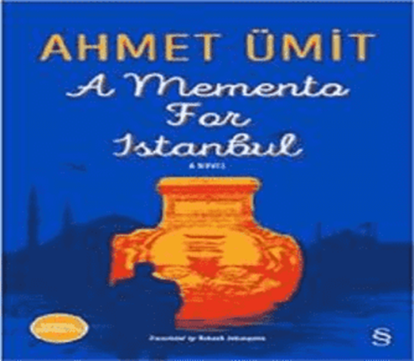
T.C. MİLLÎ EĞİTİM BAKANLIĞI
BURSA NİLÜFER Ahmet Erdem Anadolu Lisesi
The Turkish Team’s Techniques for Teaching Literature:
‘A Memento for Istanbul’ by Ahmet Ümit

Slide 116
1st sequence of techniques
1. Prediction
The teacher divides the class into 3 groups and asks the students to predict what the novel is about. Group A should do this starting from the cover of the novel, Group B from the blurb and group C from the title. They will read their ideas in front of the class.
2. The author. Students are asked to search for information about the writer of the novel in connection to the history of Istanbul.
Answer: The Turkish novelist Ahmet Ümit, the writer of best-selling books “A Rhapsody of Beyoğlu” and “A Memento for Istanbul”, is most known for his success on depicting the darkest sides of Turkish society and history. His novel, “A Memento for Istanbul”, a national bestseller, published in 2010, and translated into English a year later, was critically acclaimed as well as commercially successful. The book narrative draws on a crime police procedural, but however, what makes it amazing is definitely the historical information of Istanbul. With the placing of the murder victims at the various cultural sites of Istanbul, the author takes readers on a two- thousand-year journey from Byzantium to present, and also gives so much detail of Istanbul’s iconic architectures.
3. Research. The students do research about the novelist Ahmet Ümit.

Slide 117
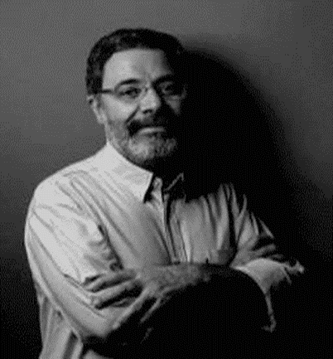
Answer: Ahmet Ümit was born in 1960 in the city of Gaziantep in southern Turkey. He moved to Istanbul in 1978 to attend university. In 1983 he both graduated from the Public Administration Faculty of Marmara University and wrote his very first story. An active member of the Turkish Communist Party from 1974 until 1989 Ümit took part in the underground movement for democracy while Turkey was under the rule of a military dictatorship between 1980-1990.
In 1985-86 he illegally attended the Academy for Social Sciences in Moscow. Ümit worked in the advertising sector from 1989-1998 and is currently employed as cultural advisor at the Goethe Foundation in Istanbul. He has one daughter Gül.
Since 1989 Ümit has published one volume of poetry, three volumes of short stories, a book of fairytales, one novella and six novels. One of Turkey’s most renowned contemporary authors Ümit is especially well-known for his mastery of the mystery genre as reflected in many of his bestselling novels and short story volumes. Drawing upon the unique political and
historical background of his home country, Ümit delves into the psyches of his well-wrought characters as he weaves enthralling tales of murder and political intrigue.

Slide 118
Ahmet Ümit ‘s work:
Street Stash (Sokağın Zulası), 1989, collection of poems; Barefooted Night (Çıplak Ayaklıydı
Gece), 1992, short stories; A Voice Divides the Night (Bir Ses Böler Geceyi), 1994, novel; A Tale Within A Tale (Masal Masal İçinde), 1995, tale; The Fog and The Night (Sis ve Gece), 1996, novel; The Smell of Snow (Kar Kokusu), 1998, novel; Agatha’s Key (Agatha’nın Anahtarı), 1999, short stories; Patasana (Patasana), 2000, novel; The Devil is Hidden in the Details (Şeytan Ayrıntıda Gizlidir), 2002, short stories; The Puppet (Kukla), 2002, novel; Beyoglu Rhapsody (Beyoğlu Rapsodisi), 2003, novel; Love is for the Dogs (Aşk Köpekliktir), 2004, short stories; Chief Inspector Nevzat (Tapınak Fahişeleri, Çiçekçinin Ölümü, Davulcu Davut’u Kim Öldürdü?), graphic novels; The Man Who Spoke the Language of Jesus (Kavim), 2006, novel; Ninatta’s Bracelet (Ninatta’nın Bileziği), 2006, novel; The Map of Human Soul (İnsan Ruhunun Haritası), 2007, essay; The Land That Not Exist (Olmayan Ülke), 2008, tale; The Dervish Gate(Bab-ı Esrar), 2008, novel; A Memento for Istanbul (İstanbul Hatırası), 2010, novel; Killing The Sultan (Sultanı Öldürmek), 2012, novel; When Pera Trees Whisper

Slide 119
(Beyoğlu’nun En Güzel Abisi), 2013, novel; Farewell My Beautiful Motherland (Elveda Güzel Vatanım), 2015, novel.
4. Historic sites. Students are asked to fınd out some information about the historic sites in Istanbul that they think there are mentioned in the novel.
2nd sequence of techniques
1. As an assignment, students read the whole novel at home.
2. The teacher organises the class in groups, giving each group a theme based scenario card ‘What would you do if?/What advice would you give?’ based on key issues in the novel. The students will discuss their findings as a whole class discussion asking the other groups what they would have done in that situation.
3. As a class activity, based on the students’ answer, the teacher draws a mind map on 3 key characters.
4. The teacher sets the class in 4 groups and tells them to flowchart the plot of the novel. Then each group will present its work.
5. Describe a place which is important in the story and explain why it is significant.
6. Students write a summary of the novel.
3rd sequence of techniques
1. Each student gets as an assignment to study a character from the chapter “The Istanbul Defence League” and for the class they have to write a description of that character.

Slide 120
2. The teacher asks the students to read two descriptions for each character and together they discuss what the common points and the differences are.
3. In groups, the students do the readers theatre with this chapter.
4. Students do verb patterns with this chapters of the novel and the teacher has to highlight the verb patterns.
5. In groups, the students make up sentences using the highlighted verb patterns.

Slide 121
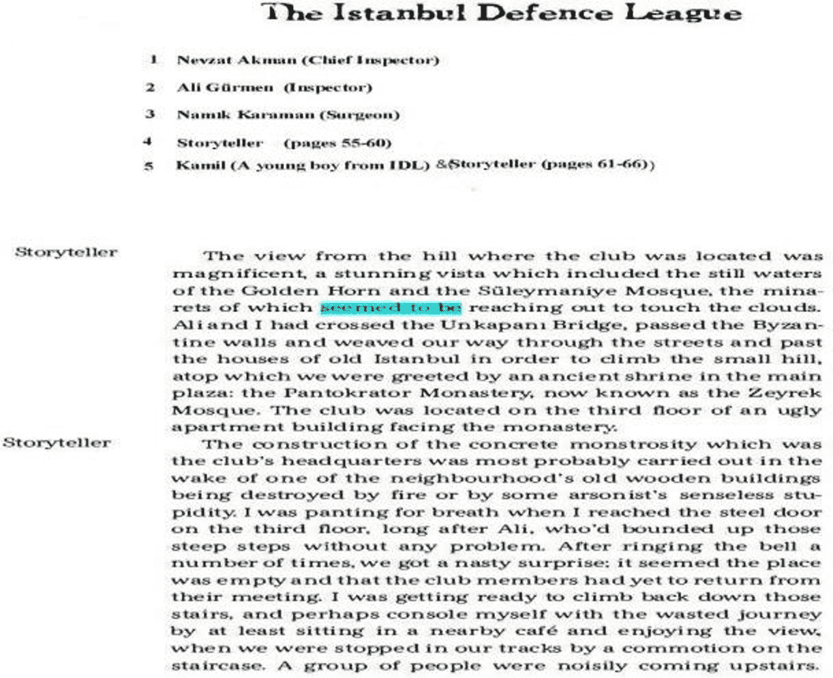
Readers’ Theatre & Verb Patterns

Slide 122
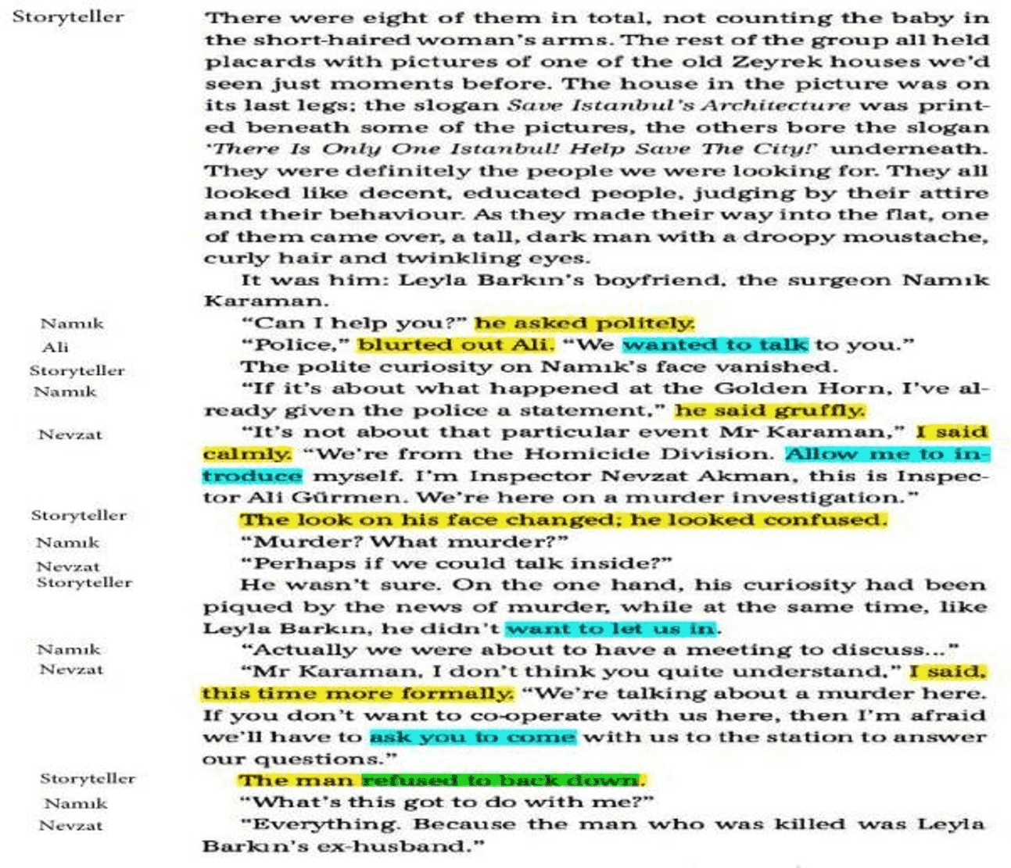

Slide 123
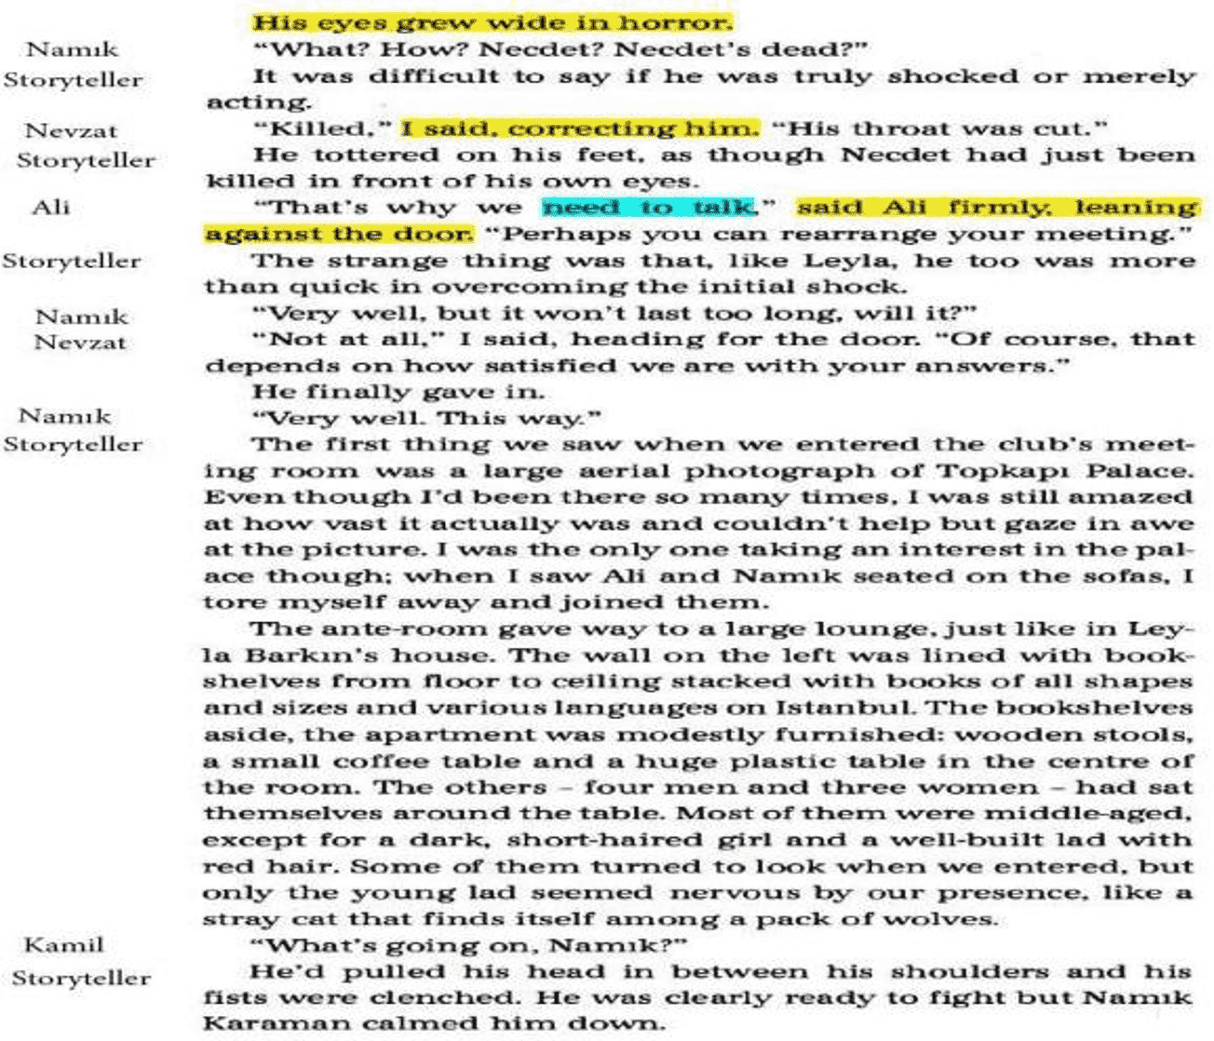

Slide 124
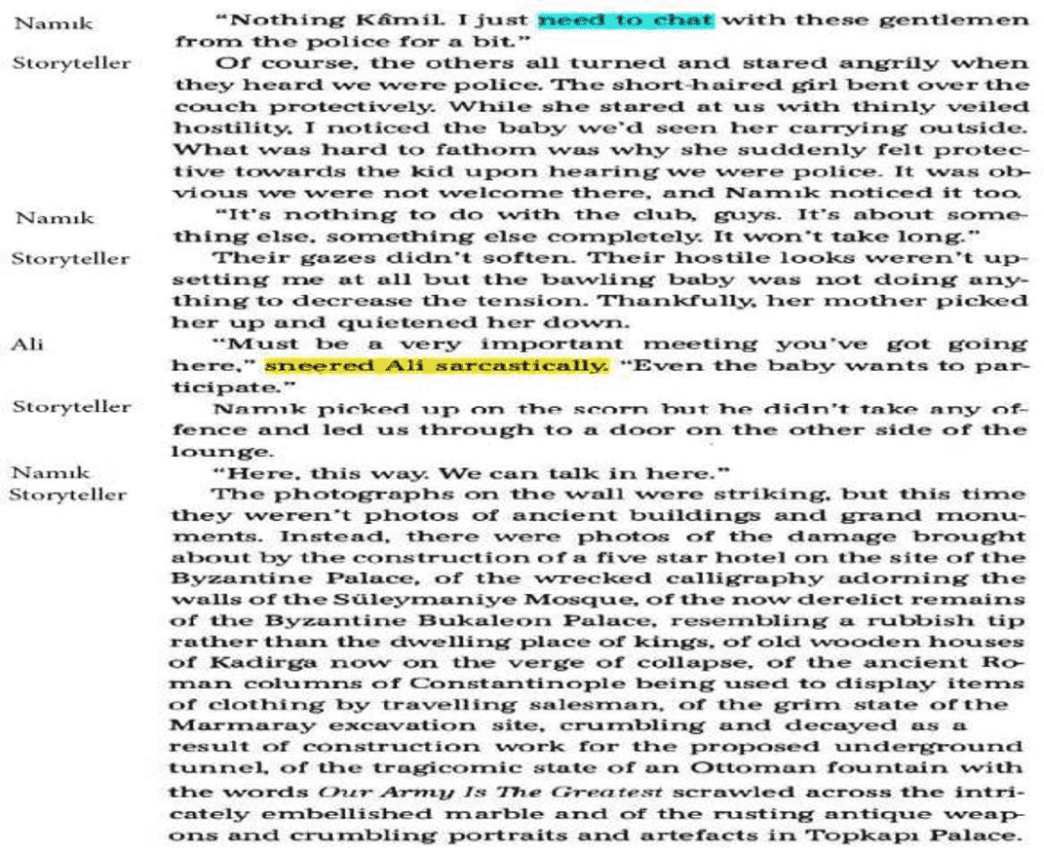

Slide 125
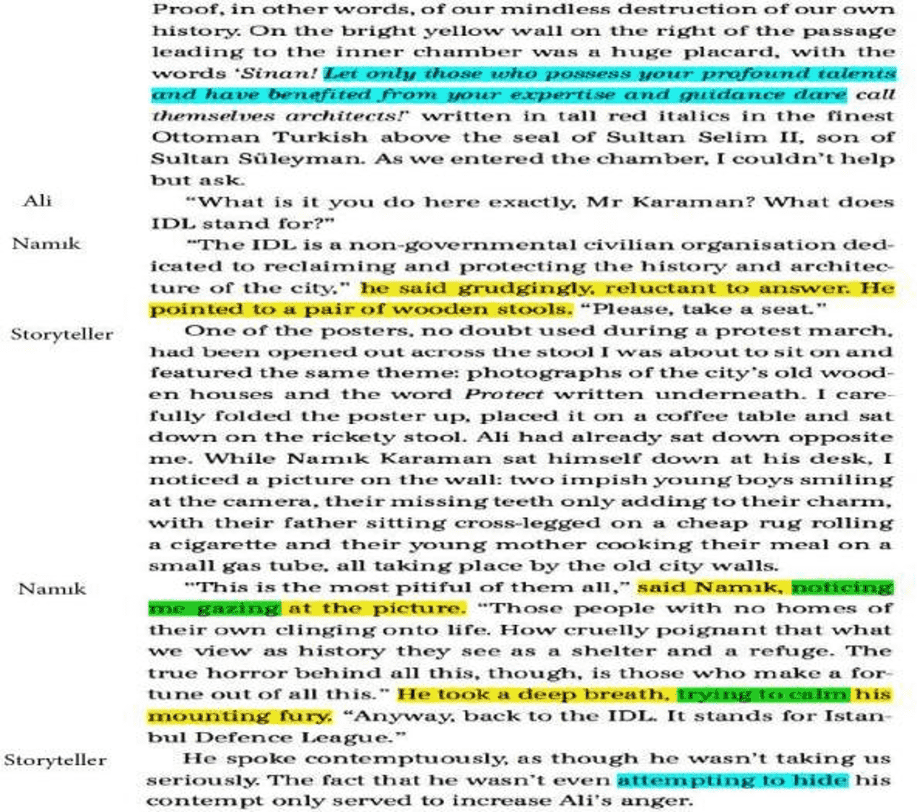

Slide 126
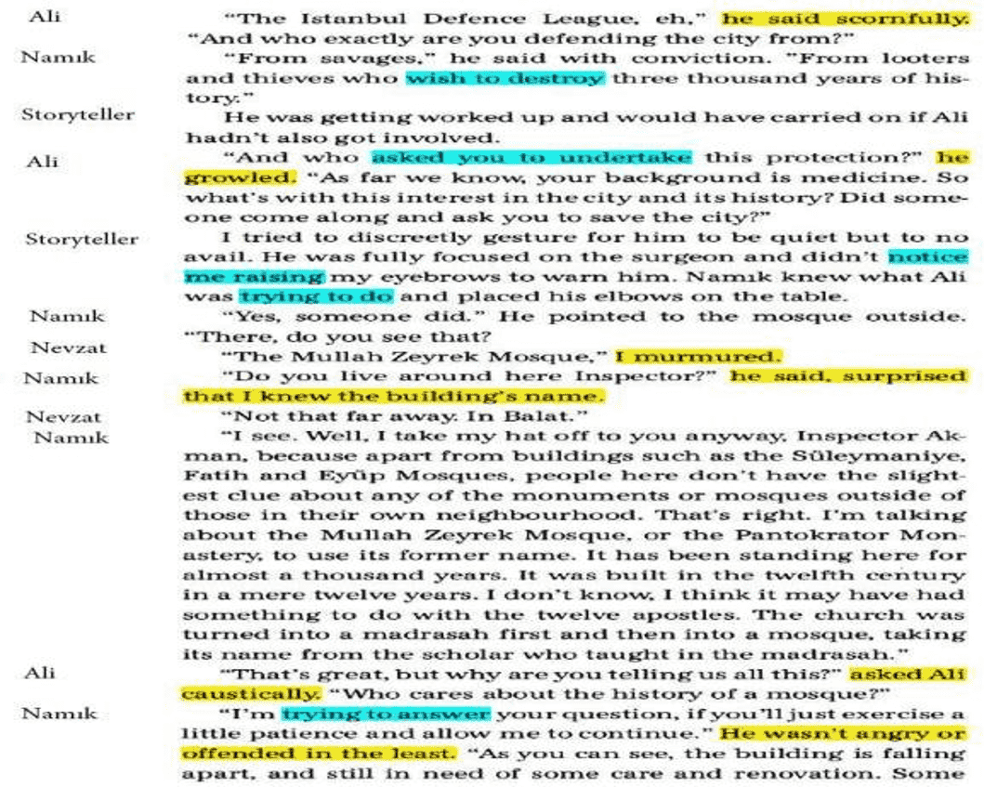

Slide 127
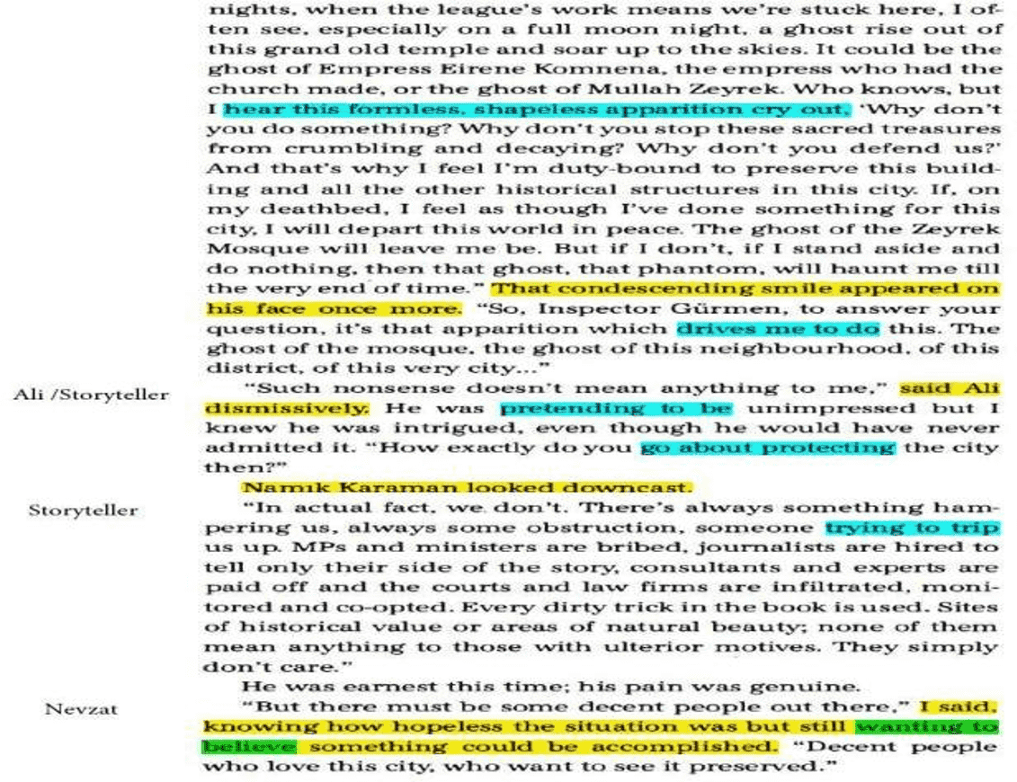

Slide 128
4th sequence of techniques
1. Sequencing. The teacher cuts up a section of the text and the students have to arrange the jumbled paragraphs in the correct order. The students give reasons why they chose that order.
2. The teacher gives the students an extract from the novel that they will write in a different form or from a different viewpoint.
3. "A good book makes you care about its characters and what happens to them." Do you agree? Is it true for the book you have read?
4. Did you like the ending of the book? Was there another possible ending? What is another way the book could have ended?
5. The teacher gives the students some xerocopies with a few pages from the novel, on which he/she highlights the items of vocabulary that are to be taught and asks the students to explain, in groups, the meaning from the context. So, the students guess the meaning of the highlighted words from one of the chapters of the novel by using contextual clues. The teacher gets feedback.
5. The students give examples of sentences with the items of vocabulary they have learnt.

Slide 129
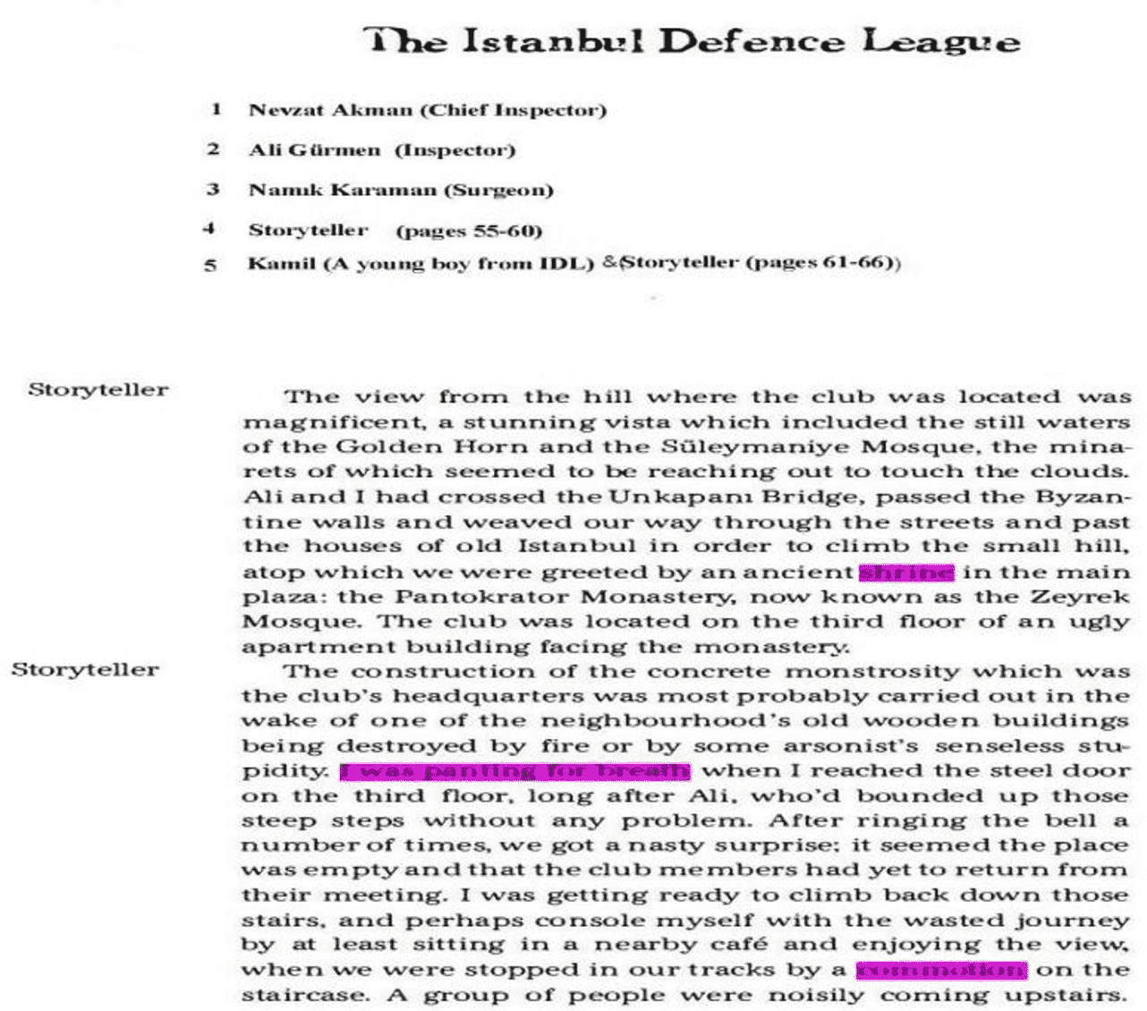
Vocabulary

Slide 130
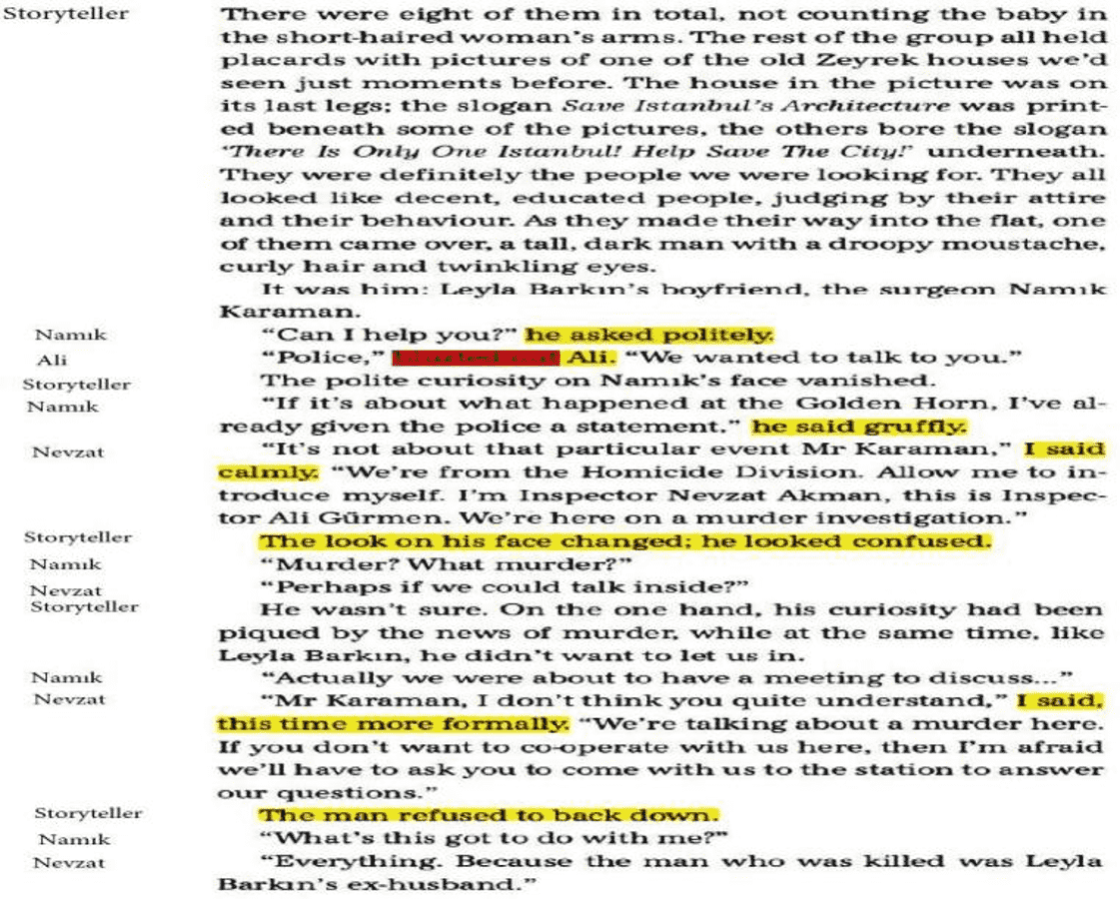

Slide 131
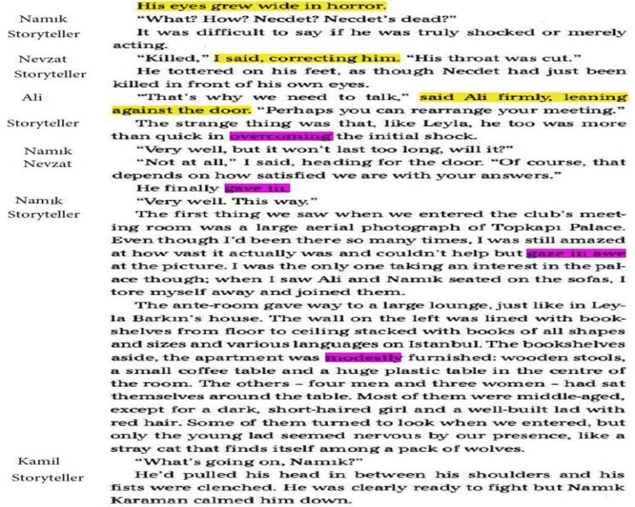

Slide 132
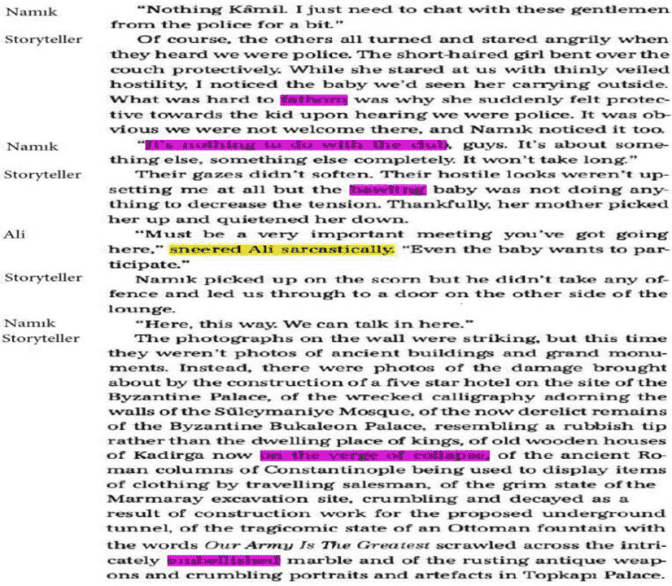

Slide 133
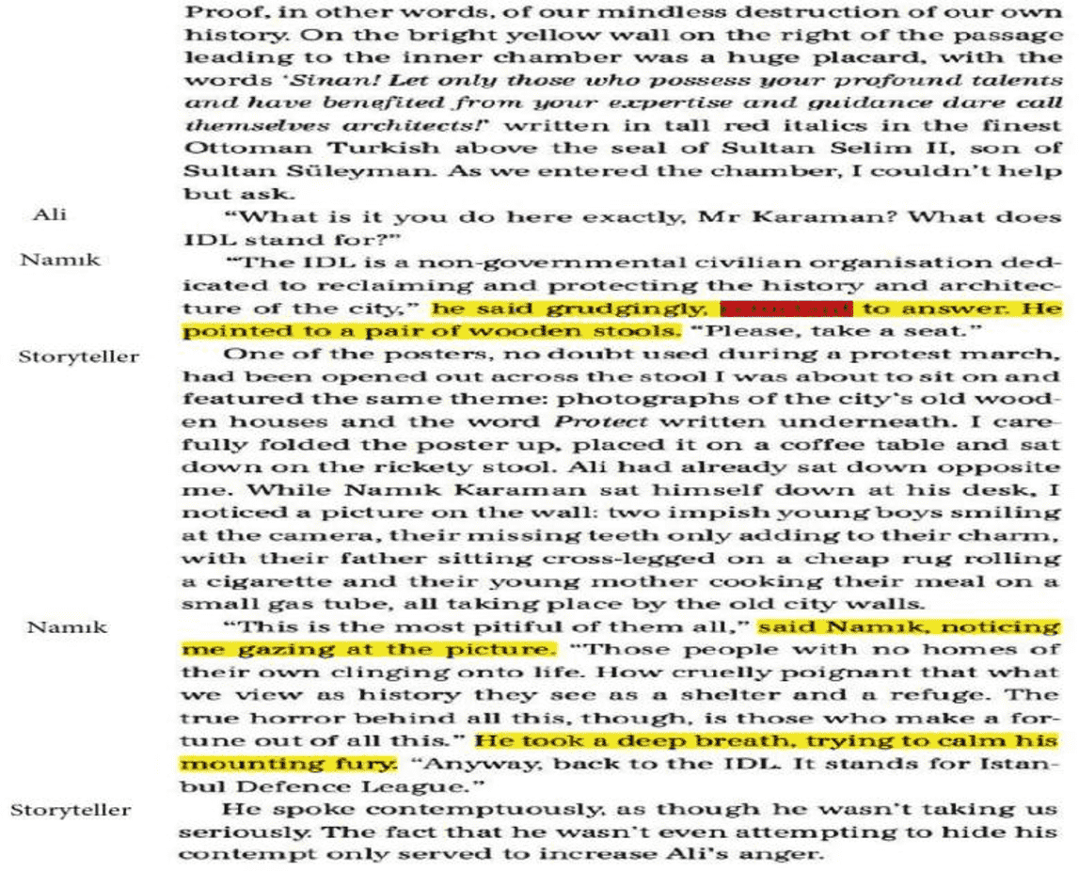

Slide 134
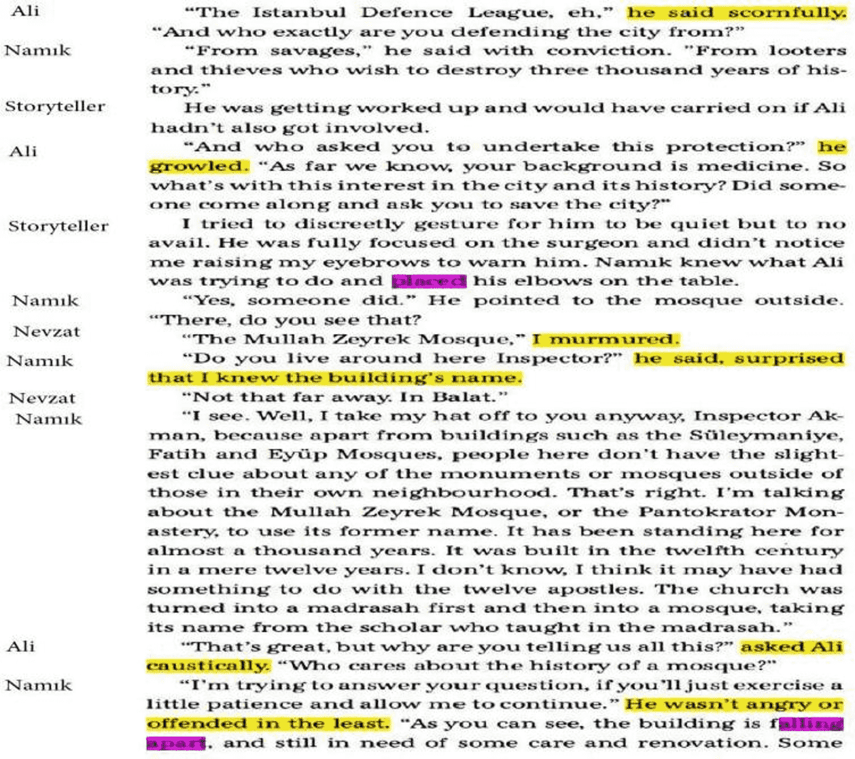

Slide 135
Answers: Vocabulary
1. shrine: a place that people visit because it is connected with someone or something that is important to them
The writer's house has become a shrine to/for his fans.
2. to pant (I was panting for breath): to breathe hard and quickly The patient was panting for breath. [=breathing heavily]
3. commotion: noisy excitement and confusion
There was a sudden commotion when the actress entered the restaurant.
4. to overcome: to successfully deal with or gain control of (something difficult) She overcame a leg injury and is back running again.
5. to give in: to stop trying to fight or resist something : to agree to do or accept something that you have been resisting or opposing
The strike has been going on for weeks, and neither side seems willing to give in.
6. to gaze: (gaze in awe) to look at someone or something in a steady way and usually for a long time (I admired the beauty of the place.)
She was gazing at the moon.
7. modest: not very large in size or amount (modestly= in a modest way)
They own a modest home near the beach. Our business has been modestly successful.

Slide 136
8. to fathom: /ˈfæðəm/ to understand the reason for (something)
I couldn't fathom why she made such a foolish decision.
9. It’s nothing to do with the club: It is unrelated to the club.
This argument has nothing to do with me.
10. bawling: crying very loudly
He lay on his bed, bawling [=sobbing, wailing] uncontrollably.
11. reluctant: not willing or eager to do something We were reluctant to get involved.
12. to place: to put (something or someone) in a particular place or position
She placed [=rested] her hand on his shoulder.
13. to fall apart: to break into parts in usually a sudden and unexpected way Something that is falling apart is in very bad condition.
14. every (dirty) trick in the book: Every possible way to do or achieve something,
especially ways that are clever, cunning, or ethically questionable.
He knows every dirty trick in the book when it comes to sealing the deal.
15. ulterior: kept hidden in order to get a particular result
I think she has an ulterior motive for helping us. [=she has a secret reason for wanting to help us]
16. to accomplish: to succeed in doing (something)
They have accomplished [=done, achieved] much in a very short period of time.

Slide 137
17. decent: polite, moral, and honest
He is a decent guy who would help anyone in need.
to snap: to speak using short, angry sentences or phrases “Leave me alone!” he snapped.
eyesore: an ugly object or building. The shack is a real eyesore.
to absolve: to give forgiveness to (someone who has sinned) or for (a sin)
21. He asked the priest to absolve him (of his sins). = He asked the priest to absolve his sins. (You are absolved= you are forgiven)
21. to split up with: to separate or divide into parts or groups Families were often split up during the war.
22. to butt in: to get involved in something (such as a conversation or someone else's activities) especially in a rude way.
Sorry to butt in (on you) like this, but I need to ask you a question.
23. mock (adj): not based on real or honest feelings
“I'd love to go,” he said with a mock [=feigned, fake] smile.
5th sequence of techniques
1. The teacher asks the students to add the theme of the novel to their mind map using 5 key words.

Slide 138
2. The students use their mind map to prepare 2 points on which characters are important to the theme.
3. The teacher gives the students a list of statements to tell if they are true or false. The students will find evidence in the novel to support their answers.
4. The teacher divides the class into groups and gives the students a list of quotes from the novel. Each group will have two quotes to judge and they should tell whom the quote belongs to. They will bring arguments to support their opinions.
6th sequence of techniques
The students are asked some general questions related to the novel :
1.Describe your favourite character in the book and say why you find her or him attractive.
2. Imagine that you spent a day as one of the characters in the book. Describe some of the things that happened to you.
3. Write a letter recommending the book to a friend and say why you think he or she would like it.
4. Imagine you could meet one of the people from the book. Who would you choose? What kind of relationship would you have with that person?
5. In what ways is the time period in which the book was set significant to the story?
6. Describe an important moment in the book, when something happens that affects everything else.

Slide 139
7. Describe a situation or event in the book which you found amusing, moving or frightening.
The summary of the novel
This is a really captivating detective story by Ahmet Ümit, a renowned poet and writer in Turkey. The novel starts with a part depicting an event happening at the ancient times of İstanbul. There, the writer gives a description of an occasion in which there is the sacrifice of an animal to God by the founder of the ancient İstanbul. Throughout the novel you can see many more parts in which there are similar descriptions by which the reader is given the love of this amazing city, İstanbul.
The writer uses many different elements of culture and history in the novel such as number 7, in seven days, seven people- who are parts of the project of building a hotel on a historical site, thus destroying the city- are murdered. History, mystery and mythology are very well blended into an exhilirating novel which immediately makes the reader equipped with the stong amazement and affection of the city and the need for the protection of it.
In fact, throughout the novel the reader can easily have the insight of the struggle between those who want to protect the city and live in a peaceful world and those who want to make profit out of whatever they can sell even if this causes the losses of people’s lives and the destruction of this beloved city.

Slide 140
In the end, some people defending the city sacrifice themselves and kill the greedy ones who
make profit out of the historical sights and this can be seen as a memento for İstanbul.
The characters are Nevzat- the chief inspector, Demir- the vet and Yekta- the architect.
These people grew up in the same peaceful neighbourhood called Balat. It is near the historical peninsula, where all the corpses are left and found near the historically important sites.
On the other hand, there is Leya Barkın, who is Necdet Denizel’s ex-wife, the first victim. He was slaughtered because of his cooperation with Adem Yezdan- a greedy businessman who wants to give the impression that he is only interested in history and the preservation of the city but the only thing he is interested in is to get more popular and richer by abusing the power of riches he has.
There is also Namık Karaman who is Leyla’s boyfriend now. He is a doctor working for a university hospital and has an active role in a non governmental organisation called İstanbul Defence League.
In the end, tragically, Nevzat finds out that his intimate childhood friends committed these murders and for a while he cannot decide what to do, but eventually decides to implement what the order of law dictates and tries to arrest his friends. Yekta is shot mistakenly and dies when he takes hostage of a policeman in a twist of events. While Nevzat is trying to convince Demir to go to hospital, he kills himself with the gun he has.

Slide 141
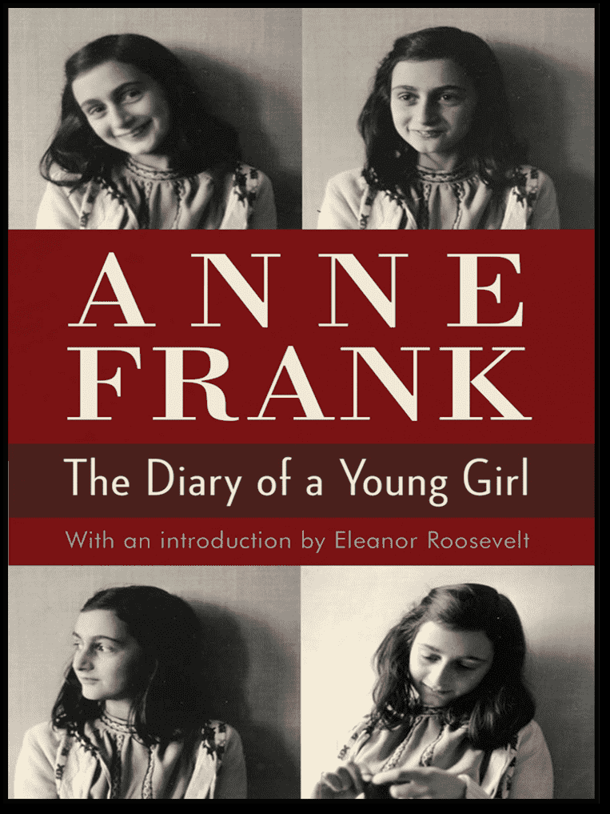
Insignare - Associacao de Ensino e Formacao, Ourém
Fatima Hospitality School
The Portuguese Team’s Techniques for Teaching Literature:
‘Anne Frank. The Diary of a Young Girl’

Slide 142
Suggested Motivational Techniques for Reading and Comprehension
1. Classes dedicated to watching the movie "Anne Frank";
2. Carrying out an educational game using a computer application named "Kahoot“
3. Applying brainstorming techniques
4. Dramatised reading: in groups, the students prepare the narration of some chapters, each group focusing on a chapter. They will tell the other groups what they have prepared, using the sequential images of the facts.
5. Musical reading: Each group is responsible for a chapter and chooses a song that matches the text that the students read.
1st sequence of techniques
1.1 The teacher selects some paragraphs from the book, divides the students into groups and asks them to identify:
1. the time the action happens
2. the place the action happens
Answers:
1. in the middle of World War II; 2. Amsterdam
1.2 Pair Work. The students are asked if they know the main event where approximately 33% of the world´s population of Jews were slaughtered;

Slide 143
Answer: The Holocaust
1.3 The students are asked if they heard about the story of Anne Frank.
If the answer is no, the students are asked to tell what they think that she had experienced taking into account that the action happened during the World War II.
If the answer is an affirmative one, they will tell the others what they know about her and about what she had to experience while she was hiding.
1.4 In groups, the students tell how life would have been different in 1940s if the Nazi party hadn’t seized control over the world.
1.5 The students are asked about the problems that people had to face with during that period of time time:
1. What did the Nazi authorities demand from the Jews?
Possible answers:
They couldn’t have any means of transport such as bicycles, cars or others;
They had to buy the food only from stores dedicated to them.
2. What awful things were happening?
Possible answers:
Genocide;
Lack of freedom of speech;

Slide 144
2nd sequence of techniques
1.1 The students have had to read the book as homework. The teacher gives them some worksheets in which they write:
1. how many main characters the book has.
2. when Ann Frank receives the diary
3. how long she stays in hiding
4. who kept the diary after the families had been taken to the concentration camps.
Answers: 1. 8 characters: Anne Frank, Margot Frank, Otto Frank, Edith Frank, Peter Van Daan, Mr. and Mrs. Van Daan and Mr. Fitz
2. on her 13th anniversary
3. 2 years
4. Miep Gies
1.2 Personality. The teacher asks the students to get into groups and tells them to name the characters’ features.
Possible answers:
1.Anne Frank: practical; kind; business man; protector; thrifty
2. Margot Frank: sentimental; critical; sociable; sympathetic
3. Otto Frank: sensitive; intelligent; creative; perceptive; innocent; tempestuous; empathic;
4. Edith Frank: controlling tendencies; odd personal hygiene habits; reserved;

Slide 145
5. Mr. Fitz: Really smart; quiet; shy; pretty; emotional
1.3 The teacher asks the students to explain why they have chosen those adjectives to characterise the main characters. In groups, the students give arguments from the novel to sustain their opinions.
2.1 Specific information
1. The teacher asks the students to recall how the people in the Annex get food and other supplies.
2. While the people there are hiding in the “Secret Annex”, several problems come to the surface. What are these problems?
3. What´s the name of Anne Frank’s diary?
4.What did Edith Frank die of?
5. What did Margot and Anne die of ?
Answers:
1. Miep, Jo Kleiman, Victor Kugler and Jan Gies help the families in the secret annex, some bring them food and others just make sure that they were not discovered.
2. The people helping the families in the "Secret Annex" are becoming ill, so the families are not able to receive food and other necessities for survival.
Kitty
Edith Frank starved herself by giving her food rations to her daughters.
Margot and Anne died from typhus.

Slide 146
3rd sequence of techniques
1. The book and the film.
1.1 The students are asked to identify the differences between the book and the film.
Possible answers:
1. The film begins with Anne's father, Otto, going back to the secret annex and being given the diary, while the book starts with Anne receiving the diary on her thirteenth birthday;
2. In the movie, Anne gets a chance to say goodbye and end her journal, whereas in the book, the story stops abruptly ;
3. The scene with the Gestapo taking them away is shown in the movie while in the book we know nothing of it;
4. The book goes extensively into Anne's beauty routine, the movie does not.
5. The book has Peter and Anne's relationship being slightly longer. She even has a heart-to-heart about it with Otto in the book.
1.2 In groups, the students will tell:
1. What aspects from the film could have been better achieved
2. What aspects from the film were more impressive than in the book
They will justify their opinions with arguments.

Slide 147
2. True or False
2.1 The students are given True or False sentences that they should solve and they should explain why the respective sentence is true or false.
1 The people helping the families in the "Secret Annex" become ill, so the families are not able to receive food and other necessities for survival.
2. The Van Daans are the only ones who have money in the secret Annex
3. Anne is really happy to be alive, yet she feels bad because her friends don’t have the same luck
4. The families were discovered in 1942
5. Edith Frank was the only one to survive
Answers: 1.T; 2. F; 3. T; 4. F; 5 F
The teacher tell the students that “The Diary of Anne Frank’ provides illustrations and narratives of how the characters lived their lives during the World War II, their stories of their everyday life, how they interacted with each other, and the situations they had to deal with during the war.
3.1 The teacher tells the students to read the following excerpt and identify the feelings Ann has.
3.2 The students identifies what activities Ann longs for .
3.3 The students explain why Ann thinks she is “on top of the world” when she compares herself to other Jewish children. They should give arguments.

Slide 148
3.4 In pairs, students explain what “Paper is more patient than people.” means for Ann and for them.
Friday, December 24, 1943
“Dear Kitty, As I’ve written you many times before, moods have a tendency to affect us quite a bit here, and in my case it’s been getting worse lately. “Himmelhoch jauchzend, zu Tode betrübt”. It certainly applies to me. I’m “on top of the world” when I think of how fortunate we are and compare myself to other Jewish children, and “in the depths of despair” when, for example, Mrs. Kleiman comes by and talks about Jopie’s hockey club, canoe trips, school plays and afternoon teas with friends.
I don’t think I’m jealous of Jopie, but I long to have a really good time for once and to laugh so hard it hurts. We’re stuck in this house like lepers, especially during winter and the Christmas and New Year’s holidays.
Actually, I shouldn’t even be writing this, since it makes me seem so ungrateful, but I can’t keep everything to myself, so I’ll repeat what I said at the beginning: “Paper is more patient than people.” Whenever someone comes in from outside, with the wind in their clothes and the cold on their cheeks, I feel like burying my head under the blankets to keep from thinking, “When will we be allowed to breathe fresh air again?” I can’t do that—on the contrary, I have to hold my head up high and put a bold face on things, but the thoughts keep coming anyway. Not just once, but over and over. Believe me, if you’ve been shut up for a year and a half, it can get to be too much for you sometimes.

Slide 149
But feelings can’t be ignored, no matter how unjust or ungrateful they seem. I long to ride a bike, dance, whistle, look at the world, feel young and know that I’m free, and yet I can’t let it show. Just imagine what would happen if all eight of us were to feel sorry for ourselves or walk around with the discontent clearly visible on our faces. Where would that get us? . . .
Yours, Anne”
3.5 In groups, the students write a manifesto against war that they will publish in the school magazine.

Slide 150

Thanks for your attention!
‘This project has been funded with support from the European Commission. This publication reflects the views only of the author, and the Commission cannot be held responsible for any use which may be made of the information contained therein.’

