Slide 1
Sierakowice May 2017
Findings after third data gathering.
Notes:
1

Slide 2
Research problem no. I
Do the plant species in the center of the city differ from the species found in suburbs?
Hypothesis no. I
There are different species of plant living in the suburbs than in the city center.
Conclusion no. I :
1 plant species both live in the suburbs and the city center. Research areas differ in 8 species of plant. The greater species diversity is appearing onon outskirts of town.
Notes:
2

Slide 3
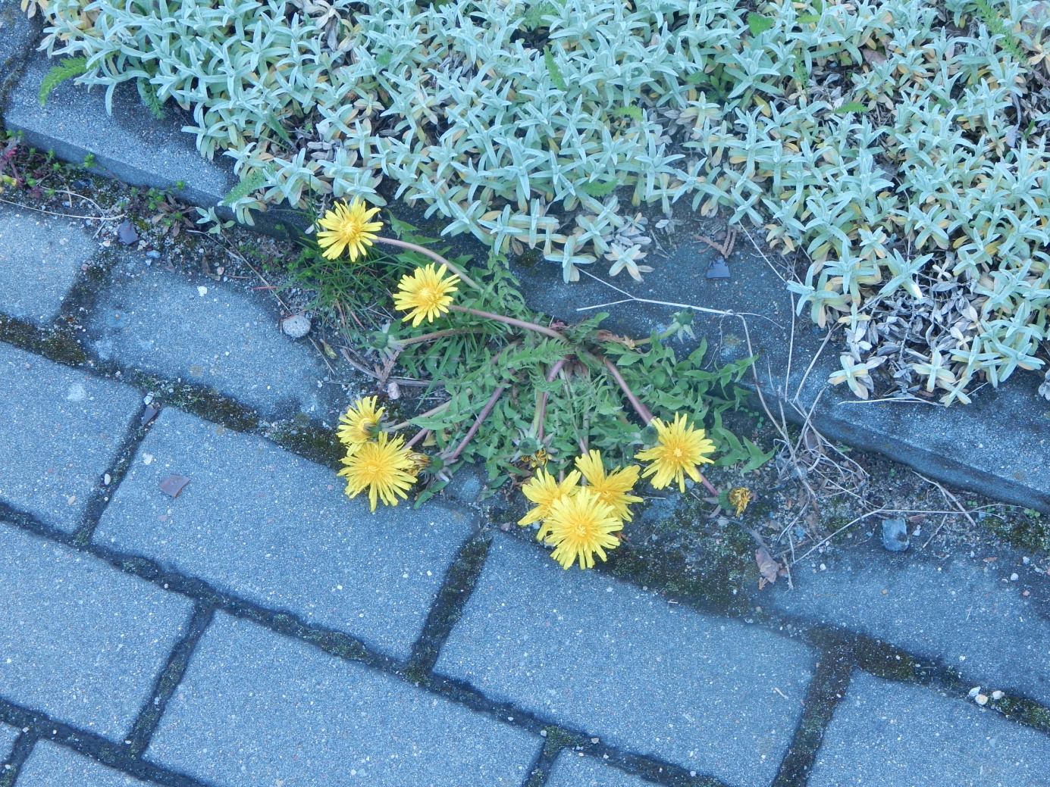
Example of the same species
Dandelion - Taraxacum officinale
Notes:
3

Slide 4
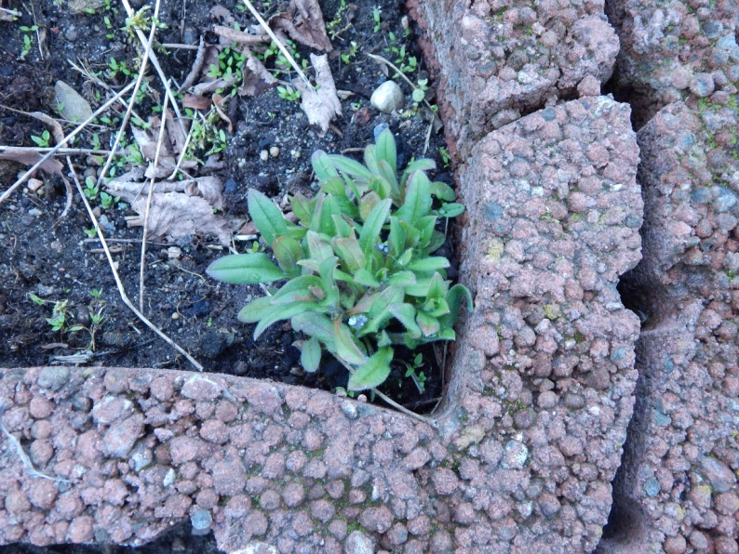
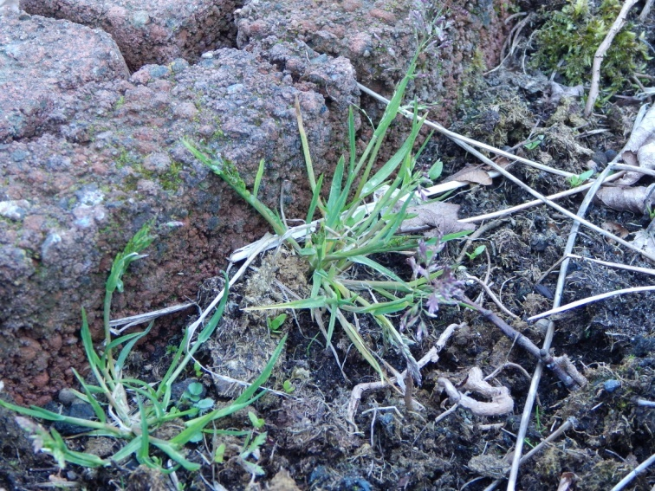
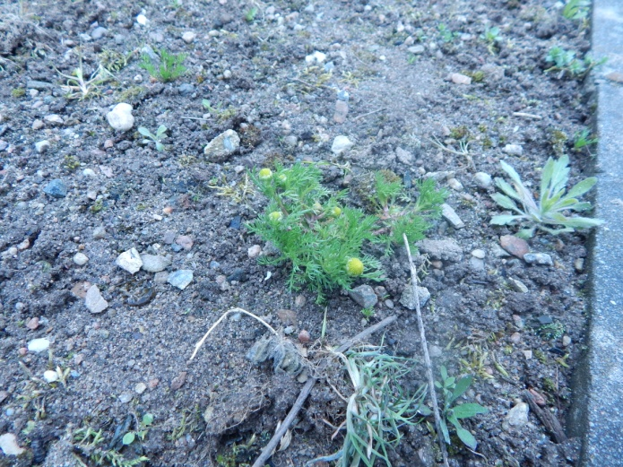
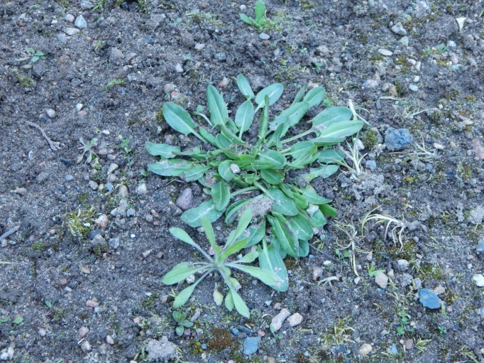
Other species
Notes:
4

Slide 5
Research problem no. II
Do the green areas surrounding the research area influence the kind of species living there?
Hypothesis no. II
Surroundings of research area have an impact on the species composition of plants.
Notes:
5

Slide 6
Conclusion:
a.) In the center of the village green areas surrounding the research area don’t have much influence on plant species found on the sidewalk (2 common species for both places)
b.) On the outskirts of the village, in research area (sidewalk and accompanying it flower beds) are the same species as in wasteland surrounding them .
Notes:
6

Slide 7
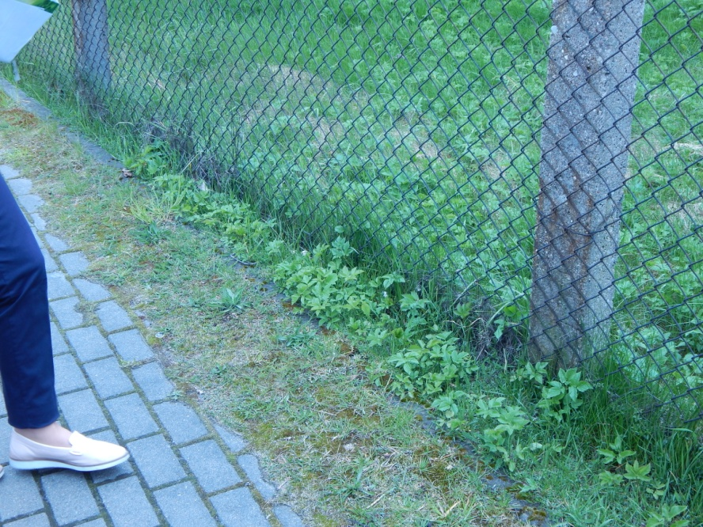
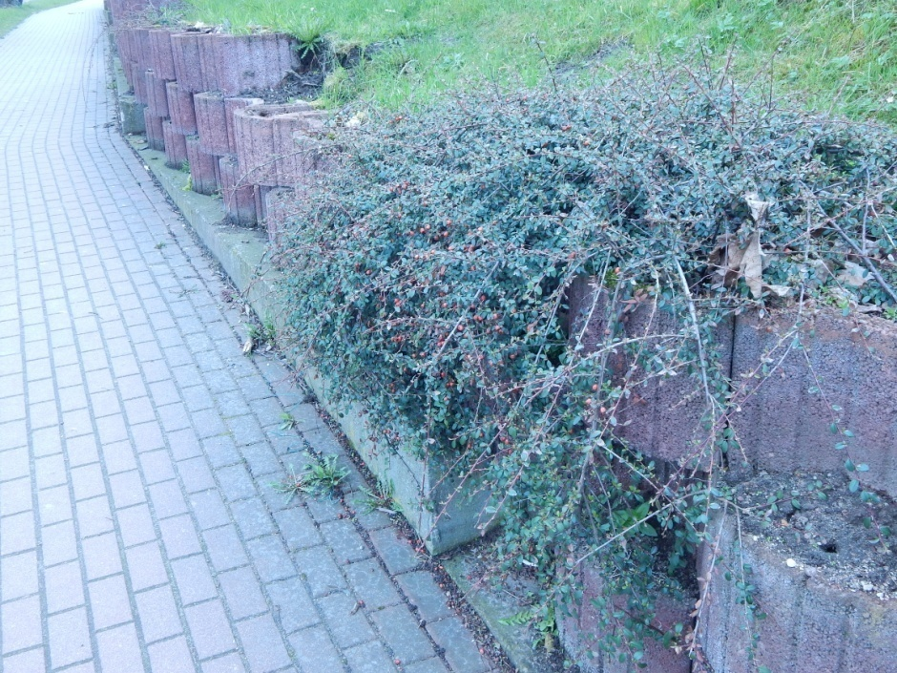
The nearby green areas
Notes:
7

Slide 8
Research problem no. III
Which species entomophilous or anemophilous are more numerous on the research area?
Hypothesis no. III
Different kind of pollination influences the number of species.
Conclusion no. III:
On both research areas entomophilous species predominate. In areas outside of the village number of wind-pollinated plants is slightly larger.
Notes:
8

Slide 9
Research problem no. IV
Does the species’ occurence differ in the autumn and the summer?
Hypothesis no. IV
The species occurence differs in the autumn and the summer.
Notes:
9

Slide 10
Conclusion:
In the center of the village in autumn there is a greater variety of plant species than in the spring.In both studies only 3 species were repeated.
On the outskirts species diversity in autumn is different than in spring (less species repeat themselves for the total number of species occurring on the outskirts).
Notes:
10

Slide 11
Because of the exceptionally long winter in research areas, vegetation period of plants typical for spring was significantly delayed and in the process there were few species of plants.
Notes:
11

Slide 12
