Slide 1
Sierakowice
Autumn 2015
Findings after first data gathering.

Slide 2
Research problem no. I Do the plant species in the center of the city differ from the species found in the suburbs? Hypothesis no. I There are different species of plants living in the suburbs than in the city center. Conclusion no. I 8 plant species both live in the suburbs and the city center. There is very marginal difference in species between both areas.

Slide 3
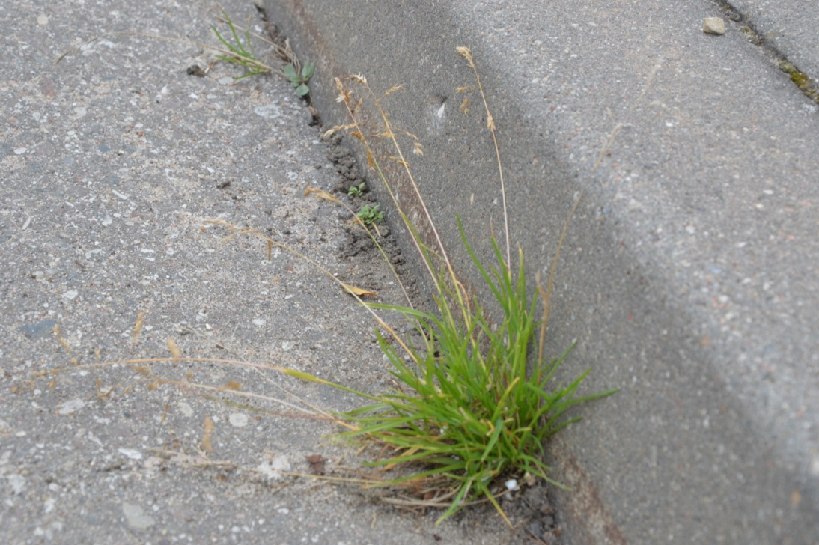
Examples of the same species

Slide 4
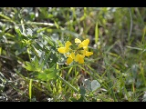
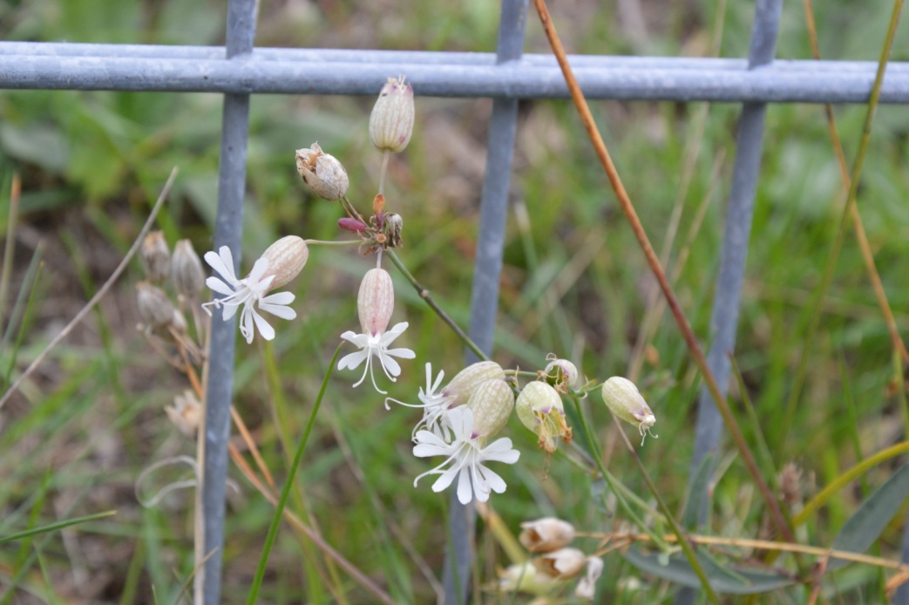
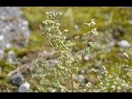
Different species

Slide 5
Research Problem no. II
Do the green areas surrounding the research area influence the kinds of species living there?
Hypothesis no. II
Green areas that surround the research area have a significant impact on the variety of plant species in the urban areas.
Our research made in autumn do no allow us to precisely answer this question but we strongly believe this hypothesis to be true.
During our next data gathering we will closely monitor the surrounding areas to prove or disprove this hypothesis.

Slide 6
Research problem no. III
Which species entomophilous or anemophilious are more numerous on the research area?
Hypothesis no. III
Different kind of pollination influences the number of species.
Conclusion no. III
Entomophilious plants are more numerous on the designated research area. There was only one recorded species of anemophilious plant in the town center and three in the suburbs.

Slide 7
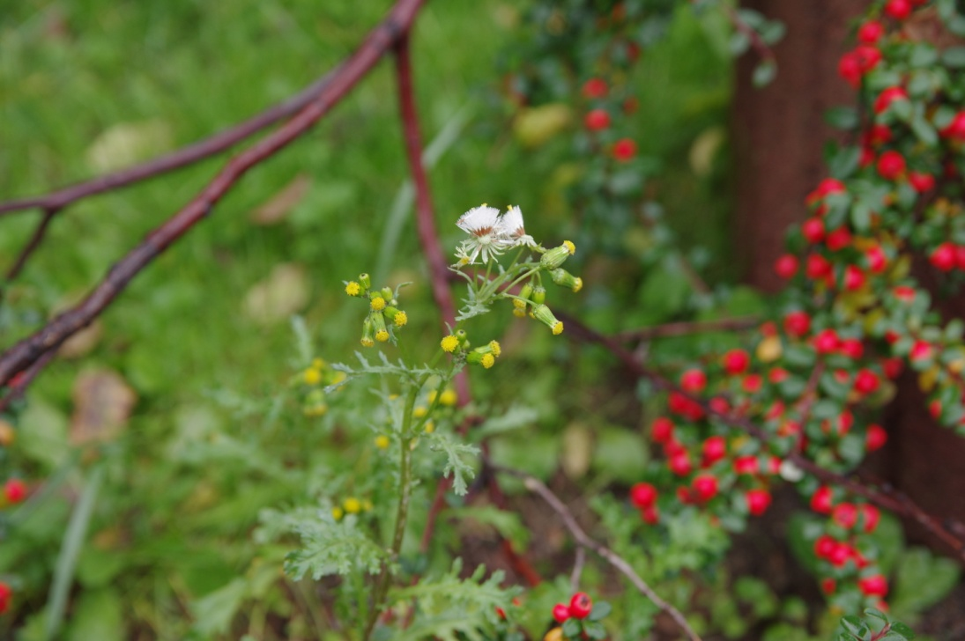
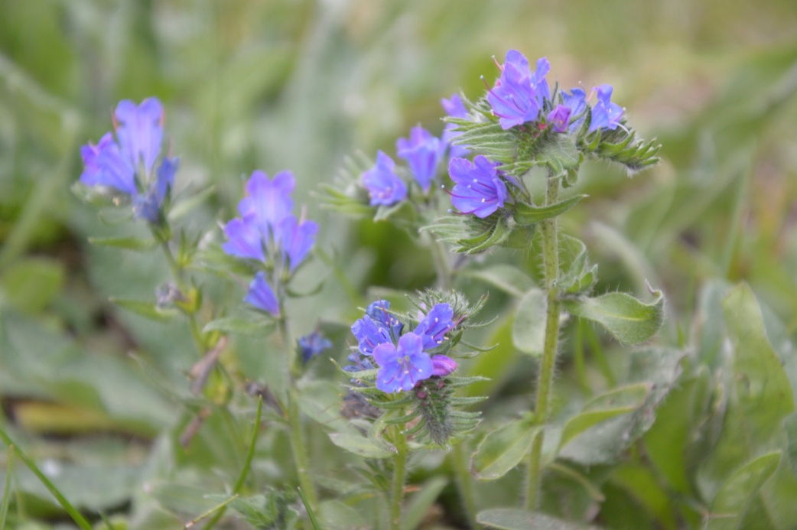
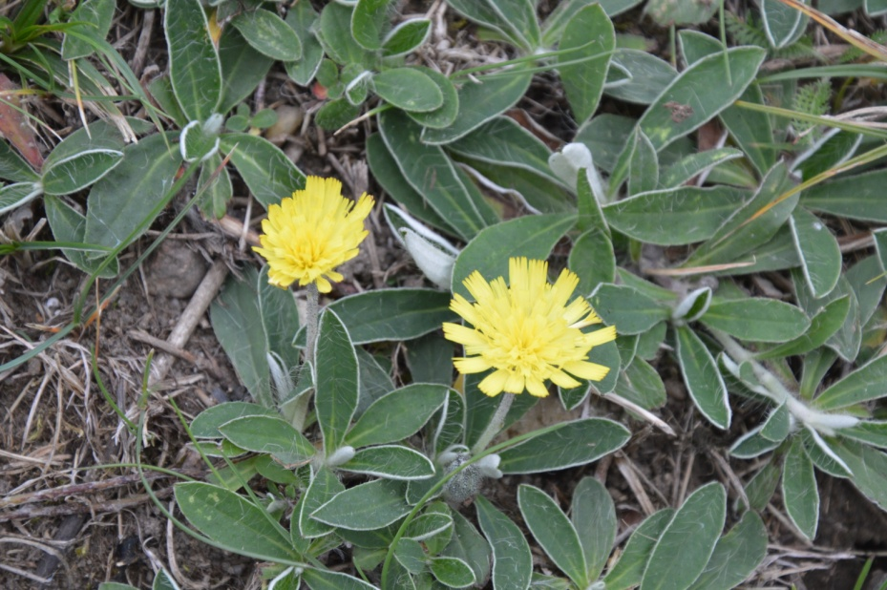
Entomophilious plants

Slide 8
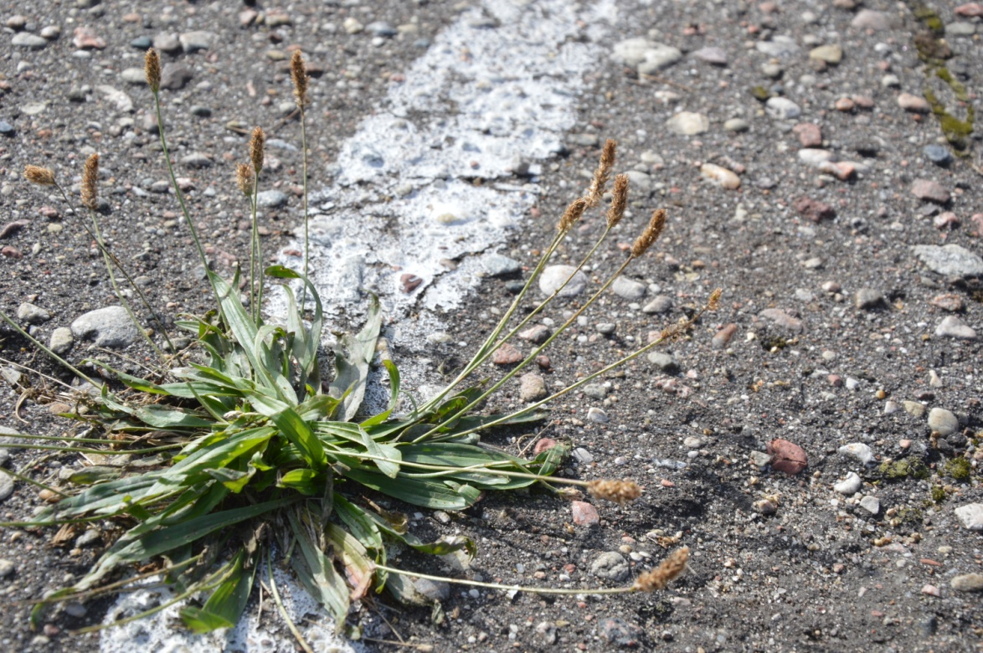
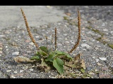
Anemophilious plants

