Slide 1
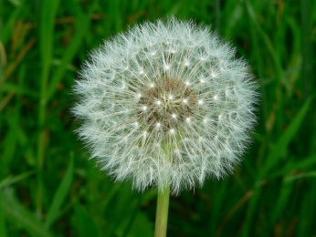
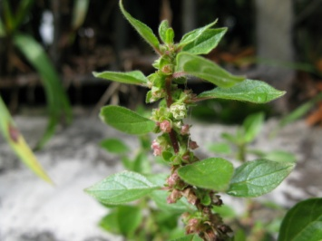
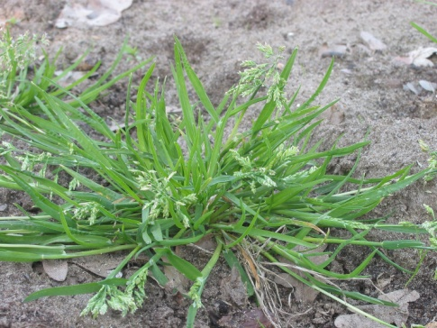
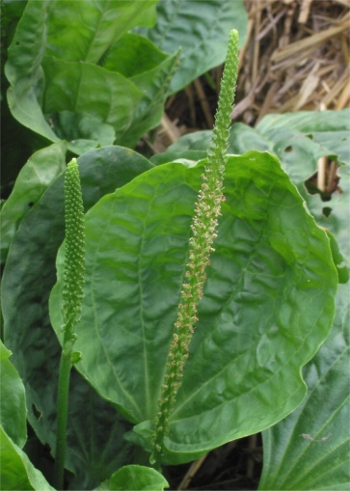
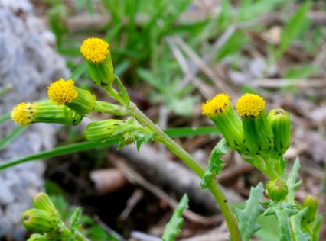
2012
.
Number 2 Parietaria judaica is a herbaceous plant species of the family Urticaceae.
Number 1
Taraxacum is a kind of plant of the Asteracae family. It’s generally called dandelion.
source : wikipédia
source: wikimédia
Number 3
The annual bluegrass is a little plant belonging to the poacées family. Very common, she is generally considerated as a bad grass.
Number 5
Greater plantain is a perennial herb of the Plantaginaceae. She is known as the first plant which as spread in the colonies
.
source : wikipédia
Number 4
The senecio vulgaris is a specie of the asteraceae family, like the taraxacum. She is very common in all the temperate areas of the world.
source : wikimédia
source : wikimedia

Slide 2
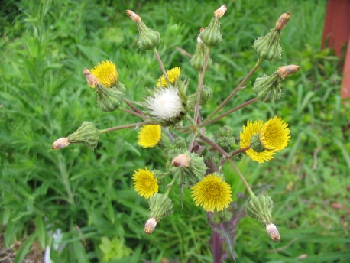
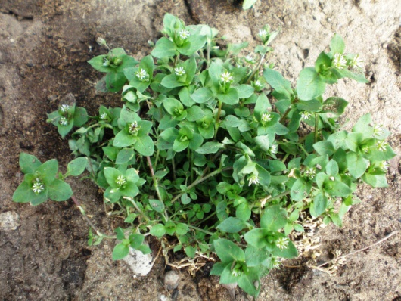
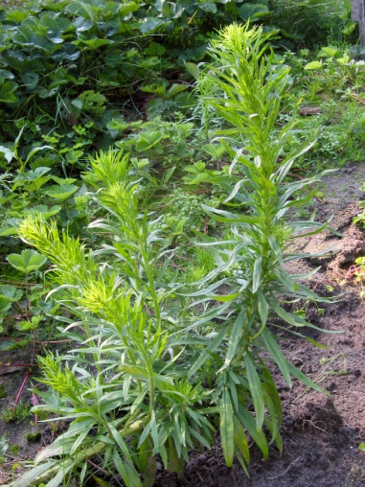
2013
Number 1
The annual bluegrass is a little plant belonging to the poacées family. Very common, she is generally considerated as a bad grass.
source: wikimédia
Number 3
Sonchus oleraceus, commonly called thistle is a specie of the herbaceous plant from the Asteraceae family.
source : wikipédia
source: wikipédia
Number 4
The stellaria media is an annual plant of the Caryophyllaceae, which is very common in Europe.
Number 2
The Canada fleabane is a herbaceous annual ruderal plant of the Asteraceae family.
source: wikimédia
source : wikipédia
Number 5
araxacum is a kind of plant of the Asteracae family. It’s generally called dandelion.
source : wikipédia

Slide 3
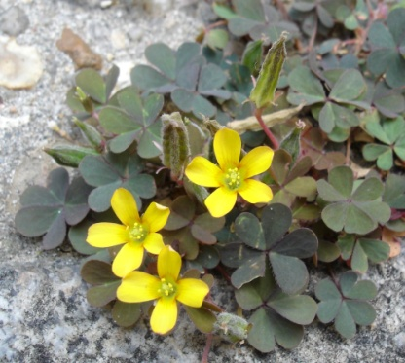
2014
source : wikipédia
Number 1
Taraxacum is a kind of plant of the Asteracae family. It’s generally called dandelion.
Number 4
The stellaria media is an annual plant of the Caryophyllaceae, which is very common in Europe.
source : wikipédia
Number 2
The annual bluegrass is a little plant belonging to the poacées family. Very common, she is generally considerated as a bad grass.
Number 5
The oxalis trefoil is a little plant of the oxalidacées family, used in traditional medecine.
Number 3
The senecio vulgaris is a specie of the asteraceae family, like the taraxacum. She is very common in all the temperate areas of the world.
source : wikipédia
source : wikipédia
source : wikimédia

Slide 4
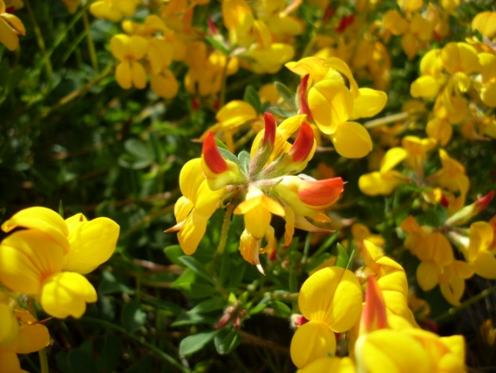
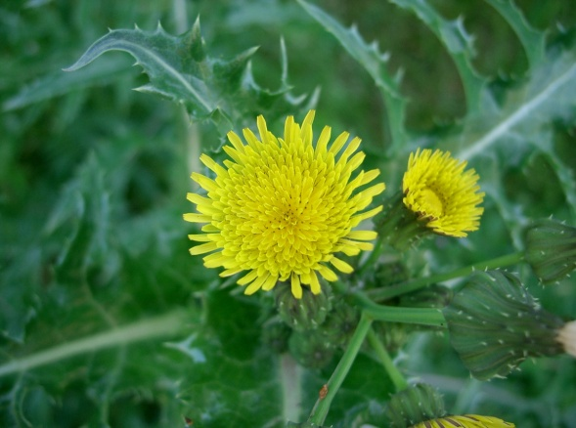
2015
Number 1
The annual bluegrass is a little plant belonging to the poacées family. Very common, she is generally considerated as a bad grass.
source : wikipédia
Number 4
The lotus corniculatus is a yellow plant frome the Fabaceae family , foten cultivated as forage.
Number 2source : wikipédia
Taraxacum is a kind of plant of the Asteracae family. It’s generally called dandelion.
source : wikipédia
Number 5
The senecio vulgaris is a specie of the asteraceae family, like the taraxacum. She is very common in all the temperate areas of the world.
source : wikipédia
Number 3
Sonchus asper is a plant with a yellow flower in spring, from the asteracées family.
source : wikimédia

