Slide 1
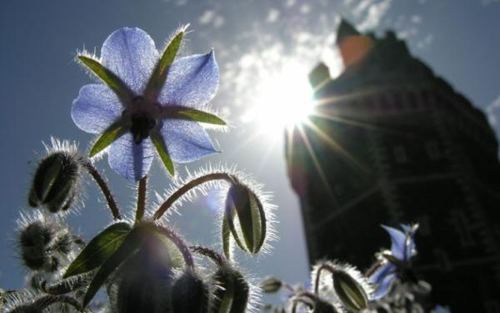
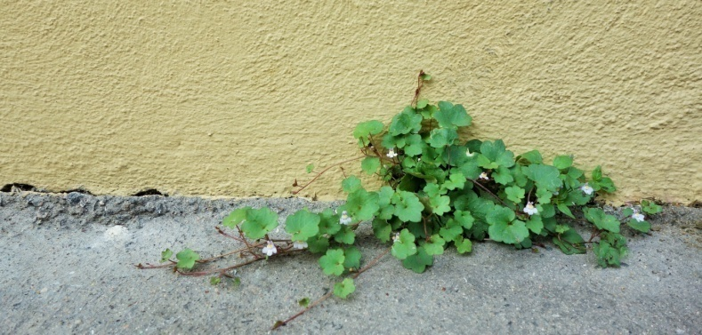
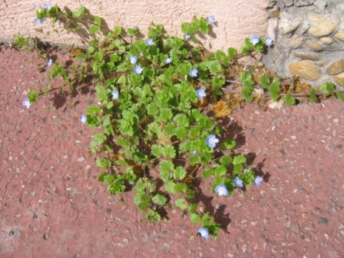
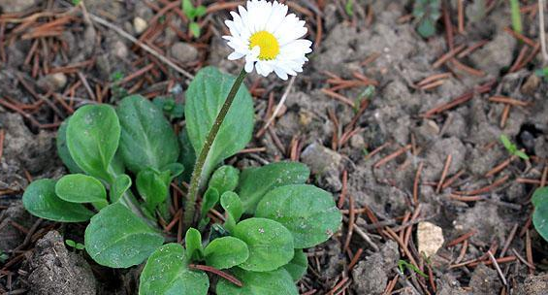
Méthodes et pratiques scientifiques

Slide 2
Statements in Paris:

Slide 3
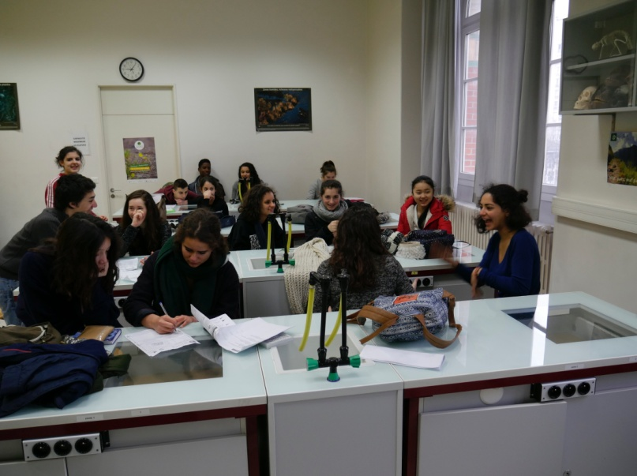
We made 2 statements the October 16th 2015 and the April 1st 2016 in the allée Darius Milhaud.
We were separated several little groups: we were 3 or 4 in each group. Groups were affected to differents bed trees distant by approximativelly 6 meters.

Slide 4
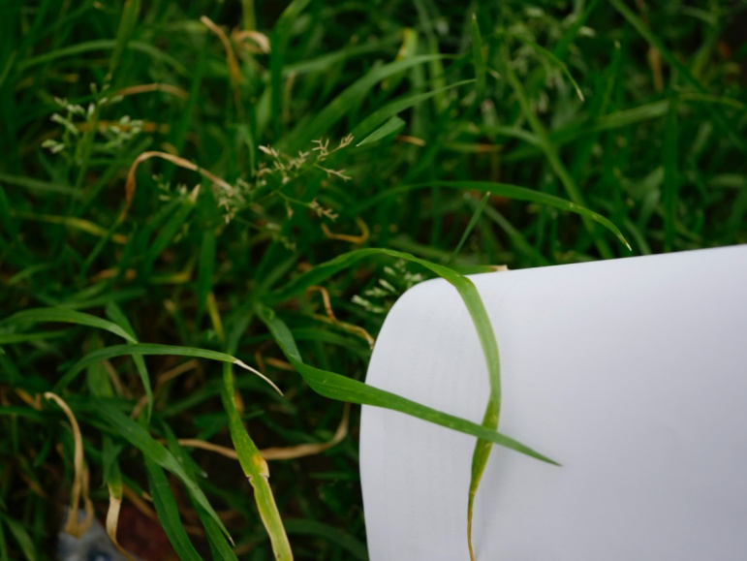
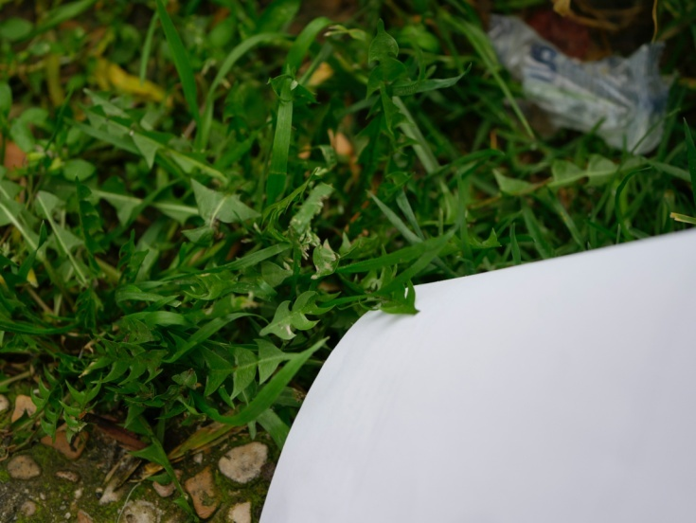
Example of Plants found:
Sterile Brominated (Bromus Sterilis)
Dandelion (Taraxacum Div)

Slide 5
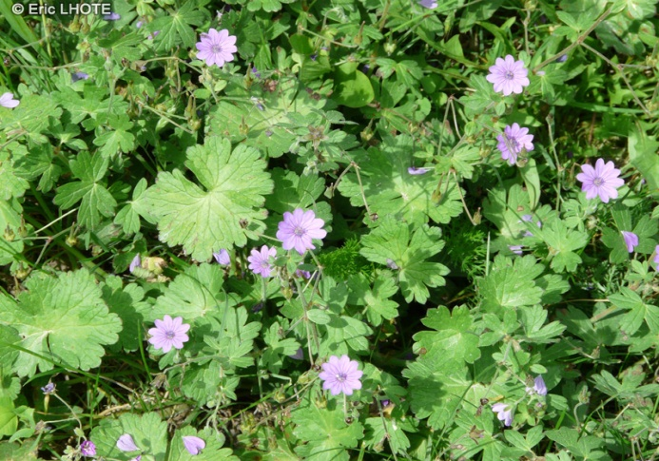
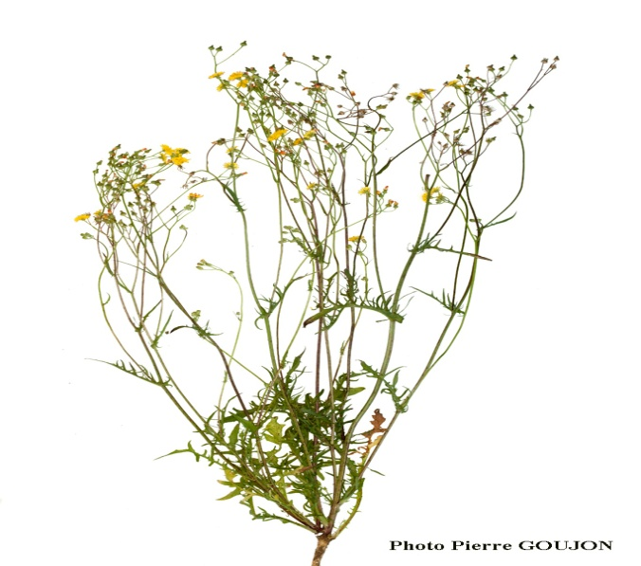
Geranium Breeches (Geranium molle)
Hair Plaster (Crepis Capillaris)

Slide 6
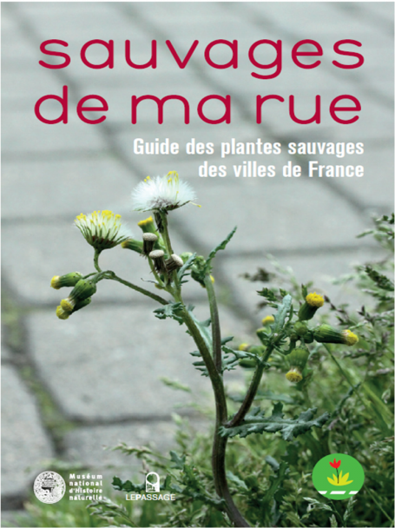
We needed a phone to take pictures and a document to write our results. Then, we used « Sauvage De Ma Rue » a book published by the french national natural museum to the name of the different species we found.

Slide 7
.
When we came back to the classroom, we recorded our results in the website « vigie nature » to compare every results from all the groups.

Slide 8
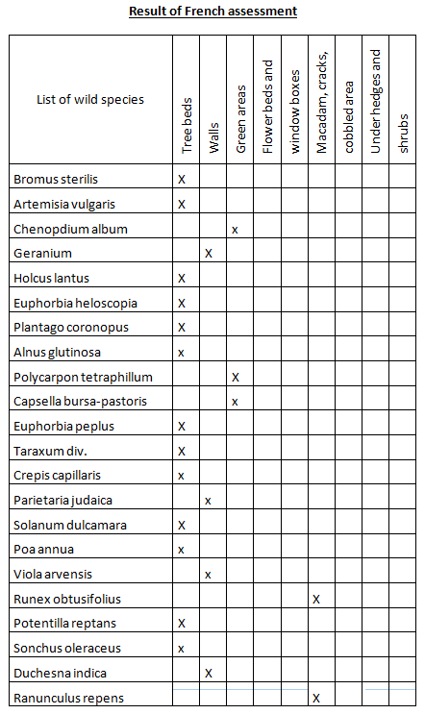

Slide 9
Participants
Students
Gouache Emilie, Paleyret Jeanne, Sereir Lotfi, Toufic Chanaelle, Moinet Nil, Achelatt Lilou, Hackel Lola, Savineau Melissa, Lugon Nahomy, Dinckel Carla, Amine Mila, Buttin Martial
, Derouvroy Nathanaël, Gouia Sonia, Hartoin Samuel, Hervé Toscane, Hidalgo Olivier, Ollivier Tanaquil, Ramond Sandra, Santiago Luena, Sato Marino, Tran N Goc Lila, Vergneaud Anita
Teachers
Perrotey Stéphanie, Lhermenault Damien
Scientific Collaboration
M. Turpin

