Slide 1
Personal portfolio of Dimana Nestorova

Slide 2
Get to know me better
Name: Dimana Nestorova
Birthplace: Plovdiv, Bulgaria /currently living in Haskovo <3 /
Birthday: 12 July / I`m 17/
Zodiac sign: Cancer
Favourite music: techno, rap, trap, pop music
Fav series: Euphoria

Slide 3
My favourite….

Slide 4
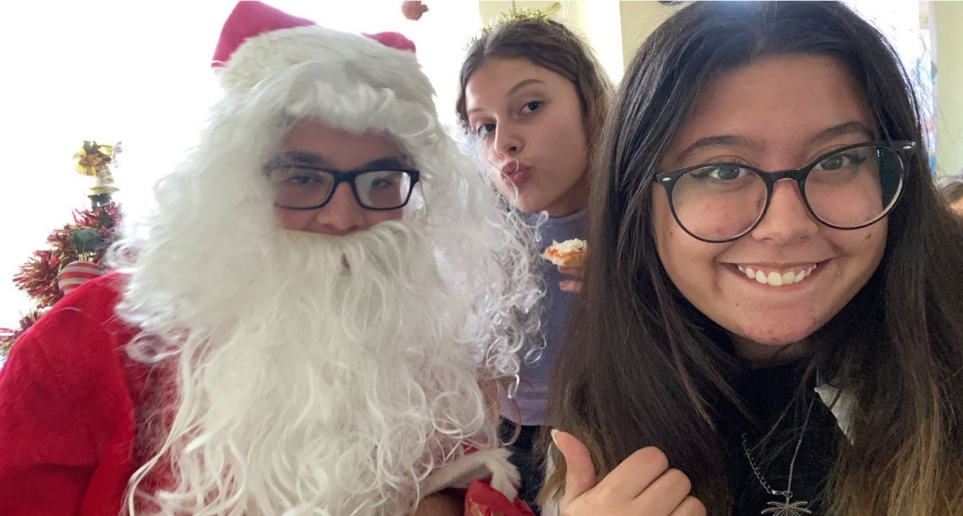
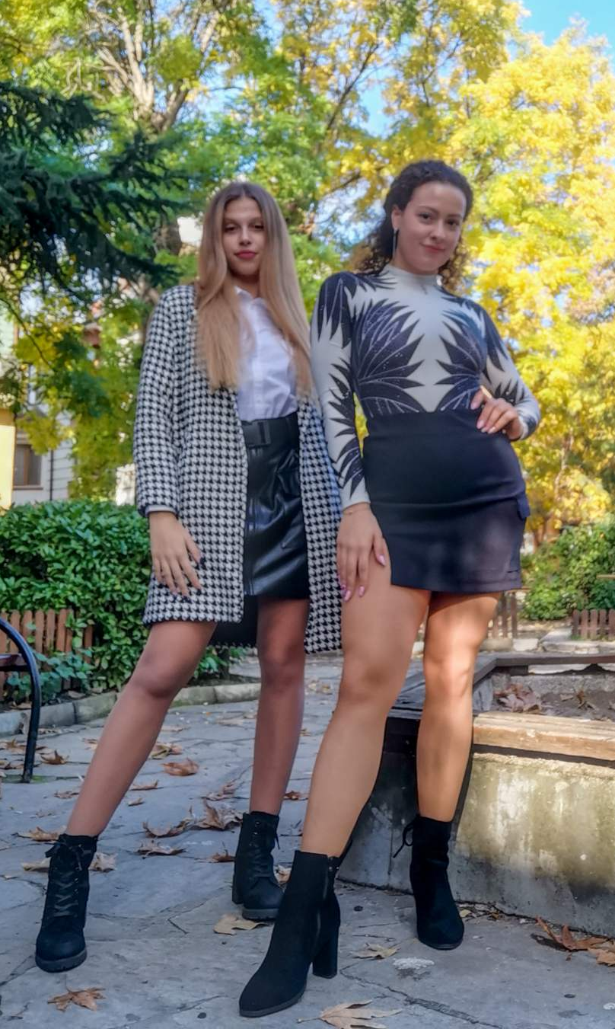
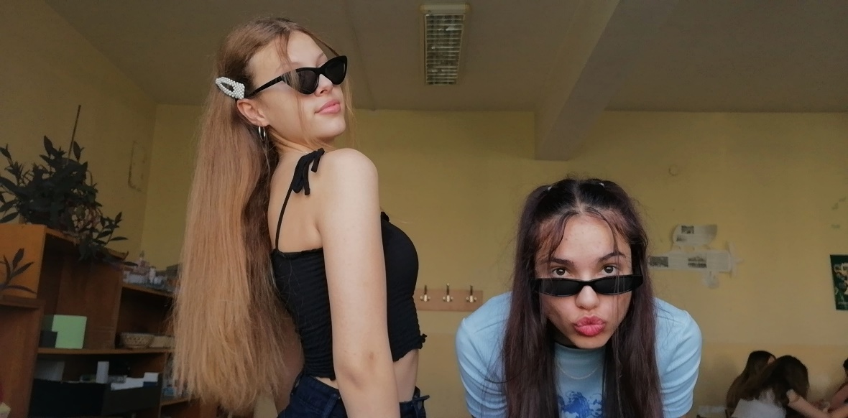
My friends

Slide 5
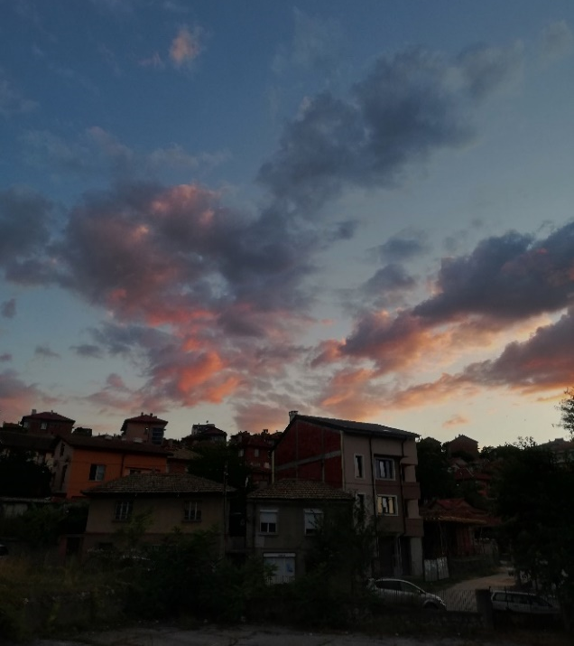
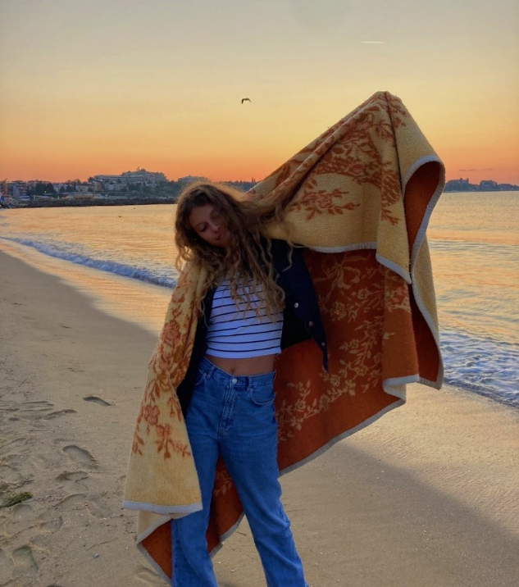
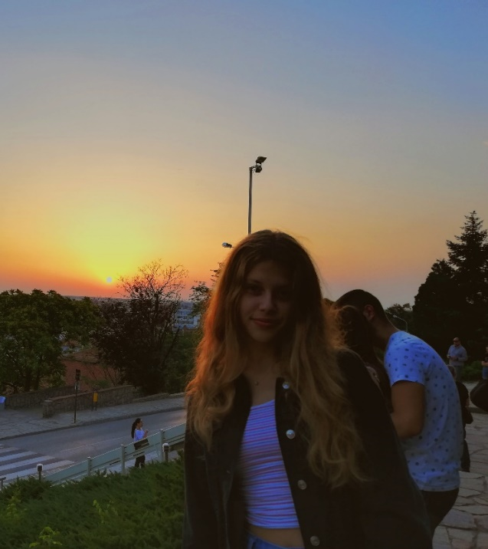
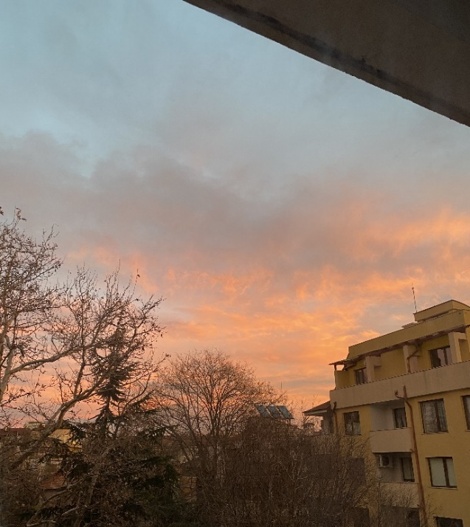
Sunrises and sunsets

Slide 6
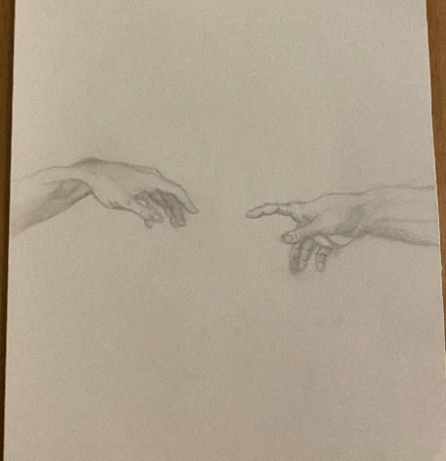
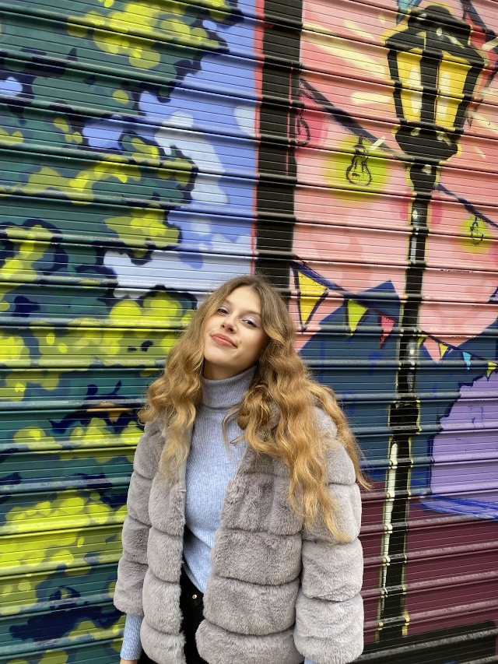
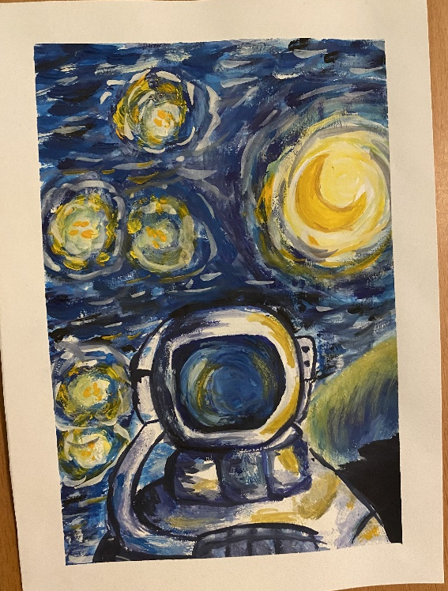
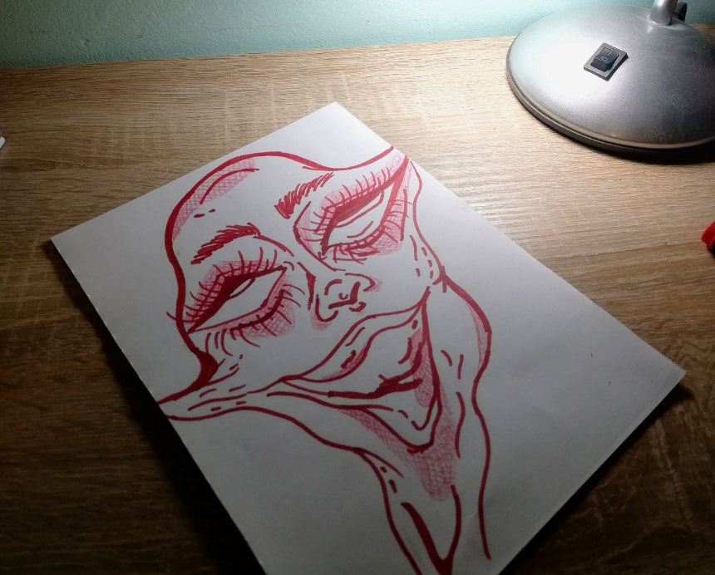
Art and art places

Slide 7
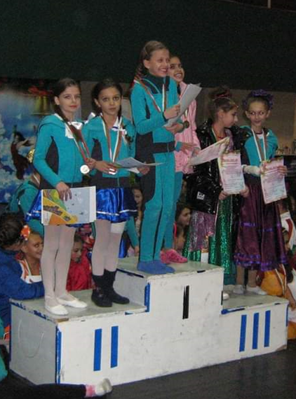
dance

Slide 8
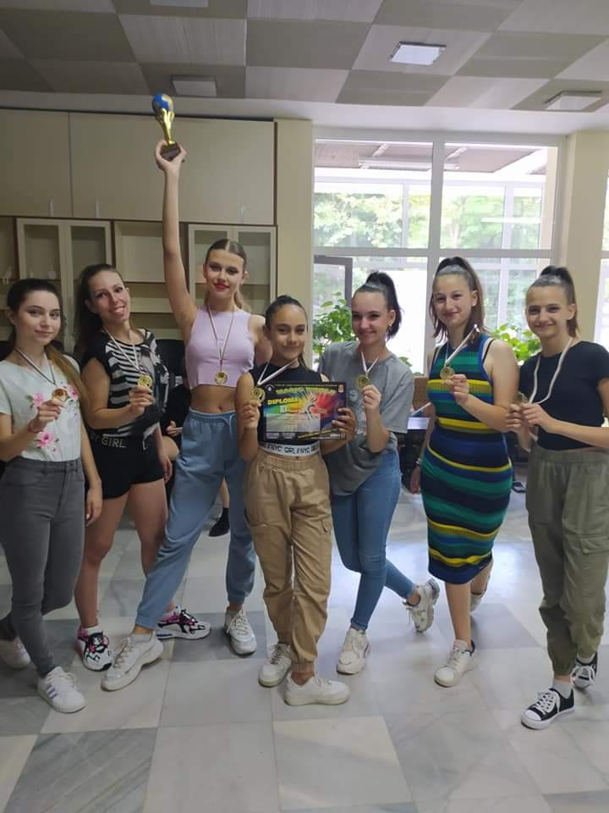
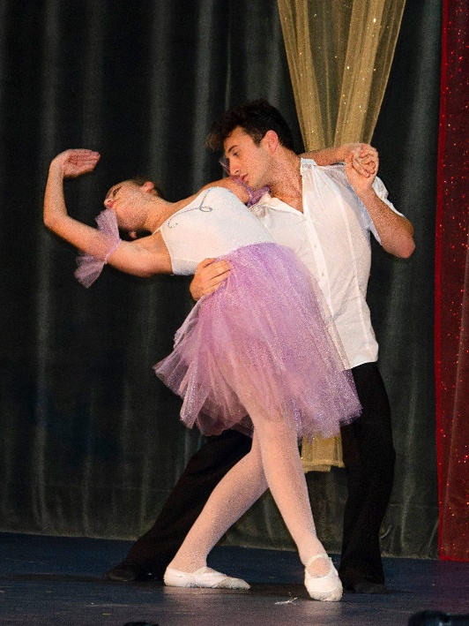
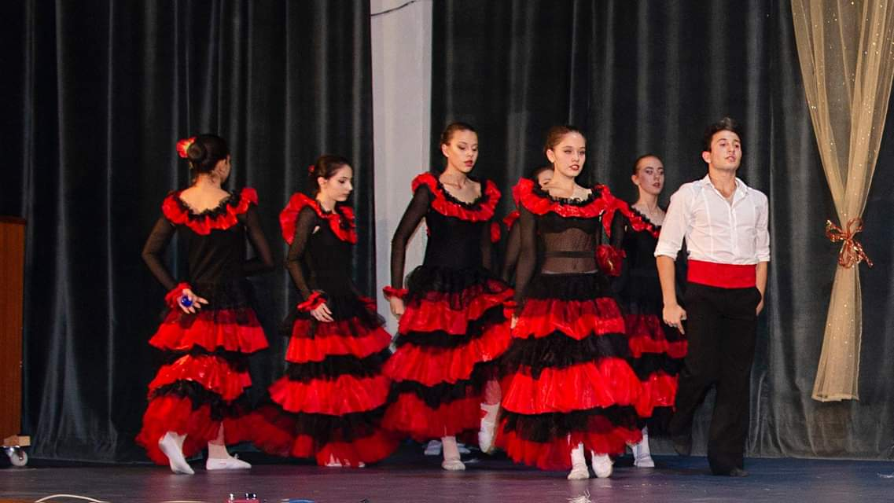

Slide 9
Biology and chemistry

Slide 10
Extracurricular activities

Slide 11
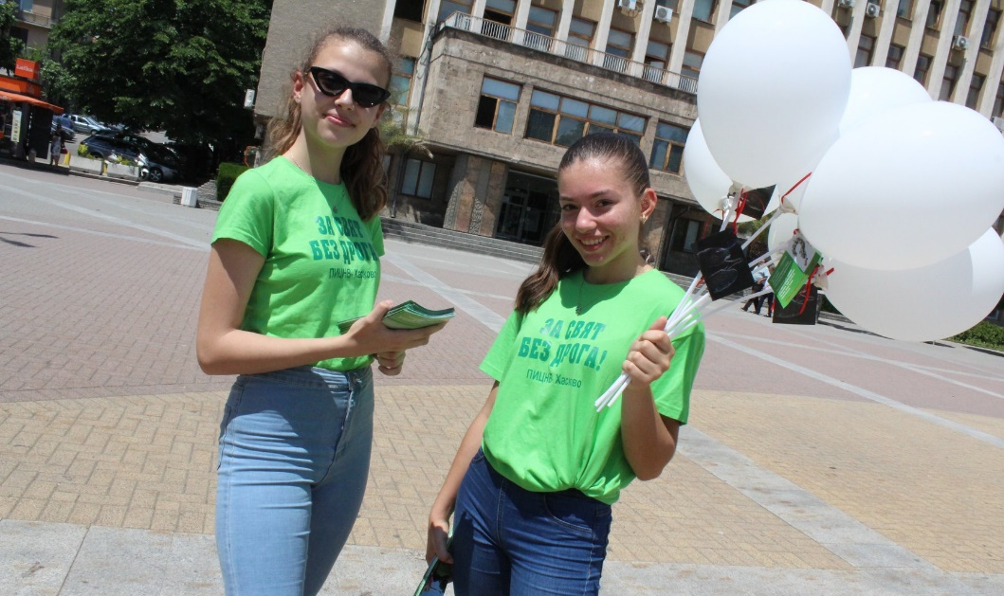
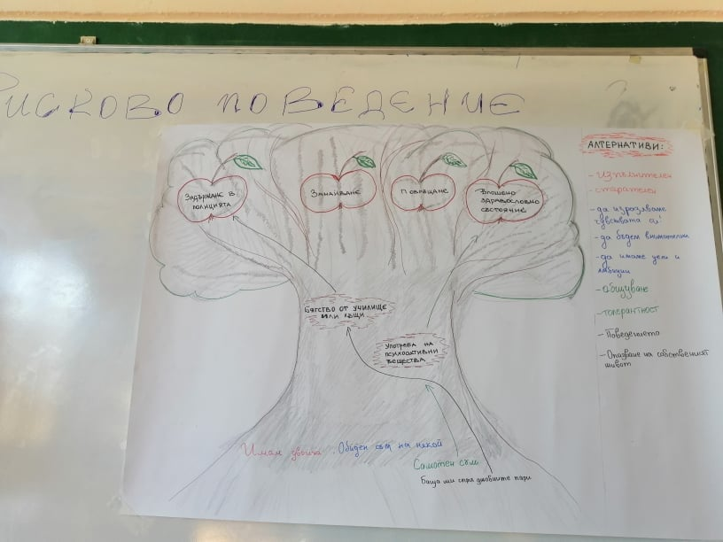
volunteering

Slide 12
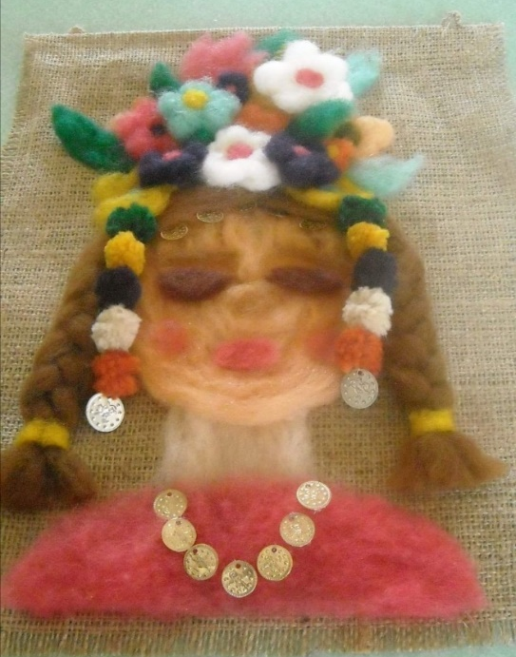
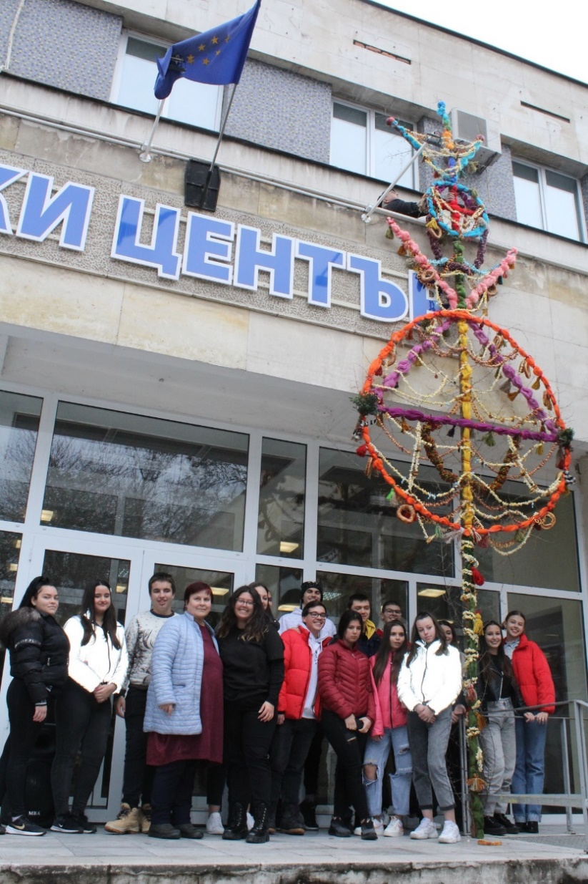
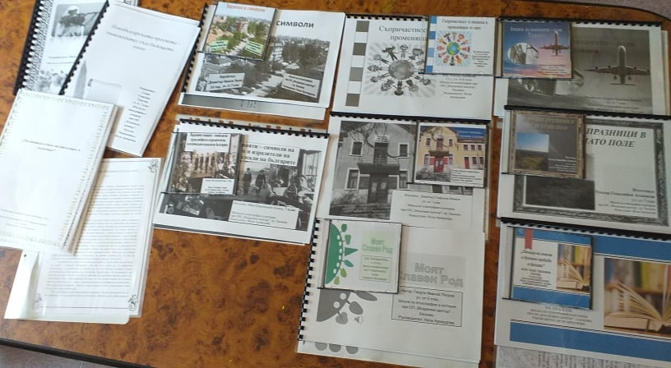
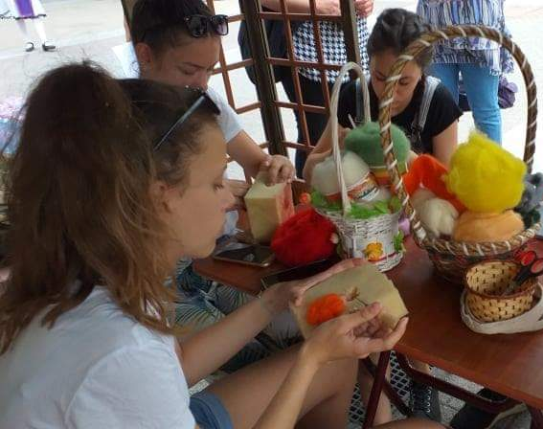
Etnography and history club

Slide 13
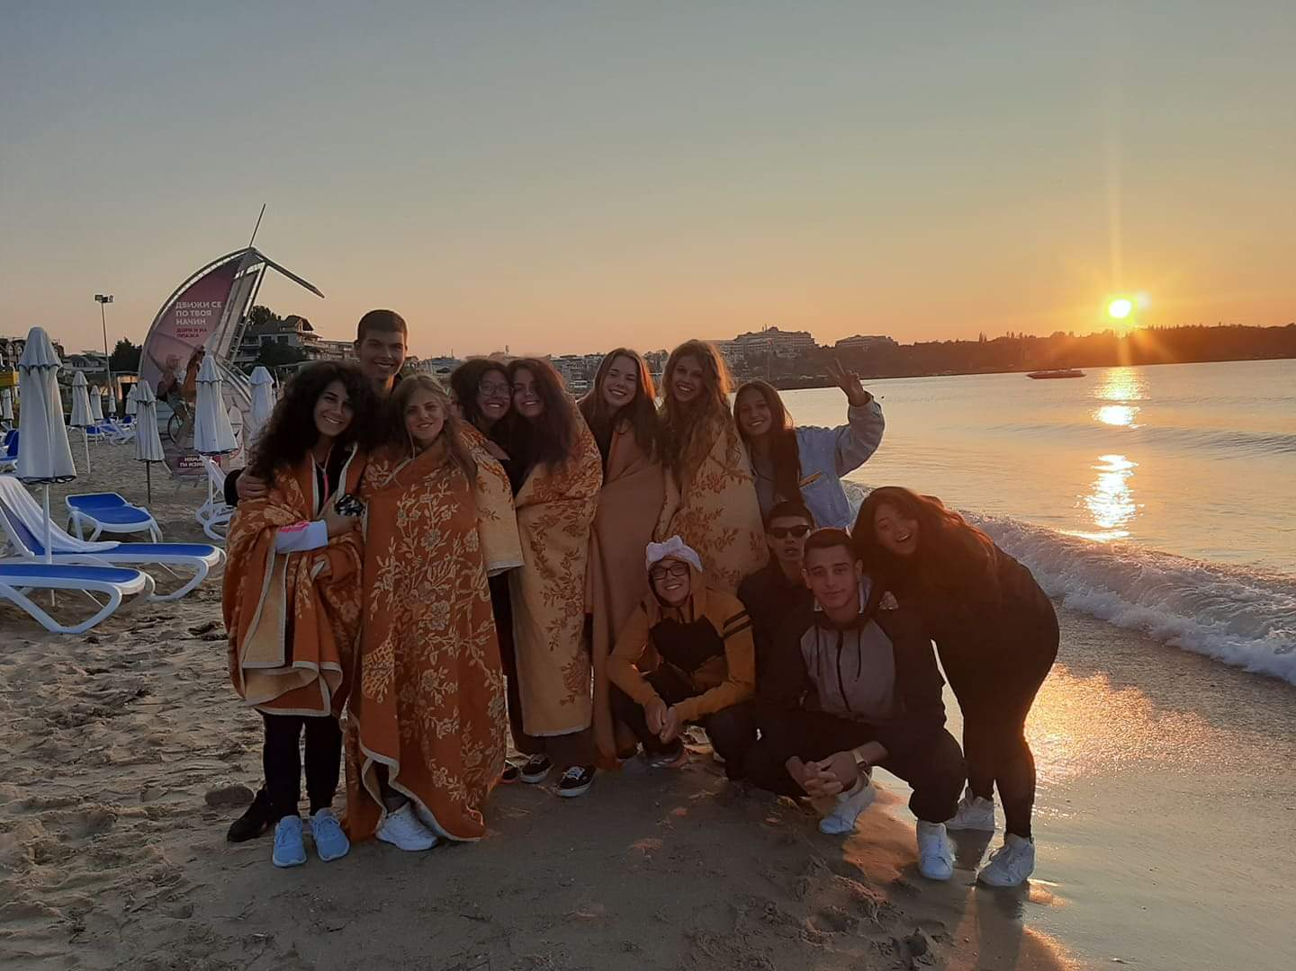
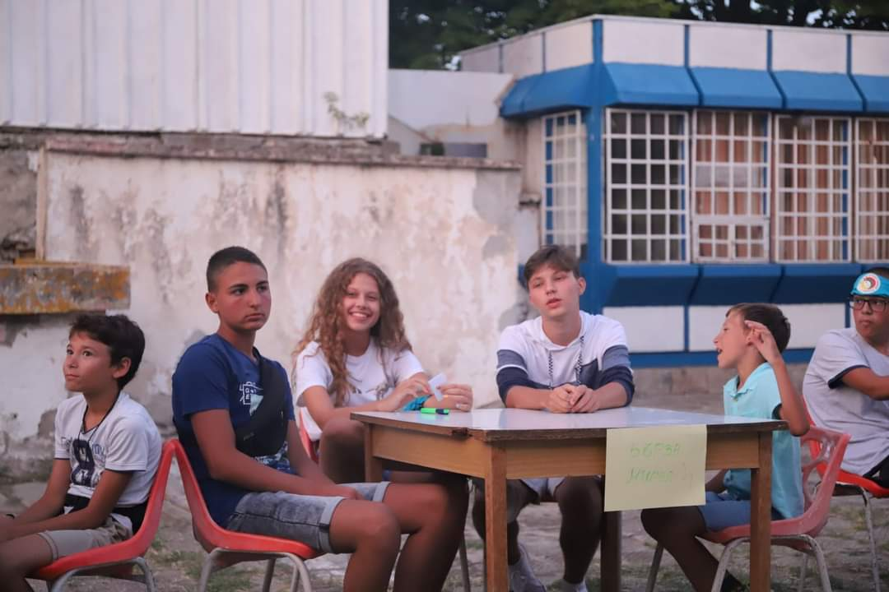
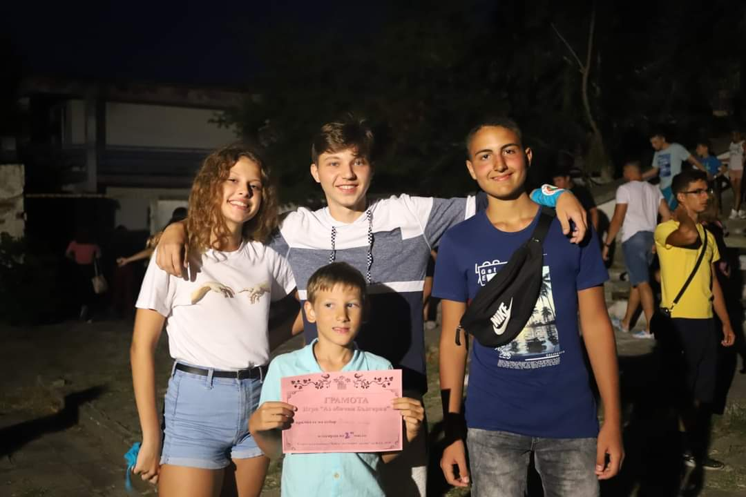

Slide 14
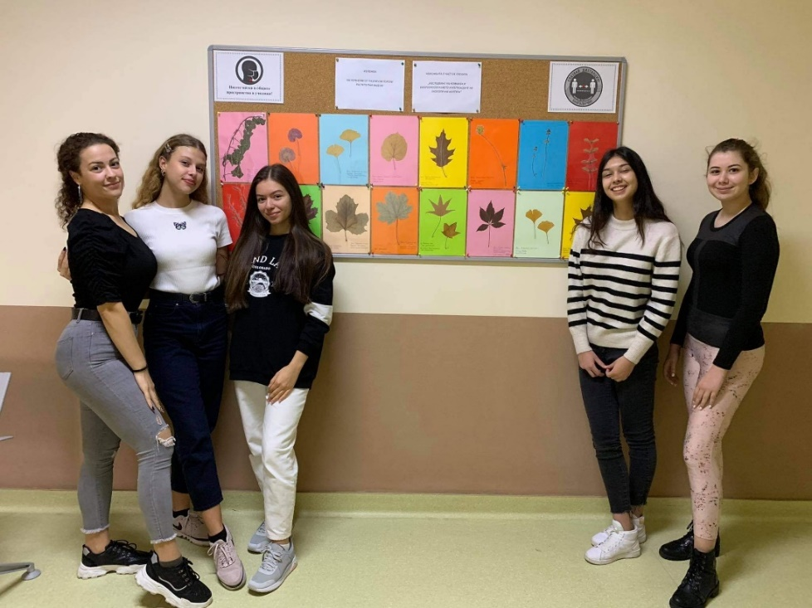
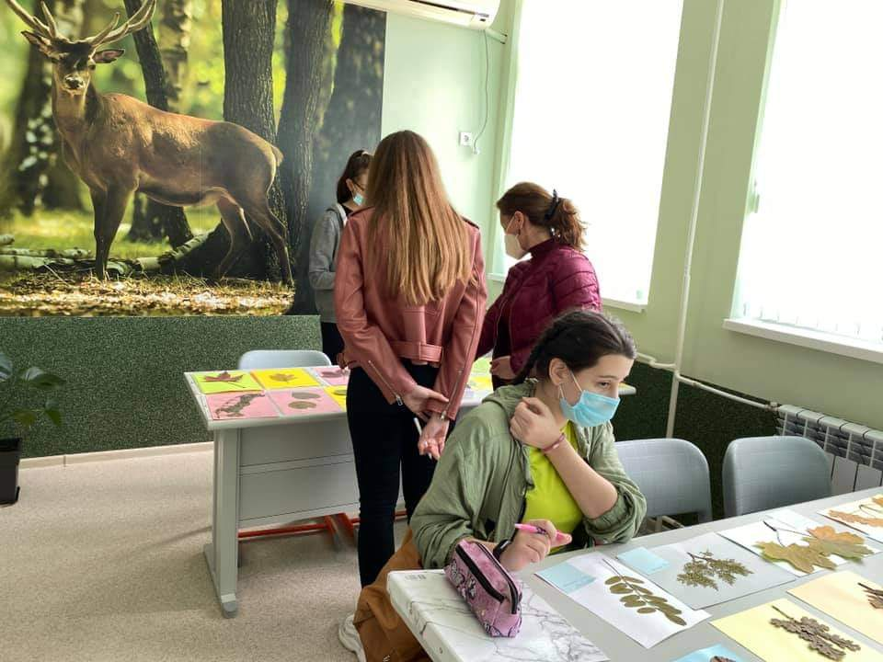
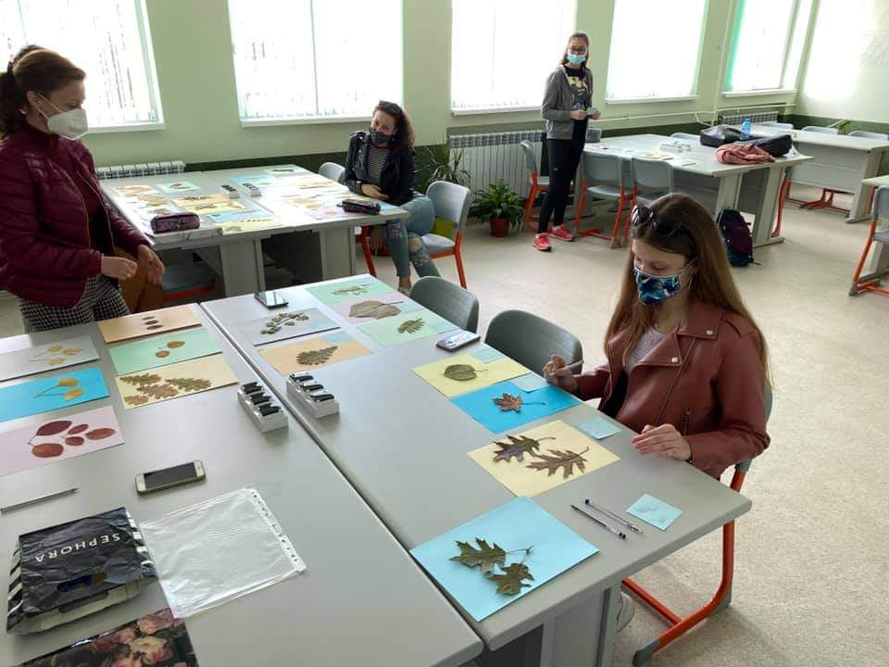
Eco club

Slide 15
Why I decided to join Erasmus +
One of the main reasons why I joined this project is because I have been interested in nature, biodiversity and climate change since I was a child. So as soon as I heard about its existence I decided to enroll.
As you saw in the previous slides, I attend an ``Etnography and history club``, which means that it is very interesting for me to get to know new countries, their landmarks, culture and traditions.
Last but not least I`m a very open- minded and extrovert person, I like meeting new people and making new friends.

Slide 16
What I learned from the project ``research and conservation of biodiversity and climate``
So far I`ve learned many interesting facts and learned even more about the biodiversity and the climate of our beautiful planet and how to protect them.
I also improved my teamwork.

Slide 17
The projects i`ve done so far

Slide 18
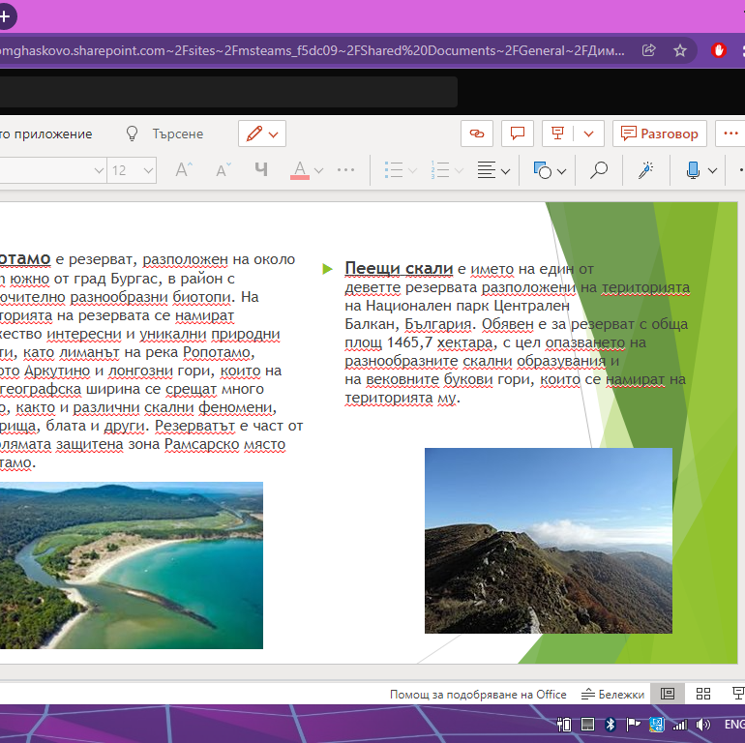
``biodiversity conservation``

Slide 19
``mammals and birds``

Slide 20
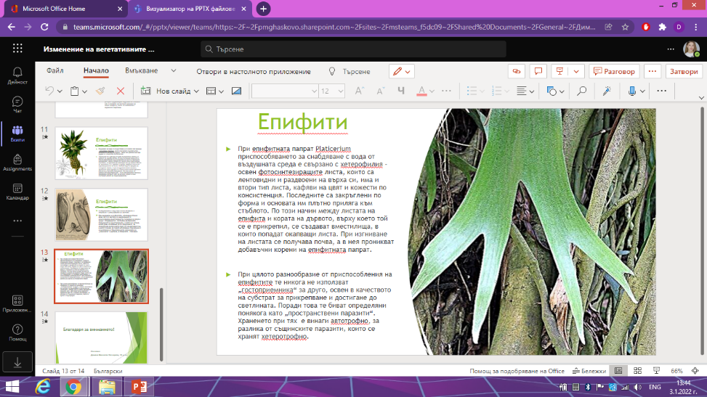
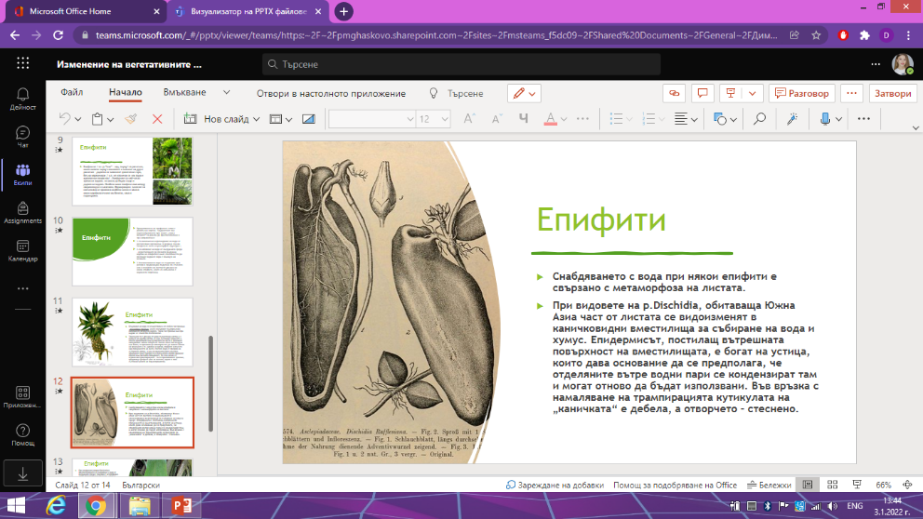
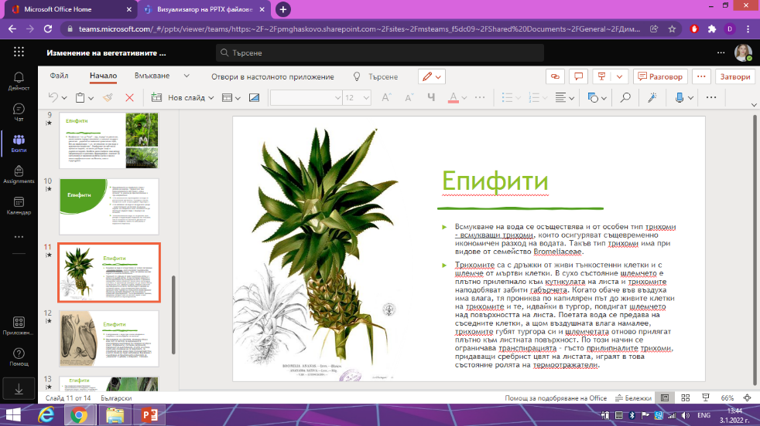
``Modification of the vegetative organs of plants to light``

Slide 21
``poda Protected Aria ``

Slide 22
``Burgas` Lake Vaya``

Slide 23
What are my expectations for this visiting
To get to know the country and the sights of it better
To learn many new things about the biodiversity and climate around the world
To have a great time and meet a lot of amazing people

Slide 24
Where can you reach me out :
dimana_nestorova
Dimana Nestorova

Slide 25
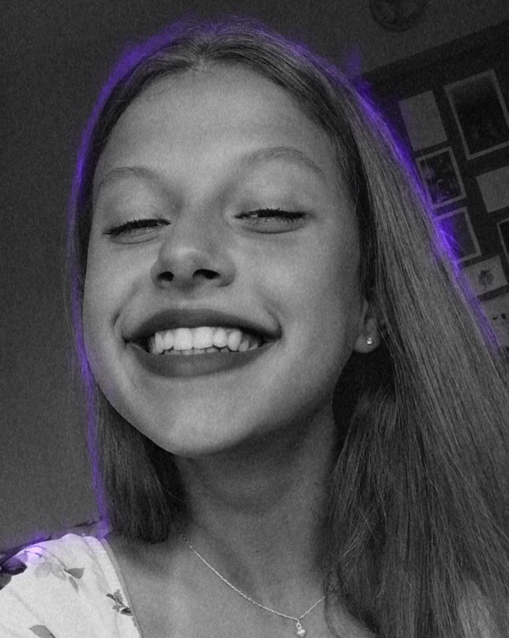
Thanks for watching!

