Slide 1
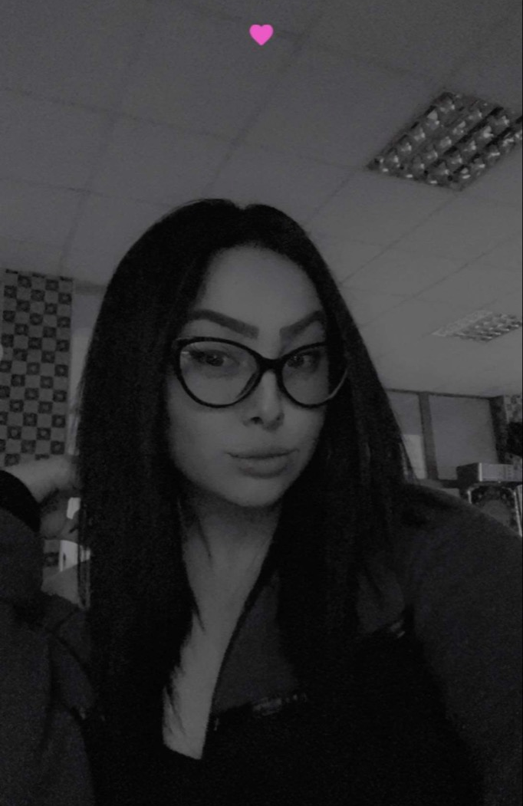
Nia Zhisova

Slide 2
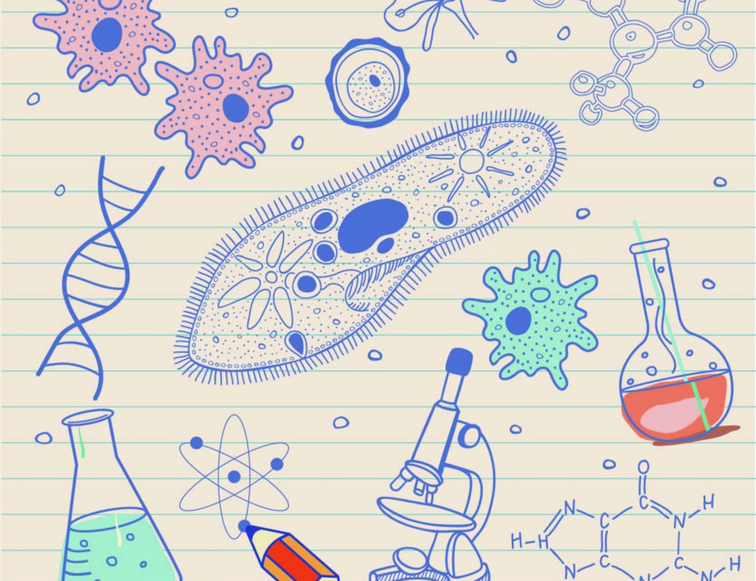
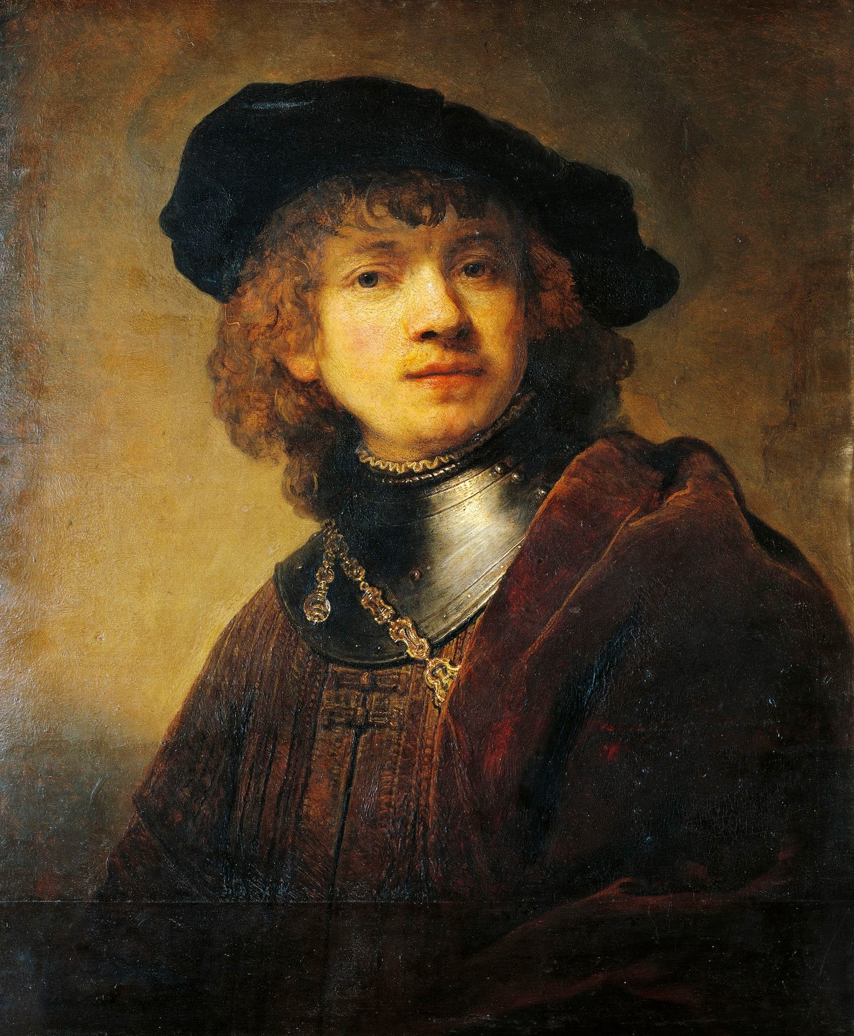
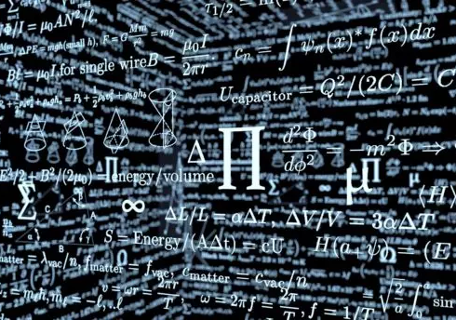
MY INTERESTS
CHEMISTRY AND BIOLOGY
LITERATURE
MATH
ART

Slide 3
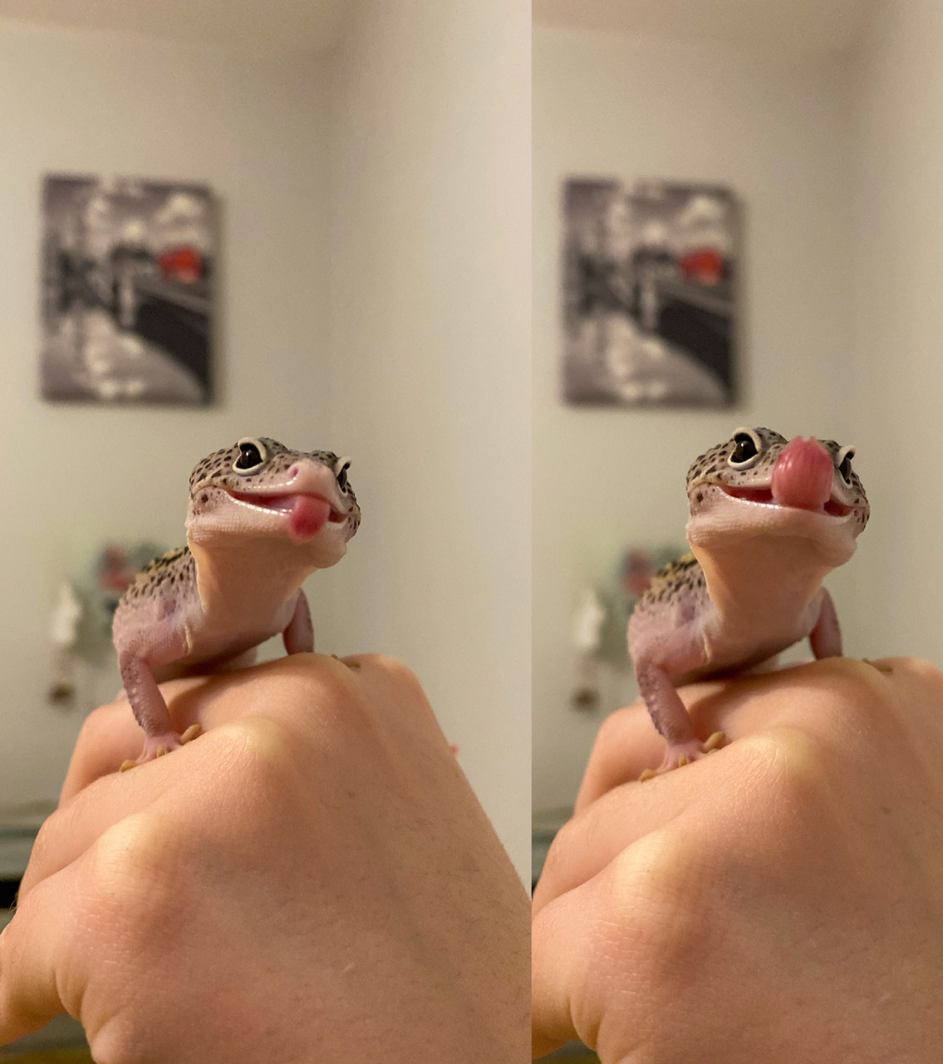
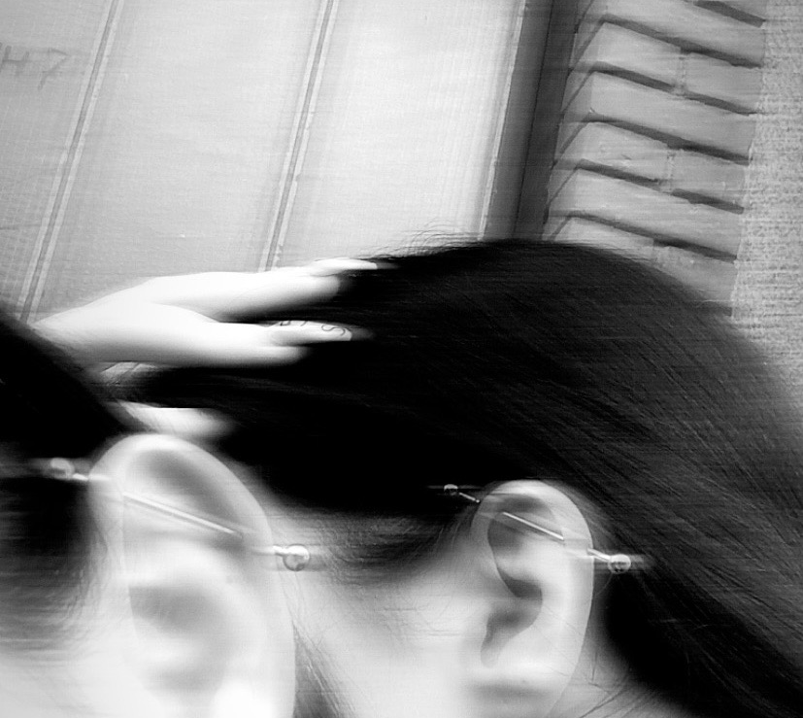
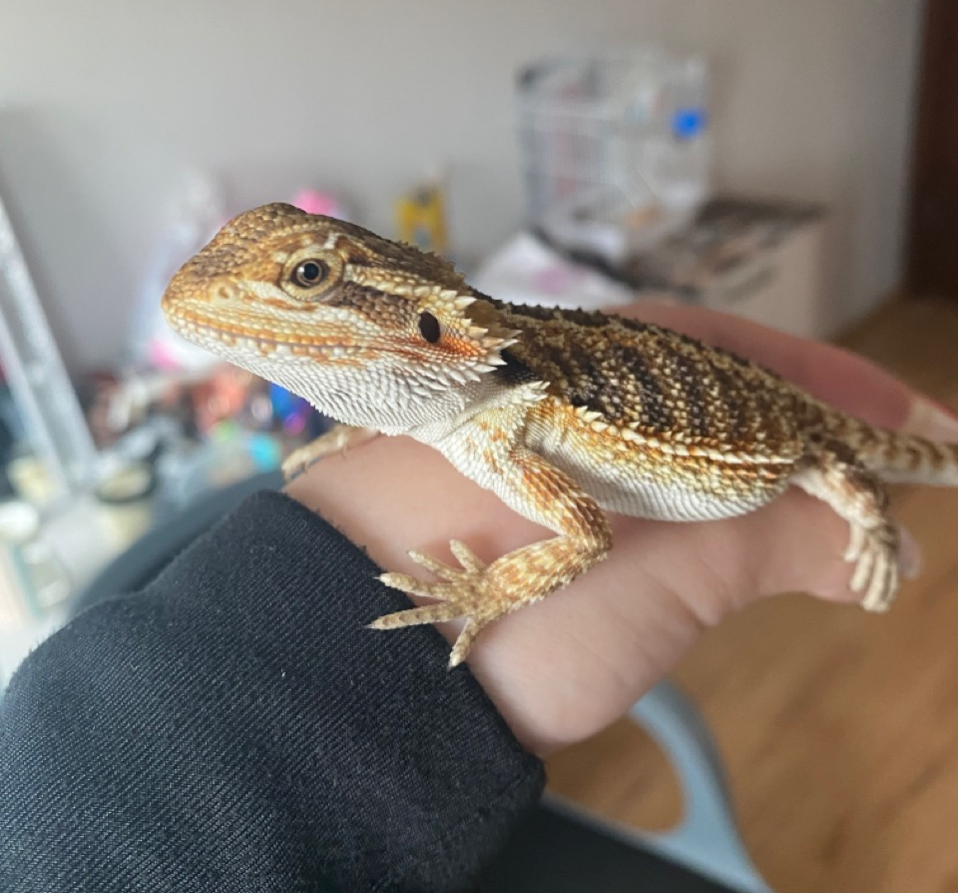
MY INTERESTS
REPTILES
BEAUTY & FASHION
FRIENDS

Slide 4
ACHIEVEMENTS
In math
In literature
In foreign languages
In sports

Slide 5
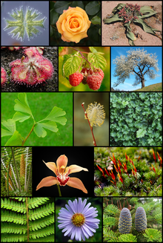
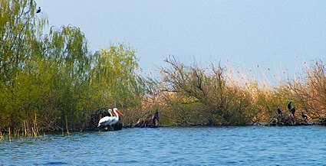
WHAT I’VE LEARNT IN THE PROJECT BY NOW?
NATIONAL PARKS AND PROTECTED AREAS
PLANTS AND ANIMAL AND THEIR STRUCTURE
ENDANGERED SPECIES
WAYS OF HELPING THE ECOLOGY

Slide 6
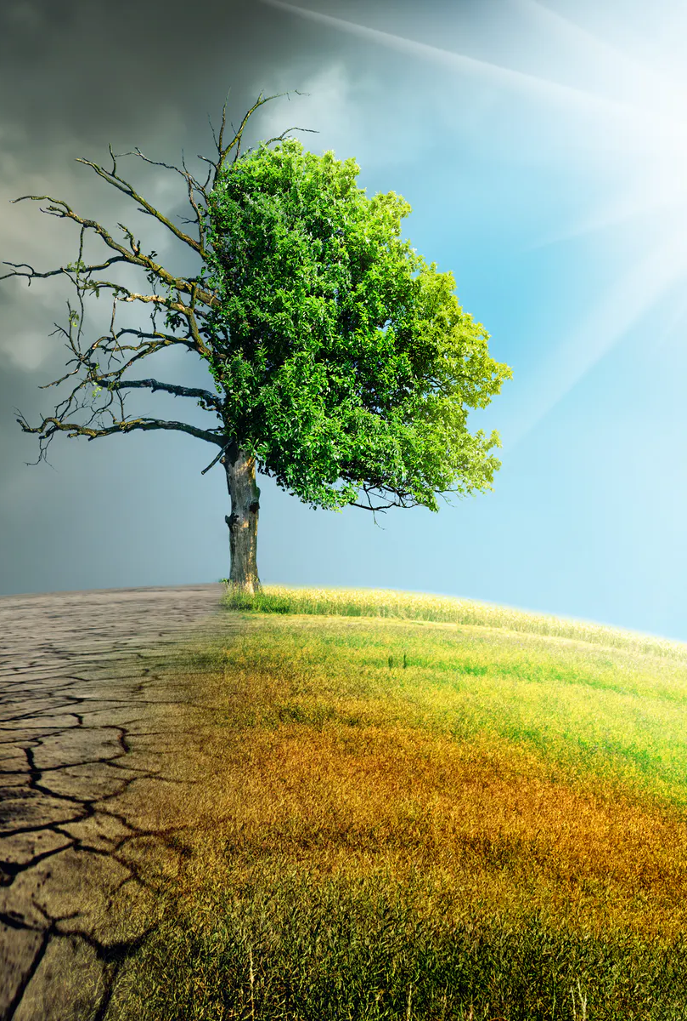
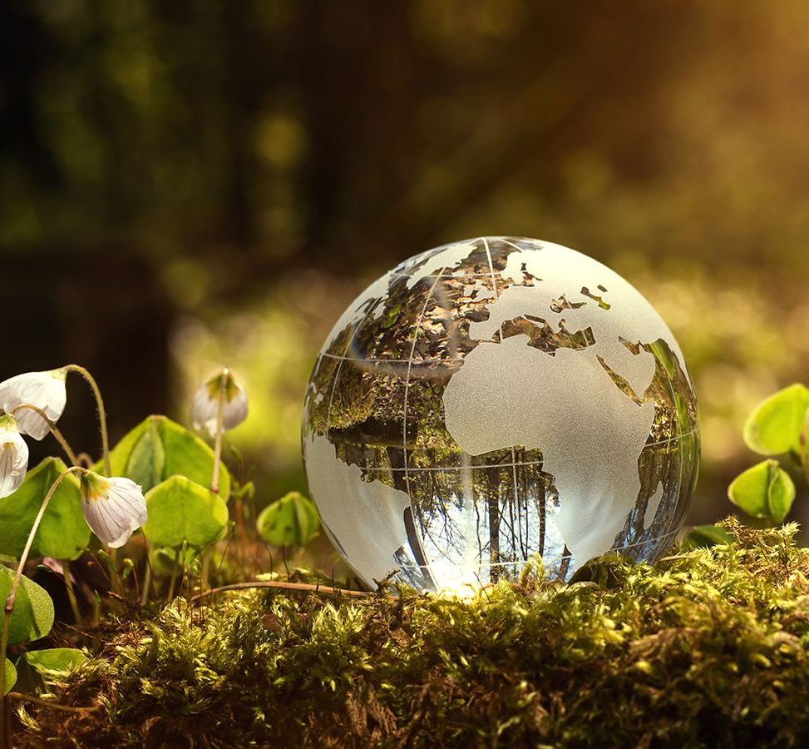
HOW THIS MOBILITY IN PORTUGAL IS USEFUL FOR ALL?
EXCHANGING POINTSAND IDEAS
ACQUISITION OF NEW KNOWLEDGES
IMPROVING SOCIAL AND REPRESENTATIVE SKILLS

Slide 7
THANKS FOR THE ATTENTION!

