Slide 1
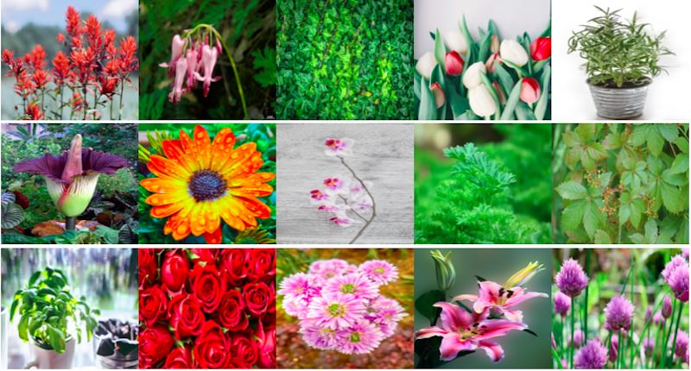
Plants Will Save Us
Quiz Time

Slide 2
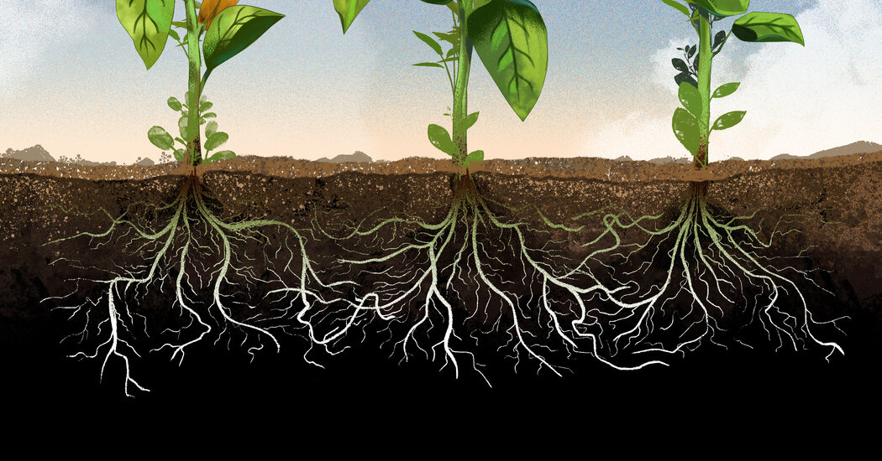
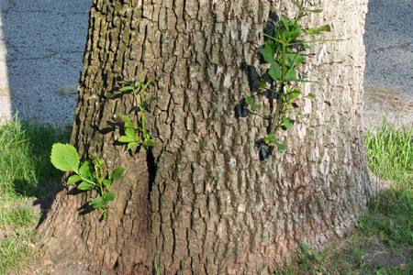
Quiz Question: 1
Choose the roots?

Slide 4
Quiz Question 2: What does a plant need?
water and sun
food

Slide 6
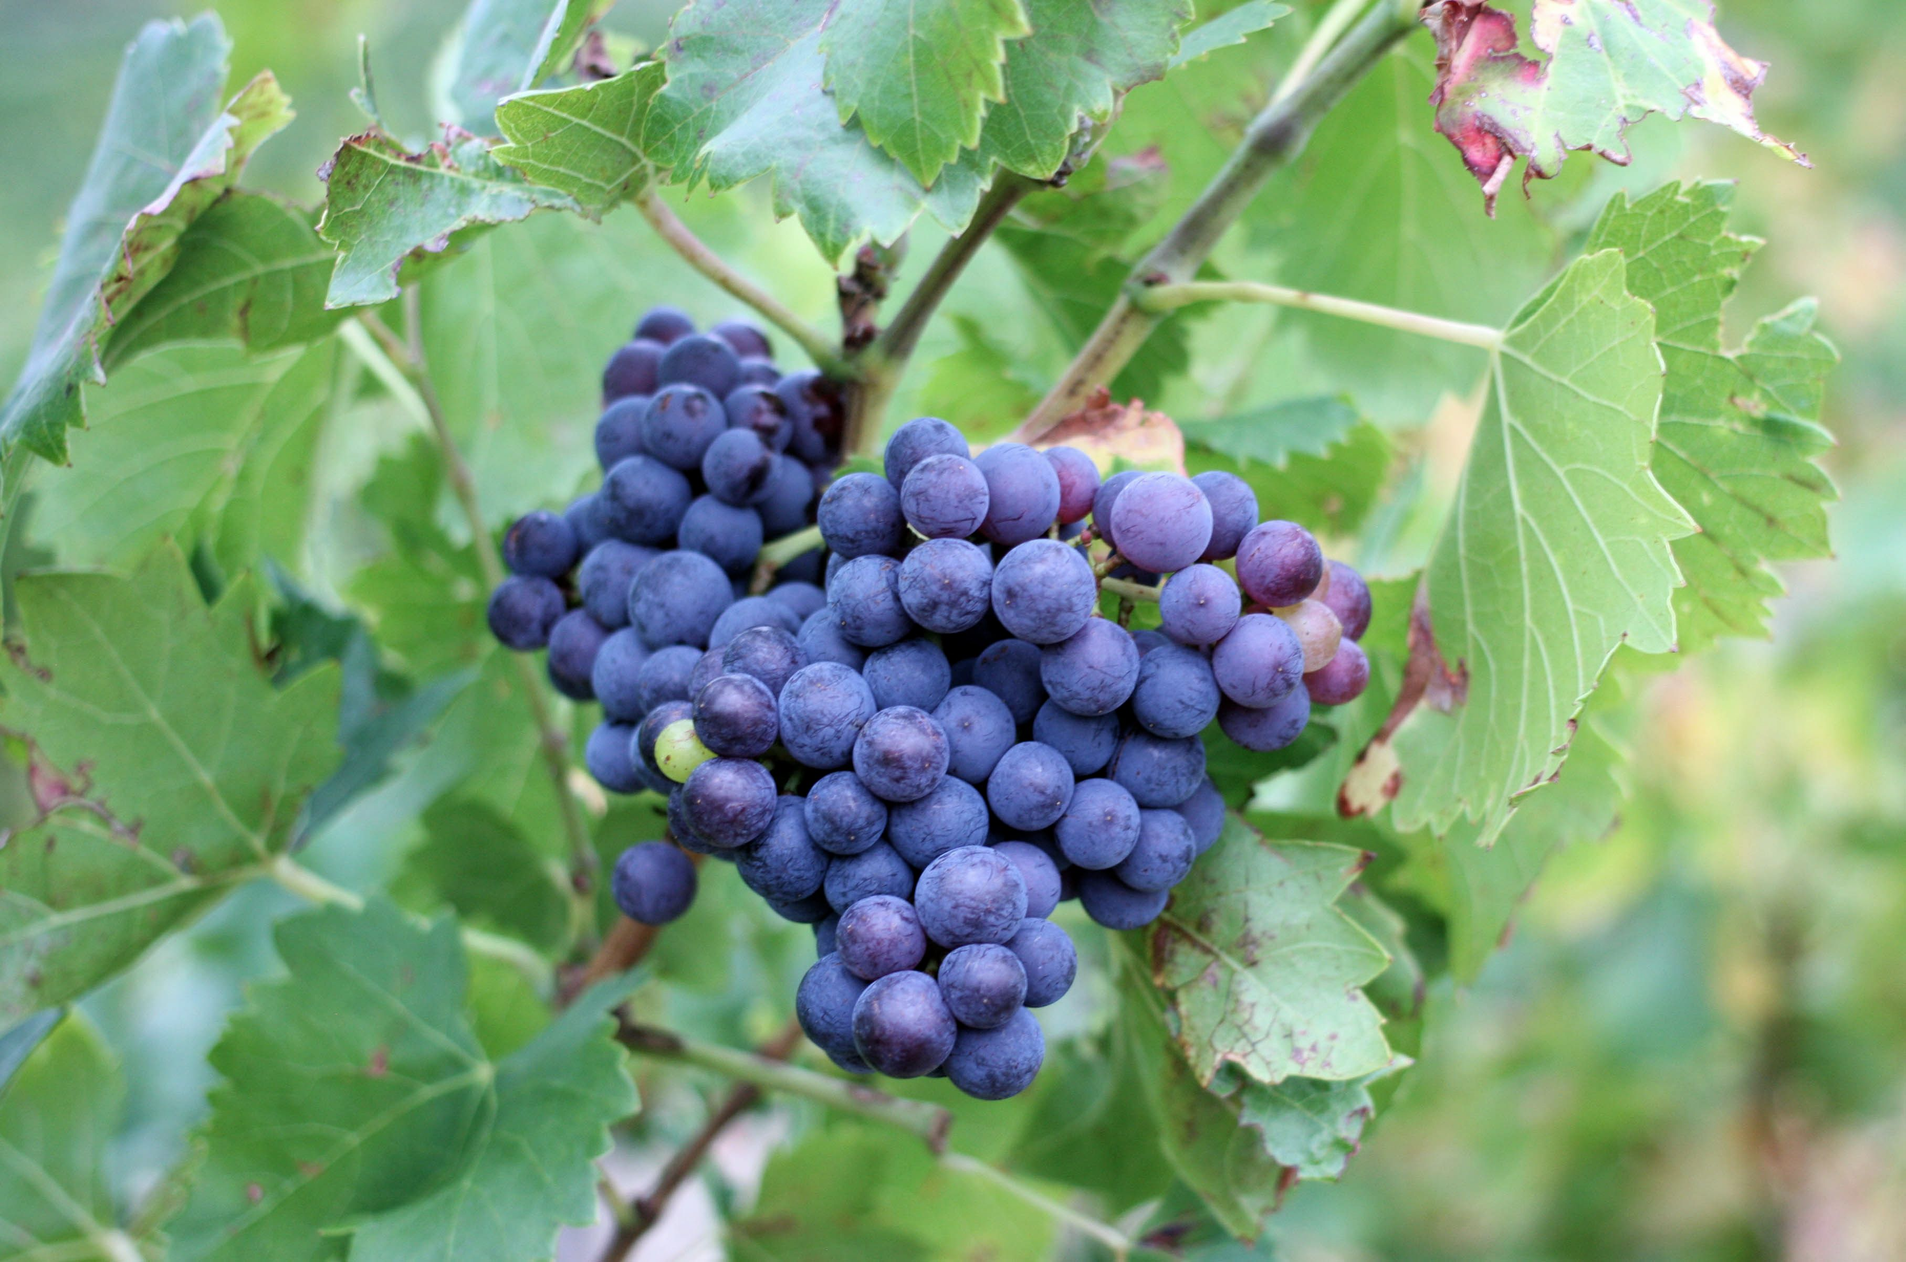
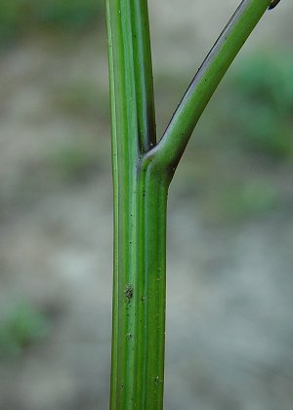
Quiz Question 3: What moves water around the plant?
fruit
stem

Slide 8
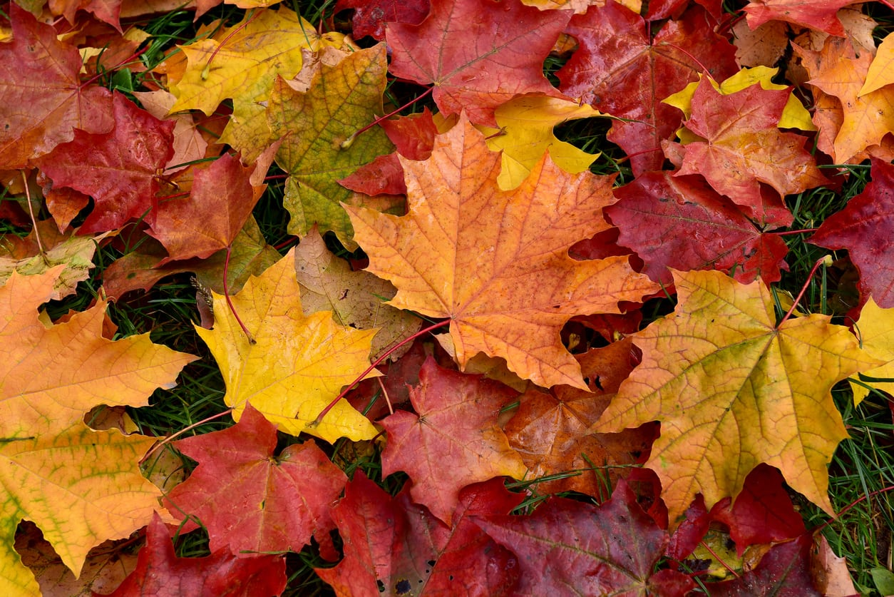
Quiz Question 4: What is the colour of leaves in Autumn?
blue
brown

Slide 10
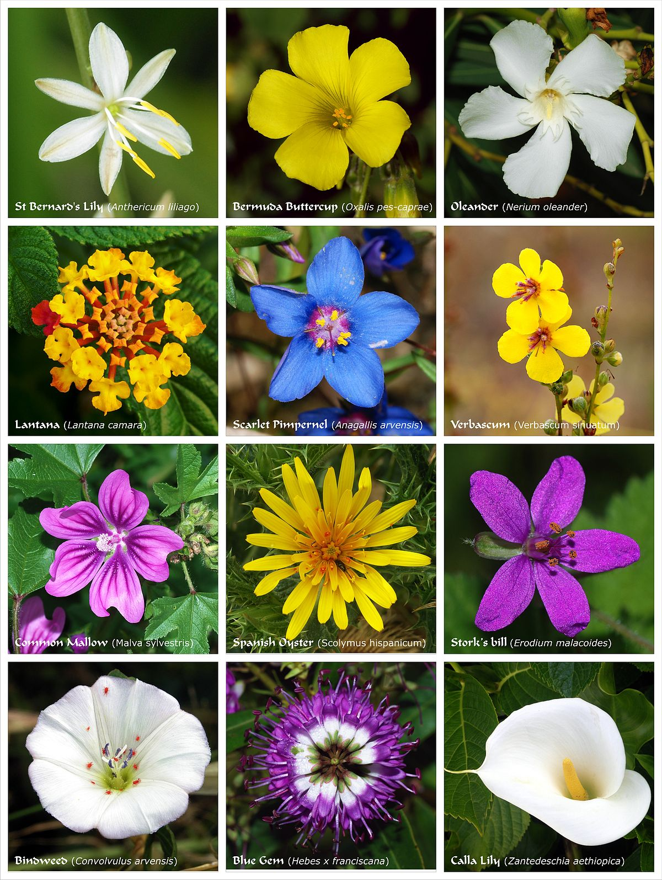
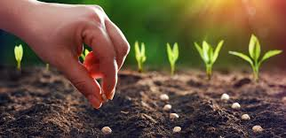
Quiz Question 5: What do we put in the soil to grow plants?
seeds
flowers

Slide 12
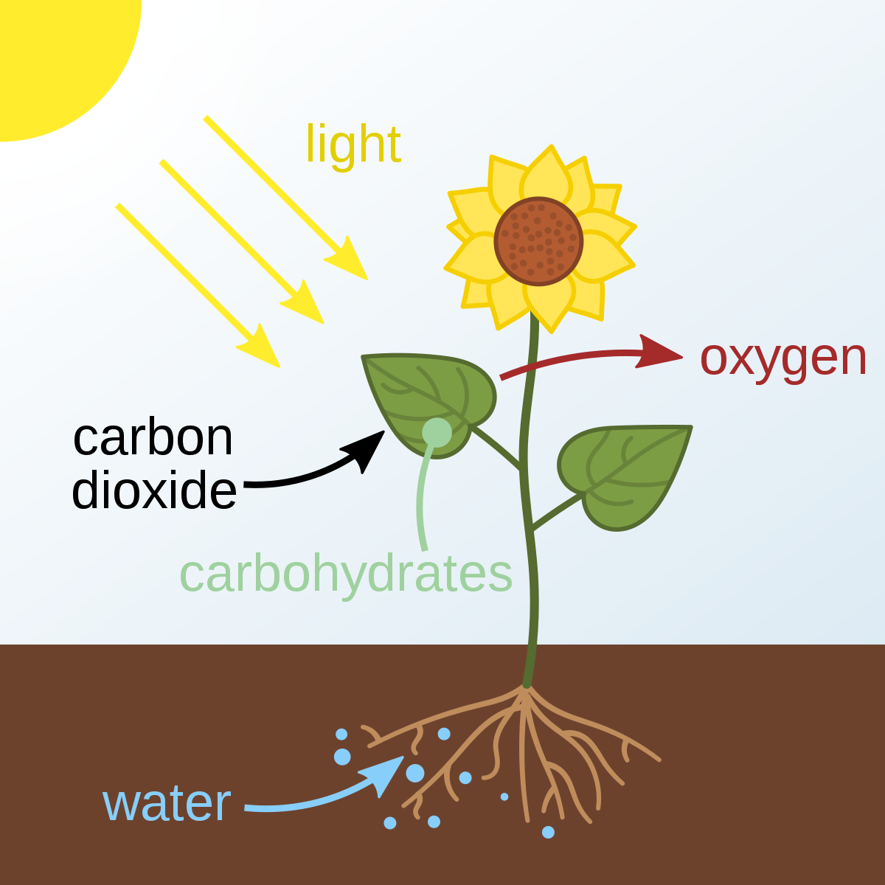
Quiz Question 6: Do plants give us clean oxygen?
yes
no

