Slide 1
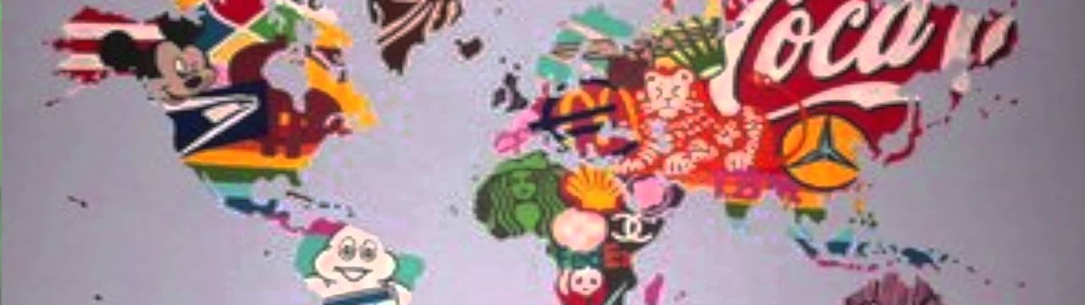
THE CONSUMERIST
SOCIETY
work by: Yasmina El Ahrar (4ºB)

Slide 2
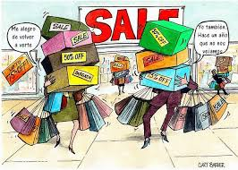
What’s consumerism?
“The idea that happiness and well-being comes from purchasing material possessions, thus leading to the populations to mass consumerism and production.”

Slide 3
Most people think of getting brand-new objects such as clothes, toys, etc, as a desirable idea.

Slide 4
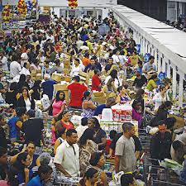
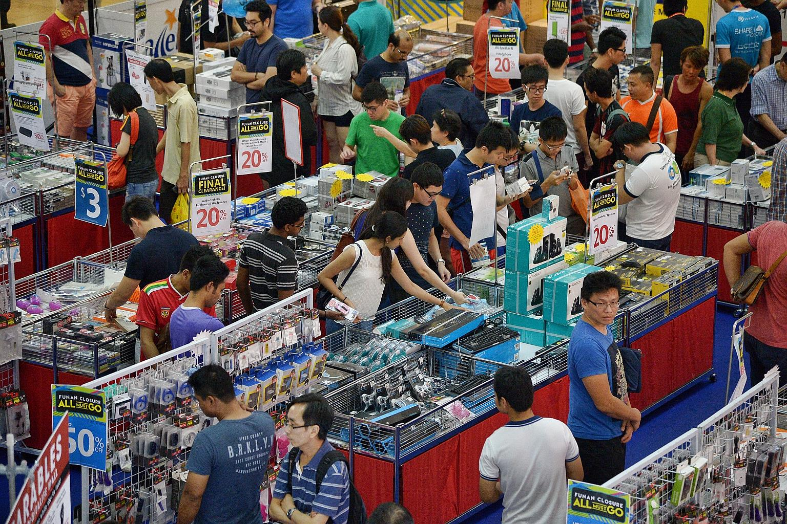
It’s inevitable to some extent, but what is the reality behind this economic system?

Slide 5
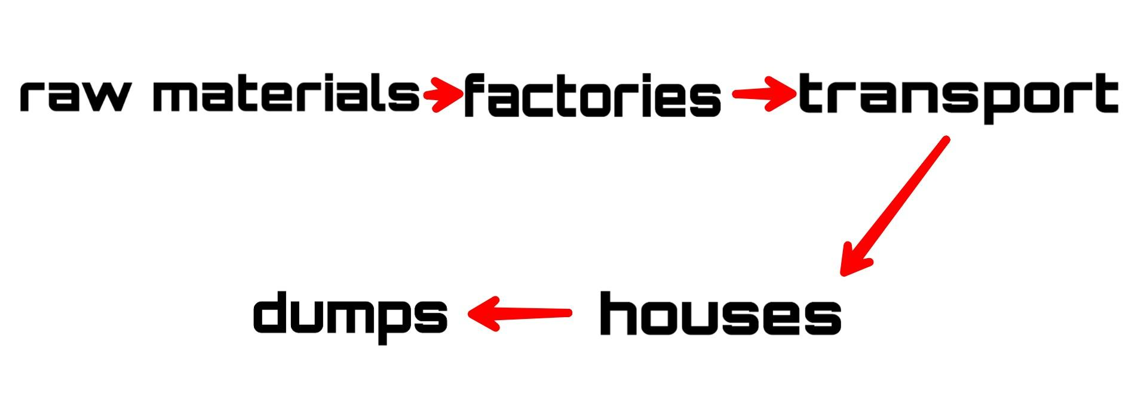
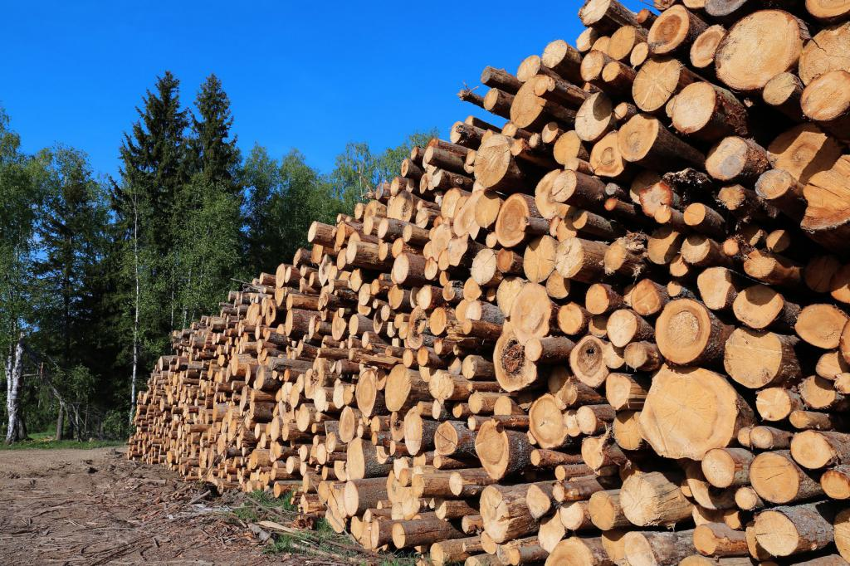
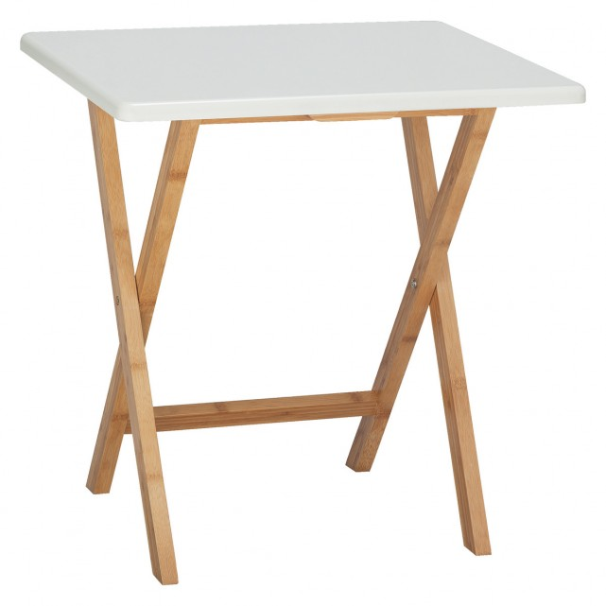
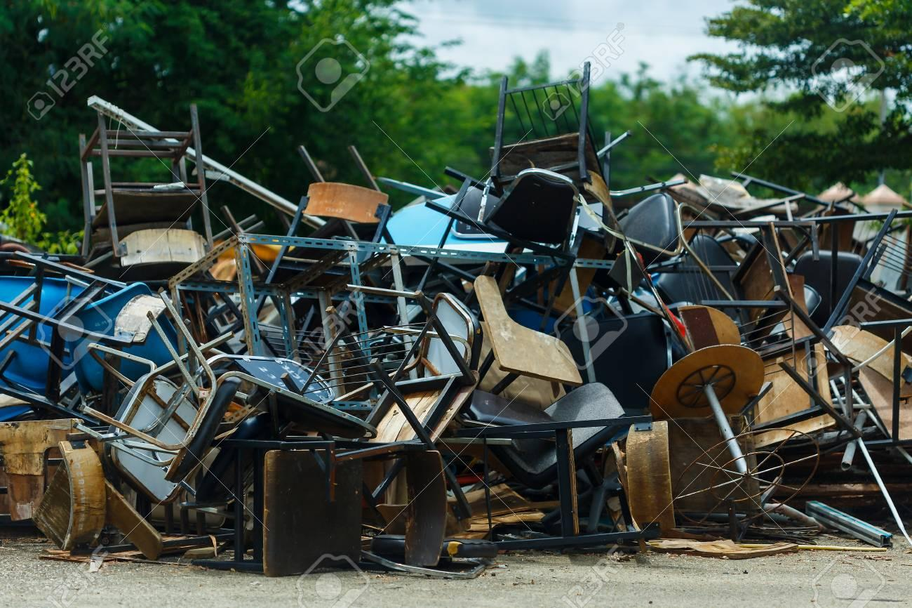
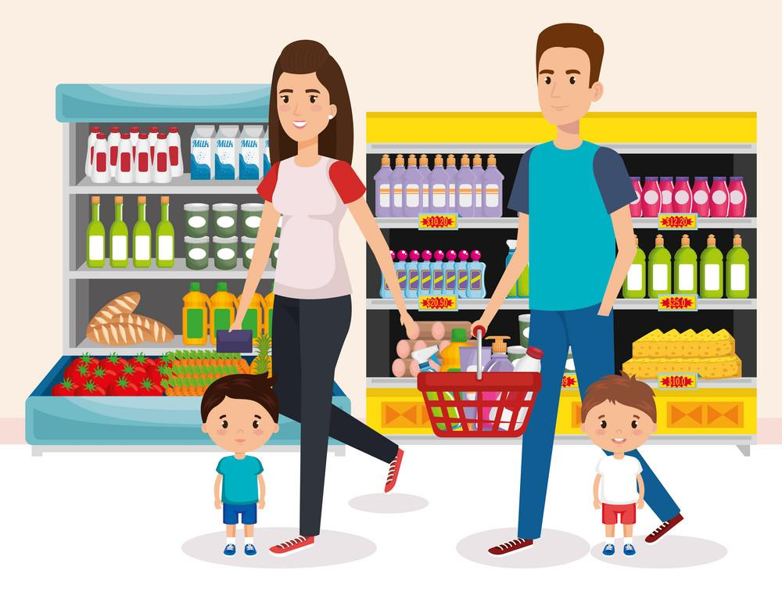
PRODUCTION CHAIN
What happens with all those objects at the end of the chain?

Slide 6
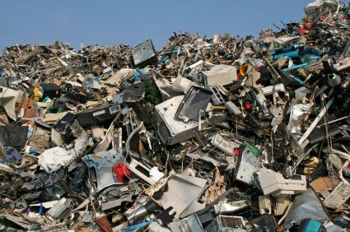
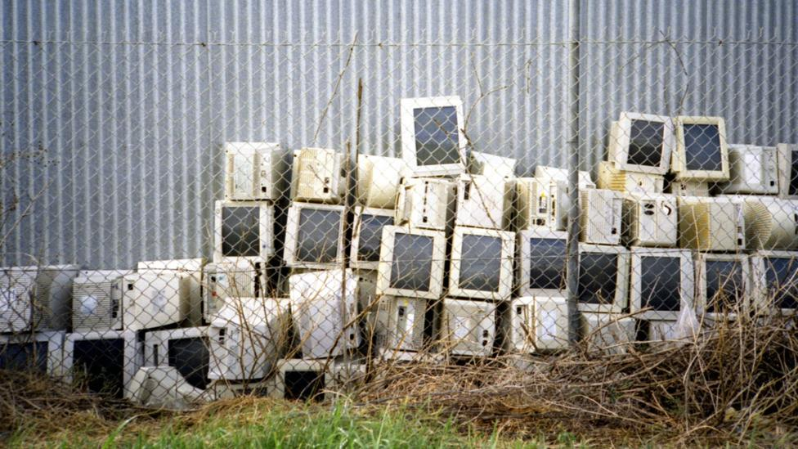
The overexploitation of natural resources and the increase of the waste cause most of the current environmental problems and they are the most difficult things to deal with.

Slide 7
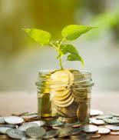
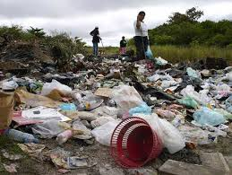
The solution is to make a change on our economic system - and that’s up to our Governments.
But that change will happen with difficulty, so we must make a change individually.
What can we do?

Slide 8
Thanks for your attention!
If you have any questions,
feel free to ask!

