Slide 1



TURKISH REPUBLIC
SULTANGAZI LOCAL AUTHORITY OF EDUCATION
DISSEMINATION OF PROJECT ACTIVITIES

Slide 2
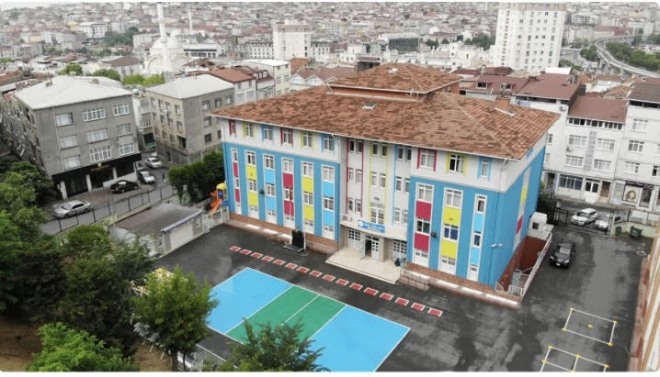
Creating an Innovative Platform of Communication and Teaching in a Digital Society
Implementation of the Project at Mobil Imam Hatip Secondary School

Slide 3
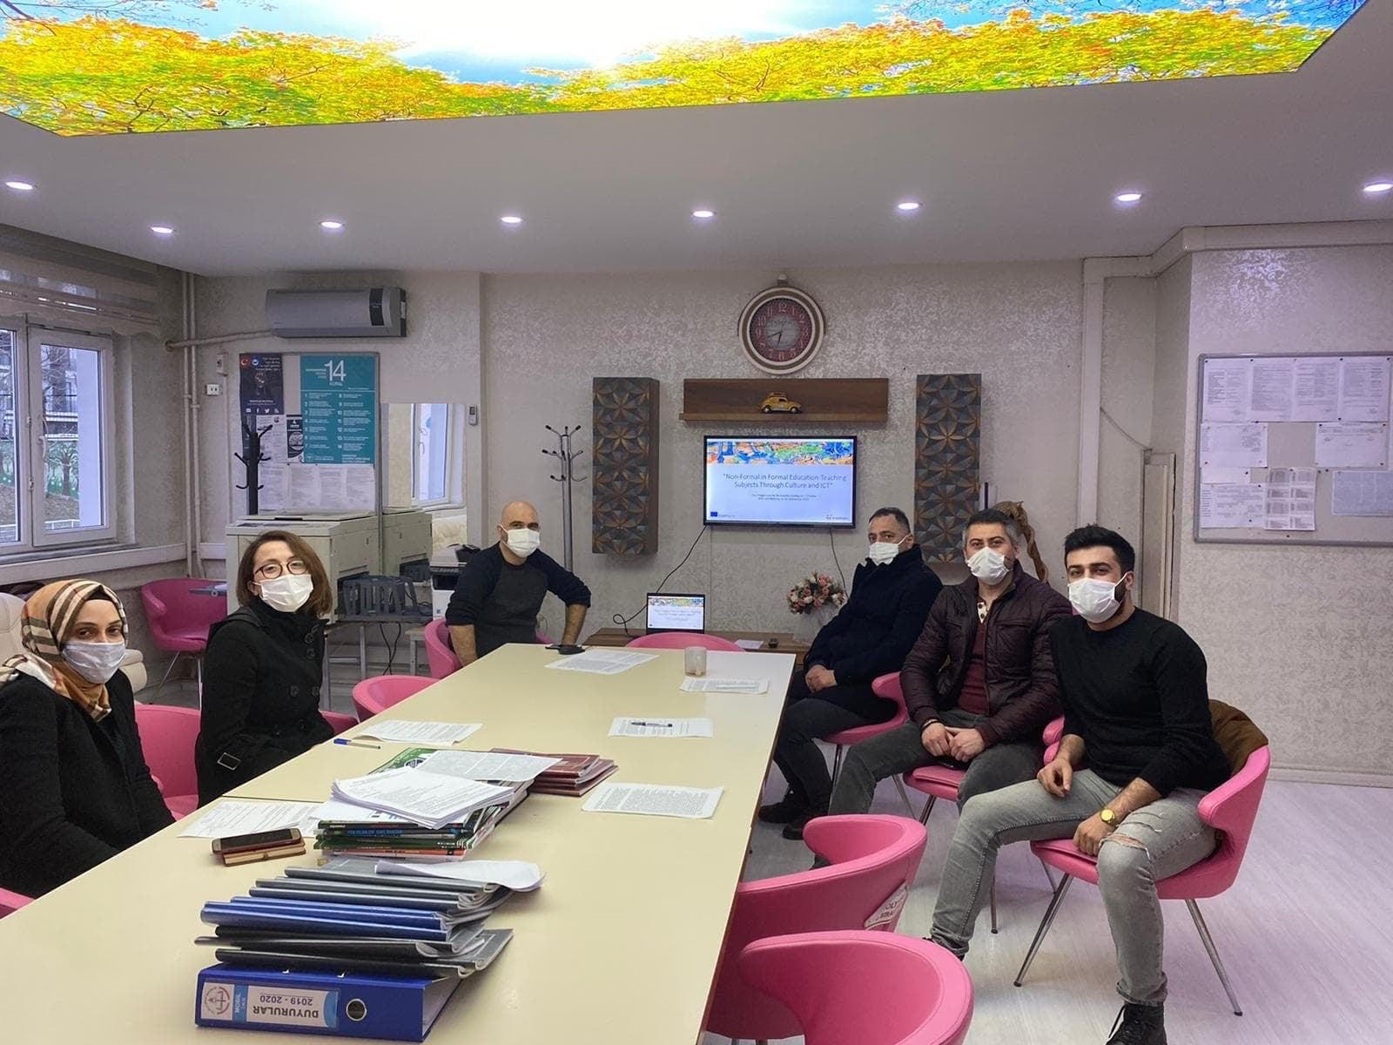
Project Team

Slide 4
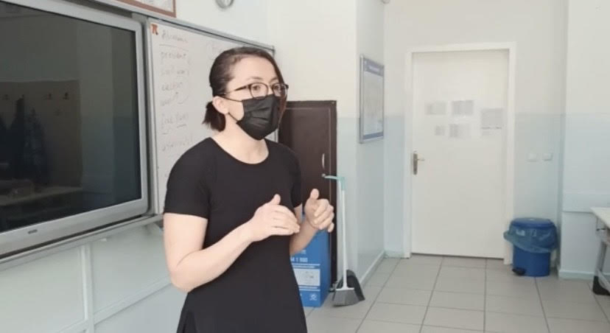
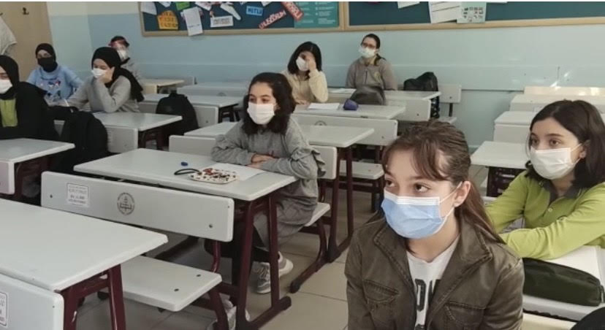
Lessons are more interesting, fun and fulfill the needs of the students
Students are better at following instructions
Students are better at pair and group works

Slide 5
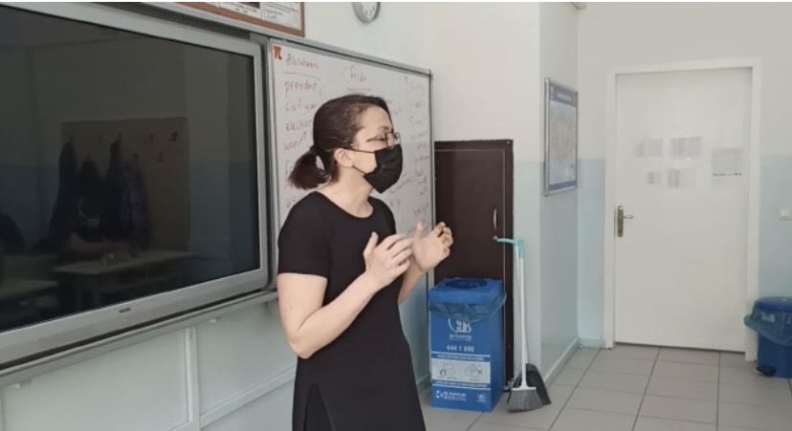
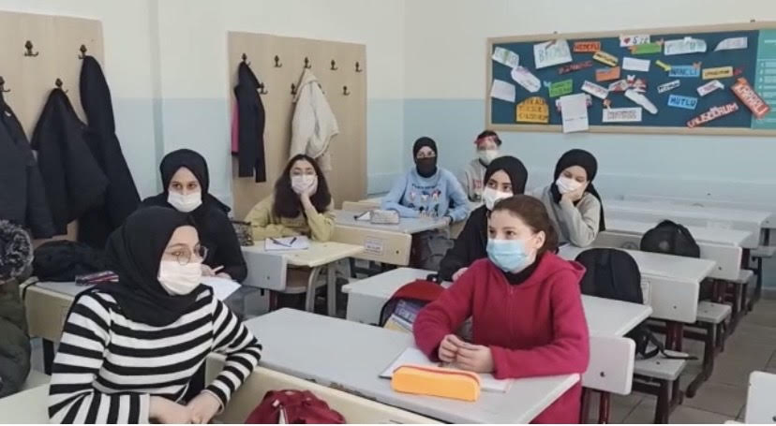
Students are better at listening and understanding English
Expressing their ideas clearly
Better at collabration with peers
Developed their debating skills
Active in their learning process
More confident while speaking in front of audiance

Slide 6
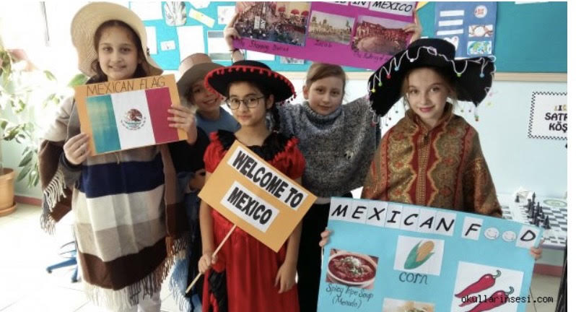
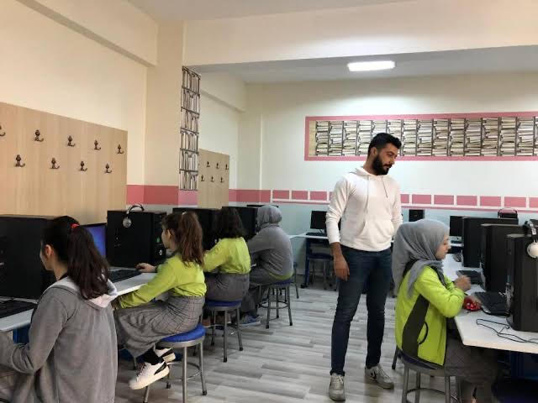
The classroom atmosphere is encouriging , motivational, non- judgemental
Peer evaluation is encouraged and supported
Students’ responses are praised frequently
Students appear to be absorbed and enjoying classroom avtivities, they are giving full attention to legitimate class activities whether doing small group time, class discussion, etc.

Slide 7
Creating an Innovative Platform of Communication and Teaching in a Digital Society
Dissemination Activities in Sultangazi

Slide 8
STATISTICS ABOUT SCHOOLS IN SULTANGAZI
Number of Students: 112.637
Number of Teachers: 4.727
Number of Classrooms: 2.461

Slide 9
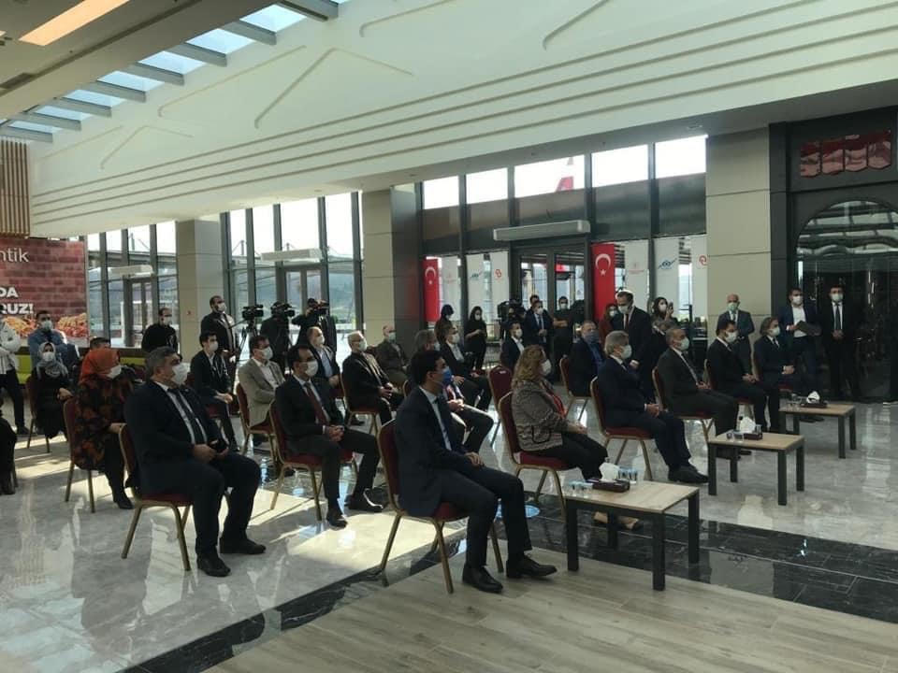
Meeting with School Principals

Slide 10
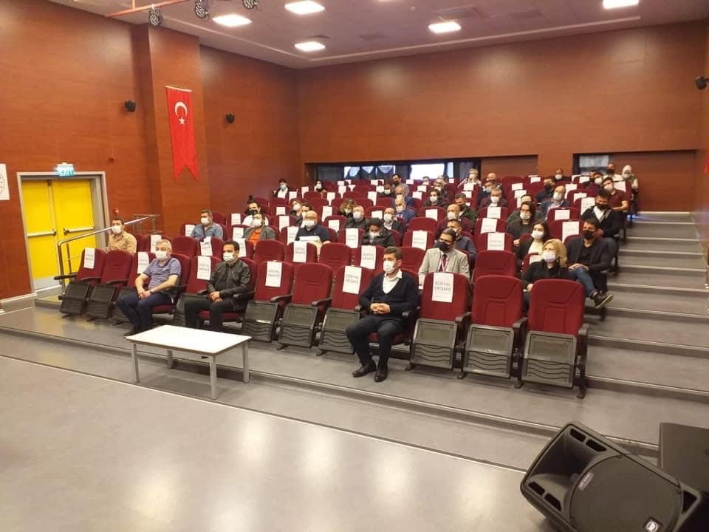
Meeting with Teachers

Slide 11
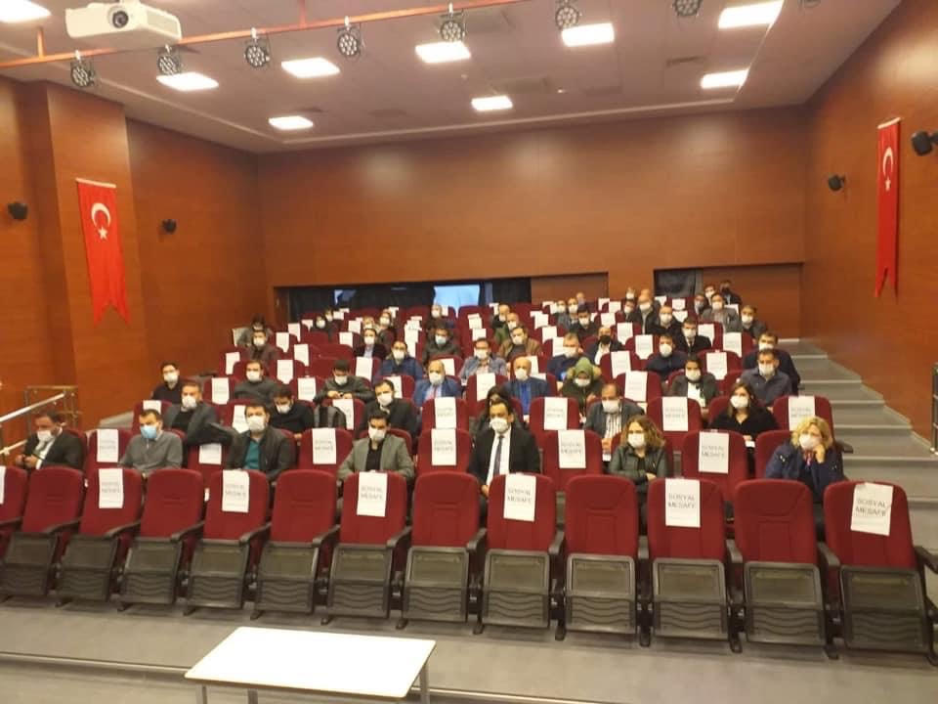
Meeting with Teachers

Slide 12
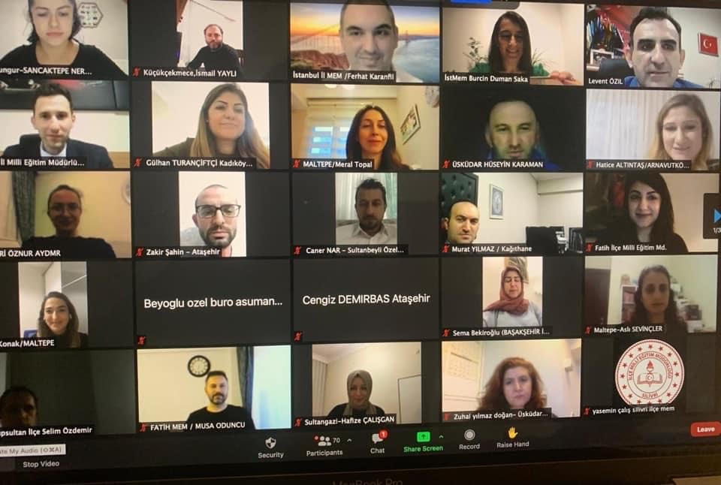
Meeting with Teachers

Slide 13
Held meetings with school principals, teachers and students
Made presantations of the project
Gave information about the purposes of the project
Showed sample lesson plans and mentioned the project’s successful implementation at Mobil Imam Hatip Secondary School
Project welcomed with excitement in our schools and teachers started to apply it in their lessons

Slide 14
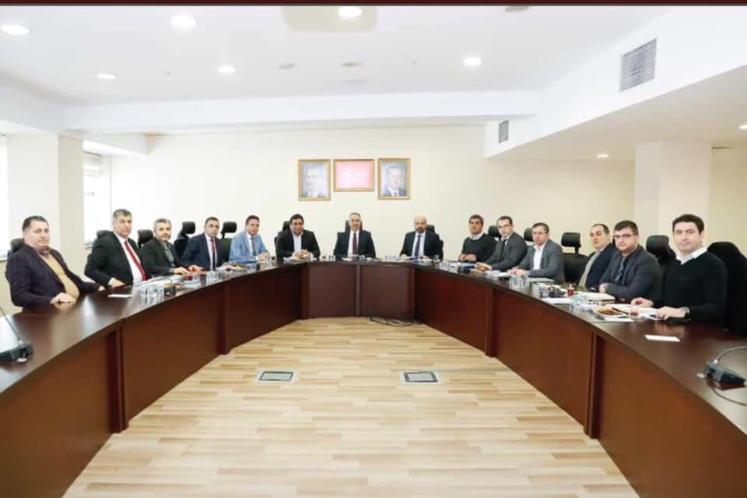
Meeting
With School Principals

Slide 15
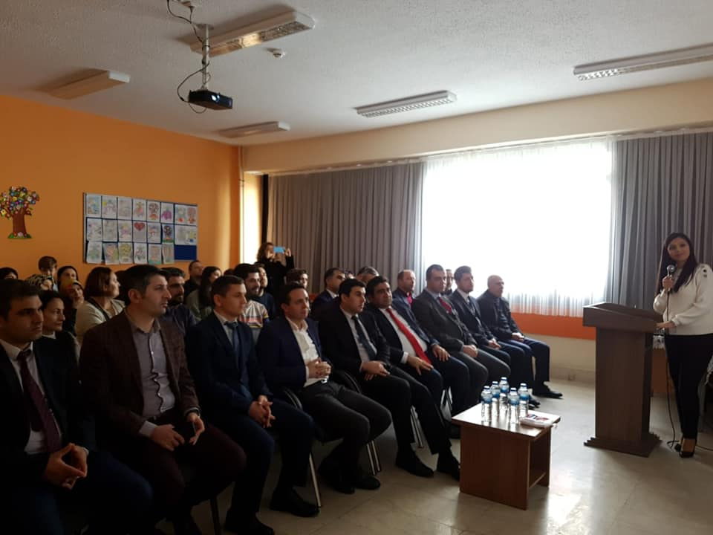
Meeting with School Principals

Slide 16
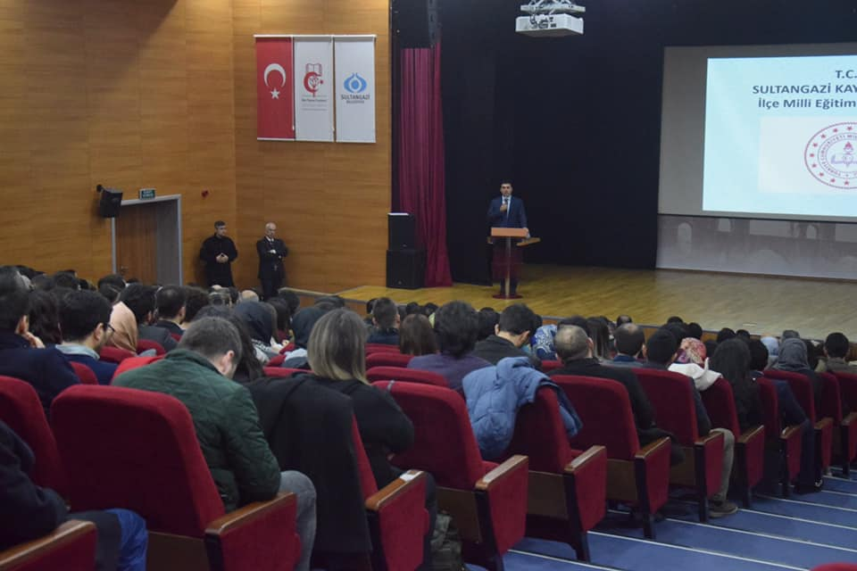
Meeting With Teachers

Slide 17
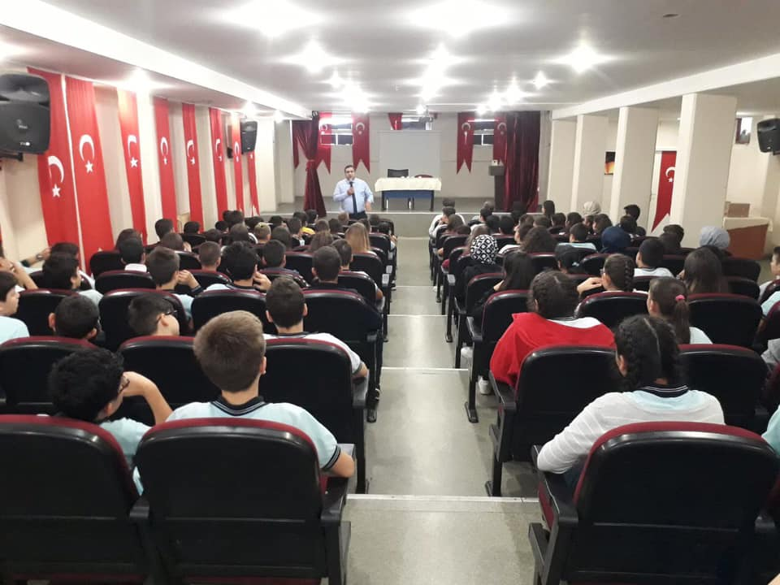
Meeting with Students

Slide 18
Dissemination Activities
We tried to reach all teachers in our district and invited them to the meetings we organized for dissemination activities of the project
We tried to reach many students in our district
Organized meetings with the students and explained them the implementation of the project and its benefits on their learning processes.

Slide 19
Dissemination Activities in Sultangazi
Meetings with school principals
Meetings with teachers
Meetings with students
We gave information about how to apply the project in their schools
Tried to develop topics related to our culture and experiences

Slide 20
Feedback Sessions
We discussed the topics and metarials, evaluation methods selected and what can be done to develop them
Evaluted the outcomes of the project
Discussed the performances of the students who took part in our project.

Slide 21
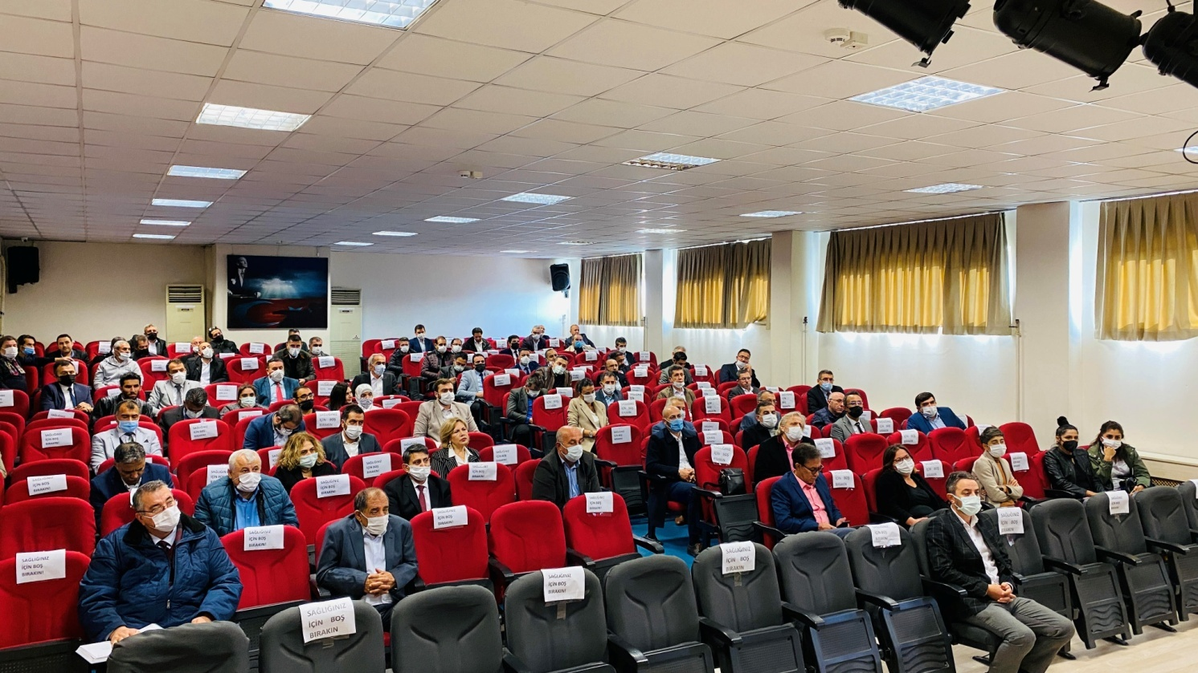
Meeting with School Principals

Slide 22
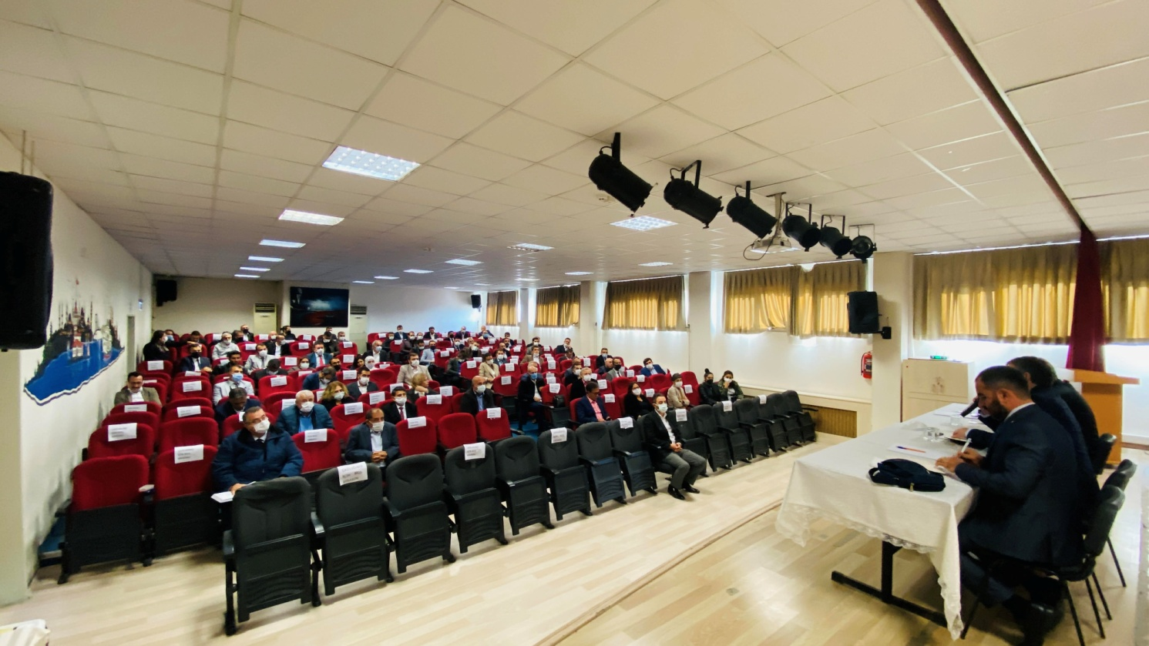
Meeting with School Principals

Slide 23
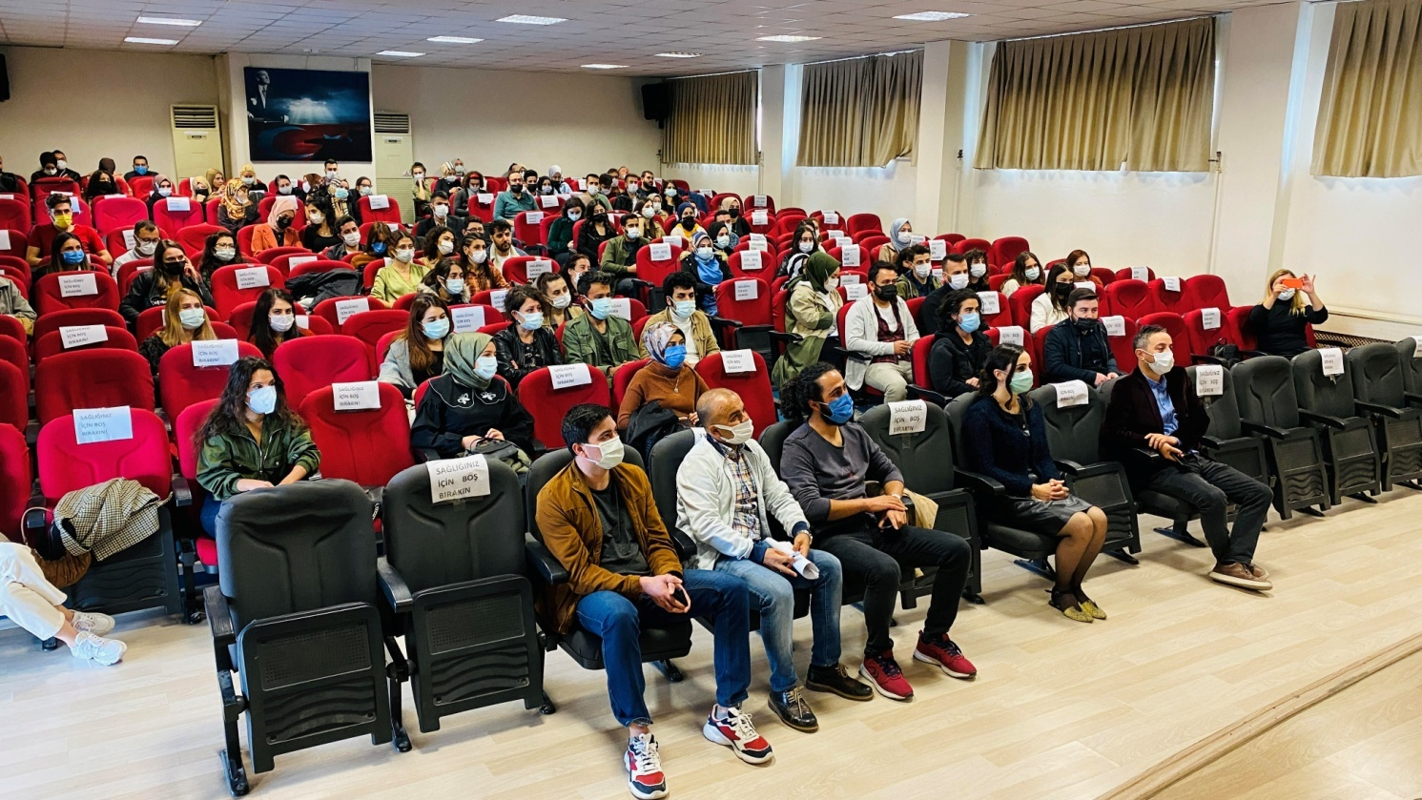
Meeting With Teachers

Slide 24
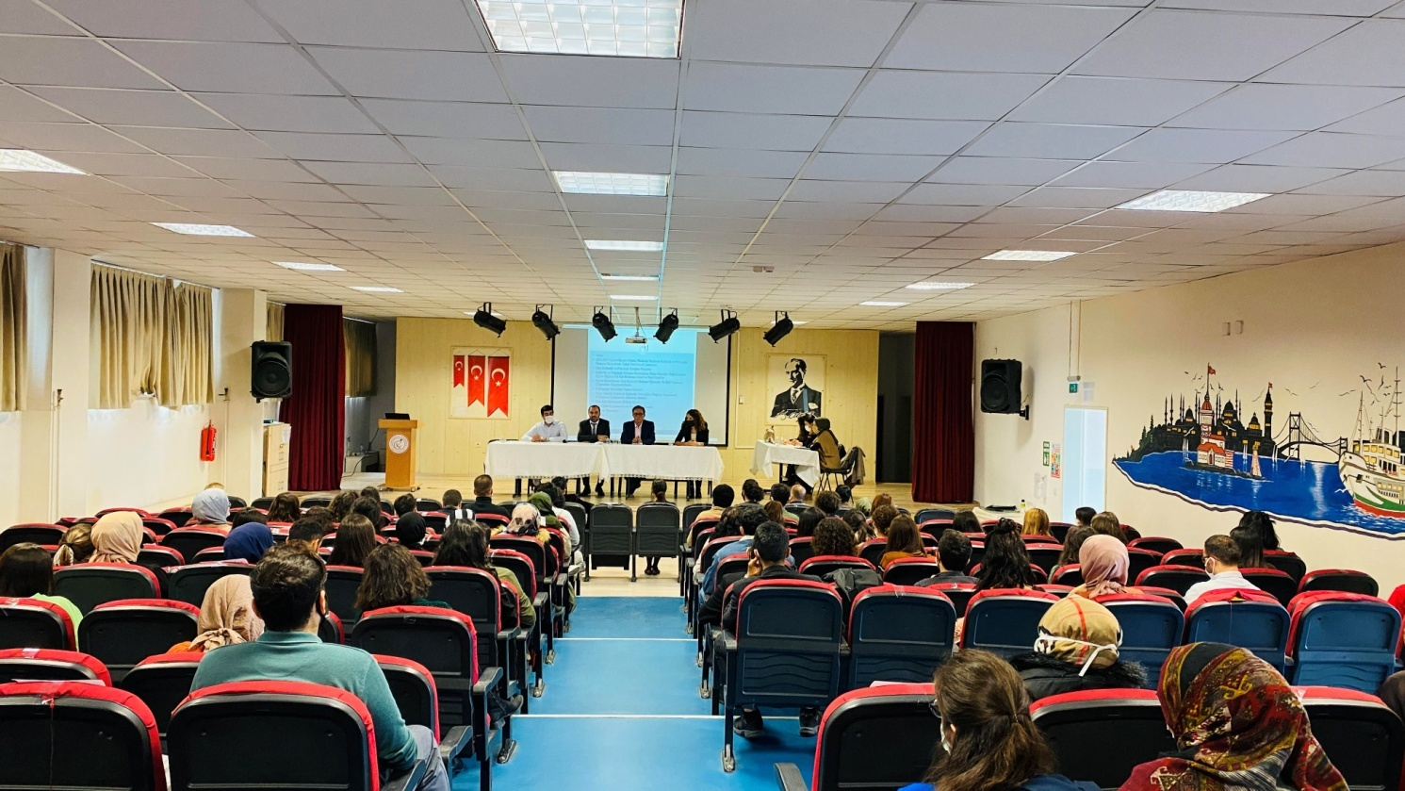
Meeting with Teachers

Slide 25
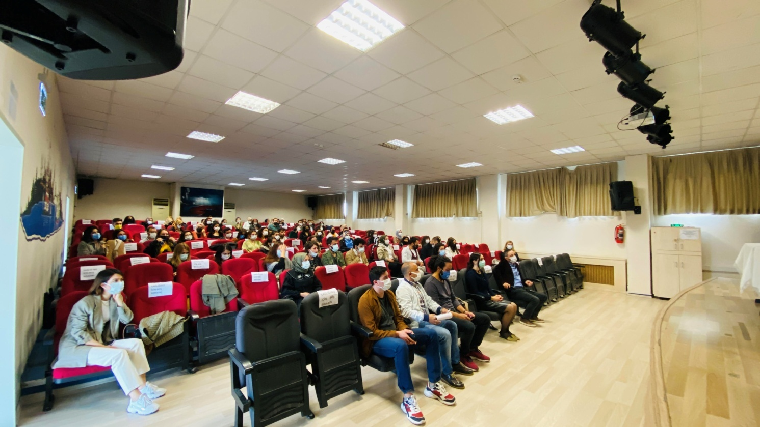
Meeting With Teachers

Slide 26
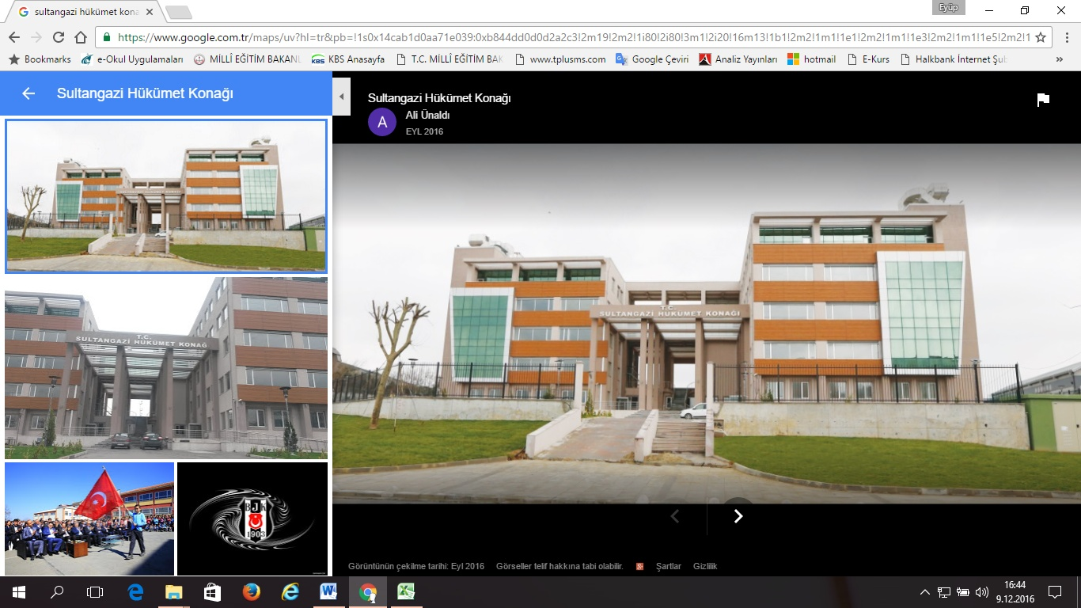
NAME OF INSTITION | : | SULTANGAZI LOCAL AUTHORITY OF EDUCATION
CITY | : | ISTANBUL
DISTRICT | : | SULTANGAZI
ADDRESS | : | Uğur Mumcu Street Atatürk Boulevard No:58 4. Floor Sultangazi / Istanbul
WEB ADDRESS | : | http://sultangazi.meb.gov.tr/
SOCIAL NETWORK ADDRESSES |  | https://www.facebook.com/sgmem https://twitter.com/sultangaziilce
E-MAIL | : | sultangazi34@meb.gov.tr
PHONE NUMBERS | : | 0212 - 606 00 76 / 606 04 52 / 606 08 94/ 606 08 95 / 606 04 52 / 606 01 25
FAX | : | 0 212 606 04 60

Slide 27
THANK YOU

